Slide 1
CS5542 Big Data Analytics and App Convolutional Neural Networks
Source: Yu Huang, Visual Detection, Recognition and Tracking with Deep Learning

Slide 2
Feature Extraction in Deep Learning

Slide 3
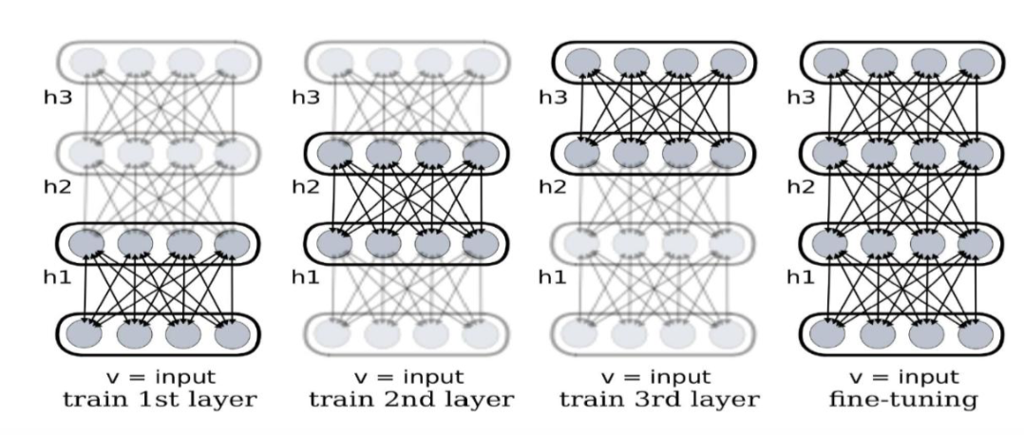
Deep Learning
Representation learning attempts to automatically learn good features or representations;
Deep learning algorithms attempt to learn multiple levels of representation of increasing complexity/abstraction (features);
Deal with the curse of dimensionality (smoothing & sparsity) and over-fitting (unsupervised, regularizer);
Semi-supervised: structure of manifold assumption;
labeled data is scarce and unlabeled data is abundant.

Slide 4
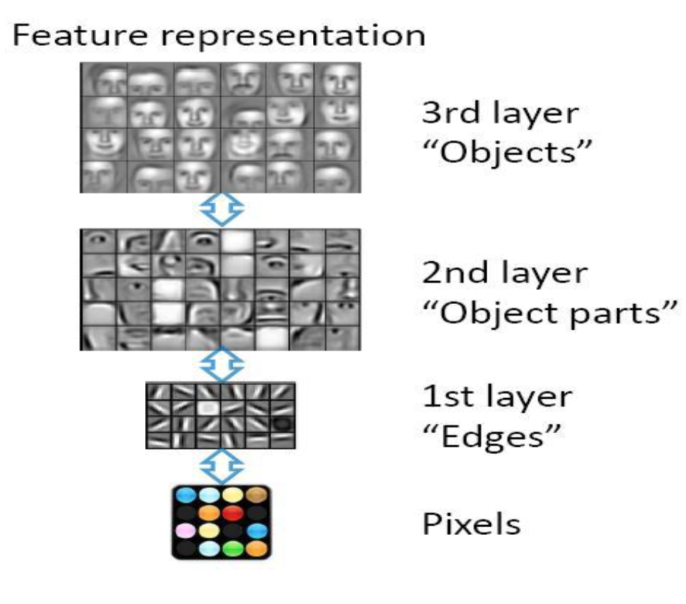
Learning Feature Hierarchy with DL
Deep architectures can be more efficient in feature representation;
Natural derivation/abstraction from low level structures to high level structures;
Share the lower-level representations for multiple tasks (such as detection, recognition, segmentation).

Slide 5
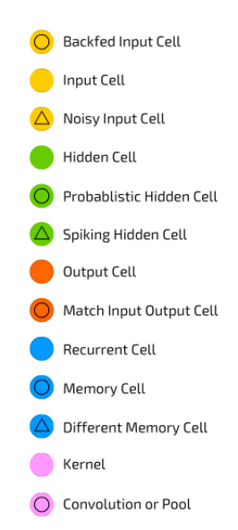
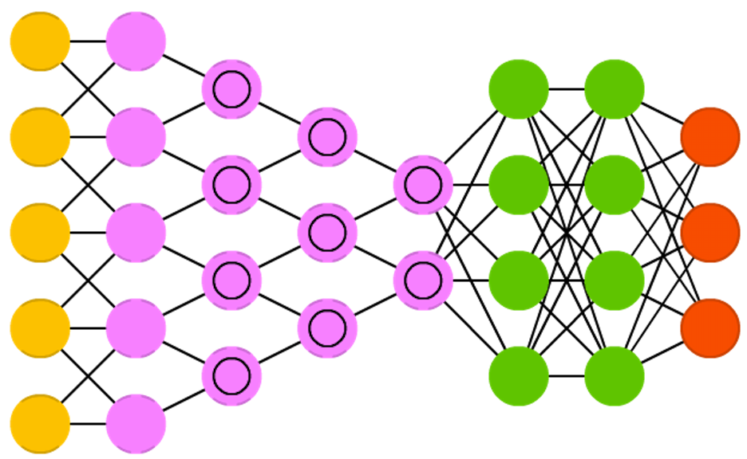
Convolution Neural Networks (CNN or Deep CNN)
http://www.asimovinstitute.org/neural-network-zoo/

Slide 6
Convolutional Neural Networks
CNN is a special kind of multi-layer NNs applied to 2-d arrays (usually images), based on spatially localized neural input;
Local receptive fields (shifted window), shared weights (weight averaging) across the hidden units, and often, spatial or temporal sub-sampling;
Each layer combines (merge, smooth) patches from previous layers
Pooling /Sampling (e.g., max or average) filter: compress and smooth the data.
Convolution filters: (translation invariance) unsupervised;
Local contrast normalization: increase sparsity, improve optimization/invariance.

Slide 7
Convolutional Neural Networks
Convolutional Networks are trainable multistage architectures composed of multiple stages;
Input and output of each stage are sets of arrays called feature maps;
At output, each feature map represents a particular feature extracted at all locations on input;
Each stage is composed of: a filter bank layer, a non-linearity layer, and a feature pooling layer;
A ConvNet is composed of 1, 2 or 3 such 3-layer stages, followed by a classification module;
A fully connected layer: softmax transfer function for posterior distribution.

Slide 8

Convolutional Neural Networks
Filter: A trainable filter (kernel) in filter bank connects input feature map to output feature map;
Nonlinearity: a pointwise sigmoid tanh() or a rectified sigmoid abs(gi•tanh()) function;
In rectified function, gi is a trainable gain parameter, might be followed a contrast normalization N;
Feature pooling: treats each feature map separately -> a reduced-resolution output feature map;
Supervised training is performed using a form of Stochastic Gradient Descent (SGD) to minimize the prediction error;
Gradients are computed with the back-propagation method.
Unsupervised pre-training: predictive sparse decomposition (PSD), then supervised fine-tuning.

Slide 9
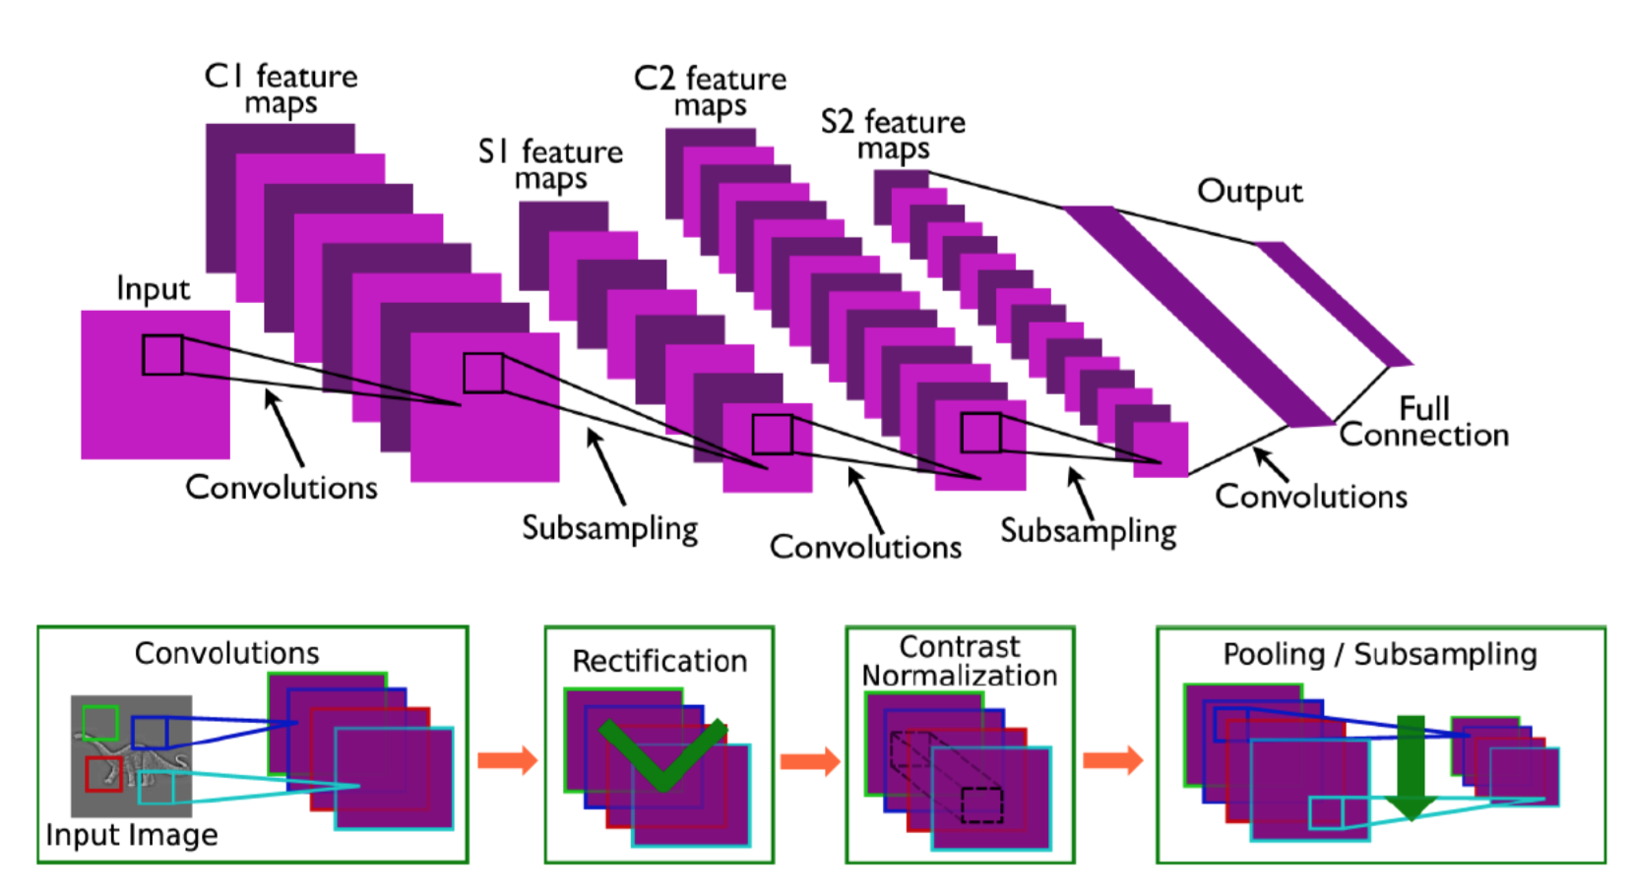
Convolutional Neural Networks

Slide 10
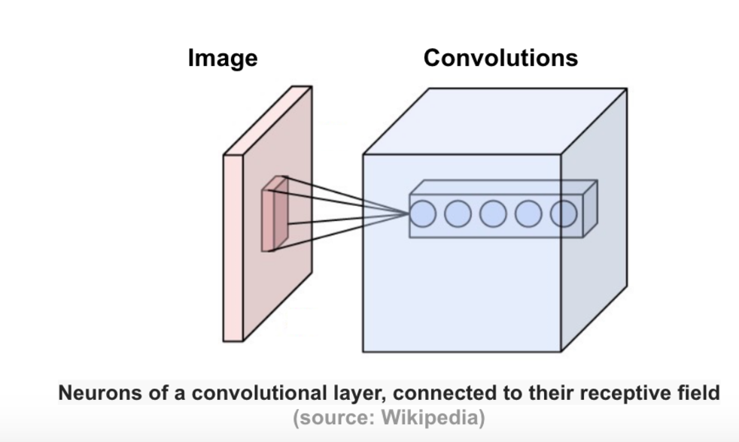
Convolution Layer
This layer consists of a set of learnable filters that we slide over the image spatially, computing dot products between the entries of the filter and the input image.
The filters should extend to the full depth of the input image.
E.g., a filter of size 5x5 to a colored image of size 32x32, then the filter depth 3 (5x5x3) to cover all 3 color channels (Red, Green, Blue) of the image.
These filters will activate to see same specific structure in the images.

Slide 11
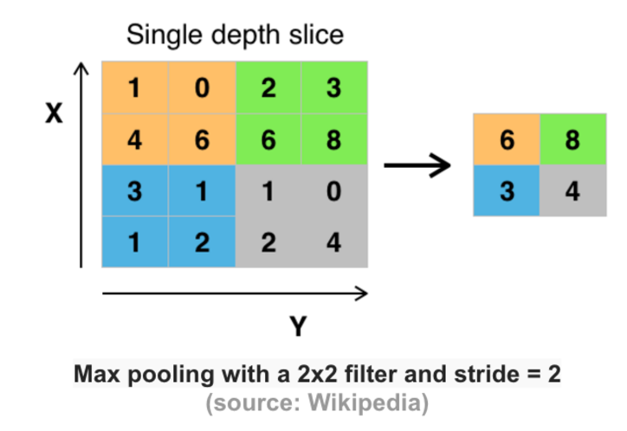
Pooling (subsampling) Layer
A form of non-linear down-sampling.
to progressively reduce the spatial size of the representation (parameters and computation) in the network
to control overfitting.
max pooling is the most common one.
applied with filters of size 2x2 applied with a stride of 2 at every depth slice.
A pooling layer of size 2x2 with stride of 2 shrinks the input image to a 1/4 of its original size.
Also Known as Downsampling

Slide 12
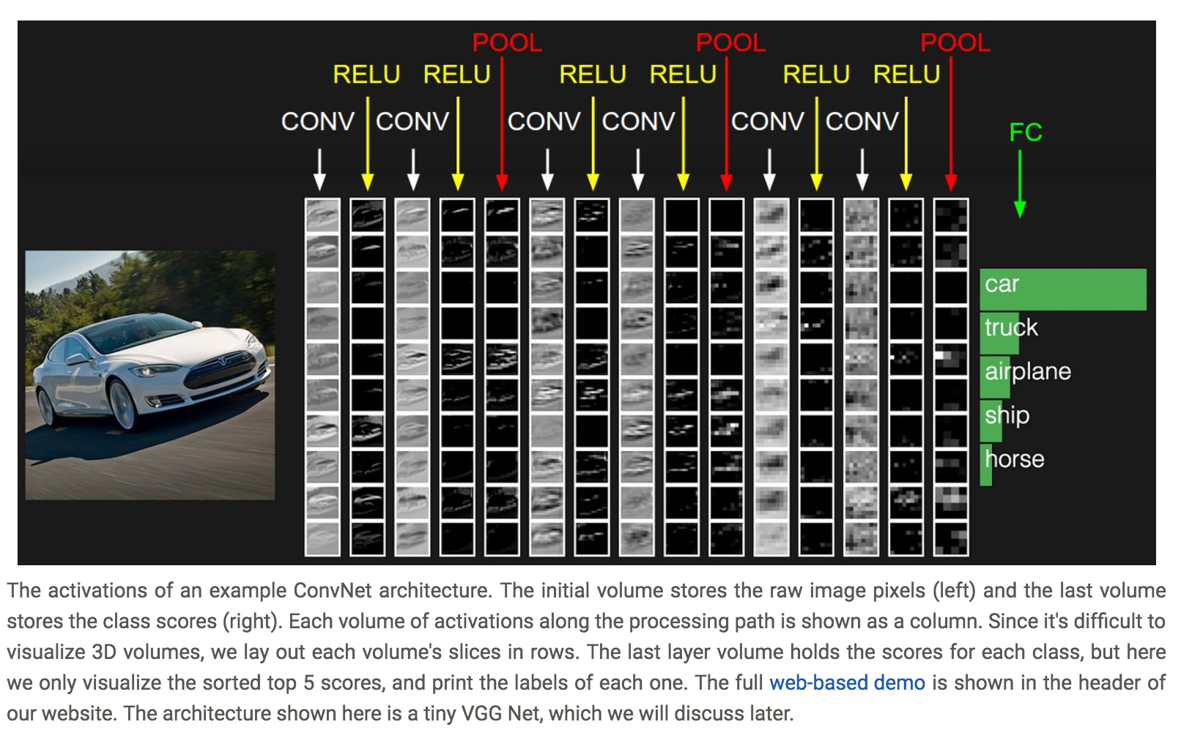
ConvNet Architecture

Slide 13
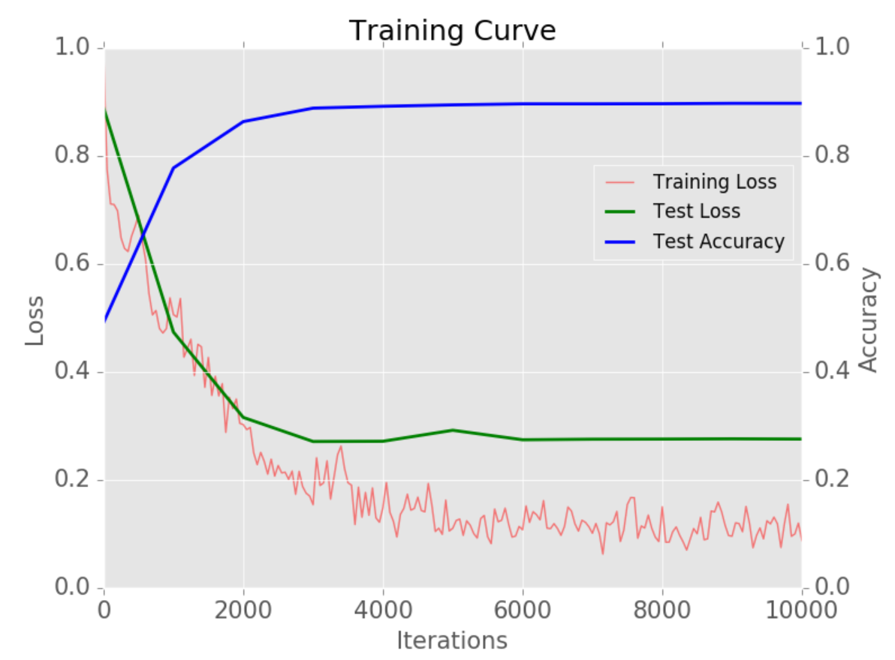
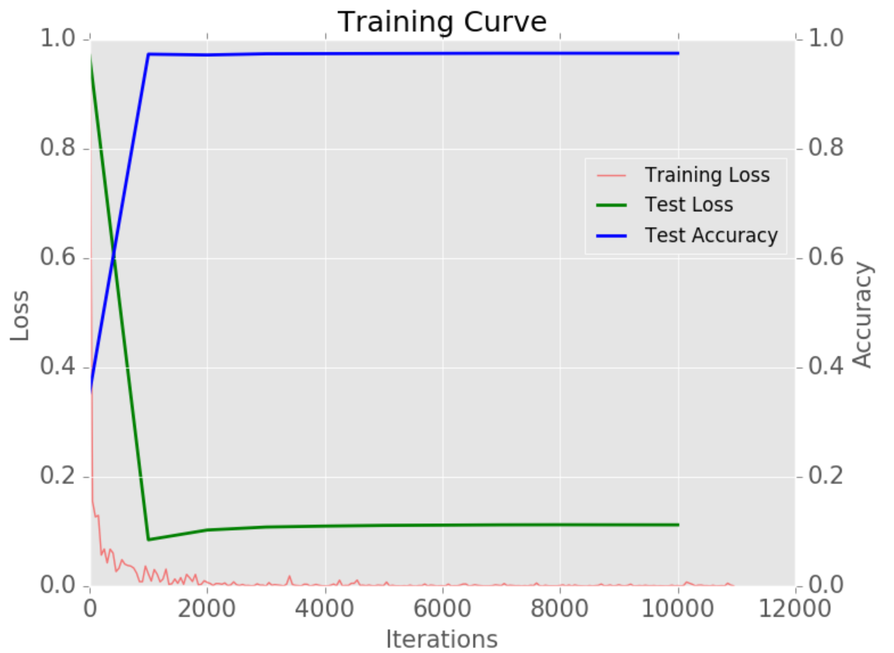
Training Curve
http://adilmoujahid.com/posts/2016/06/introduction-deep-learning-python-caffe/

Slide 14
References
Simple Logistic Regression https://gerardnico.com/data_mining/simple_logistic_regression#linear_regression_output_as_probabilities
Convolution Neural Network Slides http://www.deeplearningbook.org/slides/09_conv.pdf
Multi-layer Perceptron. Very good example on why use hidden layers in neural networks http://www.deeplearningbook.org/slides/06_mlp.pdf
Deep Learning Cheat Sheet http://www.asimovinstitute.org/neural-network-zoo/
A visual proof that neural nets can compute any function http://neuralnetworksanddeeplearning.com/chap4.html

Slide 15
References
Deep Learning Book by Ian Goodfellow http://www.deeplearningbook.org/
Neural Network and Deep Learning by Michael Nielsen
http://neuralnetworksanddeeplearning.com/
Deep Learning Lecture Slides
http://www.deeplearningbook.org/lecture_slides.html
Convolution Neural Network Live Example on Digits
http://scs.ryerson.ca/~aharley/vis/conv/flat.html

Slide 16
Video References
What is Netural Netural : https://www.youtube.com/watch?v=aircAruvnKk
How Neural Network Learns?
https://www.youtube.com/watch?v=IHZwWFHWa-w

