Slide 1
XML Design
(A Gentle Transition from XML to RDF)
Roger L. Costello
David B. Jacobs
The MITRE Corporation
(The creation of this tutorial was sponsored by DARPA)

Slide 2
What is the Purpose of RDF?
The purpose of RDF (Resource Description Framework) is to give a standard way of specifying data "about" something.
Here's an example of an XML document that specifies data about China's Yangtze river:
<?xml version="1.0"?>
<River id="Yangtze"
xmlns="http://www.geodesy.org/river">
<length>6300 kilometers</length>
<startingLocation>western China's Qinghai-Tibet Plateau</startingLocation>
<endingLocation>East China Sea</endingLocation>
</River>
"Here is data about the Yangtze River. It has a length of 6300 kilometers.
Its startingLocation is western China's Qinghai-Tibet Plateau. Its endingLocation
is the East China Sea."

Slide 3
XML --> RDF
Modify the following XML document so that it is also a valid RDF document:
<?xml version="1.0"?>
<River id="Yangtze"
xmlns="http://www.geodesy.org/river">
<length>6300 kilometers</length>
<startingLocation>western China's Qinghai-Tibet Plateau</startingLocation>
<endingLocation>East China Sea</endingLocation>
</River>
XML
Yangtze.xml
"convert to"
<?xml version="1.0"?>
<River rdf:ID="Yangtze"
xmlns:rdf="http://www.w3.org/1999/02/22-rdf-syntax-ns#"
xmlns="http://www.geodesy.org/river#">
<length>6300 kilometers</length>
<startingLocation>western China's Qinghai-Tibet Plateau</startingLocation>
<endingLocation>East China Sea</endingLocation>
</River>
RDF
Yangtze.rdf

Slide 4
The RDF Format
2
Identifies the resource being described. This
resource is an instance of River.
1
Identifies the type
(class) of the
resource being
described.
<?xml version="1.0"?>
<River rdf:ID="Yangtze"
xmlns:rdf="http://www.w3.org/1999/02/22-rdf-syntax-ns#"
xmlns="http://www.geodesy.org/river#">
<length>6300 kilometers</length>
<startingLocation>western China's Qinghai-Tibet Plateau</startingLocation>
<endingLocation>East China Sea</endingLocation>
</River>
3
These are properties,
or attributes, of the
type (class).
4
Values of the properties

Slide 5
The RDF Format
<?xml version="1.0"?>
<Class rdf:ID="Resource"
xmlns:rdf="http://www.w3.org/1999/02/22-rdf-syntax-ns#"
xmlns="uri">
<property>value</property>
<property>value</property>
...
</Class>

Slide 6
Advantage of using the RDF Format
You may ask: "Why should I bother designing my XML to be in the RDF format?"
Answer: there are numerous benefits:
  The RDF format, if widely used, will help to make XML more interoperable:
    Tools can instantly characterize the structure, "this element is a type (class), and here are its properties”.
    RDF promotes the use of standardized vocabularies ... standardized types (classes) and standardized properties.
  The RDF format gives you a structured approach to designing your XML documents. The RDF format is a regular, recurring pattern.
  It enables you to quickly identify weaknesses and inconsistencies of non-RDF-compliant XML designs. It helps you to better understand your data!
  You reap the benefits of both worlds:
    You can use standard XML editors and validators to create, edit, and validate your XML.
    You can use the RDF tools to apply inferencing to the data.
  It positions your data for the Semantic Web!
Interoperability
Network effect

Slide 7
Disadvantage of using the
RDF Format
Constrained: the RDF format constrains you on how you design your XML (i.e., you can't design your XML in any arbitrary fashion).
RDF uses namespaces to uniquely identify types (classes), properties, and resources. Thus, you must have a solid understanding of namespaces.
Another XML vocabulary to learn: to use the RDF format you must learn the RDF vocabulary.

Slide 8
Uniquely Identify the Resource
Earlier we said that RDF is very concerned about uniquely identifying the type (class) and the properties. RDF is also very concerned about uniquely identifying the resource, e.g.,
This is the resource being described. We want to uniquely
identify this resource.
<?xml version="1.0"?>
<River rdf:ID="Yangtze"
xmlns:rdf="http://www.w3.org/1999/02/22-rdf-syntax-ns#"
xmlns="http://www.geodesy.org/river#">
<length>6300 kilometers</length>
<startingLocation>western China's Qinghai-Tibet Plateau</startingLocation>
<endingLocation>East China Sea</endingLocation>
</River>

Slide 9
rdf:ID
The value of rdf:ID is a "relative URI".
The "complete URI" is obtained by concatenating the URL of the XML document with "#" and then the value of rdf:ID, e.g.,
<?xml version="1.0"?>
<River rdf:ID="Yangtze"
xmlns:rdf="http://www.w3.org/1999/02/22-rdf-syntax-ns#"
xmlns="http://www.geodesy.org/river#">
<length>6300 kilometers</length>
<startingLocation>western China's Qinghai-Tibet Plateau</startingLocation>
<endingLocation>East China Sea</endingLocation>
</River>
Yangtze.rdf
Suppose that this RDF/XML document is located at this URL: http://www.china.org/geography/rivers.
Thus, the complete URI for this resource is:
http://www.china.org/geography/rivers#Yangtze

Slide 10
xml:base
On the previous slide we showed how the URL of the document provided the base URI.
Depending on the location of the document is brittle: it will break if the document is moved, or is copied to another location.
A more robust solution is to specify the base URI in the document, e.g.,
<?xml version="1.0"?>
<River rdf:ID="Yangtze"
xmlns:rdf="http://www.w3.org/1999/02/22-rdf-syntax-ns#"
xmlns="http://www.geodesy.org/river#"
xml:base="http://www.china.org/geography/rivers">
<length>6300 kilometers</length>
<startingLocation>western China's Qinghai-Tibet Plateau</startingLocation>
<endingLocation>East China Sea</endingLocation>
</River>
Resource URI = concatenation(xml:base, '#', rdf:ID)
= concatenation(http://www.china.org/geography/rivers, '#', "Yangtze")
= http://www.china.org/geography/rivers#Yangtze

Slide 11
rdf:about
Instead of identifying a resource with a relative URI (which then requires a base URI to be prepended), we can give the complete identity of a resource. However, we use rdf:about, rather than rdf:ID, e.g.,
<?xml version="1.0"?>
<River rdf:about="http://www.china.org/geography/rivers#Yangtze"
xmlns:rdf="http://www.w3.org/1999/02/22-rdf-syntax-ns#"
xmlns="http://www.geodesy.org/river#">
<length>6300 kilometers</length>
<startingLocation>western China's Qinghai-Tibet Plateau</startingLocation>
<endingLocation>East China Sea</endingLocation>
</River>

Slide 12
Triple -> resource/property/value
http://www.china.org/geography/rivers#Yangtze has a http://www.geodesy.org/river#length of 6300 kilometers
resource
property
value
http://www.china.org/geography/rivers#Yangtze has a http://www.geodesy.org/river#startingLocation of western China's ...
resource
property
value
http://www.china.org/geography/rivers#Yangtze has a http://www.geodesy.org/river#endingLocation of East China Sea
resource
property
value

Slide 13
The RDF Format = triples!
The fundamental design pattern of RDF is to structure your XML data as resource/property/value triples!
<?xml version="1.0"?>
<Resource-A>
<property-A>
<Resource-B>
<property-B>
<Resource-C>
<property-C>
Value-C
</property-C>
</Resource-C>
</property-B>
</Resource-B>
</property-A>
</Resource-A>
Notice that the RDF design pattern is an
alternating sequence of resource-property.
This pattern is known as "striping".
value of
property-A
value of
property-B
The value of a property can be a literal (e.g., length has a value of 6300 kilometers).
Also, the value of a property can be a resource, as shown above (e.g., property-A
has a value of Resource-B, property-B has a value of Resource-C). We will see examples
of properties having a resource value in a little bit.

Slide 14
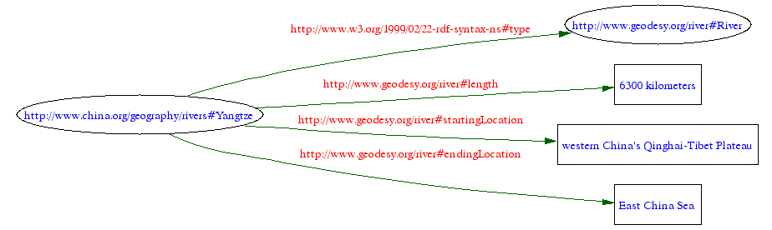
RDF Model (graph)
Legend:
Ellipse indicates "Resource"
Rectangle indicates "literal string value"

Slide 15
Terminology
As you read the RDF literature you may see the following terminology:
  Subject: this term refers to the item that is playing the role of the resource.
  predicate: this term refers to the item that is playing the role of the property.
  Object: this term refers to the item that is playing the role of the value.
Subject
predicate
Object
Equivalent!
Resource
property
Value

Slide 16
Property value must be a
Literal or a Resource
<length>6300 kilometers</length>
property
Value is a Literal
property
<obstacle>
<Dam id="ThreeGorges"
xmlns="http://www.geodesy.org/dam">
<name>The Three Gorges Dam</name>
<width>1.5 miles</width>
<height>610 feet</height>
<cost>$30 billion</cost>
</Dam>
</obstacle>
Value is a Resource

Slide 17
RDF Format
<?xml version="1.0"?>
<River rdf:ID="Yangtze"
xmlns:rdf="http://www.w3.org/1999/02/22-rdf-syntax-ns#"
xmlns="http://www.geodesy.org/river#"
xml:base="http://www.china.org/geography/rivers">
<length>6300 kilometers</length>
<startingLocation>western China's Qinghai-Tibet Plateau</startingLocation>
<endingLocation>East China Sea</endingLocation>
<obstacle>
<Dam rdf:ID="ThreeGorges"
xmlns="http://www.geodesy.org/dam#">
<name>The Three Gorges Dam</name>
<width>1.5 miles</width>
<height>610 feet</height>
<cost>$30 billion</cost>
</Dam>
</obstacle>
</River>
Changed id to rdf:ID
Added the '#' symbol
As always, the other representations using rdf:about and rdf:Description are available.

Slide 18
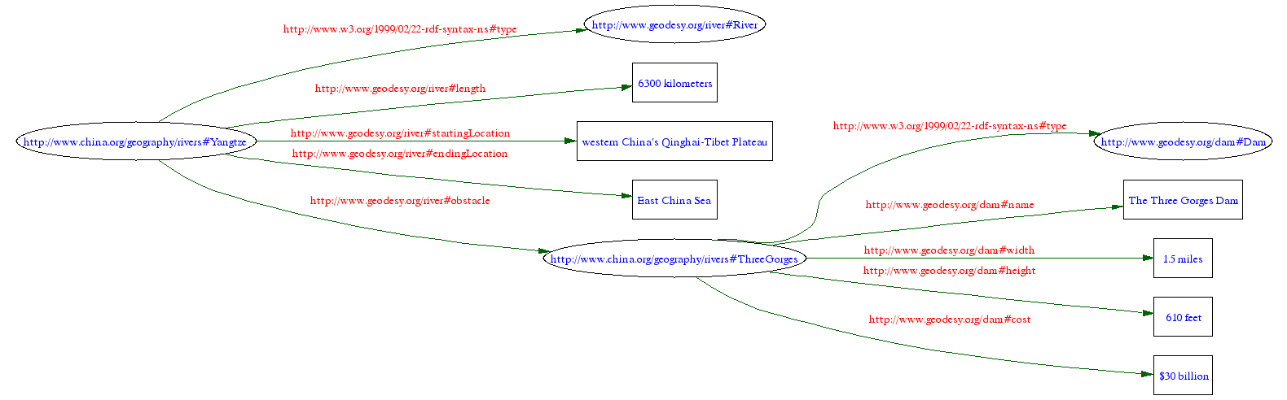
RDF Model (graph)

Slide 19
Anyone, Anywhere, Anytime Can Talk About a Resource
In all of our examples we have provided a unique identifier to resources, e.g.,
http://www.china.org/geography/rivers#Yangtze
Consequently, if another RDF document identifies the same resource then the data that it specifies gives additional data about that resource.
An aggregator tool will be able to collect all data about a resource and present a consolidated set of data for the resource. That's powerful!

Slide 20
<?xml version="1.0"?>
<River rdf:about="http://www.china.org/geography/rivers#Yangtze"
xmlns:rdf="http://www.w3.org/1999/02/22-rdf-syntax-ns#"
xmlns="http://www.geodesy.org/river#">
<length>6300 kilometers</length>
<startingLocation>western China's Qinghai-Tibet Plateau</startingLocation>
<endingLocation>East China Sea</endingLocation>
</River>
http://www.china.org/geography/rivers/yangtze.rdf
<?xml version="1.0"?>
<River rdf:about="http://www.china.org/geography/rivers#Yangtze"
xmlns:rdf="http://www.w3.org/1999/02/22-rdf-syntax-ns#"
xmlns="http://www.geodesy.org/river#">
<name>Dri Chu - Female Yak River</name>
<name>Tongtian He, Travelling-Through-the-Heavens River</name>
<name>Jinsha Jiang, River of Golden Sand</name>
</River>
http://www.encyclopedia.org/yangtze-alternate-names.rdf
Aggregator tool collects
data about the Yangtze
<?xml version="1.0"?>
<River rdf:about="http://www.china.org/geography/rivers#Yangtze"
xmlns:rdf="http://www.w3.org/1999/02/22-rdf-syntax-ns#"
xmlns="http://www.geodesy.org/river#">
<length>6300 kilometers</length>
<startingLocation>western China's Qinghai-Tibet Plateau</startingLocation>
<endingLocation>East China Sea</endingLocation>
<name>Dri Chu - Female Yak River</name>
<name>Tongtian He, Travelling-Through-the-Heavens River</name>
<name>Jinsha Jiang, River of Golden Sand</name>
</River>
A distributed network of data!
Aggregated Data!

Slide 21
rdf:value
6300
length
kilometers
length has two values - 6300 and kilometers.
RDF provides a special property, rdf:value, to
be used for specifying the "primary" value.
In this example, 6300 is the primary value, and
kilometers is a value which provides additional
information about the primary value.

Slide 22
RDF Format
<?xml version="1.0"?>
<River rdf:ID="Yangtze"
xmlns:rdf="http://www.w3.org/1999/02/22-rdf-syntax-ns#"
xmlns="http://www.geodesy.org/river#"
xmlns:uom="http://www.measurements.org/units-of-measure#">
<length>
<rdf:Description>
<rdf:value>6300</rdf:value>
<uom:units>kilometers</uom:units>
</rdf:Description>
</length>
<startingLocation>western China's Qinghai-Tibet Plateau</startingLocation>
<endingLocation>East China Sea</endingLocation>
</River>
An anonymous
resource
Yangtze4.rdf
Read this as: "The Yangtze River has a length whose value is a resource
which has a value of 6300 and whose units is kilometers.

Slide 23
Conclusion
In this tutorial we demonstrated that, with oftentimes slight modifications, "traditional XML" documents can be made RDF-compliant.
We recommend using the RDF format for all your XML documents.
We feel that the advantages accrued by formatting your XML far outweigh any possible disadvantages (having to structure your XML in a specific format and having to learn a new vocabulary)

Slide 24
Related Articles
"Make Your XML RDF-Friendly" by Bob DuCharme, John Cowan
http://www.xml.com/pub/a/2002/10/30/rdf-friendly.html

