Slide 1
CS5560 Knowledge Discovery and Management Tutorial 7
Protege

Slide 2
Outline
Protégé

Slide 3
Protégé

Slide 4
What is protégé?
Protégé is a free, open-source platform to construct domain models and knowledge-based applications with ontologies.
Ontologies range from taxonomies, classifications, database schemas to fully axiomatized theories.
Ontologies are now central to many applications such as scientific knowledge portals, information management and integration systems, electronic commerce and web services

Slide 5
Install Protege
Download Protégé desktop tool at: http://protege.stanford.edu/
Also available as Web Protégé at: http://webprotege.stanford.edu/

Slide 6
Protege
Protege OWL editor: enables users to build ontology for the Semantic Web, in particular to OWL
Classes
Properties
Instances
Reasoning

Slide 7
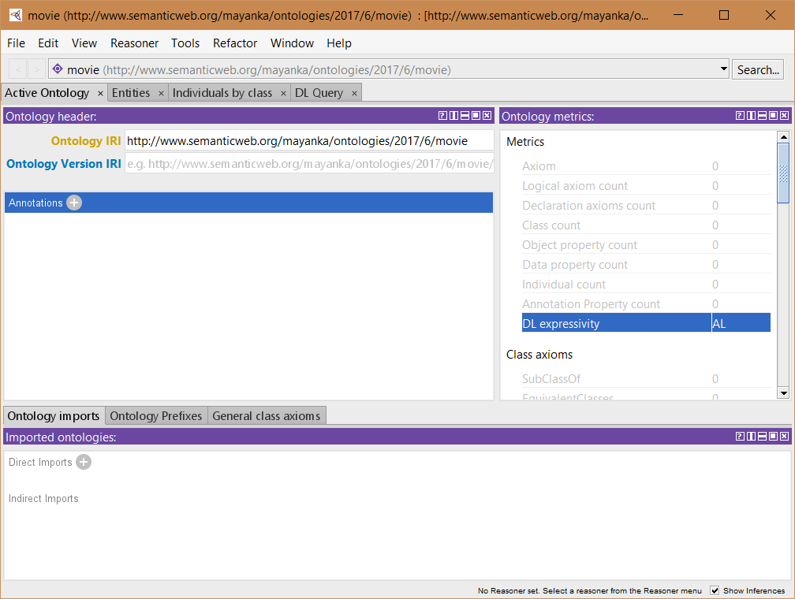
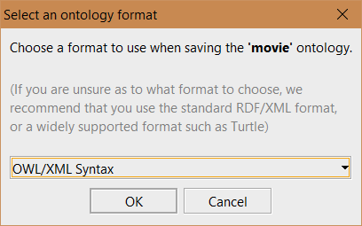
Building an OWL Ontology
Create a new OWL project
Start protege
File – New – Ontology URI (http://www.semanticweb.org/mayanka/ontologies/2017/6/family) –
A new empty Protege-OWL project has been created.
Save it in your local file as family.owl
Choose Ontology type to be OWL/XML Syntax

Slide 8
OWL Syntax : Header
<?xml version="1.0"?>
<Ontology xmlns="http://www.w3.org/2002/07/owl#"
xml:base="http://www.semanticweb.org/mayanka/ontologies/2017/6/family"
xmlns:rdf="http://www.w3.org/1999/02/22-rdf-syntax-ns#"
xmlns:xml="http://www.w3.org/XML/1998/namespace"
xmlns:xsd="http://www.w3.org/2001/XMLSchema#"
xmlns:rdfs="http://www.w3.org/2000/01/rdf-schema#"
ontologyIRI="http://www.semanticweb.org/mayanka/ontologies/2017/6/family">
<Prefix name="owl" IRI="http://www.w3.org/2002/07/owl#"/>
<Prefix name="rdf" IRI="http://www.w3.org/1999/02/22-rdf-syntax-ns#"/>
<Prefix name="xml" IRI="http://www.w3.org/XML/1998/namespace"/>
<Prefix name="xsd" IRI="http://www.w3.org/2001/XMLSchema#"/>
<Prefix name="rdfs" IRI="http://www.w3.org/2000/01/rdf-schema#"/>
</Ontology>
<!-- Generated by the OWL API (version 4.2.8.20170104-2310) https://github.com/owlcs/owlapi -->

Slide 9
Building blocks of ontology
Using owl 2.0

Slide 10
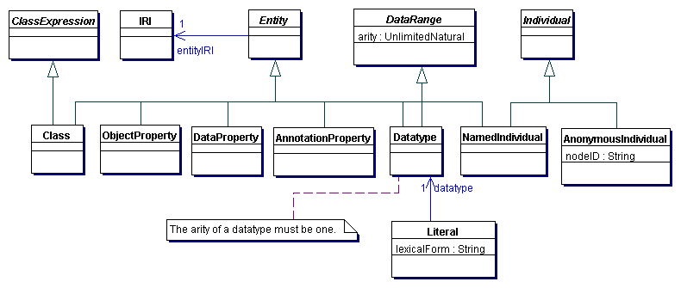
Structure of Entities and Literals
Source : https://www.w3.org/TR/owl2-syntax/#Entities.2C_Literals.2C_and_Anonymous_Individuals

Slide 11
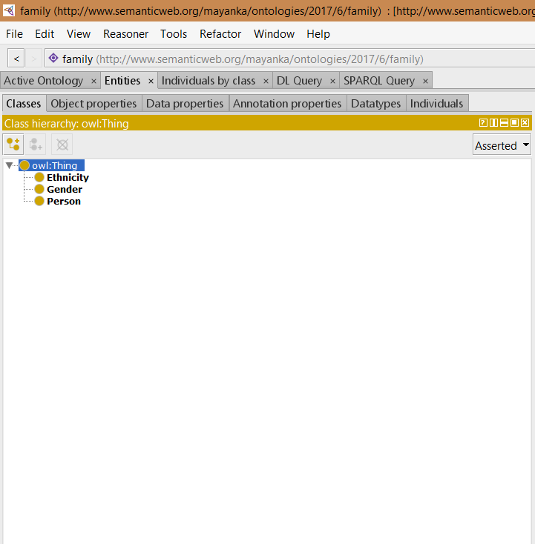
NamedClasses
Go to Entities tab then to Classes tab
The empty class tree contains one class called owl:Thing, which is superclass of everything.
Create SubClasses Person, Gender and Ethnicity. They are subclasses of owl:Thing.

Slide 12
OWL Syntax: Class
<!--After the headers as shown in slide 7 -->
<Declaration>
<Class IRI="#Person"/>
</Declaration>
<Declaration>
<Class IRI="#Gender"/>
</Declaration>
<Declaration>
<Class IRI="#Ethnicity"/>
</Declaration>
</Ontology>
<!-- Generated by the OWL API (version 4.2.8.20170104-2310) https://github.com/owlcs/owlapi -->

Slide 13
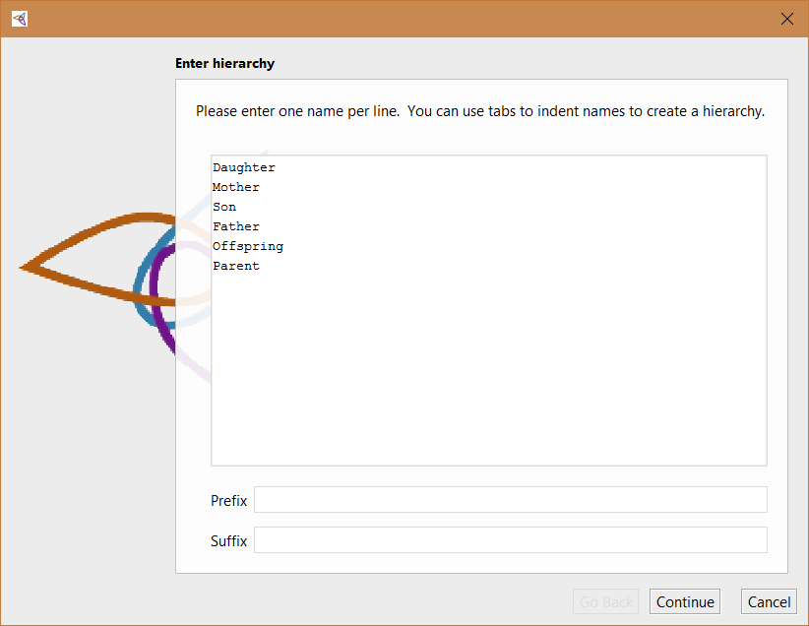
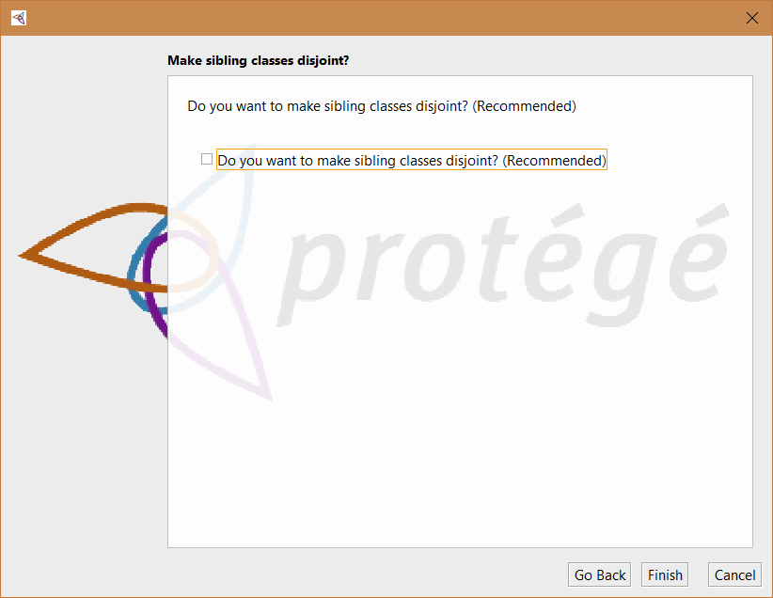
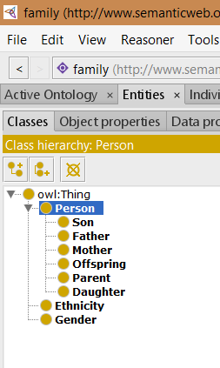
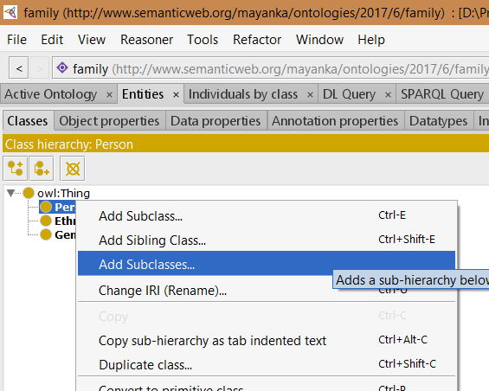
Creating SubClasses
Creating SubClasses is similar steps as done before
Create Daughter, Father, Son, Mother, Offspring, Parent

Slide 14
OWL Syntax: SubClass
<Declaration>
<Class IRI="#Mother"/>
</Declaration>
<Declaration>
<Class IRI="#Offspring"/>
</Declaration>
<Declaration>
<Class IRI="#Parent"/>
</Declaration>
<Declaration>
<Class IRI="#Son"/>
</Declaration>
<Declaration>
<Class IRI="#Father"/>
</Declaration>
<Declaration>
<Class IRI="#Daughter"/>
</Declaration>
<SubClassOf>
<Class IRI="#Daughter"/>
<Class IRI="#Person"/>
</SubClassOf>
<SubClassOf>
<Class IRI="#Father"/>
<Class IRI="#Person"/>
</SubClassOf>
<SubClassOf>
<Class IRI="#Mother"/>
<Class IRI="#Person"/>
</SubClassOf>
<SubClassOf>
<Class IRI="#Offspring"/>
<Class IRI="#Person"/>
</SubClassOf>
<SubClassOf>
<Class IRI="#Parent"/>
<Class IRI="#Person"/>
</SubClassOf>
<SubClassOf>
<Class IRI="#Son"/>
<Class IRI="#Person"/>
</SubClassOf>
</Ontology>

Slide 15
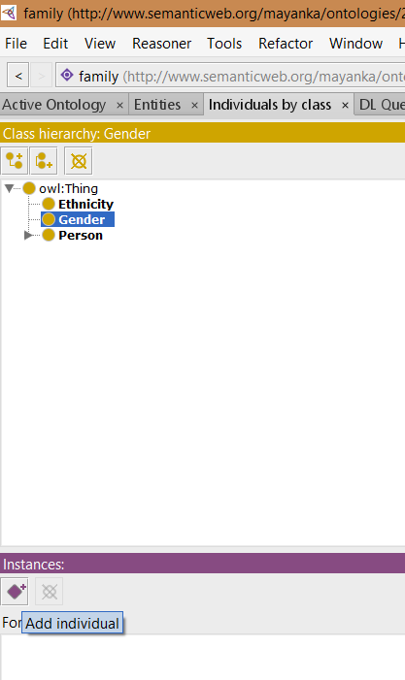
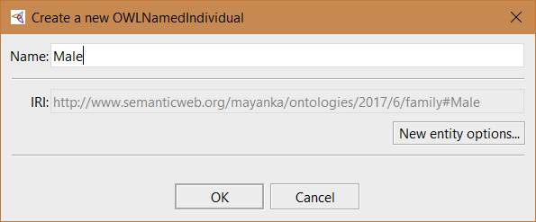
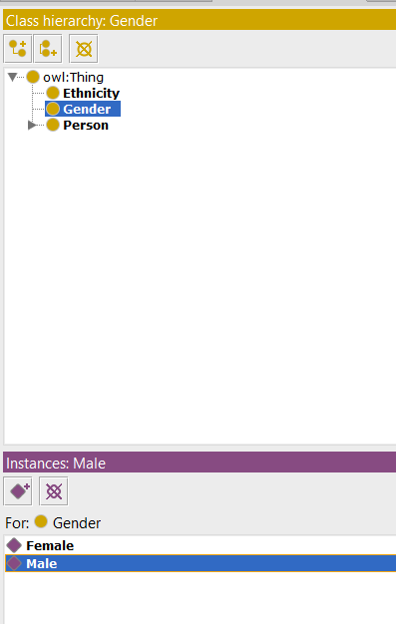
Creating NamedIndividual
Go to Individuals by Class Tab
Select Gender in Class Hierarchy
Click on AddIndividuals Icon in Instances
Type Name on PopUp Window and click ok

Slide 16
OWL Syntax: NamedIndividual
<Declaration>
<NamedIndividual IRI="#Male"/>
</Declaration>
<Declaration>
<NamedIndividual IRI="#Female"/>
</Declaration>
<ClassAssertion>
<Class IRI="#Gender"/>
<NamedIndividual IRI="#Female"/>
</ClassAssertion>
<ClassAssertion>
<Class IRI="#Gender"/>
<NamedIndividual IRI="#Male"/>
</ClassAssertion>
</Ontology>
<!-- Generated by the OWL API (version 4.2.8.20170104-2310) https://github.com/owlcs/owlapi -->

Slide 17
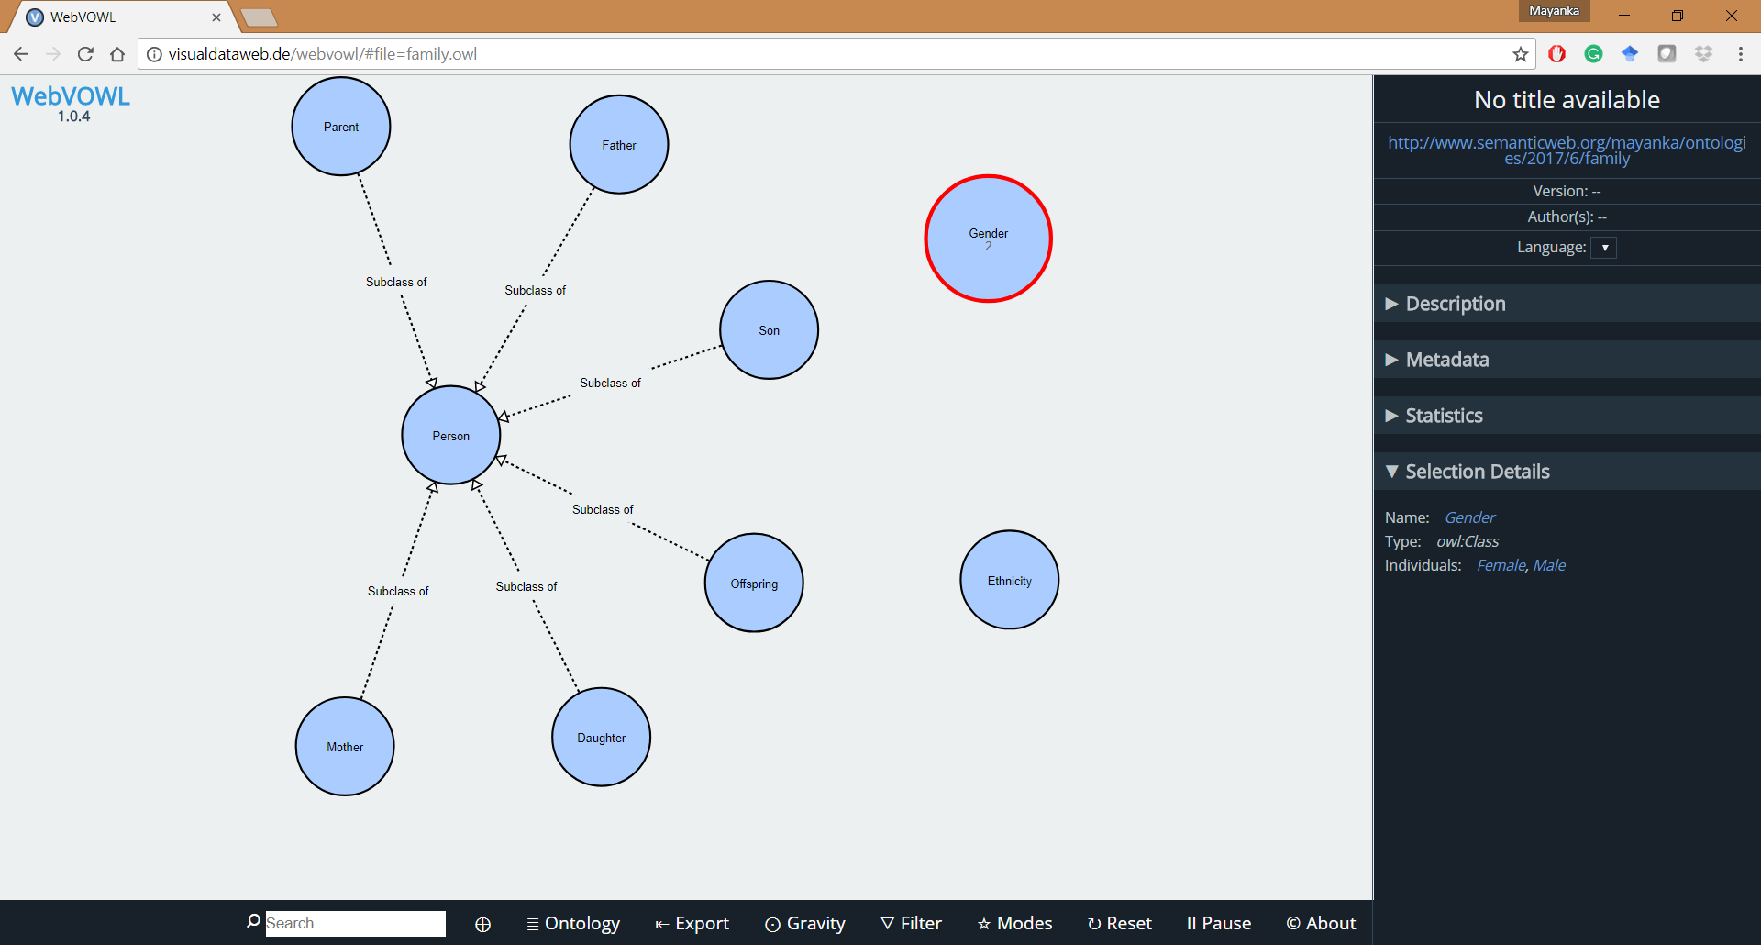
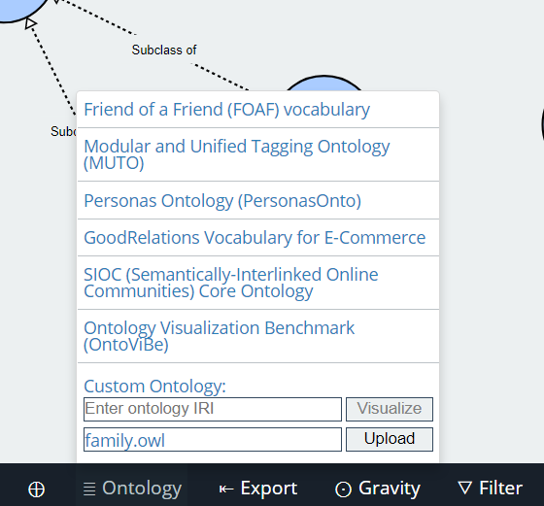
Visualization of Ontology
Using http://vowl.visualdataweb.org/webvowl.html

Slide 18
What next ?
Relating the Classes

Slide 19
Structure of Entities and Literals
Source : https://www.w3.org/TR/owl2-syntax/#Entities.2C_Literals.2C_and_Anonymous_Individuals

Slide 20
OWL Properties
OWL Properties represent relationships between two entities.
There are two main properties:
Object properties: to link entity to another entity
Datatype properties: to link entity to XML Schema datatype or rdf:literal
Annotation properties: used to add annotation information to entity (for example label, verison information, comments etc.)

Slide 21
Example for OWL Properties

Slide 22
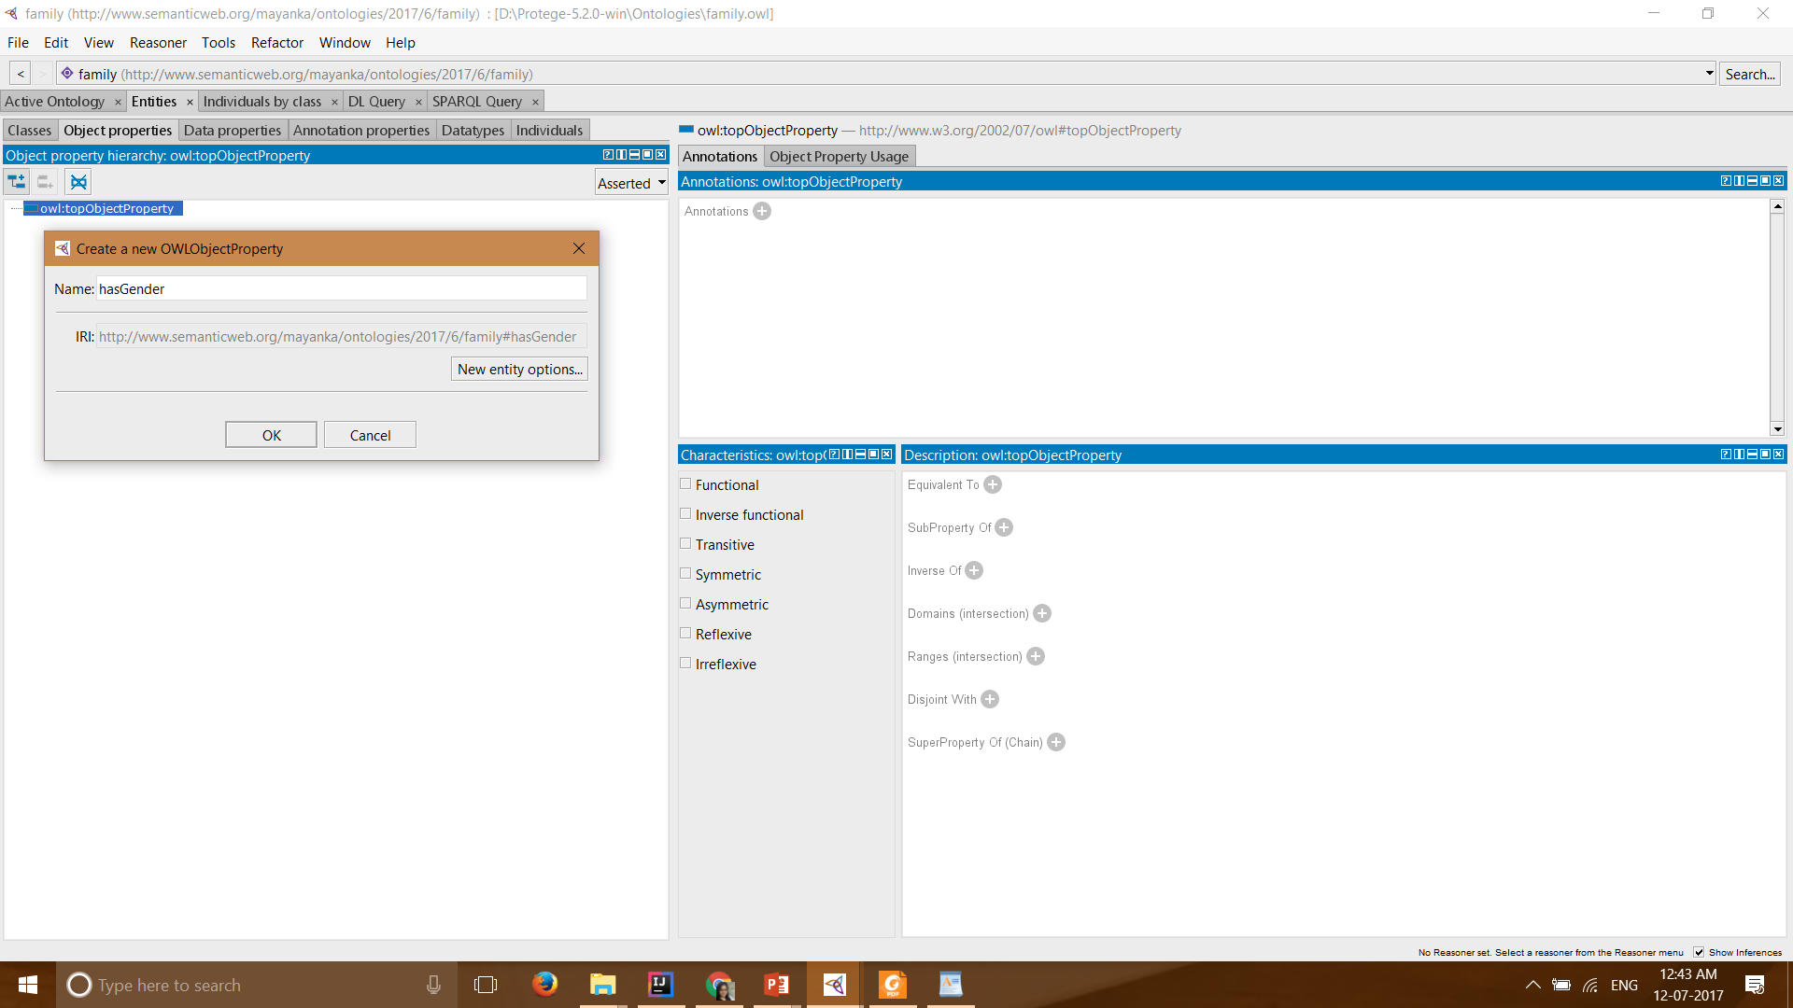
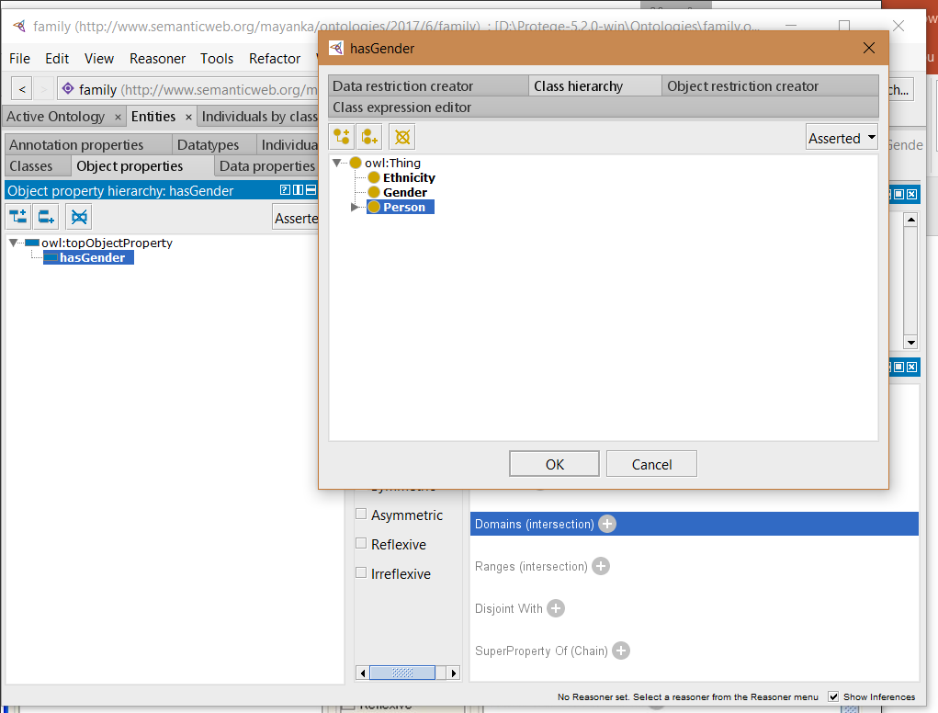
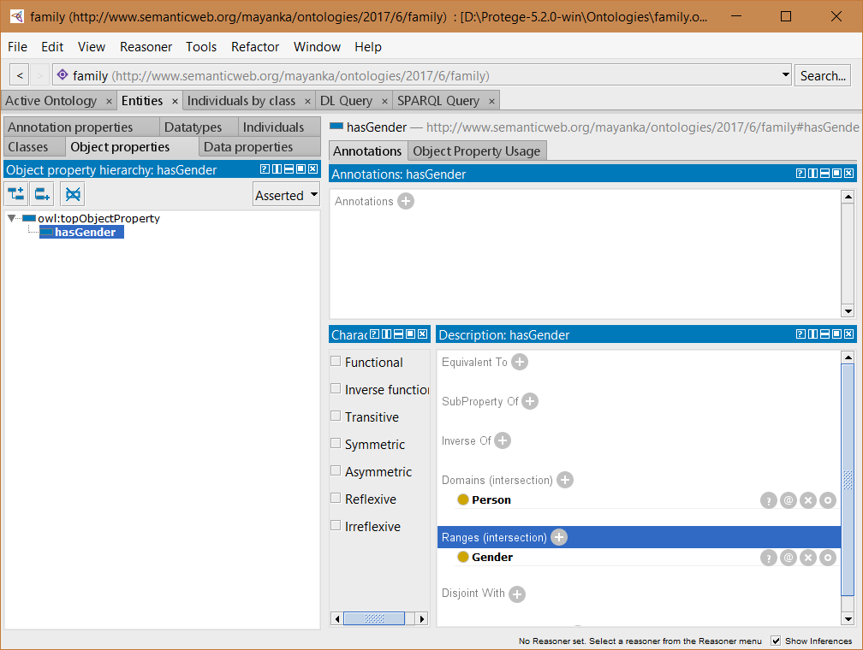
Create an object property
Switch to the “Object Properties” tab,
The empty Object property tree contains one Object property called owl:topObjectProperty
Use “Add Sub Property” button to create a new object property.
Create new sub properties “hasGender”
Add “Person” as Domain from Description
Similarly Add “Gender” as Range from Description

Slide 23
Property domains and ranges
Properties link individuals from the domain to individuals from the range.
OWL uses domain and range as axioms in reasoning.
When multiple classes are added as domain or range, they represent as the union of these classes.

Slide 24
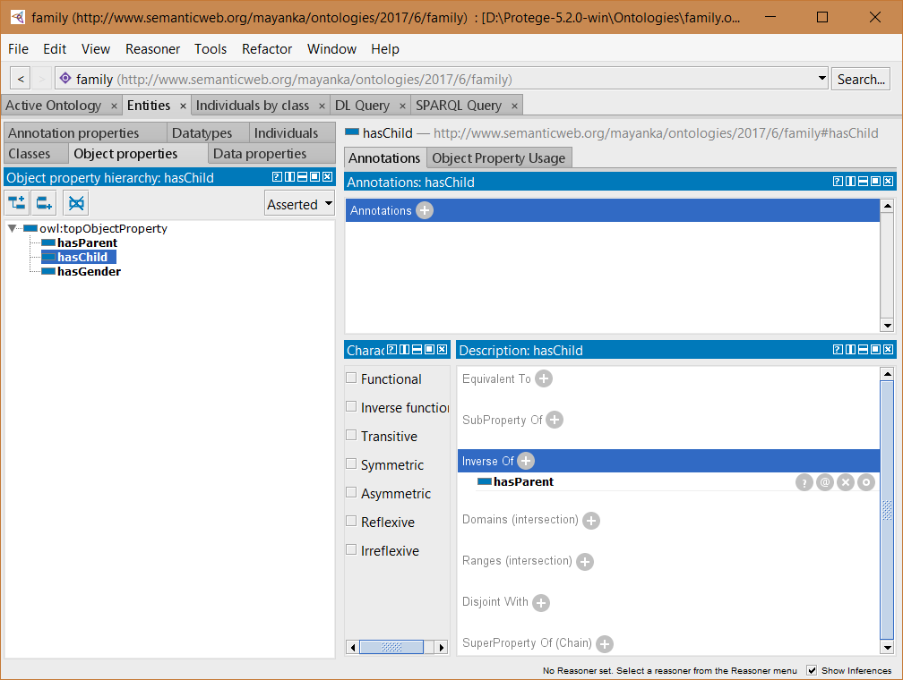
Create inverse properties
Lets make hasChild and hasParent properties inverse to each other.
Select hasChild property and select add button next to Inverse of, now select hasParent property from the hierarchy of object properties

Slide 25
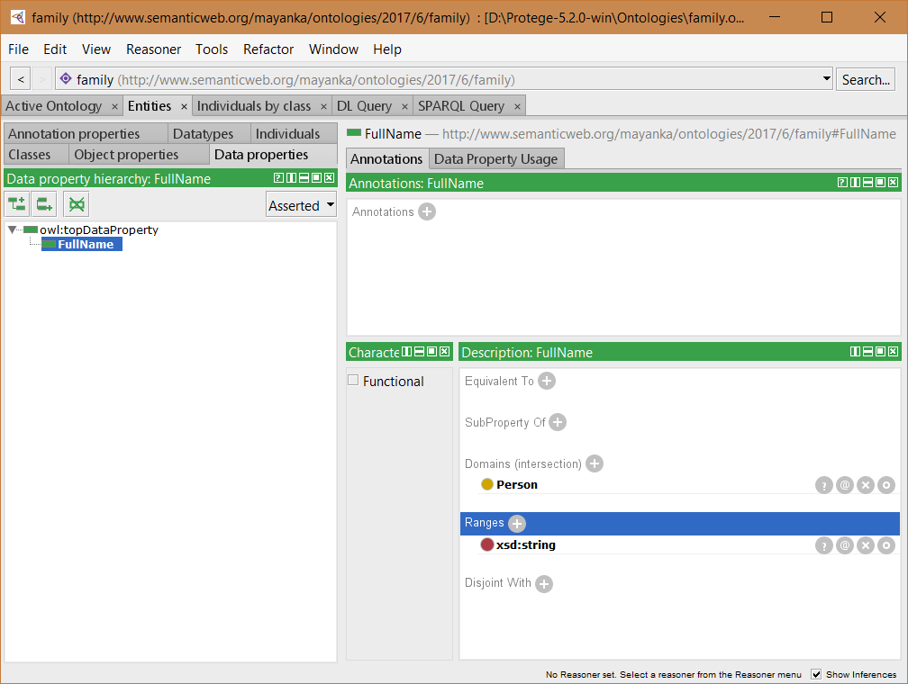
Create Data Property
Switch to “Data Properties” Tab
The empty Data property tree contains one Data property called owl:topDataProperty
Use “Add Sub Property” button to create a new object property.
Create new sub property “FullName”
Now specify domain and range of “fullName” property
Domain: Person
Range: xsd:string

Slide 26
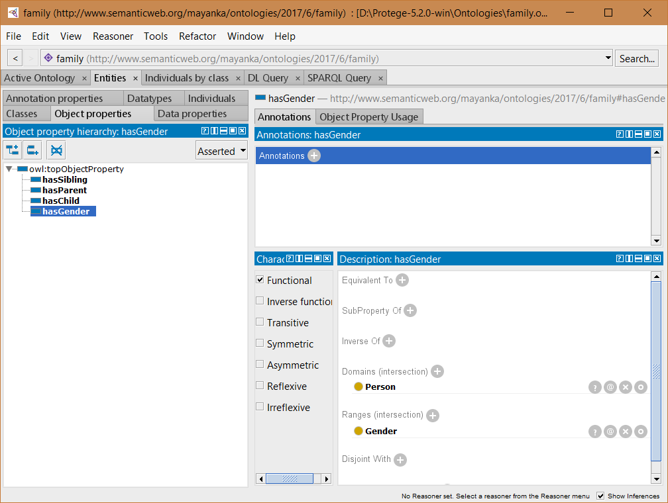
Characteristics of Object Properties
Functional and Inverse functional A functional property can have only one member in the range for any member of the domain.
For example hasGender is marked as functional so that each person can have only one gender.
Inverse functional is the opposite- each member of the domain can correspond only one member of the range.
Imagine that you would like to interface your ontology with a database of people. You might want to create a hasID property. That property could be marked as Inverse functional, since you want each ID to correspond to only one Person.

Slide 27
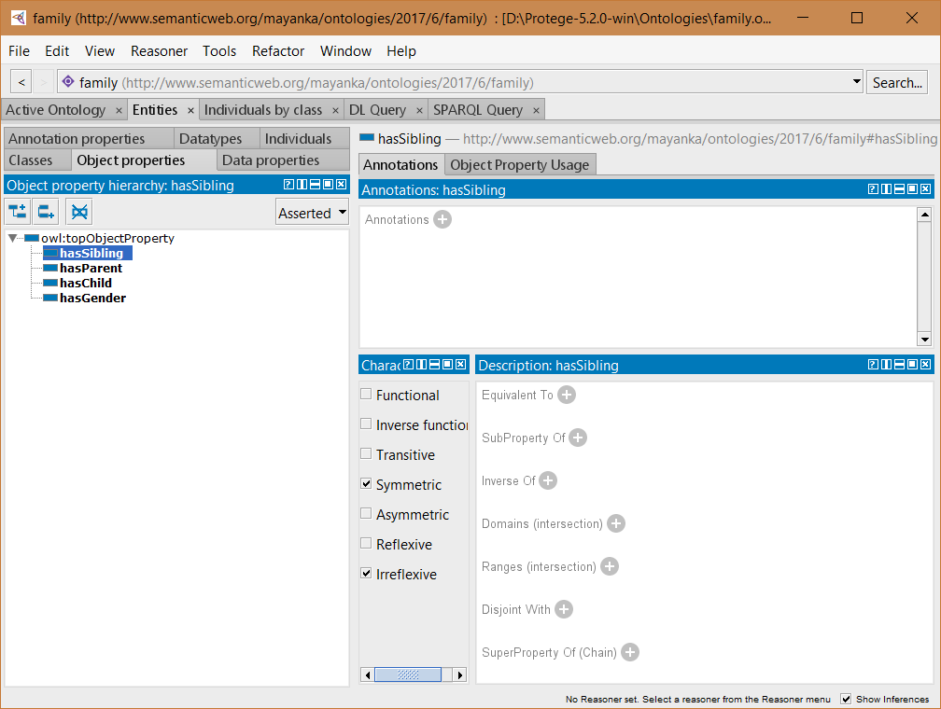
Characteristics of Object Properties
Symmetric This means that "x aProperty y" implies "y aProperty x".
Asymmetric This means that if "x aProperty y" then "y aProperty x" cannot be true as well.
Reflexive This means that "x aProperty x" is always true. For example if you were modeling networks of friends you might want a property isKnownBy. This property could be reflexive, since everyone know themselves.
Irreflexive This means that "x aProperty x" is never true. In our examples it means that a person cannot be their own sibling.

Slide 28
Characteristics of Object Properties
Transitive This means that "x aProperty y" and "y aProperty z" implies "x aProperty z". An easy example would be the hasSibling property.
If Mary is the sibling of Jane who is the sibling of Sue then Mary should also be the sibling of Sue.
However, you'll note that the hasSibling property doesn't have Transitive checked.
This is because the Transitive property has a requirement that it cannot be used if there are certain other restrictions on the property (in this case its the irreflexive thats conflicting).
Try checking Transitive and running the reasoner - you should get an error.
Uncheck it so that you can run the reasoner later. Sometimes you'll run into examples where you are trying to express something and you get vague reasoner errors.
This usually means that either you did something wrong or that what you are trying to express can't be expressed. Try to run the reasoner often when you are building your own ontologies- else you might not be able to track down where the error occurred!

Slide 29
OWL Syntax : Properties
<InverseObjectProperties>
<ObjectProperty IRI="#hasChild"/>
<ObjectProperty IRI="#hasParent"/>
</InverseObjectProperties>
<FunctionalObjectProperty>
<ObjectProperty IRI="#hasGender"/>
</FunctionalObjectProperty>
<SymmetricObjectProperty>
<ObjectProperty IRI="#hasSibling"/>
</SymmetricObjectProperty>
<IrreflexiveObjectProperty>
<ObjectProperty IRI="#hasSibling"/>
</IrreflexiveObjectProperty>
<ObjectPropertyDomain>
<ObjectProperty IRI="#hasGender"/>
<Class IRI="#Person"/>
</ObjectPropertyDomain>
<ObjectPropertyRange>
<ObjectProperty IRI="#hasGender"/>
<Class IRI="#Gender"/>
</ObjectPropertyRange>
<DataPropertyDomain>
<DataProperty IRI="#FullName"/>
<Class IRI="#Person"/>
</DataPropertyDomain>
<DataPropertyRange>
<DataProperty IRI="#FullName"/>
<Datatype abbreviatedIRI="xsd:string"/>
</DataPropertyRange>

Slide 30
Property restrictions
In OWL, properties are used to create restrictions.
Restrictions are used to restrict the individuals that belong to a class
OWL defines using the following keywords
allValuesFrom
hasValue
someValuesFrom
Cardinality
minCardinality
MaxCardinality

Slide 31
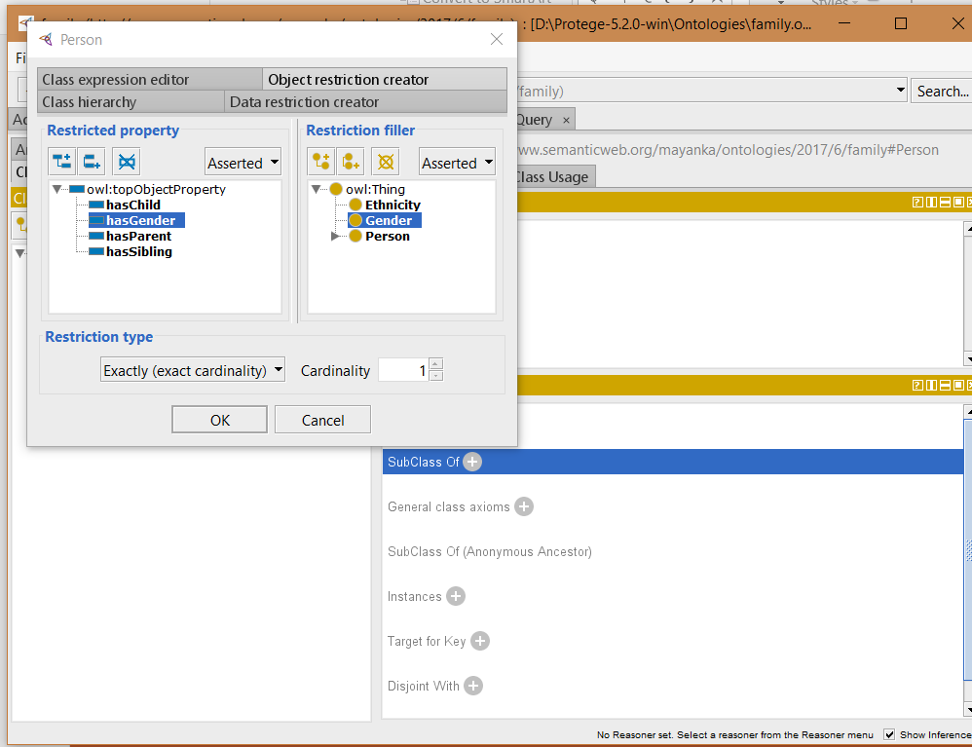
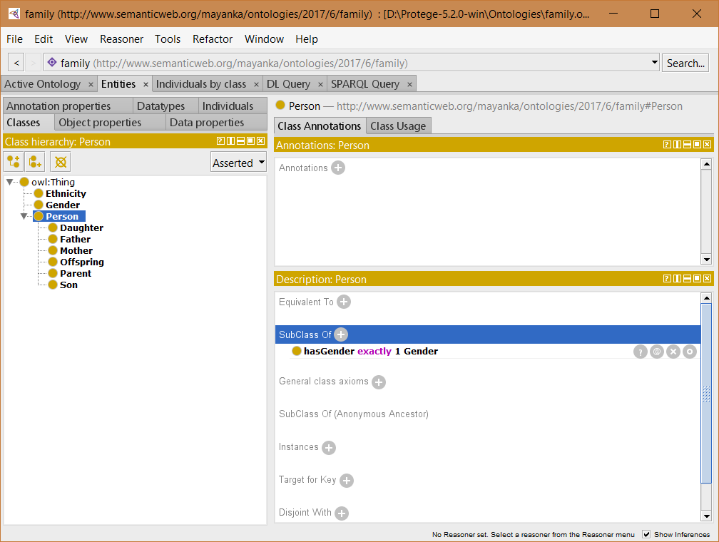
Add a restriction to Person
Add a restriction to SubClass Of Person that specifies it must have exactly one Gender
Select Person
Select Object Restriction Creator Tab
Select create a restriction wizard
Select hasGender as restricted property
Select Gender as restriction
Select Exactly(exact cardinality) as Restriction Type
Select 1 as Cardinality

Slide 32
OWL Syntax: Property Restriction
<SubClassOf>
<Class IRI="#Person"/>
<ObjectExactCardinality cardinality="1">
<ObjectProperty IRI="#hasGender"/>
<Class IRI="#Gender"/>
</ObjectExactCardinality>
</SubClassOf>

Slide 33
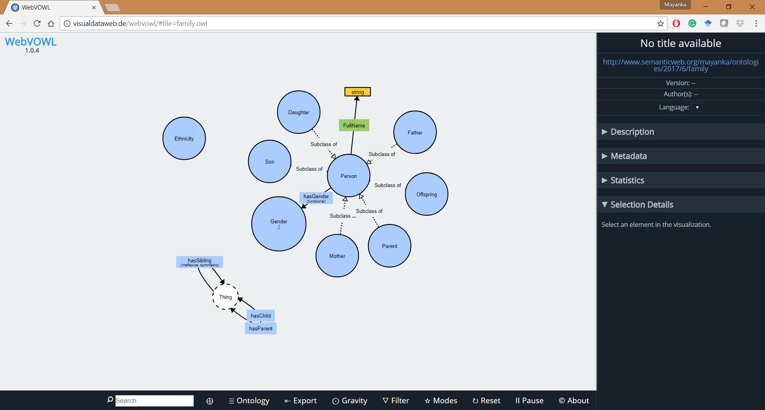
Visualization of Ontology

Slide 34
Complex Classes
Disjoint Classes
disjointWith constructor. It guarantees that an individual that is a member of one class cannot simultaneously be an instance of a specified other class.
Equivalent Classes
To tie together a set of component ontologies as part of a third it is frequently useful to be able to indicate that a particular class or property in one ontology is equivalent to a class or property in a second ontology.
Set Operators
intersectionOf
unionOf
complementOf

Slide 35
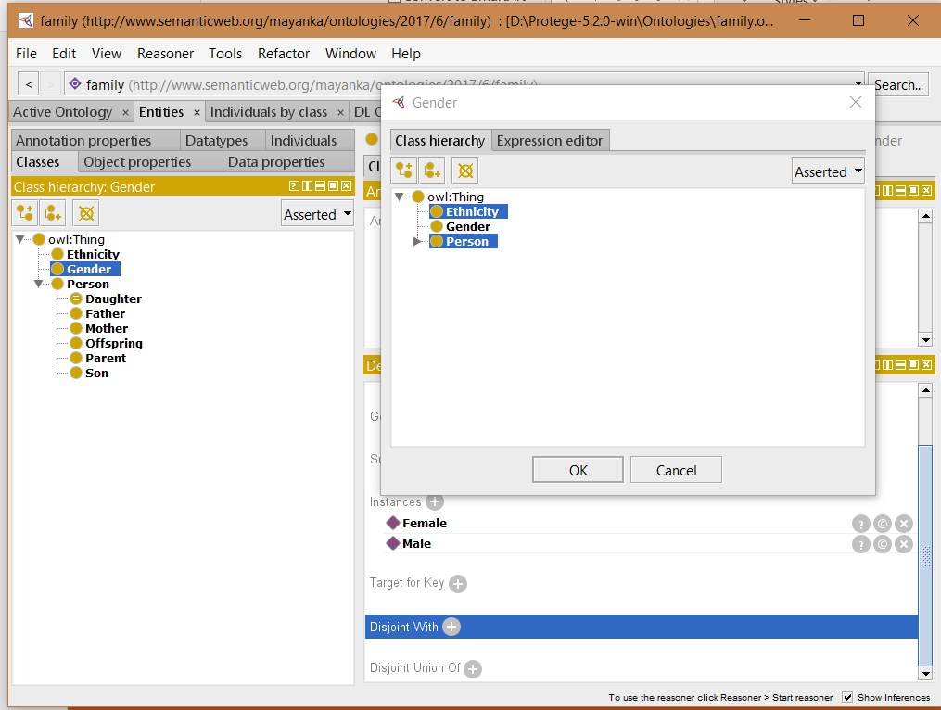
Making family ontology complex
Disjoint Class using Class hierarchy

Slide 36
OWL Syntax: Disjoint Class
<DisjointClasses>
<Class IRI="#Ethnicity"/>
<Class IRI="#Gender"/>
<Class IRI="#Person"/>
</DisjointClasses>

Slide 37
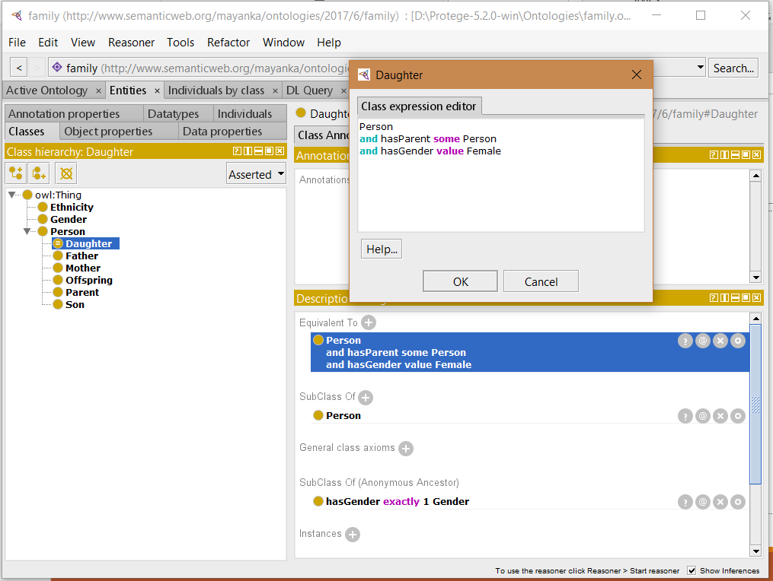
Making family ontology complex
Equivalent Class using Class Expression Editor

Slide 38
OWL Syntax: Equivalent Class and Set Operator
<EquivalentClasses>
<Class IRI="#Daughter"/>
<ObjectIntersectionOf>
<Class IRI="#Person"/>
<ObjectSomeValuesFrom>
<ObjectProperty IRI="#hasParent"/>
<Class IRI="#Person"/>
</ObjectSomeValuesFrom>
<ObjectHasValue>
<ObjectProperty IRI="#hasGender"/>
<NamedIndividual IRI="#Female"/>
</ObjectHasValue>
</ObjectIntersectionOf>
</EquivalentClasses>

Slide 39
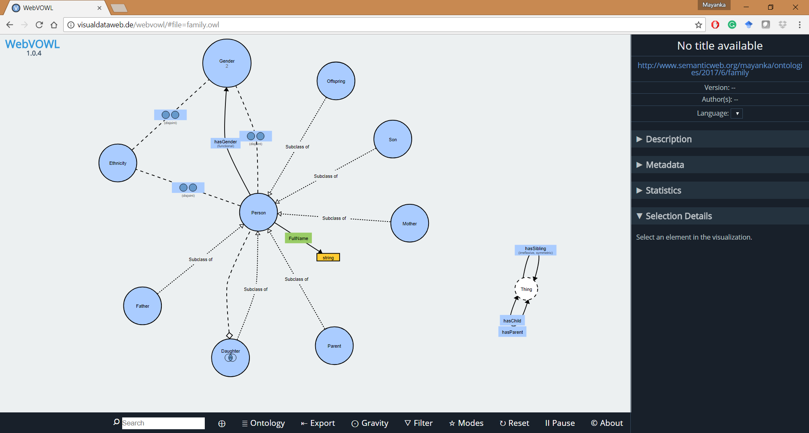
Visualization of Ontology

Slide 40
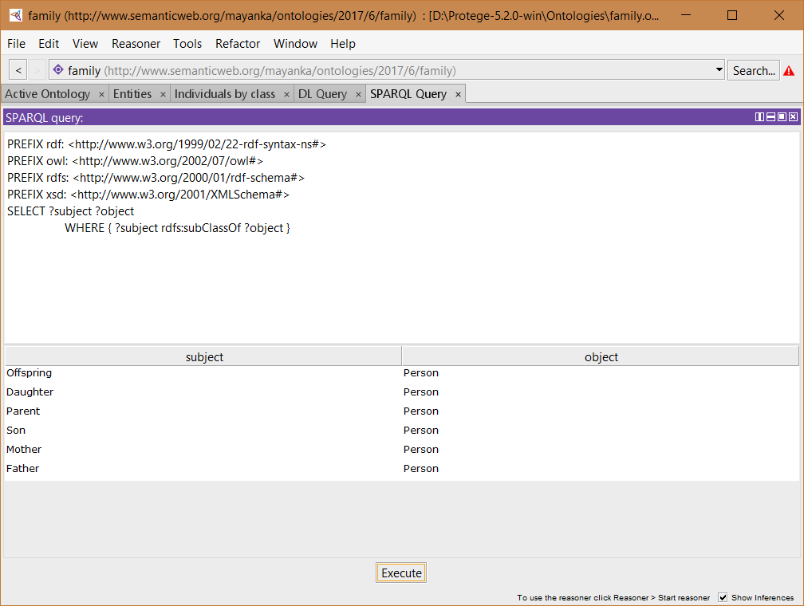
SPARQL Query
Go to Window -> Tabs -> SPARQL Query (Enable)
Click Execute
This Queries our ontology and list all the subclasses present in it

Slide 41
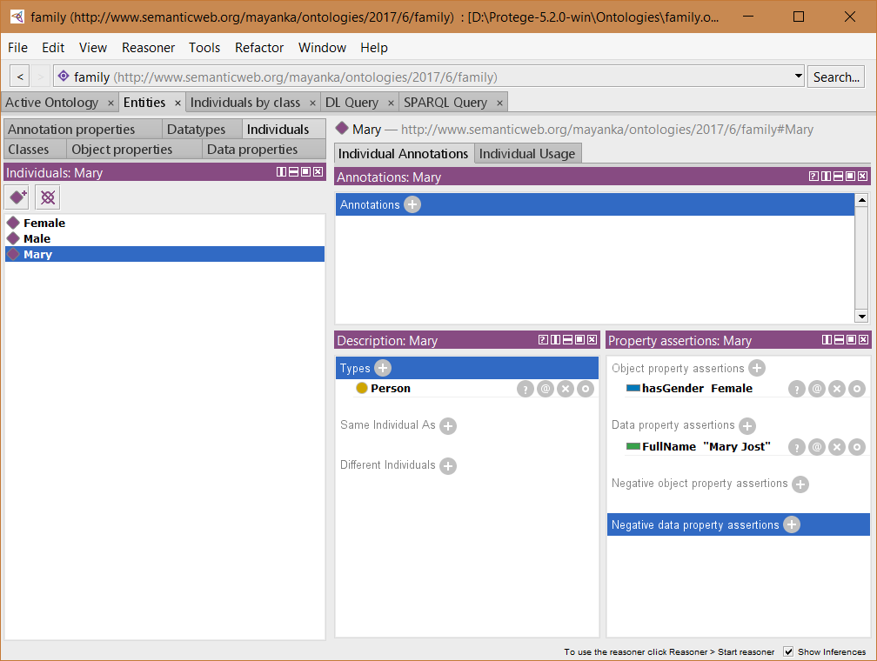
Add Individual under Person
For Example
Mary
Data Property : fullName = Mary Jost
Object Property : hasGender = Female

Slide 42
OWL Syntax:
<ClassAssertion>
<Class IRI="#Person"/>
<NamedIndividual IRI="#Mary"/>
</ClassAssertion>
<ObjectPropertyAssertion>
<ObjectProperty IRI="#hasGender"/>
<NamedIndividual IRI="#Mary"/>
<NamedIndividual IRI="#Female"/>
</ObjectPropertyAssertion>
<DataPropertyAssertion>
<DataProperty IRI="#FullName"/>
<NamedIndividual IRI="#Mary"/>
<Literal datatypeIRI="http://www.w3.org/1999/02/22-rdf-syntax-ns#PlainLiteral">Mary Jost</Literal>
</DataPropertyAssertion>

Slide 43
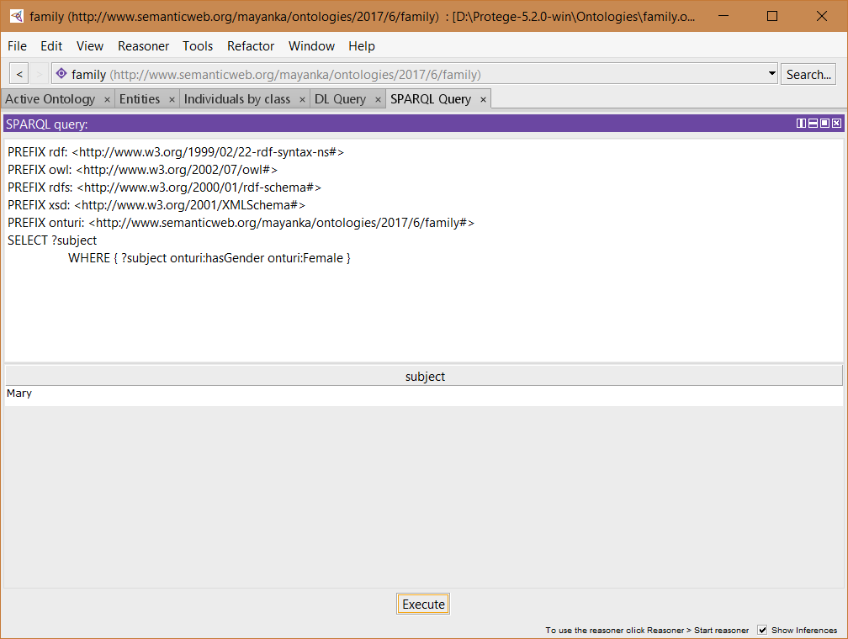
Lets Query
Add Namespace ie our Ontology URI
This queries to list all entities that hasGender Female
Lists our new individual

