Slide 1
CS5560 KDM – Tutorial 4 Spark -1

Slide 2
Ways to use spark
Spark Local Installation (Explained in first section of this ppt)
Running spark in pycharm (Recommended)

Slide 3
Overview
Installation of spark locally
Spark – WordCount
Running WordCount in pycharm

Slide 4
Installation of spark locally

Slide 5
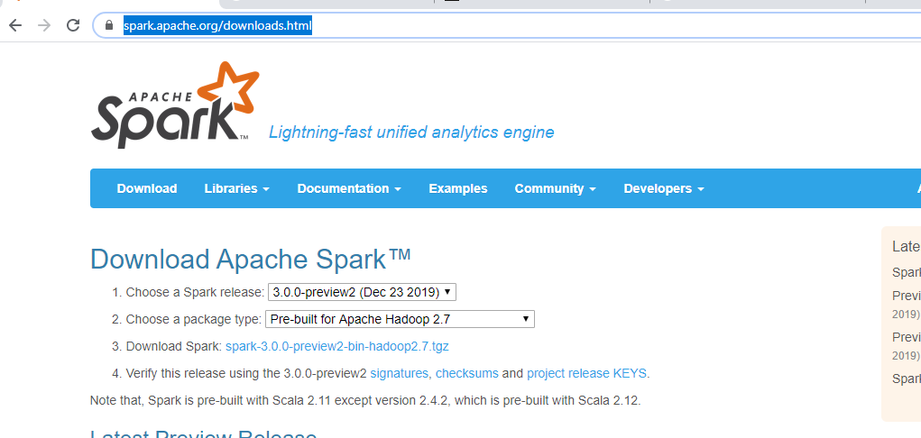
Install Apache Spark Locally
https://spark.apache.org/downloads.html

Slide 6
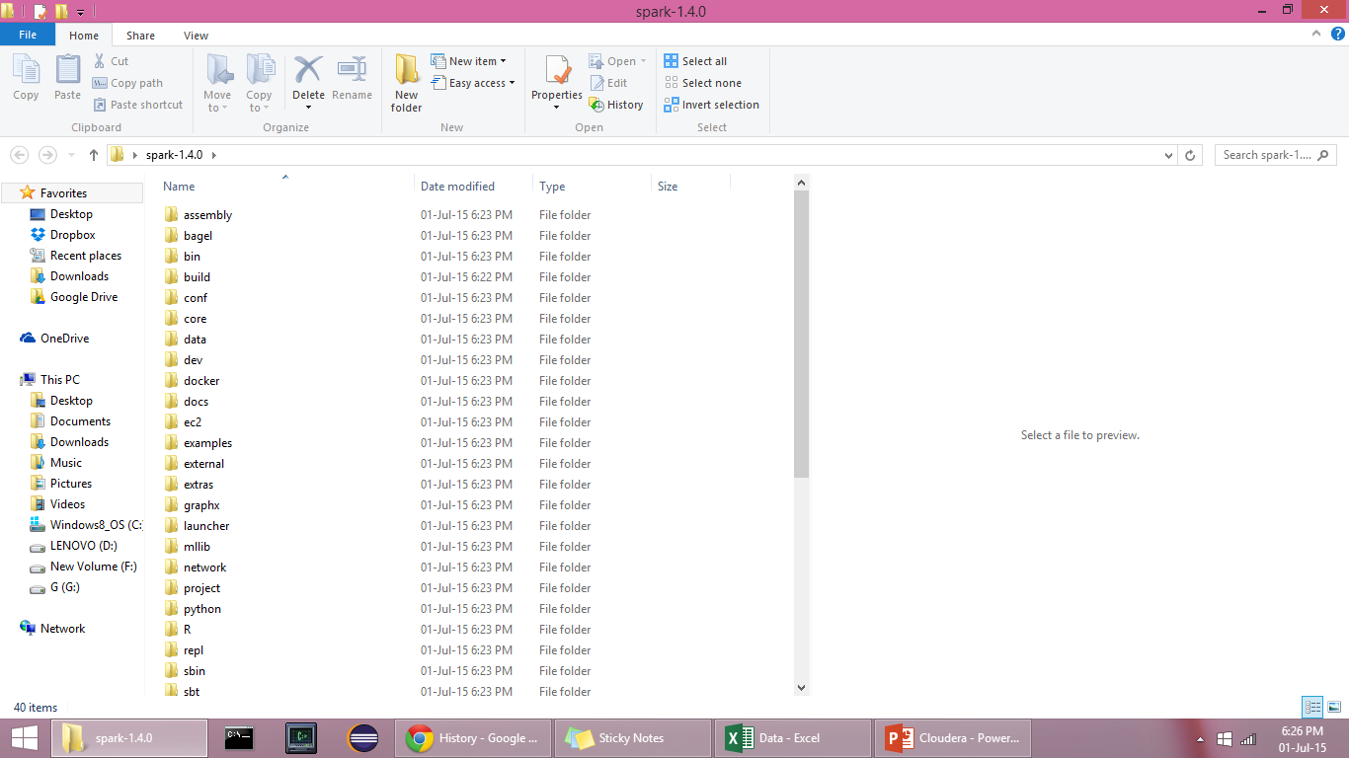
spark-1.5.0.tgz will be downloaded
Use Winrar or some tool to extract the archived file on to the destination folder.
On windows cmd prompt go to location where the spark is installed and execute the following command to extract
tar xvf spark-3.0.0-preview2-bin-hadoop2.7.tgz

Slide 7
Spark – WordCount

Slide 8
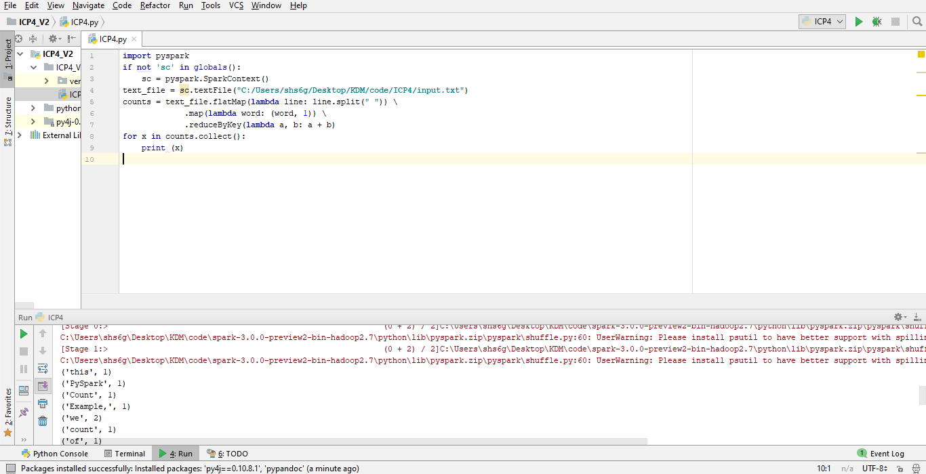
Spark - Word Count : Code Snippet

Slide 9
Note : Windows
Hadoop_Home_Dir has to be set, a bug not corrected in Spark yet.
http://public-repo-1.hortonworks.com/hdp-win-alpha/winutils.exe
Download the above .exe file, save in the following folder structure
F:\winutils\bin\winutils.exe
Write the below statement, before using any Mlib function
System.setProperty("hadoop.home.dir","F:\\winutils");

Slide 10
Running WordCount in pycharm

Slide 11
Setting up the project Structure
Go to settings > project structure > Add content Root
Add following 2 and click apply:
C:\Users\shs6g\Desktop\KDM\code\spark-3.0.0-preview2-bin-hadoop2.7\python
C:\Users\shs6g\Desktop\KDM\code\spark-3.0.0-preview2-bin-hadoop2.7\python\lib\py4j-0.10.8.1-src

Slide 12
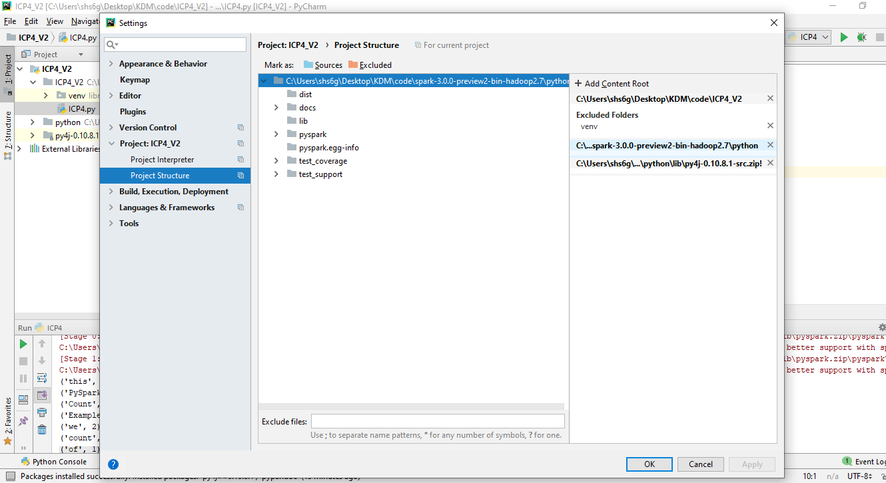
Setting up the project Structure

Slide 13
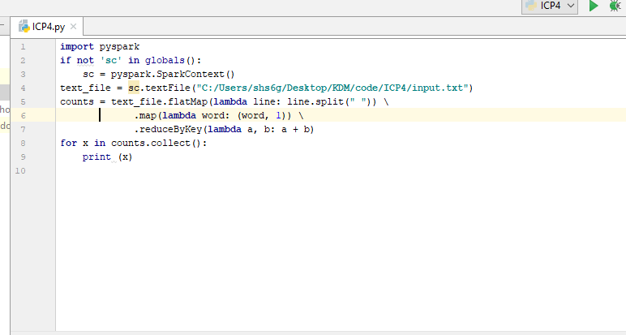
Run The Main code

Slide 14
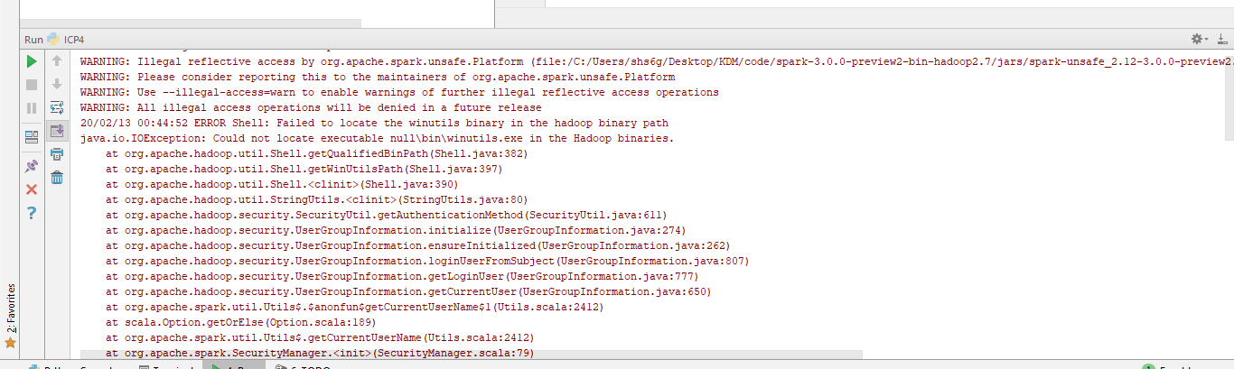

Slide 15
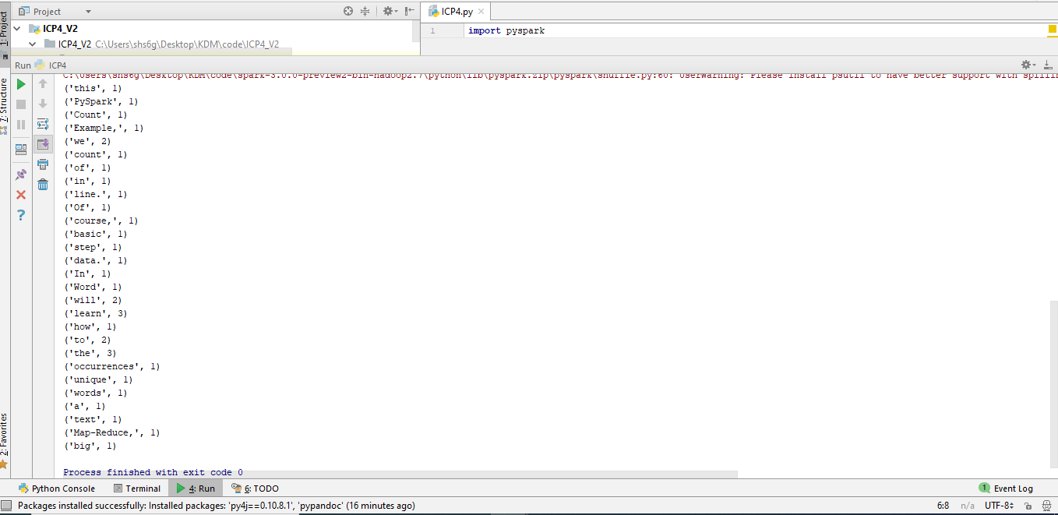
Output

Slide 16
Spark - 2
Spark Programming
Transformations and Actions

Slide 17
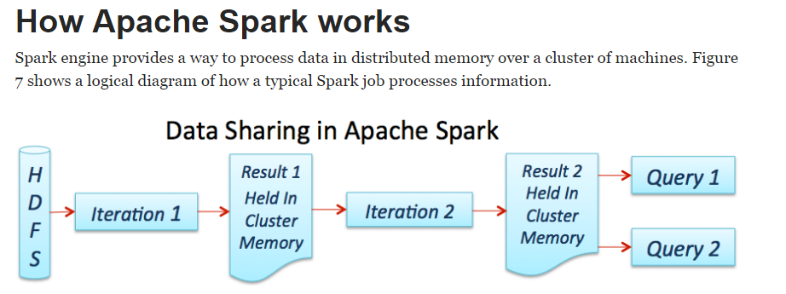
Source: https://dzone.com/refcardz/apache-spark

Slide 18
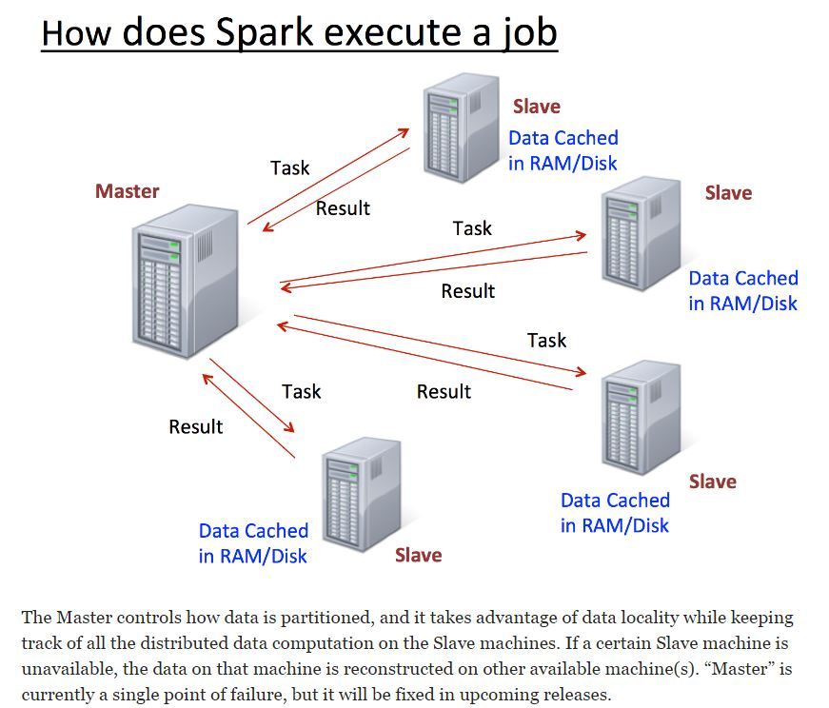
Source: https://dzone.com/refcardz/apache-spark

Slide 19
Learning Spark Programming
Easiest way: Spark interpreter (spark-shell or pyspark)
Special Scala and Python consoles for cluster use
Runs in local mode on 1 thread by default, but can control with MASTER environment var:
MASTER=local ./spark-shell # local, 1 thread MASTER=local[2] ./spark-shell # local, 2 threads MASTER=spark://host:port ./spark-shell # Spark standalone cluster

Slide 20
First Stop: SparkContext
Main entry point to Spark functionality
Created for you in Spark shells as variable sc
In standalone programs, you’d make your own (see later for details)

Slide 21
Creating RDDs
# Turn a local collection into an RDD
sc.parallelize([1, 2, 3]) #Python
sc.parallelize(Array(1, 2, 3)) #Scala
# Load text file from local FS, HDFS, or S3
sc.textFile(“file.txt”)
sc.textFile(“directory/*.txt”)
sc.textFile(“hdfs://namenode:9000/path/file”)
# Use any existing Hadoop InputFormat
sc.hadoopFile(keyClass, valClass, inputFmt, conf)

Slide 22
Basic Transformations (Python)
nums = sc.parallelize([1, 2, 3])
# Pass each element through a function
squares = nums.map(lambda x: x*x) # => {1, 4, 9}
# Keep elements passing a predicate
even = squares.filter(lambda x: x % 2 == 0) # => {4}
# Map each element to zero or more others
nums.flatMap(lambda x: range(0, x)) # => {0, 0, 1, 0, 1, 2}
Range object (sequence of numbers 0, 1, …, x-1)
Notes:
All lazy

Slide 23
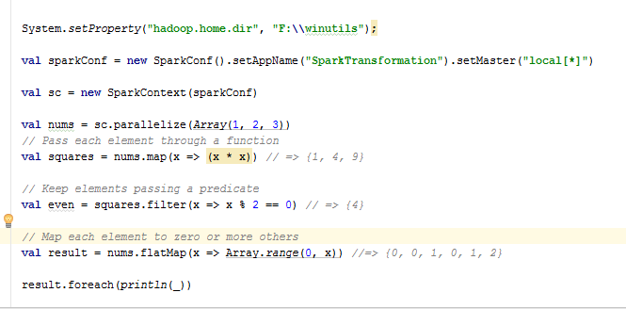
Basic Transformations (Scala)

Slide 24
Basic Actions (Python)
nums = sc.parallelize([1, 2, 3])
# Retrieve RDD contents as a local collection nums.collect() # => [1, 2, 3]
# Return first K elements nums.take(2) # => [1, 2]
# Count number of elements nums.count() # => 3
# Merge elements with an associative function nums.reduce(lambda x, y: x + y) # => 6
# Write elements to a text file nums.saveAsTextFile(“hdfs://file.txt”)
Notes:
Launch computations

Slide 25
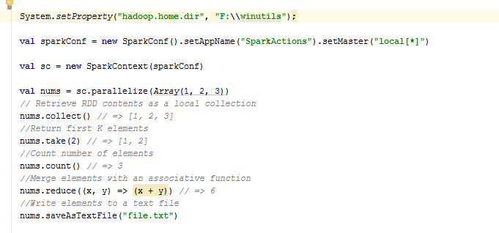
Basic Actions (Scala)

Slide 26
Working with Key-Value Pairs
Spark’s “distributed reduce” transformations act on RDDs of key-value pairs
Python: pair = (a, b)
pair[0] # => a
pair[1] # => b
Scala: val pair = (a, b)
pair._1 // => a
pair._2 // => b
Java: Tuple2 pair = new Tuple2(a, b); // class scala.Tuple2
pair._1 // => a
pair._2 // => b

Slide 27
Some Key-Value Operations (Python)
pets = sc.parallelize([(“cat”, 1), (“dog”, 1), (“cat”, 2)])
pets.reduceByKey(lambda x, y: x + y) # => {(cat, 3), (dog, 1)}
pets.groupByKey() # => {(cat, Seq(1, 2)), (dog, Seq(1)}
pets.sortByKey() # => {(cat, 1), (cat, 2), (dog, 1)}
reduceByKey also automatically implements combiners on the map side

Slide 28
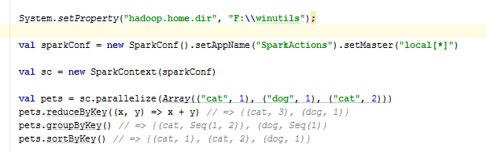
Some Key-Value Operations (Scala)

Slide 29
Example: Word Count (Python)
lines = sc.textFile(“hamlet.txt”)
counts = lines.flatMap(lambda line: line.split(“ ”)) \ .map(lambda word: (word, 1)) \ .reduceByKey(lambda x, y: x + y)
“to” “be” “or”
(to, 1) (be, 1) (or, 1)
(be, 2) (not, 1)
“to be or”
“not” “to” “be”
(not, 1) (to, 1) (be, 1)
(or, 1)
(to, 2)
“not to be”

Slide 30
Multiple Datasets (Python)
visits = sc.parallelize([(“index.html”, “1.2.3.4”), (“about.html”, “3.4.5.6”), (“index.html”, “1.3.3.1”)])
pageNames = sc.parallelize([(“index.html”, “Home”), (“about.html”, “About”)])
visits.join(pageNames) # (“index.html”, (“1.2.3.4”, “Home”)) # (“index.html”, (“1.3.3.1”, “Home”)) # (“about.html”, (“3.4.5.6”, “About”))
visits.cogroup(pageNames) # (“index.html”, (Seq(“1.2.3.4”, “1.3.3.1”), Seq(“Home”))) # (“about.html”, (Seq(“3.4.5.6”), Seq(“About”)))

Slide 31
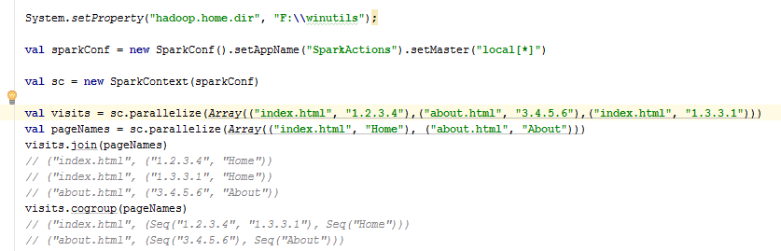
Multiple Datasets (Scala)

Slide 32
Controlling the Level of Parallelism
All the pair RDD operations take an optional second parameter for number of tasks
words.reduceByKey((x, y)=> x + y, 5)
words.groupByKey(5)
visits.join(pageViews, 5)

Slide 33
Using Local Variables
External variables you use in a closure will automatically be shipped to the cluster:
query = raw_input(“Enter a query:”)
pages.filter(lambda x: x.startswith(query)).count()
Some caveats:
Each task gets a new copy (updates aren’t sent back)
Variable must be Serializable (Java/Scala) or Pickle-able (Python)
Don’t use fields of an outer object (ships all of it!)

Slide 34
Closure Mishap Example
class MyCoolRddApp { val param = 3.14 val log = new Log(...) ... def work(rdd: RDD[Int]) { rdd.map(x => x + param) .reduce(...) } }
How to get around it:
class MyCoolRddApp { ... def work(rdd: RDD[Int]) { val param_ = param rdd.map(x => x + param_) .reduce(...) } }
NotSerializableException: MyCoolRddApp (or Log)
References only local variable instead of this.param

Slide 35
More Details
Spark supports lots of other operations!
Full programming guide: spark-project.org/documentation

