Slide 1

UMKC CS 5592 DAA by Sejun Song

Slide 2
Graph Theory Part 1

Slide 3
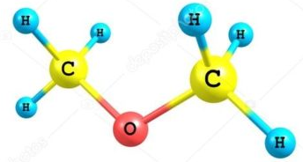
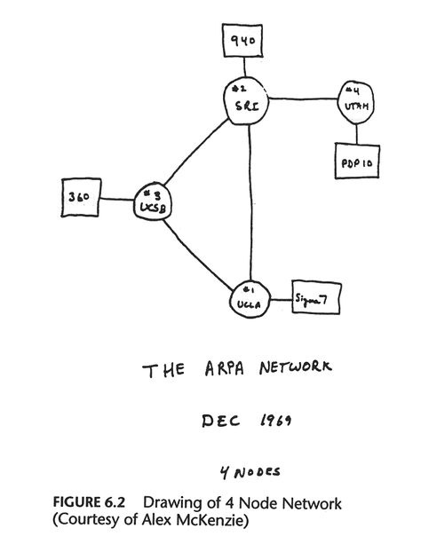
Varying Applications (Examples)
Computer networks (node and connections)
Distinguish between two chemical compounds with the same molecular formula but different structures
Solve shortest path problems between cities
Scheduling exams and assign channels to television stations

Slide 4
Topics Covered
Definitions
Types
Terminology
Representation
Sub-graphs
Connectivity
Hamilton and Euler definitions
Shortest Path
Planar Graphs
Graph Coloring

Slide 5
Definitions - Graph
A generalization of the simple concept of a set of dots, links, edges or arcs.
Representation: Graph G =(V, E) consists set of vertices denoted by V, or by V(G) and set of edges E, or E(G)

Slide 6
Definitions – Edge Type
Directed: Ordered pair of vertices. Represented as (u, v) directed from vertex u to v.
Undirected: Unordered pair of vertices. Represented as {u, v}. Disregards any sense of direction and treats both end vertices interchangeably.
u
v
u
v

Slide 7
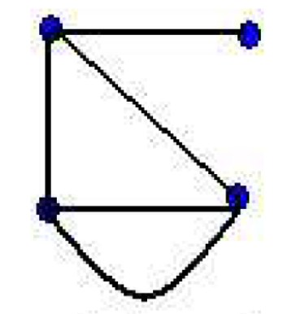
Definitions – Edge Type
Loop: A loop is an edge whose endpoints are equal i.e., an edge joining a vertex to it self is called a loop. Represented as {u, u} = {u},
Multiple Edges: Two or more edges joining the same pair of vertices.
u

Slide 8
Definitions – Graph Type
Simple (Undirected) Graph: consists of V, a nonempty set of vertices, and E, a set of unordered pairs of distinct elements of V called edges (undirected)
Representation Example: G(V, E), V = {u, v, w}, E = {{u, v}, {v, w}, {u, w}}
Is it a simple graph? NO
u
v
u
v
w
w

Slide 9
Definitions – Graph Type
Multigraph: G(V, E), consists of set of vertices V, set of Edges E. The edges e1 and e2 are called multiple or parallel edges.
Representation Example: V = {u, v, w}, E = {e₁, e₂, e₃}
u
e₁
e₂
w
v
e₃

Slide 10
Definitions – Graph Type
Pseudograph: G(V, E), consists of set of vertices V, set of Edges E. Loops allowed in such a graph.
Representation Example: V = {u, v, w}, E = {e₁, e₂, e₃, e₄}
u
e₁
w
e₂
e₄
v
e₃
A simple graph cannot contain any loops, but a pseudograph can contain both multiple edges and loops.

Slide 11
Definitions – Graph Type
Directed Graph: G(V, E), set of vertices V, and set of Edges E, that are ordered pair of elements of V (directed edges)
Representation Example: G(V, E), V = {u, v, w}, E = {(u, v), (v, w), (w, u)}
Is it a directed graph? YES
u
v
u
v
w
w

Slide 12
Definitions – Graph Type
Directed Multigraph: G(V,E), consists of set of vertices V, set of Edges E. The edges e1 and e2 are multiple edges.
Representation Example: V = {u, v, w}, E = {e₁, e₂, e₃, e₄}
u
w
e₄
e₁
e₂
v
e₃

Slide 13
Definitions – Graph Type
Type | Edges | Multiple Edges Allowed ? | Loops Allowed ?
Simple Graph | undirected | No | No
Multigraph | undirected | Yes | No
Pseudograph | undirected | Yes | Yes
Directed Graph | directed | No | Yes
Directed Multigraph | directed | Yes | Yes

Slide 14
Terminology – Undirected graphs
u and v are adjacent if {u, v} is an edge, e is called incident with u and v. u and v are called endpoints of {u, v}
Degree of Vertex (deg (v)): the number of edges incident on a vertex. A loop contributes twice to the degree (why?).
Pendant Vertex: deg (v) =1
Isolated Vertex: deg (k) = 0
Representation Example: For V = {u, v, w} , E = { {u, w}, {u, v} }, deg (u) = 2, deg (v) = 1, deg (w) = 1, deg (k) = 0, w and v are pendant , k is isolated
u
v
k
w

Slide 15
Terminology – Directed graphs
For the edge (u, v), u is adjacent to v OR v is adjacent from u, u – Initial vertex, v – Terminal vertex
In-degree (deg⁻ (u)): number of edges for which u is terminal vertex
Out-degree (deg⁺ (u)): number of edges for which u is initial vertex
Note: A loop contributes 1 to both in-degree and out-degree (why?)
Representation Example: For V = {u, v, w} , E = { (u, w), ( v, w), (u, v) }, deg⁻ (u) = 0, deg⁺ (u) = 2, deg⁻ (v) = 1, deg⁺ (v) = 1, and deg⁻ (w) = 2, deg⁺ (w) = 0
u
v
w

Slide 16
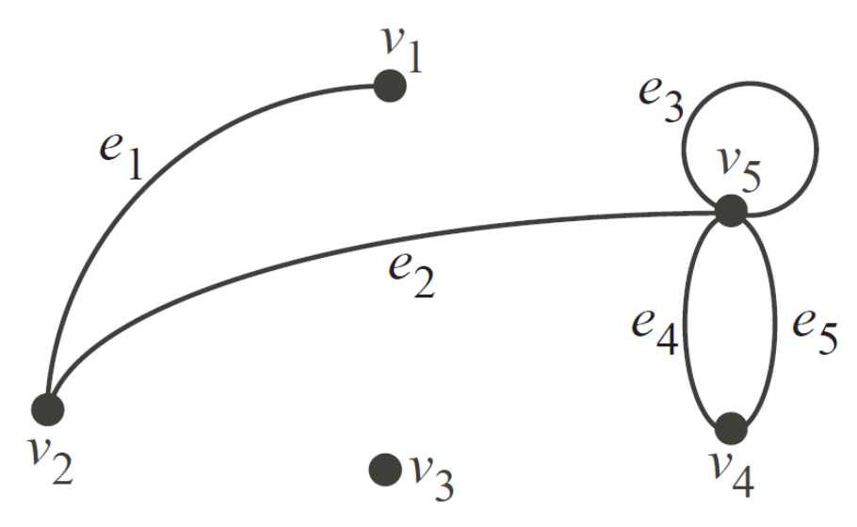
Definitions – Graph Type
So E = {e1, . . . , e5}. We have the following terminologies:
1. The two vertices u and v are end vertices of the edge (u, v).
2. Edges that have the same end vertices are parallel.
3. An edge of the form (v, v) is a loop.
4. A graph is simple if it has no parallel edges or loops.
5. A graph with no edges (i.e. E is empty) is empty.
6. A graph with no vertices (i.e. V and E are empty) is a null graph.
7. A graph with only one vertex is trivial.
8. Edges are adjacent if they share a common end vertex.
9. Two vertices u and v are adjacent if they are connected by an edge, in other words, (u, v) is an edge.
10. The degree of the vertex v, written as d(v), is the number of edges with v as an end vertex. By convention, we count a loop twice and parallel edges contribute separately.
11. A pendant vertex is a vertex whose degree is 1.
12. An edge that has a pendant vertex as an end vertex is a pendant edge.
13. An isolated vertex is a vertex whose degree is 0.

Slide 17
Definitions – Graph Type
• v4 and v5 are end vertices of e5.
• e4 and e5 are parallel.
• e3 is a loop.
• The graph is not simple.
• e1 and e2 are adjacent.
• v1 and v2 are adjacent.
• The degree of v1 is 1 so it is a pendant vertex.
• e1 is a pendant edge.
• The degree of v5 is 5.
• The degree of v4 is 2.
• The degree of v3 is 0 so it is an isolated vertex.

Slide 18
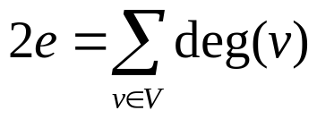
The Handshaking theorem
The Handshaking theorem:
(Why?) Every edge connects 2 vertices
Suppose a simple graph has 15 edges, 3 vertices of degree 4, and all others of degree 3. How many vertices does the graph have?
3*4 + (x-3)*3 = 30, x = 9
There are 25 telephones in a town. Is it possible to connect them with wires so that each telephone is connected with exactly 7 others?
Total degree 25*7 is 2*(number of edges), number of edges = 25*7 / 2 = 87.5
This is not an integer. As a result we can conclude that our supposition is wrong and such an arrangement is not possible.

Slide 19
Simple graphs – special cases
Complete graph: K_{n}, is the simple graph that contains exactly one edge between each pair of distinct vertices.
Representation Example: K₁, K₂, K₃, K₄
How many edges in Kn?
e = n(n-1)/2
2e = n(n-1)
K₁
K₂
K₃
K₄

Slide 20
Simple graphs – special cases
Cycle: C_{n}, n ≥ 3 consists of n vertices v₁, v₂, v₃ … v_{n} and edges {v₁, v₂}, {v₂, v₃}, {v₃, v₄} … {v_{n-1}, v_{n}}, {v_{n}, v₁}
Representation Example: C₃, C₄
C₃
C₄

Slide 21
Simple graphs – special cases
Wheels: W_{n}, obtained by adding additional vertex to C_{n} and connecting all vertices to this new vertex by new edges.
Representation Example: W₃, W₄
W₃
W₄

Slide 22
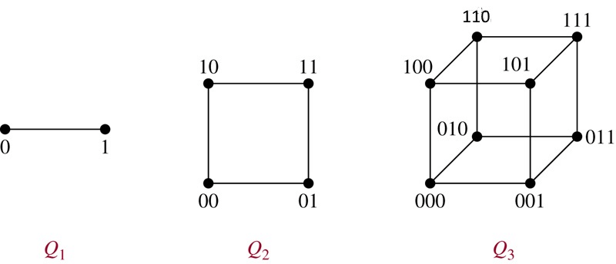
Simple graphs – special cases
N-cubes: Q_{n}, vertices represented by 2n bit strings of length n. Two vertices are adjacent if and only if the bit strings that they represent differ by exactly one bit positions
Representation Example: Q₁, Q₂

Slide 23
Bipartite graphs
In a simple graph G, if V can be partitioned into two disjoint sets V₁ and V₂ such that every edge in the graph connects a vertex in V₁ and a vertex V₂ (so that no edge in G connects either two vertices in V₁ or two vertices in V₂)
Application example: Representing Relations
Representation example: V₁ = {v₁, v₂, v₃} and V₂ = {v₄, v₅, v₆},
v₁
v₄
v₂
v₅
v₃
v₆
V₁
V₂

Slide 24
Example applications of Bipartite graphs
Movies preferences: Netflix predicts how much someone would enjoy a movie based on their preferences. This can be viewed as a bipartite graph problem. The viewers are the vertices U and the movies the vertices V and there is an edge from u to v if u viewed v. In this case the edges are weighted by the rating the viewer gave.
Students and classes: We might create a graph that maps every student to the classes they are taking. Such a graph can be used to determine conflicts, e.g. when classes cannot be scheduled together.
Stable marriage and other matching problems: This is an approach used for matching graduating medical students to resident positions in hospitals. Here U are the students and V the resident slots at hospitals and the edges are the rankings of both the hospitals and residents.

Slide 25
Complete Bipartite graphs
K_{m,n} is the graph that has its vertex set portioned into two subsets of m and n vertices, respectively. There is an edge between two vertices if and only if one vertex is in the first subset and the other vertex is in the second subset.
Representation example: K_{2,3,} K_{3,3}
K_{2,3}
K_{3,3}

Slide 26
Complete Bipartite graphs
What is the maximum number of edges in a bipartite graph on 6 vertices ? 3* 3 = 9
K_{1,5}
K_{3,3}
What is the maximum number of edges in a bipartite graph on 12 vertices ? 6 * 6 = 36

Slide 27
Subgraphs
A subgraph of a graph G = (V, E) is a graph H =(V’, E’) where V’ is a subset of V and E’ is a subset of E
Application example: solving sub-problems within a graph
u
u
u
v
w
v
w
v
G
H₁
H₂

Slide 28
Subgraphs
G = G1 U G2 wherein E = E1 U E2 and V = V1 U V2, G, G1 and G2 are simple graphs of G
Representation example: V1 = {u, w}, E1 = {{u, w}}, V2 = {w, v},
E1 = {{w, v}}, V = {u, v ,w}, E = {{{u, w}, {{w, v}}
u
u
w
v
w
w
v
G1
G2
G

Slide 29
Representation
Incidence (Matrix): Most useful when information about edges is more desirable than information about vertices.
Adjacency (Matrix/List): Most useful when information about the vertices is more desirable than information about the edges. These two representations are also most popular since information about the vertices is often more desirable than edges in most applications.

Slide 30
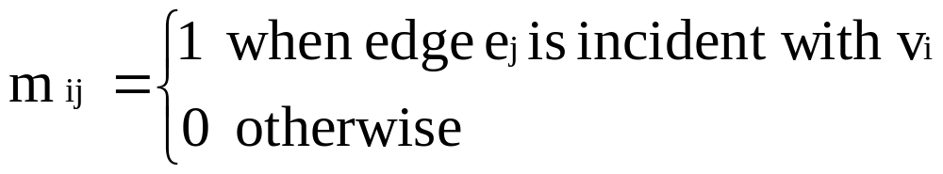
Representation- Incidence Matrix
G = (V, E) be an unditected graph. Suppose that v₁, v₂, v₃, …, v_{n} are the vertices and e₁, e₂, …, e_{m} are the edges of G. Then the incidence matrix with respect to this ordering of V and E is the nx m matrix M = [m _{ij}], where
Can also be used to represent :
Multiple edges: by using columns with identical entries, since these edges are incident with the same pair of vertices
Loops: by using a column with exactly one entry equal to 1, corresponding to the vertex that is incident with the loop

Slide 31
Representation- Incidence Matrix
Representation Example: G = (V, E)
u
 | e₁ | e₂ | e₃
v | 1 | 0 | 1
u | 1 | 1 | 0
w | 0 | 1 | 1
e1
e2
v
w
e3
u
 | e₁ | e₂ | e₃ | e₄ | e₅
v | 1 | 0 | 1 | 1 | 1
u | 1 | 1 | 0 | 0 | 0
w | 0 | 1 | 1 | 0 | 1
e1
e2
e5
e4
v
w
e3

Slide 32
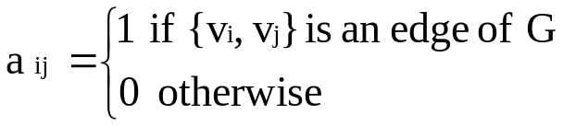

Representation- Adjacency Matrix
There is an N x N matrix, where |V| = N , the Adjacenct Matrix (NxN) A = [a_{ij}]
For undirected graph
  For directed graph
This makes it easier to find subgraphs, and to reverse graphs if needed.

Slide 33
Representation- Adjacency Matrix
Adjacency is chosen on the ordering of vertices. Hence, there are as many as n! such matrices.
The adjacency matrix of simple graphs are symmetric (a_{ij} = a_{ji})
When there are relatively few edges in the graph the adjacency matrix is a sparse matrix
Directed Multigraphs can be represented by using aij = number of edges from v_{i} to v_{j}

Slide 34
Representation- Adjacency Matrix
Example: Undirected Graph G (V, E)
 | v | u | w
v | 0 | 1 | 1
u | 1 | 0 | 1
w | 1 | 1 | 0
u
v
w

Slide 35
Representation- Adjacency Matrix
Example: directed Graph G (V, E)
 | v | u | w
v | 0 | 1 | 0
u | 0 | 0 | 1
w | 1 | 0 | 0
u
v
w

Slide 36
Representation- Adjacency List
Each node (vertex) has a list of which nodes (vertex) it is adjacent
Example: undirectd graph G (V, E)
u
node | Adjacency List
u | v , w
v | w, u
w | u , v
v
w

Slide 37
Graph - Isomorphism
G1 = (V1, E2) and G2 = (V2, E2) are isomorphic if:
There is a one-to-one and onto function f from V1 to V2 with the property that
  a and b are adjacent in G1 if and only if f(a) and f(b) are adjacent in G2, for all a and b in V1.
Function f is called isomorphism
Application Example:
In chemistry, to find if two compounds have the same structure

Slide 38
Graph - Isomorphism
Representation example: G1 = (V1, E1) , G2 = (V2, E2)
f(u₁) = v₁, f(u₂) = v₄, f(u₃) = v₃, f(u₄) = v₂,
u₁
u₂
v₁
v₂
u₃
u₄
v₄
v₃

Slide 39
Isomorphism
A isomorphic invariant for simple graphs is the existence of a simple circuit of length k , k is an integer > 2 (why ?)
Representation example: G1 and G2 are isomorphic since we have the invariants, similarity in degree of nodes, number of edges, and length of circuits
G1
G2

Slide 40
Isomorphism
You can say given graphs are isomorphic if they have:
  1. Equal number of vertices
  2. Equal number of edges
  3. Same degree sequence
  4. Same number of circuit of particular length
G1
G2

Slide 41
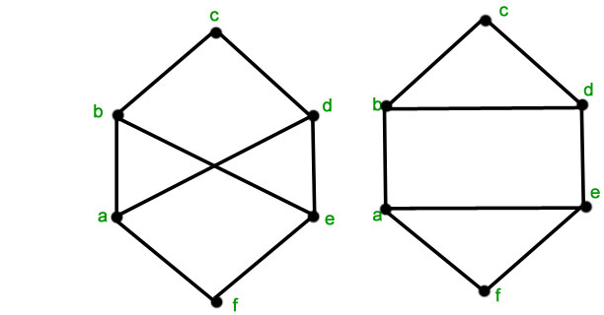
Isomorphism
Are the two graphs shown below isomorphic?
Both the graphs have 6 vertices, 9 edges and the degree sequence is the same.
However the second graph has a circuit of length 3 and the minimum length of any circuit in the first graph is 4. Hence the given graphs are not isomorphic.

Slide 42
Connectivity
Basic Idea: In a graph reachability among vertices by traversing the edges
Application Example:
- In a city to city road-network, if one city can be reached from another city.
- Problems if determining whether a message can be sent between two computer using intermediate links
- Efficiently planning routes for data delivery in the Internet

Slide 43
Connectivity – Path
A Path is a sequence of edges that begins at a vertex of a graph and travels along edges of the graph, always connecting pairs of adjacent vertices.
Representation example: G = (V, E), Path P represented, from u to v is {{u, 1}, {1, 4}, {4, 5}, {5, v}}
2
1
v
3
u
4
5

Slide 44
Connectivity – Path
Definition for Directed Graphs
A Path of length n (> 0) from u to v in G is a sequence of n edges e₁, e₂ , e₃, …, e_{n} of G such that f (e₁) = (x_{o}, x₁), f (e₂) = (x₁, x₂), …, f (e_{n}) = (x_{n-1}, x_{n}), where x₀ = u and x_{n} = v. A path is said to pass through x₀, x₁, …, x_{n} or traverse e₁, e₂ , e₃, …, e_{n}
For Simple Graphs, sequence is x₀, x₁, …, x_{n}
In directed multigraphs when it is not necessary to distinguish between their edges, we can use sequence of vertices to represent the path
Circuit/Cycle: u = v, length of path > 0
Simple Path: does not contain an edge more than once

Slide 45
Connectivity – Connectedness
Undirected Graph
An undirected graph is connected if there exists is a simple path between every pair of vertices
Representation Example: G (V, E) is connected since for V = {v₁, v₂, v₃, v₄, v₅}, there exists a path between {v_{i}, v_{j}}, 1 ≤ i, j≤ 5
v₄
v₁
v₃
v₂
v₅

Slide 46
Connectivity – Connectedness
Undirected Graph
Articulation Point (Cut vertex): removal of a vertex produces a subgraph with more connected components than in the original graph. The removal of a cut vertex from a connected graph produces a graph that is not connected
Cut Edge: An edge whose removal produces a subgraph with more connected components than in the original graph.
Representation example: G (V, E), v₃ is the articulation point or edge {v₂, v₃}, the number of connected components is 2 (> 1)
v₃
v₅
v₁
v₂
v₄

Slide 47
Connectivity – Connectedness
Directed Graph
A directed graph is strongly connected if there is a path from a to b and from b to a whenever a and b are vertices in the graph
A directed graph is weakly connected if there is a (undirected) path between every two vertices in the underlying undirected path
A strongly connected Graph can be weakly connected but the vice-versa is not true (why?)

Slide 48
Connectivity – Connectedness
Directed Graph
Representation example: G1 (Strong component), G2 (Weak Component), G3 is undirected graph representation of G2 or G1
G1
G2
G3

Slide 49
Connectivity – Connectedness
Directed Graph
Strongly connected Components: subgraphs of a Graph G that are strongly connected (Representation example: G1 is the strongly connected component in G)
G
G1

Slide 50
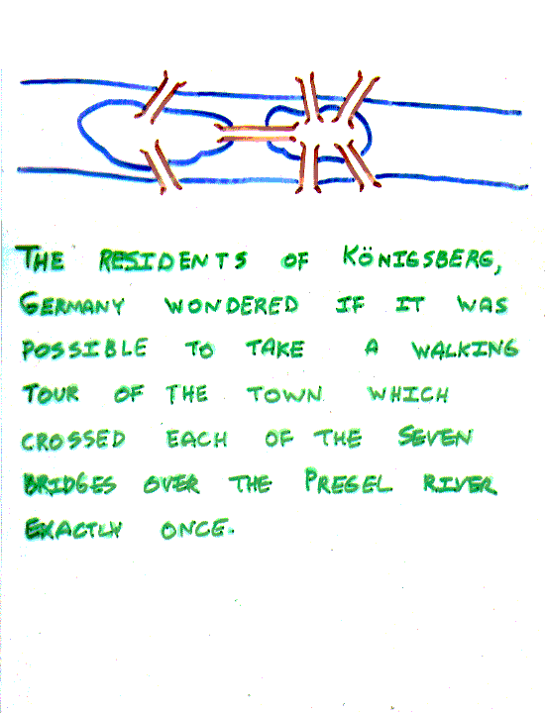
The Seven Bridges of Königsberg, Germany
The residents of Königsberg, Germany, wondered if it was possible to take a walking tour of the town that crossed each of the seven bridges over the Presel river exactly once. Is it possible to start at some node and take a walk that uses each edge exactly once, and ends at the starting node?

Slide 51
The Seven Bridges of Königsberg, Germany
You can redraw the original picture as long as for every edge between nodes i and j in the original you put an edge between nodes i and j in the redrawn version (and you put no other edges in the redrawn version).
1
Original:
2
3
4
2
Redrawn:
4
1
3

Slide 52
The Seven Bridges of Königsberg, Germany
Euler:
Has no tour that uses each edge exactly once.
(Even if we allow the walk to start and finish in different places.)
Can you see why?

Slide 53
Euler - definitions
An Eulerian path (Eulerian trail, Euler walk) is a path that uses every edge in a graph with no repeats. Being a path, it does not have to return to the starting vertex.
An Eulerian cycle (Eulerian circuit, Euler tour) ) is a path that uses every edge in a graph with no repeats. Being a circuit, it must start and end at the same vertex.
a
b
a
b
c
d
c
d
a
b
c
d
e

Slide 54
Euler’s Path and Circuit theorems
A graph will contain an Euler path if it contains at most two vertices of odd degree.
A graph will contain an Euler circuit if all vertices have even degree.
Notice: these theorems do not tell us how to find the Euler path or Euler circuit.
a
a
a

Slide 55
Determine if each graph has a Euler path. If it has one, find an Euler path.
A graph will contain an Euler path if it contains at most two vertices of odd degree.
e
a
b
e
a
b
c
d
e
c
d
e

Slide 56
Determine if each graph has a Euler circuit. If it has one, find an Euler circuit.
A graph will contain an Euler circuit if all vertices have even degree.
e
a
b
e
a
b
c
d
e
c
d
e
e
Euler Path or Circuit?

Slide 57
Euler circuit.
A graph will contain an Euler circuit if all vertices have even degree.
Police officer on patrol. Cover all by walking as little as possible.
Euler solved the question of whether or not an Euler path or circuit will exist.
a
b
e
c
d
e

Slide 58
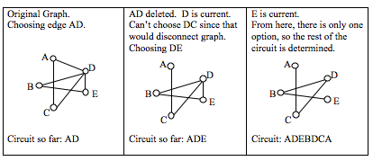
FLEURY’S ALGORITHM
A formal method to find an Euler circuit or path:
Start at any vertex if finding an Euler circuit. (If finding an Euler path, start at one of the two vertices with odd degree.)
Choose any edge leaving your current vertex, provided deleting that edge will not separate the graph into two disconnected sets of edges.
Add that edge to your circuit, and delete it from the graph.
Continue until you’re done.

Slide 59
FLEURY’S ALGORITHM
Does the graph below have an Euler Circuit? If so, find one.
a
b
f
a
b
f
c
d
e
c
d
e
acdb
a
b
f
a
b
f
c
d
e
c
d
e
acdbd
acdbdefba

Slide 60
FLEURY’S ALGORITHM
Does the graph below have an Euler Circuit? If so, find one.
a
b
f
a
b
f
e
e
c
d
g
c
d
g
edb
a
b
f
a
b
f
e
e
c
d
g
c
d
g
edbacd
edbacdbegfe

Slide 61
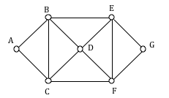
FLEURY’S ALGORITHM
Does the graph below have an Euler Circuit? If so, find one.

Slide 62
The problem in our language:
Show that is not Eulerian.
In fact, it contains no Euler trail.

Slide 63
EULERIZATION
Motivation: Not every graph has an Euler path or circuit, yet all the paths are traversed. The goal is to minimize the amount of walking to do. In order to do that, it has to duplicate some edges in the graph until an Euler circuit exists.
Note that we can only duplicate edges, not create edges where there wasn’t one before. Duplicating edges would mean walking or driving down a road twice, while creating an edge where there wasn’t one before is akin to installing a new road!
Eulerization is the process of adding edges to a graph to create an Euler circuit on a graph. To eulerize a graph, edges are duplicated to connect pairs of vertices with odd degree. Connecting two odd degree vertices increases the degree of each, giving them both even degree. When two odd degree vertices are not directly connected, we can duplicate all edges in a path connecting the two.

Slide 64




EULERIZATION
The last eulerization required duplicating seven edges, while the first two only required duplicating five edges. If we were eulerizing the graph to find a walking path, we would want the eulerization with minimal duplications. If the edges had weights representing distances or costs, then we would want to select the eulerization with the minimal total added weight.
The problem of finding the optimal eulerization is called the Chinese Postman Problem. This problem is important in determining efficient routes for garbage trucks, school buses, parking meter checkers, street sweepers, and more.

Slide 65

Hamiltonian Graph
Instead of looking for a circuit that covers every edge once, sometimes we are interested in a circuit that visits every vertex once.
This concept would be helpful for example for a delivery person wanting to stop at every delivery location rather than going down every street.
a
b
e
c
d
e
f
g
h

Slide 66
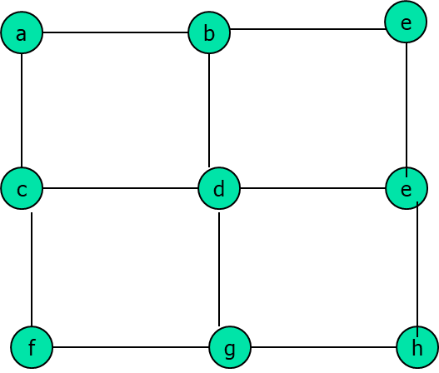
Hamiltonian Graph
A Hamiltonian cycle (also called Hamiltonian circuit, vertex tour or graph cycle) is a cycle that visits each vertex exactly once (except for the starting vertex, which is visited once at the start and once again at the end) with no repeat. Being a circuit, it must start and end at the same vertex.
A Hamiltonian path (also called traceable path) is a path that visits each vertex exactly once with no repeat, but does not have to start and end at the same vertex.

Slide 67
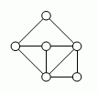
Hamiltonian Graph
Unlike with Euler circuits, there is no nice theorem that allows us to instantly determine whether or not a Hamiltonian circuit exists for all graphs.
Does a Hamiltonian path or circuit exist on the graph below?
With Hamiltonian circuits, our focus will not be on existence, but on the question of optimization. Given a graph where the edges have weights, we find the optimal Hamiltonian circuit which would be the one with the lowest total weight (TSP problem).
a
a

Slide 68
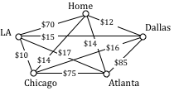
Traveling salesman problem (TSP)
Suppose a salesman needs to give sales pitches in four cities. He looks up the airfares between each city, and puts the costs in a graph. In what order should he travel to visit each city once then return home with the lowest cost?

Slide 69
A graph of the vertices of a dodecahedron.
Is it Hamiltonian?
Yes

Slide 70
This one has a Hamiltonian path, but not a Hamiltonian tour.
Hamiltonian Graph
Pendant Vertex

Slide 71
Hamiltonian Graph
Articulation Point
This one has an Euler tour, but no Hamiltonian tour.

