Slide 1
Heapsort
Combines the better attributes of merge sort and insertion sort.
  Like merge sort, but unlike insertion sort, running time is O(n lg n).
  Like insertion sort, but unlike merge sort, sorts in place.
  The most direct competitor of quicksort is heapsort. Heapsort is typically somewhat slower than quicksort, but the worst-case running time is always Θ(nlogn). Quicksort is usually faster.
Introduces an algorithm design technique
  Create data structure (heap) to manage information during the execution of an algorithm.
The heap has other applications beside sorting.
  Priority Queues

Slide 2
Data Structure Binary Heap
Array viewed as a nearly complete binary tree.
  Physically – linear array.
  Logically – binary tree, filled on all levels (except lowest.)
Map from array elements to tree nodes and vice versa
  Root – A[1]
  Left[i] – A[2i]
  Right[i] – A[2i+1]
  Parent[i] – A[⎣i/2⎦]
length[A] – number of elements in array A.
heap-size[A] – number of elements in heap stored in A.
  heap-size[A] ≤ length[A]: during the heap sort, the heap-size decreases.

Slide 3
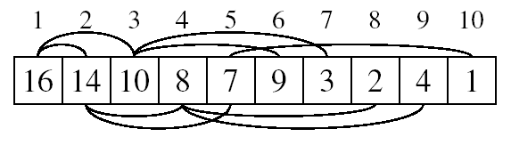
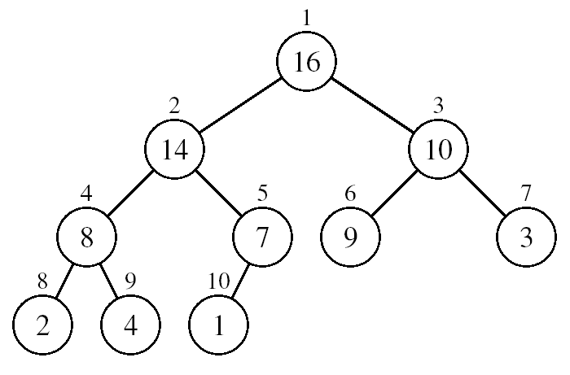
Array Representation of Heaps
A heap can be stored as an array A.
  Root of tree is A[1]
  Left child of A[i] = A[2i]
  Right child of A[i] = A[2i + 1]
  Parent of A[i] = A[ ⎣i/2⎦ ]
  Heapsize[A] ≤ length[A]
The elements in the subarray A[(⎣n/2⎦+1) .. n] are leaves

Slide 4
Special Types of Trees
Def: Full binary tree = a binary tree in which each node is either a leaf or has degree exactly 2.
Def: Complete binary tree = a binary tree in which all leaves are on the same level and all internal nodes have degree 2.
4
1
3
2
16
9
10
14
8
7
12
Full binary tree
4
1
3
2
16
9
10
Complete binary tree
& Full binary tree

Slide 5
Definitions
Height of a node = the number of edges on the longest simple path from the node down to a leaf
Level of a node = the length of a path from the root to the node
Height of tree = height of root node
4
Height of root = 3
1
3
Height of (2)= 1
2
16
9
10
Level of (10)= 2
14
8

Slide 6
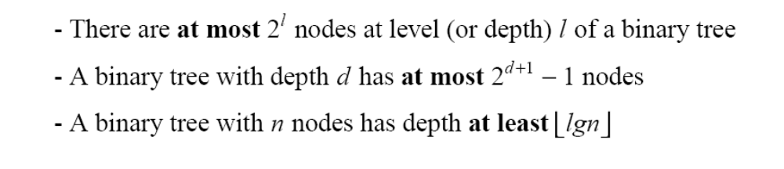
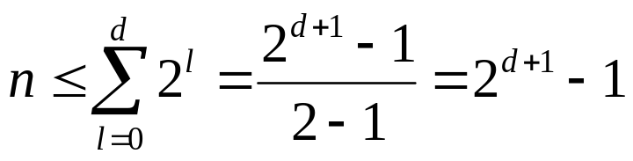
Useful Properties
height
height
4
Height of root = 3
1
3
Height of (2)= 1
2
16
9
10
Level of (10)= 2
14
8

Slide 7
Heap Property (Max and Min)
Max-Heap
  For every node excluding the root,
  value is at most that of its parent: A[parent[i]] ≥ A[i]
Largest element is stored at the root.
In any subtree, no values are larger than the value stored at subtree root.
Min-Heap
  For every node excluding the root,
  value is at least that of its parent: A[parent[i]] ≤ A[i]
Smallest element is stored at the root.
In any subtree, no values are smaller than the value stored at subtree root

Slide 8
Heaps – Example
26
24
20
18
17
19
13
12
14
11
Max-heap as an
array.
1 2 3 4 5 6 7 8 9 10
Max-heap as a binary
tree.
26
24
20
18
17
19
13
12
14
11
Last row filled from left to right.

Slide 9
The Heap Data Structure
Def: A heap is a nearly complete binary tree with the following two properties:
  Structural property: all levels are full, except possibly the last one, which is filled from left to right
  Order (heap) property: for any node x
  Parent(x) ≥ x
8
From the heap property, it follows that:
“The root is the maximum
element of the heap!”
7
4
5
2
Heap
A heap is a binary tree that is filled in order

Slide 10
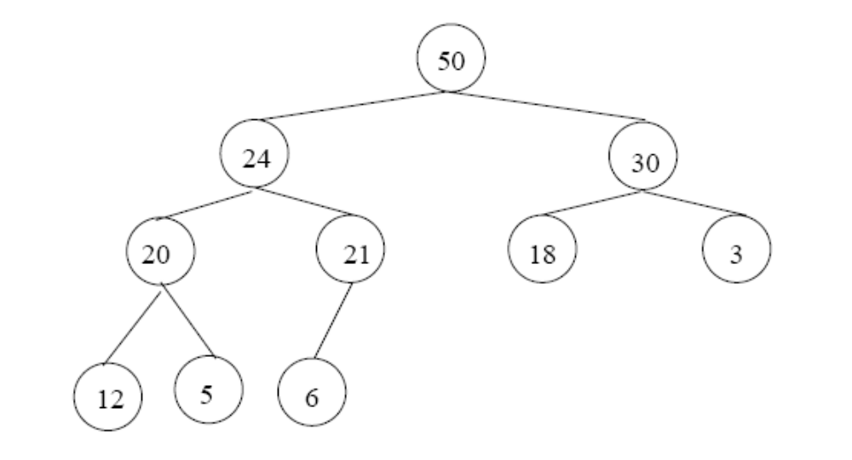
Adding/Deleting Nodes
New nodes are always inserted at the bottom level (left to right)
Nodes are removed from the bottom level (right to left)

Slide 11
Operations on Heaps
Maintain/Restore the max-heap property
  MAX-HEAPIFY
Create a max-heap from an unordered array
  BUILD-MAX-HEAP
Sort an array in place
  HEAPSORT
Priority queues

Slide 12
Heaps in Sorting
Use max-heaps for sorting.
The array representation of max-heap is not sorted.
Steps in sorting
  Convert the given array of size n to a max-heap (BuildMaxHeap)
  Swap the first and last elements of the array.
    Now, the largest element is in the last position – where it belongs.
    That leaves n – 1 elements to be placed in their appropriate locations.
    However, the array of first n – 1 elements is no longer a max-heap.
    Float the element at the root down one of its subtrees so that the array remains a max-heap (MaxHeapify)
    Repeat step 2 until the array is sorted.

Slide 13
Heap Characteristics
Height = ⎣lg n⎦
No. of leaves = ⎡n/2⎤
No. of nodes of
height h ≤ ⎡n/2^{h+1}⎤

Slide 14
Maintaining the heap property
Suppose two subtrees are max-heaps,
but the root violates the max-heap
property.
Fix the offending node by exchanging the value at the node with the larger of the values at its children.
  May lead to the subtree at the child not being a heap.
Recursively fix the children until all of them satisfy the max-heap property.

Slide 15
MaxHeapify – Example
MaxHeapify(A, 2)
Suppose a node is smaller than a child
  Left and Right subtrees of i are max-heaps
To eliminate the violation:
  Exchange with larger child
  Move down the tree
  Continue until node is not smaller than children
26
24
24
14
20
14
18
17
19
18
14
14
24
13
12
14
14
18
11

Slide 16
Procedure MaxHeapify
MaxHeapify(A, i)
1. l ← left(i)
2. r ← right(i)
3. if l ≤ heap-size[A] and A[l] > A[i]
4. then largest ← l
5. else largest ← i
6. if r ≤ heap-size[A] and A[r] > A[largest]
7. then largest ← r
8. if largest≠ i
9. then exchange A[i] ↔ A[largest]
10. MaxHeapify(A, largest)
Assumption:
Left(i) and Right(i) are max-heaps.

Slide 17
Running Time for MaxHeapify
MaxHeapify(A, i)
1. l ← left(i)
2. r ← right(i)
3. if l ≤ heap-size[A] and A[l] > A[i]
4. then largest ← l
5. else largest ← i
6. if r ≤ heap-size[A] and A[r] > A[largest]
7. then largest ← r
8. if largest≠ i
9. then exchange A[i] ↔ A[largest]
10. MaxHeapify(A, largest)
Time to fix node i and its children = Θ(1)
PLUS
Time to fix the subtree rooted at one of i’s children = T(size of subree at largest)

Slide 18
Running Time for MaxHeapify(A, n)
T(n) = T(largest) + Θ(1)
largest ≤ 2n/3 (worst case occurs when the last row of tree is exactly half full)
T(n) ≤ T(2n/3) + Θ(1) ⇒ T(n) = O(lg n)
Alternately, MaxHeapify takes O(h) where h is the height of the node where MaxHeapify is applied

Slide 19
Building a heap
Use MaxHeapify to convert an array A into a max-heap.
Call MaxHeapify on each element in a bottom-up manner.
BuildMaxHeap(A)
1. heap-size[A] ← length[A]
2. for i ← ⎣length[A]/2⎦ downto 1
3. do MaxHeapify(A, i)

Slide 20
BuildMaxHeap – Example
Input Array:
24
21
23
22
36
29
30
34
28
27
Initial Heap:
(not max-heap)
24
21
23
22
36
29
30
34
28
27

Slide 21
BuildMaxHeap – Example
MaxHeapify(⎣10/2⎦ = 5)
24
36
24
MaxHeapify(4)
MaxHeapify(3)
21
30
34
24
21
23
36
23
MaxHeapify(2)
MaxHeapify(1)
36
36
27
21
29
36
21
30
28
23
34
22
24
22
34
22
28
24
27
21

Slide 22
Correctness of BuildMaxHeap
Loop Invariant: At the start of each iteration of the for loop, each node i+1, i+2, …, n is the root of a max-heap.
Initialization:
  Before first iteration i = ⎣n/2⎦
  Nodes ⎣n/2⎦+1, ⎣n/2⎦+2, …, n are leaves and hence roots of max-heaps.
Maintenance:
  By LI, subtrees at children of node i are max heaps.
  Hence, MaxHeapify(i) renders node i a max heap root (while preserving the max heap root property of higher-numbered nodes).
  Decrementing i reestablishes the loop invariant for the next iteration.

Slide 23
Running Time of BuildMaxHeap
Loose upper bound:
  Cost of a MaxHeapify call × No. of calls to MaxHeapify
  O(lg n) × O(n) = O(nlg n)
Tighter bound:
  Cost of a call to MaxHeapify at a node depends on the height, h, of the node – O(h).
  Height of most nodes smaller than n.
  Height of nodes h ranges from 0 to ⎣lg n⎦.
  No. of nodes of height h is ⎡n/2^{h+1}⎤

Slide 24
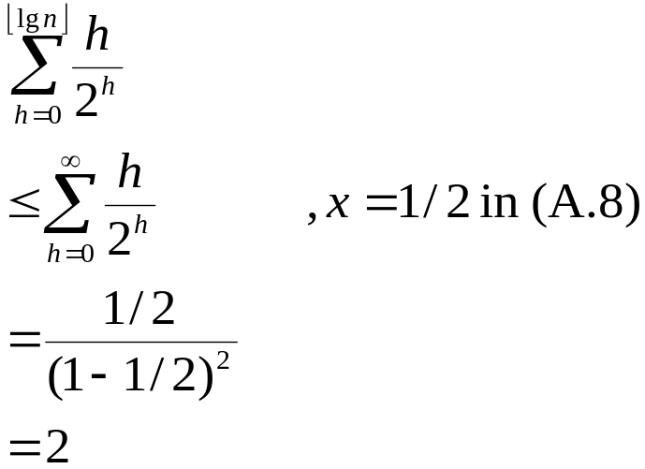
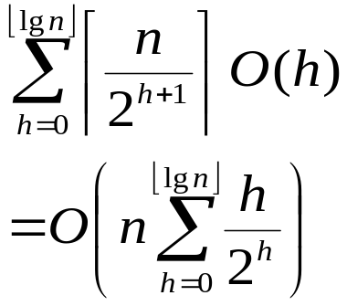
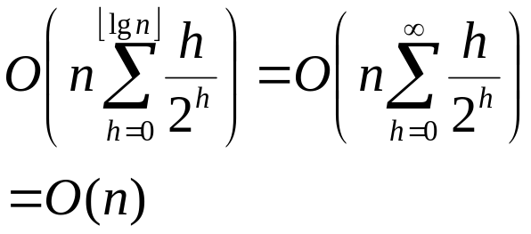
Running Time of BuildMaxHeap
Tighter Bound for T(BuildMaxHeap)
T(BuildMaxHeap)
Can build a heap from an unordered array in linear time

Slide 25
Heapsort
Sort by maintaining the as yet unsorted elements as a max-heap.
Start by building a max-heap on all elements in A.
  Maximum element is in the root, A[1].
Move the maximum element to its correct final position.
  Exchange A[1] with A[n].
Discard A[n] – it is now sorted.
  Decrement heap-size[A].
Restore the max-heap property on A[1..n–1].
  Call MaxHeapify(A, 1).
Repeat until heap-size[A] is reduced to 2.

Slide 26
Heapsort(A)
HeapSort(A)
1. Build-Max-Heap(A)
2. for i ← length[A] downto 2
3. do exchange A[1] ↔ A[i]
4. heap-size[A] ← heap-size[A] – 1
5. MaxHeapify(A, 1)

Slide 27
Heapsort – Example
26
24
20
18
17
19
13
12
14
11
1 2 3 4 5 6 7 8 9 10
26
24
20
18
17
19
13
12
14
11

Slide 28
Algorithm Analysis
HeapSort(A)
1. Build-Max-Heap(A)
2. for i ← length[A] downto 2
3. do exchange A[1] ↔ A[i]
4. heap-size[A] ← heap-size[A] – 1
5. MaxHeapify(A, 1)
In-place
Not Stable
Build-Max-Heap takes O(n) and each of the n-1 calls to Max-Heapify takes time O(lg n).
Therefore, T(n) = O(n lg n)

Slide 29
Heap Procedures for Sorting
MaxHeapify O(lg n)
BuildMaxHeap O(n)
HeapSort O(n lg n)

Slide 30
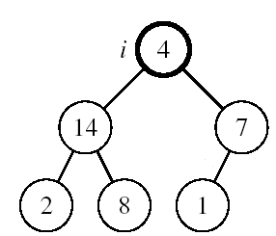
Maintaining the Heap Property
Alg: MAX-HEAPIFY(A, i, n)
l ← LEFT(i)
r ← RIGHT(i)
if l ≤ n and A[l] > A[i]
then largest ←l
else largest ←i
if r ≤ n and A[r] > A[largest]
then largest ←r
if largest ≠ i
then exchange A[i] ↔ A[largest]
MAX-HEAPIFY(A, largest, n)
Assumptions:
  Left and Right subtrees of i are max-heaps
  A[i] may be smaller than its children

Slide 31
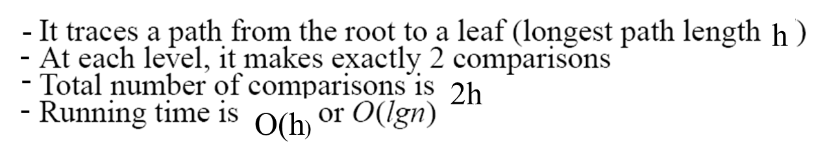
MAX-HEAPIFY Running Time
Intuitively:
Running time of MAX-HEAPIFY is O(lgn)
Can be written in terms of the height of the heap, as being O(h)
  Since the height of the heap is ⎣lgn⎦

Slide 32
Building a Heap
Convert an array A[1 … n] into a max-heap (n = length[A])
The elements in the subarray A[(⎣n/2⎦+1) .. n] are leaves
Apply MAX-HEAPIFY on elements between 1 and ⎣n/2⎦
Alg: BUILD-MAX-HEAP(A)
n = length[A]
for i ← ⎣n/2⎦ downto 1
do MAX-HEAPIFY(A, i, n)
1
4
2
3
1
3
4
5
6
7
2
16
9
10
8
9
10
14
8
7
A:
4 | 1 | 3 | 2 | 16 | 9 | 10 | 14 | 8 | 7

Slide 33
Example: A
4 | 1 | 3 | 2 | 16 | 9 | 10 | 14 | 8 | 7
i = 5
i = 4
i = 3
1
1
1
4
4
4
2
3
2
3
2
3
1
3
1
3
1
3
4
5
6
7
4
5
6
7
4
5
6
7
2
16
9
10
2
16
9
10
14
16
9
10
8
9
10
8
9
10
8
9
10
14
8
7
14
8
7
2
8
7
i = 2
i = 1
1
1
1
4
4
16
2
3
2
3
2
3
1
10
16
10
14
10
4
5
6
7
4
5
6
7
4
5
6
7
14
16
9
3
14
7
9
3
8
7
9
3
8
9
10
8
9
10
8
9
10
2
8
7
2
8
1
2
4
1

Slide 34
Running Time of BUILD MAX HEAP
Alg: BUILD-MAX-HEAP(A)
n = length[A]
for i ← ⎣n/2⎦ downto 1
do MAX-HEAPIFY(A, i, n)
O(n)
O(lgn)
⇒ Running time: O(nlgn)
This is not an asymptotically tight upper bound

Slide 35
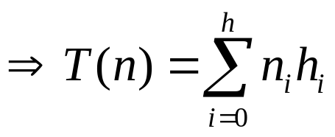
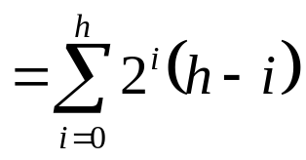

Running Time of BUILD MAX HEAP
HEAPIFY takes O(h) ⇒ the cost of HEAPIFY on a node i is proportional to the height of the node i in the tree
Height
Level
No. of nodes
h₀ = 3 (⎣lgn⎦)
i = 0
2⁰
h₁ = 2
i = 1
2¹
h₂ = 1
i = 2
2²
h₃ = 0
i = 3 (⎣lgn⎦)
2³
h_{i} = h – i height of the heap rooted at level i
n_{i} = 2^{i} number of nodes at level i

Slide 36
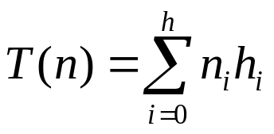
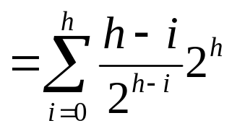

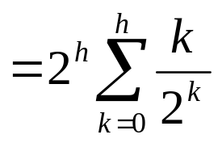
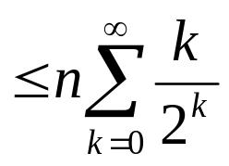
Running Time of BUILD MAX HEAP
Cost of HEAPIFY at level i ∗ number of nodes at that level
Replace the values of n_{i} and h_{i} computed before
Multiply by 2^{h} both at the nominator and denominator and
write 2^{i} as
Change variables: k = h - i
The sum above is smaller than the sum of all elements to ∞ and h = lgn
The sum above is smaller than 2
Running time of BUILD-MAX-HEAP: T(n) = O(n)

Slide 37
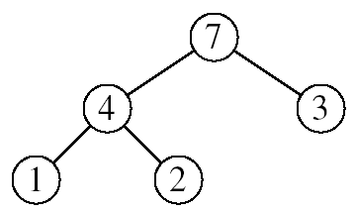
Heapsort
Goal:
  Sort an array using heap representations
Idea:
  Build a max-heap from the array
  Swap the root (the maximum element) with the last element in the array
  “Discard” this last node by decreasing the heap size
  Call MAX-HEAPIFY on the new root
  Repeat this process until only one node remains

Slide 38
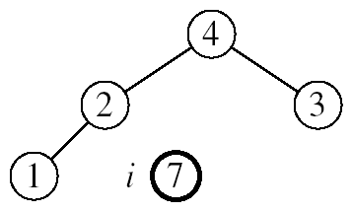
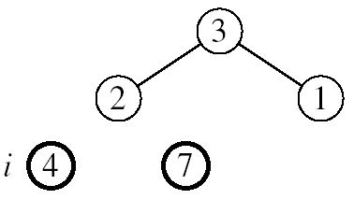
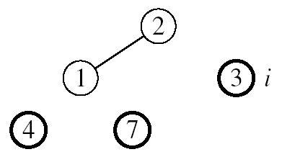
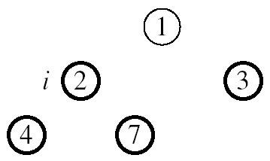

Example: A=[7, 4, 3, 1, 2]
MAX-HEAPIFY(A, 1, 4)
MAX-HEAPIFY(A, 1, 3)
MAX-HEAPIFY(A, 1, 2)
MAX-HEAPIFY(A, 1, 1)

Slide 39
Alg: HEAPSORT(A)
BUILD-MAX-HEAP(A)
for i ← length[A] downto 2
do exchange A[1] ↔ A[i]
MAX-HEAPIFY(A, 1, i - 1)
Running time: O(nlgn) --- Can be shown to be Θ(nlgn)
O(n)
n-1 times
O(lgn)

