Slide 1
Graph Theory Part 3

Slide 2
Traveling Salesman Problem
Given a number of cities and the costs of traveling from one to the other, what is the cheapest roundtrip route that visits each city once and then returns to the starting city?
An equivalent formulation in terms of graph theory is: Find the Hamiltonian cycle with the least weight in a weighted graph.
It can be shown that the requirement of returning to the starting city does not change the computational complexity of the problem.
A related problem is the (bottleneck TSP): Find the Hamiltonian cycle in a weighted graph with the minimal length of the longest edge.

Slide 3
Brute Force Approach
There are two dogs (d1, d2) and one cat (c1). What are the all possible orders?
1
c1
d1
d2
2
3
4
d1
c1
c1
d2
d2
d1
Restriction 1: Cat cannot seat in the middle
5
6
7
8
9
10
d1
d2
c1
c1
d2
d1
10
11
12
13
14
15

Slide 4
Traveling Salesman Problem
Adjacency Matrix
 | a | b | c | d
a | 0 | 10 | 15 | 20
b | 5 | 0 | 9 | 10
c | 6 | 13 | 0 | 12
d | 8 | 8 | 9 | 0
a
b
c
d

Slide 5
Traveling Salesman Problem
Adjacency Matrix
a
 | a | b | c | d
a | 0 | 10 | 15 | 20
b | 5 | 0 | 9 | 10
c | 6 | 13 | 0 | 12
d | 8 | 8 | 9 | 0
10
b
c
d
9
10
c
d
b
d
c
b
a
b
12
9
d
c
d
b
b
c
8
6
c
d
a
a
a

Slide 6
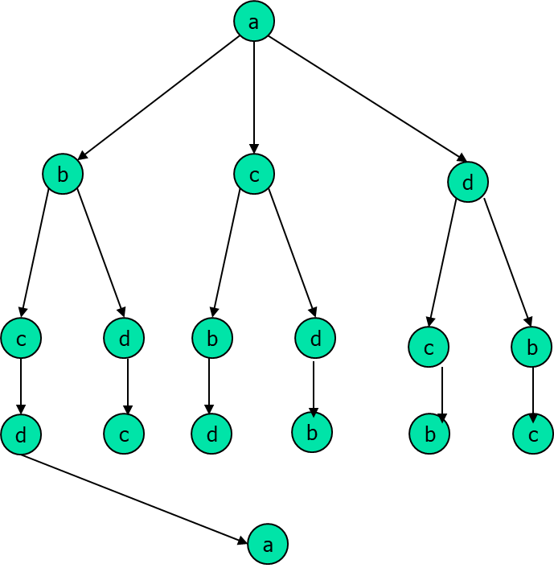
Traveling Salesman Problem
(Dynamic Programming)
Adjacency Matrix
g(i,S) = min (C_{ik} + g(k, S – {k}) ), k ϵ S
 | a | b | c | d
a | 0 | 10 | 15 | 20
b | 5 | 0 | 9 | 10
c | 6 | 13 | 0 | 12
d | 8 | 8 | 9 | 0
i = a, S = {b, c, d}
g(a, {b, c, d}) = min (C_{ik} + g(k, {b, c, d} – {k}) )
k ϵ S = {b, c, d}
i: source
S: a set of cities to visit
a
b
c
d

Slide 7
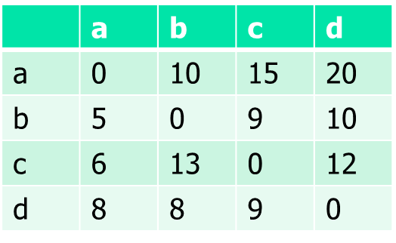
Traveling Salesman Problem
a
g(b, 0) = 5
g(c, 0) = 6
g(d, 0) = 8
g(b, {c}) = 9 + 6 =15
g(b, {d}) = 10 + 8 =18
g(c, {b}) = 13 + 5 = 18
g(c, {d}) = 12 + 8 = 20
g(d, {b}) = 8 + 5 = 13
g(d, {c}) = 9 + 6 = 15
g(b, {c,d}) = min (29, 25) = 25
g(c, {b,d}) = min (25, 31) = 25
g(d, {b,c}) = min (23, 27) = 23
25
C_{ab} + g(b, {c, d})
25
23
b
c
d
13
12
9
8
C_{bc} + g(c, {d})
c
d
b
d
C_{bd} + g(d, {c})
c
b
10
8
13
9
C_{cd} + g(d, 0)
d
c
d
b
b
c
C_{dc} + g(c, 0)
g(b, {c,d}) = min (C_{bc} + g(c, {d}), C_{bd} + g(d, {c}))
9 + 20, 10 + 15
min (25 + 10 = 35, 15 + 25 = 40, 23 + 20 = 43)
6
8
5
5
6
8
a
a
a
a
a
a

Slide 8
Branch & Bound
a
BFS
b
c
d
e
35
53
25
31
Bound
b
e
c
a
Branch
28

Slide 9
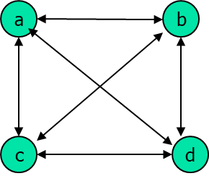
Traveling Salesman Problem
(Branch & Bound)
Adjacency Matrix
 | a | b | c | d
a | x | 10 | 15 | 20
b | 5 | x | 9 | 10
c | 6 | 13 | x | 12
d | 8 | 8 | 9 | x
Find where to branch
a
 | a | b | c | d
a | x | 0 | 4 | 5 | 10
b | 0 | x | 3 | 0 | 5
c | 0 | 7 | x | 1 | 6
d | 0 | 0 | 0 | x | 8
 | 0 | 0 | 1 | 5 | 35
(1) Find min and subtract it from all row
b
c
d
(2) Find min from non zero col and subtract it from all col
minU = col + row
Reduced cost
 | a | b | c | d
a | x | x | x | x | 0
b | x | x | 3 | 0 | 0
c | 0 | x | x | 1 | 0
d | 0 | x | 0 | x | 0
 | 0 | 0 | 0 | 0 | 0
 | a | b | c | d
a | x | x | x | x | 0
b | 0 | x | x | 0 | 0
c | x | 6 | x | 0 | 1
d | 0 | 0 | x | x | 0
 | 0 | 0 | 0 | 0 | 1
 | a | b | c | d
a | x | x | x | x | 0
b | 0 | x | 3 | x | 0
c | 0 | 7 | x | x | 0
d | x | 0 | 0 | x | 0
 | 0 | 0 | 0 | 0 | 0
a – d
d – a
0 + 35 + 0 = 35
minL
4 + 35 + 1 = 40
5 + 35 + 0 = 40
C(a,b) + minU +minL
C(a,c) + minU +minL
C(a,d) + minU +minL
(3) Try the min of the level and do BFS, choose a → b.

Slide 10
Traveling Salesman Problem
Adjacency Matrix
 | a | b | c | d
a | x | 10 | 15 | 20
b | 5 | x | 9 | 10
c | 6 | 13 | x | 12
d | 8 | 8 | 9 | x
Find where to branch
 | a | b | c | d
a | x | x | x | x | 0
b | x | x | 3 | 0 | 0
c | 0 | x | x | 1 | 0
d | 0 | x | 0 | x | 0
 | 0 | 0 | 0 | 0 | 0
a
35
a
b
c
35
b
c
d
d
40
40
c
minU
c
d
d
0 + 35 + 0 = 35
39
35
Choose d
 | a | b | c | d
a | x | x | x | x | 0
b | x | x | x | x | 0
c | 0 | x | x | 0 | 0
d | 0 | x | x | x | 0
 | 0 | 0 | 0 | 1 | 1
 | a | b | c | d
a | x | x | x | x | 0
b | x | x | x | x | 0
c | 0 | x | x | x | 0
d | 0 | x | 0 | x | 0
 | 0 | 0 | 0 | 0 | 0
3 + 35 + 1 = 39
minL
0 + 35 + 0 = 35
minL
C(b,c) + minU +minL
C(b,d) + minU +minL

Slide 11
Traveling Salesman Problem
Adjacency Matrix
(Branch & Bound)
 | a | b | c | d
a | x | 10 | 15 | 20
b | 5 | x | 9 | 10
c | 6 | 13 | x | 12
d | 8 | 8 | 9 | x
a
 | a | b | c | d
a | x | x | x | x | 0
b | x | x | x | x | 0
c | 0 | x | x | x | 0
d | 0 | x | 0 | x | 0
 | 0 | 0 | 0 | 0 | 0
35
a
b
c
35
b
c
d
d
40
40
35 a → b → d → c → a
c
c
d
d
d
0 + 35 + 0 = 35
minU
39
35
c
c
 | a | b | c | d
a | x | x | x | x | 0
b | x | x | x | x | 0
c | 0 | x | x | x | 0
d | x | x | x | x | 0
 | 0 | 0 | 0 | 0 | 0
 | a | b | c | d
a | x | x | x | x | 0
b | x | x | x | x | 0
c | x | x | x | x | 0
d | x | x | x | x | 0
 | 0 | 0 | 0 | 0 | 0
35
a
a
35
0 + 35 + 0 = 35
minL
0 + 35 + 0 = 35
C(d,c) + minU +minL
C(c,a) + minU +minL

Slide 12
Traveling Salesman Problem
(Branch & Bound)
Adjacency Matrix
 | a | b | c | d | e
a | x | 20 | 30 | 10 | 11
b | 15 | x | 16 | 4 | 2
c | 3 | 5 | x | 2 | 4
d | 19 | 6 | 18 | x | 3
e | 16 | 4 | 7 | 16 | x
 | a | b | c | d | e
a | x | 10 | 17 | 0 | 1 | 10
b | 12 | x | 11 | 2 | 0 | 2
c | 0 | 3 | x | 0 | 2 | 2
d | 15 | 3 | 12 | x | 0 | 3
e | 11 | 0 | 0 | 12 | x | 4
 | 1 | 0 | 3 | 0 | 0 | 21 + 4 = 25
a
b
(1) Find min and subtract it from all row
minU = col + row
c
d
Reduced cost
(2) Find min from non zero col and subtract it from all col
e

Slide 13
Traveling Salesman Problem
(Branch & Bound)
Adjacency Matrix
 | a | b | c | d | e
a | x | 20 | 30 | 10 | 11
b | 15 | x | 16 | 4 | 2
c | 3 | 5 | x | 2 | 4
d | 19 | 6 | 18 | x | 3
e | 16 | 4 | 7 | 16 | x
 | a | b | c | d | e
a | x | 10 | 17 | 0 | 1 | 10
b | 12 | x | 11 | 2 | 0 | 2
c | 0 | 3 | x | 0 | 2 | 2
d | 15 | 3 | 12 | x | 0 | 3
e | 11 | 0 | 0 | 12 | x | 4
 | 1 | 0 | 3 | 0 | 0 | 25
a
b
c
d
e

Slide 14
Traveling Salesman Problem
(Branch & Bound)
 | a | b | c | d | e
a | x | 10 | 17 | 0 | 1 | 10
b | 12 | x | 11 | 2 | 0 | 2
c | 0 | 3 | x | 0 | 2 | 2
d | 15 | 3 | 12 | x | 0 | 3
e | 11 | 0 | 0 | 12 | x | 4
 | 1 | 0 | 3 | 0 | 0 | 25
a – b
b – a
 | a | b | c | d | e
a | x | x | x | x | x | 0
b | x | x | 11 | 2 | 0 | 0
c | 0 | x | x | 0 | 2 | 0
d | 15 | x | 12 | x | 0 | 0
e | 11 | x | 0 | 12 | x | 0
 | 0 | 0 | 0 | 0 | 0 | 0
25
a
b
c
d
e
35
53
25
31
a → b
10 + 25 + 0 = 35
 | a | b | c | d | e
a | x | x | x | x | x | 0
b | 1 | x | x | 2 | 0 | 0
c | x | 3 | x | 0 | 2 | 0
d | 4 | 3 | x | x | 0 | 0
e | 0 | 0 | x | 12 | x | 0
 | 11 | 0 | 0 | 0 | 0 | 11
 | a | b | c | d | e
a | x | x | x | x | x | 0
b | 12 | x | 11 | x | 0 | 0
c | 0 | 3 | x | x | 2 | 0
d | x | 3 | 12 | x | 0 | 0
e | 11 | 0 | 0 | x | x | 0
 | 0 | 0 | 0 | 0 | 0 | 0
 | a | b | c | d | e
a | x | x | x | x | x | 0
b | 10 | x | 9 | 0 | x | 2
c | 0 | 3 | x | 0 | x | 0
d | 12 | 0 | 9 | x | x | 3
e | x | 0 | 0 | 12 | x | 0
 | 0 | 0 | 0 | 0 | 0 | 5
a → c
17 + 25 + 11 = 53
a → d
0 + 25 + 0 = 25
a → e
1 + 25 + 5 = 31

Slide 15
Traveling Salesman Problem
(Branch & Bound)
 | a | b | c | d | e
a | x | x | x | x | x | 0
b | 12 | x | 11 | x | 0 | 0
c | 0 | 3 | x | x | 2 | 0
d | x | 3 | 12 | x | 0 | 0
e | 11 | 0 | 0 | x | x | 0
 | 0 | 0 | 0 | 0 | 0 | 0
25
a
b
c
d
e
35
53
25
31
28
b
37
c
36
e
0 + 25 + 0 = 25
 | a | b | c | d | e
a | x | x | x | x | x | 0
b | x | x | 11 | x | 0 | 0
c | 0 | x | x | x | 2 | 0
d | x | x | x | x | x | 0
e | 11 | x | 0 | x | x | 0
 | 0 | 0 | 0 | 0 | 0 | 0
 | a | b | c | d | e
a | x | x | x | x | x | 0
b | 12 | x | x | x | 0 | 0
c | 0 | 1 | x | x | 0 | 0
d | x | x | x | x | x | 0
e | 11 | 0 | x | x | x | 0
 | 0 | 0 | 0 | 0 | 0 | 0
 | a | b | c | d | e
a | x | x | x | x | x | 0
b | 1 | x | 0 | x | x | 11
c | 0 | 3 | x | x | x | 0
d | x | x | x | x | x | 0
e | x | 0 | 0 | x | x | 0
 | 0 | 0 | 0 | 0 | 0 | 11
3 + 25 + 0 = 28
12 + 25 + 0 = 37
0 + 25 + 11 = 36

Slide 16
Traveling Salesman Problem
(Branch & Bound)
 | a | b | c | d | e
a | x | x | x | x | x | 0
b | x | x | 11 | x | 0 | 0
c | 0 | x | x | x | 2 | 0
d | x | x | x | x | x | 0
e | 11 | x | 0 | x | x | 0
 | 0 | 0 | 0 | 0 | 0 | 0
 | a | b | c | d | e
a | x | x | x | x | x | 0
b | x | x | x | x | x | 0
c | 0 | x | x | x | x | 0
d | x | x | x | x | x | 0
e | 0 | x | x | x | x | 11
 | 0 | 0 | 0 | 0 | 2 | 13
25
11 + 28 + 13 = 52
a
b
c
d
e
 | a | b | c | d | e
a | x | x | x | x | x | 0
b | x | x | x | x | x | 0
c | 0 | x | x | x | x | 0
d | x | x | x | x | x | 0
e | 11 | x | 0 | x | x | 0
 | 0 | 0 | 0 | 0 | 0 | 0
35
53
25
31
28
b
37
c
36
e
52
c
e
28
c
a
0 + 28 + 0 = 28

Slide 17
Traveling Salesman Problem
(Branch & Bound)
 | a | b | c | d | e
a | x | x | x | x | x | 0
b | x | x | x | x | x | 0
c | 0 | x | x | x | x | 0
d | x | x | x | x | x | 0
e | 11 | x | 0 | x | x | 0
 | 0 | 0 | 0 | 0 | 0 | 0
 | a | b | c | d | e
a | x | x | x | x | x | 0
b | x | x | x | x | x | 0
c | 0 | x | x | x | x | 0
d | x | x | x | x | x | 0
e | x | x | x | x | x | 0
 | 0 | 0 | 0 | 0 | 0 | 0
0 + 28 + 0 = 28
25
0 + 28 + 0 = 28
a
 | a | b | c | d | e
a | x | x | x | x | x | 0
b | x | x | x | x | x | 0
c | x | x | x | x | x | 0
d | x | x | x | x | x | 0
e | x | x | x | x | x | 0
 | 0 | 0 | 0 | 0 | 0 | 0
b
c
d
e
35
53
25
31
28
b
37
c
36
e
52
c
e
28
28
c
0 + 28 + 0 = 28
a
28

Slide 18
A Salesman wishes to travel around a given set of cities, and return to the beginning, covering the smallest total distance
Easy to State
Difficult to Solve

Slide 19
How Hard?
Number of possible tours:
  N! = 1×2×3×⋅⋅⋅×(N-1)×N = Θ(2^{NlogN})
  10! = 3,628,200
  20! ~ 2.43×10¹⁸ (2.43 quadrillion)
Dynamic Programming Solution:
  O(N²2^{N})
  10²2¹⁰ = 102,400
  20²2²⁰ = 419,430,400

Slide 20
If the TSP is so hard, why bother?
The TSP is interesting because it is in the class that is called NP-complete. If the TSP is found to have an algorithm that does not take exponential time, the other problems that are NP-complete will also be solved, and vice-a-versa.

Slide 21
If the TSP is so hard, why bother?
The TSP has quite a history.
-In the Odyssey by Homer, Ulysses has to
travel to 16 cities. 653,837,184,000 distinct
routes are possible.
-One of the first TSP papers was published in
the 1920s.

Slide 22
If the TSP is so hard, why bother?
The TSP has many practical applications
manufacturing
plane routing
telephone routing
networks
traveling salespeople
structure of crystals

Slide 23
Traveling Salesman Problem
(Branch & Bound)
a
a
b
c
d
b
 | a | b | c | d
a | x | 0 | 5 | 10 | 10
b | 0 | x | 4 | 5 | 5
c | 0 | 7 | x | 6 | 6
d | 0 | 0 | 1 | x | 8
Adjacency Matrix
 | a | b | c | d
a | x | 10 | 15 | 20
b | 5 | x | 9 | 10
c | 6 | 13 | x | 12
d | 8 | 8 | 9 | x
 | a | b | c | d
a | x | 0 | 4 | 5 | 10
b | 0 | x | 3 | 0 | 5
c | 0 | 7 | x | 1 | 6
d | 0 | 0 | 0 | x | 8
 | 0 | 0 | 1 | 5 | 35
a
b
c
d
Cost a→ b : 0 + 35 + 0 = 35

Slide 24
Traveling Salesman Problem
(Branch & Bound)
Adjacency Matrix
 | a | b | c | d
a | x | 0 | 4 | 5 | 10
b | 0 | x | 3 | 0 | 5
c | 0 | 7 | x | 1 | 6
d | 0 | 0 | 0 | x | 8
 | 0 | 0 | 1 | 5 | 29 + 6 = 35
 | a | b | c | d
a | x | 10 | 15 | 20
b | 5 | x | 9 | 10
c | 6 | 13 | x | 12
d | 8 | 8 | 9 | x
a
b
c
d

