Slide 1
Keys into Buckets:
Lower bounds, Linear-time sort, & Hashing

Slide 2
How Fast Can We Sort?
Insertion sort: O(n²)
Bubble Sort, Selection Sort:
Merge sort:
Quicksort:
What is common to all these algorithms?
  These algorithms sort by making comparisons between the input elements
Θ(n²)
Θ(nlgn)
Θ(nlgn) - average

Slide 3
Comparison Sorts
Comparison sorts use comparisons between elements to gain information about an input sequence ⟨a₁, a₂, …, a_{n}⟩
Perform tests:
a_{i} < a_{j}, a_{i} ≤ a_{j}, a_{i} = a_{j}, a_{i} ≥ a_{j}, or a_{i} > a_{j}
to determine the relative order of a_{i} and a_{j}
For simplicity, assume that all the elements are distinct

Slide 4
Comparison-based Sorting
Comparison sort
  Only comparison of pairs of elements may be used to gain order information about a sequence.
  Hence, a lower bound on the number of comparisons will be a lower bound on the complexity of any comparison-based sorting algorithm.
All sorts so far have been comparison sorts
The best worst-case complexity so far is Θ(n lg n) (merge sort and heapsort).
We discuss a lower bound of Ω(n lg n) for any comparison sort: merge sort and heapsort are optimal.
The idea is simple: there are n! outcomes, so we need a tree with n! leaves, and therefore lg(n!) = O(nlogn)

Slide 5
Decision Tree
Represents the comparisons made by a sorting algorithm on an input of a given size.
  Models all possible execution traces
  Control, data movement, other operations are ignored
  Count only the comparisons
1:2
Simply unroll all loops for all possible inputs.
Node i:j means compare A[i] to A[j].
Leaves show outputs.
No two paths go to same leaf.
≤
>
2:3
1:3
≤
≤
>
⟨1,2,3⟩
1:3
⟨2,1,3⟩
2:3
≤
>
≤
>
⟨1,3,2⟩
⟨3,1,2⟩
⟨2,3,1⟩
⟨3,2,1⟩
Contains 3! = 6 leaves.

Slide 6
Decision Tree (Contd.)
Execution of sorting algorithm corresponds to tracing a path from root to leaf.
The tree models all possible execution traces.
At each internal node, a comparison a_{i} ≤ a_{j} is made.
  If a_{i} ≤ a_{j}, follow left subtree, else follow right subtree.
  View the tree as if the algorithm splits in two at each node, based on information it has determined up to that point.
When we come to a leaf, ordering a_{π(1)} ≤ a _{π(2)} ≤ … ≤ a _{π(n)} is established.
A correct sorting algorithm must be able to produce any permutation of its input.
  Hence, each of the n! permutations must appear at one or more of the leaves of the decision tree.

Slide 7
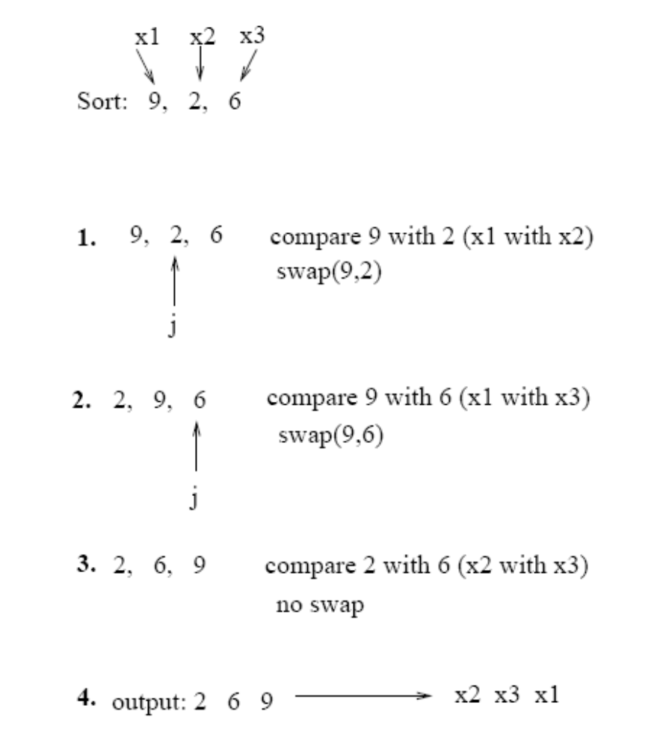
Example: Insertion Sort

Slide 8
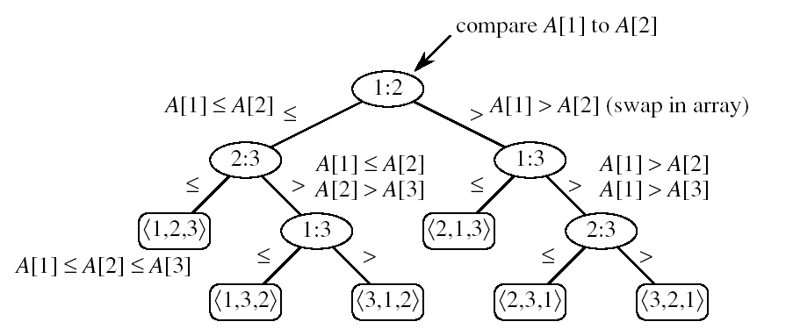
Worst-case number of comparisons?
Worst-case number of comparisons depends on:
  the length of the longest path from the root to a leaf
  (i.e., the height of the decision tree)

Slide 9
Lemma
Any binary tree of height h has at most
Proof: induction on h
Basis: h = 0 ⇒ tree has one node, which is a leaf
2⁰ = 1
Inductive step: assume true for h-1
  Extend the height of the tree with one more level
  Each leaf becomes parent to two new leaves
  No. of leaves at level h = 2 ∗ (no. of leaves at level h-1)
  = 2 ∗ 2^{h-1}
  = 2^{h}
2^{h} leaves
4
1
3
h-1
2
16
9
10
h

Slide 10
What is the least number of leaves in a Decision Tree Model?
All permutations on n elements must appear as one of the leaves in the decision tree:
At least n! leaves
n! permutations

Slide 11
A Lower Bound for Worst Case
Worst case no. of comparisons for a sorting algorithm is
  Length of the longest path from root to any of the leaves in the decision tree for the algorithm.
    Which is the height of its decision tree.
A lower bound on the running time of any comparison sort is given by
  A lower bound on the heights of all decision trees in which each permutation appears as a reachable leaf.

Slide 12
Optimal sorting for three elements
Any sort of six elements has 5 internal nodes.
1:2
≤
>
2:3
1:3
≤
≤
>
⟨1,2,3⟩
1:3
⟨2,1,3⟩
2:3
≤
>
≤
>
⟨1,3,2⟩
⟨3,1,2⟩
⟨2,3,1⟩
⟨3,2,1⟩
There must be a worst-case path of length ≥ 3.

Slide 13
A Lower Bound for Worst Case
Theorem 8.1:
Any comparison sort algorithm requires Ω(n lg n) comparisons in the worst case.
Proof:
Suffices to determine the height of a decision tree.
The number of leaves is at least n! (# outputs)
The number of internal nodes ≥ n!–1
The height is at least lg (n!–1) = Ω(n lg n)
QED

Slide 14
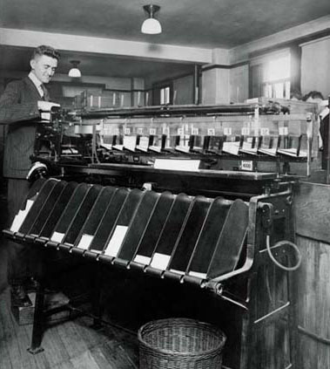
Beating the lower bound
We can beat the lower bound if we don’t base our sort on comparisons:
  Counting sort for keys in [0..k], k=O(n)
  Radix sort for keys with a fixed number of “digits”
  Bucket sort for random keys (uniformly distributed)

Slide 15
Counting Sort
Assumption: we sort integers in {0, 1, 2, …, k}.
Input: A[1..n] ⊂{0, 1, 2, …, k}^{n}.
Array A and values n and k are given.
Output: B[1..n] sorted. Assume B is already allocated and given as a parameter.
Auxiliary Storage: C[0..k] counts
Runs in linear time if k = O(n).

Slide 16
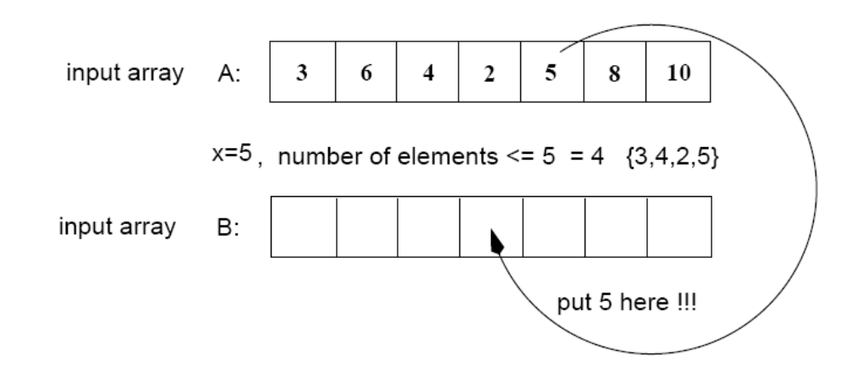
Counting Sort
Assumptions:
  Sort n integers which are in the range [0 ... r]
  r is in the order of n, that is, r=O(n)
Idea:
  For each element x, find the number of elements <= x
  Place x into its correct position in the output array
output array

Slide 17
Example
1
2
3
4
5
6
7
8
0
1
2
3
4
5
A
2
5
3
0
2
3
0
3
C
2
2
4
7
7
8
0
1
2
3
4
5
(cumulative sums)
C
2
0
2
3
0
1
(frequencies)
1
2
3
4
5
6
7
8
1
2
3
4
5
6
7
8
B
3
B
0
3
0
1
2
3
4
5
0
1
2
3
4
5
C
2
2
4
6
7
8
C
1
2
4
6
7
8
1
2
3
4
5
6
7
8
1
2
3
4
5
6
7
8
B
0
3
3
B
0
2
3
3
0
1
2
3
4
5
0
1
2
3
4
5
C
1
2
4
5
7
8
C
1
2
3
5
7
8

Slide 18
Example (cont.)
1
2
3
4
5
6
7
8
A
2
5
3
0
2
3
0
3
1
2
3
4
5
6
7
8
1
2
3
4
5
6
7
8
B
0
0
2
3
3
B
0
0
2
3
3
3
5
0
1
2
3
4
5
0
1
2
3
4
5
C
0
2
3
5
7
8
C
0
2
3
4
7
7
1
2
3
4
5
6
7
8
1
2
3
4
5
6
7
8
B
0
0
2
3
3
3
B
0
0
2
2
3
3
3
5
0
1
2
3
4
5
C
0
2
3
4
7
8

Slide 19
Counting-Sort (A, B, k)
CountingSort(A, B, k)
1. for i ← 1 to k
2. do C[i] ← 0
3. for j ← 1 to length[A]
4. do C[A[j]] ← C[A[j]] + 1
5. for i ← 2 to k
6. do C[i] ← C[i] + C[i –1]
7. for j ← length[A] downto 1
8. do B[C[A[ j ]]] ← A[j]
9. C[A[j]] ← C[A[j]]–1
O(k) init counts
O(n) count
O(k) prefix sum
O(n) reorder

Slide 20
Analysis of Counting Sort
Overall time: Θ(n + r)
In practice we use COUNTING sort when r = O(n)
⇒ running time is Θ(n)
Counting sort is stable
Counting sort is not in place sort

Slide 21
Radix Sort
Used to sort on card-sorters:
Do a stable sort on each column,
one column at a time.
The human operator is
part of the algorithm!
Key idea: sort on the “least significant digit” first and on the remaining digits in sequential order. The sorting method used to sort each digit must be “stable”.
  If we start with the “most significant digit”, we’ll need extra storage.

Slide 22
Radix Sort
Represents keys as d-digit numbers in some base-k
e.g., key = x₁x₂...x_{d} where 0≤x_{i}≤k-1
Example: key=15
key₁₀ = 15, d=2, k=10 where 0≤x_{i}≤9
key₂ = 1111, d=4, k=2 where 0≤x_{i}≤1

Slide 23
An Example
Input
After sorting
on LSD
After sorting
on middle digit
After sorting
on MSD
392 631 928 356
356 392 631 392
446 532 532 446
928 ⇒ 495 ⇒ 446 ⇒ 495
631 356 356 532
532 446 392 631
495 928 495 928
↑ ↑ ↑

Slide 24
Radix-Sort(A, d)
RadixSort(A, d)
1. for i ← 1 to d
2. do use a stable sort to sort array A on digit i
Correctness of Radix Sort
By induction on the number of digits sorted.
Assume that radix sort works for d – 1 digits.
Show that it works for d digits.
Radix sort of d digits ≡ radix sort of the low-order d – 1 digits followed by a sort on digit d .

Slide 25
Algorithm Analysis
Each pass over n d-digit numbers then takes time Θ(n+k). (Assuming counting sort is used for each pass.)
There are d passes, so the total time for radix sort is Θ(d (n+k)).
When d is a constant and k = O(n), radix sort runs in linear time.
Radix sort, if uses counting sort as the intermediate stable sort, does not sort in place.
  If primary memory storage is an issue, quicksort or other sorting methods may be preferable.

Slide 26
Bucket Sort
Assumes input is generated by a random process that distributes the elements uniformly over [0, 1).
Idea:
  Divide [0, 1) into n equal-sized buckets.
  Distribute the n input values into the buckets.
  Sort each bucket.
  Then go through the buckets in order, listing elements in each one.

Slide 27
Example - Bucket Sort
A
1
.78
.17
.39
.26
.72
.94
.21
.12
.23
.68
B
0
/
2
1
.17
.12 /
3
2
.26
.21
.23 /
4
3
.39 /
5
4
/
6
5
/
7
6
.68 /
8
7
.78
.72 /
9
8
/
10
9
.94 /

Slide 28
Example - Bucket Sort
.12
.17
.21
.23
.26
.39
.68
.72
.78
.94 /
0
/
1
.12
.17 /
2
.21
.23
.26 /
3
.39 /
4
/
5
/
6
.68 /
7
.72
.78 /
Concatenate the lists from
0 to n – 1 together, in order
8
/
9
.94 /

Slide 29
Bucket-Sort (A)
Input: A[1..n], where 0 ≤ A[i] < 1 for all i.
Auxiliary array: B[0..n – 1] of linked lists, each list initially empty.
BucketSort(A)
1. n ← length[A]
2. for i ← 1 to n
3. do insert A[i] into list B[ ⎣nA[i]⎦ ]
4. for i ← 0 to n – 1
5. do sort list B[i] with insertion sort
concatenate the lists B[i]s together in order
return the concatenated lists

Slide 30
Analysis of Bucket Sort
Alg.: BUCKET-SORT(A, n)
for i ← 1 to n
do insert A[i] into list B[⎣nA[i]⎦]
for i ← 0 to n - 1
do sort list B[i] with quicksort sort
concatenate lists B[0], B[1], . . . , B[n -1] together in order
return the concatenated lists
O(n)
Θ(n)
O(n)
Θ(n)

Slide 31
Analysis
Relies on no bucket getting too many values.
All lines except insertion sorting in line 5 take O(n) altogether.
Intuitively, if each bucket gets a constant number of elements, it takes O(1) time to sort each bucket ⇒ O(n) sort time for all buckets.
We “expect” each bucket to have few elements, since the average is 1 element per bucket.
But we need to do a careful analysis.

Slide 32
Dictionary
Dictionary:
  Dynamic-set data structure for storing items indexed using keys.
  Supports operations Insert, Search, and Delete.
  Applications:
    Symbol table of a compiler.
    Memory-management tables in operating systems.
    Large-scale distributed systems.
Hash Tables:
  Effective way of implementing dictionaries.
  Generalization of ordinary arrays.

Slide 33
Direct-address Tables
Direct-address Tables are ordinary arrays.
Facilitate direct addressing.
  Element whose key is k is obtained by indexing into the k^{th} position of the array.
Applicable when we can afford to allocate an array with one position for every possible key.
  i.e. when the universe of keys U is small.
Dictionary operations can be implemented to take O(1) time.

Slide 34
Hash Tables
Notation:
  U – Universe of all possible keys.
  K – Set of keys actually stored in the dictionary.
  |K| = n.
When U is very large,
  Arrays are not practical.
  |K| << |U|.
Use a table of size proportional to |K| – The hash tables.
  However, we lose the direct-addressing ability.
  Define functions that map keys to slots of the hash table.

Slide 35
Hashing
Hash function h: Mapping from U to the slots of a hash table T[0..m–1].
  h : U → {0,1,…, m–1}
With arrays, key k maps to slot A[k].
With hash tables, key k maps or “hashes” to slot T[h[k]].
h[k] is the hash value of key k.

Slide 36
Hashing
0
U
(universe of keys)
h(k₁)
h(k₄)
K
(actual
keys)
k₁
k₄
k₂
collision
h(k₂)=h(k₅)
k₅
k₃
h(k₃)
m–1

Slide 37
Issues with Hashing
Multiple keys can hash to the same slot – collisions are possible.
  Design hash functions such that collisions are minimized.
  But avoiding collisions is impossible.
    Design collision-resolution techniques.
Search will cost Ө(n) time in the worst case.
  However, all operations can be made to have an expected complexity of Ө(1).

Slide 38
Problems
You are given 5 distinct numbers to sort. Describe an algorithm which sorts them using at most 6 comparisons, or argue that no such algorithm exists.
Solution:
Total # of leaves in the comparison tree = 5!
If the height of the tree is h, then (total # of leaves ≤ 2^{h} )
  2^{h} ≥ 5!
  h ≥ log₂ (5!)
  ≥ log₂ 120
  h > 6
There is at least one input permutation which will require at least 7 comparisons to sort. Therefore, no such algorithm exists.

Slide 39
Problems
Show how you can sort n integers in the range 0 to n² – 1 in O(n) time.
First run through the list of integers and convert each one to base n, then radix sort them. Each number will have at most log_{n} (n²) = 2 digits so there will only need to be 2 passes. For each pass, there are n possible values which can be taken on, so we can use counting sort to sort each digit in O(n) time.

Slide 40
Conclusion
Any comparison sort will take at least nlgn to sort an array of n numbers
We can achieve a better running time for sorting if we can make certain assumptions on the input data:
  Counting sort: each of the n input elements is an integer in the range [0 ... r] and r=O(n)
  Radix sort: the elements in the input are integers represented with d digits in base-k, where d=Θ(1) and k =O(n)
  Bucket sort: the numbers in the input are uniformly distributed over the interval [0, 1)

