Slide 1


Sorting – Definitions
Input: n records, R₁ … R_{n} , from a file.
Each record R_{i} has
  a key K_{i}
  possibly other (satellite) information
The keys must have an ordering relation that satisfies the following properties:
  Trichotomy: For any two keys a and b, exactly one of a b, a = b, or a b is true.
  Transitivity: For any three keys a, b, and c, if a b and
  b c, then a c.
  The relation = is a total ordering (linear ordering) on keys.

Slide 2
Sorting – Definitions
Sorting: determine a permutation (reordering) Π = (p₁, … , p_{n}) of n records that puts the keys in non-decreasing order Kp₁ < … < Kp_{n}.
Permutation: a one-to-one function from {1, …, n} onto itself. There are n! distinct permutations of n items.
Rank: Given a collection of n keys, the rank of a key is the number of keys that precede it. That is, rank(K_{j}) = |{K_{i}| K_{i} < K_{j}}|. If the keys are distinct, then the rank of a key gives its position in the output file.

Slide 3
Why Study Sorting Algorithms?
There are a variety of situations that we can encounter
  Have randomly ordered keys (not sorted)
  Are all keys distinct?
  How large is the set of keys to be ordered?
  Need guaranteed performance?
Various algorithms are better suited to some of these situations

Slide 4
Sorting Terminology
Internal (the file is stored in main memory and can be randomly accessed) vs. External (the file is stored in secondary memory & can be accessed sequentially only (tape))
Comparison-based sort: uses only the relation among keys, not any special property of the representation of the keys themselves.
Array-based (consecutive keys are stored in consecutive memory locations→ time consuming rearrangement) vs. List-based sort (may be stored in nonconsecutive locations in a linked manner→ space consuming rearrangement )
In-place sort: needs only a constant amount of extra space in addition to that needed to store keys.

Slide 5
Sorting Categories
Sorting by Insertion insertion sort
Sorting by Exchange bubble sort, quicksort
Sorting by Selection selection sort, heapsort
Sorting by Merging merge sort
Sorting by Distribution radix sort

Slide 6
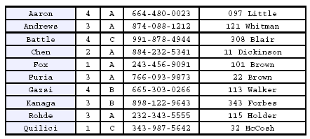
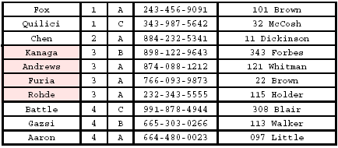
Stability
A STABLE sort preserves relative order of records with equal keys; records with equal keys retain their original relative order
Sorted on first key:
Sort file on second key:
Not stable → Records with key value 3 are not in order on first key!!

Slide 7
Elementary Sorting Methods
Insertion, Selection, Bubble sorts
Easier to understand the basic mechanisms of sorting.
Good for small files.
Good for well-structured files that are relatively easy to sort, such as those almost sorted.
Can be used to improve efficiency of more powerful methods.
https://www.cs.usfca.edu/~galles/visualization/ComparisonSort.html
http://www.algostructure.com/sorting/heapsort.php

Slide 8
Insertion Sort
Idea: like sorting a hand of playing cards
  Start with an empty left hand and the cards facing down on the table.
  Remove one card at a time from the table, and insert it into the correct position in the left hand
    compare it with each of the cards already in the hand, from right to left
  The cards held in the left hand are sorted
    these cards were originally the top cards of the pile on the table

Slide 9
Insertion Sort
To insert 12, we need to make room for it by moving first 36 and then 24.
6
10
24
36
12

Slide 10
Insertion Sort
6
10
24
36
12

Slide 11
Insertion Sort
6
10
24
36
12

Slide 12

Insertion Sort
input array
5 2 4 6 1 3
at each iteration, the array is divided in two sub-arrays:
left sub-array
right sub-array
sorted
unsorted

Slide 13





Insertion Sort

Slide 14
INSERTION-SORT
Alg.: INSERTION-SORT(A)
for j ← 2 to n
do key ← A[ j ]
Insert A[ j ] into the sorted sequence A[1 . . j -1]
i ← j - 1
while i > 0 and A[i] > key
do A[i + 1] ← A[i]
i ← i – 1
A[i + 1] ← key
Insertion sort – sorts the elements in place
1
2
3
4
5
6
7
8
a₁
a₂
a₃
a₄
a₅
a₆
a₇
a₈
key

Slide 15
Loop Invariant for Insertion Sort
Alg.: INSERTION-SORT(A)
for j ← 2 to n
do key ← A[ j ]
Insert A[ j ] into the sorted sequence A[1 . . j -1]
i ← j - 1
while i > 0 and A[i] > key
do A[i + 1] ← A[i]
i ← i – 1
A[i + 1] ← key
Invariant: at the start of the for loop the elements in A[1 . . j-1] are in sorted order

Slide 16
Proving Loop Invariants
Proving loop invariants works like induction
Initialization (base case):
  It is true prior to the first iteration of the loop
Maintenance (inductive step):
  If it is true before an iteration of the loop, it remains true before the next iteration
Termination:
  When the loop terminates, the invariant gives us a useful property that helps show that the algorithm is correct
  Stop the induction when the loop terminates

Slide 17
Loop Invariant for Insertion Sort
Initialization:
  Just before the first iteration, j = 2:
  the subarray A[1 . . j-1] = A[1], (the element originally in A[1]) – is sorted

Slide 18
Loop Invariant for Insertion Sort
Maintenance:
  the while inner loop moves A[j -1], A[j -2], A[j -3], and so on, by one position to the right until the proper position for key (which has the value that started out in A[j]) is found
  At that point, the value of key is placed into this position.

Slide 19

Loop Invariant for Insertion Sort
Termination:
  The outer for loop ends when j = n + 1 ⇒ j-1 = n
  Replace n with j-1 in the loop invariant:
    the subarray A[1 . . n] consists of the elements originally in A[1 . . n], but in sorted order
The entire array is sorted!
j - 1
j
Invariant: at the start of the for loop the elements in A[1 . . j-1] are in sorted order

Slide 20


Analysis of Insertion Sort
INSERTION-SORT(A)
for j ← 2 to n
do key ← A[ j ]
Insert A[ j ] into the sorted sequence A[1 . . j -1]
i ← j - 1
while i > 0 and A[i] > key
do A[i + 1] ← A[i]
i ← i – 1
A[i + 1] ← key
cost times
c₁ n
c₂ n-1
0 n-1
c₄ n-1
c₅
c₆
c₇
c₈ n-1
t_{j}: # of times the while statement is executed at iteration j
Notes:
₇

Slide 21
Best Case Analysis
The array is already sorted
  A[i] ≤ key upon the first time the while loop test is run (when i = j -1)
  t_{j} = 1
T(n) = c₁n + c₂(n -1) + c₄(n -1) + c₅(n -1) + c₈(n-1) = (c₁ + c₂ + c₄ + c₅ + c₈)n + (c₂ + c₄ + c₅ + c₈)
= an + b = Θ(n)
“while i > 0 and A[i] > key”

Slide 22
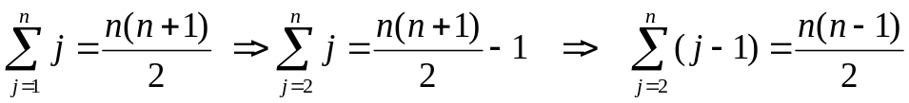

Worst Case Analysis
The array is in reverse sorted order
  Always A[i] > key in while loop test
  Have to compare key with all elements to the left of the j-th position ⇒ compare with j-1 elements ⇒ t_{j} = j
  a quadratic function of n
T(n) = Θ(n²) order of growth in n²
“while i > 0 and A[i] > key”
using
we have:

Slide 23
Comparisons and Exchanges in Insertion Sort
INSERTION-SORT(A)
for j ← 2 to n
do key ← A[ j ]
Insert A[ j ] into the sorted sequence A[1 . . j -1]
i ← j - 1
while i > 0 and A[i] > key
do A[i + 1] ← A[i]
i ← i – 1
A[i + 1] ← key
cost times
c₁ n
c₂ n-1
0 n-1
c₄ n-1
c₅
c₆
c₇
c₈ n-1
≈ n²/2 comparisons
≈ n²/2 exchanges

Slide 24
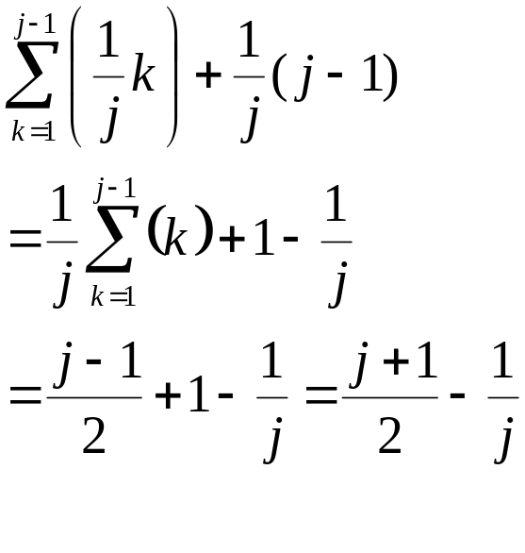
Average-case Analysis
Want to determine the average number of comparisons taken over all possible inputs.
Determine the average no. of comparisons for a key A[j].
A[j] can belong to any of the j locations, 1..j, with equal probability.
The number of key comparisons for A[j] is j–k+1, if A[j] belongs to location k, 1 < k ≤ j and is j–1 if it belongs to location 1.
Average no. of comparisons for inserting key A[j] is:
Notes:
If it’s in slot 1 or slot 2, it still has to do i-1 comparisons.

Slide 25
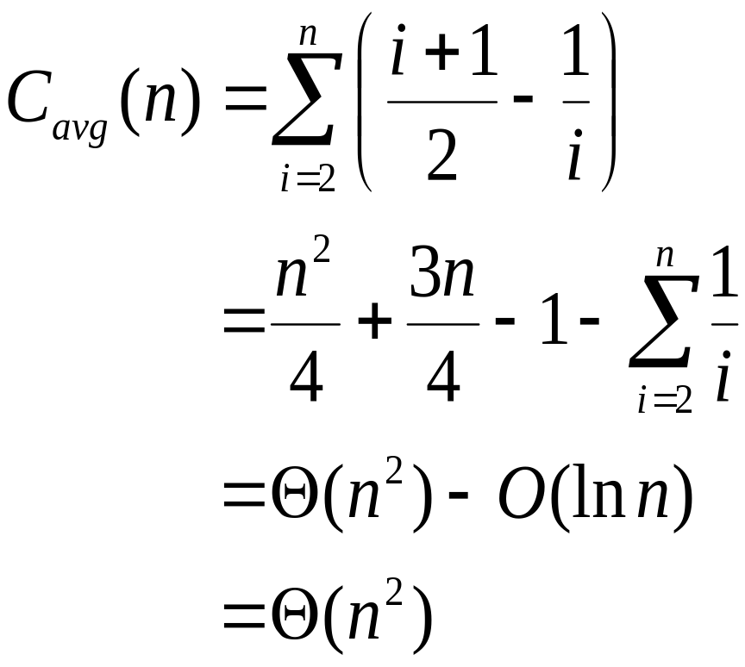
Average-case Analysis
Summing over the no. of comparisons for all keys,
Therefore, T_{avg}(n) = Θ(n²)

Slide 26
Analysis of Inversions in Permutations
Inversion: A pair (i, j) is called an inversion of a permutation Π if i < j and Π(i) > Π(j).
Worst Case: n(n-1)/2 inversions.
Average Case:
  Let Π^{T} = {Π₁, Π₂, …, Π_{n} } be the transpose of Π.
  Consider the pair (i, j) with i < j, there are n(n-1)/2 pairs.
  (i, j) is an inversion of Π if and only if (n-j+1, n-i+1) is not an inversion of Π^{T}.
  This implies that the pair (Π, Π^{T}) together have n(n-1)/2 inversions.
  ⇒ The average number of inversions is n(n-1)/4.

Slide 27
Algorithm Analysis
Is it in-place? yes
Is it stable? yes
No. of Comparisons:
  If A is sorted: Θ(n) comparisons
  If A is reverse sorted: Θ(n²) comparisons
  If A is randomly permuted: Θ(n²) comparisons
Advantages
  Good running time for “almost sorted” arrays Θ(n)
Disadvantages
  Θ(n²) running time in worst and average case
  ≈ n²/2 comparisons and exchanges
 | Comparison | Movement
Search | O(n) | O(n) | O(n) *(n-1) ~ O(n²)
Binary Search | O(lgn) | O(n) | O(n) *(n-1) ~ O(n²)
Linked List | O(n) | O(1) | O(n) *(n-1) ~ O(n²)
Sorted Area
Unsorted Area

Slide 28
Bubble Sort
Idea:
  Repeatedly pass through the array
  Swaps adjacent elements that are out of order
Easier to implement, but slower than Insertion sort
i
1
2
3
n
8
4
6
9
2
3
1
j

Slide 29
Bubble Sort
Alg.: BUBBLESORT(A)
for i ← 1 to length[A]
do for j ← length[A] downto i + 1
do if A[j] < A[j -1]
then exchange A[j] ↔ A[j-1]
i
8
4
6
9
2
3
1
i = 1
j

Slide 30




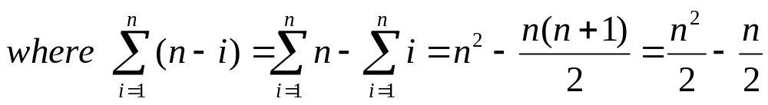
Bubble-Sort Running Time
Alg.: BUBBLESORT(A)
for i ← 1 to length[A]
do for j ← length[A] downto i + 1
do if A[j] < A[j -1]
then exchange A[j] ↔ A[j-1]
c₁
c₂
Comparisons: ≈ n²/2
c₃
c₄
Exchanges: ≈ n²/2
T(n) =
c₁(n+1) +
c₂
c₃
c₄
= Θ(n) +
(c₂ + c₂ + c₄)
Thus,T(n) = Θ(n²)

Slide 31
Selection Sort
Idea:
  Find the smallest element in the array
  Exchange it with the element in the first position
  Find the second smallest element and exchange it with the element in the second position
  Continue until the array is sorted
Disadvantage:
  Running time depends only slightly on the amount of order in the file (but less exchange ←Advantage)

Slide 32
Example
8
4
6
9
2
3
1
1
2
3
4
9
6
8
1
4
6
9
2
3
8
1
2
3
4
6
9
8
1
2
6
9
4
3
8
1
2
3
4
6
8
9
1
2
3
9
4
6
8
1
2
3
4
6
8
9

Slide 33
Selection Sort
Alg.: SELECTION-SORT(A)
n ← length[A]
for j ← 1 to n - 1
do smallest ← j
for i ← j + 1 to n
do if A[i] < A[smallest]
then smallest ← i
exchange A[j] ↔ A[smallest]
8
4
6
9
2
3
1

Slide 34


Analysis of Selection Sort
Alg.: SELECTION-SORT(A)
n ← length[A]
for j ← 1 to n - 1
do smallest ← j
for i ← j + 1 to n
do if A[i] < A[smallest]
then smallest ← i
exchange A[j] ↔ A[smallest]
cost times
c₁ 1
c₂ n
c₃ n-1
c₄
c₅
c₆
c₇ n-1
n²/2
comparisons
n
exchanges

Slide 35
Sorting
Insertion sort
  Design approach:
  Sorts in place:
  Best case:
  Worst case:
Bubble Sort
  Design approach:
  Sorts in place:
  Running time:
incremental
Yes
Θ(n)
Θ(n²)
incremental
Yes
Θ(n²)

Slide 36
Sorting
Selection sort
  Design approach:
  Sorts in place:
  Running time:
Merge Sort
  Design approach:
  Sorts in place:
  Running time:
incremental
Yes
Θ(n²)
divide and conquer
No
Let’s see!!
https://www.cs.usfca.edu/~galles/visualization/ComparisonSort.html

Slide 37
Divide-and-Conquer
Divide the problem into a number of sub-problems
  Similar sub-problems of smaller size (recursion)
Conquer the sub-problems
  Solve the sub-problems recursively
  Sub-problem size small enough ⇒ solve the problems in straightforward manner
Combine the solutions of the sub-problems
  Obtain the solution for the original problem

Slide 38
Merge Sort Approach
To sort an array A[p . . r]:
Divide
  Divide the n-element sequence to be sorted into two subsequences of n/2 elements each
Conquer
  Sort the subsequences recursively using merge sort
  When the size of the sequences is 1 there is nothing more to do
Combine
  Merge the two sorted subsequences

Slide 39
Merge Sort
p
q
r
1
2
3
4
5
6
7
8
Alg.: MERGE-SORT(A, p, r)
if p < r Check for base case
then q ← ⎣(p + r)/2⎦ Divide
MERGE-SORT(A, p, q) Conquer
MERGE-SORT(A, q + 1, r) Conquer
MERGE(A, p, q, r) Combine
Initial call: MERGE-SORT(A, 1, n)
5
2
4
7
1
3
2
6

Slide 40
Example – n Power of 2
Divide
1
2
3
4
5
6
7
8
5
2
4
7
1
3
2
6
q = 4
1
2
3
4
5
6
7
8
5
2
4
7
1
3
2
6
1
2
3
4
5
6
7
8
5
2
4
7
1
3
2
6
1
2
3
4
5
6
7
8
5
2
4
7
1
3
2
6

Slide 41
Example – n Power of 2
Conquer
and
Merge
1
2
3
4
5
6
7
8
1
2
2
3
4
5
6
7
1
2
3
4
5
6
7
8
2
4
5
7
1
2
3
6
1
2
3
4
5
6
7
8
2
5
4
7
1
3
2
6
1
2
3
4
5
6
7
8
5
2
4
7
1
3
2
6

Slide 42
Example – n Not a Power of 2
1
2
3
4
5
6
7
8
9
10
11
Divide
4
7
2
6
1
4
7
3
5
2
6
q = 6
1
2
3
4
5
6
7
8
9
10
11
q = 3
4
7
2
6
1
4
7
3
5
2
6
q = 9
1
2
3
4
5
6
7
8
9
10
11
4
7
2
6
1
4
7
3
5
2
6
1
2
3
4
5
6
7
8
9
10
11
4
7
2
6
1
4
7
3
5
2
6
1
2
4
5
7
8
4
7
6
1
7
3

Slide 43
Example – n Not a Power of 2
Conquer
and
Merge
1
2
3
4
5
6
7
8
9
10
11
1
2
2
3
4
4
5
6
6
7
7
1
2
3
4
5
6
7
8
9
10
11
1
2
4
4
6
7
2
3
5
6
7
1
2
3
4
5
6
7
8
9
10
11
2
4
7
1
4
6
3
5
7
2
6
1
2
3
4
5
6
7
8
9
10
11
4
7
2
1
6
4
3
7
5
2
6
1
2
4
5
7
8
4
7
6
1
7
3

Slide 44
Merging
p
q
r
1
2
3
4
5
6
7
8
2
4
5
7
1
2
3
6
Input: Array A and indices p, q, r such that p ≤ q < r
  Subarrays A[p . . q] and A[q + 1 . . r] are sorted
Output: One single sorted subarray A[p . . r]

Slide 45
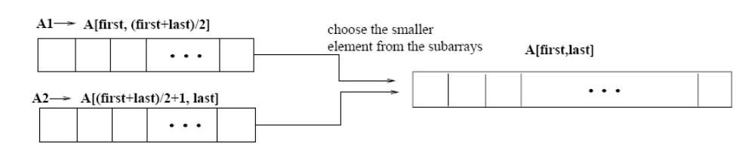
Merging
p
q
r
Idea for merging:
  Two piles of sorted cards
    Choose the smaller of the two top cards
    Remove it and place it in the output pile
  Repeat the process until one pile is empty
  Take the remaining input pile and place it face-down onto the output pile
1
2
3
4
5
6
7
8
2
4
5
7
1
2
3
6
A1← A[p, q]
A[p, r]
A2← A[q+1, r]

Slide 46
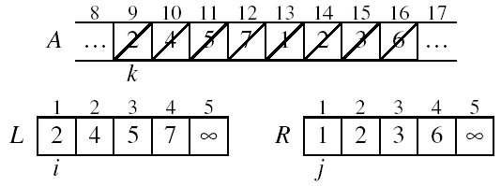
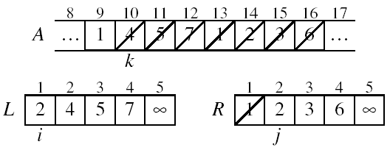
Example: MERGE(A, 9, 12, 16)
p
q
r

Slide 47
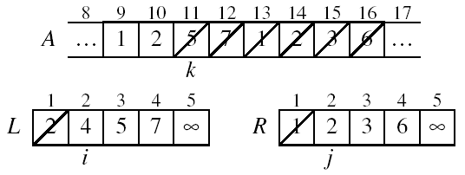
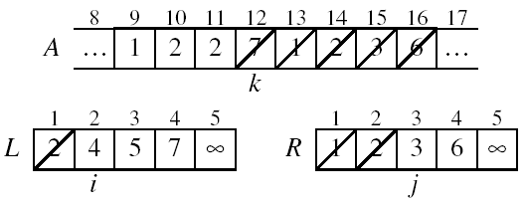
Example: MERGE(A, 9, 12, 16)

Slide 48
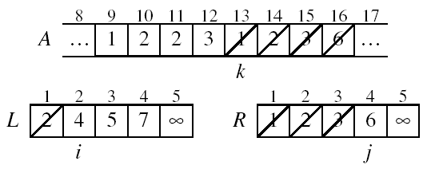
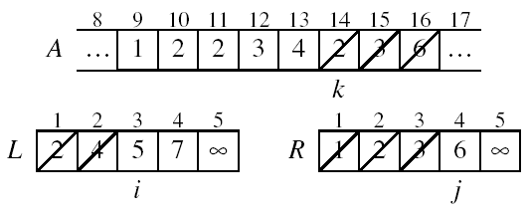
Example (cont.)

Slide 49
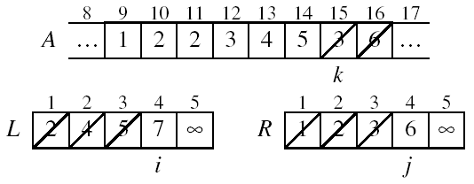
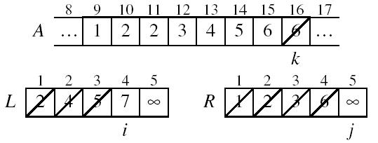
Example (cont.)

Slide 50
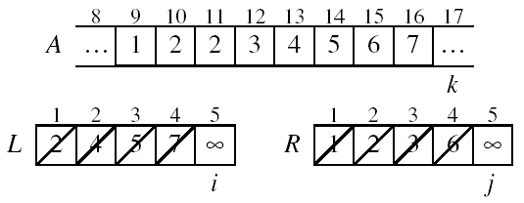
Example (cont.)
Done!

Slide 51
Merge - Pseudocode
p
q
r
Alg.: MERGE(A, p, q, r)
Compute n₁ and n₂
Copy the first n₁ elements into L[1 . . n₁ + 1] and the next n₂ elements into R[1 . . n₂ + 1]
L[n₁ + 1] ← ∞; R[n₂ + 1] ← ∞
i ← 1; j ← 1
for k ← p to r
do if L[ i ] ≤ R[ j ]
then A[k] ← L[ i ]
i ←i + 1
else A[k] ← R[ j ]
j ← j + 1
1
2
3
4
5
6
7
8
2
4
5
7
1
2
3
6
n₁
n₂
p
q
L
2
4
5
7
∞
q + 1
r
R
1
2
3
6
∞

Slide 52
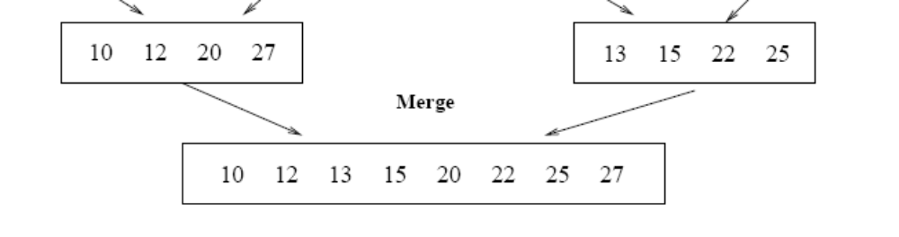
Running Time of Merge (assume last for loop)
Initialization (copying into temporary arrays):
  Θ(n₁ + n₂) = Θ(n)
Adding the elements to the final array:
  n iterations, each taking constant time ⇒ Θ(n)
Total time for Merge:
  Θ(n)

Slide 53
Analyzing Divide-and Conquer Algorithms
The recurrence is based on the three steps of the paradigm:
  T(n) – running time on a problem of size n
  Divide the problem into a subproblems, each of size n/b: takes D(n)
  Conquer (solve) the subproblems aT(n/b)
  Combine the solutions C(n)
Θ(1) if n ≤ c
T(n) = aT(n/b) + D(n) + C(n) otherwise

Slide 54
MERGE-SORT Running Time
Divide:
  compute q as the average of p and r: D(n) = Θ(1)
Conquer:
  recursively solve 2 subproblems, each of size n/2 ⇒ 2T (n/2)
Combine:
  MERGE on an n-element subarray takes Θ(n) time ⇒ C(n) = Θ(n)
Θ(1) if n =1
T(n) = 2T(n/2) + Θ(n) if n > 1

Slide 55
Solve the Recurrence
T(n) = c if n = 1
2T(n/2) + cn if n > 1
Use Master’s Theorem:
Compare n with f(n) = cn
Case 2: T(n) = Θ(nlgn)

Slide 56
Merge Sort - Discussion
Running time insensitive of the input
Advantages:
  Guaranteed to run in Θ(nlgn)
Disadvantage (not inspace)
  Requires extra space ≈N

Slide 57
Sorting Challenge 1
Problem: Sort a file of huge records with tiny keys → It means less comparison overhead but more exchange overhead
Example application: Reorganize your Video files
Which method to use?
  merge sort, guaranteed to run in time ∼NlgN
  selection sort
  bubble sort
  a custom algorithm for huge records/tiny keys
  insertion sort

Slide 58
Sorting Files with Huge Records and Small Keys
Insertion sort or bubble sort?
  NO, too many exchanges
Selection sort?
  YES, it takes linear time for exchanges
Merge sort or custom method?
  Probably not: selection sort simpler, does less swaps
  Need extra N space

Slide 59
Sorting Challenge 2
Problem: Sort a huge randomly-ordered file of small records → It means less exchange overhead but worst-case bounded
Application: Process transaction record for a phone company
Which sorting method to use?
  Bubble sort
  Selection sort
  Mergesort guaranteed to run in time ∼NlgN
  Insertion sort

Slide 60
Sorting Huge, Randomly - Ordered Files
Selection sort?
  NO, always takes quadratic time
Bubble sort?
  NO, quadratic time for randomly-ordered keys
Insertion sort?
  NO, quadratic time for randomly-ordered keys
Mergesort?
  YES, it is designed for this problem

Slide 61
Sorting Challenge 3
Problem: sort a file that is already almost in order
Applications:
  Re-sort a huge database after a few changes
  Double check that someone else sorted a file
Which sorting method to use?
  Mergesort, guaranteed to run in time ∼NlgN
  Selection sort
  Bubble sort
  A custom algorithm for almost in-order files
  Insertion sort

Slide 62
Sorting Files That are Almost in Order
Selection sort?
  NO, always takes quadratic time
Bubble sort?
  NO, bad for some definitions of “almost in order”
  Ex: B C D E F G H I J K L M N O P Q R S T U V W X Y Z A
Insertion sort?
  YES, takes linear time for most definitions of “almost in order”
Mergesort or custom method?
  Probably not: insertion sort simpler and faster
  Takes less memory space

Slide 63
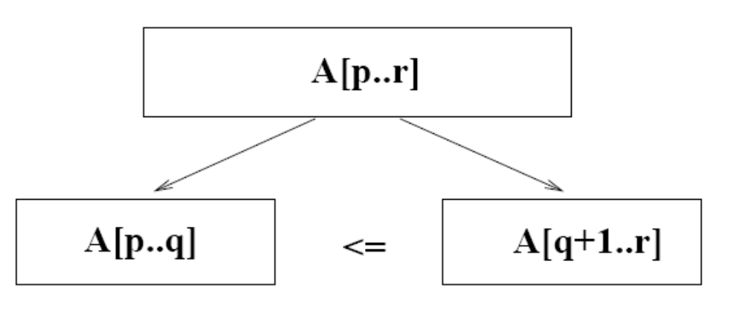
Quicksort
A[p…q]
A[q+1…r]
≤
Sort an array A[p…r]
Divide
  Partition the array A into 2 subarrays A[p..q] and A[q+1..r], such that each element of A[p..q] is smaller than or equal to each element in A[q+1..r]
  Need to find index q to partition the array (Pivot)

Slide 64
Quicksort
A[p…q]
A[q+1…r]
≤
Conquer
  Recursively sort A[p..q] and A[q+1..r] using Quicksort
Combine
  Trivial: the arrays are sorted in place
  No additional work is required to combine them
  The entire array is now sorted

Slide 65
Performance
A triumph of analysis by C.A.R. Hoare
Worst-case execution time – Θ(n²).
Average-case execution time – Θ(n lg n).
  How do the above compare with the complexities of other sorting algorithms?
Empirical and analytical studies show that quicksort can be expected to be twice as fast as its competitors.

Slide 66
QUICKSORT
Initially: p=1, r=n
Alg.: QUICKSORT(A, p, r)
if p < r
then q ← PARTITION(A, p, r)
QUICKSORT (A, p, q)
QUICKSORT (A, q+1, r)
Recurrence:
T(n) = T(q) + T(n – q) + f(n)
PARTITION())

Slide 67
Partitioning the Array
Choosing PARTITION()
  There are different ways to do this
  Each has its own advantages/disadvantages
Hoare partition vs. Lomuto partition scheme
Select a pivot element x around which to partition
  Grows two regions
A[p…i] ≤ x
x ≤ A[j…r]
A[p…i] ≤ x
x ≤ A[j…r]
i
j
Hoare: partition(A, lo, hi) is pivot := A[(lo + hi) / 2]

Slide 68
Partitioning
Select the last element A[r] in the subarray A[p..r] as the pivot – the element around which to partition. (Lomuto partition scheme)
As the procedure executes, the array is partitioned into four (possibly empty) regions.
  A[p..i] — All entries in this region are ≤ pivot.
  A[i+1..j – 1] — All entries in this region are > pivot.
  A[r] = pivot.
  A[j..r – 1] — Not known how they compare to pivot.
The above hold before each iteration of the for loop, and constitute a loop invariant.

Slide 69
Example
Select the first element A[r] in the subarray A[p..r] as the pivot x = 5
A[p…r]
5
3
2
6
4
1
3
7
5
3
2
6
4
1
3
7
i
j
i
j
3
3
2
6
4
1
5
7
3
3
2
6
4
1
5
7
i
j
i
j
A[p…q]
A[q+1…r]
3
3
2
1
4
6
5
7
3
3
2
1
4
6
5
7
i
j
j
i

Slide 70
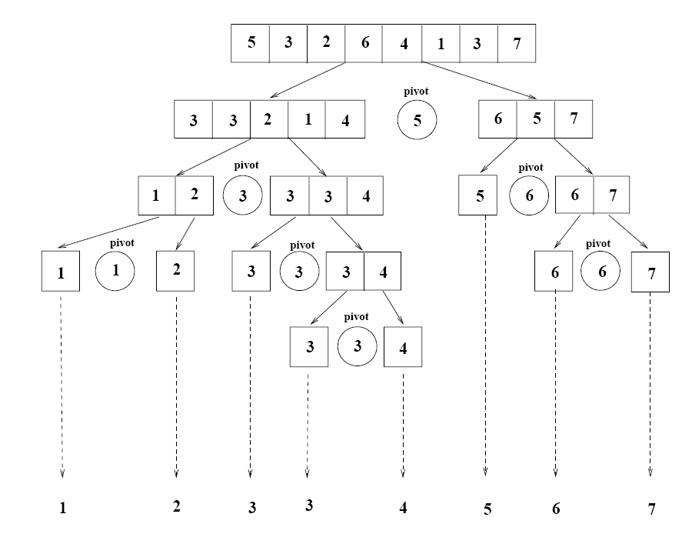
Example

Slide 71
Partitioning the Array
Alg. PARTITION (A, p, r)
x ← A[p]
i ← p – 1
j ← r + 1
while TRUE
do repeat j ← j – 1
until A[j] ≤ x
do repeat i ← i + 1
until A[i] ≥ x
if i < j
then exchange A[i] ↔ A[j]
else return j
p
r
A:
5
3
2
6
4
1
3
7
i
j
A[p…q]
A[q+1…r]
≤
A:
a_{p}
a_{r}
j=q
i
Each element is
visited once!
Running time: Θ(n)
n = r – p + 1

Slide 72
Recurrence
Initially: p=1, r=n
Alg.: QUICKSORT(A, p, r)
if p < r
then q ← PARTITION(A, p, r)
QUICKSORT (A, p, q)
QUICKSORT (A, q+1, r)
Recurrence:
T(n) = T(q) + T(n – q) + n

Slide 73
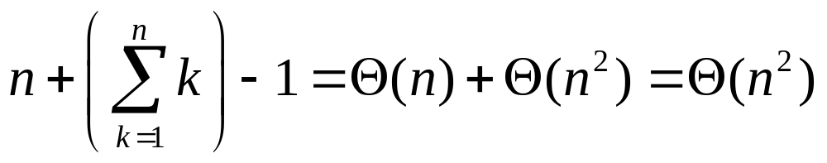
Worst Case Partitioning
Worst-case partitioning
  One region has one element and the other has n – 1 elements
  Maximally unbalanced
Recurrence: q=1
  T(n) = T(1) + T(n – 1) + n,
  T(1) = Θ(1)
  T(n) = T(n – 1) + n
  =
n
n
1
n - 1
n
1
n - 2
n - 1
n
1
n - 3
n - 2
1
2
3
1
1
2
Θ(n²)
When does the worst case happen?

Slide 74
Worst Case Partitioning
(1, 2, 3, 4, 5, 6)
  Choose the last element A[r] in the subarray A[p..r] as the pivot = 6
  T(n) = T(1) + T(n – 1) + n, T(1) = Θ(1)
  T(n) = T(n – 1) + n = O(n²)
  What about (6, 2, 3, 4, 5, 1) ?
  T(n) = T(n – 1) + n = O(n²)
  What about (3, 3, 3, 3, 3, 3) ?
  T(n) = T(n – 1) + n = O(n²)

Slide 75
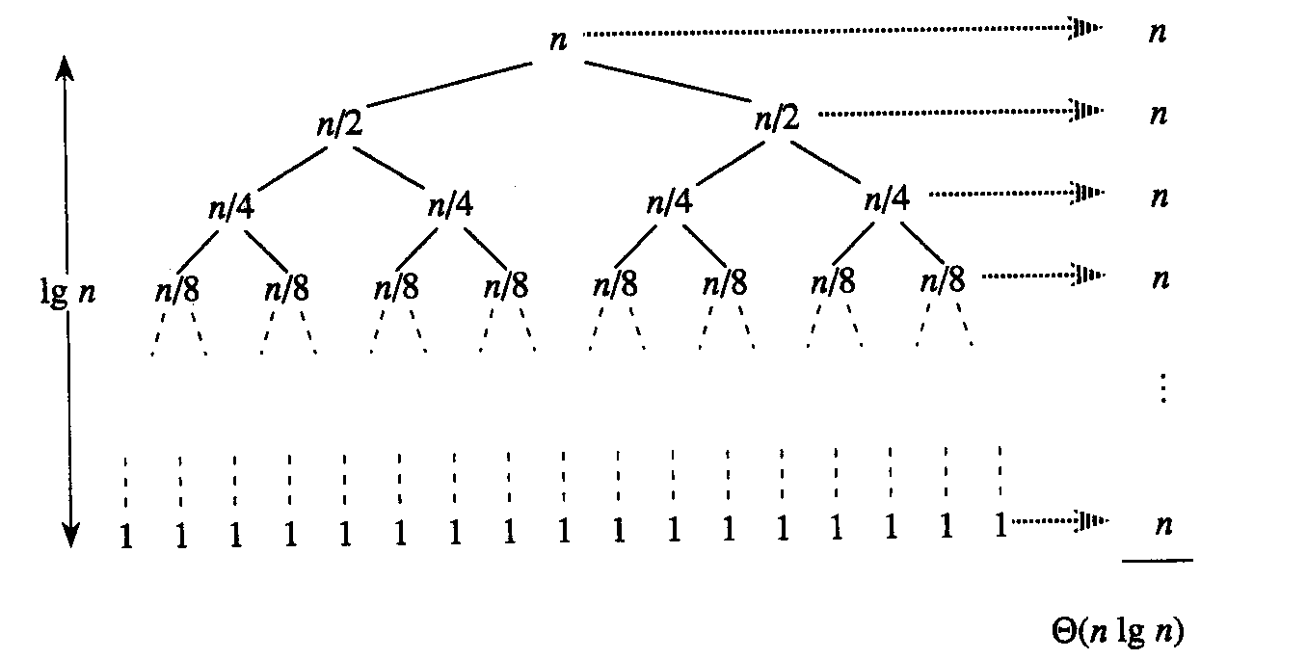
Best Case Partitioning
Best-case partitioning
  Partitioning produces two regions of size n/2
Recurrence: q=n/2
  T(n) = 2T(n/2) + Θ(n)
  T(n) = Θ(nlgn) (Master theorem)

Slide 76
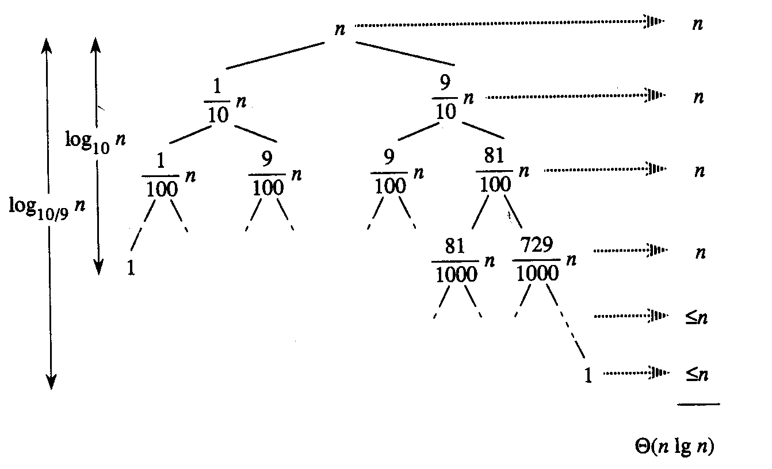
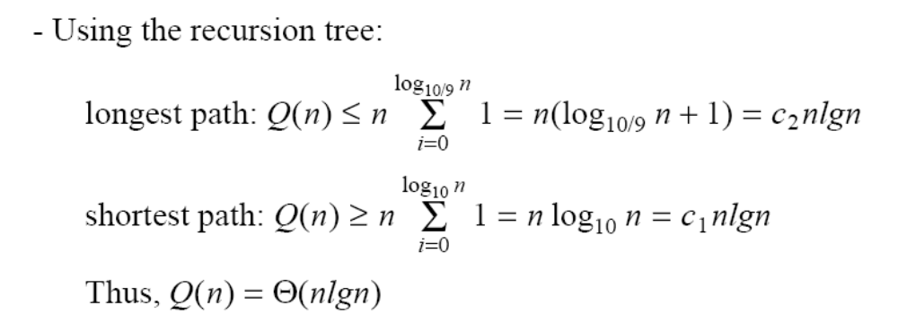
Case Between Worst and Best
9-to-1 proportional split
Q(n) = Q(9n/10) + Q(n/10) + n

Slide 77
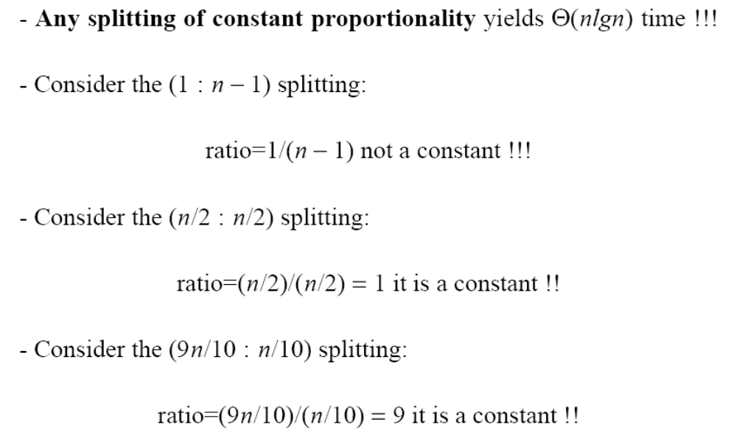
How does partition affect performance?

Slide 78
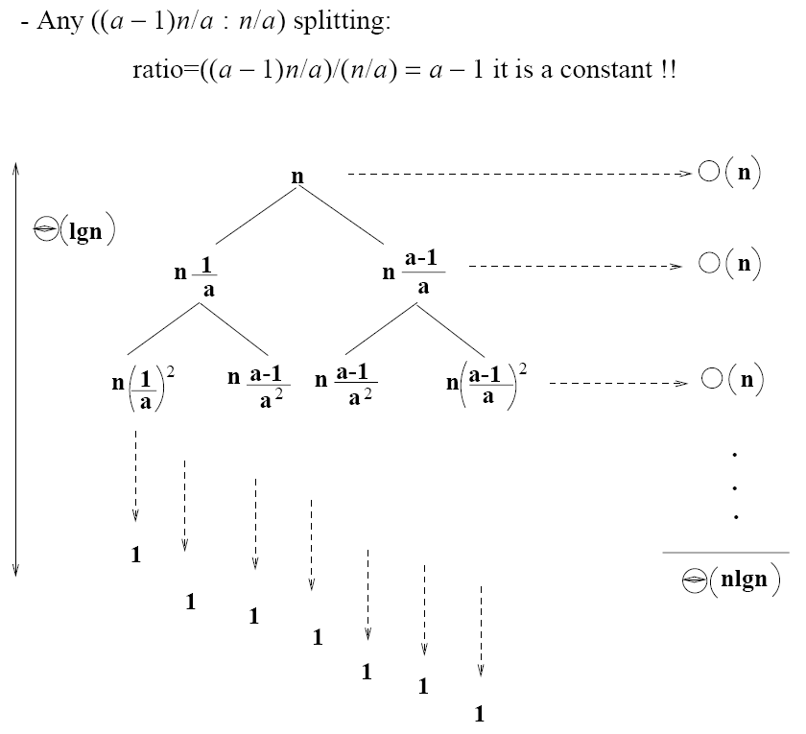
How does partition affect performance?

Slide 79
Performance of Quicksort
Average case
  All permutations of the input numbers are equally likely
  On a random input array, we will have a mix of well balanced and unbalanced splits
  Good and bad splits are randomly distributed across throughout the tree
combined partitioning cost:
2n-1 = Θ(n)
partitioning cost:
n = Θ(n)
n
n
1
n - 1
(n – 1)/2 + 1
(n – 1)/2
(n – 1)/2
(n – 1)/2
Alternate of a good
and a bad split
Nearly well
balanced split
Running time of Quicksort when levels alternate between good and bad splits is O(nlgn)

Slide 80
Quick sort question
Problem: The median of n elements can be found in O(n) time. What is the time complexity of quick sort in which median is selected as pivot?
T(n) = O(n) + O(1) + O(n) + 2T(n/2) = O(nlogn)

Slide 81
Quick sort question
Problem: The median of n elements can be found in O(n) time. What is the worst case time complexity of quick sort in which median is selected as pivot?
T(n) = O(n) + O(1) + O(n) + 2T(n/2) = O(nlogn)

Slide 82
Quick sort question
Problem: The (n/4)th smallest element is selected as pivot using O(n) time. What is the worst case time complexity of quick sort?
T(n) = O(n) + O(1) + O(n) + T(n/4) + T(3n/4)
= O(n) + T(n/4) + T(3n/4)
= O(nlogn)

