Slide 1
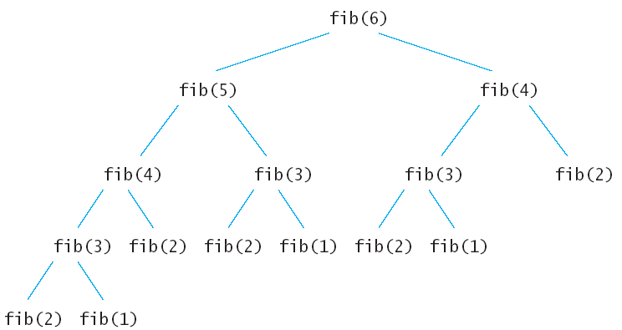
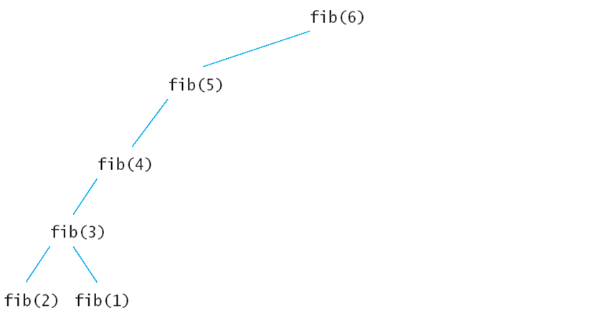
Memoize
void fib () {
fibresult[0] = 1;
fibresult[1] = 1;
for (int i = 2; i<n; i++)
fibresult[i] = fibresult[i-1] + fibresult[i-2];
}
Don’t recalculate but reuse!
Remove the recurrences.
Efficiency:
  Time – O(n)
  Space – O(n)
1
1
2
3
5
8
0 1 2 3 4 5

Slide 2
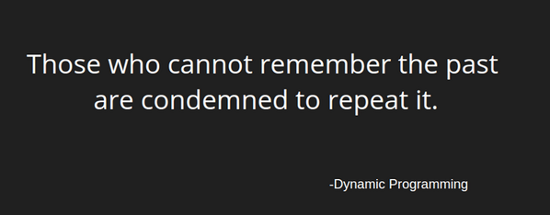
Dynamic Programming
What is that equal to ? "1+1+1+1+1+1+1+1 =“
What about that? “1+ 1+1+1+1+1+1+1+1 =“
How did you calculate it? DP.
Some famous Dynamic Programming algorithms are:
  Unix diff for comparing two files
  Bellman-Ford for shortest path routing in networks
  TeX the ancestor of LaTeX
  WASP - Winning and Score Predictor

Slide 3
Dynamic Programming
Dynamic Programming is an algorithm design technique for optimization problems: often minimizing or maximizing.
Like divide and conquer, DP solves problems by combining solutions to subproblems.
Unlike divide and conquer, subproblems are not independent.
  Subproblems may share subsubproblems,
  However, solution to one subproblem may not affect the solutions to other subproblems of the same problem.
DP reduces computation by
  Solving subproblems in a bottom-up fashion.
  Storing solution to a subproblem the first time it is solved.
  Looking up the solution when subproblem is encountered again.
Key: determine structure of optimal solutions

Slide 4
Steps in Dynamic Programming
Characterize structure of an optimal solution.
Define value of optimal solution recursively.
Compute optimal solution values either top-down with caching or bottom-up in a table.
Construct an optimal solution from computed values.
We study these with the help of examples.

Slide 5
Longest Common Subsequence (LCS)
Problem: Given 2 sequences, X = ⟨x₁,...,x_{m}⟩ and
Y = ⟨y₁,...,y_{n}⟩, find a common subsequence whose length is maximum.
springtime ncaa tournament basketball
printing north carolina krzyzewski
Subsequence need not be consecutive, but must be in order.

Slide 6
Motivating Applications
Molecular biology: DNA sequences (genes) can be represented as sequences of four letters ACGT, corresponding to the four submolecules forming DNA. When biologists find a new sequences, they typically want to know what other sequences it is most similar to. One way of computing how similar two sequences are is to find the length of their longest common subsequence.
File comparison: The Unix program "diff" is used to compare two different versions of the same file, to determine what changes have been made to the file. It works by finding a longest common subsequence of the lines of the two files; any line in the subsequence has not been changed, so what it displays is the remaining set of lines that have changed. In this instance of the problem we should think of each line of a file as being a single complicated character in a string.
Screen redisplay: Many text editors like "emacs" display part of a file on the screen, updating the screen image as the file is changed. For slow dial-in terminals, these programs want to send the terminal as few characters as possible to cause it to update its display correctly. It is possible to view the computation of the minimum length sequence of characters needed to update the terminal as being a sort of common subsequence problem (the common subsequence tells you the parts of the display that are already correct and don't need to be changed).

Slide 7
Longest Common Subsequence
Given two sequences
X = ⟨x₁, x₂, …, x_{m}⟩
Y = ⟨y₁, y₂, …, y_{n}⟩
find a maximum length common subsequence (LCS) of X and Y
E.g.:
X = ⟨A, B, C, B, D, A, B⟩
Subsequences of X:
  A subset of elements in the sequence taken in order
⟨A, B, D⟩, ⟨B, C, D, B⟩, etc.

Slide 8
Example
X = ⟨A, B, C, B, D, A, B⟩ X = ⟨A, B, C, B, D, A, B⟩
Y = ⟨B, D, C, A, B, A⟩ Y = ⟨B, D, C, A, B, A⟩
⟨B, C, B, A⟩ and ⟨B, D, A, B⟩ are longest common subsequences of X and Y (length = 4)
⟨B, C, A⟩, however is not a LCS of X and Y

Slide 9
Naïve Algorithm
Brute-Force Solution
For every subsequence of X, check whether it’s a subsequence of Y
There are 2^{m} subsequences of X to check
Each subsequence takes Θ(n) time to check
  scan Y for first letter, from there scan for second, and so on
Running time: Θ(n2^{m})

Slide 10
Recursive Solution
Int LCS(i,j) {
if (A[i] == ‘\0’ || B[j] == ‘\0’) return 0;
Else if (A[i] = B[j])
Return 1 + LCS(i+1, j+1);
Else
Return max(LCS(i+1, j), LCS(i, j+1));
0 1 2
A
B
b | d | \0
a | b | c | d | \0
A[0],B[0]
=2
b, a
A[1],B[0]
=1
A[0],B[1]
=2
d, a
b, b
1 +
A[1],B[2]
=1
A[2],B[0]
A[1],B[1]
d, c
=1
\0, a
d, b
=0
A[2],B[2]
=0
A[1],B[3]
\0, c
d, d
=1
A[2],B[1]
A[1],B[2]
=1
\0, b
d, c
=0
1 +
A[2],B[4]
=0
\0, \0
A[2],B[2]
A[1],B[3]
\0, c
=1
d, d
=0
1 +
A[2],B[4]
\0, \0
=0

Slide 11
Recursive Solution (memoize)
0 1 2 3 4
0 1 2
A
B
0
1
2
2 | 2
1 | 1 | 1 | 1
0 | 0 | 0 |  | 0
b | d | \0
a | b | c | d | \0
A[0],B[0]
=2
b, a
A = m
B = n
A[1],B[0]
=1
A[0],B[1]
=2
d, a
b, b
O(mn)
1 +
A[1],B[2]
=1
A[2],B[0]
A[1],B[1]
d, c
=1
\0, a
d, b
=0
A[2],B[2]
=0
A[1],B[3]
\0, c
d, d
=1
A[2],B[1]
A[1],B[2]
=1
\0, b
d, c
=0
1 +
A[2],B[4]
=0
\0, \0
A[2],B[2]
A[1],B[3]
\0, c
=1
d, d
=0
1 +
A[2],B[4]
\0, \0
=0

Slide 12
Recursive Solution
0 1 2
0 1 2 3 4
A
B
b | d | \0
0
1
2
2 | 2
1 | 1 | 1 | 1
0 | 0 | 0 |  | 0
a | b | c | d | \0
A[0],B[0]
=2
b, a
A = m
B = n
A[1],B[0]
=1
A[0],B[1]
=2
d, a
b, b
O(mn)
1 +
A[1],B[2]
=1
A[2],B[0]
A[1],B[1]
d, c
=1
\0, a
d, b
=0
A[2],B[2]
=0
A[1],B[3]
\0, c
d, d
=1
A[2],B[1]
A[1],B[2]
=1
\0, b
d, c
=0
1 +
A[2],B[4]
=0
\0, \0
A[2],B[2]
A[1],B[3]
\0, c
=1
d, d
=0
1 +
A[2],B[4]
\0, \0
=0

Slide 13
DP Solution
0 1 2 3 4
Int LCS(i,j) {
if (A[i] = B[j])
LCS[i,j] = 1 + LCS[i-1, j-1];
Else
LCS[i,j] = max(LCS(i-1, j), LCS(i, j-1));
A
B
b | d
a | b | c | d
a b c d
0 1 2 3 4
A = m
B = n
0
1
2
0 | 0 | 0 | 0 | 0
0 | 0 | 1 | 1 | 1
0 | 0 | 1 | 1 | 2
b
d
O(mn)
a b c d
0 1 2 3 4
0
1
2
0 | 0 | 0 | 0 | 0
0 | 0 | 1 | 1 | 1
0 | 0 | 1 | 1 | 2
b
d

Slide 14
Notations
Given a sequence X = ⟨x₁, x₂, …, x_{m}⟩ we define the i-th prefix of X, for i = 0, 1, 2, …, m
X_{i} = ⟨x₁, x₂, …, x_{i}⟩
c[i, j] = the length of a LCS of the sequences X_{i} = ⟨x₁, x₂, …, x_{i}⟩ and Y_{j} = ⟨y₁, y₂, …, y_{j}⟩

Slide 15
Computing the Length of the LCS
  0 if i = 0 or j = 0
  c[i, j] = c[i-1, j-1] + 1 if x_{i} = y_{j}
  max(c[i-1, j], c[i, j-1]) if x_{i} ≠ y_{j}
0
1
2
n
x_{j:}
x₁
x₂
x_{n}
0
y_{i}
0 | 0 | 0 | 0 | 0 | 0
0
0
0
0
0
1
y₁
first
2
y₂
second
i
m
y_{m}
j

Slide 16
Overlapping Subproblems
X = ⟨A, B, C, B, D, A⟩
Y = ⟨B, D, C, A, B, A⟩
A | B | C | B | D | A
0 | 0 | 0 | 0 | 0 | 0 | 0
0
0
0
0
0
0
B
D
C
A
B
A

Slide 17
Overlapping Subproblems
X = ⟨A, B, C, B, D, A⟩
Y = ⟨B, D, C, A, B, A⟩
A | B | C | B | D | A
0 | 0 | 0 | 0 | 0 | 0 | 0
0 | 0 | 1 | 1 | 1 | 1 | 1
0 | 0 | 1 | 1 | 1 | 2 | 2
0 | 0 | 1 | 2 | 2 | 2 | 2
0 | 1 | 1 | 2 | 2 | 2 | 3
0 | 1 | 2 | 2 | 3 | 3 | 3
0 | 1 | 2 | 2 | 3 | 3 | 4
B
D
C
A
B
A

Slide 18
Overlapping Subproblems
X = ⟨A, B, C, B, D, A⟩
Y = ⟨B, D, C, A, B, A⟩
B C BA
A | B | C | B | D | A
0 | 0 | 0 | 0 | 0 | 0 | 0
0 | 0 | 1 | 1 | 1 | 1 | 1
0 | 0 | 1 | 1 | 1 | 2 | 2
0 | 0 | 1 | 2 | 2 | 2 | 2
0 | 1 | 1 | 2 | 2 | 2 | 3
0 | 1 | 2 | 2 | 3 | 3 | 3
0 | 1 | 2 | 2 | 3 | 3 | 4
B
D
C
A
B
A

Slide 19
LCS-LENGTH(X, Y, m, n)
for i ← 1 to m
do c[i, 0] ← 0
for j ← 0 to n
do c[0, j] ← 0
for i ← 1 to m
do for j ← 1 to n
do if x_{i} = y_{j}
then c[i, j] ← c[i - 1, j - 1] + 1
b[i, j ] ← “ ”
else if c[i - 1, j] ≥ c[i, j - 1]
then c[i, j] ← c[i - 1, j]
b[i, j] ← “↑”
else c[i, j] ← c[i, j - 1]
b[i, j] ← “←”
return c and b
The length of the LCS if one of the sequences
is empty is zero
Case 1: x_{i} = y_{j}
Case 2: x_{i} ≠ y_{j}
Running time: Θ(mn)

Slide 20
PRINT-LCS(b, X, i, j)
if i = 0 or j = 0
then return
if b[i, j] = “ ”
then PRINT-LCS(b, X, i - 1, j - 1)
print x_{i}
elseif b[i, j] = “↑”
then PRINT-LCS(b, X, i - 1, j)
else PRINT-LCS(b, X, i, j - 1)
Initial call: PRINT-LCS(b, X, length[X], length[Y])
Running time: Θ(m + n)

Slide 21
LCS Example
X = ⟨longest⟩
Y = ⟨stone⟩
l | o | n | g | e | s | t
0 | 0 | 0 | 0 | 0 | 0 | 0 | 0
0
0
0
0
0
s
t
o
n
e

Slide 22
LCS Example
X = ⟨longest⟩
Y = ⟨stone⟩
l | o | n | g | e | s | t
0 | 0 | 0 | 0 | 0 | 0 | 0 | 0
0 | 0 | 0 | 0 | 0 | 0 | 1 | 1
0 | 0 | 0 | 0 | 0 | 0 | 1 | 2
0 | 0 | 1 | 1 | 1 | 1 | 1 | 2
0 | 0 | 1 | 2 | 2 | 2 | 2 | 2
0 | 0 | 1 | 2 | 2 | 3 | 3 | 3
s
t
o
n
e

Slide 23
LCS Example
X = ⟨longest⟩
Y = ⟨stone⟩
one
l | o | n | g | e | s | t
0 | 0 | 0 | 0 | 0 | 0 | 0 | 0
0 | 0 | 0 | 0 | 0 | 0 | 1 | 1
0 | 0 | 0 | 0 | 0 | 0 | 1 | 2
0 | 0 | 1 | 1 | 1 | 1 | 1 | 2
0 | 0 | 1 | 2 | 2 | 2 | 2 | 2
0 | 0 | 1 | 2 | 2 | 3 | 3 | 3
s
t
o
n
e

Slide 24
Improving the Code
What can we say about how each entry c[i, j] is computed?
  It depends only on c[i -1, j - 1], c[i - 1, j], and c[i, j - 1]
  Eliminate table b and compute in O(1) which of the three values was used to compute c[i, j]
  We save Θ(mn) space from table b
  However, we do not asymptotically decrease the auxiliary space requirements: still need table c
0 | 0
0 | 1

Slide 25
Improving the Code
If we only need the length of the LCS
  LCS-LENGTH works only on two rows of c at a time
    The row being computed and the previous row
  We can reduce the asymptotic space requirements by storing only these two rows

Slide 26
Optimal Binary Search Trees
BST + Access frequency
Problem
  Given sequence K = k₁ < k₂ <··· < k_{n} of n sorted keys, with a search probability p_{i} for each key k_{i}.
  Want to build a binary search tree (BST)
  with minimum expected search cost.
  Actual cost = # of items examined * p_{i}.
  For key k_{i}, cost = depth_{T}(k_{i})+1, where depth_{T}(k_{i}) = depth of k_{i} in BST T .

Slide 27
BST Example
What is BST?
BST with 3 keys [10, 11, 12] : 5 unique BSTs
12
10
11
10
10
11
10
12
11
12
12
12
11
11
10

Slide 28
Count the number of possible unique BSTs for n keys
The number of keys G(n):
n = 0, # BST 1
n = 1, # BST 1
n = 2, #BST 2
n = 3, #BST 5 (2 + 1 + 2)
n = 4, #BST 14 (5 + 2 + 2 + 5)
n = 5, #BST 42 (14 + 5 + 4 + 5 + 14)
n = 6, #BST 132 (42 + 14 + 10 + 10 + 14 + 42)
Catalan sequence
G(n): the nth Catalan number. Given [1,2,…n] how many structurally unique BSTs?
F(i,n): with i at the root for the given n.
G(3) = F(1,3) + F(2,3) + F(3,3)
G(3)
F(1,3) + F(2,3) + F(3,3)
G(0)
*
G(2)
G(1)
*
G(1)
G(2)
*
G(0)
F(i,n) = G(i-1) * G(n-i)
= 2nC_{n}/(n+1) = (2n)!/n!n!(n+1)
There are Ω(4^{n}/n^{3/2}) different BSTs with n nodes (exponential).

Slide 29
Example
Consider 5 keys with these search probabilities:
p₁ = 0.25, p₂ = 0.2, p₃ = 0.05, p₄ = 0.2, p₅ = 0.3.
k₂
i depth_{T}(k_{i}) depth_{T}(k_{i})·p_{i}
1 1 0.25
2 0 0
3 2 0.1
4 1 0.2
5 2 0.6
1.15
k₁
k₄
k₃
k₅
Therefore, E[search cost] = 1.15.

Slide 30
Example
p₁ = 0.25, p₂ = 0.2, p₃ = 0.05, p₄ = 0.2, p₅ = 0.3.
k₂
i depth_{T}(k_{i}) depth_{T}(k_{i})·p_{i}
1 1 0.25
2 0 0
3 3 0.15
4 2 0.4
5 1 0.3
1.10
k₁
k₅
k₄
Therefore, E[search cost] = 1.10.
k₃
Among the 42 unique BSTs, which one is the optimal BST? (exponential to find this with a naïve brute force algorithm)

Slide 31
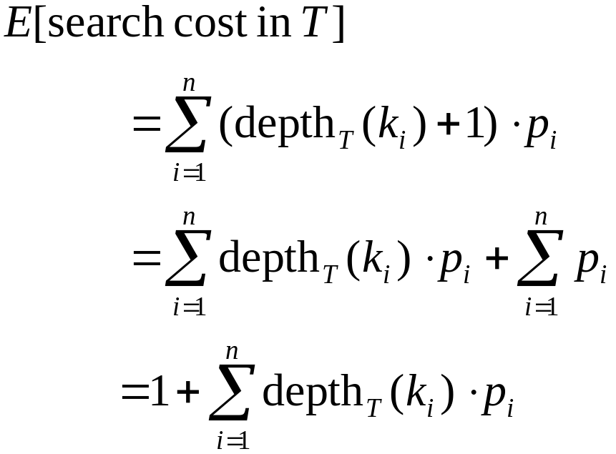
Expected Search Cost
Sum of probabilities is 1.

Slide 32
Example
Observations:
  Optimal BST may not have smallest height.
  Optimal BST may not have highest-probability key at root.
Build by exhaustive checking?
  Construct each n-node BST.
  For each, assign keys and compute expected search cost.
  But there are Ω(4^{n}/n^{3/2}) different BSTs with n nodes.

Slide 33
Optimal Substructure
Any subtree of a BST contains keys in a contiguous range k_{i}, ..., k_{j} for some 1 ≤ i ≤ j ≤ n.
If T is an optimal BST and T contains subtree T′ with keys k_{i}, ... ,k_{j} , then T′ must be an optimal BST for keys k_{i}, ..., k_{j}.
One of the keys in k_{i}, …,k_{j}, say k_{r}, where i ≤ r ≤ j, must be the root of an optimal subtree for these keys.
  Left subtree of k_{r} contains k_{i},...,k_{r−1}.
  Right subtree of k_{r} contains k_{r}+1, ...,k_{j}.
To find an optimal BST:
  Examine all candidate roots k_{r} , for i ≤ r ≤ j
  Determine all optimal BSTs containing k_{i},...,k_{r−1} and containing k_{r+1},...,k_{j}
k_{r}
T
T′
k_{i}
k_{r-1}
k_{r+1}
k_{j}

Slide 34
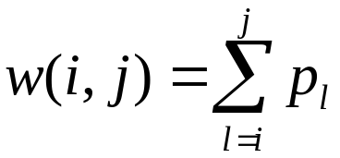
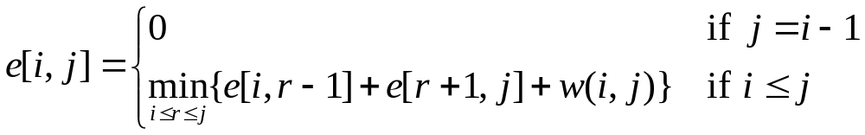
Recursive Solution
When the OPT subtree becomes a subtree of a node:
  Depth of every node in OPT subtree goes up by 1.
  Expected search cost increases by
If k_{r} is the root of an optimal BST for k_{i},..,k_{j} :
  e[i, j ] = p_{r} + (e[i, r−1] + w(i, r−1))+(e[r+1, j] + w(r+1, j))
  = e[i, r−1] + e[r+1, j] + w(i, j).
But, we don’t know k_{r}. Hence,
(because w(i, j)=w(i,r−1) + p_{r} + w(r + 1, j))

Slide 35
Computing an Optimal Solution
For each subproblem (i,j), store:
expected search cost in a table e[1 ..n+1 , 0 ..n]
  Will use only entries e[i, j ], where j ≥ i−1.
root[i, j ] = root of subtree with keys k_{i},..,k_{j}, for 1 ≤ i ≤ j ≤ n.
w[1..n+1, 0..n] = sum of probabilities
  w[i, i−1] = 0 for 1 ≤ i ≤ n.
  w[i, j ] = w[i, j-1] + p_{j} for 1 ≤ i ≤ j ≤ n.

Slide 36
Example
k | 1 | 2 | 3 | 4
key | 10 | 20 | 30 | 40
Feq. | 4 (p=4/15) | 2 | 6 | 3
i.e., C[1,2] = min {c[1,0]+c[2,2]+w,
c[1,1]+c[3,2]+w}
w = 4 + 2 = 6
K =1
K =2
1 =< i =< j+1 =< n
C[i,i] = P_{i}
C[i,i-1] = 0
C[i,j] = min {C[i,k-1] + C[k+1,j] + w(i,j)} for k =i to j
i \ j | 0 | 1 | 2 | 3 | 4
1 | 0 | 4 | 8¹
2 |  | 0 | 2
3 |  |  | 0 | 6
4 |  |  |  | 0 | 3
5 |  |  |  |  | 0

Slide 37
Example
i.e., C[1,4] = min {c[1,0]+c[2,4]+w,
c[1,1]+c[3,4]+w,
c[1,2]+c[4,4]+w,
c[1,3]+c[5,4]+w}
w = 4 + 2 + 6 + 3 = 15
K =1
k | 1 | 2 | 3 | 4
key | 10 | 20 | 30 | 40
Feq. | 4 (p=4/15) | 2 | 6 | 3
K =2
K =3
K =4
1 =< i =< j+1 =< n
C[i,i] = P_{i}
C[i,i-1] = 0
C[i,j] = min {C[i,k-1] + C[k+1,j] + w(i,j)} for k =i to j
i \ j | 0 | 1 | 2 | 3 | 4
1 | 0 | 4 | 8¹ | 20³ | 26³
2 |  | 0 | 2 | 10³ | 16³
3 |  |  | 0 | 6 | 12³
4 |  |  |  | 0 | 3
5 |  |  |  |  | 0
30
10
40
20

Slide 38
Pseudo-code
OPTIMAL-BST(p, q, n)
for i ← 1 to n + 1
do e[i, i− 1] ← 0
w[i, i− 1] ← 0
for l ← 1 to n
do for i ← 1 to n−l + 1
do j ←i + l−1
e[i, j ]←∞
w[i, j ] ← w[i, j−1] + p_{j}
for r ←i to j
do t ← e[i, r−1] + e[r + 1, j ] + w[i, j ]
if t < e[i, j ]
then e[i, j ] ← t
root[i, j ] ←r
return e and root
Consider all trees with l keys.
Fix the first key.
Fix the last key
Determine the root
of the optimal
(sub)tree
Time: O(n³)

Slide 39
Elements of Dynamic Programming
Optimal substructure
Overlapping subproblems

Slide 40
Optimal Substructure
Show that a solution to a problem consists of making a choice, which leaves one or more subproblems to solve.
Suppose that you are given this last choice that leads to an optimal solution.
Given this choice, determine which subproblems arise and how to characterize the resulting space of subproblems.
Show that the solutions to the subproblems used within the optimal solution must themselves be optimal. Usually use cut-and-paste.
Need to ensure that a wide enough range of choices and subproblems are considered.

Slide 41
Optimal Substructure
Optimal substructure varies across problem domains:
  1. How many subproblems are used in an optimal solution.
  2. How many choices in determining which subproblem(s) to use.
Informally, running time depends on (# of subproblems overall) × (# of choices).
How many subproblems and choices do the examples considered contain?
Dynamic programming uses optimal substructure bottom up.
  First find optimal solutions to subproblems.
  Then choose which to use in optimal solution to the problem.

