Slide 1
Program/Algorithms
Consists of
Which one depends on the input size N?
Instructions in sequence;
Condition;
Loop;
Loop;
Iteration
Recursion (Divide-and-Conquer):
  How to divide? linear, Binary, etc.

Slide 2
Algorithms Analysis
While Loop:
Alg.: Countdown (n)
while (n > 1) {
Printf(n);
n = n – 1;
}
Printf(n);
Θ(n)
Countdown (3) → 321
Recursion:
Alg.: Countdown (n)
if (n <= 1)
Printf(n);
else:
Printf(n);
Countdown(n-1);
?
T(n) = c + T(n-1), n > 1
= c , n = 1
Countdown (3) → 321

Slide 3
Methods for Solving Recurrences
Iteration or Substitution method
Recursion tree method
Master method

Slide 4
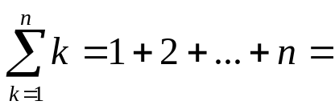
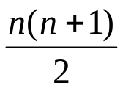
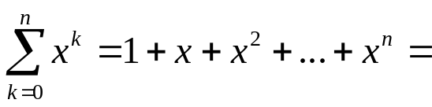
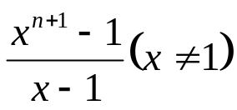
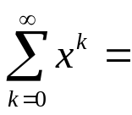
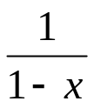
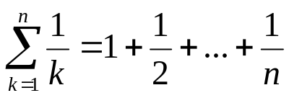

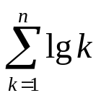

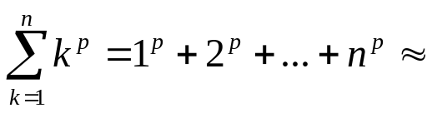
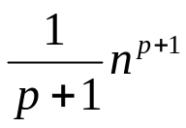
Common Summations
Arithmetic series:
Geometric series:
  Special case: |x| < 1:
Harmonic series:
Other important formulas:

Slide 5
Recurrences and Running Time
An equation or inequality that describes a function in terms of its value on smaller inputs.
T(n) = T(n-1) + c
Recurrences arise when an algorithm contains recursive calls to itself
What is the actual running time of the algorithm for n?
Need to solve the recurrence
  Find an explicit formula of the expression
  Bound the recurrence by an expression that involves n

Slide 6
Countdown Algorithm Analysis: Iteration Method (substitution)
T(n) = c + T(n-1), n > 1
= c , n = 1
T(n) = c + T(n-1)
= c + c + T(n-2)
= c + c + c + T(n-3)
n – k = 1
T(n) = c + c + … + c + T(1)
= (n-1)c + T(1) = (n-1)c +c = nc
= Θ(n)
T(n-1) = c + T(n-2)
T(n-2) = c + T(n-3)
n-1 times

Slide 7
Recurrent Algorithms: BINARY-SEARCH
for an ordered array A, finds if x is in the array A[lo…hi]
Alg.: BINARY-SEARCH (A, lo, hi, x)
if (lo > hi)
return FALSE
mid ← ⎣(lo+hi)/2⎦
if x = A[mid]
return TRUE
if ( x < A[mid] )
BINARY-SEARCH (A, lo, mid-1, x)
if ( x > A[mid] )
BINARY-SEARCH (A, mid+1, hi, x)

Slide 8
Recurrent Algorithms: BINARY-SEARCH
for an ordered array A, finds if x is in the array A[lo…hi]
Alg.: BINARY-SEARCH (A, lo, hi, x)
if (lo > hi)
return FALSE
mid ← ⎣(lo+hi)/2⎦
if x = A[mid]
return TRUE
if ( x < A[mid] )
BINARY-SEARCH (A, lo, mid-1, x)
if ( x > A[mid] )
BINARY-SEARCH (A, mid+1, hi, x)
1
2
3
4
5
6
7
8
2
3
5
7
9
10
11
12
mid
lo
hi

Slide 9
Example
A[8] = {1, 2, 3, 4, 5, 7, 9, 11}
  lo = 1 hi = 8 x = 7
1
2
3
4
5
6
7
8
1
2
3
4
5
7
9
11
mid = 4, lo = 5, hi = 8
5
6
7
8
1
2
3
4
5
7
9
11
mid = 6, A[mid] = x Found!

Slide 10
Another Example
A[8] = {1, 2, 3, 4, 5, 7, 9, 11}
  lo = 1 hi = 8 x = 6
1
2
3
4
5
6
7
8
1
2
3
4
5
7
9
11
mid = 4, lo = 5, hi = 8
low
high
1
2
3
4
5
7
9
11
mid = 6, A[6] = 7, lo = 5, hi = 5
low
high
1
2
3
4
5
7
9
11
mid = 5, A[5] = 5, lo = 6, hi = 5
NOT FOUND!
1
2
3
4
5
7
9
11
high
low

Slide 11
Analysis of BINARY-SEARCH
Alg.: BINARY-SEARCH (A, lo, hi, x)
if (lo > hi)
return FALSE
mid ← ⎣(lo+hi)/2⎦
if x = A[mid]
return TRUE
if ( x < A[mid] )
BINARY-SEARCH (A, lo, mid-1, x)
if ( x > A[mid] )
BINARY-SEARCH (A, mid+1, hi, x)
T(n) = c +
  T(n) – running time for an array of size n
constant time: c₁
constant time: c₂
constant time: c₃
same problem
of size n/2
same problem
of size n/2
T(n/2)

Slide 12
Binary search Algorithm Analysis: Iteration Method (substitution)
T(n) = c + T(n/2)
T(n) = c + T(n/2)
= c + c + T(n/4)
= c + c + c + T(n/8)
Assume n = 2^{k} → k = lgn
T(n) = c + c + … + c + T(1)
= clgn + T(1)
= Θ(lgn)
T(n/2) = c + T(n/4)
T(n/4) = c + T(n/8)
k times

Slide 13
Iteration Method (substitution)
T(n) = n + T(n-1), n > 1
= 1 , n = 1
T(n) = n + T(n-1)
= n + n-1 + T(n-2)
= n + n-1 + n-2 + T(n-3)
= n + n-1 + n-2 + … +n-k + T(n-(k+1))
T(n) = n + n-1 + n-2 + … +n-(n-2) + T(1)
= n + n-1 + n-2 + … + 2 + 1
= n(n + 1)/2
= Θ(n²)
T(n-1) = n-1 + T(n-2)
T(n-2) = n-2 + T(n-3)
n – k - 1 = 1 → k = n -2

Slide 14
Iteration Method (substitution)
T(n) = n + T(n/2)
T(n) = n + T(n/2)
= n + n/2 + T(n/4)
= n + n/2 + n/4 + T(n/8)
T(n) = n
= Θ(n)
T(n/2) = n/2 + T(n/4)
T(n/4) = n/4 + T(n/8)
T(n/2) ~ O(lgn)
n ~ O(n)
Which one dominates?
→ O(n)

Slide 15
Iteration Method (substitution)
T(n) = 1 + 2T(n/2)
T(n) = 1 + 2T(n/2)
= 1 + 2 + 4T(n/4)
= 1 + 2 + 4 + 8T(n/8)
… (n = 2^{k})
= 1 + 2 + 4 + … + 2^{k}
T(n) = ( (2^{k+1} - 1)/ (2-1)) = 2n
= Θ(n)
T(n/2) = 1 + 2T(n/4)
T(n/4) = 1 + 2T(n/8)

Slide 16
Recursion tree method
T(n) = c + 2T(n/2), n>1
= c , n =1
c
1c
T(n) = c + 2c +4c + .. + nc
= c(1 + 2 + 4 + … +n)
n =2^{K}
= c((2^{k+1} - 1)/ (2-1)) = c2n
c
c
2c
4c
c
c
c
c
= Θ(n)
8c
T(n/8)
T(1)
nc

Slide 17
Example Recurrences
T(n) = T(n-1) + n Θ(n²)
  Recursive algorithm that loops through the input to eliminate one item
T(n) = T(n/2) + c Θ(lgn)
  Recursive algorithm that halves the input in one step
T(n) = T(n/2) + n Θ(n)
  Recursive algorithm that halves the input but must examine every item in the input
T(n) = 2T(n/2) + 1 Θ(n)
  Recursive algorithm that splits the input into 2 halves and does a constant amount of other work

Slide 18
The Iteration Method
Convert the recurrence into a summation and try to bound it using known series
  Iterate the recurrence until the initial condition is reached.
  Use back-substitution to express the recurrence in terms of n and the initial (boundary) condition.

Slide 19
More Questions
T(n) = n² + 2T(n/2)
?
T(n) = n³ + 2T(n/2)
?

Slide 20
Divide and Conquer (Merge Sort)

Slide 21
Iteration Method – Example
T(n) = n + 2T(n/2)
T(n) = n + 2T(n/2)
= n + 2(n/2 + 2T(n/4))
= n + n + 4T(n/4)
= n + n + 4(n/4 + 2T(n/8))
= n + n + n + 8T(n/8)
… = in + 2^{i}T(n/2^{i})
= kn + 2^{k}T(1)
= nlgn + nT(1) = Θ(nlgn)
Assume: n = 2^{k}
T(n/2) = n/2 + 2T(n/4)

Slide 22
Divide and Conquer
Recursive in structure
  Divide the problem into sub-problems that are similar to the original but smaller in size
  Conquer the sub-problems by solving them recursively. If they are small enough, just solve them in a straightforward manner.
  Combine the solutions to create a solution to the original problem

Slide 23
An Example: Merge Sort
Sorting Problem: Sort a sequence of n elements into non-decreasing order.
Divide: Divide the n-element sequence to be sorted into two subsequences of n/2 elements each
Conquer: Sort the two subsequences recursively using merge sort.
Combine: Merge the two sorted subsequences to produce the sorted answer.

Slide 24
Merge Sort – Example
18
26
32
6
43
15
9
1
22
26
19
55
37
43
99
2
18
26
32
6
43
15
9
1
22
26
19
55
37
43
99
2
18
26
32
6
43
15
9
1
22
26
19
55
37
43
99
2
18
26
32
6
43
15
9
1
22
26
19
55
37
43
99
2
18
26
32
6
43
15
9
1
22
26
19
55
37
43
99
2

Slide 25
Merge Sort – Example
Original Sequence
Sorted Sequence
18
26
32
6
43
15
9
1
18
26
32
6
43
15
9
1
1
6
9
15
18
26
32
43
18
26
32
6
43
15
9
1
18
26
32
6
43
15
9
1
6
26
32
6
18
26
32
18
1
9
15
43
1
9
15
43
18
26
43
15
9
1
18
26
32
6
43
15
9
1
32
6
18
26
6
32
15
43
18
26
6
32
15
43
1
9
1
9
18
26
32
15
1
15
18
26
32
6
43
15
9
1
18
26
6
43
9
26
32
6
43
15
9
9
1
18
32
6
43
1
18
26
32
6
43
15
9
1
18
26
32
6
43
15
9
1

Slide 26
Merge-Sort (A, p, r)
INPUT: a sequence of n numbers stored in array A
OUTPUT: an ordered sequence of n numbers
MergeSort (A, p, r) // sort A[p..r] by divide & conquer
if p < r
then q ← ⎣(p+r)/2⎦
MergeSort (A, p, q)
MergeSort (A, q+1, r)
Merge (A, p, q, r) // merges A[p..q] with A[q+1..r]
Initial Call: MergeSort(A, 1, n)

Slide 27
Procedure Merge
Merge(A, p, q, r)
1 n₁ ← q – p + 1
2 n₂ ← r – q
for i ← 1 to n₁
do L[i] ← A[p + i – 1]
for j ← 1 to n₂
do R[j] ← A[q + j]
L[n₁+1] ← ∞
R[n₂+1] ← ∞
i ← 1
j ← 1
for k ←p to r
do if L[i] ≤ R[j]
then A[k] ← L[i]
i ← i + 1
else A[k] ← R[j]
j ← j + 1
Input: Array containing sorted subarrays A[p..q] and A[q+1..r].
Output: Merged sorted subarray in A[p..r].
Sentinels, to avoid having to
check if either subarray is
fully copied at each step.

Slide 28
Merge – Example
A
…
6
8
26
32
1
9
42
43
…
1
6
8
9
26
32
42
43
k
k
k
k
k
k
k
k
k
L
6
8
26
32
∞
R
6
8
26
32
1
9
42
43
∞
1
9
42
43
i
i
i
i
i
j
j
j
j
j

Slide 29
Correctness of Merge
Merge(A, p, q, r)
1 n₁ ← q – p + 1
2 n₂ ← r – q
for i ← 1 to n₁
do L[i] ← A[p + i – 1]
for j ← 1 to n₂
do R[j] ← A[q + j]
L[n₁+1] ← ∞
R[n₂+1] ← ∞
i ← 1
j ← 1
for k ←p to r
do if L[i] ≤ R[j]
then A[k] ← L[i]
i ← i + 1
else A[k] ← R[j]
j ← j + 1
Loop Invariant for the for loop
At the start of each iteration of the
for loop:
Subarray A[p..k – 1]
contains the k – p smallest elements
of L and R in sorted order.
L[i] and R[j] are the smallest elements of
L and R that have not been copied back into
A.
Initialization:
Before the first iteration:
A[p..k – 1] is empty.
i = j = 1.
L[1] and R[1] are the smallest
elements of L and R not copied to A.

Slide 30
Correctness of Merge
Merge(A, p, q, r)
1 n₁ ← q – p + 1
2 n₂ ← r – q
for i ← 1 to n₁
do L[i] ← A[p + i – 1]
for j ← 1 to n₂
do R[j] ← A[q + j]
L[n₁+1] ← ∞
R[n₂+1] ← ∞
i ← 1
j ← 1
for k ←p to r
do if L[i] ≤ R[j]
then A[k] ← L[i]
i ← i + 1
else A[k] ← R[j]
j ← j + 1
Maintenance:
Case 1: L[i] ≤ R[j]
By LI, A contains p – k smallest elements of L and R in sorted order.
By LI, L[i] and R[j] are the smallest elements of L and R not yet copied into A.
Line 13 results in A containing p – k + 1 smallest elements (again in sorted order).
Incrementing i and k reestablishes the LI for the next iteration.
Similarly for L[i] > R[j].
Termination:
On termination, k = r + 1.
By LI, A contains r – p + 1 smallest
elements of L and R in sorted order.
L and R together contain r – p + 3 elements.
All but the two sentinels have been copied
back into A.

Slide 31
Analysis of Merge Sort
Running time T(n) of Merge Sort:
Divide: computing the middle takes Θ(1)
Conquer: solving 2 subproblems takes 2T(n/2)
Combine: merging n elements takes Θ(n)
Total:
    T(n) = Θ(1) if n = 1
    T(n) = 2T(n/2) + Θ(n) if n > 1
  ⇒ T(n) = Θ(n lg n)

Slide 32
Recursion-tree Method
Making a good guess is sometimes difficult with the substitution method.
Use recursion trees to devise good guesses.
Recursion Trees
  Show successive expansions of recurrences using trees.
  Keep track of the time spent on the subproblems of a divide and conquer algorithm.
  Help organize the algebraic bookkeeping necessary to solve a recurrence.

Slide 33
Recursion Tree – Example
Running time of Merge Sort:
    T(n) = Θ(1) if n = 1
    T(n) = 2T(n/2) + Θ(n) if n > 1
Rewrite the recurrence as
    T(n) = c if n = 1
    T(n) = 2T(n/2) + cn if n > 1
    c > 0: Running time for the base case and time per array element for the divide and combine steps.

Slide 34
Recursion Tree for Merge Sort
For the original problem, we have a cost of cn, plus two subproblems each of size (n/2) and running time T(n/2).
Each of the size n/2 problems has a cost of cn/2 plus two subproblems, each costing T(n/4).
cn
cn
Cost of divide and merge.
cn/2
cn/2
T(n/2)
T(n/2)
T(n/4)
T(n/4)
T(n/4)
T(n/4)
Cost of sorting subproblems.

Slide 35
Recursion Tree for Merge Sort
Continue expanding until the problem size reduces to 1.
cn
cn
cn/2
cn/2
cn
lg n
cn/4
cn/4
cn/4
cn/4
cn
c
c
c
c
c
c
cn
n/2⁰ + n/2¹ ⁺ n/2² + …+ n/2^{k}
n= 2^{k} , k = log n, (k+1) = log n + 1
Total : cnlgn+cn

Slide 36
Recursion Tree for Merge Sort
Continue expanding until the problem size reduces to 1.
cn
Each level has total cost cn.
Each time we go down one level, the number of subproblems doubles, but the cost per subproblem halves ⇒ cost per level remains the same.
There are lg n + 1 levels, height is lg n. (Assuming n is a power of 2.)
  Can be proved by induction.
Total cost = sum of costs at each level = (lg n + 1)cn = cnlgn + cn = Θ(n lgn).
cn/2
cn/2
cn/4
cn/4
cn/4
cn/4
c
c
c
c
c
c

Slide 37
Other Examples
Use the recursion-tree method to determine a guess for the recurrences
  T(n) = 3T(⎣n/4⎦) + Θ(n²).
  T(n) = T(n/3) + T(2n/3) + O(n). ?

Slide 38
Recursion Trees – Caution Note
Recursion trees only generate guesses.
  Verify guesses using substitution method.
A small amount of “sloppiness” can be tolerated.
If careful when drawing out a recursion tree and summing the costs, can be used as direct proof.

Slide 39
The Master Method
Based on the Master theorem.
“Cookbook” approach for solving recurrences of the form
  T(n) = aT(n/b) + f(n)
    a ≥ 1, b > 1 are constants.
    f(n) is asymptotically positive.
    n/b may not be an integer, but we ignore floors and ceilings. Why?
Requires memorization of three cases (?)

Slide 40
The Master Theorem
Theorem 4.1
Let a ≥ 1 and b > 1 be constants, let f(n) be a function, and
Let T(n) be defined on nonnegative integers by the recurrence
T(n) = aT(n/b) + f(n), where we can replace n/b by ⎣n/b⎦ or ⎡n/b⎤.
T(n) can be bounded asymptotically in three cases:
If f(n) = O(n^{logba–ε}) for some constant ε > 0, then T(n) = Θ(n^{logba}).
If f(n) = Θ(n^{logba}), then T(n) = Θ(n^{logba}lg n).
If f(n) = Ω(n^{logba+ε}) for some constant ε > 0,
and if, for some constant c < 1 and all sufficiently large n,
we have a·f(n/b) ≤ c f(n), then T(n) = Θ(f(n)).
We’ll return to recurrences as we need them…
Comp 122

Slide 41
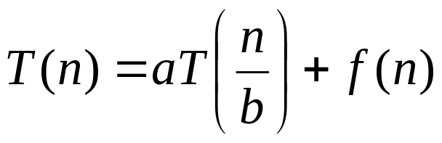
Master’s method
“Cookbook” for solving recurrences of the form:
where, a ≥ 1, b > 1, and f(n) > 0
Idea: compare f(n) with n^{log}_{b}ª
f(n) is asymptotically smaller or larger than n^{log}_{b}ª by a polynomial factor n^{ε}
f(n) is asymptotically equal with n^{log}_{b}ª

Slide 42
Master’s method
“Cookbook” for solving recurrences of the form:
where, a ≥ 1, b > 1, and f(n) > 0
Case 1: if f(n) = O(n^{log}_{b}^{a -ε}) for some ε > 0, then: T(n) = Θ(n^{log}_{b}ª)
Case 2: if f(n) = Θ(n^{log}_{b}ª), then: T(n) = Θ(n^{log}_{b}ª lgn)
Case 3: if f(n) = Ω(n^{log}_{b}^{a +ε}) for some ε > 0, and if
af(n/b) ≤ cf(n) for some c < 1 and all sufficiently large n, then:
T(n) = Θ(f(n))
regularity condition

Slide 43
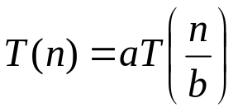
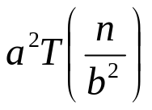
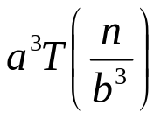
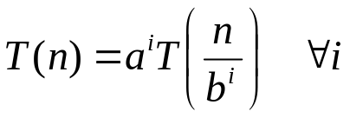
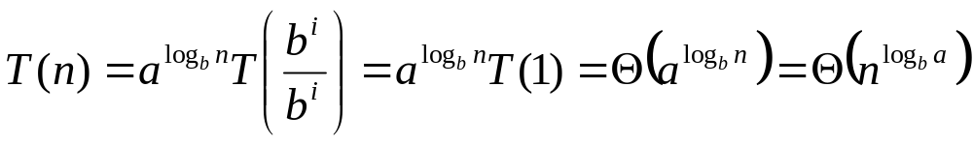
Why n^{log}_{b}ª?
Case 1:
  If f(n) is dominated by n^{log}_{b}ª:
    T(n) = Θ(n^{log}_{b}^{n})
Case 3:
  If f(n) dominates n^{log}_{b}ª:
    T(n) = Θ(f(n))
Case 2:
  If f(n) = Θ(n^{log}_{b}ª):
    T(n) = Θ(n^{log}_{b}ª logn)
Assume n = b^{k} ⇒ k = log_{b}n
At the end of iteration i = k:

Slide 44
Examples
T(n) = 2T(n/2) + n
a = 2, b = 2, log₂2 = 1
Compare n^{log}₂² with f(n) = n
⇒ f(n) = Θ(n) ⇒ Case 2
⇒ T(n) = Θ(nlgn)

Slide 45
Examples
T(n) = 2T(n/2) + n²
a = 2, b = 2, log₂2 = 1
Compare n with f(n) = n²
⇒ f(n) = Ω(n^{1+ε}) Case 3 ⇒ verify regularity cond.
a f(n/b) ≤ c f(n)
⇔ 2 n²/4 ≤ c n² ⇒ c = ½ is a solution (c<1)
⇒ T(n) = Θ(n²)

Slide 46

Examples (cont.)
T(n) = 2T(n/2) +
a = 2, b = 2, log₂2 = 1
Compare n with f(n) = n^{1/2}
⇒ f(n) = O(n^{1-ε}) Case 1
⇒ T(n) = Θ(n)

Slide 47
Examples
T(n) = 3T(n/4) + nlgn
a = 3, b = 4, log₄3 = 0.793
Compare n^{0.793} with f(n) = nlgn
f(n) = Ω(n^{log}₄^{3+ε}) Case 3
Check regularity condition:
3∗(n/4)lg(n/4) ≤ (3/4)nlgn = c ∗f(n), c=3/4
⇒T(n) = Θ(nlgn)

Slide 48
Examples
T(n) = 2T(n/2) + nlgn
a = 2, b = 2, log₂2 = 1
Compare n with f(n) = nlgn
  seems like case 3 should apply
f(n) must be polynomially larger by a factor of n^{ε}
In this case it is only larger by a factor of lgn

Slide 49
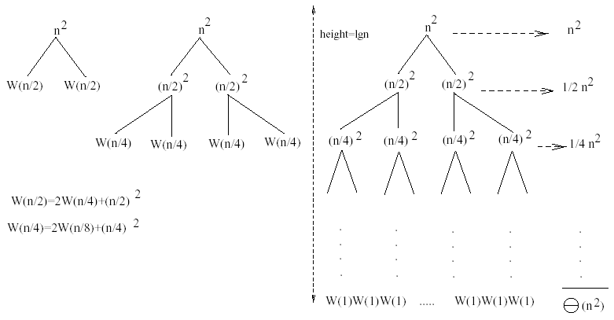
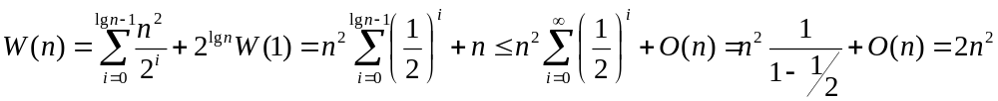
Examples
W(n) = 2W(n/2) + n²
Subproblem size at level i is: n/2^{i}
Subproblem size hits 1 when 1 = n/2^{i} ⇒ i = lgn
Cost of the problem at level i = (n/2^{i})² No. of nodes at level i = 2^{i}
Total cost:
⇒ W(n) = O(n²)

Slide 50
More Examples
T(n) = 3T(n/4) + n² ⇒T(n) = Θ(n²)
T(n) = 4T(n/2) + n² ⇒T(n) = Θ(n² lgn)
T(n) = T(n/2) + n² ⇒T(n) = Θ(n²)
T(n) = 2^{n} T(n/2) + n^{n} no Master Method
T(n) = 16T(n/4) + n ⇒T(n) = Θ(n² )
T(n) = 2T(n/2) + n lgn ⇒T(n) = Θ(n lgn )
T(n) = 2T(n/4) + n^{0.51} ⇒T(n) = Θ(n^{0.51})

