Slide 1

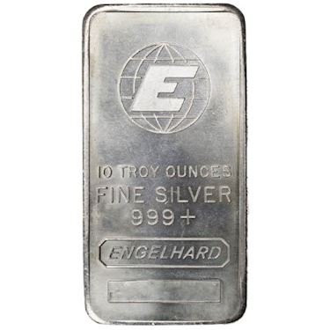
What is your choice?
A gold is $100 and a silver bar is $10. You can choose 3 from them.
What is your choices?

Slide 2
What is your choice?
You can choose 3 from them. What is your choices to make the maximum sum?
3 5 7 8 100 13 1 2 9

Slide 3
Overview
Like dynamic programming, used to solve optimization problems.
Problems exhibit optimal substructure (like DP).
Problems also exhibit the greedy-choice property.
  When we have a choice to make, make the one that looks best right now.
  Make a locally optimal choice in hope of getting a globally optimal solution.

Slide 4
Greedy Strategy
The choice that seems best at the moment is the one we go with.
  Prove that when there is a choice to make, one of the optimal choices is the greedy choice. Therefore, it’s always safe to make the greedy choice.
  Show that all but one of the subproblems resulting from the greedy choice are empty.

Slide 5
Example: Counting Money
Suppose you want to count out a certain amount of money, using the fewest possible bills and coins
A greedy algorithm to do this would be:
At each step, take the largest possible bill or coin that does not overshoot
  Example: To make $6.39, you can choose:
    a $5 bill
    a $1 bill, to make $6
    a 25¢ coin, to make $6.25
    A 10¢ coin, to make $6.35
    four 1¢ coins, to make $6.39
For US money, the greedy algorithm always gives the optimum solution
Notes:
3

Slide 6
Greedy Algorithm Failure
In some (fictional) monetary system, “krons” come in 1 kron, 7 kron, and 10 kron coins
Using a greedy algorithm to count out 15 krons, you would get
  A 10 kron piece
  Five 1 kron pieces, for a total of 15 krons
  This requires six coins
A better solution would be to use two 7 kron pieces and one 1 kron piece
  This only requires three coins
The greedy algorithm results in a solution, but not in an optimal solution
Notes:
4

Slide 7
A Scheduling Problem
You have to run nine jobs, with running times of 3, 5, 6, 10, 11, 14, 15, 18, and 20 minutes.
You have three processors on which you can run these jobs.
You decide to do the longest-running jobs first, on whatever processor is available.
P1
P2
P3
20
10
3
18
11
6
15
14
5
Time to completion: 18 + 11 + 6 = 35 minutes
This solution isn’t bad, but we might be able to do better
Notes:
5

Slide 8
Another Approach
What would be the result if you ran the shortest job first?
Again, the running times are 3, 5, 6, 10, 11, 14, 15, 18, and 20 minutes
P1
P2
P3
3
10
15
5
11
18
6
14
20
That wasn’t such a good idea; time to completion is now
6 + 14 + 20 = 40 minutes
Note, however, that the greedy algorithm itself is fast
  All we had to do at each stage was to pick the minimum or maximum
Notes:
6

Slide 9
An Optimum Solution
Better solutions do exist:
P1
P2
P3
20
14
18
11
5
15
10
6
3
This solution is clearly optimal (why?)
Clearly, there are other optimal solutions (why?)
How do we find such a solution?
  One way: Try all possible assignments of jobs to processors
  Unfortunately, this approach can take exponential time
Notes:
7

Slide 10


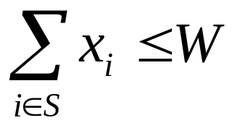
The Fractional Knapsack Problem
Given: A set S of n items, with each item i having
  b_{i} - a positive benefit
  w_{i} - a positive weight
Goal: Choose items with maximum total benefit but with weight at most W.
If we are allowed to take fractional amounts, then this is the fractional knapsack problem.
  In this case, we let x_{i} denote the amount we take of item i
  Objective: maximize
  Constraint:

Slide 11

Example
Items:
1
2
3
4
5
Weight:
4 ml
8 ml
2 ml
6 ml
1 ml
Benefit:
$12
$32
$40
$30
$50
“knapsack”
Value:
3
4
20
5
50
($ per ml)
Solution:
1 ml of 5
2 ml of 3
6 ml of 4
1 ml of 2
How many potential cases?
10 ml

Slide 12

The Fractional Knapsack Algorithm
Greedy choice: Keep taking item with highest value (benefit to weight ratio)
  Since
  Run time: O(n log n). Why?
Correctness: Suppose there is a better solution
  there is an item i with higher value than a chosen item j, but x_{i}<w_{i}, x_{j}>0 and v_{i}<v_{j}
  If we substitute some i with j, we get a better solution
  How much of i: min{w_{i}-x_{i}, x_{j}}
  Thus, there is no better solution than the greedy one
Algorithm fractionalKnapsack(S, W)
Input: set S of items w/ benefit b_{i} and weight w_{i}; max. weight W Output: amount x_{i} of each item i to maximize benefit w/ weight at most W
for each item i in S
  x_{i} ← 0
  v_{i} ← b_{i} / w_{i} {value per unit}
  w ← 0 {total weight}
  while w < W
  remove item i w/ highest v_{i}
  x_{i} ← min{w_{i} , W - w}
  w ← w + min{w_{i} , W - w}
The Greedy Method

Slide 13
Knapsack Problem
One wants to pack n items in a luggage
  The ith item is worth v_{i} dollars and weighs w_{i} pounds
  Maximize the value but cannot exceed W pounds
  v_{i} , w_{i}, W are integers
0-1 knapsack → each item is taken or not taken
Fractional knapsack → fractions of items can be taken
Both exhibit the optimal-substructure property
  0-1: If item j is removed from an optimal packing, the remaining packing is an optimal packing with weight at most W-w_{j}
  Fractional: If w pounds of item j is removed from an optimal packing, the remaining packing is an optimal packing with weight at most W-w that can be taken from other n-1 items plus w_{j} – w of item j

Slide 14
Greedy Algorithm for Fractional Knapsack problem
Fractional knapsack can be solvable by the greedy strategy
  Compute the value per pound v_{i}/w_{i} for each item
  Obeying a greedy strategy, take as much as possible of the item with the greatest value per pound.
  If the supply of that item is exhausted and there is still more room, take as much as possible of the item with the next value per pound, and so forth until there is no more room
  O(n lg n) (we need to sort the items by value per pound)

Slide 15
O-1 knapsack is harder!
0-1 knapsack cannot be solved by the greedy strategy
  Unable to fill the knapsack to capacity, and the empty space lowers the effective value per pound of the packing
  We must compare the solution to the sub-problem in which the item is included with the solution to the sub-problem in which the item is excluded before we can make the choice → Dynamic Programming

Slide 16
Job sequencing with Deadlines
N = 7,
1 unit per step
Jobs | J1 | J2 | J3 | J4 | J5 | J6 | J7
Profits | 35 | 30 | 25 | 20 | 15 | 12 | 5
deadlines | 3 | 4 | 4 | 2 | 3 | 1 | 2
Assign the biggest profit job as late as possible.
1 | 2 | 3 | 4
J4 | J3 | J1 | J2
35 + 30 + 25 + 20 = 110
1) Sort all jobs in decreasing order of profit.
2) Initialize the result sequence as first job in sorted jobs.
3) Do following for remaining n-1 jobs → If the current job can fit in the current result sequence without missing the deadline, add current job to the result. Else ignore the current job.
Notes:
8

Slide 17
Huffman encoding
Data compression
The Huffman encoding algorithm is a greedy algorithm
Given the percentage the each character appears in a corpus, determine a variable-bit pattern for each char.
You always pick the two smallest percentages to combine.
EX: to send the following characters, how many bits are necessary?
eaabbccdeceaabbccdece n = 20
Using ASCII code 8 bits for each, 160 bits
Not all 256 characters are here.
A couple of way of optimize the data.
  Fixed encoding
  Huffman encoding
Notes:
8

Slide 18
Fixed encoding
eaabbccdeceaabbccdece n = 20
a, b, c, d, e are the (5) characters in this data.
Needs 3 bits
Data 20 * 3 = 60
Table size 5 * 8 (ASCII) + 3 * 5 = 55
Total size is 115 bits which is less than 160 bits
8 bits | 3 bits
a | 000
b | 001
c | 010
d | 011
e | 100
Notes:
8

Slide 19
Huffman encoding
Using variable codes
Idea: encoding less bits for the frequent data.
Sort by frequency and build a min-heap (greedy algorithm)
Data 6 + 12 + 8 + 8 + 12 = 46
Table size 5 * 8 (ASCII) + 12= 52
Total size is 98 bits which is less than others
eaabbccdeceaabbccdece →11 001 001 10 10 01 01…..
(20)
d | 000 | 2 | 6
a | 001 | 4 | 12
b | 10 | 4 | 8
e | 11 | 4 | 8
c | 01 | 6 | 12
5 * 8 | 12 |  | 46
0
1
(12)
0
1
(6)
(8)
0
1
0
1
d (2)
a (4)
c (6)
b (4)
e (4)
Notes:
8

Slide 20
Huffman encoding
Data compression
The Huffman encoding algorithm is a greedy algorithm
Given the percentage the each character appears in a corpus, determine a variable-bit pattern for each char.
You always pick the two smallest percentages to combine.
100%
54%
27%
46%
15%
22% 12% 24% 6% 27% 9%
A B C D E F
Notes:
8

Slide 21
Huffman Encoding
100%
100%
54%
0
1
A=00
B=100
C=01
D=1010
E=11
F=1011
54%
27%
46%
0
1
27%
E
46%
15%
A
C
B
15%
A B C D E F
D
F
Average bits/char:
0.22*2 + 0.12*3 + 0.24*2 + 0.06*4 + 0.27*2 + 0.09*4 = 2.42
The solution found doing this is an optimal solution.
The resulting binary tree is a full tree.

Slide 22
Analysis
A greedy algorithm typically makes (approximately) n choices for a problem of size n
  (The first or last choice may be forced)
Hence the expected running time is:
O(n * O(choice(n))), where choice(n) is making a choice among n objects
  Counting: Must find largest useable coin from among k sizes of coin (k is a constant), an O(k)=O(1) operation;
    Therefore, coin counting is (n)
  Huffman: Must sort n values before making n choices
    Therefore, Huffman is O(n log n) + O(n) = O(n log n)
Notes:
11

Slide 23
Minimum Spanning Trees

Slide 24
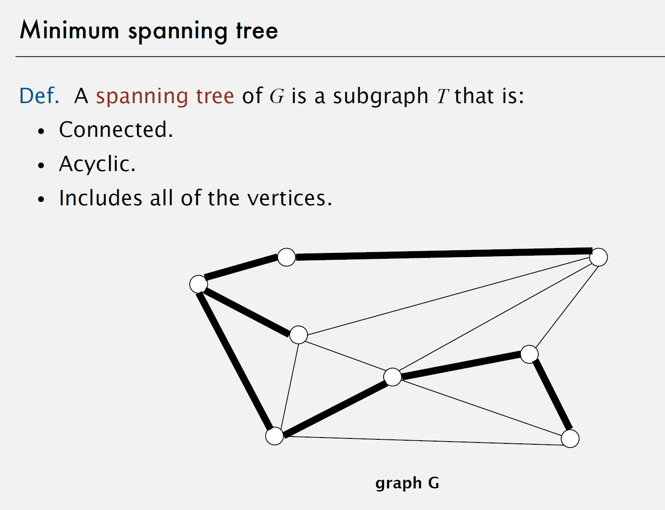
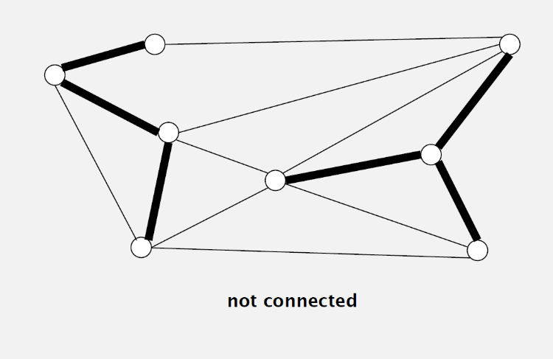
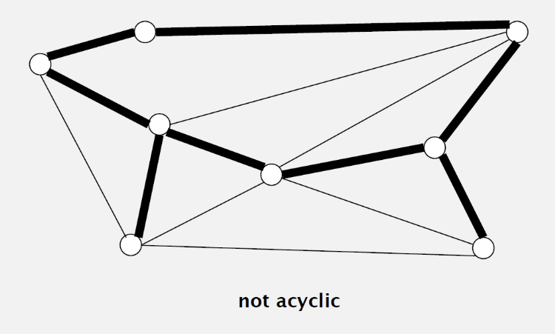
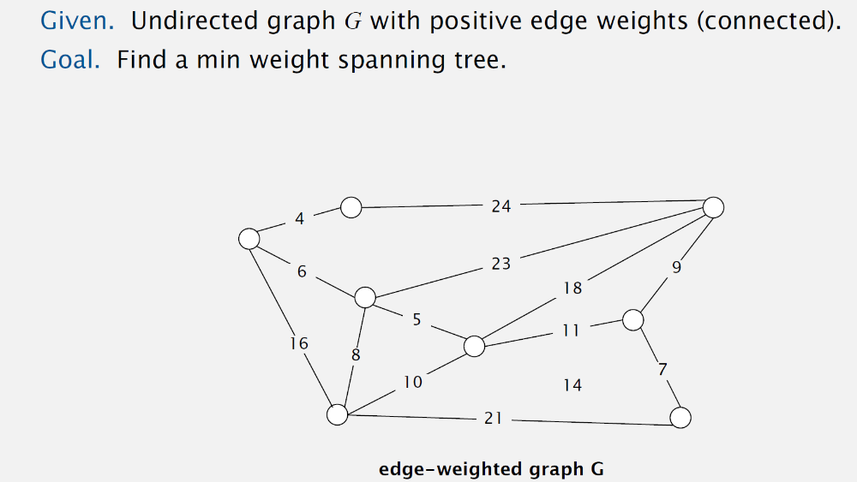
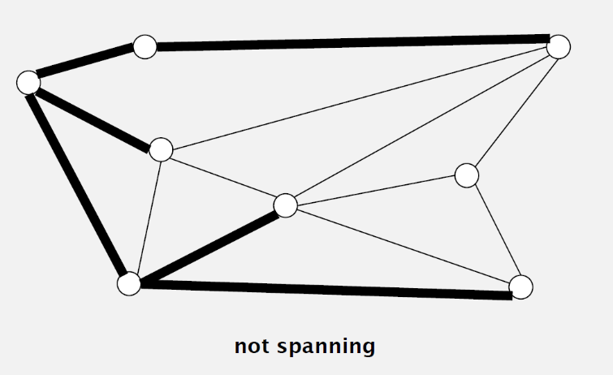

Slide 25
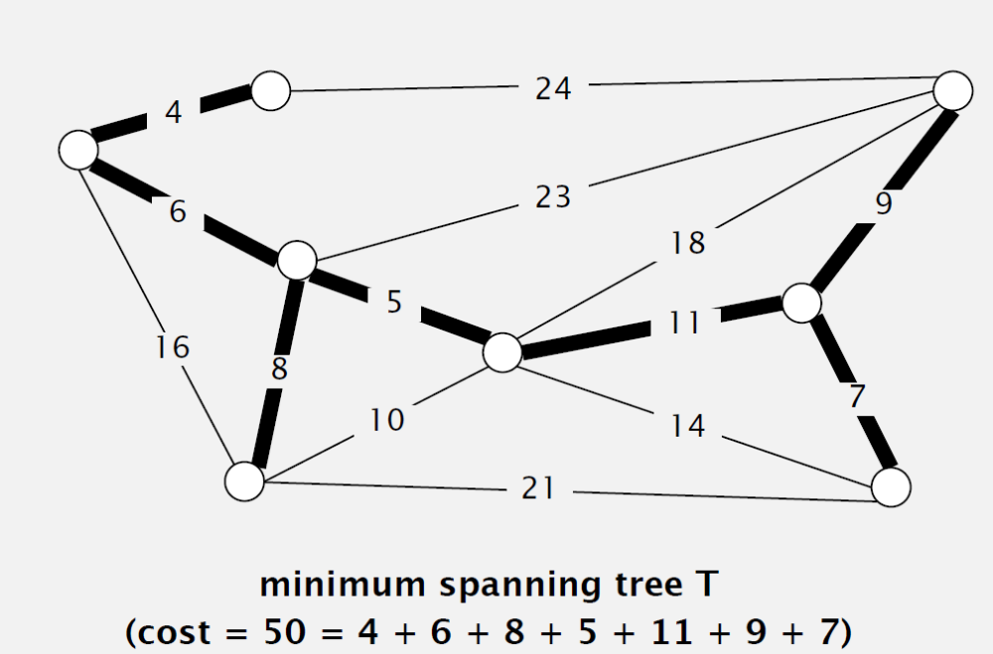
|V| = 8
|E| = |V| - 1 =7
Brute Force:
Try all spanning trees?

Slide 26
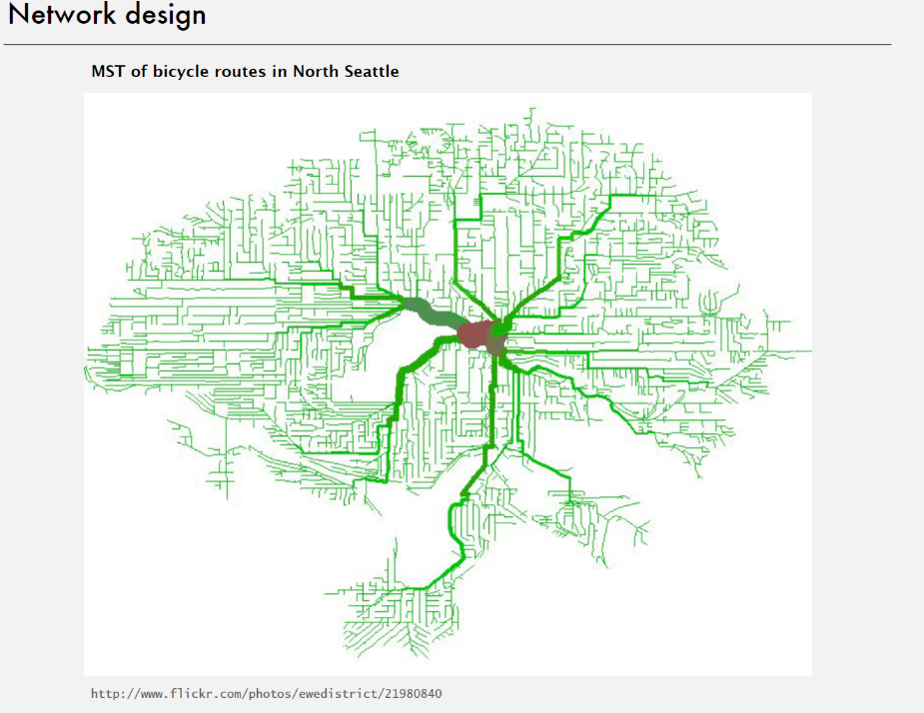
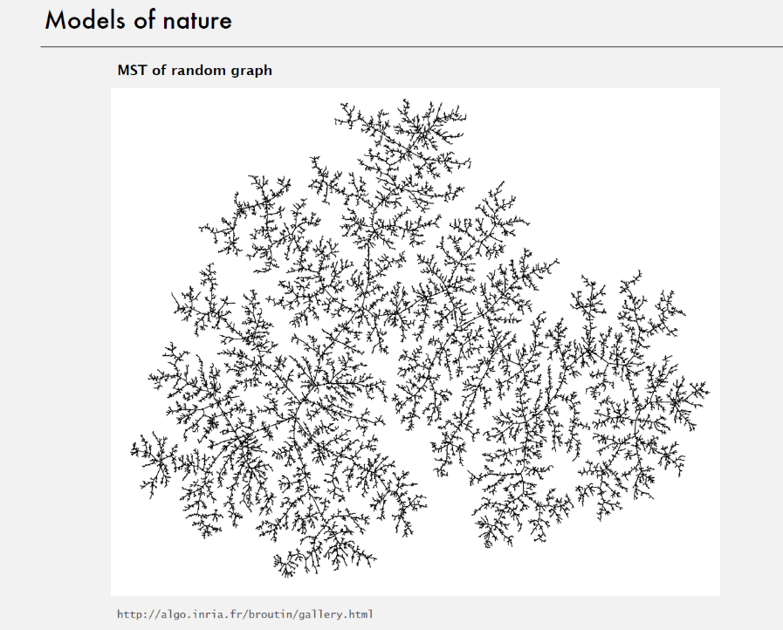

Slide 27
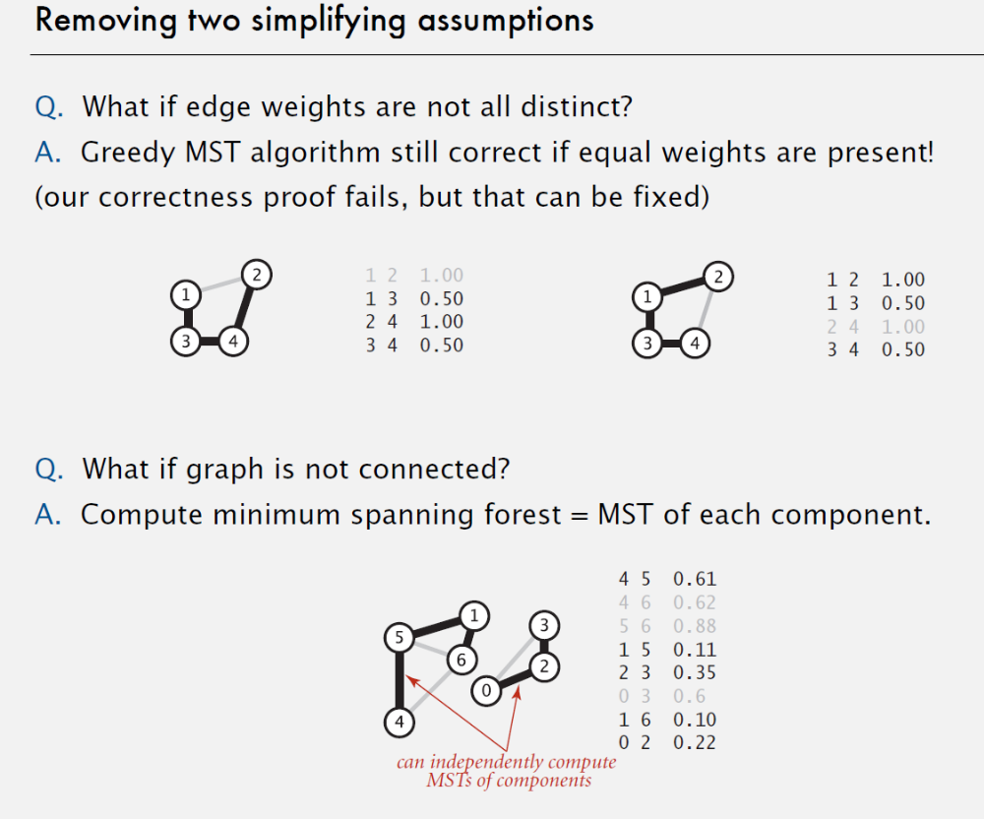

Slide 28
Minimum Connector Algorithms
Kruskal’s algorithm
Select the shortest edge in a network
Select the next shortest edge which does not create a cycle
Repeat step 2 until all vertices have been connected
Prim’s algorithm
Select any vertex
Select the shortest edge connected to that vertex
Select the shortest edge connected to any vertex already connected
Repeat step 3 until all vertices have been connected

Slide 29
Minimum Spanning Trees
Given: Connected, undirected, weighted graph, G
Find: Minimum - weight spanning tree, T
Example:
b
7
c
5
Acyclic subset of edges(E) that connects
all vertices of G.
a
1
-3
3
11
d
e
f
0
2
b
c
5
a
1
3
-3
d
e
f
0

Slide 30
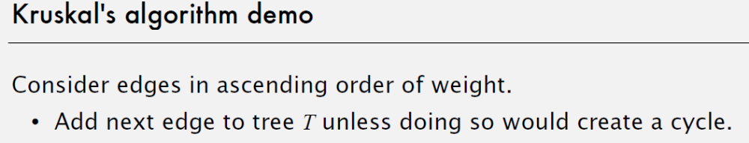
Kruskal’s Algorithm
Starts with each vertex in its own component.
Repeatedly merges two components into one by choosing a light edge that connects them (i.e., a light edge crossing the cut between them).
Scans the set of edges in monotonically increasing order by weight.
Uses a disjoint-set data structure to determine whether an edge connects vertices in different components.

Slide 31
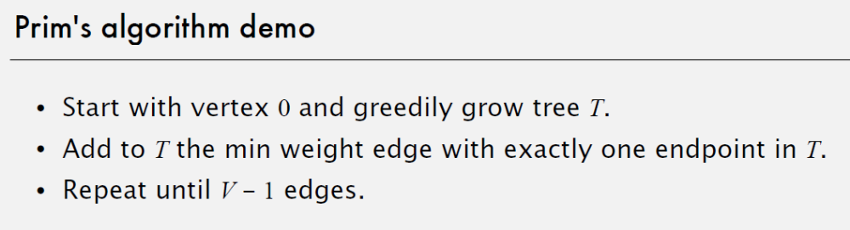
Prim’s Algorithm
Builds one tree, so A is always a tree.
Starts from an arbitrary “root” r .
At each step, adds a light edge crossing cut (V_{A}, V - V_{A}) to A.
  V_{A} = vertices that A is incident on.

Slide 32
Prim’s Algorithm
Uses a priority queue Q to find a light edge quickly.
Each object in Q is a vertex in V - V_{A}.
Key of v is minimum weight of any edge (u, v), where u ∈ V_{A}.
Then the vertex returned by Extract-Min is v such that there exists u ∈ V_{A} and (u, v) is light edge crossing (V_{A}, V - V_{A}).
Key of v is ∞ if v is not adjacent to any vertex in V_{A}.

Slide 33
Prim’s Algorithm
Q := V[G];
for each u ∈ Q do
key[u] := ∞
od;
key[r] := 0;
π[r] := NIL;
while Q ≠ ∅ do
u := Extract - Min(Q);
for each v ∈ Adj[u] do
if v ∈ Q ∧ w(u, v) < key[v] then
π[v] := u;
key[v] := w(u, v)
fi
od
od
Complexity:
Using binary heaps: O(E lg V).
Initialization – O(V).
Building initial queue – O(V).
V Extract-Min’s – O(V lgV).
E Decrease-Key’s – O(E lg V).
Using Fibonacci heaps: O(E + V lg V).
(see book)
⇦ decrease-key operation
Note: A = {(v, π[v]) : v ∈ v - {r} - Q}.

Slide 34
A cable company want to connect five villages to their network which currently extends to the market town of Avonford. What is the minimum length of cable needed?
Example
Brinleigh
5
Cornwell
3
4
8
6
8
Avonford
Fingley
Donster
7
5
4
2
Edan

Slide 35
We model the situation as a network, then the problem is to find the minimum connector for the network
B
5
C
3
4
8
6
8
A
F
D
7
5
4
2
E

Slide 36
Kruskal’s Algorithm
List the edges in order of size:
ED 2
AB 3
AE 4
CD 4
BC 5
EF 5
CF 6
AF 7
BF 8
CF 8
B
5
C
3
4
8
6
8
A
D
7
F
5
4
2
E

Slide 37
Kruskal’s Algorithm
Select the shortest
edge in the network
ED 2
B
5
C
3
4
8
6
8
A
D
7
F
5
4
2
E

Slide 38
Kruskal’s Algorithm
Select the next shortest
edge which does not
create a cycle
ED 2
AB 3
B
5
C
3
4
8
6
8
A
D
7
F
5
4
2
E

Slide 39
Kruskal’s Algorithm
Select the next shortest
edge which does not
create a cycle
ED 2
AB 3
CD 4 (or AE 4)
B
5
C
3
4
8
6
8
A
D
7
F
5
4
2
E

Slide 40
Kruskal’s Algorithm
Select the next shortest
edge which does not
create a cycle
ED 2
AB 3
CD 4
AE 4
B
5
C
3
4
8
6
8
A
D
7
F
5
4
2
E

Slide 41
Kruskal’s Algorithm
Select the next shortest
edge which does not
create a cycle
ED 2
AB 3
CD 4
AE 4
BC 5 – forms a cycle
EF 5
B
5
C
3
4
8
6
8
A
D
7
F
5
4
2
E

Slide 42
Kruskal’s Algorithm
All vertices have been
connected.
The solution is
ED 2
AB 3
CD 4
AE 4
EF 5
Total weight of tree: 18
B
5
C
3
4
8
6
8
A
D
7
F
5
4
2
E

Slide 43
Prim’s Algorithm
Select any vertex
A
Select the shortest edge connected to that vertex
AB 3
B
5
C
3
4
8
6
8
A
D
7
F
5
4
2
E

Slide 44
Prim’s Algorithm
Select the shortest
edge connected to
any vertex already
connected.
AE 4
B
5
C
3
4
8
6
8
A
D
7
F
5
4
2
E

Slide 45
Prim’s Algorithm
Select the shortest
edge connected to
any vertex already
connected.
ED 2
B
5
C
3
4
8
6
8
A
D
7
F
5
4
2
E

Slide 46
Prim’s Algorithm
Select the shortest
edge connected to
any vertex already
connected.
DC 4
B
5
C
3
4
8
6
8
A
D
7
F
5
4
2
E

Slide 47
Prim’s Algorithm
Select the shortest
edge connected to
any vertex already
connected.
EF 5
B
5
C
3
4
8
6
8
A
D
7
F
5
4
2
E

Slide 48
Prim’s Algorithm
All vertices have been
connected.
The solution is
AB 3
AE 4
ED 2
DC 4
EF 5
Total weight of tree: 18
B
5
C
3
4
8
6
8
A
D
7
F
5
4
2
E

