Slide 1
Graph Theory Part 2

Slide 2

Shortest Path
Generalize distance to weighted setting
Digraph G = (V,E) with weight function W: E → R (assigning real values to edges)
Weight of path p = v₁ → v₂ → … → v_{k} is
Shortest path = a path of the minimum weight
Applications
  static/dynamic network routing
  robot motion planning
  map/route generation in traffic

Slide 3
Shortest-Path Problems
Shortest-Path problems
  Single-source (single-destination). Find a shortest path from a given source (vertex s) to each of the vertices. The topic of this lecture.
  Single-pair. Given two vertices, find a shortest path between them. Solution to single-source problem solves this problem efficiently, too.
  All-pairs. Find shortest-paths for every pair of vertices. Dynamic programming algorithm.
  Unweighted shortest-paths – BFS.

Slide 4

Optimal Substructure
Theorem: subpaths of shortest paths are shortest paths
Proof (”cut and paste”)
  if some subpath were not the shortest path, one could substitute the shorter subpath and create a shorter total path
  If B is less than A, the shortest path should be X + B + Y
  If X + A + Y is the shortest path, A should be less than B
X
A
Y
B

Slide 5
Negative Weights and Cycles?
Negative edges are OK, as long as there are no negative weight cycles (otherwise paths with arbitrary small “lengths” would be possible)
Shortest-paths can have no cycles (otherwise we could improve them by removing cycles)
  Any shortest-path in graph G can be no longer than n – 1 edges, where n is the number of vertices

Slide 6
Relaxation
Relaxation: if a shorter subpath is found replace it with the existing path!
For each vertex v in the graph, we maintain d[v], the estimate of the shortest path from u, initialized to ∞ at the start
Relaxing an edge (u,v) means testing whether we can improve the shortest path to v found so far by going through u
If(d[u] + c(u,v) < d[v]) d[v] = d[u] + c(u,v)
0
∞
0
5
6
6
u
v
u
v
Relax
Relax
0
6
0
5
6
6
u
v
u
v

Slide 7
Relaxation Example
Relaxation with BFS:
If(d[u] + c(u,v) < d[v]) d[v] = d[u] + c(u,v)
(1,2), (1,4), (2,3), (3,4)
c(1,2) = 6, d[1] = 0, d[2] = ∞
d[2] = 6
c(1,4) = 5, d[1] = 0, d[4] = ∞
d[4] = 5
c(2,3) = 1, d[2] = 6, d[3] = ∞
d[3] = 7
c(3,4) = 3, d[3] = 7, d[4] = 5
d[4] = 5
6
7
6
1
1
2
3
∞
∞
3
5
5
∞
4

Slide 8
Relaxation Example
Relaxation:
If(d[u] + c(u,v) < d[v]) d[v] = d[u] + c(u,v)
(1,2), (2,3), (3,4), (1,4)
c(1,2) = 6, d[1] = 0, d[2] = ∞
d[2] = 6
c(2,3) = 1, d[2] = 6, d[3] = ∞
d[3] = 7
c(3,4) = 3, d[3] = 7, d[4] = ∞
d[4] = 10
c(1,4) = 5, d[1] = 0, d[4] = 10
d[4] = 5
6
7
∞
∞
6
1
1
2
3
3
5
10
5
∞
4

Slide 9
Dijkstra's Algorithm
Non-negative edge weights
Greedy, similar to Prim's algorithm for MST
Like breadth-first search (if all weights = 1, one can simply use BFS)
Use Q, a priority queue ADT keyed by v.d() (BFS used FIFO queue, here we use a PQ, which is re-organized whenever some d decreases)
Basic idea
  maintain a set S of solved vertices
  at each step select "closest" vertex u, add it to S, and relax all edges from u

Slide 10
Dijkstra's Algorithm
8
13
a
b
f
5
3
2
2
6
2
2
c
d
h
3
6
5
1
1
e
g

Slide 11
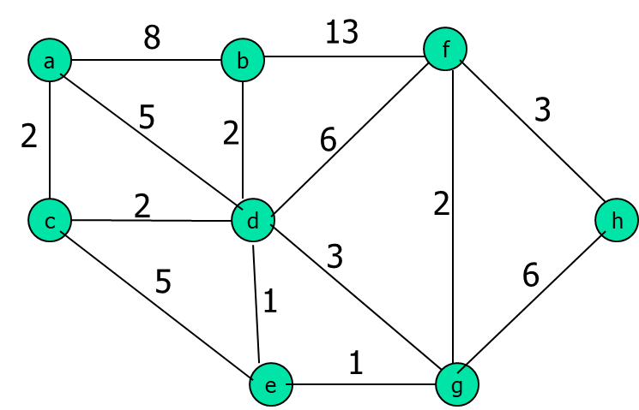
Dijkstra's Algorithm
 | a | b | c | d | e | f | g | h
a

Slide 12
Dijkstra's Algorithm
 | a | b | c | d | e | f | g | h
a | 0/a | 8/a | 2/a | 5/a | x | x | x | x
c |  |  | 2/a | 4/c | 7/c | x | x | x
d |  | 6/d |  | 4/c | 5/d | 10/d | 7/d | x
e |  |  |  |  | 5/d | 10/d | 6/e | x
b |  | 6/d |  |  |  | 10/d | 6/e | x
g |  |  |  |  |  | 8/g | 6/e | 12/g
f |  |  |  |  |  | 8/g |  | 11/f

Slide 13
Dijkstra's Algorithm
A→C→D→E→G→F→H
2 + 2 + 1 + 1 +2 + 3 = 11
 | a | b | c | d | e | f | g | h
a | 0/a | 8/a | 2/a | 5/a | x | x | x | x
c |  | 8/a | 2/a | 4/c | 7/c | x | x | x
d |  | 6/d |  | 4/c | 5/d | 10/d | 7/d | x
e |  | 6/d |  |  | 5/d | 10/d | 6/e | x
b |  | 6/d |  |  |  | 10/d | 6/e | x
g |  |  |  |  |  | 8/g | 6/e | 12/g
f |  |  |  |  |  | 8/g |  | 11/f
 |  |  |  |  |  |  |  | 11/f

Slide 14
Dijkstra's Algorithm
 | a | b | c | d | e | f
a
f
3
3
4
d
e
2
3
2
1
1
b
c
1
2
a

Slide 15
Dijkstra's Algorithm
 | a | b | c | d | e | f
a | 0/a | 1/a | 2/a | x | x | x
b |  | 1/a | 2/a | 4/b | 3/b | x
c |  |  | 2/a | 3/c | 3/b | x
e |  |  |  | 3/c | 3/b | 6/e
d |  |  |  | 3/c |  | 6/e
f |  |  |  |  |  | 6/e
f
3
3
4
d
e
2
3
2
1
1
b
c
1
2
a

Slide 16
Dijkstra’s ALgorithm
Solution to Single-source (single-destination).
Input: Graph G, start vertex s
Dijkstra(G,s)
01 for each vertex u ∈ G.V()
02 u.setd(∞)
03 u.setparent(NIL)
04 s.setd(0)
05 S ← ∅ // Set S is used to explain the algorithm
06 Q.init(G.V()) // Q is a priority queue ADT
07 while not Q.isEmpty()
08 u ← Q.extractMin()
09 S ← S ∪ {u}
10 for each v ∈ u.adjacent() do
11 Relax(u, v, G)
12 Q.modifyKey(v)
relaxing edges

Slide 17
Dijkstra’s Example
u
v
1
10
∞
∞
Dijkstra(G,s)
01 for each vertex u ∈ G.V()
02 u.setd(∞)
03 u.setparent(NIL)
04 s.setd(0)
05 S ← ∅
06 Q.init(G.V())
07 while not Q.isEmpty()
08 u ← Q.extractMin()
09 S ← S ∪ {u}
10 for each v ∈ u.adjacent() do
11 Relax(u, v, G)
12 Q.modifyKey(v)
9
s
0
2
3
4
6
7
5
∞
∞
2
x
y
u
v
1
10
10
∞
9
s
0
2
3
4
6
7
5
5
∞
2
x
y

Slide 18
Dijkstra’s Example
u
v
1
10
8
14
Dijkstra(G,s)
01 for each vertex u ∈ G.V()
02 u.setd(∞)
03 u.setparent(NIL)
04 s.setd(0)
05 S ← ∅
06 Q.init(G.V())
07 while not Q.isEmpty()
08 u ← Q.extractMin()
09 S ← S ∪ {u}
10 for each v ∈ u.adjacent() do
11 Relax(u, v, G)
12 Q.modifyKey(v)
9
s
0
2
3
4
6
7
5
5
7
2
x
y
u
v
1
10
8
13
9
s
0
2
3
4
6
7
5
5
7
2
x
y

Slide 19
Dijkstra’s Example
u
v
1
10
8
9
Dijkstra(G,s)
01 for each vertex u ∈ G.V()
02 u.setd(∞)
03 u.setparent(NIL)
04 s.setd(0)
05 S ← ∅
06 Q.init(G.V())
07 while not Q.isEmpty()
08 u ← Q.extractMin()
09 S ← S ∪ {u}
10 for each v ∈ u.adjacent() do
11 Relax(u, v, G)
12 Q.modifyKey(v)
9
0
2
3
4
6
7
5
5
7
2
x
y
u
v
1
10
8
9
9
0
2
3
4
6
7
5
5
7
2
x
y

Slide 20
Dijkstra’s Algorithm
O(n²) operations
  (n-1) iterations: 1 for each vertex added to the distinguished set S.
  (n-1) iterations: for each adjacent vertex of the one added to the distinguished set.
Note: it is single source – single destination algorithm

Slide 21
Prim MST vs. Dijkstra's SP Algorithm
Minimum spanning tree from a (root)
d
2
2
b
c
2
3
Shortest Path from a to d
a
 | a | b | c | d
a | 0/a | 2/a | 3/a | x
b |  | 2/a | 3/a | x
c |  |  | 3/a | 5/c

Slide 22
Dijkstra's SP Algorithm
3
a
b
5
-3
Shortest Path
c
d
 | a | b | c | d
a | 0/a | 3/a | 5/a | x
b |  | 3/a | 5/a | x
c |  |  | 5/a | 7/c
d |  |  |  | 7/c
2

Slide 23
Dijkstra's SP Algorithm
3
a
b
Dijkstra’s SP may work or may not work for the negative edges.
Due to the nature of greedy algorithm.
5
-10
c
d
2
Shortest Path
 | a | b | c | d
a | 0 | 3/a | 5/a | x
b |  | 3/a | 5/a | x
c |  |  | 5/a | 7/c
d |  | -3/d |  | 7/c
The shortest path is already selected.
But there is a shorter path!!

Slide 24
Bellman-Ford Algorithm for Single Source Shortest Paths
More general than Dijkstra’s algorithm:
    Edge-weights can be negative
Detects the existence of negative-weight cycle(s) reachable from s.

Slide 25
Bellman-Ford Algorithm for Single Source Shortest Paths
Relaxation:
If(d[u] + c(u,v) < d[v]) d[v] = d[u] + c(u,v)
c(u,v) = 6
d[u] = 0
d[v] = ∞
u
v
6
-1
1
2
5
5
3
-2
1
5
3
7
-2
3
-1
4
6

Slide 26
Bellman-Ford Algorithm for Single Source Shortest Paths
6
-1
1
2
5
5
3
-2
1
5
3
7
-2
3
-1
4
6

Slide 27
Bellman-Ford Algorithm for Single Source Shortest Paths
BELMAN-FORD( G, s )
INIT( G, s )
for i ←1 to |V|-1 do
for each edge (u, v) ∈ E do
RELAX( u, v )
for each edge ( u, v ) ∈ E do
if d[v] > d[u]+w(u,v) then
return FALSE > neg-weight cycle
return TRUE

Slide 28
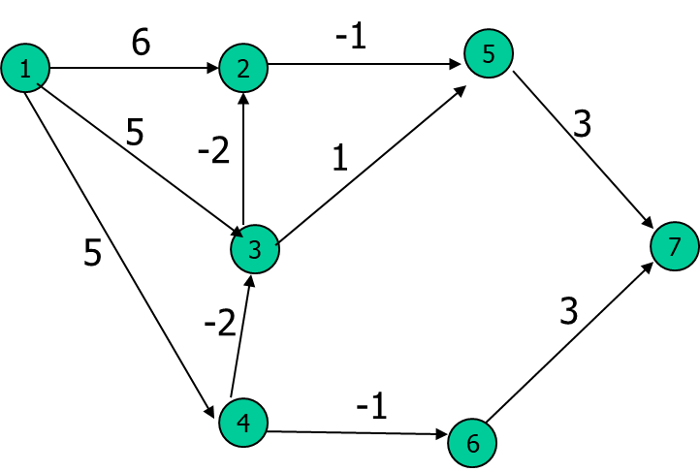
Bellman-Ford Algorithm for Single Source Shortest Paths
(1,2) | (1,3) | (1,4) | (2,5) | (3,2) | (3,5) | (4,3) | (4,6) | (5,7) | (6,7)
 | 2 | 3 | 4 | 5 | 6 | 7
 | 6 | 5 | 5 | 5 | 4 | 8
 | 3 | 3 |  | 5 |  | 7
 | 1 | 3 |  | 2 | 4 | 5
 | 1 | 3 | 5 | 0 | 4 | 3
for each edge (u, v) ∈ E do RELAX( u, v )
if (d[u] + c(u,v) < d[v]) d[v] = d[u] + c(u,v)
1 ~ n-1

Slide 29
Bellman-Ford Algorithm for Single Source Shortest Paths
(1,2) | (1,3) | (1,4) | (2,5) | (3,2) | (3,5) | (4,3) | (4,6) | (5,7) | (6,7)
 | 2 | 3 | 4 | 5 | 6 | 7
 | 6 | 5 | 5 | 5 | 4 | 8
 | 3 | 3 |  | 5 |  | 7
 | 1 | 3 | 5 | 2 | 4 | 5
 | 1 | 3 | 5 | 0 |  | 3
for each edge (u, v) ∈ E do RELAX( u, v )
if (d[u] + c(u,v) < d[v]) d[v] = d[u] + c(u,v)
1 ~ n-1

Slide 30
Bellman-Ford Algorithm for Single Source Shortest Paths
(1,2) | (1,3) | (1,4) | (2,5) | (3,2) | (3,5) | (4,3) | (4,6) | (5,7) | (6,7)
 | 2 | 3 | 4 | 5 | 6 | 7
1st | 6 | 5 | 5 | 5 | 4 | 8
 | 3 | 3 |  |  |  | 7
2nd | 1 |  |  | 2 |  | 5
3rd |  |  |  | 0 |  | 3
1 ~ n-1

Slide 31
Bellman-Ford Algorithm for Single Source Shortest Paths
(1,2) | (1,4) | (4,3) | (3,2)
4
1
2
 | 2 | 3 | 4
 | 4 | 8 | 5
 | -2
-10
5
3
3
4

Slide 32
Bellman-Ford Algorithm for Single Source Shortest Paths
(1,2) | (1,4) | (4,3) | (3,2) | (2,4)
 | 2 | 3 | 4
 | 4 | 8 | 5
 | -2 |  | 3
 | -4 | 6
 | -6 | 4 | 1
 |  |  | -1
4
1
2
5
-10
5
3
3
4
There is a negative cycle! → BF failed.
e(4,3) + e(3,2) + e(2,4) = -2

Slide 33
Bellman-Ford Algorithm for Single Source Shortest Paths
There is a negative cycle! → BF failed.
2
1
2
e(1,4) + e(4,3) + e(3,2) + e(2,1) = -1
-10
4
3
3
4

Slide 34
Bellman-Ford Algorithm for Single Source Shortest Paths
Observe:
First nested for-loop performs |V|-1 relaxation passes; relax every edge at each pass
Last for-loop checks the existence of a negative-weight cycle reachable from s

Slide 35
Bellman-Ford Algorithm for Single Source Shortest Paths
Running time = O(VxE) = O(n²)
Constants are good; it’s simple, short code(very practical)
If it is a complete graph, |E| = n(n-1)/2.
n(n-1)/2 * (n-1) = O(n³)
Example: Run algorithm on a sample graph with no negative weight cycles.

Slide 36
Bellman-Ford Algorithm
Example
t
5
x
-2
6
∞
∞
-3
s
0
8
-4
7
2
7
∞
∞
9
y
z

Slide 37
Bellman-Ford Algorithm
Example
t
5
x
6
-2
∞
6
-3
s
0
8
-4
7
2
7
7
∞
9
y
z

Slide 38
Bellman-Ford Algorithm
Example
t
5
x
-2
6
6
4
-3
s
0
8
-4
7
2
7
7
2
9
y
z

Slide 39
Bellman-Ford Algorithm
Example
t
5
x
-2
6
2
4
-3
s
0
8
-4
7
2
7
7
2
9
y
z

Slide 40
Bellman-Ford Algorithm
Example
t
5
x
-2
6
2
4
-3
s
0
8
-4
7
2
7
7
−2
9
y
z

Slide 41
Bellman-Ford Algorithm for Single Source Shortest Paths
Converges in just 2 relaxation passes
Values you get on each pass & how early converges depend on edge process order
d value of a vertex may be updated more than once in a pass

