Slide 1
Problem Solution Methods
How to travel from KC to NYC?
  By walk, bike, scooter, car, taxi, bus, train, airplane, rocket, missile, ship, etc.
  No constraint to arrive alive ☺
  Change it to deliver something …
How to travel from KC to NYC in 24 hours (← a new constraint)?
  Some methods (walk and bike) are not feasible.
  There are several feasible solutions such as airplane, car, missile, etc.
Among the feasible solutions, which one takes the shortest time (a minimum cost solution)?
  Only one optimal solution.
If a sales man travels, which one route results the maximum benefits?
Optimization Problem !!

Slide 2
Problem Solution Methods
How to solve the Optimization Problems?
  Dynamic Programming
    exhibiting the properties of overlapping subproblems and optimal substructure that takes much less time than naïve methods.
  Greedy Method
    making the locally optimal choice at each stage with the intent of finding a global optimum.
Starts with Dynamic Programming
  Choosing an optimal solution from all the feasible solutions.
  Try all feasible solutions.

Slide 3
Dynamic Programming
Dynamic Programming is an algorithm design technique for optimization problems: often minimizing or maximizing.
Like divide and conquer, DP solves problems by combining solutions to sub-problems.
  Partition the problem into independent subproblems
  Solve the subproblems recursively
  Combine the solutions to solve the original problem
Unlike divide and conquer, sub-problems are not independent.
  Sub-problems may share sub-sub-problems (reusable)
  Applicable when subproblems are not independent, E.g.: Fibonacci Numbers
A divide and conquer approach would repeatedly solve the common subproblems
Dynamic programming solves every subproblem just once and stores the answer in a table

Slide 4
Dynamic Programming (DP)
Originally used in the 1940s by Richard Bellman
To describe the process of solving problems where one needs to find the best decisions one after another.
General and powerful algorithm design technique.
  DP is a “careful brute force”
  DP is subprograms and “reuse”
Why it is named as a Dynamic Programming?
  Programming is a French version of optimization.
  No particular connection to computer programming.
  Bellman named it for “Hiding he is doing math research…”

Slide 5
Dynamic Programming (DP)
Why it is named as a Dynamic Programming?
  The term Dynamic Programming comes from Control Theory, not computer science. Programming refers to the use of tables (arrays) to construct a solution. Programming is a French version of optimization. No particular connection to computer programming.
  Originally used in the 1940s by Richard Bellman to describe the process of solving problems where one needs to find the best decisions one after another. Bellman named it for “Hiding he is doing math research…”
In dynamic programming we usually reduce time by increasing the amount of space
We solve the problem by solving sub-problems of increasing size and saving each optimal solution in a table (usually).
The table is then used for finding the optimal solution to larger problems.
Time is saved since each sub-problem is solved only once.

Slide 6
Fibonacci Numbers
Computing the n^{th} Fibonacci number recursively:
  F(n) = F(n-1) + F(n-2)
  F(0) = 0
  F(1) = 1
  Top-down approach
int Fib(int n)
{
if (n <= 1)
return 1;
else
return Fib(n - 1) + Fib(n - 2);
}
  F(n)
  F(n-1) + F(n-2)
  F(n-2) + F(n-3) F(n-3) + F(n-4)

Slide 7
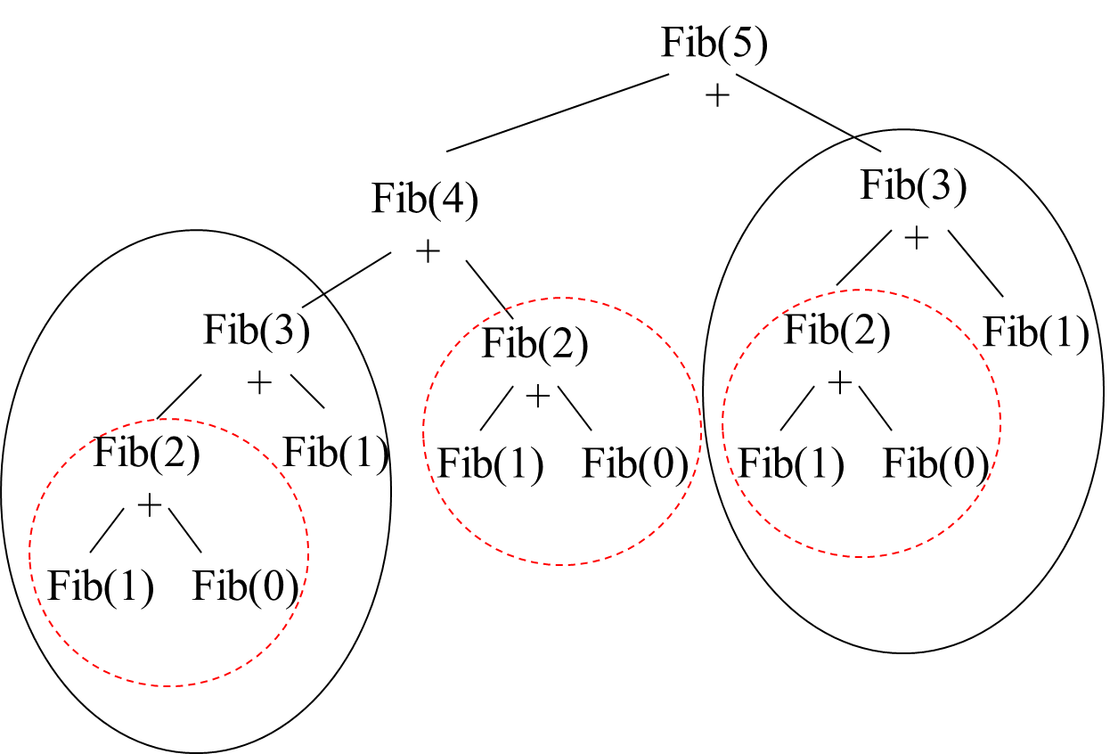
Fibonacci Numbers
Why is the top-down so inefficient?
  Recomputes many sub-problems. How many times is F(3) computed?

Slide 8
Fibonacci Numbers
// Fibonacci Series using Recursion
int fib(int n)
{
if (n <= 1)
return n;
return fib(n - 1) + fib(n - 2);
}
int main()
{
int n = 6;
printf("%d", fib(n));
return 0;
}

Slide 9
Fibonacci Numbers
int term[1000];
// Fibonacci Series using memoized Recursion
int fib(int n)
{
// base case
if (n <= 1)
return n;
if (term[n] != 0)
return term[n];
else {
term[n] = fib(n - 1) + fib(n - 2);
return term[n];
}
}
int main()
{
int n = 6;
printf("%d", fib(n));
return 0;
}

Slide 10
Naïve Recursive Algorithm
What is the Recurrence relationship?
  T(n) = T(n-1) + T(n-2) + 1 >= 2T(n-2) + 1
  2T(n-1) + 1 >= T(n) = T(n-1) + T(n-2) + 1 >= 2T(n-2) + 1
  O(2^{n}) and Ω(2^{n/2}) ← linear master method
  it is O(2^{n}) → Exponential
Obviously not very good, but we know that there is a better way to solve it!

Slide 11
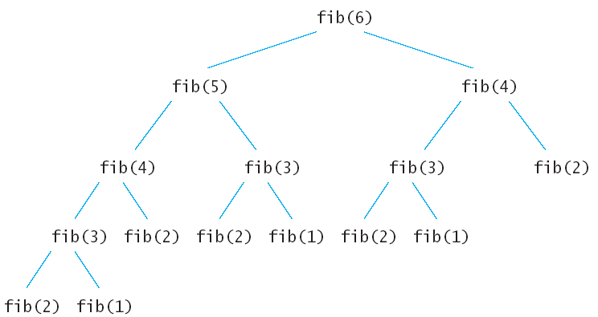
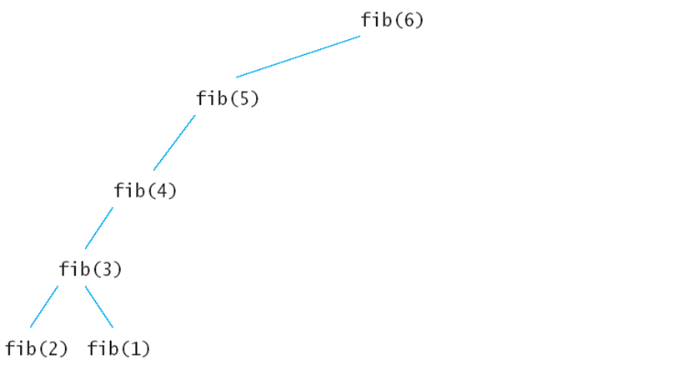
Memoize → Tabulation
(bottom-up)
void fib () {
fibresult[0] = 1;
fibresult[1] = 1;
for (int i = 2; i<n; i++)
fibresult[i] = fibresult[i-1] + fibresult[i-2];
}
Don’t recalculate but reuse!
Remove the recurrences.
Efficiency:
  Time – O(n)
  Space – O(n)
1
1
2
3
5
8
0 1 2 3 4 5

Slide 12
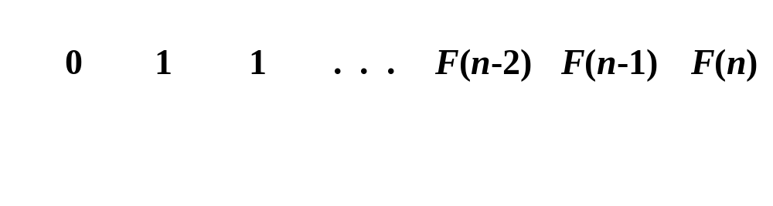
Bottom-up approach
  Computing the n^{th} Fibonacci number using a bottom-up approach:
  F(0) = 0
  F(1) = 1
  F(2) = 1+0 = 1
  …
  F(n-2) =
  F(n-1) =
  F(n) = F(n-1) + F(n-2)
Efficiency:
  Time – O(n)
  Space – O(n)

Slide 13
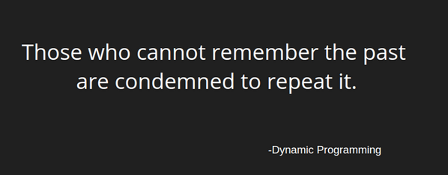
Dynamic Programming
What is that equal to ? "1+1+1+1+1+1+1+1 =“
What about that? “1+ 1+1+1+1+1+1+1+1 =“
How did you calculate it? DP.
Some famous Dynamic Programming algorithms are:
  Unix diff for comparing two files
  Bellman-Ford for shortest path routing in networks
  TeX the ancestor of LaTeX
  WASP - Winning and Score Predictor

Slide 14
Dynamic Programming Algorithm
Characterize the structure of an optimal solution
Recursively define the value of an optimal solution
Compute the value of an optimal solution in a bottom-up fashion
Construct an optimal solution from computed information (not always necessary)

Slide 15
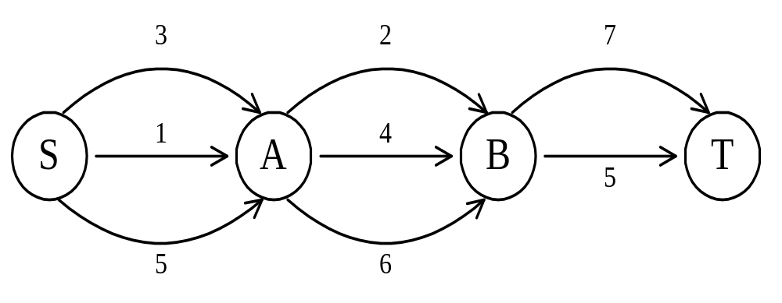
The shortest path
To find a shortest path in a multi-stage graph
Apply the greedy method :
the shortest path from S to T :
1 + 2 + 5 = 8

Slide 16
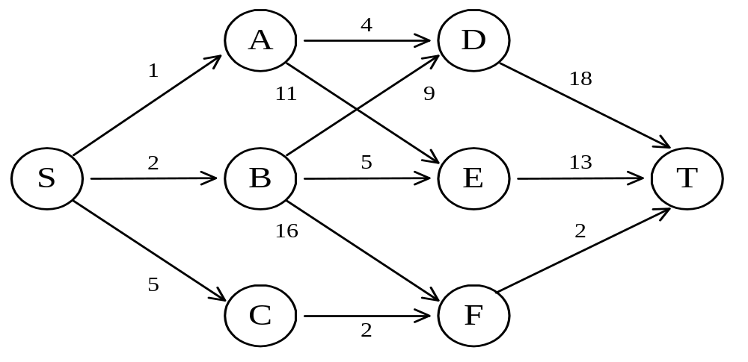
The shortest path in multistage graphs
The greedy method can not be applied to this case: (S, A, D, T) 1+4+18 = 23.
The real shortest path is: (S, C, F, T) 5+2+2 = 9.
S | A | B | C | D | E | F | T
Cost
Dst

Slide 17
The shortest path in multistage graphs
The greedy method can not be applied to this case: (S, A, D, T) 1+4+18 = 23.
The real shortest path is: (S, C, F, T) 5+2+2 = 9.
S | A | B | C | D | E | F | T
9 | 22 | 18 | 4 | 18 | 13 | 2 | 0
C | D | E/F | F | T | T | T | T

Slide 18
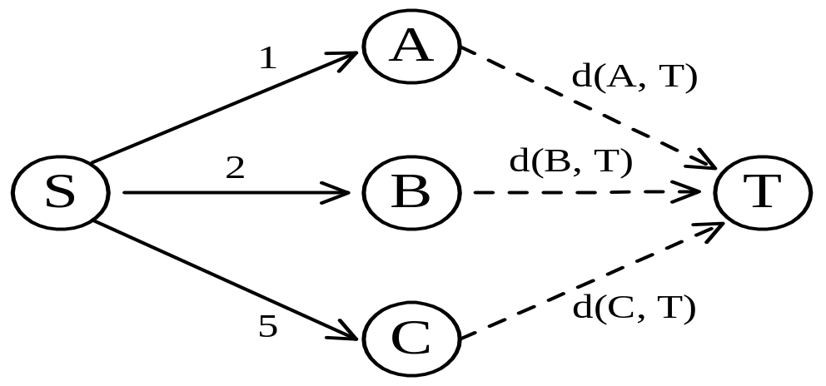
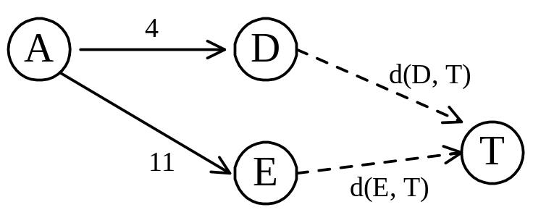
Dynamic programming approach
Dynamic programming approach (forward approach):
d(S, T) = min{1+d(A, T), 2+d(B, T), 5+d(C, T)}
d(A,T) = min{4+d(D,T), 11+d(E,T)}
= min{4+18, 11+13} = 22.

Slide 19
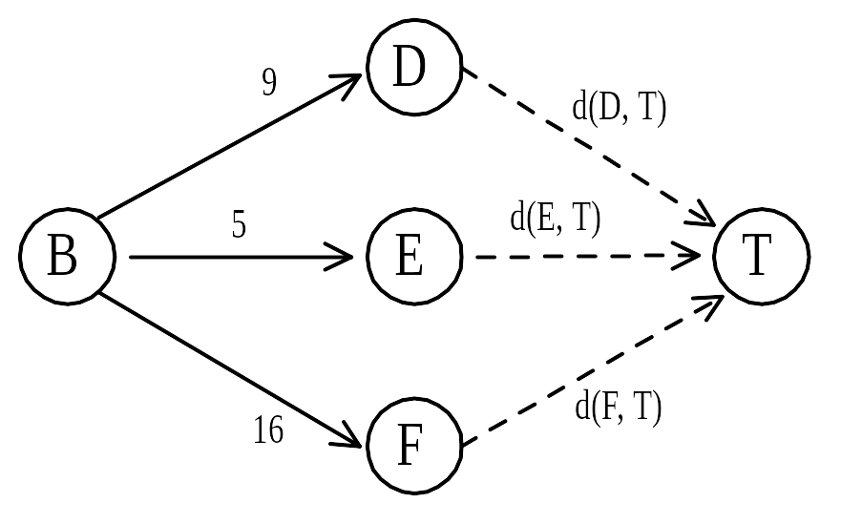
Dynamic programming
d(B, T) = min{9+d(D, T), 5+d(E, T), 16+d(F, T)}
= min{9+18, 5+13, 16+2} = 18.
d(C, T) = min{2+d(F, T)} = 2+2 = 4
d(S, T) = min{1+d(A, T), 2+d(B, T), 5+d(C, T)}
= min{1+22, 2+18, 5+4} = 9.
The above way of reasoning is called
backward reasoning.

Slide 20
Backward approach (forward reasoning)
d(S, A) = 1
d(S, B) = 2
d(S, C) = 5
d(S,D)=min{d(S, A)+d(A, D),d(S, B)+d(B, D)}
= min{ 1+4, 2+9 } = 5
d(S,E)=min{d(S, A)+d(A, E),d(S, B)+d(B, E)}
= min{ 1+11, 2+5 } = 7
d(S,F)=min{d(S, A)+d(A, F),d(S, B)+d(B, F)}
= min{ 2+16, 5+2 } = 7
d(S,T) = min{d(S, D)+d(D, T),d(S,E)+
d(E,T), d(S, F)+d(F, T)}
= min{ 5+18, 7+13, 7+2 } = 9

Slide 21
The shortest path in multistage graphs
Stage v1 v2 v3 v4 v5
2
4
2
6
6
9
1
4
9
5
3
2
4
1
7
7
2
7
3
10
12
3
4
11
5
2
5
8
6
11
5
11
8
Cost(i, j) = min {C(j,t) + Cost(i+1,t)} i:stage, j: vertex #, t ϵ V_{i+1}, (j,t) ϵ Edge
 | 1 | 2 | 3 | 4 | 5 | 6 | 7 | 8 | 9 | 10 | 11 | 12
cost | 16 | 7 | 9 | 18 | 15 | 7 | 5 | 7 | 4 | 2 | 5 | 0
v | 2/3 | 7 | 6 | 8 | 8 | 10 | 10 | 10 | 12 | 12 | 12 | 12

Slide 22
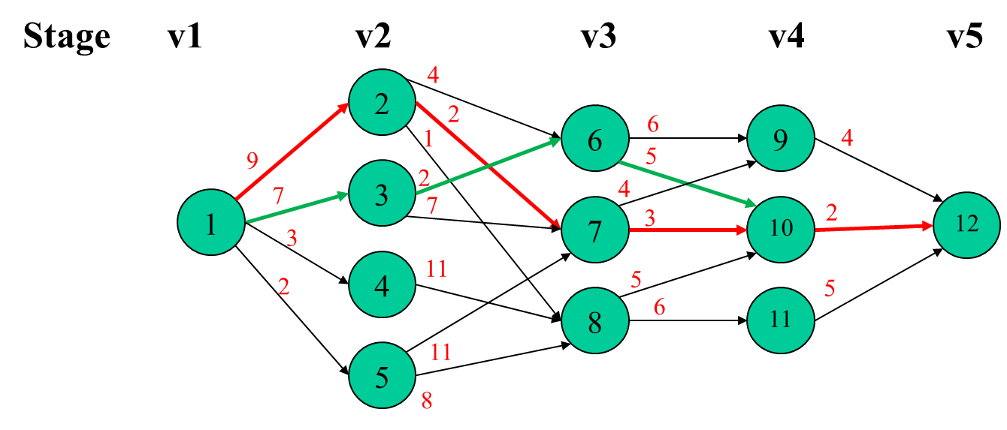
The shortest path in multistage graphs
cost(5,12) = 0,
cost(4,9) = 4,
cost(4,10) = 2,
cost(4,11) =5,
cost(3,6) = min{6 + cost(4,9), 5 + cost(4,10)} = 7,
cost(3,7) = min{4 + cost(4,9), 3 + cost(4,10)} = 5,
cost(3,8) = min{5 + cost(4,10), 6 + cost(4,11)} = 7,
cost(2,2) = min{4 + cost(3,6), 2 + cost(3,7), 1 + cost(3,8)} = 7,
cost(2,3) = min{ 2 + cost(3,6), 7 + cost(3,7)} = 9,
cost(2,4) = min{11 + cost(3,8)} = 18,
cost(2,5) = min{11 + cost(3,7), 8 + cost(3,8)} = 15,
cost(1,1) = min{9 + cost(2,2), 7 + cost(2,3), 3 + cost(2,4), 2 + cost(2,5)} = 16
Cost(i, j) = min {C(j,t) + Cost(i+1,t)} i:stage, j: vertex # , t ϵ Vi+1, (j,t) ϵ Edge
 | 1 | 2 | 3 | 4 | 5 | 6 | 7 | 8 | 9 | 10 | 11 | 12
cost | 16 | 7 | 9 | 18 | 15 | 7 | 5 | 7 | 4 | 2 | 5 | 0
v | 2/3 | 7 | 6 | 8 | 8 | 10 | 10 | 10 | 12 | 12 | 12 | 12

Slide 23
Principle of optimality
Principle of optimality: Suppose that in solving a problem, we have to make a sequence of decisions D₁, D₂, …, D_{n}. If this sequence is optimal, then the last k decisions, 1 < k < n must be optimal.
e.g. the shortest path problem
If i, i₁, i₂, …, j is a shortest path from i to j, then i₁, i₂, …, j must be a shortest path from i₁ to j
In summary, if a problem can be described by a multistage graph, then it can be solved by dynamic programming. ← memo the optimal of each sub path and skip other path

Slide 24
Dynamic programming
Forward approach and backward approach:
  Note that if the recurrence relations are formulated using the forward approach then the relations are solved backwards. i.e., beginning with the last decision
  On the other hand if the relations are formulated using the backward approach, they are solved forwards.
To solve a problem by using dynamic programming:
  Find out the recurrence relations.
  Represent the problem by a multistage graph.

Slide 25
Matrix-Chain Multiplication
Problem: given a sequence ⟨A₁, A₂, …, A_{n}⟩, compute the product:
A₁ ⋅ A₂ ⋅⋅⋅ A_{n}
Matrix compatibility:
C = A ⋅ B C=A₁ ⋅ A₂ ⋅⋅⋅ A_{i} ⋅ A_{i+1} ⋅⋅⋅ A_{n}
col_{A} = row_{B} col_{i} = row_{i+1}
row_{C} = row_{A} row_{C} = row_{A1}
col_{C} = col_{B} col_{C} = col_{An}

Slide 26
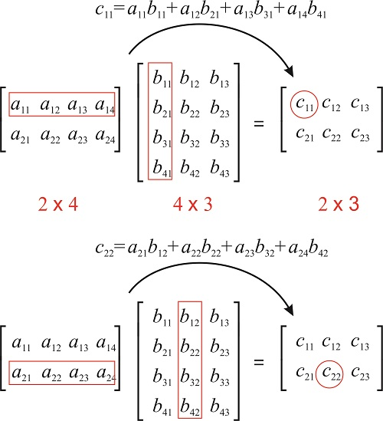
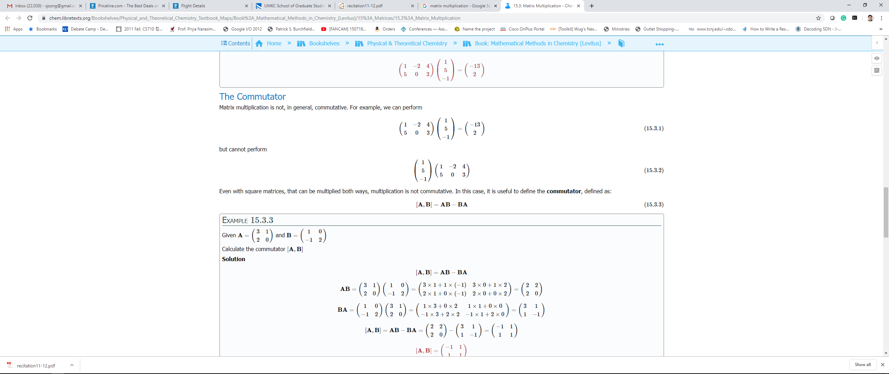
MATRIX-MULTIPLY(A, B)
- 13
2

Slide 27
MATRIX-MULTIPLY(A, B)
if columns[A] ≠ rows[B]
then error “incompatible dimensions”
else for i ← 1 to rows[A]
do for j ← 1 to columns[B]
do C[i, j] = 0
for k ← 1 to columns[A]
do C[i, j] ← C[i, j] + A[i, k] B[k, j]
rows[A] ⋅ cols[A] ⋅ cols[B]
multiplications
k
j
cols[B]
j
cols[B]
i
*
=
i
k
A
B
C
rows[A]
rows[A]

Slide 28
Matrix-Chain Multiplication
In what order should we multiply the matrices?
A₁ ⋅ A₂ ⋅⋅⋅ A_{n}
Parenthesize the product to get the order in which matrices are multiplied
E.g.: A₁ ⋅ A₂ ⋅ A₃ = ((A₁ ⋅ A₂) ⋅ A₃)
= (A₁ ⋅ (A₂ ⋅ A₃))
Which one of these orderings should we choose?
  The order in which we multiply the matrices has a significant impact on the cost of evaluating the product

Slide 29
Example
A₁ ⋅ A₂ ⋅ A₃
A₁: 10 x 100
A₂: 100 x 5
A₃: 5 x 50
1. ((A₁ ⋅ A₂) ⋅ A₃): A₁ ⋅ A₂ = 10 x 100 x 5 = 5,000 (10 x 5)
((A₁ ⋅ A₂) ⋅ A₃) = 10 x 5 x 50 = 2,500
Total: 7,500 scalar multiplications
2. (A₁ ⋅ (A₂ ⋅ A₃)): A₂ ⋅ A₃ = 100 x 5 x 50 = 25,000 (100 x 50)
(A₁ ⋅ (A₂ ⋅ A₃)) = 10 x 100 x 50 = 50,000
Total: 75,000 scalar multiplications
one order of magnitude difference!!

Slide 30
Matrix-Chain Multiplication: Problem Statement
Given a chain of matrices ⟨A₁, A₂, …, A_{n}⟩, where A_{i} has dimensions p_{i-1}x p_{i}, fully parenthesize the product A₁ ⋅ A₂ ⋅⋅⋅ A_{n} in a way that minimizes the number of scalar multiplications.
A₁ ⋅ A₂ ⋅⋅⋅ A_{i} ⋅ A_{i+1} ⋅⋅⋅ A_{n}
p₀ x p₁ p₁ x p₂ p_{i-1} x p_{i} p_{i} x p_{i+1} p_{n-1} x p_{n}
What is the number of possible parenthesizations?
  Exhaustively checking all possible parenthesizations is not efficient!
  It can be shown that the number of parenthesizations grows as Ω(4^{n}/n^{3/2}) ← exponential

Slide 31
The Structure of an Optimal Parenthesization
Notation:
A_{i…j} = A_{i} A_{i+1} ⋅⋅⋅ A_{j}, i ≤ j
Suppose that an optimal parenthesization of A_{i…j} splits the product between A_{k} and A_{k+1}, where i ≤ k < j
A_{i…j} = A_{i} A_{i+1} ⋅⋅⋅ A_{j}
= A_{i} A_{i+1} ⋅⋅⋅ A_{k} A_{k+1} ⋅⋅⋅ A_{j}
= A_{i…k} A_{k+1…j}
The parenthesization of the “prefix” A_{i…k} must be an optimal parentesization
If there were a less costly way to parenthesize A_{i…k}, we could substitute that one in the parenthesization of A_{i…j} and produce a parenthesization with a lower cost than the optimum ⇒ contradiction!
An optimal solution to an instance of the matrix-chain multiplication contains within it optimal solutions to subproblems

Slide 32
A Recursive Solution
Subproblem:
determine the minimum cost of parenthesizing A_{i…j} = A_{i} A_{i+1} ⋅⋅⋅ A_{j} for 1 ≤ i ≤ j ≤ n
Let m[i, j] = the minimum number of multiplications needed to compute A_{i…j}
  full problem (A_{1..n}): m[1, n]
  i = j: A_{i…i} = A_{i} ⇒ m[i, i] =
  0, for i = 1, 2, …, n

Slide 33
A Recursive Solution
Consider the subproblem of parenthesizing A_{i…j} = A_{i} A_{i+1} ⋅⋅⋅ A_{j} for 1 ≤ i ≤ j ≤ n
= A_{i…k} A_{k+1…j} for i ≤ k < j
Assume that the optimal parenthesization splits the product A_{i} A_{i+1} ⋅⋅⋅ A_{j} at k (i ≤ k < j)
  m[i, j] =
p_{i-1}p_{k}p_{j}
m[i, k]
m[k+1,j]
m[i, k] + m[k+1, j] + p_{i-1}p_{k}p_{j}
min # of multiplications
to compute A_{i…k}
min # of multiplications
to compute A_{k+1…j}
# of multiplications
to compute A_{i…k}A_{k…j}

Slide 34
A Recursive Solution (cont.)
  m[i, j] = m[i, k] + m[k+1, j] + p_{i-1}p_{k}p_{j}
We do not know the value of k
  There are j – i possible values for k: k = i, i+1, …, j-1
Minimizing the cost of parenthesizing the product A_{i} A_{i+1} ⋅⋅⋅ A_{j} becomes:
0 if i = j
m[i, j] = min {m[i, k] + m[k+1, j] + p_{i-1}p_{k}p_{j}} if i < j
^{i≤k<j}

Slide 35
Computing the Optimal Costs (cont.)
0 if i = j
m[i, j] = min {m[i, k] + m[k+1, j] + p_{i-1}p_{k}p_{j}} if i < j
^{i≤k<j}
How do we fill in the tables m[1..n, 1..n]?
  Determine which entries of the table are used in computing m[i, j]
  A_{i…j} = A_{i…k} A_{k+1…j}
  Subproblems’ size is one less than the original size
  Idea: fill in m such that it corresponds to solving problems of increasing length

Slide 36
Computing the Optimal Costs (cont.)
0 if i = j
m[i, j] = min {m[i, k] + m[k+1, j] + p_{i-1}p_{k}p_{j}} if i < j
^{i≤k<j}
Length = 1: i = j, i = 1, 2, …, n
Length = 2: j = i + 1, i = 1, 2, …, n-1
1
2
3
n
1
2
3
m[1, n] gives the optimal
solution to the problem
j
second
n
first
i

Slide 37
Example: min {m[i, k] + m[k+1, j] + p_{i-1}p_{k}p_{j}}
m[2, 2] + m[3, 5] + p₁p₂p₅
m[2, 3] + m[4, 5] + p₁p₃p₅
m[2, 4] + m[5, 5] + p₁p₄p₅
k = 2
m[2, 5] = min
k = 3
k = 4
1
2
3
4
5
6
1
2
Values m[i, j] depend only on values that have been previously computed
3
j
4
5
6
i

Slide 38
Example min {m[i, k] + m[k+1, j] + p_{i-1}p_{k}p_{j}}
Compute A₁ ⋅ A₂ ⋅ A₃
A₁: 10 x 100 (p₀ x p₁)
A₂: 100 x 5 (p₁ x p₂)
A₃: 5 x 50 (p₂ x p₃)
m[i, i] = 0 for i = 1, 2, 3
m[1, 2] = m[1, 1] + m[2, 2] + p₀p₁p₂ (A₁A₂)
= 0 + 0 + 10 *100* 5 = 5,000
m[2, 3] = m[2, 2] + m[3, 3] + p₁p₂p₃ (A₂A₃)
= 0 + 0 + 100 * 5 * 50 = 25,000
m[1, 3] = min m[1, 1] + m[2, 3] + p₀p₁p₃ = 75,000 (A₁(A₂A₃))
m[1, 2] + m[3, 3] + p₀p₂p₃ = 7,500 ((A₁A₂)A₃)
 | 1 | 2 | 3
1 | 0 | 5k/1 | 75k/2
2 |  | 0 | 25k/2
3 |  |  | 0

Slide 39
Example min {m[i, k] + m[k+1, j] + p_{i-1}p_{k}p_{j}}
 | 1 | 2 | 3 | 4
1 | 0 | 120/1 | 88/1 | 158/3
2 |  | 0 | 48/2 | 104/3
3 |  |  | 0 | 84/3
4 |  |  |  | 0
Compute A₁ ⋅ A₂ ⋅ A₃ . A₄ (5, 4, 6, 2, 7)
A₁: 5 x 4 (p₀ x p₁)
A₂: 4 x 6 (p₁ x p₂)
A₃: 6 x 2 (p₂ x p₃)
A₄: 2 x 7 (p₃ x p₄)
m[i, i] = 0 for i = 1, 2, 3, 4
m[1, 2] = m[1, 1] + m[2, 2] + p₀p₁p₂ (A₁A₂)
= 0 + 0 + 5 *4* 6 = 120
m[2, 3] = m[2, 2] + m[3, 3] + p₁p₂p₃ (A₂A₃)
= 0 + 0 + 4 * 6 * 2 = 48
m[3, 4] = m[3, 3] + m[4, 4] + p₂p₃p₄ (A₃A₄)
= 0 + 0 + 6 * 2 * 7 = 84
m[1, 3] = min {m[1, 1] + m[2, 3] + p₀p₁p₃ = 48 + 40 = (A₁(A₂A₃)), m[1, 2] + m[3, 3] + p₀p₂p₃ = 120 + 60 = ((A₁A₂)A₃)}
m[2, 4] = min {m[2, 2] + m[3, 4] + p₁p₂p₄ = 84 + 168 = (A₂(A₃A₄)), m[2, 3] + m[4, 4] + p₁p₃p₄ = 48 + 56 = ((A₂A₃)A₄)}
m[1, 4] = min {m[1, 1] + m[2, 4] + p₀p₁p₄ = 104 + 140 = ((A₁)(A₂A₃A₄)),
m[1, 2] + m[3, 4] + p₀p₂p₄ = 120+84+210 = ((A₁A₂)(A₃A₄)),
m[1, 3] + m[4, 4] + p₀p₃p₄ = 88+70 = ((A₁A₂A₃)(A₄)) }
A₁
A₂
A₃
A₄

Slide 40
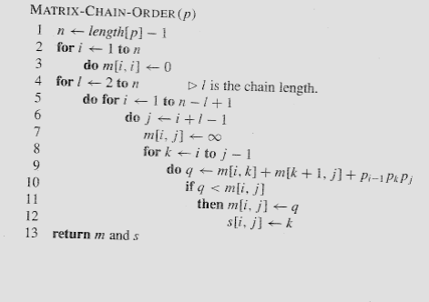
Matrix-Chain-Order(p)
O(N³)

Slide 41
Memoization
Top-down approach with the efficiency of typical dynamic programming approach
Maintaining an entry in a table for the solution to each subproblem
  memoize the inefficient recursive algorithm
When a subproblem is first encountered its solution is computed and stored in that table
Subsequent “calls” to the subproblem simply look up that value

Slide 42
Memoized Matrix-Chain
Alg.: MEMOIZED-MATRIX-CHAIN(p)
n ← length[p] – 1
for i ← 1 to n
do for j ← i to n
do m[i, j] ← ∞
return LOOKUP-CHAIN(p, 1, n)
Initialize the m table with
large values that indicate
whether the values of m[i, j]
have been computed
Top-down approach

Slide 43
Memoized Matrix-Chain
Alg.: LOOKUP-CHAIN(p, i, j)
if m[i, j] < ∞
then return m[i, j]
if i = j
then m[i, j] ← 0
else for k ← i to j – 1
do q ← LOOKUP-CHAIN(p, i, k) +
LOOKUP-CHAIN(p, k+1, j) + p_{i-1}p_{k}p_{j}
if q < m[i, j]
then m[i, j] ← q
return m[i, j]
Running time is O(n³)

Slide 44
Dynamic Progamming vs. Memoization
Advantages of dynamic programming vs. memoized algorithms
  No overhead for recursion, less overhead for maintaining the table
  The regular pattern of table accesses may be used to reduce time or space requirements
Advantages of memoized algorithms vs. dynamic programming
  Some subproblems do not need to be solved

Slide 45
Matrix-Chain Multiplication - Summary
Both the dynamic programming approach and the memoized algorithm can solve the matrix-chain multiplication problem in O(n³)
Both methods take advantage of the overlapping subproblems property
There are only Θ(n²) different subproblems
  Solutions to these problems are computed only once
Without memoization the natural recursive algorithm runs in exponential time

Slide 46
Elements of Dynamic Programming
Optimal Substructure
  An optimal solution to a problem contains within it an optimal solution to subproblems
  Optimal solution to the entire problem is build in a bottom-up manner from optimal solutions to subproblems
Overlapping Subproblems
  If a recursive algorithm revisits the same subproblems over and over ⇒ the problem has overlapping subproblems

Slide 47
Parameters of Optimal Substructure
How many subproblems are used in an optimal solution for the original problem
  Assembly line:
  Matrix multiplication:
How many choices we have in determining which subproblems to use in an optimal solution
  Assembly line:
  Matrix multiplication:
One subproblem (the line that gives best time)
Two subproblems (subproducts A_{i..k}, A_{k+1..j})
Two choices (line 1 or line 2)
j - i choices for k (splitting the product)

Slide 48
Parameters of Optimal Substructure
Intuitively, the running time of a dynamic programming algorithm depends on two factors:
  Number of subproblems overall
  How many choices we look at for each subproblem
Assembly line
  Θ(n) subproblems (n stations)
  2 choices for each subproblem
Matrix multiplication:
  Θ(n²) subproblems (1 ≤ i ≤ j ≤ n)
  At most n-1 choices
Θ(n) overall
Θ(n³) overall

