Slide 1
An Activity Selection Problem
(Conference Scheduling Problem)
Input: A set of activities S = {a₁,…, a_{n}}
Each activity has start time and a finish time
  a_{i}=(s_{i}, f_{i})
Two activities are compatible if and only if their interval does not overlap
Output: a maximum-size subset of mutually compatible activities

Slide 2
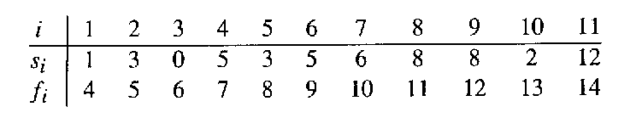
The Activity Selection Problem
Here are a set of start and finish times
What is the maximum number of activities that can be completed?
  {a₃, a₉, a₁₁} can be completed
  But so can {a₁, a₄, a_{8’} a₁₁} which is a larger set
  But it is not unique, consider {a₂, a₄, a_{9’} a₁₁}

Slide 3

Interval Representation
0 1 2 3 4 5 6 …

Slide 4
0 1 2 3 4 5 6 7 8 9 10 11 12 13 14 15

Slide 5
0 1 2 3 4 5 6 7 8 9 10 11 12 13 14 15

Slide 6
0 1 2 3 4 5 6 7 8 9 10 11 12 13 14 15

Slide 7
0 1 2 3 4 5 6 7 8 9 10 11 12 13 14 15

Slide 8
Greedy templates
[Earliest start time] Consider jobs in ascending order of s_{j}.
[Earliest finish time] Consider jobs in ascending order of f_{j}.
[Shortest interval] Consider jobs in ascending order of f_{j} - s_{j}.
[Fewest conflicts] For each job j, count the number of conflicting jobs c_{j}. Schedule in ascending order of c_{j}.

Slide 9
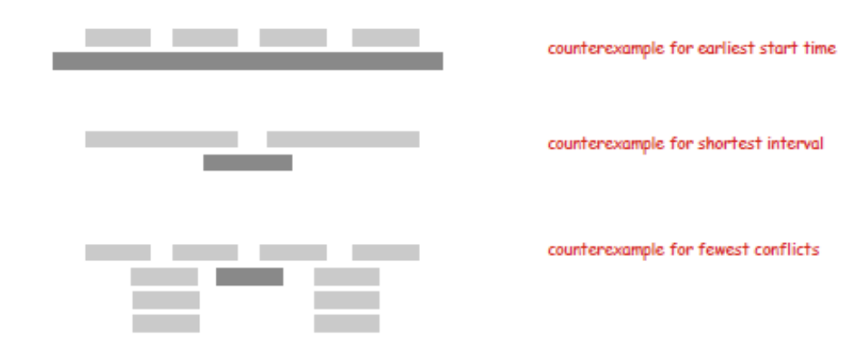
Greedy templates
Counter examples
[Earliest start time]
[Shortest interval]
[Fewest conflicts]

Slide 10
Early Finish Greedy
Sort by finishing time
Select the activity with the earliest finish
Eliminate the activities that could not be scheduled
Repeat!

Slide 11
0 1 2 3 4 5 6 7 8 9 10 11 12 13 14 15

Slide 12
0 1 2 3 4 5 6 7 8 9 10 11 12 13 14 15

Slide 13
0 1 2 3 4 5 6 7 8 9 10 11 12 13 14 15

Slide 14
0 1 2 3 4 5 6 7 8 9 10 11 12 13 14 15

Slide 15
0 1 2 3 4 5 6 7 8 9 10 11 12 13 14 15

Slide 16
0 1 2 3 4 5 6 7 8 9 10 11 12 13 14 15

Slide 17
0 1 2 3 4 5 6 7 8 9 10 11 12 13 14 15

Slide 18
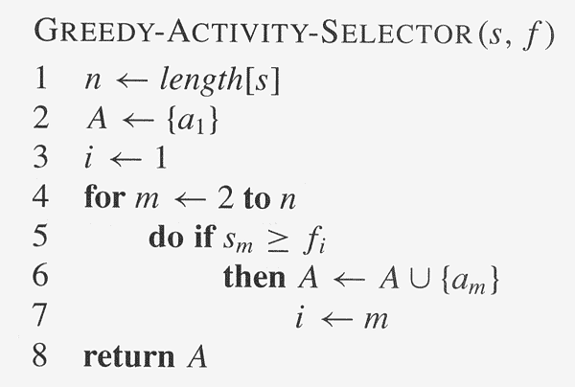
Assuming activities are sorted by finish time

Slide 19
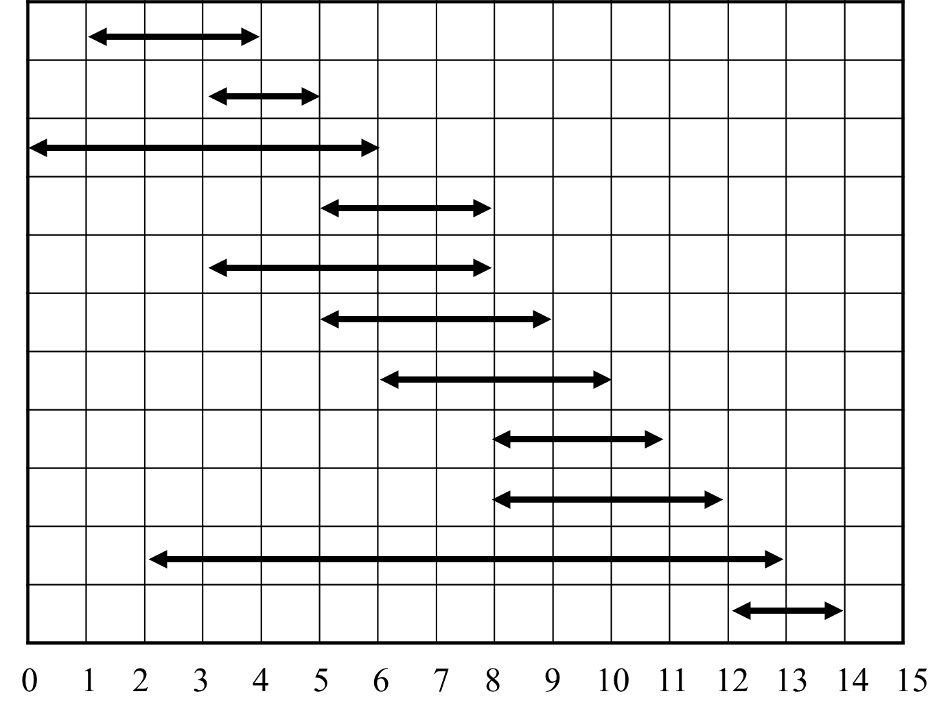
Interval Partitioning
Interval partitioning.
  Lecture j starts at s_{j} and finishes at f_{j}.
  Goal: find minimum number of classrooms to schedule all lectures so that no two occur at the same time in the same room.
Def. The depth of a set of open intervals is the maximum number that contain any given time. Ex. 5
Key observation Number of classrooms needed ≥ depth.
Q. Does there always exist a schedule equal to depth of intervals?

Slide 20
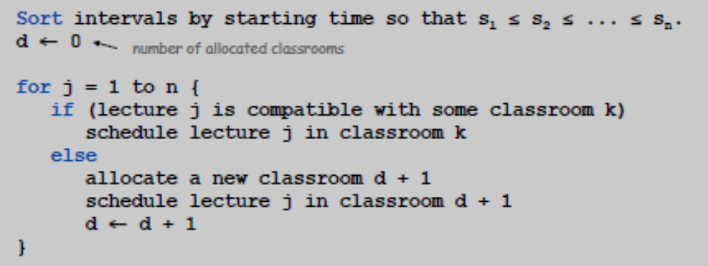
Interval Partitioning
Greedy algorithm. Consider lectures in increasing order of start time: assign lecture to any compatible classroom.
Implementation. O(n log n).
  For each classroom k, maintain the finish time of the last job added.
  Keep the classrooms in a priority queue.

Slide 21
Interval Partitioning
Observation. Greedy algorithm never schedules two incompatible lectures in the same classroom.
Theorem. Greedy algorithm is optimal.
Pf.
  Let d = number of classrooms that the greedy algorithm allocates.
  Classroom d is opened because we needed to schedule a job, say j, that is incompatible with all d-1 other classrooms.
  These d jobs each end after s_{j}.
  Since we sorted by start time, all these incompatibilities are caused by lectures that start no later than s_{j}.
  Thus, we have d lectures overlapping at time s_{j} + ε.
  Key observation ⇒ all schedules use ≥ d classrooms.

Slide 22
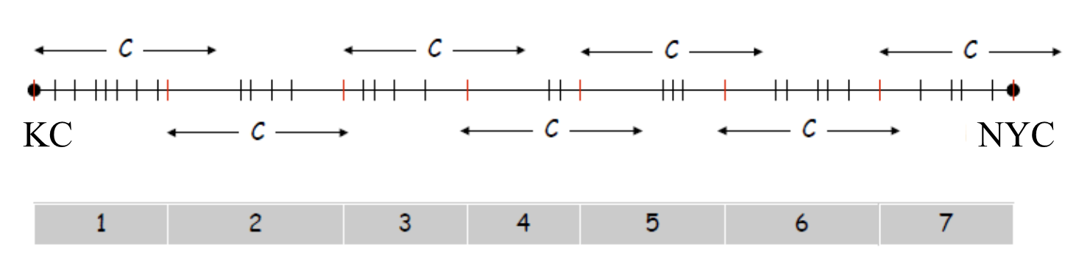
Selecting Breakpoints
Selecting breakpoints.
  Road trip from KC to NYC along fixed route.
  Refueling stations at certain points along the way.
  Fuel capacity = C.
  Goal: makes as few refueling stops as possible.
Greedy algorithm. Go as far as you can before refueling.

Slide 23
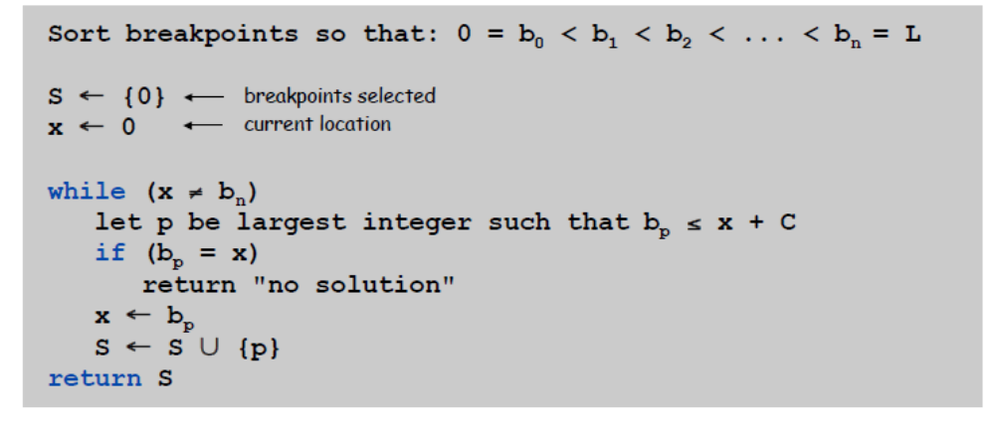
Selecting Breakpoints
Truck driver's algorithm.
Implementation. O(n log n)
  Use binary search to select each breakpoint p.

Slide 24
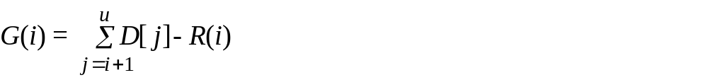
The gas station scheduling problem
Goal: the amount of gas at each station to minimize the total cost from A to B.
  Road trip from A (station 0) to B (station n+1) along fixed route, assuming the gas tank is empty initially.
  n gas stations: refueling stations at certain points along the way (1, 2, …, n).
  L:the distance a car can run with full tank of gas.
  D[i]: the distance from station i-1 to station i .
  P[i]: the gas price at station i . P[n+1] = 0
  R[i]: the miles the remaining gas in the tank can run (R[i] ≤ L). R[0] = 0 (empty).
  G[i]: the amount of gas needs to be added at station i.
Greedy algorithm.
  Within L miles, station u is the first such that P[u] <= P[i]. add gas enough to arrive to station u.
  Within L miles, station u has the lowest price but P[u] > P[i]. add as much gas as possible to make the tank full. G(i) = L - R(i) gas.
The complexity is T(n) = O(kn) = O(n), at station i, we need look at most k stations ahead.

Slide 25
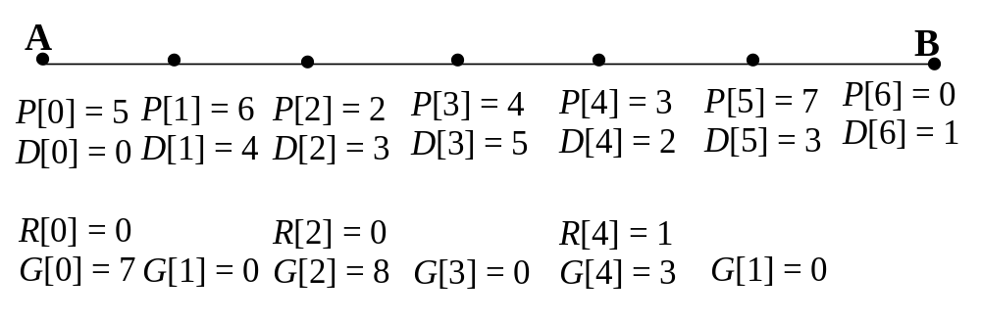

The gas station scheduling problem
4
3
5
2
3
1
6 gas stations, L is 8 miles
Within L, find the first station which is cheaper than current. Fill gas to the first station (R[i] + G[i] == D[i to j]).
Else, within L, find the cheapest station (which is more expensive than current). Fill gas to full tank (R[i] + G[i] == L).
The minimum total cost is 7×5 + 8×2 + 3×3 = 60

Slide 26
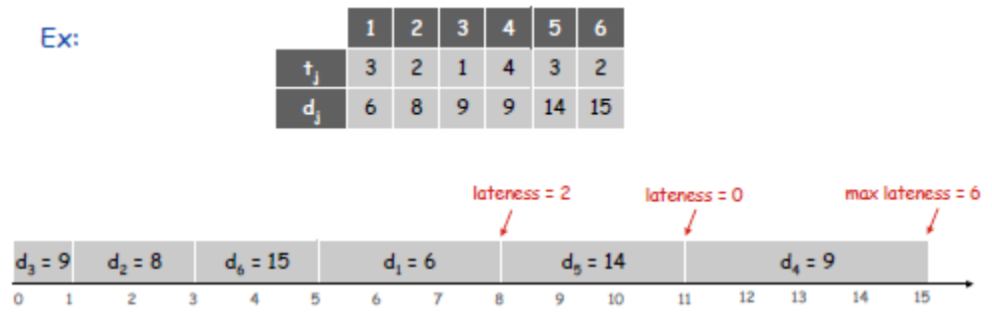
Scheduling to Minimize Lateness
Minimizing lateness problem.
  Single resource processes one job at a time.
  Job j requires t_{j} units of processing time and is due at time d_{j}.
  If j starts at time s_{j}, it finishes at time f_{j} = s_{j} + t_{j}.
  Lateness: l_{j} = max { 0, f_{j} - d_{j} }.
  Goal: schedule all jobs to minimize maximum lateness L = max l_{j}.

Slide 27
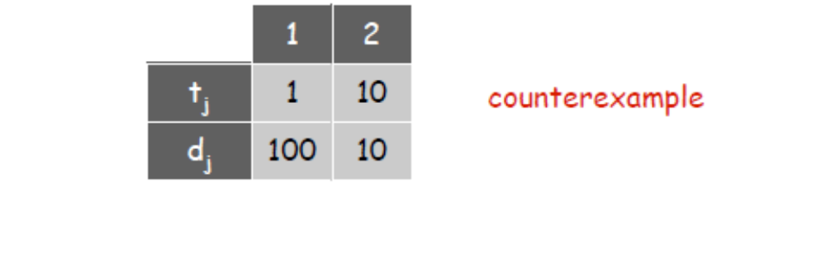
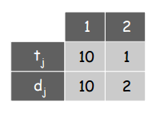
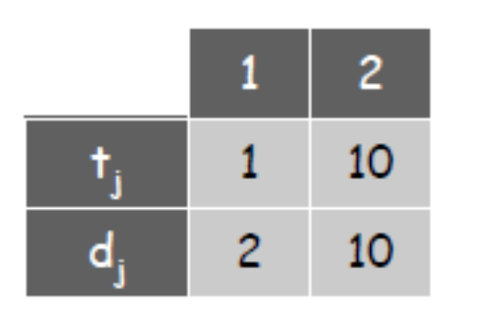
Minimizing Lateness: Greedy Algorithms
[Shortest processing time first] Consider jobs in ascending order of processing time t_{j}.
[Earliest deadline first] Consider jobs in ascending order of deadline d_{j}.
[Smallest slack] Consider jobs in ascending order of slack d_{j} - t_{j}. ← used for different arrival tasks
vs
Counter example of 1
Counter example of 3

Slide 28
Schedulability
A set of tasks is said to be schedulable under a given set of constraints, if a schedule exists for that set of tasks and constraints.← anything missing deadline is not schedulable.
  Exact tests are NP-hard in many situations.
  Sufficient tests: sufficient conditions for guaranteeing a schedule are checked.
  Necessary tests: checking necessary conditions. Can be used to show that no schedule exists.

Slide 29
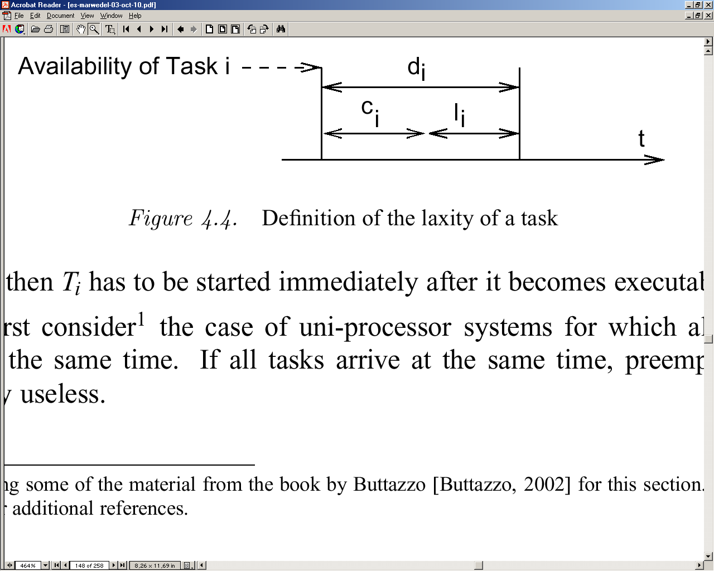
Cost Functions
Cost function: Different algorithms aim at minimizing different functions.
Def.: Maximum lateness (l) is defined as the difference between the completion time (c) and the deadline (d), maximized over all tasks.

Slide 30
Scheduling with No Precedence Constraints
Let {T_{i} } be a set of tasks. Let:
  c_{i} be the execution time of T_{i} ,
  d_{i} be the deadline interval, that is, the time between T_{i} becoming available and the time until which T_{i} has to finish execution.
  l_{i} be the laxity or slack, defined as l_{i} = d_{i} - c_{i}

Slide 31
Uniprocessor with Equal Arrival Times
Preemption is useless (tasks are scheduled in priority at the beginning).
Earliest Due Date (EDD): Based on Jackson's rule:
  Given a set of n independent tasks, any algorithm that executes the tasks in order of non-decreasing deadlines is optimal with respect to minimizing the maximum lateness. Proof: See [Buttazzo, 2002]
  EDD requires all tasks to be sorted by their deadlines. Complexity is O(n log(n)).
Deadline

Slide 32
Earliest Deadline First (EDF)
Different arrival times
  Preemption potentially reduces lateness.
Theorem [Horn74]: Given a set of n independent tasks with arbitrary arrival times, any algorithm that at any instant executes the task with the earliest absolute deadline among all the ready tasks is optimal with respect to minimizing the maximum lateness.
Earliest deadline first (EDF): each time a new ready task arrives, it is inserted into a queue of ready tasks, sorted by their deadlines. If a newly arrived task is inserted at the head of the queue, the currently executing task is preempted.
  If sorted lists are used, the complexity is O(n²)

Slide 33
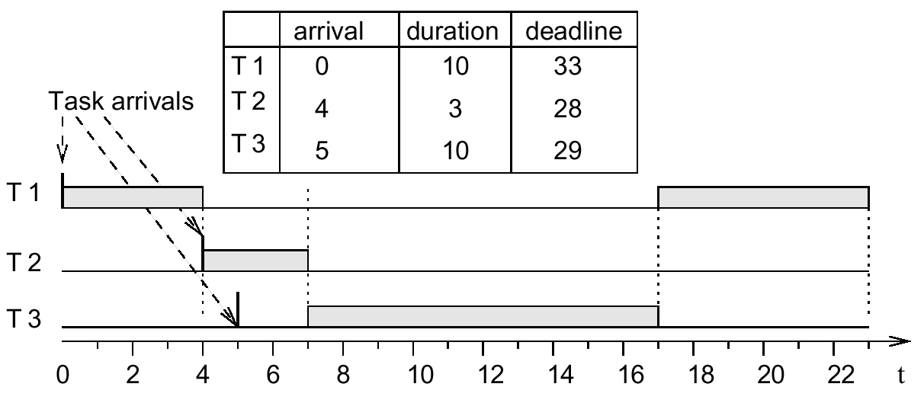
Earliest Deadline First (EDF)
Earlier deadline
☞ preemption
Later deadline
☞ no preemption

Slide 34
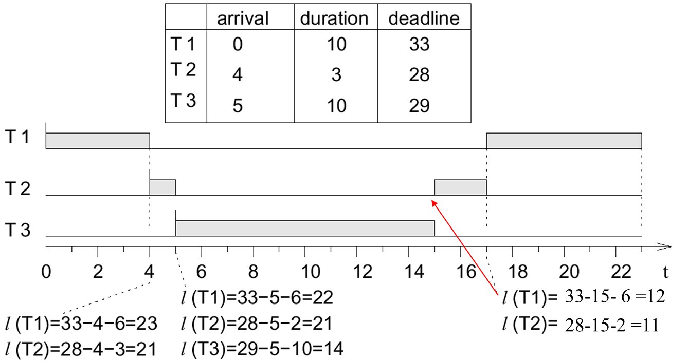
Least laxity, Least Slack Time First
Priorities = decreasing function of the laxity (the less laxity, the higher the priority); dynamically changing priority; preemptive.
Requires calling the scheduler periodically, and to recompute the laxity. Overhead for many calls of the scheduler and many context switches. Detects missed deadlines early.

Slide 35
Periodic Scheduling
T1
T2
For periodic scheduling, the best that we can do is to design an algorithm which will always find a schedule if one exists.
  A scheduler is defined to be optimal iff it will find a schedule if one exists.

Slide 36
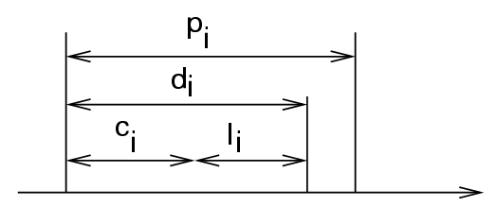
Periodic scheduling
Let
  p_{i} be the period of task T_{i},
  c_{i} be the execution time of T_{i},
  d_{i} be the deadline interval, that is, the time between a job of T_{i} becoming available and the time after which the same job T_{i} has to finish execution.
  l_{i} be the laxity or slack, defined as l_{i} = d_{i} - c_{i}

Slide 37
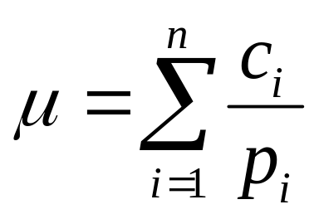
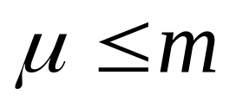
Accumulated Utilization
Accumulated utilization:
Necessary condition for schedulability
(with m=number of processors):
Example: T1 has c1 = 25ms and p1 = 50ms
T2 has c2 = 40ms and p2 = 100ms
U1 = 0.5 and U2 = 0.4;
For total utilization is 0.9, it is schedulable for a processor.

Slide 38
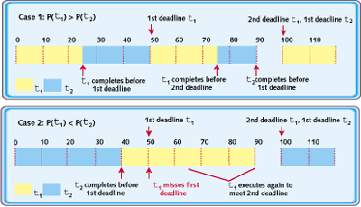
Case Study

Slide 39
Case Study
Case 1: Priority (T1) > Priority (T2)
Case 2: Priority (T1) < Priority (T2)
Case 1 meets deadline, but case 2 missed the deadline, despite 0.1 idle time (total U is 0.9).
Priority assignment do an important role.
Assign the priority of each task according to its period, so that the shorter the period the higher the priority.
The example T1 has shorter period.

Slide 40
Optimal Scheduling Algorithm
A scheduling algorithm S is optimal if S cannot schedule a real-time task set T, no other scheduling algorithm can schedule T
E.g., Rate Monotonic & EDF

Slide 41
Fixed Priority vs. Dynamic Priority Scheduling Algorithms
Fixed priority system
  Assign the same priority to all the jobs in each task
  Rate monotonic
Dynamic priority system
  Assign different priorities to the individual jobs in each task
  EDF

Slide 42
Rate Monotonic (RM) Scheduling
RMA is the optimal fixed-priority algorithm. If a task set cannot be scheduled using the RMA algorithm, it cannot be scheduled using any fixed-priority algorithm.
One major limitation of fixed-priority scheduling is that it is not always possible to fully utilize the CPU.

Slide 43
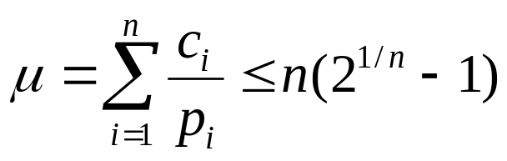
Rate Monotonic (RM) Scheduling
Well-known technique for scheduling independent periodic tasks [Liu, 1973].
Assumptions:
  All tasks that have hard deadlines are periodic.
  All tasks are independent.
  d_{i}=p_{i} (Deadline equals period) for all tasks.
  c_{i} is constant and is known for all tasks.
  The time required for context switching is negligible
  For a single processor with n tasks, the following equation holds for the accumulated utilization µ:

Slide 44
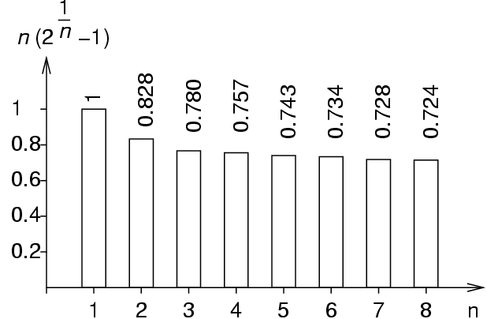
Rate Monotonic (RM) Scheduling
RM policy: The priority of a task is a monotonically decreasing function of its period (Shorter period → Higher priority & Higher rate → Higher priority).
At any time, a highest priority task among all those that are ready for execution is allocated.
If all assumptions are met, schedulability is guaranteed.
Maximum utilization as a function of the number of tasks:

Slide 45
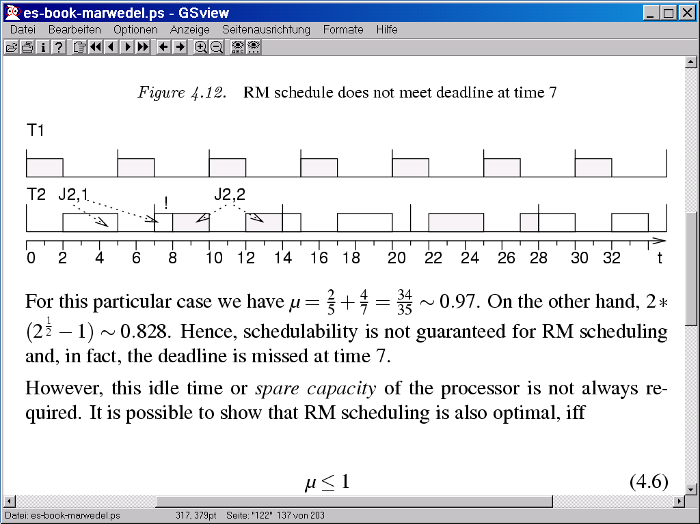
Case of failing RM scheduling
Task 1: period 5, execution time 2
Task 2: period 7, execution time 4
µ=2/5+4/7=34/35 ≈ 0.97
2(2^{1/2}-1) ≈ 0.828
Not enough idle time
Missed deadline
Missing computations scheduled in the next period

Slide 46
When Is There an RMS Schedule?
Asymptotic result:
  If the required processor utilization is under 69%, RMS will give a valid schedule
Converse is not true. Instead:
  If the required processor utilization is over 69%, RMS might still give a valid schedule, but there is no guarantee

Slide 47
Utilization Bound (UB) Test
C_{i}
Processor Utilization for a task, i
U_{i} =
T_{i}
1
Utilization Bound for n tasks
U(n) = n(2 - 1)
n
Results:
If U (=Σ U_{i}) ≤ U(n) then the set of tasks is schedulable.
If U(n) < Σ U_{i} ≤ 1 then the test is inconclusive.

Slide 48
Utilization Bound Test
Task | Execution Time (C) | Period (T)
τ₁ | 40 | 100
τ₂ | 40 | 150
τ₃ | 100 | 350
U₁ = 40 / 100 = 0.4
U(3) = 3(2^{1/3} – 1) = 0.779
U₂ = 40 / 150 = 0.267
Result:
U₁₊₂ = 0.667, schedulable.
However, 0.779 < 0.953 < 1
Therefore, inconclusive for τ₃.
U₃ = 100 / 350 = 0.286
U_{total} = 0.953

Slide 49
EDF
RMS assumes fixed priorities (fixed greedy).
Can you do better with dynamically-chosen priorities?
  Earliest deadline first can also be applied to periodic scheduling.
  Processes with soonest deadline given highest priority
  EDF optimal for every period
    Optimal for periodic scheduling
    EDF must be able to schedule the example in which RMS failed.

Slide 50
EDF: Properties
EDF requires dynamic priorities
  EDF cannot be used with a standard operating system just providing static priorities.

Slide 51
Comparisons
RMS
  RMS may not guarantee schedulability even when U < 1
  Low overhead: Priorities do not change for a fixed task set
EDF
  EDF guarantee schedulability as long as U <= 1
  High overhead: Task priorities may change dynamically

Slide 52
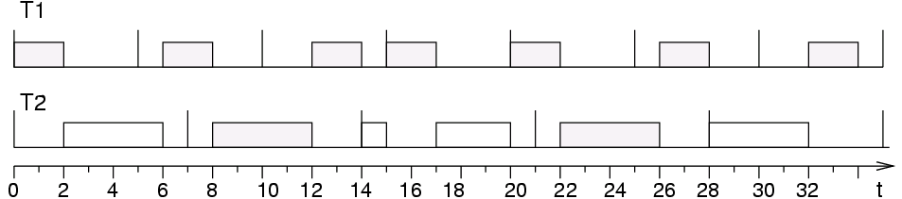
Comparison EDF/RMS
RMS:
EDF:
T2 not preempted, due to its earlier deadline.

Slide 53
Static Scheduling More Prevalent
RMA only guarantees feasibility at 69% utilization, EDF guarantees it at 100%
EDF is complicated enough to have unacceptable overhead
More complicated than RMA: harder to analyze
Less predictable: can’t guarantee which process runs when

