Slide 1


Keras
Keras for Deep Learning Research

Slide 2
Feedback is greatly appreciated!

Slide 3

Overview
Difference between Feedforward Neural Network (FNN) and Recurrent Neural Network (RNN)
The importance of context
RNN
LSTM
Use case

Slide 4
Why Recurrent Neural Network
Humans don’t start their thinking from scratch every second. As you read this essay, you understand each word based on your understanding of previous words.
You don’t throw everything away and start thinking from scratch again. Your thoughts have persistence.

Slide 5
Why Recurrent Neural Network
Traditional neural networks can’t do this, and it seems like a major shortcoming.
For example, imagine you want to classify what kind of event is happening at every point in a movie.
It’s unclear how a traditional neural network could use its reasoning about previous events in the film to inform later ones.
Recurrent neural networks address this issue.
They are networks with loops in them, allowing information to persist.

Slide 6
The importance of context
Recall the 5th digit of your phone number
Sing your favorite song beginning at third sentence
Recall 10th character of the alphabet
Probably you went straight from the beginning of the stream in each case…
because in sequences, order matters!
Idea: retain the information preserving the importance of order

Slide 7
Recurrent Neural Network (RNN)

Slide 8
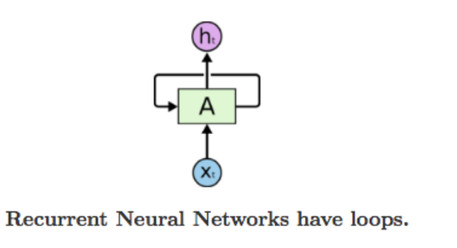
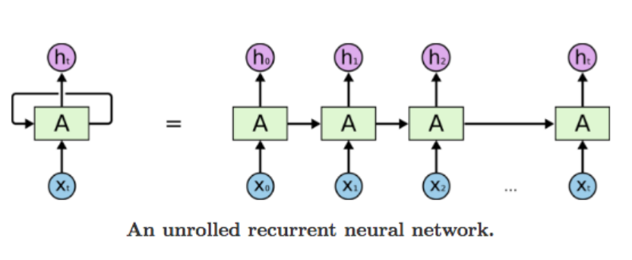
Recurrent Neural Network
A recurrent neural network can be thought of as multiple copies of the same network, each passing a message to a successor.

Slide 9
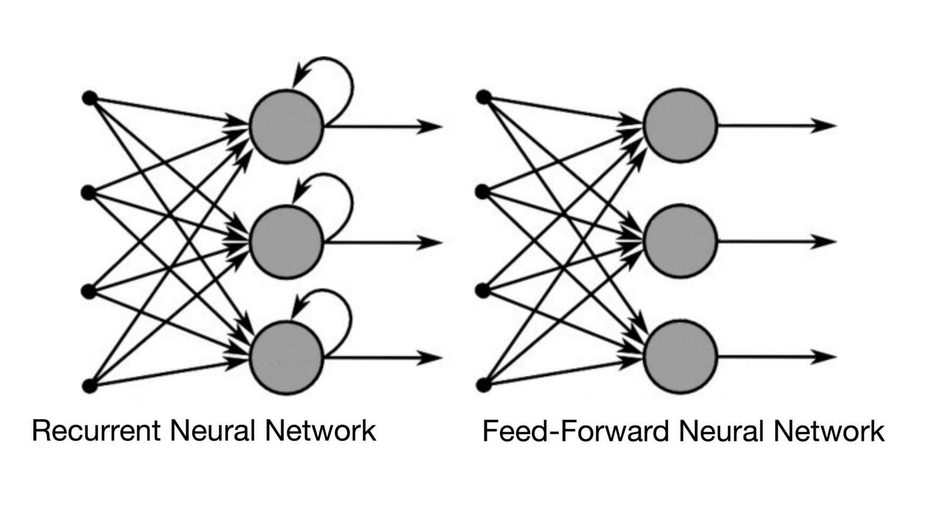
Difference between RNN and feed forward
Source: https://towardsdatascience.com/recurrent-neural-networks-and-lstm-4b601dd822a5
Notes:
In a Feed-Forward NN, the information only moves in one direction, from the input layer, through the hidden layers, to the output layer. The information moves straight through the network. Because of that, the information never touches a node twice.
In a RNN, the information cycles through a loop. When it makes a decision, it takes into consideration the current input and also what it has learned from the inputs it received previously.

Slide 10
Recurrent Neural Network (RNN)
Good for Sequential data, or ordered data
Internal memory: remember important things about input
Produces output, copies and output, loop it back into input

Slide 11
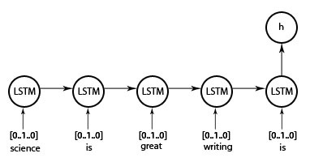
Example

Slide 12
Recurrent Neural Network (RNN)
"Unrolled" layer
Output at t=0
Output at t+1
Output at t+2
Input
at t=0
Input at t+1
Input at t+2
Time

Slide 13
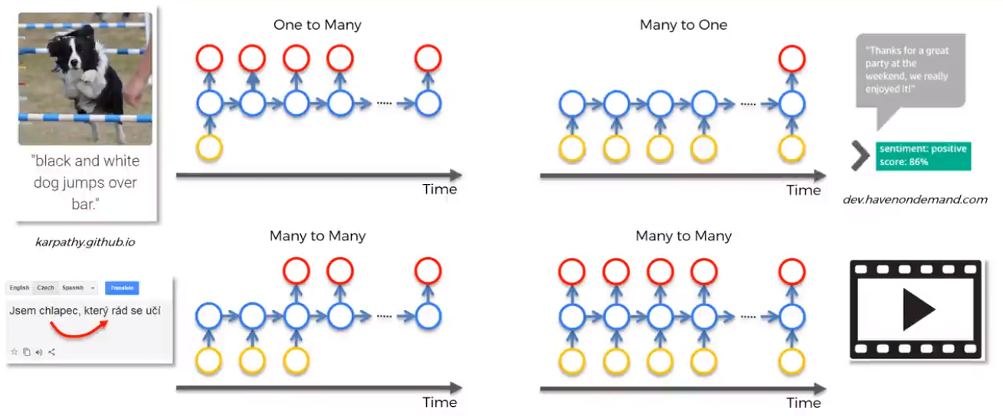
Different kind of RNN

Slide 14
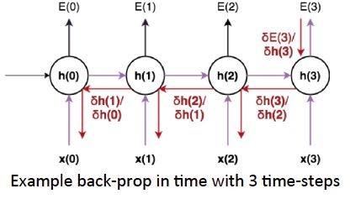
Recurrent Neural Network (RNN)
Back Propagation Through Time (BPTT): The training method has to take into account the time operations → a cost function E is defined to train our RNN, and in this case the total error at the output of the network is the sum of the errors at each time-step

Slide 15
Recurrent Neural Network (RNN)
Main problems:
Sometimes, we only need to look at recent information to perform the present task - "the clouds are in the sky"
But there are also cases where we need more context - "I grew up in France… I speak fluent French."
Source: http://colah.github.io/posts/2015-08-Understanding-LSTMs/

Slide 16
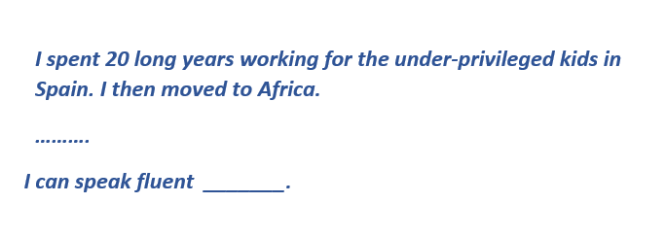
Limitations of RNNs
However, simple RNNs fail to understand the context behind an input. Something that was said long before, cannot be recalled when making predictions in the present. Let’s understand this as an example:
we can understand that since the author has worked in Spain for 20 years, it is very likely that he may possess a good command over Spanish. But, to make a proper prediction, the RNN needs to remember this context. The relevant information may be separated from the point where it is needed, by a huge load of irrelevant data. This is where a Recurrent Neural Network fails!

Slide 17
Limitations of RNNs
The reason behind this is the problem of Vanishing Gradient.
We know that for a conventional feed-forward neural network, the weight updating that is applied on a particular layer is a multiple of the learning rate, the error term from the previous layer and the input to that layer.
Thus, the error term for a particular layer is somewhere a product of all previous layers’ errors.
When dealing with activation functions like the sigmoid function, the small values of its derivatives (occurring in the error function) gets multiplied multiple times as we move towards the starting layers. As a result of this, the gradient almost vanishes as we move towards the starting layers, and it becomes difficult to train these layers

Slide 18
Recurrent Neural Network (RNN)
Main problems:
Exploding Gradients: weights assigns high importance: unstable network.
Vanishing Gradients: values of gradients are too small: model stops learning

Slide 19
Long Short Term Memory (LSTM)

Slide 20
LSTM
LSTMs on the other hand, make small modifications to the information by multiplications and additions.
With LSTMs, the information flows through a mechanism known as cell states. This way, LSTMs can selectively remember or forget things. The information at a particular cell state has three different dependencies.
The previous cell state (i.e. the information that was present in the memory after the previous time step)
The previous hidden state (i.e. this is the same as the output of the previous cell)
The input at the current time step (i.e. the new information that is being fed in at that moment)

Slide 21
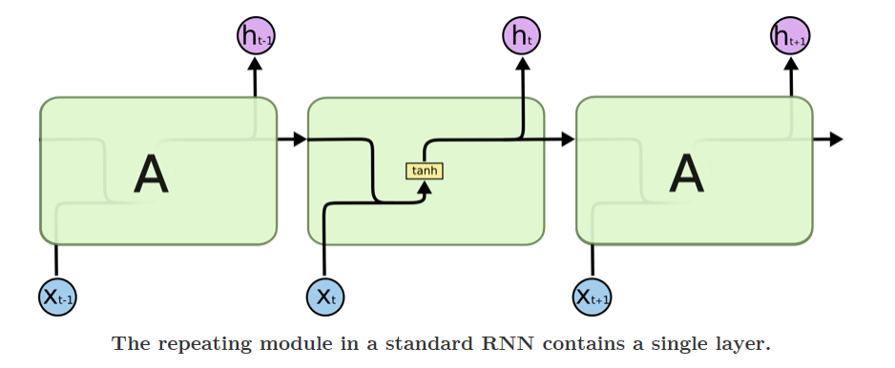
RNN vs LSTM
Source: http://colah.github.io/posts/2015-08-Understanding-LSTMs/

Slide 22
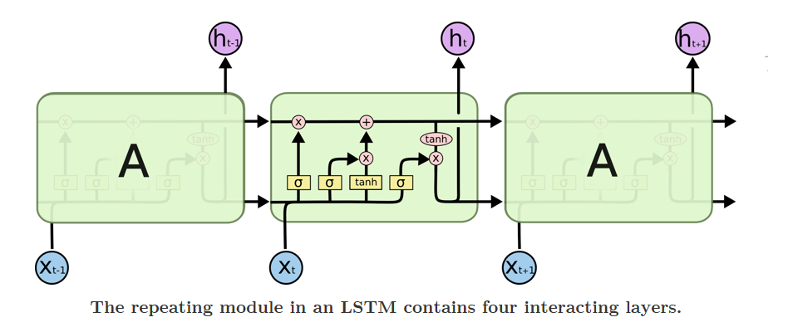
RNN vs LSTM
Source: http://colah.github.io/posts/2015-08-Understanding-LSTMs/

Slide 23
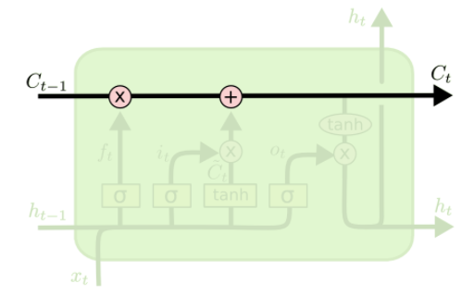
Core idea behind LSTM
The key to LSTMs is the cell state, the horizontal line running through the top of the diagram.
The LSTM does have the ability to remove or add information to the cell state, carefully regulated by structures called gates.
Source: http://colah.github.io/posts/2015-08-Understanding-LSTMs/

Slide 24
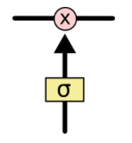
Gate
Gates are a way to optionally let information through.
They are composed out of a sigmoid neural net layer and a pointwise multiplication operation
The sigmoid layer outputs numbers between zero and one, describing how much of each component should be let through.
A value of zero means "let nothing through," while a value of one means "let everything through!"
An LSTM has three of these gates, to protect and control the cell state.
Source: http://colah.github.io/posts/2015-08-Understanding-LSTMs/

Slide 25
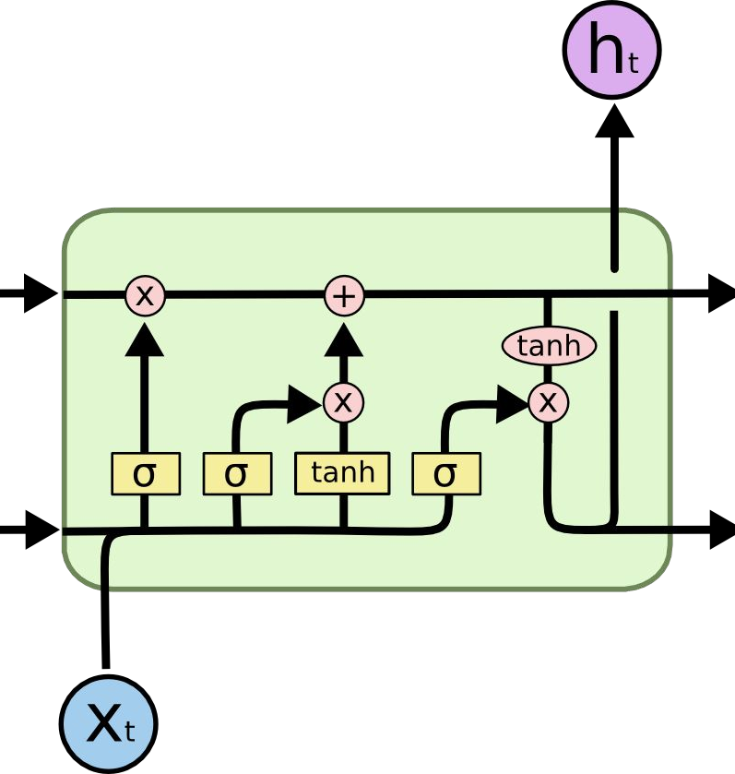
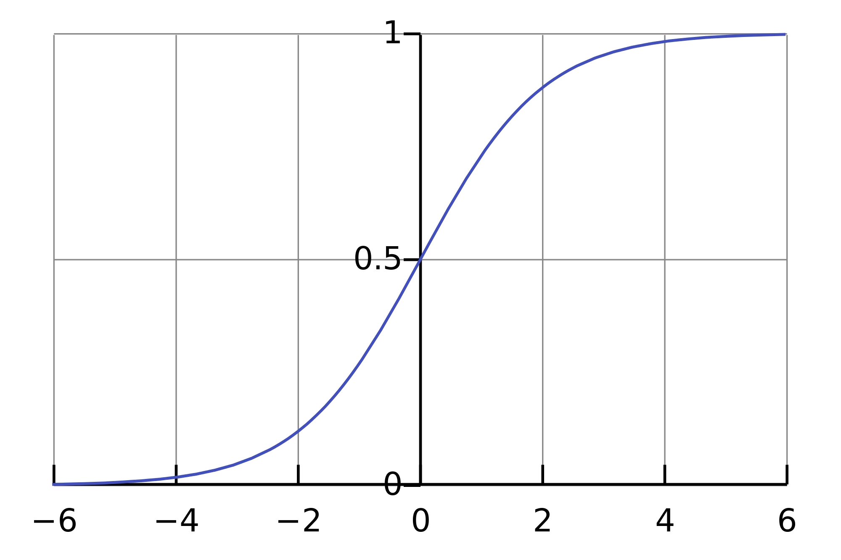
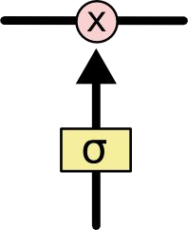
Long Short Term Memory (LSTM)
Source: http://colah.github.io/posts/2015-08-Understanding-LSTMs/

Slide 26
Long Short Term Memory (LSTM)
Forget irrelevant parts of the previous state
Selectively update cell state values
Output certain part of cell state
Source: http://colah.github.io/posts/2015-08-Understanding-LSTMs/

Slide 27
Meaning Of the Symbols
+ : Adding information
σ : Sigmoid layer
tanh: tanh layer
h(t-1) : Output of last LSTM unit
c(t-1) : Memory from last LSTM unit
X(t) : Current input
c(t) : New updated memory
h(t) : Current output

Slide 28
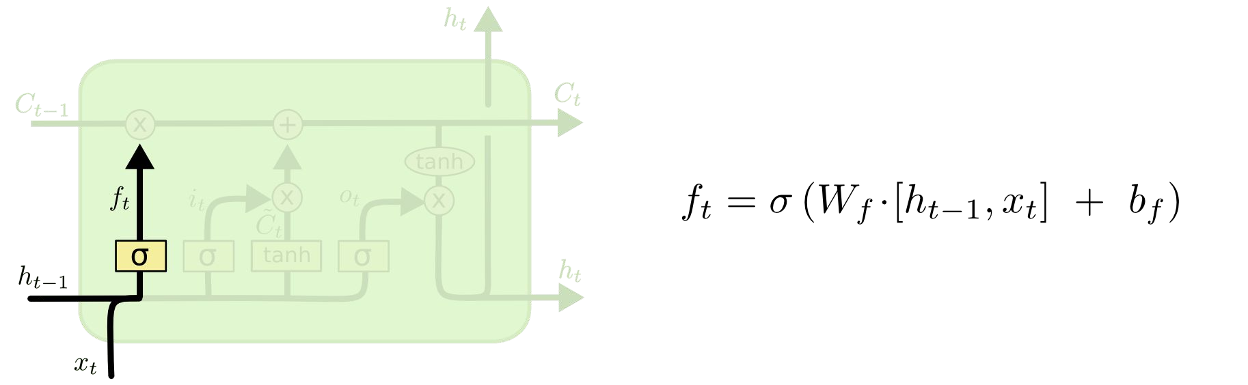
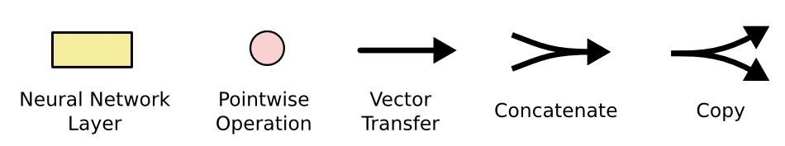
Long Short Term Memory (LSTM)
Forget Gate Layer
Decide how much of the past is should remember
Concatenate
Ft = forget gate
Decides which information to delete that is not important from the previous time step
Source: http://colah.github.io/posts/2015-08-Understanding-LSTMs/
Notes:
The first step in our LSTM is to decide what information we’re going to throw away from the cell state.

Slide 29
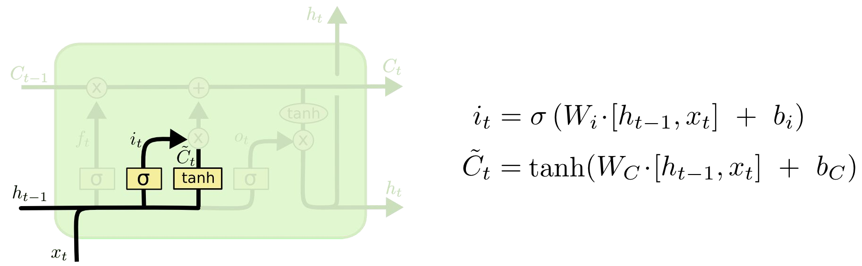
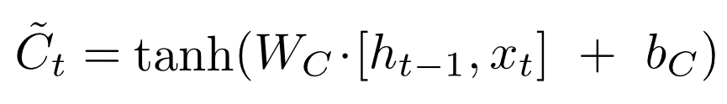
Long Short Term Memory (LSTM)
Input Gate Layer
Decides how much should this unit add to the current state
it = input gate
Determines which information to let through based on its significance in the current time step
New contribution to cell state
Concatenate
Source: http://colah.github.io/posts/2015-08-Understanding-LSTMs/
Notes:
The next step is to decide what new information we’re going to store in the cell state.

Slide 30
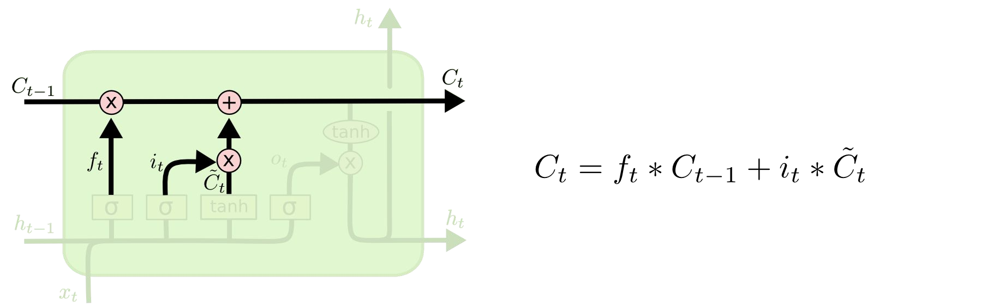
Long Short Term Memory (LSTM)
Update Cell State (memory)
Source: http://colah.github.io/posts/2015-08-Understanding-LSTMs/
Notes:
It's now time to update the old cell state Ct−1, into the new cell state Ct. The previous steps already decided what to do, we just need to actually do it.

Slide 31
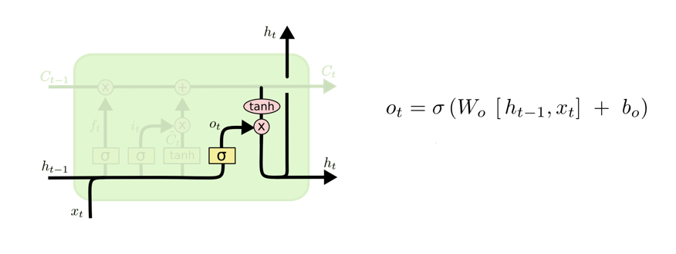

Long Short Term Memory (LSTM)
Output Gate Layer
Decides what part of the current cell state makes it to the output
Ot = output gate
Allows the passed information to impact the current time step
Output to next layer
Source: http://colah.github.io/posts/2015-08-Understanding-LSTMs/
Notes:
Finally, we need to decide what we're going to output. This output will be based on our cell state, but will be a filtered version.

Slide 32

Long Short Term Memory (LSTM)
Source: http://colah.github.io/posts/2015-08-Understanding-LSTMs/

Slide 33
Overfitting
Overfitting occurs when you achieve a good fit of your model on the training data, while it does not generalize well on new, unseen data.
In other words, the model learned patterns specific to the training data, which are irrelevant in other data

Slide 34
Different ways to avoid overfitting
Get more data
Reduce the network’s capacity
Apply regularization
Use Dropout layers

Slide 35
Regularization techniques https://keras.io/regularizers/
Regularization: adding an extra element to the loss function, which punishes our model for being too complex or, for using too high values in the weight matrix
L1: Least Absolute Deviations (Lasso)
L2: Least Square Errors (Ridge)

Slide 36
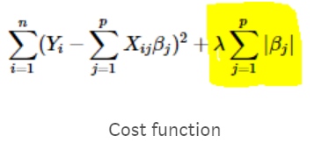
L1: Least Absolute Deviations (Lasso)
Lasso shrinks the less important feature’s coefficient to zero
Removing some feature altogether.
This works well for feature selection in case we have a huge number of features.
https://www.youtube.com/watch?v=9lRv01HDU0s

Slide 37
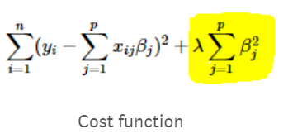
L2:Least Square Errors (Ridge)
Adds “squared magnitude” of coefficient as penalty term to the loss function
https://www.youtube.com/watch?v=9lRv01HDU0s

Slide 38
Hyperparameter Optimization
Grid Search
Random Search
Hand-tuning
Gaussian Process with Expected Improvement
Tree-structured Parzen Estimators (TPE)

Slide 39
Hyperparameter Optimization
Grid search capability from the scikit-learn python machine learning library
Grid search is a model hyperparameter optimization technique
It tune the hyperparameters of deep learning models

Slide 40
How to Use Keras Models in scikit-learn
Keras models can be used in scikit-learn by wrapping them with the KerasClassifier or KerasRegressor class.

Slide 41
How to Tune Batch Size and Number of Epochs
model = KerasClassifier(build_fn=model,verbose=0) batch_size = [10, 20, 40] epochs = [1, 2, 3] param_grid = dict(batch_size=batch_size, epochs=epochs) from sklearn.model_selection import GridSearchCV grid = GridSearchCV(estimator=model, param_grid=param_grid) grid_result = grid.fit(X_train, Y_train) # summarize results print("Best: %f using %s" % (grid_result.best_score_, grid_result.best_params_))

Slide 42
Results
Best: 0.846411 using {'batch_size’: 40, 'epochs’: 3}

Slide 43
List of hyperparameters to be tuned
Optimization Algorithm
optimizer = ['SGD', 'RMSprop', 'Adagrad', 'Adadelta', 'Adam', 'Adamax', 'Nadam’]
Network Weight Initialization
init_mode = ['uniform', 'lecun_uniform', 'normal', 'zero', 'glorot_normal', 'glorot_uniform', 'he_normal', 'he_uniform’]
Neuron Activation Function
activation = ['softmax', 'softplus', 'softsign', 'relu', 'tanh', 'sigmoid', 'hard_sigmoid', 'linear’]
Dropout Regularization
dropout_rate = [0.0, 0.1, 0.2, 0.3, 0.4, 0.5, 0.6, 0.7, 0.8, 0.9]

Slide 44
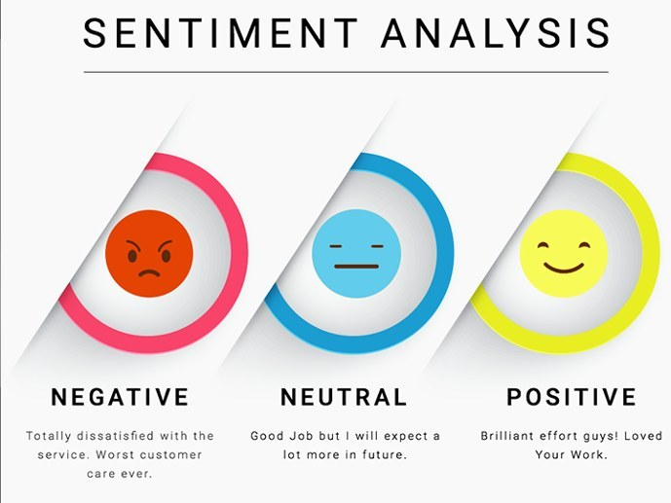
Use case: Sentiment Analysis using LSTM

Slide 45
Sentiment Classification
The process of computationally identifying and categorizing opinions expressed in a piece of text
In order to determine whether the writer's attitude towards a particular topic, product, etc. is positive, negative, or neutral.

Slide 46
First GOP Debate Twitter Sentiment
Analyze tweets on the first 2016 GOP Presidential Debate

Slide 47
keeping the necessary columns
Only keeping the necessary columns.
data = pd.read_csv('../input/Sentiment.csv’)
# Keeping only the neccessary columns
data = data[['text','sentiment']]

Slide 48
Filtering the tweets, using Tokenizer to vectorize, convert text into Sequences
data['text'] = data['text'].apply(lambda x: x.lower())
data['text'] = data['text'].apply((lambda x: re.sub('[^a-zA-z0-9\s]','',x)))
for idx, row in data.iterrows():
row[0] = row[0].replace('rt',' ‘)
max_features = 2000
tokenizer = Tokenizer(num_words=max_fatures, split=' ‘)
tokenizer.fit_on_texts(data['text'].values)
X = tokenizer.texts_to_sequences(data['text'].values)
X = pad_sequences(X)

Slide 49
composing the LSTM Network
https://keras.io/layers/recurrent/#lstm
embed_dim = 128
lstm_out = 196
model = Sequential()
model.add(Embedding(max_fatures, embed_dim,input_length = X.shape[1]))
model.add(LSTM(lstm_out, dropout=0.2, recurrent_dropout=0.2))
model.add(Dense(3,activation='softmax’))
model.compile(loss = 'categorical_crossentropy', optimizer='adam',metrics = ['accuracy'])
(model.summary())

Slide 50
Defining training and test data
labelencoder = LabelEncoder() integer_encoded = labelencoder.fit_transform(data['sentiment’]) Y = to_categorical(integer_encoded)
X_train, X_test, Y_train, Y_test = train_test_split(X,Y, test_size = 0.33, random_state = 42)
(X_train.shape,Y_train.shape)
(X_test.shape,Y_test.shape)
batch_size = 32
model.fit(X_train, Y_train, epochs = 7, batch_size=batch_size, verbose = 2)

Slide 51
Evaluating the model
score,acc = model.evaluate(X_test, Y_test, verbose = 2, batch_size = batch_size)
("score: %.2f" % (score))
("acc: %.2f" % (acc))

Slide 52
References
https://stats.stackexchange.com/questions/181/how-to-choose-the-number-of-hidden-layers-and-nodes-in-a-feedforward-neural-netw
https://stackoverflow.com/questions/47788799/grid-search-the-number-of-hidden-layers-with-keras
https://medium.com/@erikhallstrm/hello-world-rnn-83cd7105b767
https://towardsdatascience.com/exploring-activation-functions-for-neural-networks-73498da59b02
https://medium.com/lingvo-masino/introduction-to-recurrent-neural-network-d77a3fe2c56c
http://colah.github.io/posts/2015-08-Understanding-LSTMs/
https://www.slideshare.net/ashraybhandare/deep-learning-cnn-and-rnn?qid=0f39b4da-a290-4e9e-9d31-ed21816598e3&v=&b=&from_search=27
https://machinelearningmastery.com/truncated-backpropagation-through-time-in-keras/
https://medium.com/explore-artificial-intelligence/an-introduction-to-recurrent-neural-networks-72c97bf0912
https://medium.com/datadriveninvestor/how-do-lstm-networks-solve-the-problem-of-vanishing-gradients-a6784971a577

Slide 53
Cheat Code
Code for saving the model: model.save(‘model.h5’)
Code for loading the model:
from keras.models import load_model
model = load_model(‘model.h5’)
Code for predicting on new data:
model.predict([‘’new text’]

