Slide 1

Keras
.
Keras for Deep Learning Research

Slide 2
Feedback is greatly appreciated!

Slide 3
Unsupervised Learning
Most of the world’s data is unlabeled!
New articles, movie reviews, user Netflix ratings, images on the internet, etc.
What approaches can we take to make use of this type of unlabeled data?
Source: https://www.udemy.com/deeplearning/learn/v4/overview

Slide 4
Unsupervised Learning
Two main approaches
Dimensionality Reduction
Clustering
Source: https://www.udemy.com/deeplearning/learn/v4/overview

Slide 5
Autoencoder
The autoencoder is actually a very simple neural network and will feel similar to a multi-layer perceptron model.
It is designed to reproduce its input at the output layer.
The key difference between an autoencoder and a typical MLP network is that the number of input neurons is equal to the number of output neurons.
Source: https://www.udemy.com/deeplearning/learn/v4/overview

Slide 6
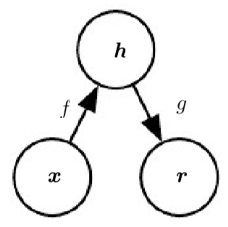
Autoencoder
An autoencoder is a neural network that has three layers:
an input layer,
a hidden (encoding) layer,
and a decoding layer.
The network is trained to reconstruct its inputs, which forces the hidden layer to try to learn good representations of the inputs.

Slide 7
Autoencoder
The general structure of an autoencoder, mapping an input x to an output r (called reconstruction) through an internal representation or code h.
The autoencoder has two components: the encoder f (mapping x to h) and the decoder g (mapping h to r).

Slide 8
Example Autoencoder
Source: https://www.udemy.com/deeplearning/learn/v4/overview

Slide 9
Autoencoder
Outputs
Feed forward network trained to reproduce its input at the output layer.
Output size is the same as the input layer.
Hidden
Inputs
Source: https://www.udemy.com/deeplearning/learn/v4/overview

Slide 10
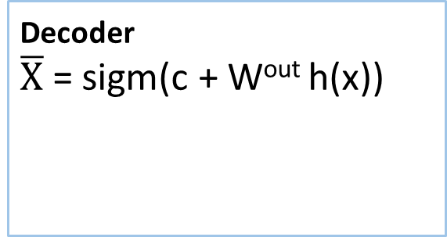

Autoencoder
c
Decoder
$\overline{X}$ = sigm(c + W^{out} h(x))
$$\overline{X}$$
Outputs
W^{out} = W^{T}
h(X)
b
Hidden
Encoder
h(x)= sigm(b + Wx)
W
Tied Weights
X
Inputs
Source: https://www.udemy.com/deeplearning/learn/v4/overview

Slide 11
Autoencoder
Outputs
The hidden/internal representation maintains all the information of the input.
We can use the hidden layer to extract meaningful features.
Hidden
Inputs
Source: https://www.udemy.com/deeplearning/learn/v4/overview

Slide 12
Applications of Autoencoder
Dimensionality Reduction
Data Denoising
Image Reconstruction
Information Retrieval

Slide 13
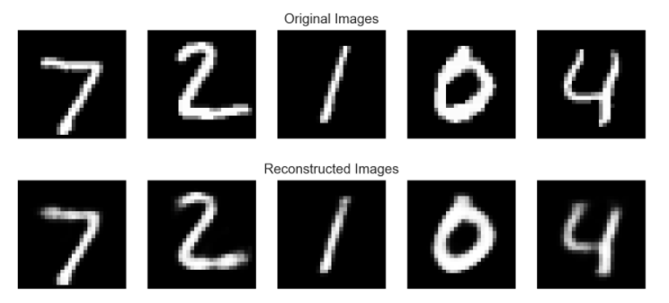
Dimensionality Reduction

Slide 14
Dimensionality Reduction
Dimensionality reduction allows us to get a lower dimension representation of our data.
The encoder creates new (fewer) features from the input features.
For example we can input a 3 dimensional data set and output a 2 dimensional representation of it.
Source: https://www.udemy.com/deeplearning/learn/v4/overview
Notes:
Linear Autoencoders can be used to perform a principal component analysis, which allows us to reduce the dimensionality of our data.
Keep in mind, we are not simply choosing 2 of the previous 3, but instead constructing 2 new features from the 3.
We achieve this effect by using a linear autoencoder.
Linear autoencoders perform the linear transformations by only using the weights and bias terms.

Slide 15
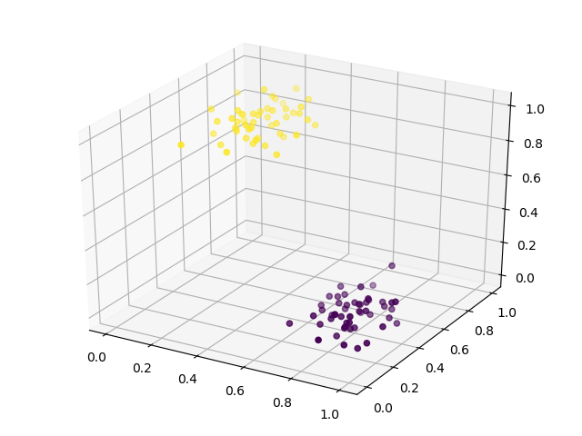
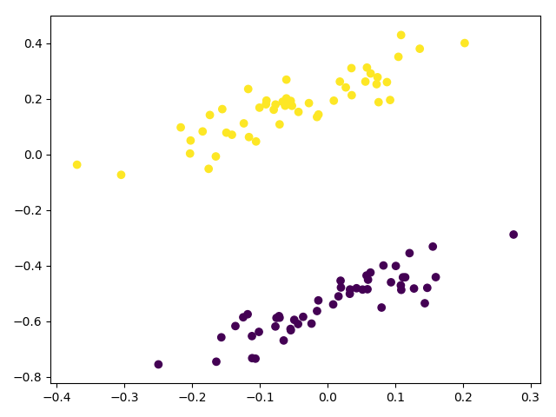
Dimensionality Reduction

Slide 16
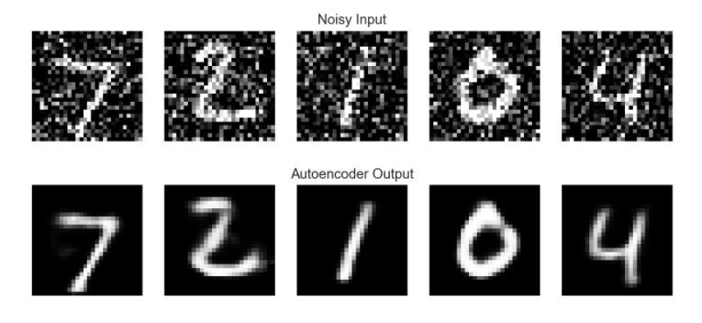
Data Denoising

Slide 17
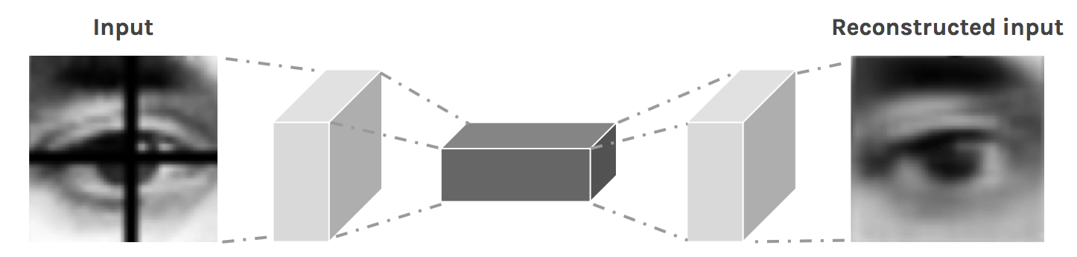
Image Reconstruction
Removes the dark cross-bar in the image

Slide 18
Information Retrieval
This is related to text domain
We can use an autoencoder to find low dimensional codes for documents that allow fast and accurate retrieval of similar documents from a large set.

Slide 19
Autoencoder vs PCA
PCA is restricted to a linear map, while auto encoders can have nonlinear encoder/decoders.
A single layer auto encoder with linear transfer function is nearly equivalent to PCA, where nearly means that the W found by AE and PCA won't be the same--but the subspace spanned by the respective W's will.
Source: https://www.cs.toronto.edu/~urtasun/courses/CSC411/14_pca.pdf

Slide 20
Stacked Autoencoder
Source: https://www.udemy.com/deeplearning/learn/v4/overview

Slide 21
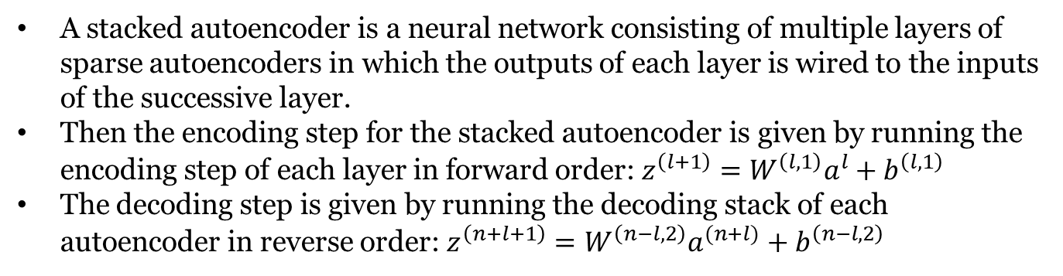
Stacked Autoencoder
A stacked autoencoder is a neural network consisting of multiple layers of sparse autoencoders in which the outputs of each layer is wired to the inputs of the successive layer.
Then the encoding step for the stacked autoencoder is given by running the encoding step of each layer in forward order: $z^{\left(l+1\right)}=W^{\left(l,1\right)}a^{l}+b^{\left(l,1\right)}$
The decoding step is given by running the decoding stack of each autoencoder in reverse order: $z^{\left(n+l+1\right)}=W^{\left(n−l,2\right)}a^{(n+l)}+b^{\left(n−l,2\right)}$
Source: http://ufldl.stanford.edu/wiki/index.php/Stacked_Autoencoders

Slide 22
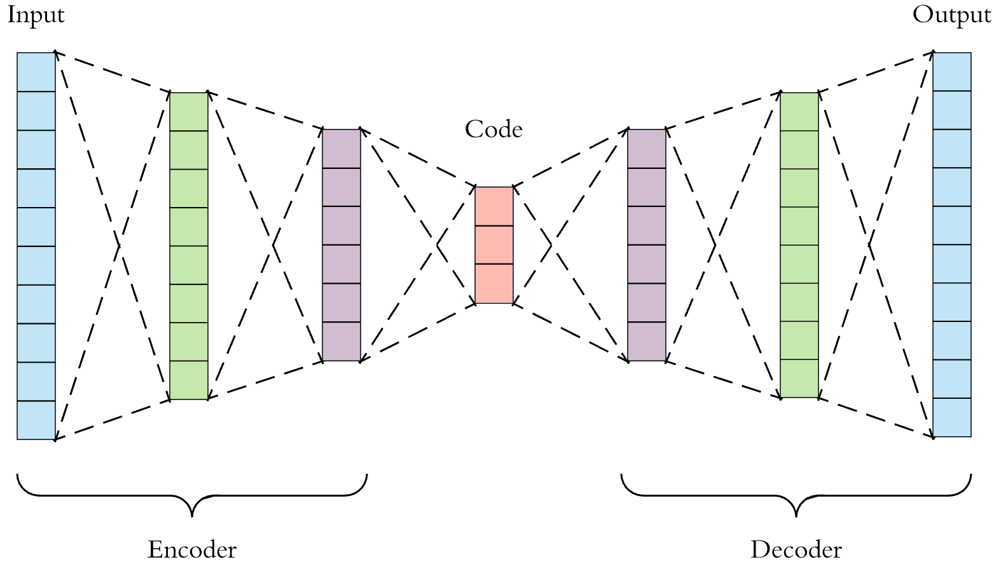
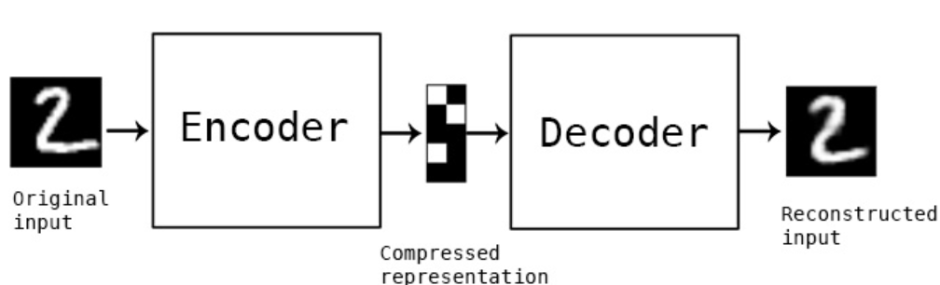
Architecture of Autoencoder

Slide 23
Architecture of Autoencoders
Both the encoder and decoder are fully-connected feedforward neural networks
Code is a single layer of an ANN with the dimensionality of our choice.
The number of nodes in the code layer (code size) is a hyperparameter that we set before training the autoencoder.
Note that the decoder architecture is the mirror image of the encoder.
The only requirement is the dimensionality of the input and output needs to be the same. Anything in the middle can be played with.

Slide 24
Hyperparameters of Autoencoder
Code size
Number of layers
Number of nodes per layer
Loss function

Slide 25
Types of Autoencoder
Undercomplete Autoencoder: An autoencoder whose code dimension is less than the input dimension is called undercomplete. Learning an undercomplete representation forces the autoencoder to capture the most salient features of the training data.
Overcomplete Autoencoder: An autoencoder whose code dimension is greater than the input dimension is called overcomplete.
Regularized Autoencoders: Rather than limiting the size of the code dimension for the sake of feature learning, we can add a loss function to prevent it memorizing the task and the training data.
Source: http://machinelearninguru.com/deep_learning/tensorflow/neural_networks/autoencoder/autoencoder.html

Slide 26
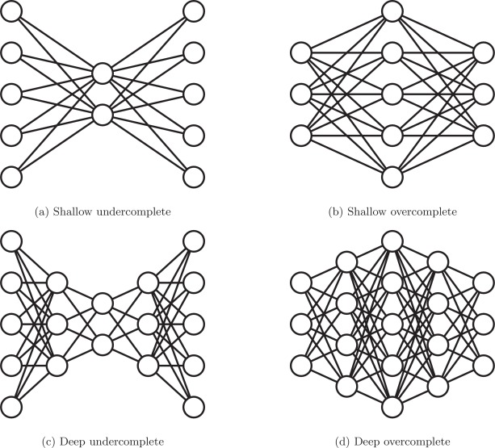
Undercomplete and Overcomplete AE
Source: http://machinelearninguru.com/deep_learning/tensorflow/neural_networks/autoencoder/autoencoder.html
https://www.sciencedirect.com/science/article/pii/S1566253517307844

Slide 27
Types of Regularized Autoencoders
Denoising Autoencoder (DAE)
Sparse Autoencoder (SAE)
Variational Autoencoder (VAE)
Contractive Autoencoder (CAE)
Source: http://machinelearninguru.com/deep_learning/tensorflow/neural_networks/autoencoder/autoencoder.html
https://en.wikipedia.org/wiki/Autoencoder#Variations

Slide 28
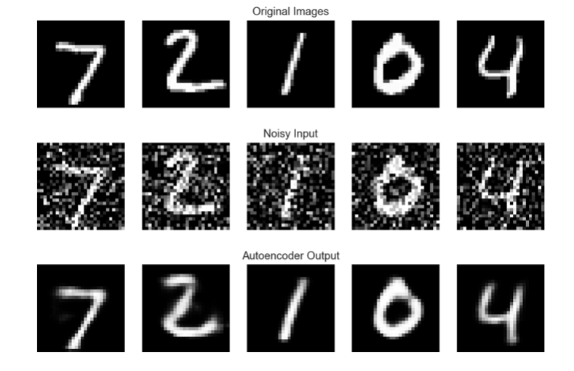
Denoising Autoencoder

Slide 29
Denoising Autoencoder
There is another way to force the autoencoder to learn useful features, which is adding random noise to its inputs and making it recover the original noise-free data.
This way the autoencoder can’t simply copy the input to its output because the input also contains random noise.
We are asking it to subtract the noise and produce the underlying meaningful data.
This is called a denoising autoencoder.

Slide 30
Different kinds of noises
Salt and Pepper Noise
Gaussian Noise
Periodic Noise
Speckle Noise

Slide 31
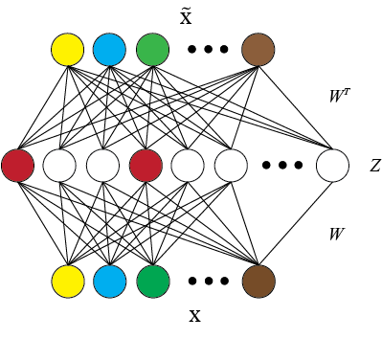
Sparse Autoencoder

Slide 32
Sparse Autoencoder
An autoencoder which has a sparsity penalty in the training loss in addition to the reconstruction error.
We can regularize the autoencoder by using a sparsity constraint such that only a fraction of the nodes would have nonzero values, called active nodes.
In particular, we add a penalty term to the loss function such that only a fraction of the nodes become active.
This method works even if the code size is large, since only a small subset of the nodes will be active at any time.

Slide 33
Usage of callbacks
A callback is a set of functions to be applied at given stages of the training procedure
You can use callbacks to get a view on internal states and statistics of the model during training

Slide 34
Usage of callbacks
TerminateOnNaN: Callback that terminates training when a NaN loss is encountered.
History: Callback that records events into a History object
ModelCheckpoint: Save the model after every epoch.
EarlyStopping: Stop training when a monitored quantity has stopped improving.
LearningRateScheduler: Learning rate scheduler.
ReduceLROnPlateau: Reduce learning rate when a metric has stopped improving.

Slide 35
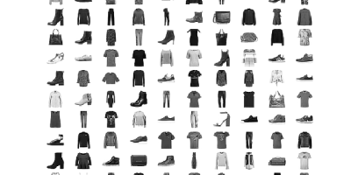
Use Case: Fashion_MNIST data set

Slide 36
Creating model
encoding_dim = 32 # this is our input placeholder input_img = Input(shape=(784,)) # "encoded" is the encoded representation of the input encoded = Dense(encoding_dim, activation='relu')(input_img) # "decoded" is the lossy reconstruction of the input decoded = Dense(784, activation='sigmoid')(encoded) # this model maps an input to its reconstruction autoencoder = Model(input_img, decoded) autoencoder.compile(optimizer='adadelta', loss='binary_crossentropy')

Slide 37
Reading data set
First, we'll configure our model to use a per-pixel binary
crossentropy loss, and the Adadelta optimizer:
from keras.datasets import fashion_ mnist import numpy as np (x_train, _), (x_test, _) = fashion_mnist.load_data()

Slide 38
Fitting model
We will normalize all values between 0 and 1 and we will flatten the 28x28 images into vectors of size 784.
x_train = x_train.astype('float32') / 255. x_test = x_test.astype('float32') / 255. x_train = x_train.reshape((len(x_train), np.prod(x_train.shape[1:]))) x_test = x_test.reshape((len(x_test), np.prod(x_test.shape[1:]))) autoencoder.fit(x_train, x_train, epochs=5, batch_size=256, shuffle=True, validation_data=(x_test, x_test))
prediction = autoencoder.predict(X_test[0])

Slide 39
Use case2: Denoising Autoencoder
The only difference is that we feed a noisy data to the model:
Noise factor controls the noisiness of images
clip the values to make sure that the elements of feature vector representing image are between 0 and 1
#introducing noise noise_factor = 0.5 x_train_noisy = x_train + noise_factor * np.random.normal(loc=0.0, scale=1.0, size=x_train.shape) x_test_noisy = x_test + noise_factor * np.random.normal(loc=0.0, scale=1.0, size=x_test.shape) autoencoder.fit(x_train_noisy, x_train, epochs=10, batch_size=256, shuffle=True, validation_data=(x_test_noisy, x_test_noisy))

Slide 40
Visualizing the train data
from matplotlib import pyplot as plt plt.imshow(x_train[1].reshape(28,28))
plt.show()
from matplotlib import pyplot as plt plt.imshow(prediction.reshape(28,28))
plt.show()

Slide 41
References
http://www.wildml.com/2015/12/implementing-a-cnn-for-text-classification-in-tensorflow/
https://towardsdatascience.com/a-walkthrough-of-convolutional-neural-network-7f474f91d7bd
https://medium.com/@syoya/what-happens-in-sparse-autencoder-b9a5a69da5c6
https://medium.com/@venkatakrishna.jonnalagadda/sparse-stacked-and-variational-autoencoder-efe5bfe73b64

