Slide 1
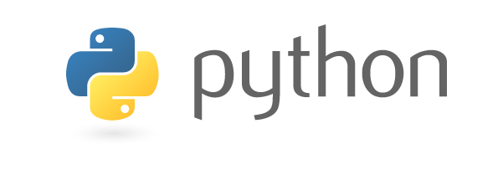
COMP-SCI 5590 - 0011 Special Topics
Python and Deep Learning Programming for Engineers and Scientists
Introduction To Python
A readable, dynamic, pleasant, flexible, fast and powerful language

Slide 2
General Information
Unlike C/C++ or Java, Python statements do not end in a semicolon
In Python, indentation is the way you indicate the scope of a conditional, function, etc.
Look, no braces!
Python is interpretive.
You can just enter statements into the Python environment, and they’ll execute.

Slide 3
Why do people use Python…?
The following primary factors cited by Python users seem to be these:
Python is object-oriented
Structure supports such concepts as polymorphism, operation overloading, and multiple inheritance.
Indentation
Indentation is one of the greatest feature in Python.
It's free (open source)
Downloading and installing Python is free and easy
Source code is easily accessible

Slide 4
It's powerful
- Dynamic typing
- Built-in types and tools
- Library utilities
- Third party utilities (e.g. Numeric, NumPy, SciPy)
- Automatic memory management
It's portable
- Python runs virtually every major platform used today
- As long as you have a compatible Python interpreter installed, Python programs will run in exactly the same manner, irrespective of platform.

Slide 5
It's mixable
Python can be linked to components written in other languages easily
Linking to fast, compiled code is useful to computationally intensive problems
Python/C integration is quite common
It's easy to use
No intermediate compile and link steps as in C/ C++
Python programs are compiled automatically to an intermediate form called bytecode, which the interpreter then reads
This gives Python the development speed of an interpreter without the performance loss inherent in purely interpreted languages
It's easy to learn
Structure and syntax are pretty intuitive and easy to grasp

Slide 6
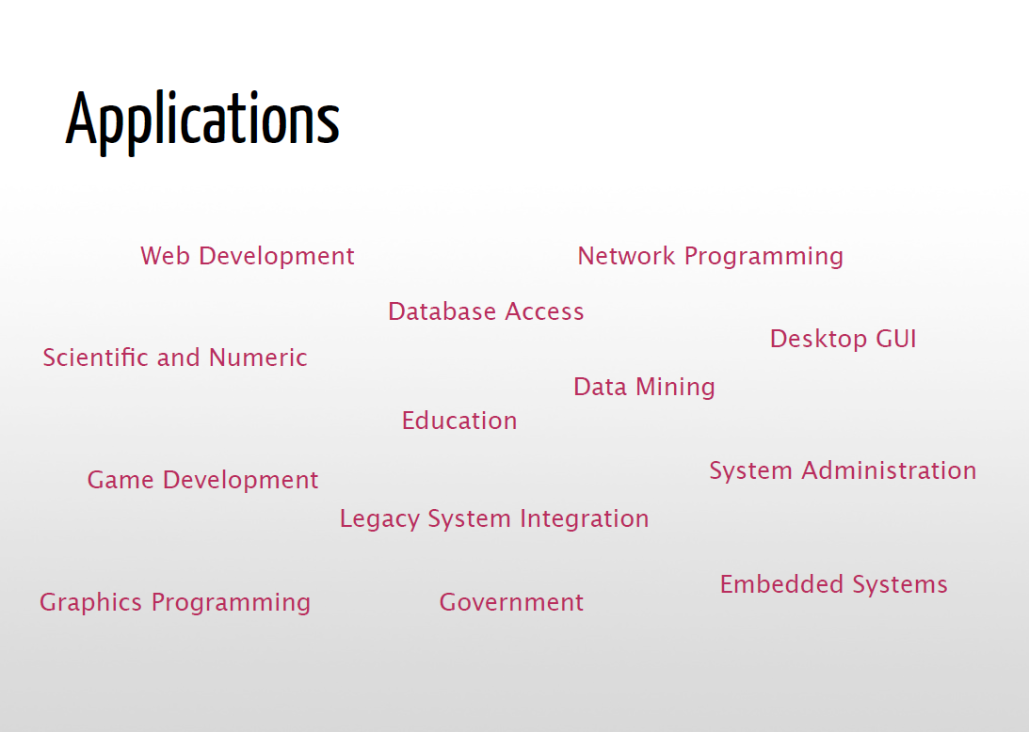
Applications
Science
- Bioinformatics
System Administration
-Unix
-Web logic
-Web sphere
Web Application Development
-CGI
-Jython – Servlets
Testing scripts

Slide 7
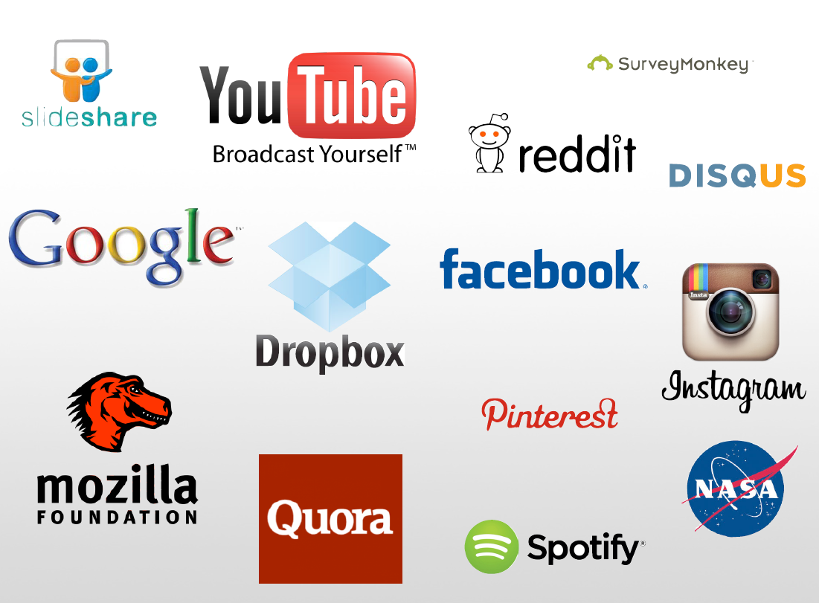
Who uses python today…
Python is being applied in real revenue-generating products by real companies. For instance:
Google makes extensive use of Python in its web search system and employs Python’s creator.
Intel, Cisco, Hewlett-Packard, Seagate, Qualcomm, and IBM use Python for hardware testing.
ESRI uses Python as an end-user customization tool for its popular GIS mapping products.
The YouTube video sharing service is largely written in Python
The list goes on…….

Slide 8
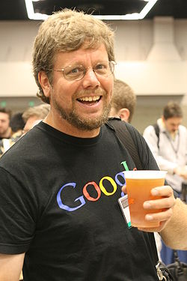
Who created Python?
"My original motivation for creating Python was the perceived need for a higher level language in the Amoeba [Operating Systems] project.
I realized that the development of system administration utilities in C was taking too long. Moreover, doing these things in the Bourne shell wouldn't work for a variety of reasons. ...
So, there was a need for a language that would bridge the gap between C and the shell”
Guido Van Rossum
-The Creator

Slide 9

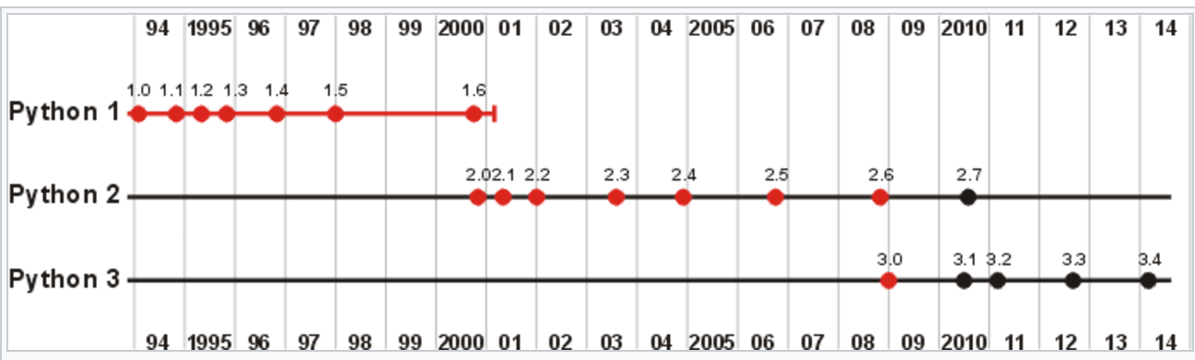
4 Major Versions of Python
“Python” or “CPython” is written in C/C++
- Version 2.7 came out in mid-2010
- Version 3.4 came out in early 2014
“Jython” is written in Java for the JVM
“IronPython” is written in C# for the .Net environment

Slide 10
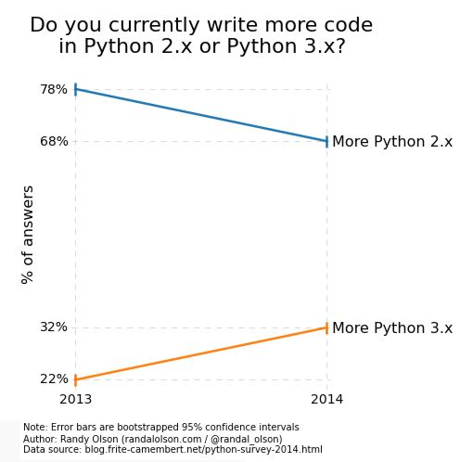
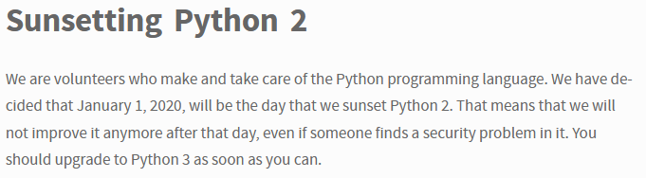
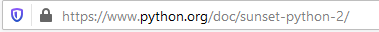
Python 2 vs 3
Learn more from below link:
http://learntocodewith.me/programming/python/python-2-vs-python-3/

Slide 11
Development Environments what IDE to use? http://stackoverflow.com/questions/81584
PyDev with Eclipse
Komodo
Emacs
Vim
TextMate
Gedit
Idle
PIDA (Linux)(VIM Based)
NotePad++ (Windows)
BlueFish (Linux)
PyCharm
Our choice of IDE !!
https://help.uis.cam.ac.uk/help-support/training/downloads/course-files/programming-student-files/python-courses/pythonab/pythonab-files/python3-slides.pdf

Slide 12
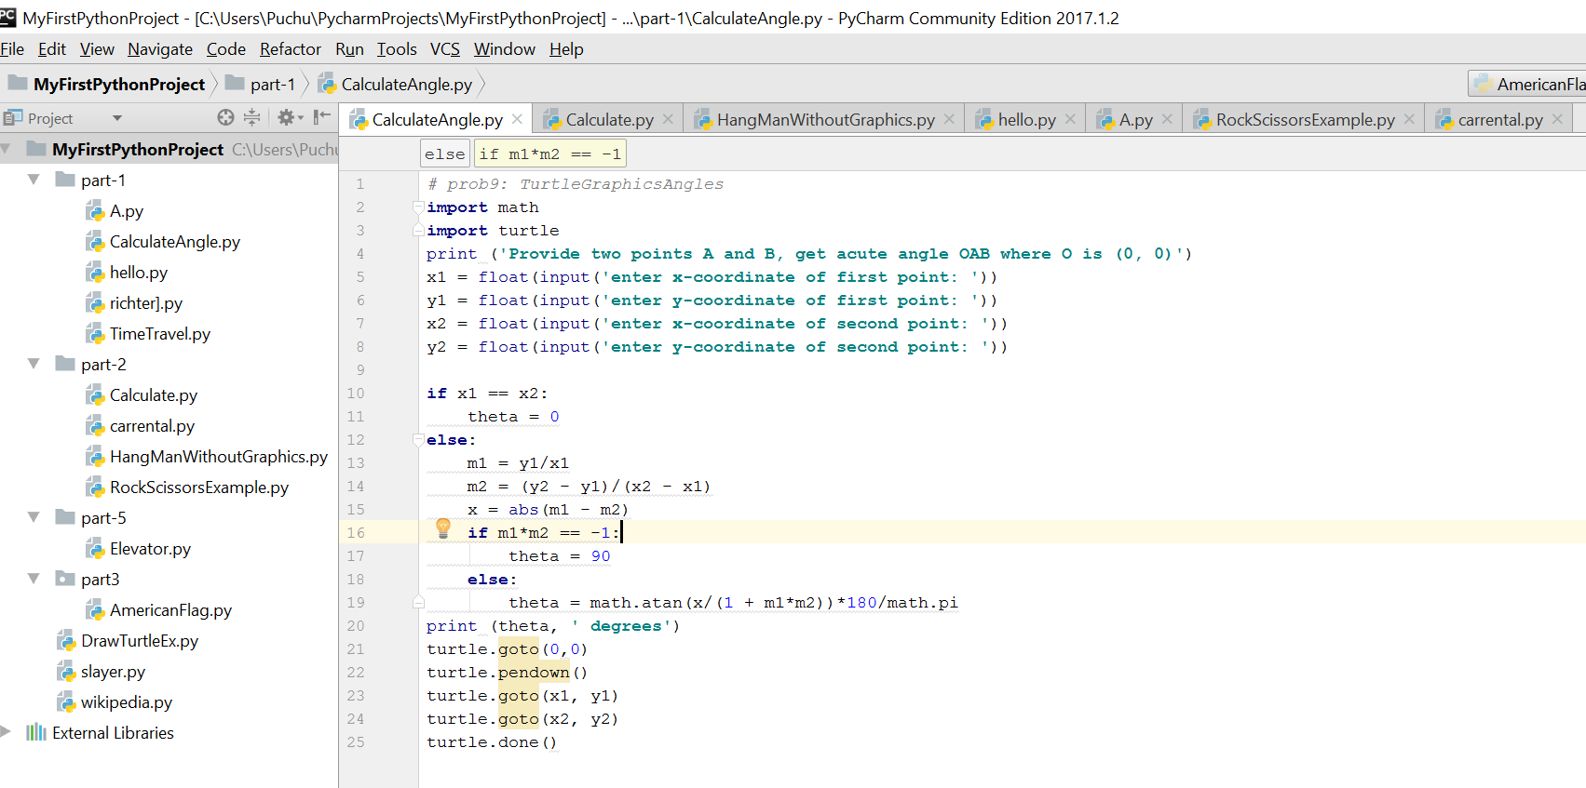
Pycharm IDE
Python File Name
Project Name

Slide 13
Start >>>

Slide 14
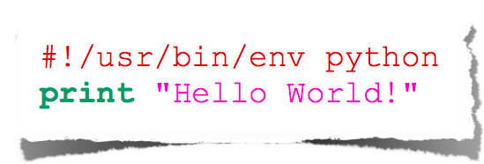
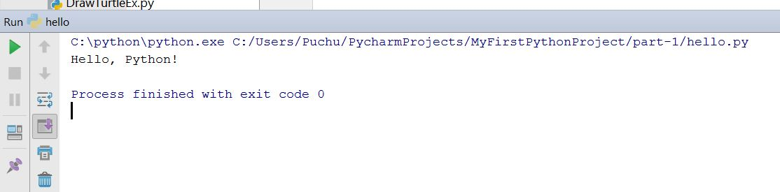
Usecase 1 - Hello World
Output
hello_world.py
Input Sample Program

Slide 15
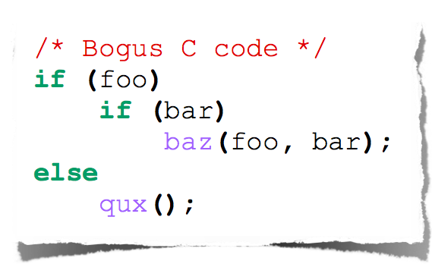
Indentation
Most languages don’t care about indentation
Most humans do
We tend to group similar things together
The else here actually belongs to the 2nd if statement

Slide 16
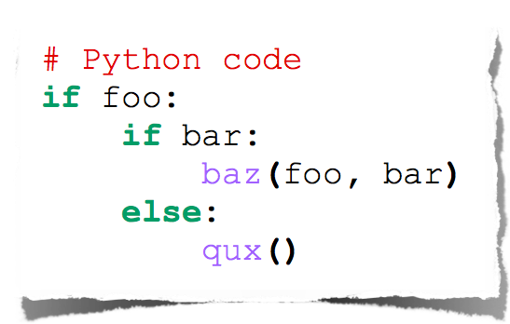
Indentation
Text
Python embraces indentation

Slide 17
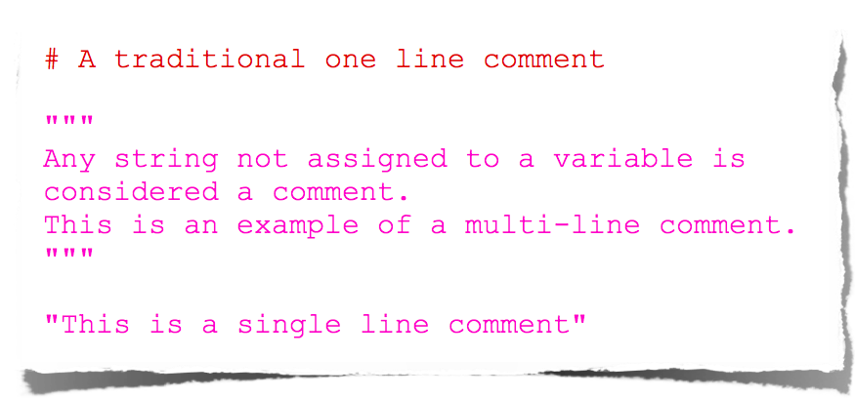
Comments

Slide 18
Types

Slide 19
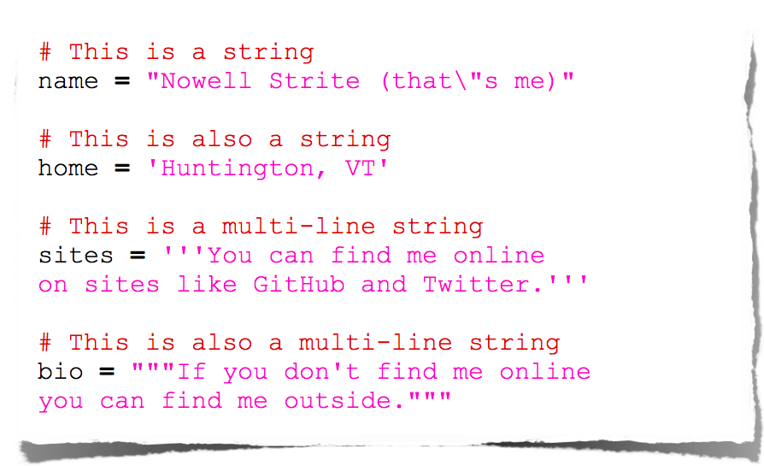
Strings

Slide 20
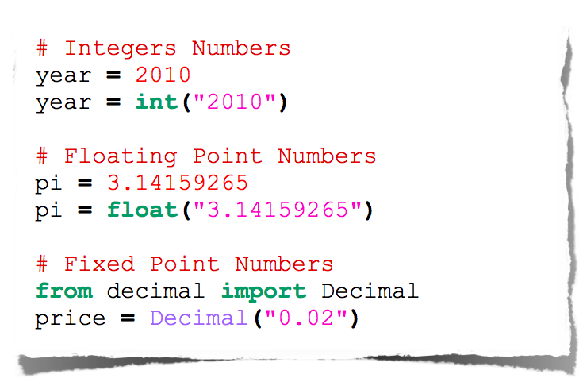
Numbers

Slide 21
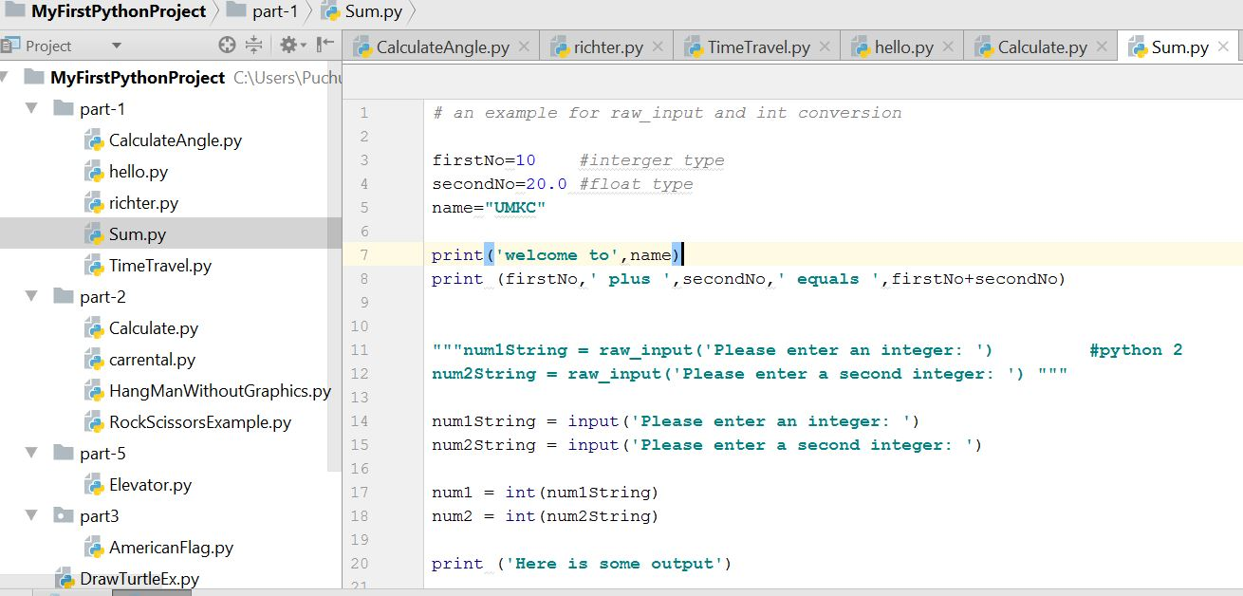
Use case 2- Add two numbers
Variable declaration
Print statement
Python 2 way
Taking Input from user

Slide 22
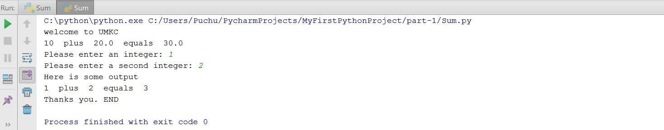
Use case 2- Output

Slide 23
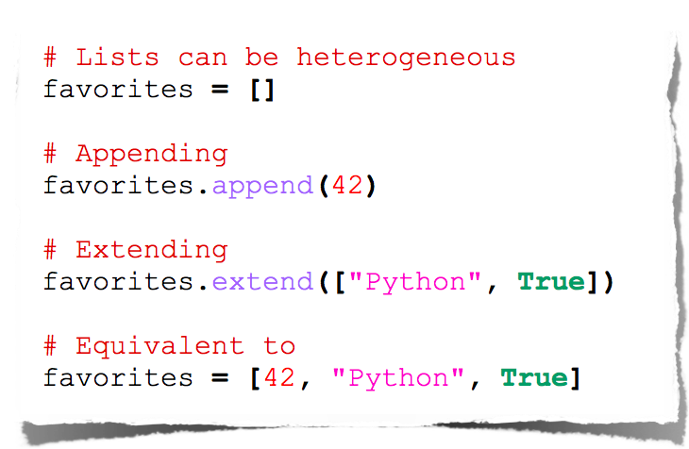
Lists

Slide 24
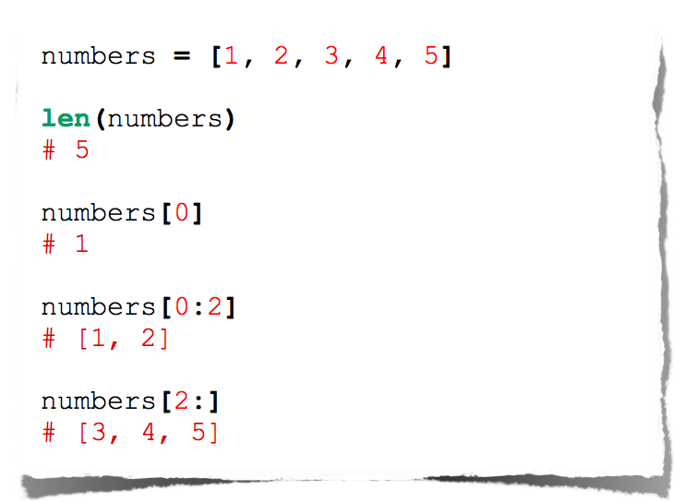
Lists

Slide 25
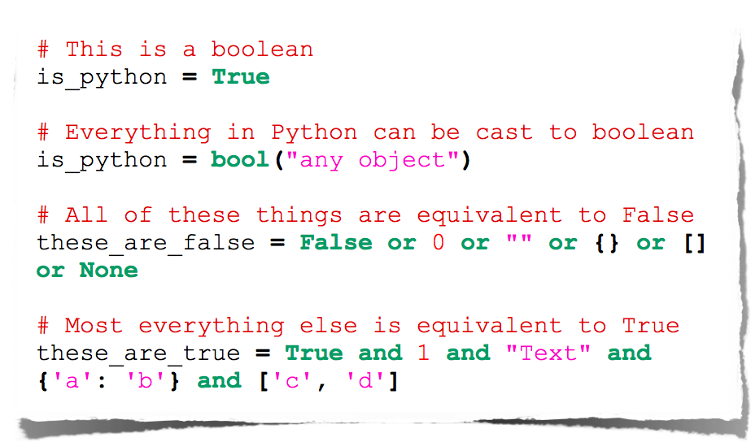
Booleans

Slide 26
Operators

Slide 27
String Formatting
uses C-style string formatting to create new, formatted strings
The "%" operator is used to format
Let's say you have a variable called "name" with your user name in it, and you would then like to print

Slide 28
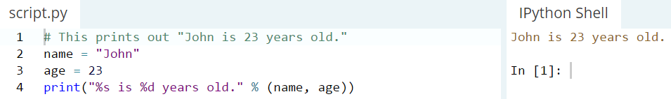
String Formatting: Example

Slide 29
Basic String Operations
we have variable astring = “Hello World!”
print(len(astring)) => 12
print(astring.index("o")) => 4
print(astring.count("l")) => 3

Slide 30
Basic String Operations
print(astring[3:7]) => lo w
print(astring.startswith("Hello")) => true
print(astring.endswith("asdfasdfasdf")) => false
There is no function to reverse a string but we can do like this:
print(astring[::-1]) => !dlrow olleH

Slide 31
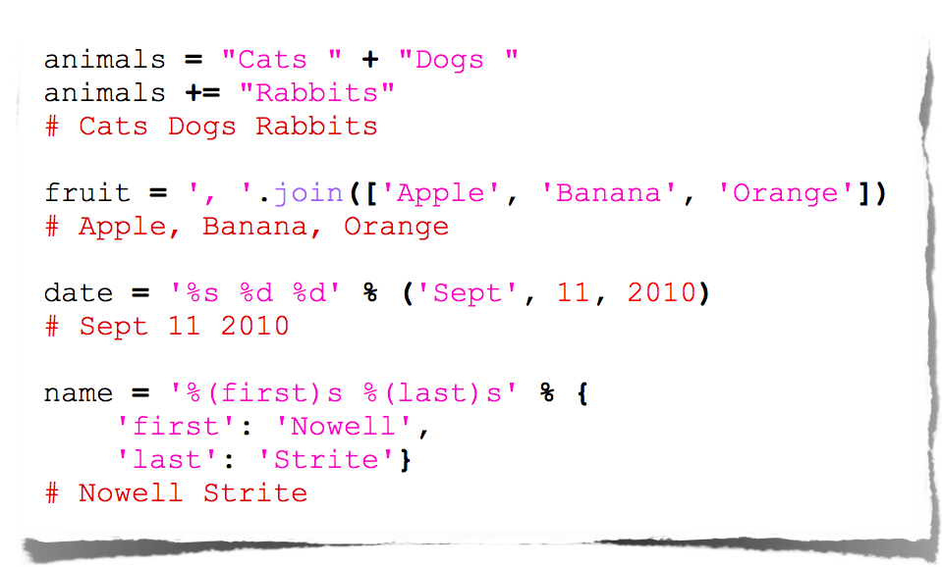
String Manipulation

Slide 32
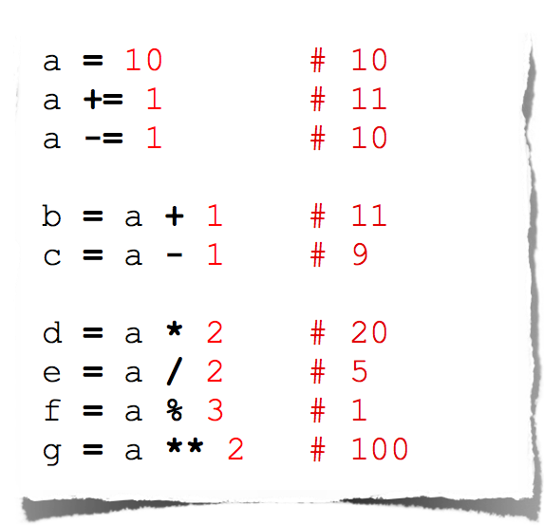
Arithmetic

Slide 33
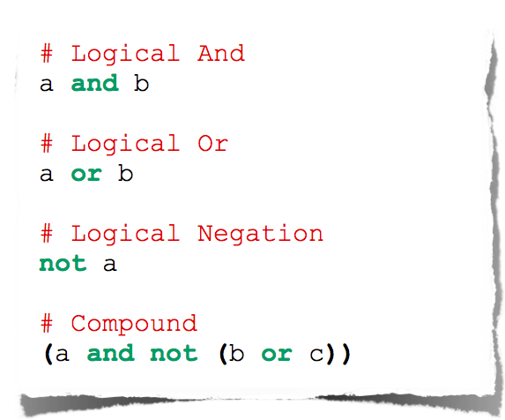
Logical Comparison

Slide 34
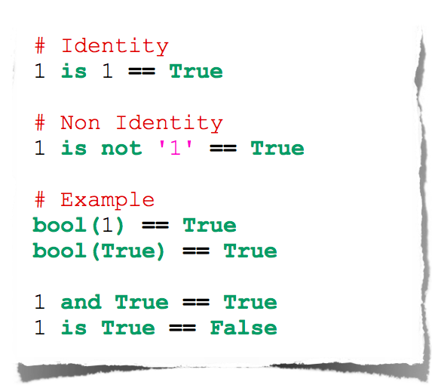
Identity Comparison

Slide 35
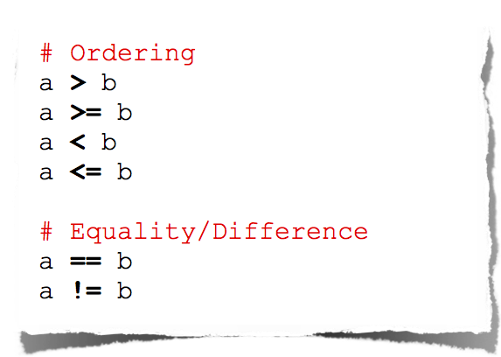
Arithmetic Comparison

Slide 36
Operators Precedence
Operator | Description
** | Exponentiation (raise to the power)
~ + - | Complement, unary plus and minus (method names for the last two are +@ and -@)
* / % // | Multiply, divide, modulo and floor division
+ - | Addition and subtraction
>> << | Right and left bitwise shift
& | Bitwise 'AND'
^ | | Bitwise exclusive `OR' and regular `OR'
<= < > >= | Comparison operators
<> == != | Equality operators
= %= /= //= -= += *= **= | Assignment operators
is is not | Identity operators
in not in | Membership operators
not or and | Logical operators
The order in which operators are executed in any expression

Slide 37
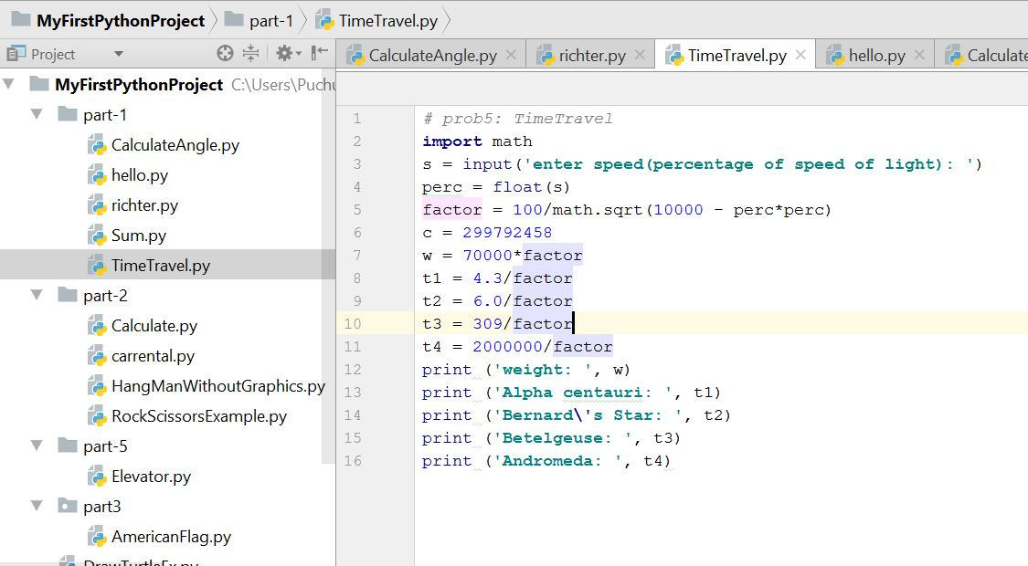
Use case 3- Basic operations
Basic Operations

Slide 38
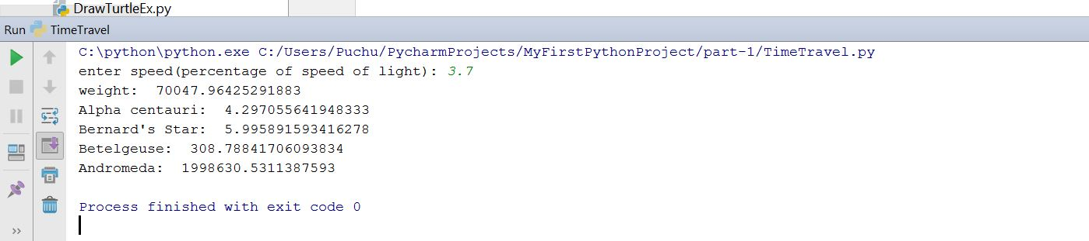
Use case 3- Output

Slide 39
Importing and Modules
Use classes & functions defined in another file to get additional functionality
A Python module is a file with the same name (plus the .py extension)
Like Java import, C++ include
modules have private symbol tables
Three formats of the command:
import somefile
from somefile import *
from somefile import className
When a Python program starts it only has access to a basic functions and classes.
(“int”, “dict”, “len”, “sum”, “range”, ...)

Slide 40
import …
import somefile
Everything in somefile.py gets imported.
To refer to something in the file, append the text “somefile.” to the front of its name:
somefile.className.method(“abc”)
somefile.myFunction(34)

Slide 41
from … import …
from somefile import className
Only the item className in somefile.py gets imported.
After importing className, you can just use it without a module prefix. It’s brought into the current namespace.

Slide 42
import the math module
>>> import math
>>> math.pi
3.1415926535897931
>>> math.cos(0)
1.0
>>> math.cos(math.pi)
-1.0
>>> dir(math)
['__doc__', '__file__', '__name__', '__package__', 'acos', 'acosh',
'asin', 'asinh', 'atan', 'atan2', 'atanh', 'ceil', 'copysign', 'cos',
'cosh', 'degrees', 'e', 'exp', 'fabs', 'factorial', 'floor', 'fmod',
'frexp', 'fsum', 'hypot', 'isinf', 'isnan', 'ldexp', 'log', 'log10',
'log1p', 'modf', 'pi', 'pow', 'radians', 'sin', 'sinh', 'sqrt', 'tan',
'tanh', 'trunc']

Slide 43
Basic Statements: The If Statement (1)
If statements have the following basic structure:
if condition:
action
Subsequent indented lines are assumed to be part of the if statement. The same is true for most other types of python statements. A statement typed into an interpreter ends once an empty line is entered, and a statement in a script ends once an unindented line appears. The same is true for defining functions.
If statements can be combined with else if (elif) and else statements as follows:
if condition1: # if condition1 is true, execute action1
action1
elif condition2: # if condition1 is not true, but condition2 is, execute
action2 # action2
else: # if neither condition1 nor condition2 is true, execute
action3 # action3

Slide 44
Basic Statements: The If Statement (2)
Conditions in if statements may be combined using and & or statements
if condition1 and condition2:
action1
# if both condition1 and condition2 are true, execute action1
if condition1 or condition2:
action2
# if either condition1 or condition2 is true, execute action2
Conditions may be expressed using the following operations:
<, <=, >, >=, ==, !=, in
Somewhat unrealistic example:
x = 2; y = 3; L = [0,1,2]
if (1<x<=3 and 4>y>=2) or (1==1 or 0!=1) or 1 in L:
print 'Hello world'

Slide 45
If-Else-Statement examples
if yearsWorked > 10 :
bonus = 1000 else : bonus = 500
if age >= 65 : price = 0.85 * price numSeniors = numSeniors + 1 else : nonSeniors = nonSeniors + 1

Slide 46
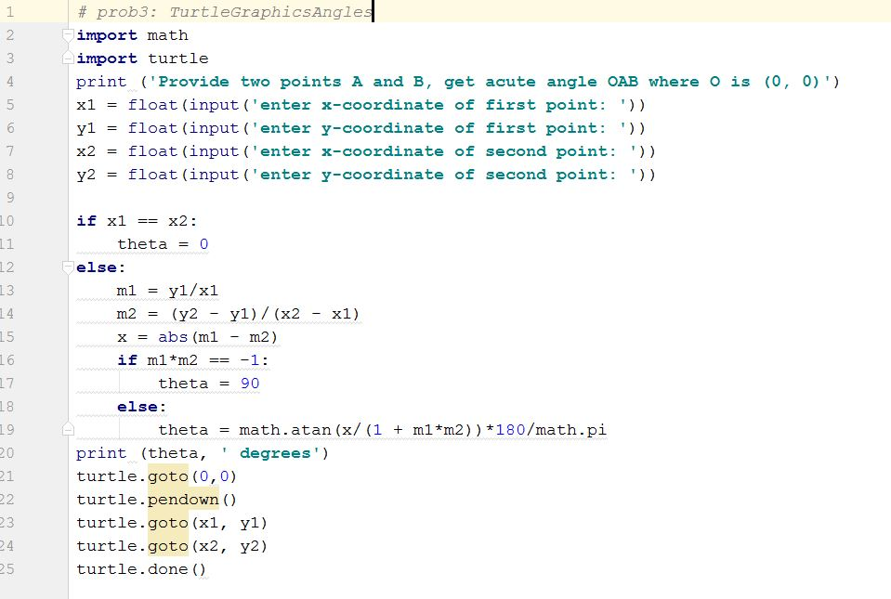
Use Case 4 – Import Turtle Graphics and create the two lines. Also calculate angle between them
Import statements
If block

Slide 47
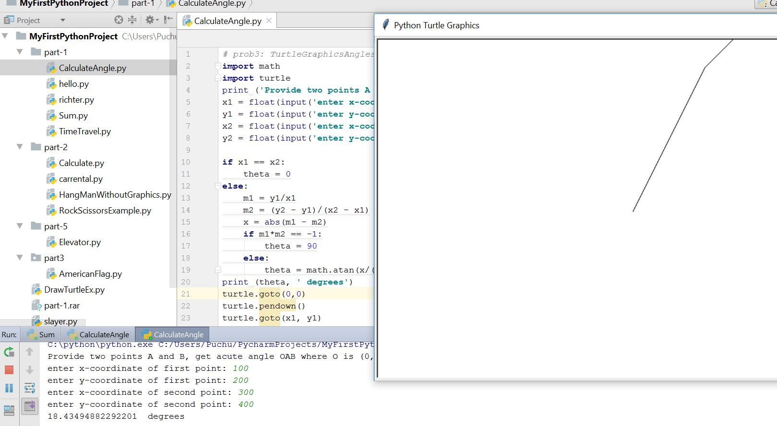
Use Case 4 -Output

Slide 48
Basic Statements: The For Statement (1)
For statements have the following basic structure:
for item i in set s:
action on item i
# item and set are not statements here; they are merely intended to clarify the relationships between i and s
Example:
for i in range(1,7):
print i, i**2, i**3, i**4
1 1 1 1
2 4 8 16
3 9 27 81
4 16 64 256
5 25 125 625
6 36 216 1296
>>>

Slide 49
Basic Statements: The For Statement (2)
The item i is often used to refer to an index in a list, tuple, or array
Example:
L = [0,1,2,3] # or, equivalently, range(4)
for i in range(len(L)):
L[i] = L[i]**2
L
[0,1,4,9]
Of course, we could accomplish this particular task more compactly using arrays:
L = arange(4)
L = L**2
L
[0,1,4,9,]

Slide 50
Range
The range function specifies a range of integers:
range(start, stop) - the integers between start (inclusive)
and stop (exclusive)
It can also accept a third value specifying the change between values.
range(start, stop, step) - the integers between start (inclusive)
and stop (exclusive) by step

Slide 51
Loops: break, continue, else
break and continue like C
else after loop exhaustion
for n in range(2,10):
for x in range(2,n):
if n % x == 0:
print n, 'equals', x, '*', n/x
break
else:
# loop fell through without finding a factor
print n, 'is prime'

Slide 52
Basic Statements: The While Statement (1)
While statements have the following basic structure:
# inside a script
while condition:
action
As long as the condition is true, the while statement will execute the action
Example:
x = 1
while x < 4: # as long as x < 4...
print x**2 # print the square of x
x = x+1 # increment x by +1
1 # only the squares of 1, 2, and 3 are printed, because
4 # once x = 4, the condition is false
9

Slide 53
Basic Statements: The While Statement (2)
Pitfall to avoid:
While statements are intended to be used with changing conditions. If the condition in a while statement does not change
, the program will be stuck in an infinite loop until the user hits ctrl-C.
Example:
x = 1
while x == 1:
print 'Hello world'
Since x does not change, Python will continue to print “Hello world” until interrupted

Slide 54
Basic Statements: Combining Statements
The user may combine statements in a myriad of ways
Example:
L = [0,1,2,3] # or, equivalently, range(4)
for i in range(len(L)):
j = i/2.
if j – int(j) == 0.0:
L[i] = L[i]+1
else: L[i] = -i**2
L
[1,-1,3,-9]

Slide 55
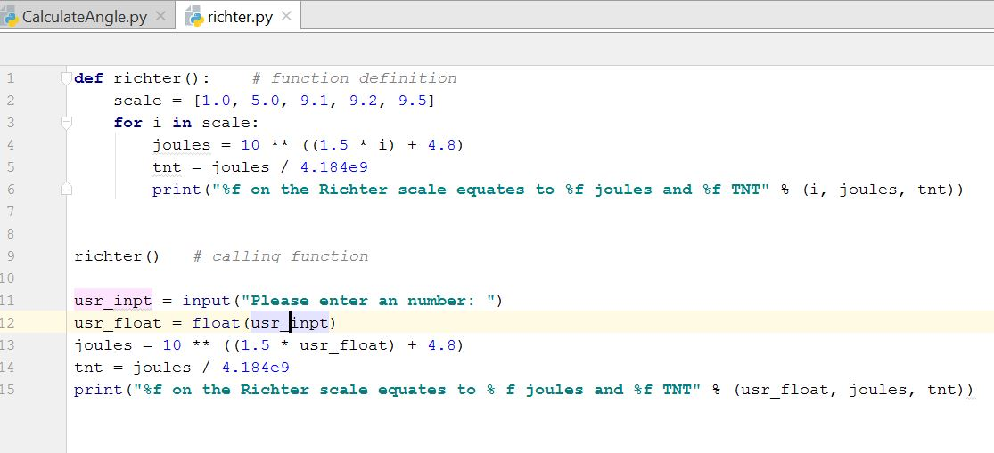
Use Case 5 – Basic for loop
For loop

Slide 56
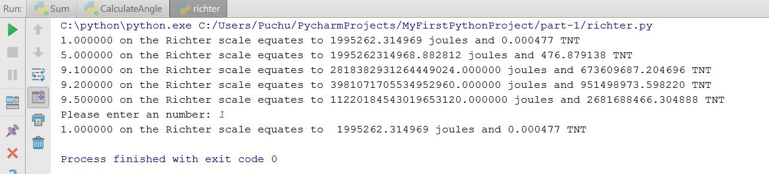
Use Case 5 – Output

Slide 57
References
https://www.slideshare.net/nowells/introduction-to-python-5182313
https://www.slideshare.net/sujithkumar9212301/introduction-to-python-36647807
https://github.com/galactocalypse/python
http://www.cse.msu.edu/~cse231/PracticeOfComputingUsingPython/
https://ocw.mit.edu/courses/electrical-engineering-and-computer-science/6-189-a-gentle-introduction-to-programming-using-python-january-iap-2011/download-course-materials/

