Slide 1

Python Programming
Clustering

Slide 2
Feedback is greatly appreciated!

Slide 3
Clustering

Slide 4

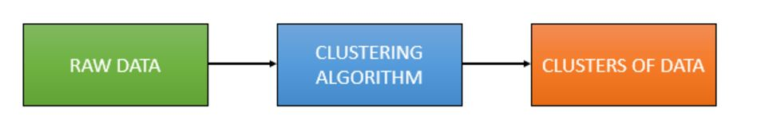
Clustering
Clustering is the grouping of objects together so that objects belonging in the same group (cluster) are more similar to each other than those in other groups (clusters)

Slide 5
Clustering
Clustering is an unsupervised learning algorithm that will attempt to group similar clusters together in your data.
So what does a typical clustering problem look like?
Cluster Similar Documents
Cluster Customers based on Features
Market Segmentation
Identify similar physical groups

Slide 6
Contd.
Method name | Parameters | Scalability | Use case | Geometry (metric used)
K-Means | number of clusters | Very large n_samples, medium n_clusterswith MiniBatch code | General-purpose, even cluster size, flat geometry, not too many clusters | Distances between points
Affinity propagation | damping, sample preference | Not scalable with n_samples | Many clusters, uneven cluster size, non-flat geometry | Graph distance (e.g. nearest-neighbor graph)
Mean-shift | bandwidth | Not scalable with n_samples | Many clusters, uneven cluster size, non-flat geometry | Distances between points
Spectral clustering | number of clusters | Medium n_samples, small n_clusters | Few clusters, even cluster size, non-flat geometry | Graph distance (e.g. nearest-neighbor graph)
Ward hierarchical clustering | number of clusters | Large n_samples and n_clusters | Many clusters, possibly connectivity constraints | Distances between points
Agglomerative clustering | number of clusters, linkage type, distance | Large n_samples and n_clusters | Many clusters, possibly connectivity constraints, non Euclidean distances | Any pairwise distance
DBSCAN | neighborhood size | Very large n_samples, medium n_clusters | Non-flat geometry, uneven cluster sizes | Distances between nearest points
Gaussian mixtures | many | Not scalable | Flat geometry, good for density estimation | Mahalanobis distances to centers
Birch | branching factor, threshold, optional global clusterer. | Large n_clustersand n_samples | Large dataset, outlier removal, data reduction. | Euclidean distance between points

Slide 7
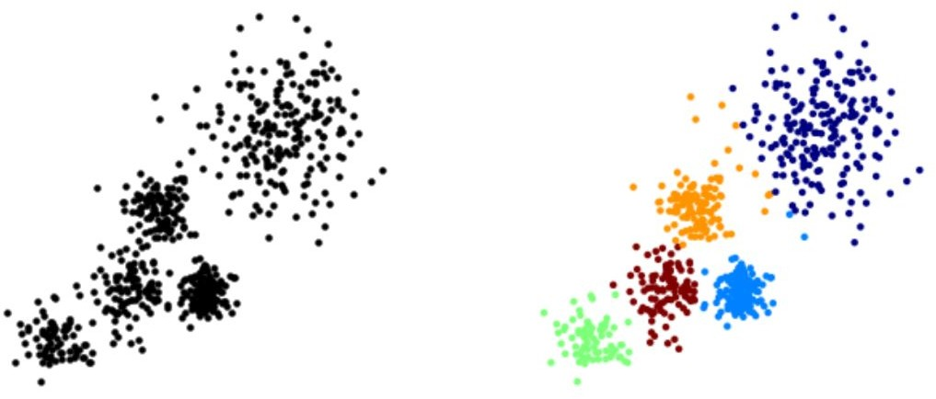
Clustering
The overall goal is to divide data into distinct groups such that observations within each group are similar

Slide 8
K Means Clustering

Slide 9
K Means Clustering
The K Means Algorithm
Choose a number of Clusters “K”
Randomly assign each point to a cluster
Until clusters stop changing, repeat the following:
For each cluster, compute the cluster centroid by taking the mean vector of points in the cluster
Assign each data point to the cluster for which the centroid is the closest

Slide 10
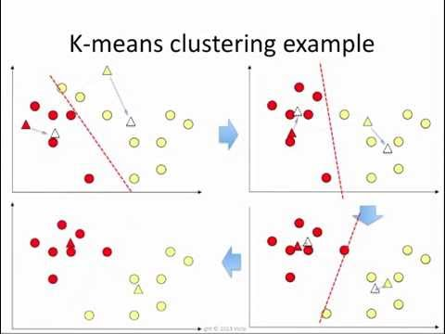
K Means Clustering

Slide 11
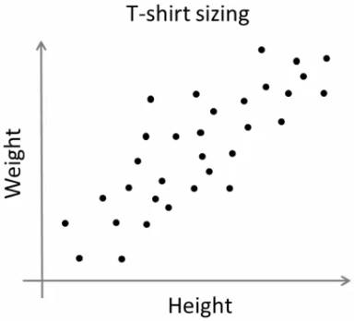
K-Means
T-shirt size problem
Consider a company, which is going to release a new model of T-shirt to market.
Obviously they will have to manufacture models in different sizes to satisfy people of all sizes.
So the company make a data of people’s height and weight, and plot them on to a graph.
Company can’t create t-shirts with all the sizes. Instead, they divide people to Small, Medium and Large, and manufacture only these 3 models which will fit into all the people.

Slide 12
As a first step in finding a sensible initial partition(k=2)
Subject | A | B
1 | 1.0 | 1.0
2 | 1.5 | 2.0
3 | 3.0 | 4.0
4 | 5.0 | 7.0
5 | 3.5 | 5.0
6 | 4.5 | 5.0
7 | 3.5 | 4.5
 | Individual | Mean Vector (centroid)
Group 1 | 1 | (1.0, 1.0)
Group 2 | 4 | (5.0, 7.0)

Slide 13
Steps to do clustering
The remaining individuals are now examined in sequence and allocated to the cluster to which they are closest, in terms of Euclidean distance to the cluster mean.
The mean vector is recalculated each time a new member is added.
 | Cluster 1 |  | Cluster 2
Step | Individual | Mean Vector (centroid) | Individual | Mean Vector (centroid)
1 | 1 | (1.0, 1.0) | 4 | (5.0, 7.0)
2 | 1, 2 | (1.2, 1.5) | 4 | (5.0, 7.0)
3 | 1, 2, 3 | (1.8, 2.3) | 4 | (5.0, 7.0)
4 | 1, 2, 3 | (1.8, 2.3) | 4, 5 | (4.2, 6.0)
5 | 1, 2, 3 | (1.8, 2.3) | 4, 5, 6 | (4.3, 5.7)
6 | 1, 2, 3 | (1.8, 2.3) | 4, 5, 6, 7 | (4.1, 5.4)

Slide 14
Steps to do clustering
Now the initial partition has changed, and the two clusters at this stage having the following characteristics
 | Individual | Mean Vector (centroid)
Cluster 1 | 1, 2, 3 | (1.8, 2.3)
Cluster 2 | 4, 5, 6, 7 | (4.1, 5.4)

Slide 15
Steps to do clustering
But we cannot yet be sure that each individual has been assigned to the right cluster.
So, we compare each individual’s distance to its own cluster mean and to that of the opposite cluster.
Individual | Distance to mean (centroid) of Cluster 1 | Distance to mean (centroid) of Cluster 2
1 | 1.5 | 5.4
2 | 0.4 | 4.3
3 | 2.1 | 1.8
4 | 5.7 | 1.8
5 | 3.2 | 0.7
6 | 3.8 | 0.6
7 | 2.8 | 1.1

Slide 16
Steps to do clustering
Only individual 3 is nearer to the mean of the opposite cluster (Cluster 2) than its own (Cluster 1).
In other words, each individual's distance to its own cluster mean should be smaller that the distance to the other cluster's mean (which is not the case with individual 3).
Thus, individual 3 is relocated to Cluster 2
 | Individual | Mean Vector (centroid)
Cluster 1 | 1, 2 | (1.3, 1.5)
Cluster 2 | 3, 4, 5, 6, 7 | (3.9, 5.1)

Slide 17
Web tools for kmeans clustering
https://www.naftaliharris.com/blog/visualizing-k-means-clustering/

Slide 18
Evaluation
Silhouette score can be used to study the separation distance between the resulting clusters
The silhouette plot displays a measure of how close each point in one cluster is to points in the neighboring clusters and thus provides a way to assess parameters like number of clusters visually
This measure has a range of [-1, 1]
Silhouette coefficients near +1 indicate that the sample is far away from the neighboring clusters
A value of 0 indicates that the sample is on or very close to the decision boundary between two neighboring clusters
Negative values indicate that samples might have been assigned to the wrong cluster.

Slide 19
Dimensionality Reduction
dimension reduction is the process of reducing the number of random variables under consideration by obtaining a set of principal variables.
It can be divided into feature selection and feature extraction

Slide 20
Why do we need Dimension reduction
In machine learning, to catch useful indicators and obtain a more accurate result, we tend to add as many features as possible at first.
However, after a certain point, the performance of the model will decrease with the increasing number of elements
This phenomenon is often referred to as “The Curse of Dimensionality.”

Slide 21
Feature selection and feature extraction
Feature selection tries to select a subset of the original features for use in the machine learning model. In this way, we could remove redundant and irrelevant features without incurring much loss of information
Whereas feature selection returns a subset of the original features, feature extraction creates new features by projecting the data in the high-dimensional space to a space of fewer dimensions.

Slide 22
In addition to avoiding overfitting and redundancy, dimensionality reduction also leads to better human interpretations and less computational cost with simplification of models

Slide 23
Principal Component Analysis(PCA)
The main linear technique for dimensionality reduction
principal component analysis, performs a linear mapping of the data to a lower-dimensional space in such a way that the variance of the data in the low-dimensional representation is maximized.

Slide 24
Feature scaling
It refers to putting the values in the same range or same scale so that no variable is dominated by the other.
It is mostly used in the categorical data where the categories are assigned simple integers such as 0,1,2…which might represent different categories.
But the problem is that when we put this through a machine learning model, it may interpret it as the weightage or something else .
For instance, it may use 0 as the least preference and 2 as a high preference

Slide 25
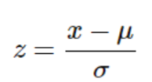
Various methods of feature scaling
Standardization: It is also called Z-score normalization
Min-Max Scaling: It is also referred to as Normalization The features are scaled between 0 and 1

Slide 26
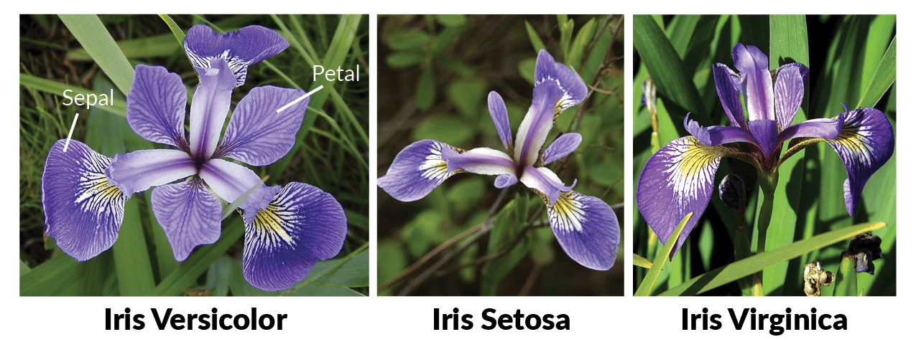
Use Case: Clustering and Dimension Reduction on Iris data set

Slide 27
Clustering
Reading data:
dataset = pd.read_csv('Iris.csv') x = dataset.iloc[:,[1,2,3,4]] y = dataset.iloc[:-1] # see how many samples we have of each species dataset["Species"].value_counts()
Iris-versicolor 50
Iris-setosa 50
Iris-virginica 50

Slide 28
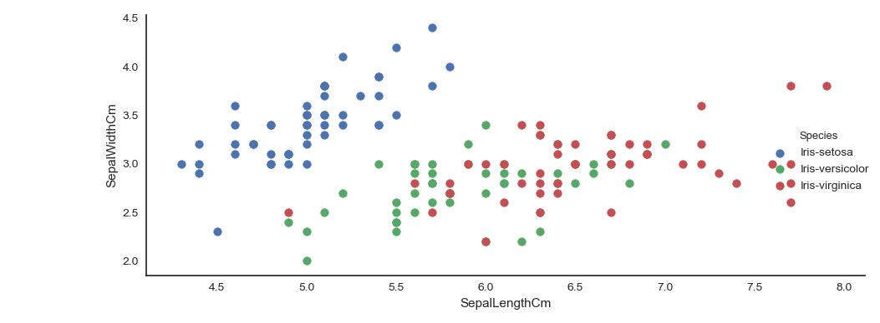
Visualize data
sns.FacetGrid(dataset, hue="Species", size=4).map (plt.scatter,"SepalLengthCm",SepalWidthCm").add_legend()

Slide 29
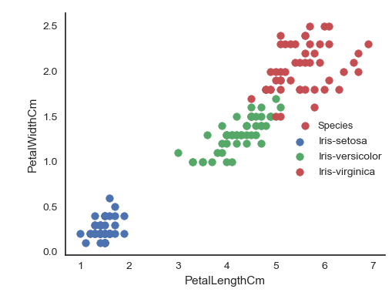
Visualize data
# do same for petals sns.FacetGrid(dataset, hue="Species", size=4).map(plt.scatter, "PetalLengthCm","PetalWidthCm").add_legend()

Slide 30
observations
Note that the species are nearly linearly separable with petal size, but sepal sizes are more mixed.
A clustering algorithm might have a hard time realizing that there were three separate species

Slide 31
Standardization
The data is unbalanced, so should do feature scaling
Otherwise larger feature will dominate the other
from sklearn import preprocessing
scaler = preprocessing.StandardScaler()
scaler.fit(X)
X_scaled_array = scaler.transform(X)
X_scaled = pd.DataFrame(X_scaled_array, columns = X.columns)

Slide 32
K-Means Clustering
from sklearn.cluster import Kmeans
nclusters = 3 # this is the k in kmeans
seed = 0
km = KMeans(n_clusters=nclusters, random_state=seed)
km.fit(X_scaled) # predict the cluster for each data point
y_cluster_kmeans = km.predict(X_scaled)

Slide 33
Silhouette score
# predict the cluster for each data point y_cluster_kmeans = km.predict(x) from sklearn import metrics score = metrics.silhouette_score(x, y_cluster_kmeans)

Slide 34
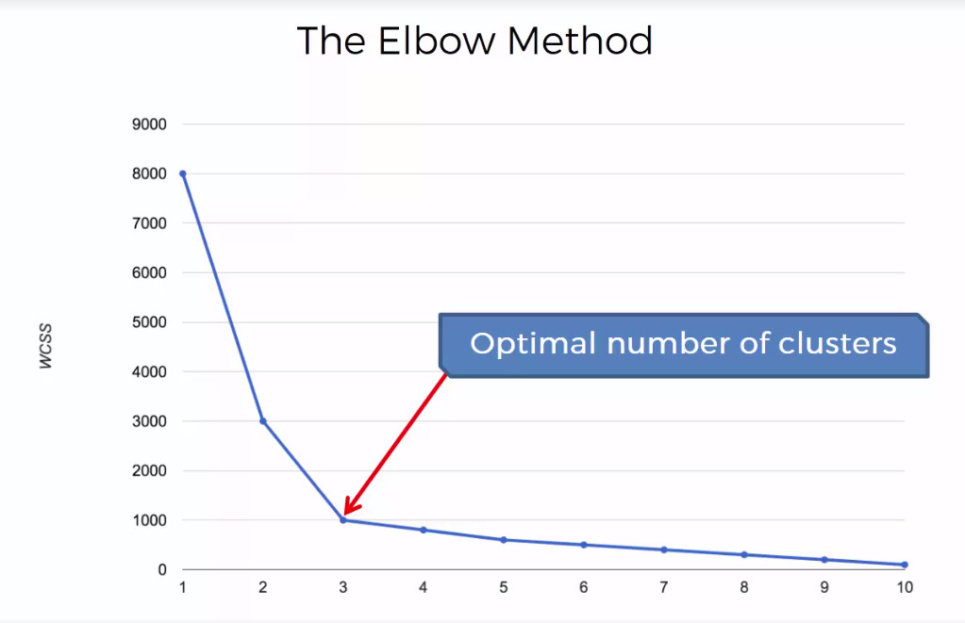
Elbow plot: number of clusters
wcss = [] ##Within Cluster Sum of Squares ##elbow method to know the number of clusters for i in range(1,11): kmeans = KMeans(n_clusters=i,
max_iter=300,random_state=0) kmeans.fit(x) wcss.append(kmeans.inertia_) plt.plot(range(1,11),wcss) plt.title('the elbow method') plt.xlabel('Number of Clusters') plt.ylabel('Wcss') plt.show()
Sum of squared distances of samples to their closest cluster center.

Slide 35
Dimensionality reduction on IRIS data

Slide 36
Read data and Standardize
PCA is effected by scale
you need to scale the features in the data before applying PCA
You can transform the data onto unit scale (mean = 0 and variance = 1)
dataset = pd.read_csv('Iris.csv') x = dataset.iloc[:,[1,2,3,4]] y = dataset.iloc[:,-1] from sklearn.preprocessing import StandardScaler scaler = StandardScaler() # Fit on training set only. scaler.fit(x) # Apply transform to both the training set and the test set. x_scaler = scaler.transform(x)

Slide 37
Apply PCA
Notice the code below has 2 for the number of components parameter.
It means that scikit-learn choose 2 of principal components
from sklearn.decomposition import PCA# Make an instance of the Model pca = PCA(2)
X_pca = pca.fit_transform(x_scaler)

Slide 38
References
http://www-bcf.usc.edu/~gareth/ISL/ISLR%20Sixth%20Printing.pdf
https://web.stanford.edu/~schmit/cme193/lec/lec5.pdf
http://machinelearningmastery.com/machine-learning-in-python-step-by-step/
http://scikit-learn.org/stable/auto_examples/linear_model/plot_ols.html
https://www.analyticsvidhya.com/blog/2015/08/comprehensive-guide-regression/
http://scikit-learn.org/stable/modules/clustering.html
http://scikit-learn.org/stable/auto_examples/cluster/plot_kmeans_digits.html
http://www.kdnuggets.com/2015/11/seven-steps-machine-learning-python.html/2
http://beancoder.com/linear-regression-stock-prediction/
https://github.com/tarlen5/coursera_ml/blob/master/unit6/ex2_sklearn
https://www.kaggle.com/bburns/iris-exploration-pca-k-means-and-gmm-clustering
https://towardsdatascience.com/pca-using-python-scikit-learn-e653f8989e60

Slide 39
Filling null values with mean
data_new.apply(lambda x: x.fillna(x.mean()),axis=0)

