Slide 1

Python Programming
Natural language processing in Python using NLTK

Slide 2
Feedback is greatly appreciated!

Slide 3

Objective
NLP (Natural language processing)
NLTK (Natural Language Toolkit)

Slide 4
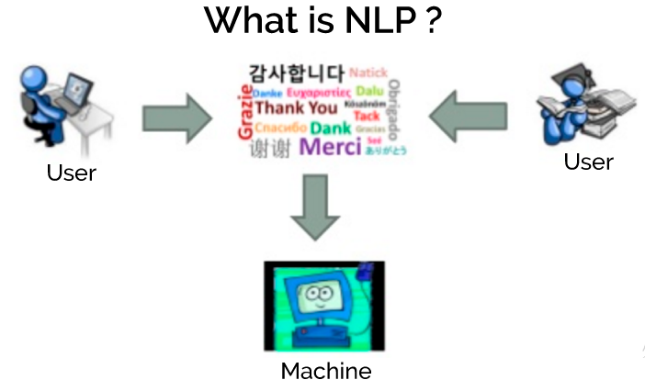
Natural Language Processing
Computer aided text analysis of human language
The goal is to enable machines to understand human language and extract meaning from text
The “Natural Language Toolkit” is a python module that provides a variety of functionality that will aid us in processing text
https://www.upwork.com/hiring/for-clients/artificial-intelligence-and-natural-language-processing-in-big-data/

Slide 5
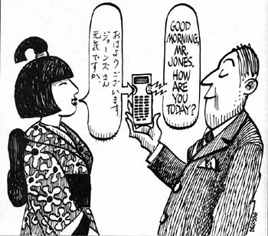
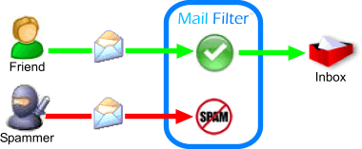
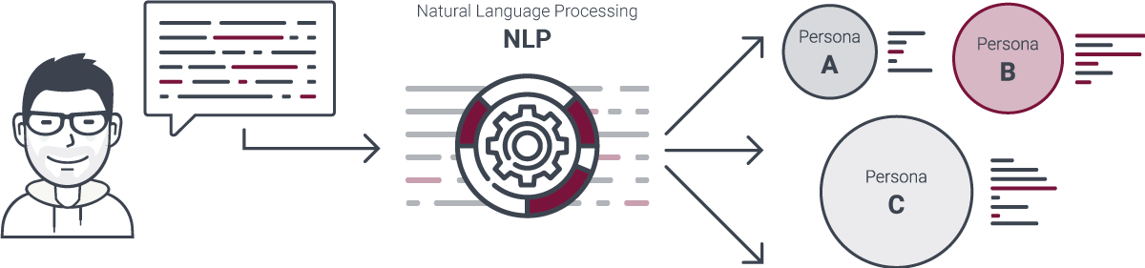

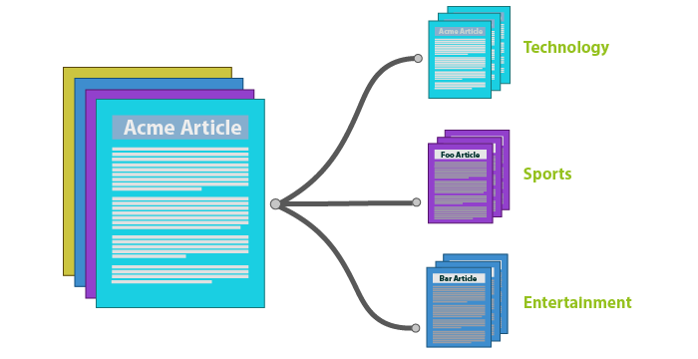
NLP Applications
Consumer behavior Analysis
Site recommendation
Spam filtering
Detecting fake news
Automatic Summarization (to generate summary of given text) and Machine Translation (translation of one language into another)

Slide 6
NLP Libraries
NLTK (Natural Language Toolkit)
SpaCy
Stanford NLP
Apache OpenNLP
https://opensource.com/business/15/7/five-open-source-nlp-tools

Slide 7
NLTK (Natural Language Toolkit)
An open source library which simplifies the implementation of Natural Language Processing(NLP) in Python.
https://www.nltk.org/

Slide 8
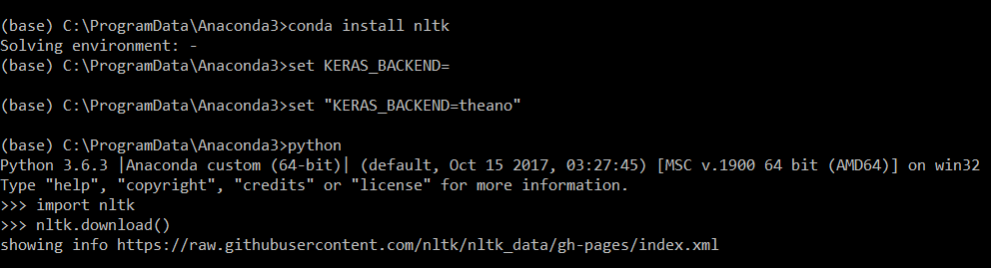
Download and Installation
For Anaconda and Python3.6
Run the Python interpreter and type the commands:
> conda install nltk
>python
>>> import nltk
>>>nltk.download()
https://www.nltk.org/

Slide 9
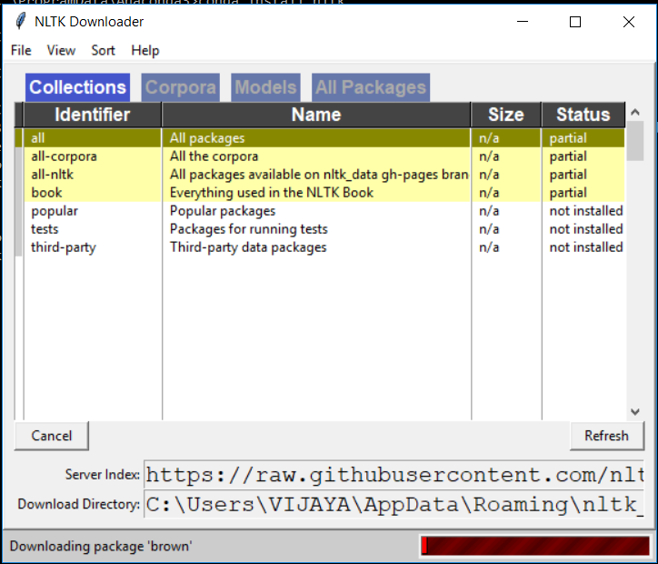
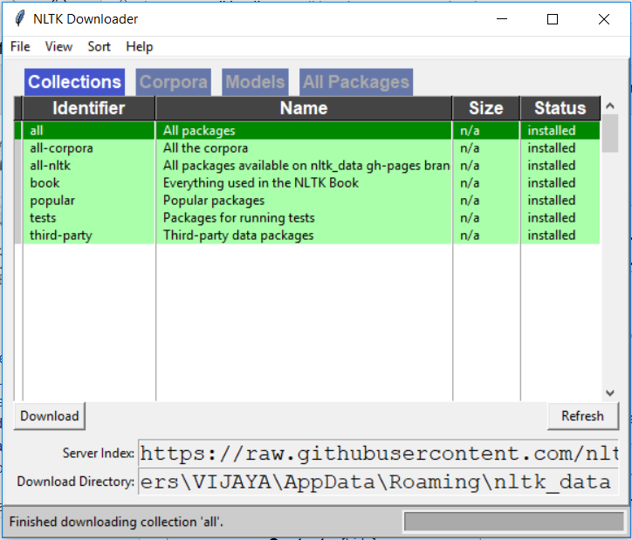
Download and Installation
https://www.nltk.org/

Slide 10

Download and Installation
For pip or other
Installation instructions at: http://www.nltk.org/
Run the Python interpreter and type the commands:
Opens the NLTK downloader, you can choose what to download.
https://www.nltk.org/

Slide 11
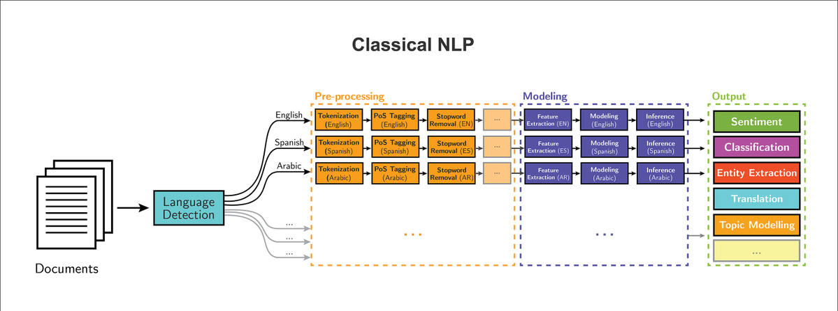
Basic NLP pipeline
https://www.nltk.org/

Slide 12
Text corpora
Corpus
Large collection of text
Raw or categorized
Concentrate on a topic or open domain
The plural form of corpus is corpora
Examples
Brown Corpus - first, largest corpus, categorized by genre such as news, editorial, and so on
Web and Chat Text - discussion forum, reviews, etc.
Reuters Corpus - news, 90 topics
Universal Declaration of Human Rights (UDHR) corpus – multilingual (372)
https://www.nltk.org/book/ch02.html

Slide 13
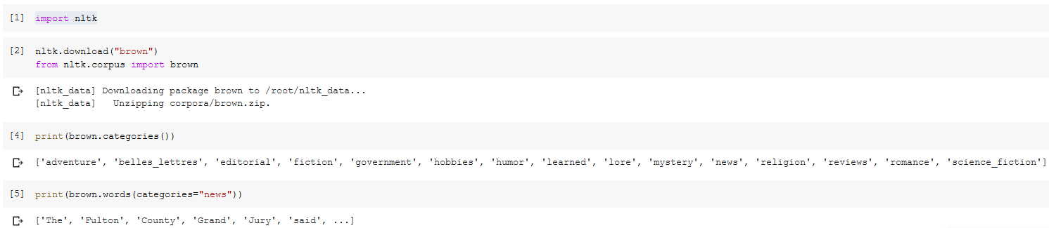
Working with brown corpus example

Slide 14
WordNet
WordNet is a lexical database for the English language
It groups English words into sets of synonyms called synsets
WordNet is freely and publicly available for download
WordNet's structure makes it a useful tool for natural language processing
The main relation among words in WordNet is synonymy, as between the words car and automobile
https://en.wikipedia.org/wiki/WordNet

Slide 15
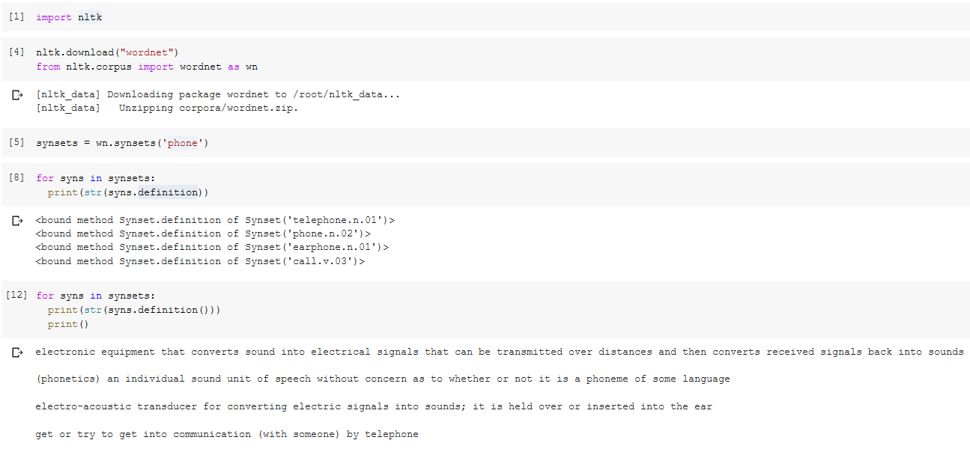
WordNet: Example
https://wordnet.princeton.edu/

Slide 16
Steps for natural language processing

Slide 17
Tokenization
Tokenization is the process of breaking a stream of text up into words, phrases, symbols, or other meaningful elements called tokens.
The tokens may be the sentences, words, numbers or punctuation marks.
Example:
I/P: Mango, banana, pineapple and apple all are fruits.
O/P: Mango | Banana | Pineapple | and | Apple | all | are | Fruits
https://www.tutorialspoint.com/artificial_intelligence_with_python/artificial_intelligence_with_python_nltk_package.htm

Slide 18
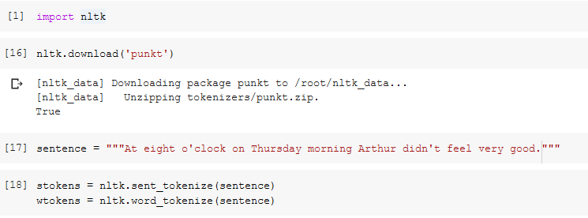
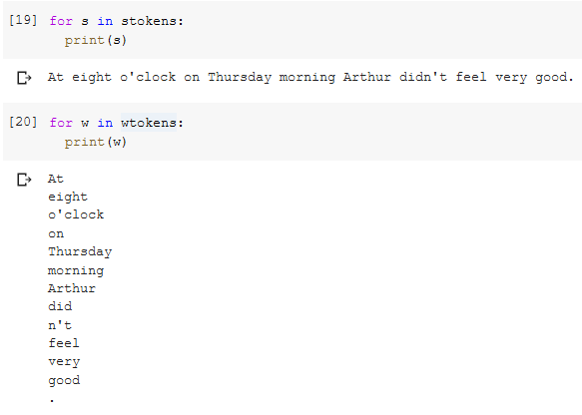
Tokenization: Example
1 2

Slide 19
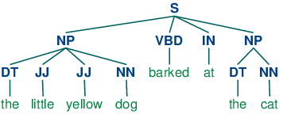
Part of Speech tagging
The process of classifying the words in a text(corpus) into their parts of speech and labeling them accordingly is known as part-of-speech tagging, POS-tagging, or simply tagging
Parts of speech are also known as word classes or lexical categories
The collection of tags used for a particular task is known as a tagset
In English the main parts of speech are noun, pronoun, adjective, determiner, verb, adverb, preposition, conjunction, and interjection

Slide 20
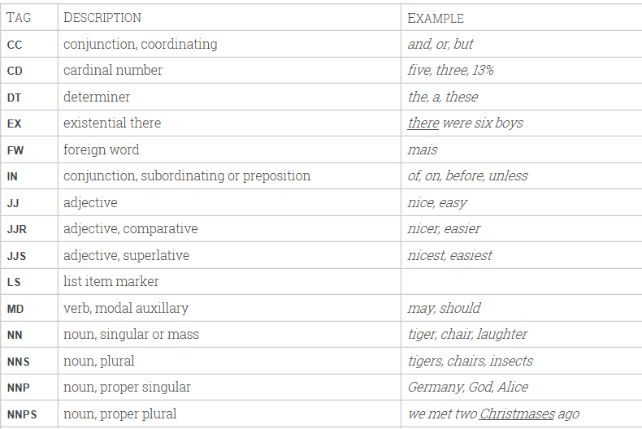
Penn Treebank Part-of-Speech Tags
https://www.clips.uantwerpen.be/pages/mbsp-tags
https://www.ling.upenn.edu/courses/Fall_2003/ling001/penn_treebank_pos.html

Slide 21
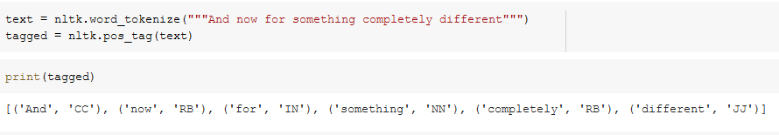
Part of Speech tagging: Example
POS-tagger, processes a sequence of words, and attaches a part of speech tag to each word.
Here we see that:
And is CC, a coordinating conjunction;
now and completely are RB, or adverbs;
for is IN, a preposition;
something is NN, a noun;
different is JJ, an adjective.
https://www.nltk.org/book/ch05.html

Slide 22

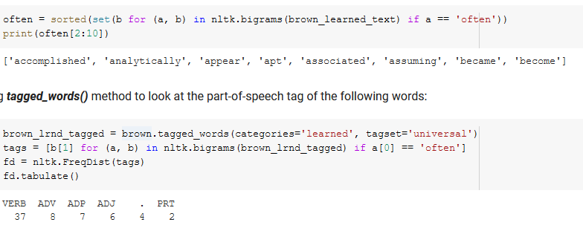
Part of Speech tagging: Example
Exploring Tagged Corpora
Suppose we're studying the word often and want to see how it is used in text. We could ask to see the words that follow often
the most high-frequency parts of speech following often are verbs
https://www.nltk.org/book/ch05.html

Slide 23
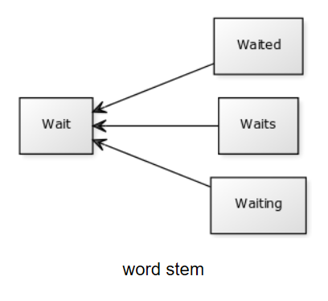
Stemming
For grammatical reasons, documents are going to use different forms of a word, such as organize, organizes, and organizing
Stemming is the process for reducing injected words to their stem, base root form
ies -> Y Applies -> Apply
Ing-> reading -> read
https://pythonspot.com/nltk-stemming/

Slide 24
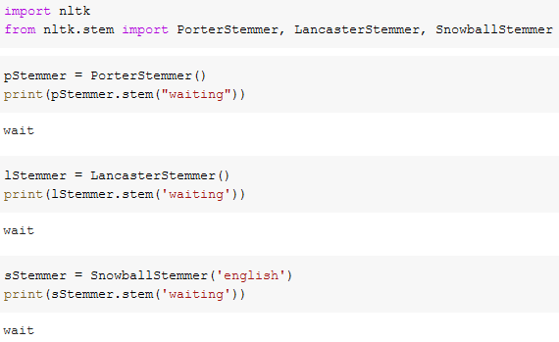
Stemming: Example
http://text-processing.com/demo/stem/

Slide 25
Lemmatization
Lemmatization process involves first determining the part of speech of a word and applying different normalization rules for each part of speech
The WordNet Lemmatizer uses the WordNet Database to lookup lemmas
Lemmatization and stemming are related, but different. The difference is that a stemmer operates on a single word without knowledge of the context, and therefore cannot discriminate between words which have different meaning depending on part of speech.
https://pythonprogramming.net/lemmatizing-nltk-tutorial/

Slide 26
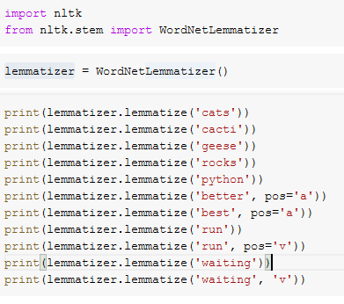
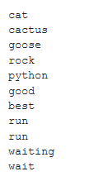
Lemmatization: Example
https://pythonprogramming.net/lemmatizing-nltk-tutorial/

Slide 27
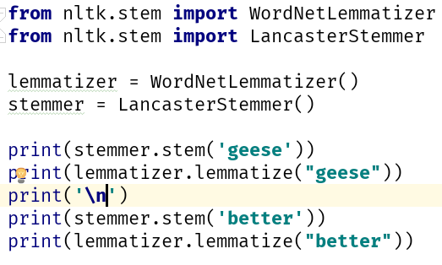
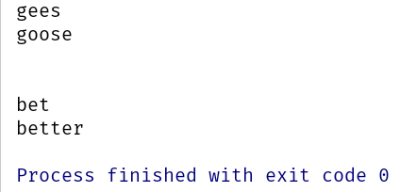
Stemming vs Lemmatization
Input
Output
https://pythonprogramming.net/lemmatizing-nltk-tutorial/

Slide 28
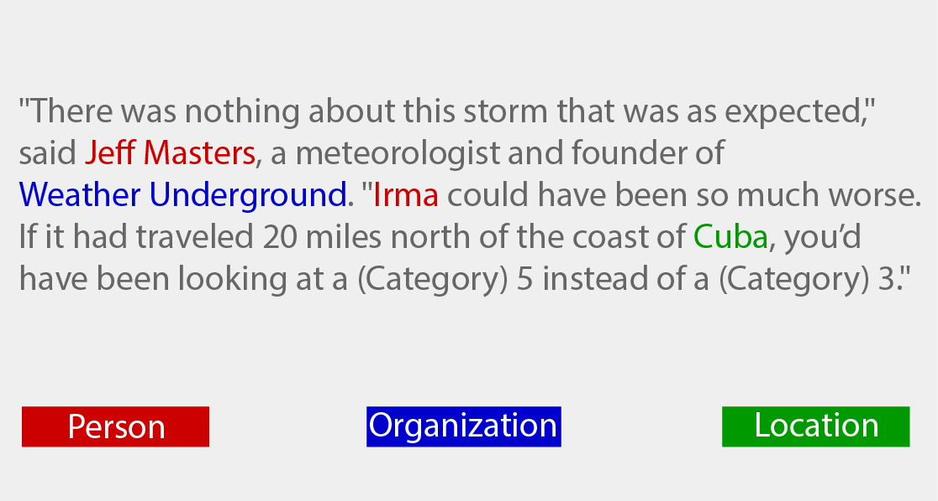
Named Entity Recognition (NER)
Named entity recognition is the subtask of information extraction that seeks to locate and classify elements in text into pre-defined categories such as the names of the person, organizations, locations, expressions of times, quantities, etc.
https://www.nltk.org/book/ch07.html
Notes:
Why do you need this information? You might want to map it against a knowledge base to understand what the sentence is about, or you might want to extract relationships between different named entities (like who works where, when the event takes place etc.)

Slide 29
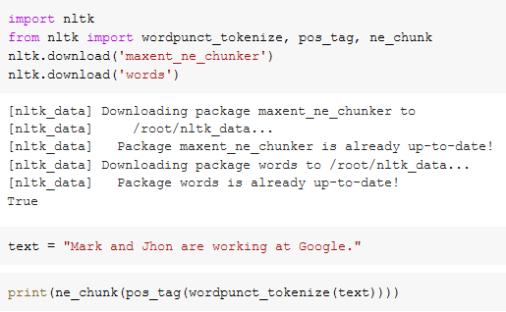
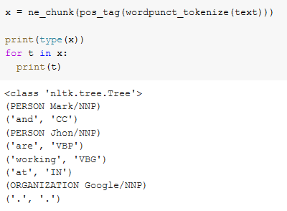
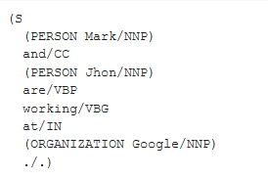
Named Entity Recognition (NER): Example
https://www.nltk.org/book/ch07.html

Slide 30
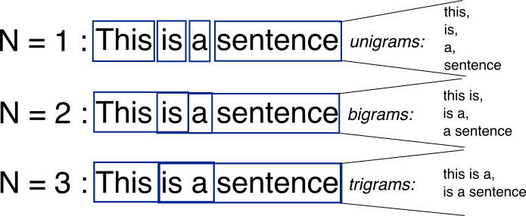
N-gram
An n-gram is a contiguous sequence of n items from a given sample of text or speech.

Slide 31
Trigram: Example
The sentence "the quick red fox jumps over the lazy brown dog" has the following word level trigrams:
the quick red
quick red fox
red fox jumps
fox jumps over
jumps over the
over the lazy
the lazy brown
lazy brown dog

Slide 32
NLTK modules and functionality
NLTK modules | Functionality
nltk.corpus | Corpus
nltk.tokenize, nltk.stem | Tokenizers, Stemmer
nltk.collacations | T-test, chi-squared, mutual-info
nltk.tag | N-gram
nltk.cluster, nltk.classify | Decision tree, Naïve Bayes, K means
nltk.chunk | Regex, n-gram, named-entity
nltk.parsing | parsing
nltk.metrics | Evaluation metrics
nltk.probability | Probability and estimation
nltk.app, nltk.chat | Applications

Slide 33
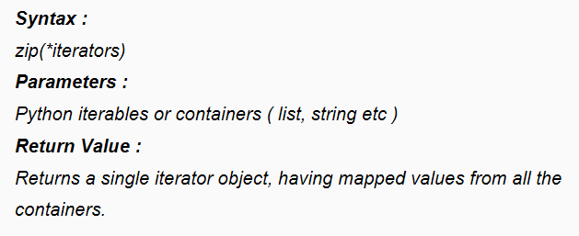
zip() in Python
The purpose of zip() is to map the similar index of multiple containers so that they can be used just as single entity

Slide 34
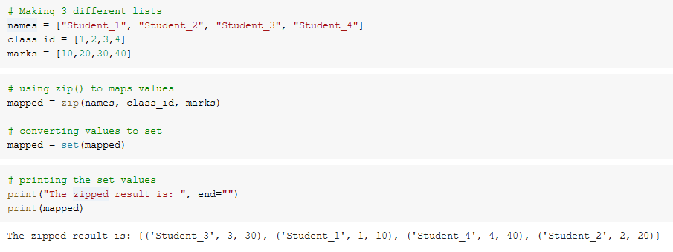
zip(): Example

Slide 35
We are here to think about
Determining the topic of an article or a book
Deciding if an email is spam or not
Determining who wrote a text
Determining the meaning of a word in a particular context
Creating a new poem out of a text

Slide 36
Text Classification
Text classification is:
the process of assigning tags or categories to text according to its content.
Unstructured data in the form of text is everywhere:
emails, chats, web pages, social media, support tickets, survey responses, and more.
Text can be an extremely rich source of information but:
extracting insights from it can be hard and time-consuming due to its unstructured nature.

Slide 37
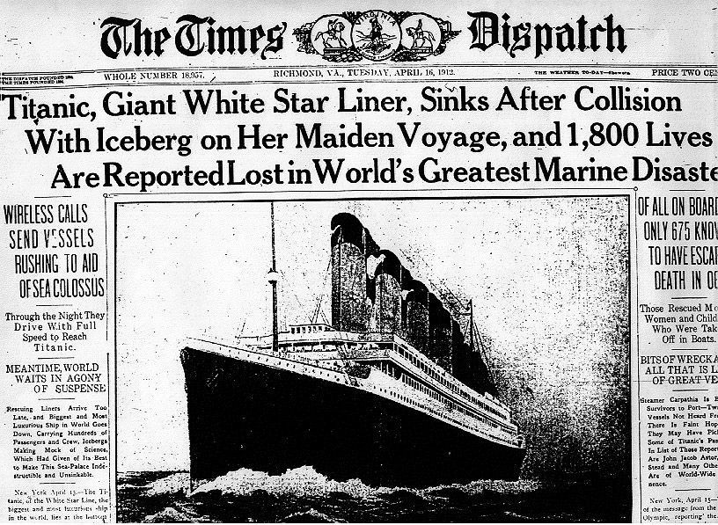
Example: News article classification
What is the category of this news article?

Slide 38
Word Embedding
Why word embedding?
Computer algorithms like machine learning & deep learning can’t understand or process string or plain text in raw format. They require numbers as input data.
A Word Embedding format generally tries to map a word using a dictionary to a vector.
Sentence = “Word Embeddings are Word converted into numbers”
Dictionary of Sentence: {“Word”, “Embeddings”, “are”, “converted”, “into” , “numbers”}
To represent the word “Embedding” in one-hot-encoding:
[0, 1, 0, 0, 0, 0]
http://elgibborsms.com/blog/intuitive-understanding-of-word-embeddings-count-vectors-to-word2vec/

Slide 39
Word Embedding
Frequency based Embedding type:
Count Vector.
TF-IDF Vector.
Co-Occurrence Vector.
http://elgibborsms.com/blog/intuitive-understanding-of-word-embeddings-count-vectors-to-word2vec/

Slide 40
Word Embedding
Count Vector:
Sentence1 = Python is a great language.
Sentence2 = I can write python program.
Dictionary of the sentences: {“Python”, “great”, “language”, “I”, “can”, “write” , “program”}
Count matrix:
 | python | great | language | i | can | write | program
Sentence1 | 1 | 1 | 1 | 0 | 0 | 0 | 0
Sentence2 | 1 | 0 | 0 | 1 | 1 | 1 | 1
A column can also be understood as a word vector for the corresponding word in our matrix.
For example, the word vector for ‘python’ in the above matrix is [1,1] and so on.
Here, the rows correspond to the documents in the corpus and the columns correspond to the tokens in the dictionary.
The second row in the above matrix may be read as – Sentence2 contains ‘python’: once, ‘i’: once, ‘can’ once, ‘write’: once, and ‘program’: once.
http://elgibborsms.com/blog/intuitive-understanding-of-word-embeddings-count-vectors-to-word2vec/

Slide 41
Word Embedding
TF-IDF vector: Term Frequency – Inverse Document Frequency
what we would want is to down weight the common words occurring in almost all documents and give more importance to words that appear in a subset of documents.
TF-IDF works by penalising these common words by assigning them lower weights while giving importance to words like python in a particular document.
Document 1
Term | Count
this | 1
is | 1
about | 2
python | 4
Document 2
Term | Count
this | 1
is | 2
about | 1
nlp | 1
TF(t) = (Number of times term t appears in a document) /(Total number of terms in the document)
- is a scoring of the frequency of the word in the current document.
IDF(t) = log(Total number of documents / Number of documents with term t in it)
- is a scoring of how rare the word is across documents.
TF(This,Document1) = 1/8
TF(Python,Document1) = 4/8
TF(This,Document2) = 1/5
To compare the TF-IDF for a common word ‘This’ and a word ‘Python’ which seems to be of relevance to Document 1.
TF-IDF(This,Document1) = (1/8) * (0) = 0
TF-IDF(This, Document2) = (1/5) * (0) = 0
TF-IDF(Python, Document1) = (4/8)*0.301 = 0.15
IDF(This) = log(2/2) = 0.
IDF(python) = log(2/1) = 0.301
http://elgibborsms.com/blog/intuitive-understanding-of-word-embeddings-count-vectors-to-word2vec/

Slide 42
Text = sparse
Sparse vectors require more memory and computational resources when modeling and the vast number of positions or dimensions can make the modeling process very challenging for traditional algorithms.
Feature dimensions | Document 1: Class A | Document 2: Class A | Document 3: Class A | Document 4: Class A | Document 5: Class ?
1: acquired | 0 | 0 | 1 | 0 | 0
2: received | 0 | 2 | 0 | 0 | 0
3: collected | 1 | 0 | 0 | 0 | 0
4: a | 0 | 0 | 0 | 2 | 0
5: energy | 0 | 0 | 0 | 0 | 1

Slide 43
Classification score - pipeline
Documents = text + category
20%
words+categories
Training
verification
80%
Trained model
score

Slide 44
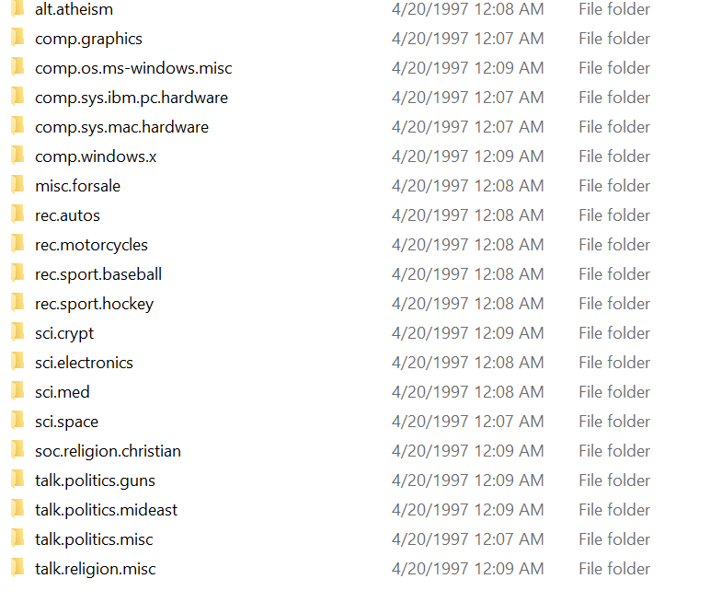
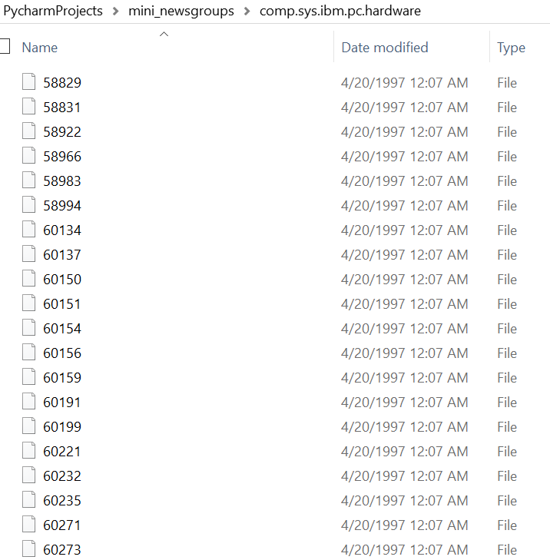
Use Case: Text Classification on 20 newsgroup
http://qwone.com/~jason/20Newsgroups/
The 20 Newsgroups data set is a collection of approximately 20,000 newsgroup documents, partitioned (nearly) evenly across 20 different newsgroups. To the best of my knowledge, it was originally collected by Ken Lang, probably for his Newsweeder: Learning to filter netnews paper, though he does not explicitly mention this collection. The 20 newsgroups collection has become a popular data set for experiments in text applications of machine learning techniques, such as text classification and text clustering.
https://scikit-learn.org/stable/tutorial/text_analytics/working_with_text_data.html

Slide 45
Step1:Dataset preparation
Reading the data
twenty_train = fetch_20newsgroups(subset='train', shuffle=True)

Slide 46
2. Feature Engineering
The next step is the feature engineering step.
In this step, raw text data will be transformed into feature vectors
new features will be created using the existing dataset.

Slide 47
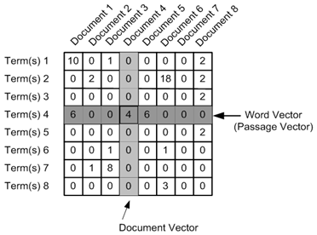
2.1 Count Vectors as features
Count Vector is a matrix notation of the dataset in which every row represents a document from the corpus,
every column represents a term from the corpus, and
every cell represents the frequency count of a particular term in a particular document.
count_vect = CountVectorizer() X_train_counts = count_vect.fit_transform(twenty_train.data)

Slide 48
2.2 TF-IDF Vectors as features Term Frequency – Inverse Document Frequency
TF-IDF score represents the relative importance of a term in the document and the entire corpus. TF-IDF score is composed by two terms:
TF(t) = (Number of times term t appears in a document) / (Total number of terms in the document)
is a scoring of the frequency of the word in the current document.
IDF(t) = log_e(Total number of documents / Number of documents with term t in it)
is a scoring of how rare the word is across documents.
tfidf_Vect = TfidfVectorizer() X_train_tfidf = tfidf_Vect.fit_transform(twenty_train.data)

Slide 49
3. Model Building
The final step in the text classification framework is to train a classifier using the features created in the previous step.
clf = MultinomialNB() clf.fit(X_train_tfidf, twenty_train.target)

Slide 50
Evaluation
twenty_test = fetch_20newsgroups(subset='test', shuffle=True) X_test_tfidf = tfidf_Vect.transform(twenty_test.data) predicted = clf.predict(X_test_tfidf) score = metrics.accuracy_score(twenty_test.target, predicted) print(score)

Slide 51
References
https://github.com/wade12/WikiScraper/blob/master/
http://www.w3resource.com/python-exercises/
https://www.learnpython.org/
http://elgibborsms.com/blog/intuitive-understanding-of-word-embeddings-count-vectors-to-word2vec/
https://scikit-learn.org/stable/tutorial/text_analytics/working_with_text_data.html
https://www.nltk.org/book/ch05.html

