Slide 1

COMP-SCI 5590 - 0001 Special Topics
Loop structures, List, Tuples, Set, Dictionary and Functions

Slide 2
Objective
loops: for and while statements.
Interactive loop and sentinel loop: implementations using while statement
Nested loop
Reading from a file in loop
Tuples
Set
dictionaries
Use case

Slide 3
For Loops: A Quick Review
Suppose we want to write a program that can compute the average of a series of numbers entered by the user.
A series of numbers could be handled by some sort of loop. If there are n numbers, the loop should execute n times.
We need a running sum. This will use an accumulator.

Slide 4
For Loops
n = input("How many numbers do you have? ")
sum = 0.0
for i in range(n):
x = int(input("Enter a number >> "))
sum = sum + x
print("\nThe average of the numbers is", sum / n)
Note that sum is initialized to 0.0 so that sum/n returns a float!

Slide 5
For Loops: Expected Result
How many numbers do you have? 5
Enter a number >> 32
Enter a number >> 45
Enter a number >> 34
Enter a number >> 76
Enter a number >> 45
The average of the numbers is 46.4

Slide 6
Indefinite Loops
We can’t use a definite loop unless we know the number of iterations ahead of time.
We can’t know how many iterations we need until all the numbers have been entered.
The indefinite or conditional loop keeps iterating until certain conditions are met.

Slide 7
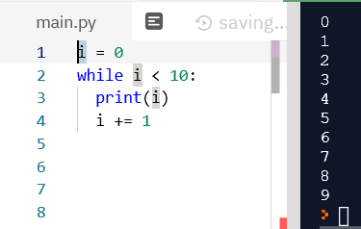
Indefinite Loop: Example
Here’s an example of a while loop that counts from 0 to 10:
i = 0 while i <= 10: print(i) i = i + 1

Slide 8
Interactive Loops
One good use of the indefinite loop is to write interactive loops.
Interactive loops allow a user to repeat certain portions of a program on demand.

Slide 9
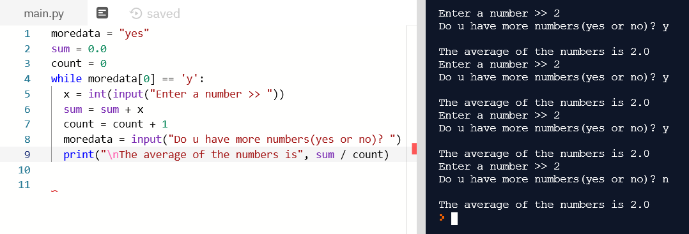
Interactive Loops: Example
moredata = "yes"
sum = 0.0
count = 0
while moredata[0] == 'y':
x = int(input("Enter a number >> "))
sum = sum + x
count = count + 1
moredata = input("Do u have more numbers(yes or no)? ")
print("\nThe average of the numbers is", sum / count)

Slide 10
File Loops
Many languages don’t have a mechanism for looping through a file like this. Rather, they use a sentinel!
We could use readline in a loop to get the next line of the file.
At the end of the file, readline returns an empty string, “”

Slide 11
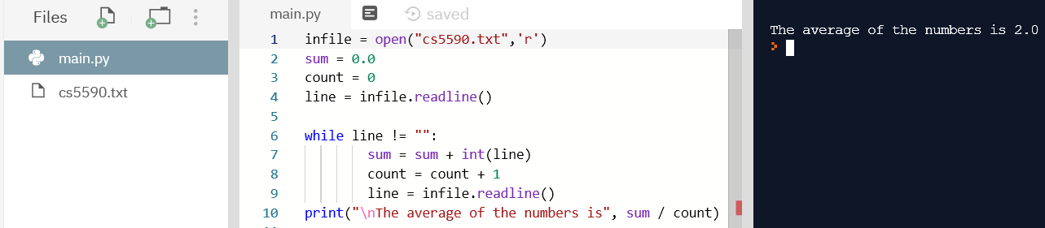
File Loops: Example
infile = open(fileName,'r')
sum = 0.0
count = 0
line = infile.readline()
while line != "":
sum = sum + int(line)
count = count + 1
line = infile.readline()
print("\nThe average of the numbers is", sum / count)

Slide 12
Nested Loops
At the top level, we will use a file-processing loop that computes a running sum and count.
In the next level, we need to update the sum and count in the body of the loop.
Since each line of the file contains one or more numbers separated by commas, we can split the string into substrings, each of which represents a number.
Then we need to loop through the substrings, convert each to a number, and add it to sum.
We also need to update count.

Slide 13
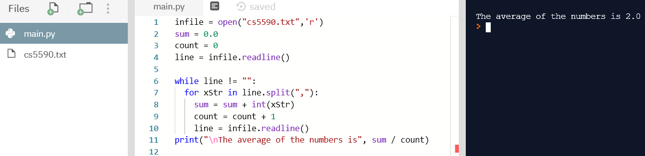
Nested Loops: Example
infile = open(fileName,'r')
sum = 0.0
count = 0
line = infile.readline()
while line != "":
for xStr in line.split(","):
sum = sum + int(xStr)
count = count + 1
line = infile.readline()
print("\nThe average of the numbers is", sum / count)
1,2,3
4,5,6

Slide 14
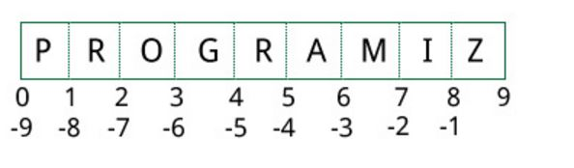
Lists
CHANGEABLE Sequences of Data
Syntax:
list_name = [item1, item2]
Lists are created by using square brackets:
breakfast = [ “coffee”, “tea”, “toast”, “egg” ]
Indexing mechanism:
It starts from 0
From back it starts from -1

Slide 15
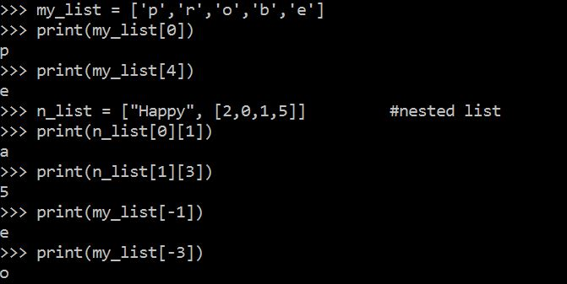
Indexing
Index: a number specifying the position of an element in a list
Enables access to individual element in list
Index of first element in the list is 0, second element is 1, and n’th element is n-1
Negative indexes identify positions relative to the end of the list
The index -1 identifies the last element, -2 identifies the next to last element, etc.

Slide 16
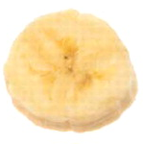
List Slicing
Slice: a span of items that are taken from a sequence
List slicing format: list[start : end]
Span is a list containing copies of elements from start up to, but not including, end
If start not specified, 0 is used for start index
If end not specified, len(list) is used for end index
Slicing expressions can include a step value and negative indexes relative to end of list

Slide 17
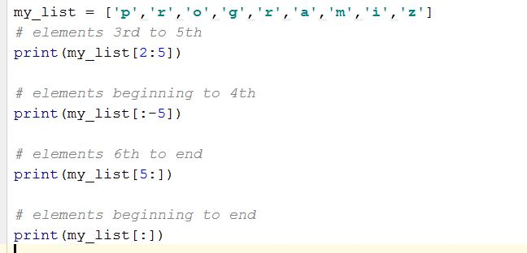
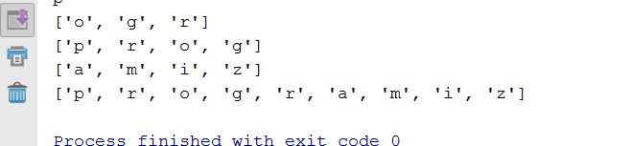
Slicing Examples
Output
Input

Slide 18
List Methods and Useful Built-in Functions
insert(index, item): used to insert item at position index in the list
sort(): used to sort the elements of the list in ascending order
remove(item): removes the first occurrence of item in the list
reverse(): reverses the order of the elements in the list
del statement: removes an element from a specific index in a list
General format: del list[i]
min and max functions: built-in functions that returns the item that has the lowest or highest value in a sequence
The sequence is passed as an argument

Slide 19
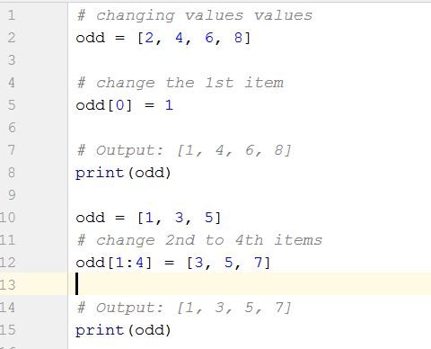

Changing Elements
List are mutable, meaning, their elements can be changed.
We can use assignment operator (=) to change an item or a range of items.
list[1] = new_value can be used to assign a new value to a list element
Must use a valid index to prevent raising of an IndexError exception
Output

Slide 20
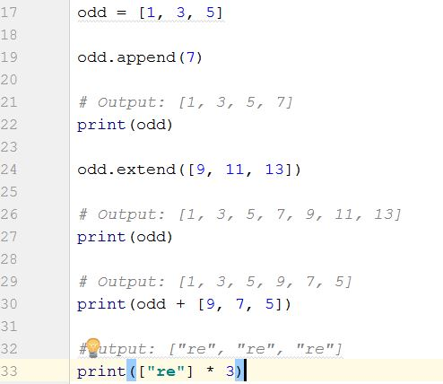
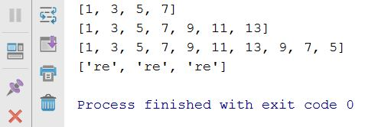
Addition
We can add one item to a list using append() method or add several items using extend()method
Output
We can also use + operator to combine two lists. This is also called concatenation.

Slide 21
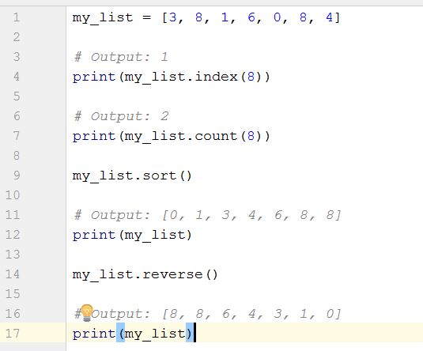
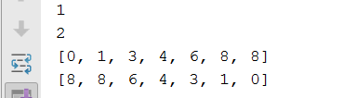
Other built in function Examples
Output

Slide 22
Deletion
mylist = ['p','k','h','a','o'] del mylist[0] print(mylist)
del mylist[2:3] print(mylist)
Output
['k', 'h', 'a', 'o']
['k', 'h', 'o']

Slide 23
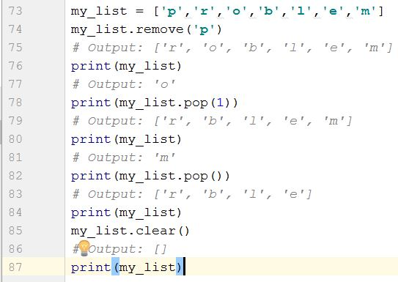
Continued…
We can use remove() method to remove the given item or pop() method to remove an item at the given index.
The pop() method removes and returns the last item if index is not provided.
This helps us implement lists as stacks (first in, last out data structure).
We can also use the clear() method to empty a list.

Slide 24
Finding Items in Lists with the in Operator
You can use in operator to determine whether an item is contained in a list
General format: item in list
Returns True if the item is in the list, or False if it is not in the list
Similarly you can use the not in operator to determine whether an item is not in a list

Slide 25
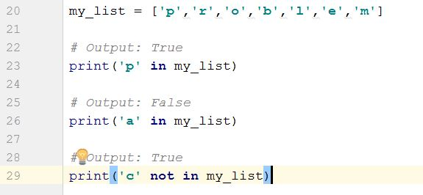

Continued…
Output

Slide 26
Two-Dimensional Lists
Two-dimensional list: a list that contains other lists as its elements
Also known as nested list
Common to think of two-dimensional lists as having rows and columns
Useful for working with multiple sets of data
To process data in a two-dimensional list need to use two indexes
Typically use nested loops to process

Slide 27
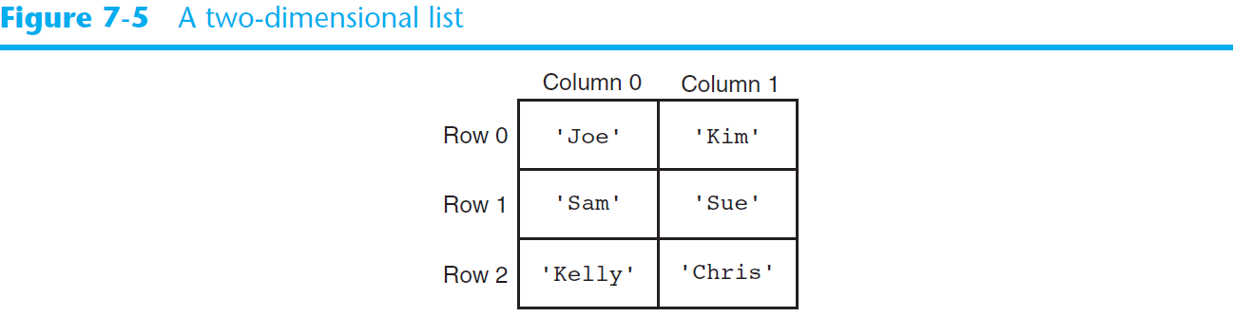
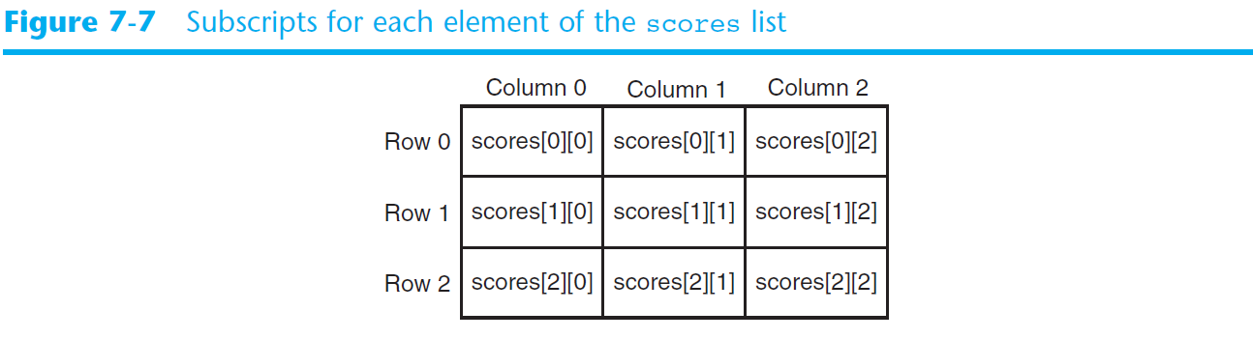
Two-Dimensional Lists (cont’d.)

Slide 28
Tuples
UNCHANGABLE Sequences of Data
Syntax:
tuple_name = (item1, item2)
Enclosed in parentheses:
Example: tuple1 = (“This”, “is”, “a”, “tuple”)
They have elements which are indexed starting at 0
A tuple with a single element must have a comma inside the parentheses:
a = (11,)

Slide 29
Operations
Tuples support operations as lists
Subscript indexing for retrieving elements
Methods such as index
Built in functions such as len, min, max
Slicing expressions
The in, +, and * operators
Tuples do not support the methods:
Append, remove, insert, reverse, sort

Slide 30
Basic Operations
Suppose
>>> tup1=(1,2,3)
>>>>tup2=(4,5,6)
>>>tup3=(‘Hi’,)
Python Expression | Results | Description
len(tup1) | 3 | Length
tup1 + tup2 | (1, 2, 3, 4, 5, 6) | Concatenation
tup3* 4 | ('Hi!', 'Hi!', 'Hi!', 'Hi!') | Repetition
3 in tup1 | True | Membership
for x in tup1: print x | 1 2 3 | Iteration

Slide 31
Indexing, Slicing
Suppose
>>> L=(‘welcome’ , ’to’ , ’python’)
Python Expression | Results | Description
L[2] | ‘python’ | Offsets start at zero
L[-2] | ‘to' | Negative: count from the right
L[1:] | [‘to', ‘python'] | Slicing fetches sections
Same as String

Slide 32
Tuples are Comparable
The comparison operators work with tuples and other sequences If the first item is equal, Python goes on to the next element, and so on, until it finds elements that differ.
print((0,1,2)<(4,0,1))
True
print(('jones','sam')<('jones','saria’))
True

Slide 33
Deleting Tuple
mytuple = (1,2,3) del mytuple print(mytuple)
Traceback (most recent call last):
File "C:/Users/saria/PycharmProjects/myexercises/testaki.py", line 13, in <module>
print(mytuple)
NameError: name 'mytuple' is not defined
As tuple is already deleted

Slide 34
Tuples are more efficient than lists
We generally use tuple for heterogeneous (different) datatypes and list for homogeneous (similar) datatypes.
Since tuple are immutable, iterating through tuple is faster than with list.
So there is a slight performance boost. They are more simpler in nature.
Tuples that contain immutable elements can be used as key for a dictionary. With list, this is not possible.
If you have data that doesn't change, implementing it as tuple will guarantee that it remains write-protected.

Slide 35
SETS

Slide 36
Sets
Set: object that stores a collection of data in same way as mathematical set
All items must be unique
Set is unordered
Elements can be of different data types
Sets are mutable and it contains immutable elements
e.g.:
>>> aset = {11, 22, 33}
>>> bset = aset
>>> aset = aset | {55}
>>> aset {33, 11, 22, 55}
>>> bset {33, 11, 22}

Slide 37
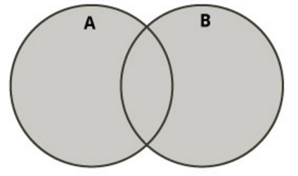
Boolean operations on sets (I)
Union of two sets
Contains all elements that are in set A or in set B
>>> aset = {11, 22, 33}
>>> bset = {12, 23, 33}
Union of two sets
>>> aset | bset {33, 22, 23, 11, 12}

Slide 38
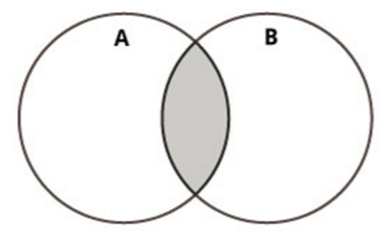
Boolean operations on sets (II)
Intersection of two sets
Contains common elements that are in both sets A and B
>>> aset = {11, 22, 33}
>>> bset = {12, 23, 33}
Intersection of two sets:
>>> aset & bset {33}

Slide 39
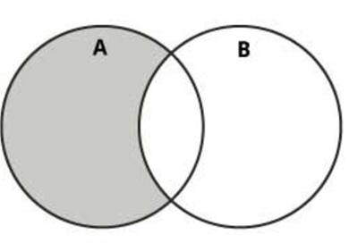
Boolean operations on sets (III)
Difference of two sets
Contains all elements that are in A but not in B
>>> aset = {11, 22, 33}
>>> bset = {12, 23, 33}
Difference:
>>> aset – bset {11, 22}

Slide 40
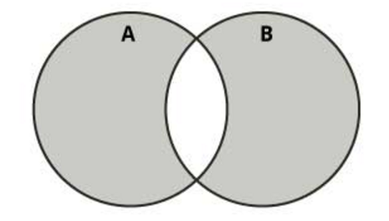
Boolean operations on sets (IV)
Symmetric difference of two sets
Contains all elements that are either
in set A but not in set B or
in set B but not in set A
>>> aset = {11, 22, 33}
>>> bset = {12, 23, 33}
Symmetric difference:
>>> aset ^ bset {11, 12, 22, 23}

Slide 41
Creating a Set
For empty set, call set()
For non-empty set, call set(argument) where argument is an object that contains iterable elements
{'Alice', 'Bob', 'Carol'}
{'Dean'} is a singleton
argument can be a list, string, or tuple
If argument is a string, each character becomes a set element
If argument contains duplicates, only one of the duplicates will appear in the set

Slide 42
Len, add, update function
len function: returns the number of elements in the set
myset = {'Apples', 'Bananas', 'Oranges'}
len(myset) → 3
add method: adds an element to a set
myset.add(‘strawberry’)
print(myset) -> {'Apples', 'Bananas', 'Oranges’, ‘strawberry’}
update method: adds a group of elements to a set
myset.update(‘1’,’2’)
print(myset) -> {'Apples', 'Bananas', 'Oranges’,’1’,’2’}

Slide 43
Deleting Elements From a Set
Remove and discard methods: remove the specified item from the set
The item that should be removed is passed to both methods as an argument
Behave differently when the specified item is not found in the set
remove method raises a KeyError exception
discard method does not raise an exception
>>> myset.remove(‘Apples’)
>>> print(myset) -> {'Bananas', 'Oranges’)}
clear method: clears all the elements of the set

Slide 44
For Loop, in, and not in Operators With a Set
A for loop can be used to iterate over elements in a set
General format: for item in set:
The loop iterates once for each element in the set
The in operator can be used to test whether a value exists in a set
Similarly, the not in operator can be used to test whether a value does not exist in a set

Slide 45
Sets do not support indexing
myset = {'Apples', 'Bananas', 'Oranges’}
Print(myset) {'Bananas', 'Oranges', 'Apples’}
myset[0] Traceback (most recent call last): File "<pyshell#2>", line 1, in <module> myset[0] TypeError: 'set' object does not support indexing

Slide 46
DICTIONARIES

Slide 47
Dictionaries
A dictionary is a container that keeps associations between keys and values.
Keys are unique, but a value may be associated with several keys.
Values
Keys
John
$15,000
Ann
$12,000
Mike
Mary
$30,000

Slide 48

Creating Dictionaries
Each key/value pair is separated by a colon.
You enclose the key/value pairs in braces.
To create an empty dictionary:
Use {}
Use built-in function dict()
Use a for loop to iterate over a dictionary
General format: for key in dictionary:

Slide 49
Sets and dictionaries
When the braces contain key/value pairs, they denote a dictionary, not a set.
The only ambiguous case is an empty {}.
By convention, it denotes an empty dictionary, not an empty set.
You can create a duplicate copy of a dictionary using the dict function:
oldSalaries = dict(salaries)
salaries = { “John": 15000, “Ann": 30000, “Mike": 12000, “Mary": 15000 }

Slide 50
Accessing Dictionary Values
The subscript operator [] is used to return the value associated with a key.
The statement:
print(“Ann’s salary is", salaries[“Ann"])
prints 30000
Note that the dictionary is not a sequence-type container like a list.
Even though the subscript operator is used with a dictionary, you cannot access the items by index or position.
A value can only be accessed using its associated key

Slide 51
Searching For Keys
The key supplied to the subscript operator must be a valid key in the dictionary or a KeyError exception will be raised.
To find out whether a key is present in the dictionary, use the in (or not in) operator:
if “Ann" in salaries : print(“Ann’s salary is", salaries[“Ann”]) else : print(“Ann’s salary is not in my list.”)

Slide 52
Dictionaries are mutable
age = {'Alice' : 25, 'Bob' : 28}
saved = age
age['Bob'] = 29
age {'Bob': 29, 'Alice': 25}
saved {'Bob': 29, 'Alice': 25}

Slide 53
Adding Elements to an Existing Dictionary
To add a new key-value pair:
dictionary[key] = value
If key exists in the dictionary, the value associated with it will be changed

Slide 54
Updating Dictionaries
>>> age = {'Alice': 26 , 'Carol' : 22}
>>> age.update({'Bob' : 29})
>>> age {'Bob': 29, 'Carol': 22, 'Alice': 26}
>>> age.update({'Carol' : 23})
>>> age {'Bob': 29, 'Carol': 23, 'Alice': 26}

Slide 55
Returning a value
>>> age = {'Bob': 29, 'Carol': 23, 'Alice': 26}
>>> age.get('Bob') 29
>>> age['Bob'] 29

Slide 56
Displaying Contents
>>> age = {'Alice' : 25, 'Carol': 'twenty-two’}
>>> age.items() dict_items([ ('Alice', 25), ('Carol', 'twenty-two')])
>>> age.keys() dict_keys([ 'Alice', 'Carol'])
>>> age.values() dict_values([25, 'twenty-two'])

Slide 57
Removing a specific item
>>> a = {'Alice' : 26, 'Carol' : 'twenty-two’}
>>> a {'Carol': 'twenty-two', 'Alice': 26}
>>> a.pop('Carol’) 'twenty-two’
>>> a {'Alice': 26}

Slide 58
Remove a random item
>>> age = {'Bob': 29, 'Carol': 23, 'Alice': 26}
>>> age.popitem() ('Bob', 29)
>>> age
{'Carol': 23, 'Alice': 26}
>>> age.popitem() ('Carol', 23)
>>> age {'Alice': 26}

Slide 59

Different Ways Of Doing The Same Thing
Lists
prerequisites = ["COP 2271c", "Introduction to Computation and Programming", 3]
print(prerequisites[2]) # Prints the element at index 2
Sets
cheesePizza = {"Creamy garlic", "Parmesan sauce", "Cheese", "Toasted Parmesan"}
if "Toasted Parmesan" in cheesePizza:
Dictionaries
salaries = {"John": 15000, "Ann": 30000, "Mike": 12000, "Mary": 15000 }
print("Ann’s salary is", salaries["Ann"])

Slide 60
Function
Function is defined using the def keyword
Creating a Function
def my_function(): print("Hello from a function")
Calling a Function
my_function()
Parameters
def my_function(fname): print(fname + " Refsnes")
my_function("Emil")

Slide 61
Function
Default Parameter Value
def my_function(country = "Norway"): print("I am from " + country) my_function("Sweden") my_function()
Return Values
def my_function(x): return 5 * x print(my_function(3))

Slide 62
Use case: Car Rental

Slide 63
Use case: Car Rental
The goal of this use case is to calculate the money one should pay when renting a car.
Surely this money will be affected by the kind of car, distance, kind of petrol, number of days…
So in this use case, there is a couple of questions that a user answers then the amount of money one should pay will be printed.

Slide 64
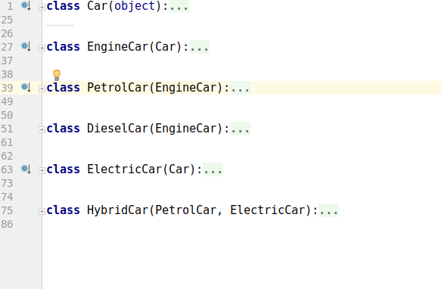
Module cars
It contains six classes which helps to choose various features of a car for hiring

Slide 65
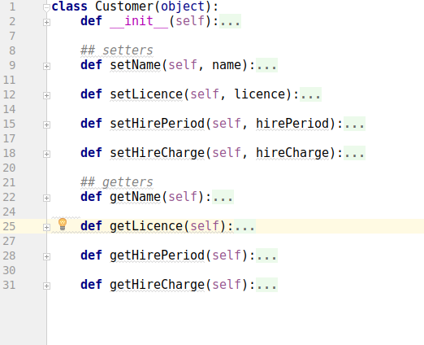
Module customer
This module includes details about information of the customer

Slide 66
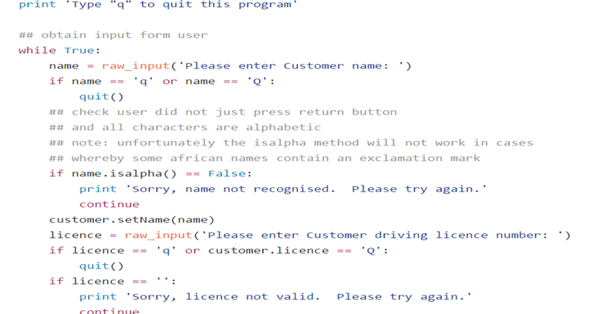
Getting information of the customer

Slide 67
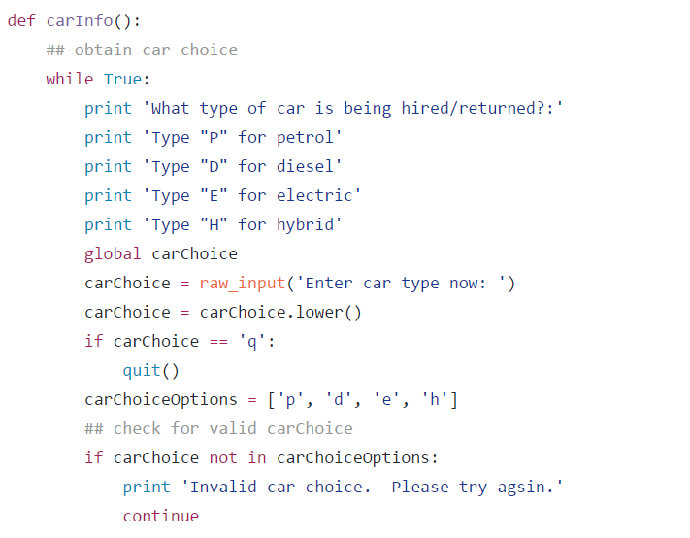
Choosing one of the car options available

Slide 68
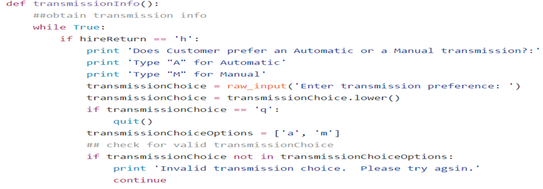
Automatic or Manual car

Slide 69
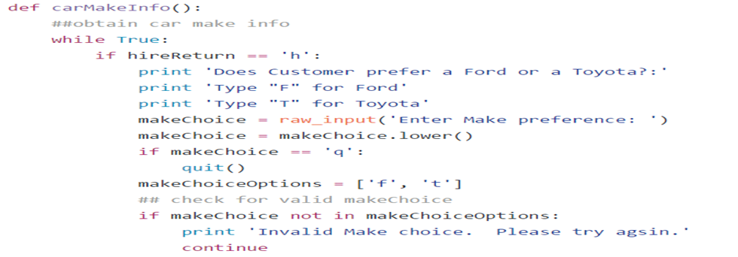
Ford Or Toyota

Slide 70
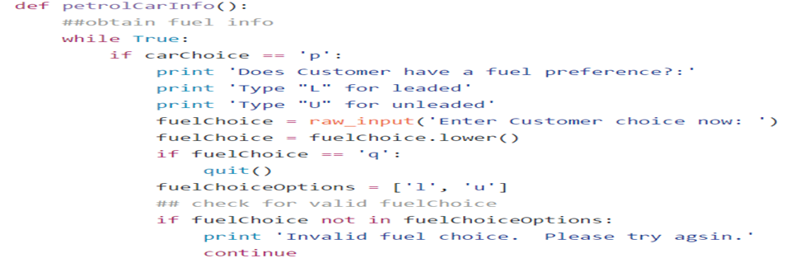
Fuel Preference

Slide 71
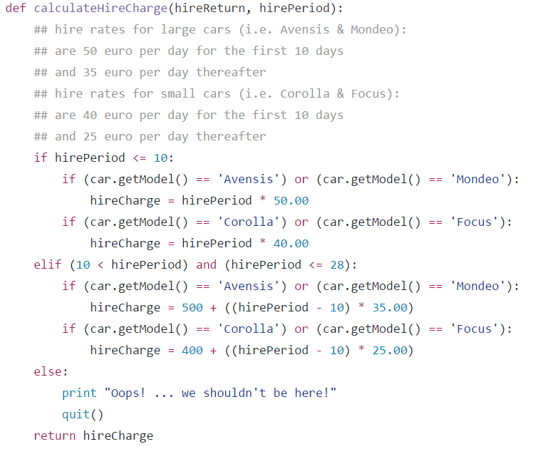
Rates of hiring

Slide 72
References
https://github.com/wade12/ProgrammingForBigDataCA2CarRental/blob/master/carRentalApp.py
http://www.w3resource.com/python-exercises/python-conditional-statements-and-loop-exercises.php
https://www.learnpython.org/

Slide 73
Thank you

