Slide 1
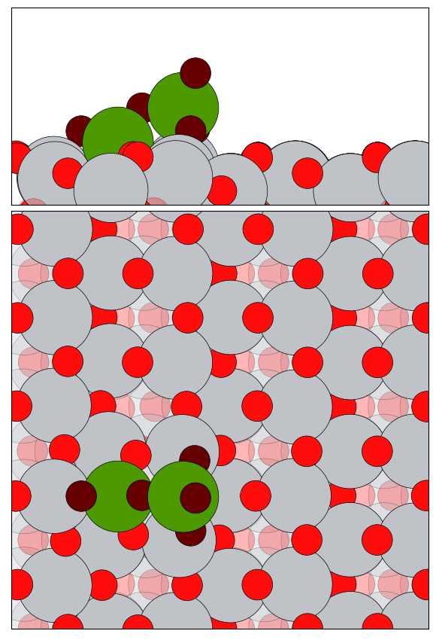
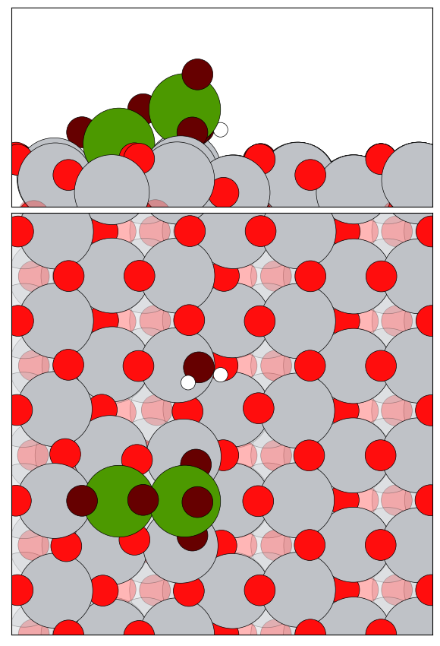
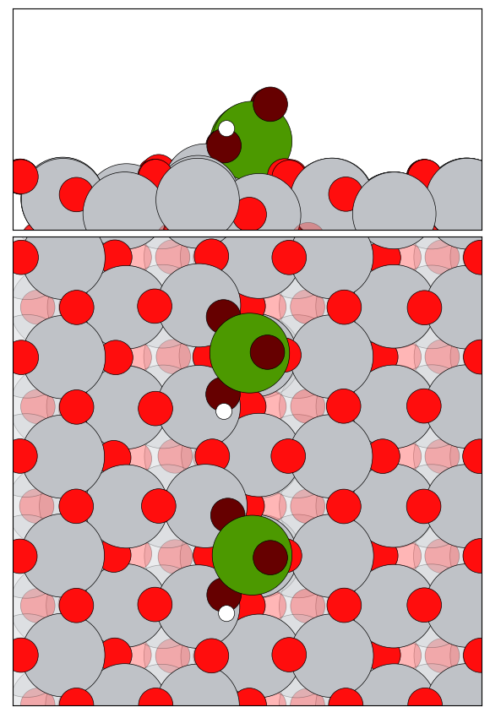
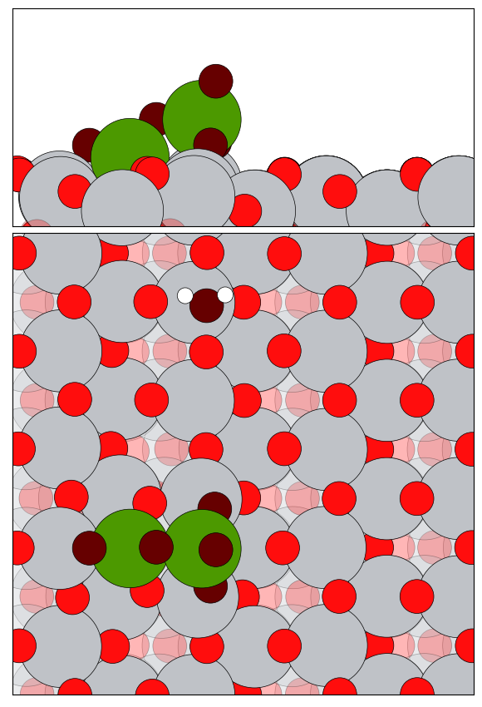
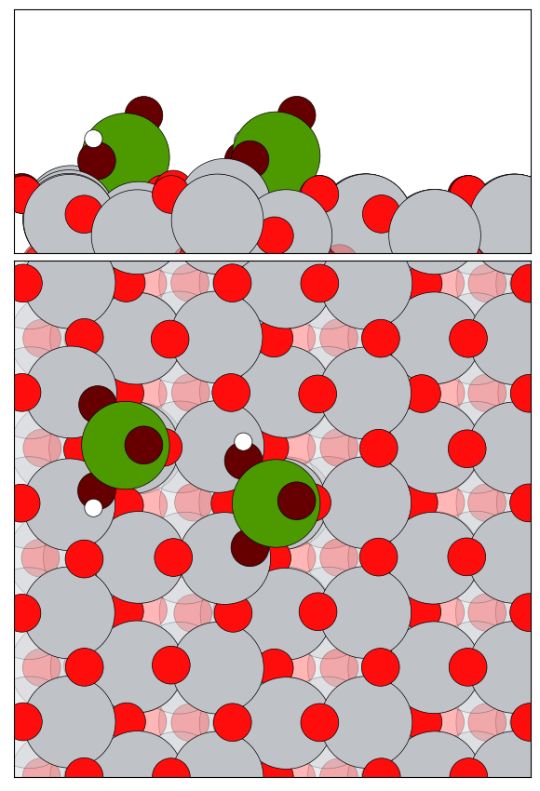
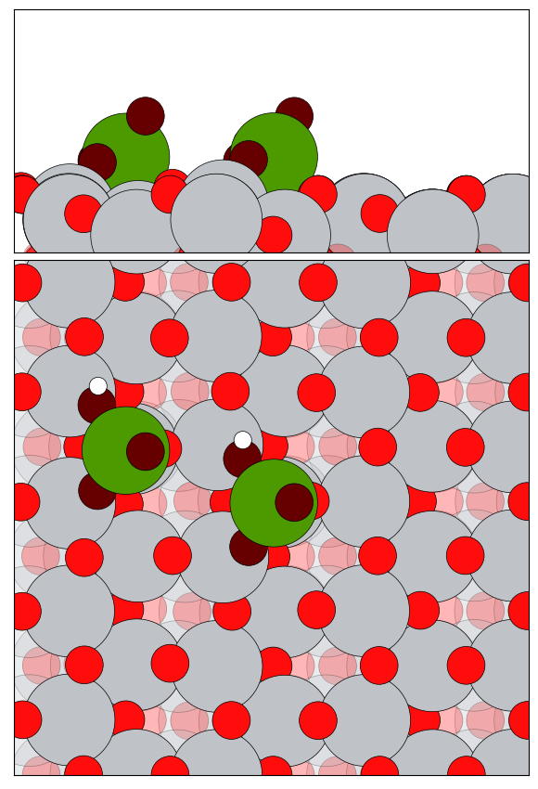
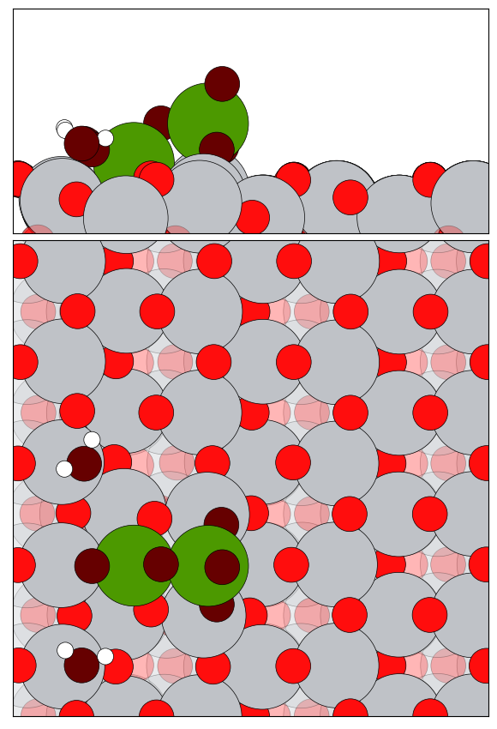
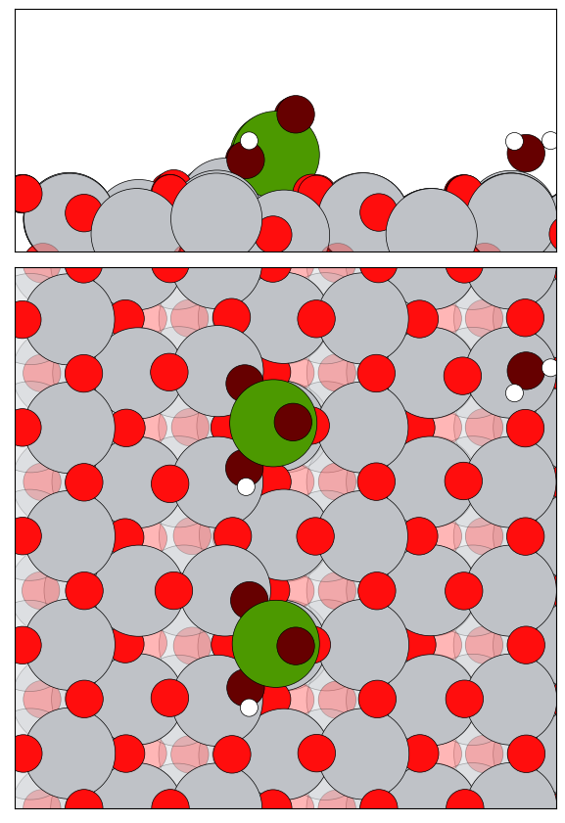
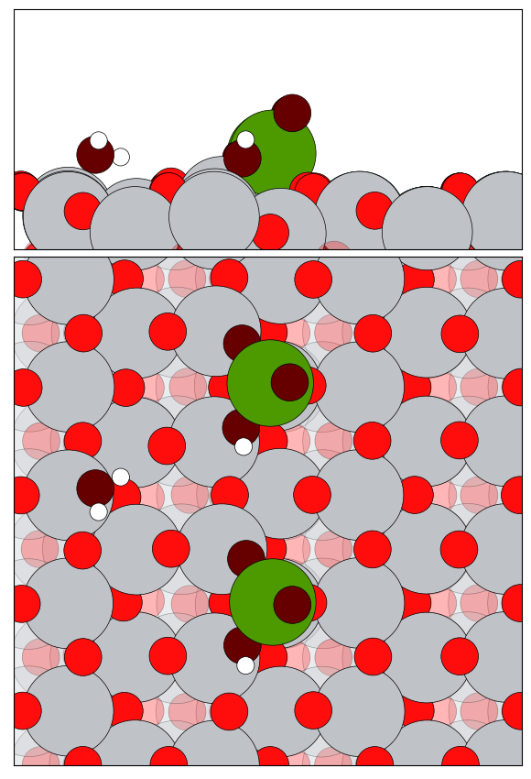
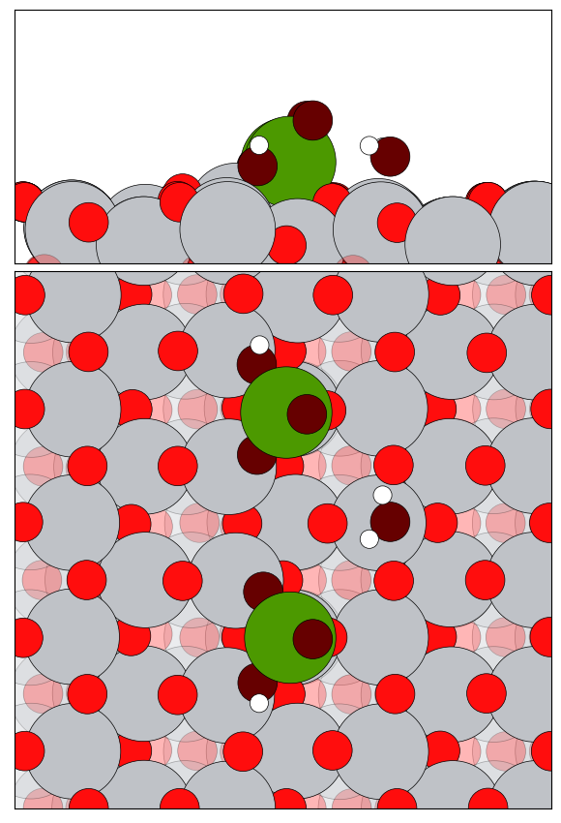
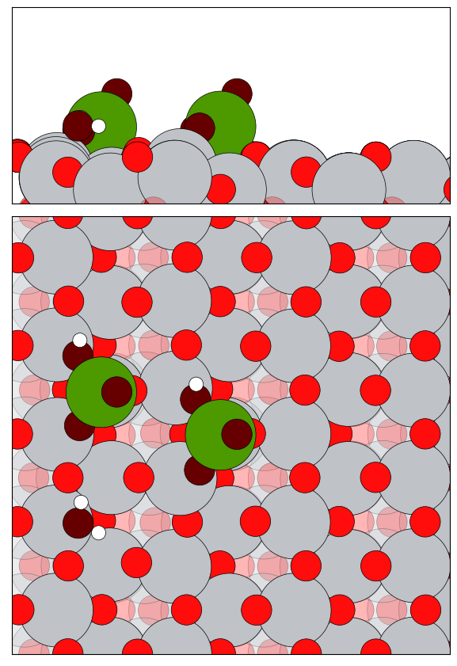













Binding Energy of H₂O on V₂O₅/TiO₂ (6$×2$ super cell)
$$∆E=0.000eV$$
$$BE=−1.279 eV$$
$$BE=−0.551 eV$$
$$BE=−0.640 eV$$
$$BE=−0.943 eV$$
$$BE=−1.001 eV$$
$$∆E =−0.572 eV$$
$$∆E =−0.670 eV$$
$$BE=−1.515 eV$$
$$BE=−1.610 eV$$
$$∆E =−0.395 eV$$
$$BE=−1.640 eV$$
$$BE=−1.670 eV$$

