Slide 1
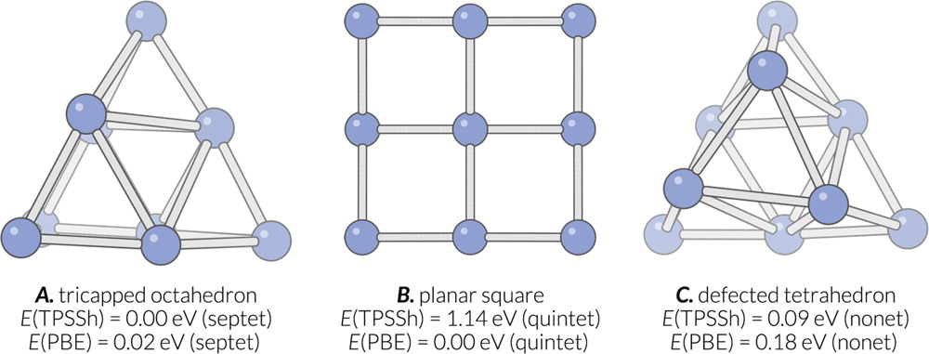
Putative global minima for gas phase Pt9 cluster proposed in this work (A) and other literature (A, B, C). C is also found in this work. The TPSSh and PBE energies relative to the energies of respective lowest energy structure are also listed. The TPSSh energy is evaluated using Turbomole 6.6 with the def2-TZVP basis set. The PBE energy is evaluated using VASP 5.4.1 with 20 Å cubic cell and energy cutoff 500 eV.
Published in: Huanchen Zhai; Anastassia N. Alexandrova; J. Chem. Theory Comput. 2016, 12, 6213-6226.
DOI: 10.1021/acs.jctc.6b00994
Copyright © 2016 American Chemical Society

