Slide 1
QAGenCI
AI-powered intelligent test case generation

Slide 2
Problem
Manual test writing is time-consuming and requires skilled testers.
Limited team size leads to delays in test creation and execution.
High maintenance effort for large test suites in fast-paced CI/CD environments.
Repetitive test case writing wastes valuable engineering time.
Automation challenges arise due to frequent UI changes and flaky tests.
Writing automated testing and feature generation takes a lot of time.
There is no standard way of doing it.

Slide 3
Solution
Generates test scripts (Selenium, TestNG, Cucumber) in seconds.
Reduces manual effort in writing repetitive test cases.
It suggests edge cases and negative test scenarios.
Ensures input validation, error handling, and security checks.
Ensures uniform structure across test scripts.
Helps small QA teams scale automation efficiently.
Reduces the learning curve for new test automation frameworks.
Generates optimized locators (XPath, CSS Selectors) for stability.
Automates smarter, tests faster, and scales efficiently.
AI + Human Expertise = Faster, Reliable, and Scalable Testing
GenAI enhances (not replaces) manual testing expertise.

Slide 4
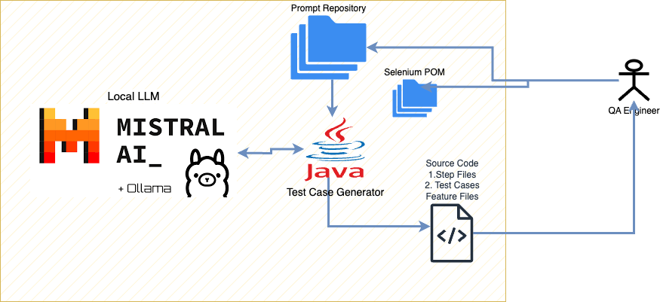
Approch, Phase I

