Slide 1
Ninja – Stock analysis Application
Is a stock analysis application
Retrieves the feed from various sources (NSE, Sentiment indicators & Currency rates)
Builds the portfolio strength/value for a given trade strategy
Problems at Application
Long time to take changes to production
Delay in co-ordination between various development teams
Increased demand to run the application at ‘On-Premise’ servers
Solution Approach
Bring all applications to one code repository
Build pipelines to reduce the timeline
Leverage containerization using Dockers run the application at ‘On-Premise’ servers
Leverage Kubernetis for scalability of the application

Slide 2



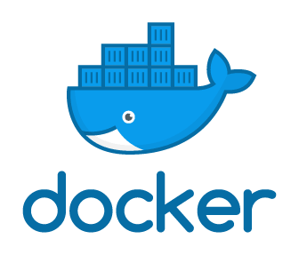
Code Repo
Ninja Application
Kubernetics
Build Data
Build
Feedback
Master
Data Preparation
Test
Data Processing
Presentation
Deploy
Python
N3
N3
N3
Java
Java
JSP

Slide 3
JSP code presents th data
Presentation

Slide 4
Kubernetics Clusters
Master
Node1
Node2
Node3
N1
N2
N3

Slide 5
Kubernetics
Build
Master
Test
Deploy
N1
N2
N3

Slide 6
Kubernetics
Master
N3
N3
N3

