Slide 1

Stock Analytics application – Receives the Data feed from various sources (NSE, Sentiment indicators & Currency rates) and Build the portfolio strength/value for a given trade strategy.
Ninja Stock Analytics
Pain Areas
Long time to market
Inconsistent in application logs
Unavailability of Unified application strength
Frequent downtime
Areas of Improvement:
Missing Collaboration
Environment inconsistency
Goal Statement:
Reduced Cost/time to delivery
Deploy with reliable/repeatable process
Reduce deployment downtime
Ensure High Availability
Identified Solutions:
Unified Code Repository
Pipeline the process from Build to Deploy for Continuous Integration
Use Containerized applications to eliminate the environmental inconsistency
Use Kubernetes cluster to ensure Continuous Delployment & High Availability
Improve the Health & Build monitoring using ELK(Elastic Search, Logstash & Kibana)

Slide 2






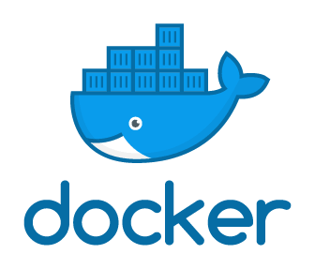
Solution Architecture
Ninja Application
Application Log Analysis
Build Data
Build
Kubernetics
Data Preparation
Data Processing
Code Cover
Master
Code Repo
Presentation
Test
Feedback
Deploy
N1
N2
N3
Python
Build – Maven
Code Coverage – SonarQube
Java
Application Log Analysis
Elastic Search
LogStash
Kibana
JSP
Enhancements in pipeline

Slide 3
Story #1 Change the application to consider sentiment analysis indicator for the strategy
Application in Use..
Story #2 Change the currency from INR to USD, based on the rate
Achieved Benefits:
Reduced time to market
Inconsistent environment to immutable environment
Zero downtime for change deployment
High Application availability
Scalable Unified Application log monitoring & Log analytics
Benefits in Pipeline:
Build Logs monitoring with ELK stack in pipeline

Slide 4

Questions

