Slide 1


Genin
Chuunin
Kage
Siva Sunku
Suneel Kulkarni
Ayyappan P
Ms Srinivas
Gokul Mn
Rakesh Kumar

Slide 2



Ninja Stock Analytics
Data feed from various sources (NSE, BSE and NYSE) and Build the portfolio strength/value
No Collaboration
Downtime
Traceability

Slide 3







Solution Architecture
Ninja Application
Application Log Analysis
Build Data
Build
Kubernetics
Data Preparation
Data Processing
Code Cover
Master
Code Repo
Presentation
Test
Feedback
Deploy
Python
N1
N2
N3
Java
Build – Maven
Test - Junit
Code Quality – SonarQube
Application Log Analysis
Elastic Search
Fluentd
Kibana
JSP
Future enhancements

Slide 4
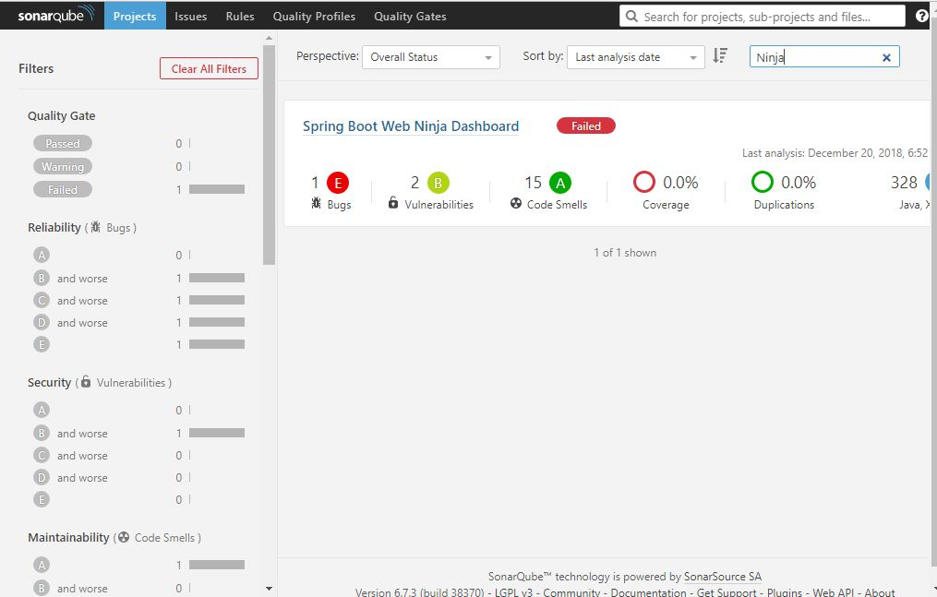
SonarQube

Slide 5
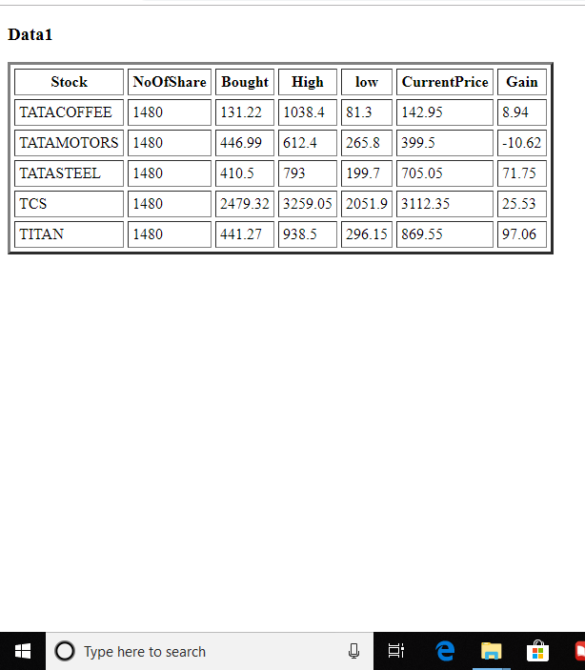
Application

Slide 6
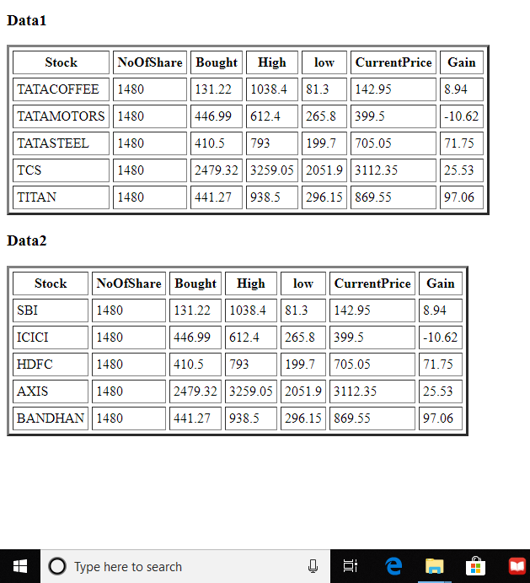
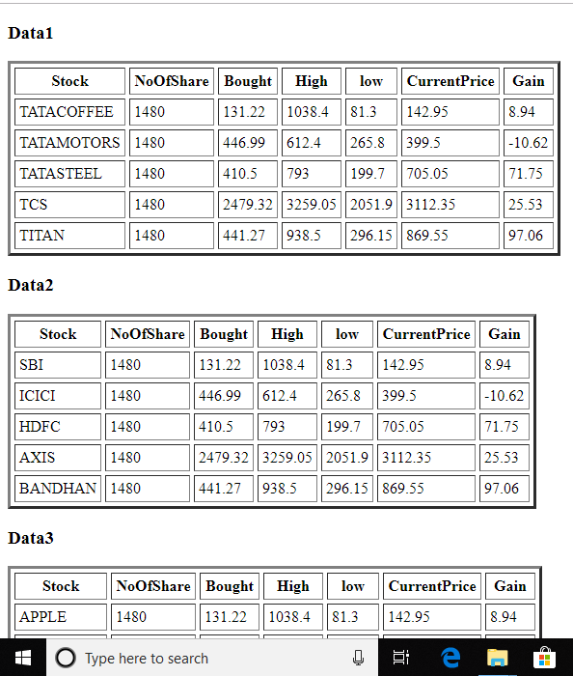
Faster Delivery

Slide 7
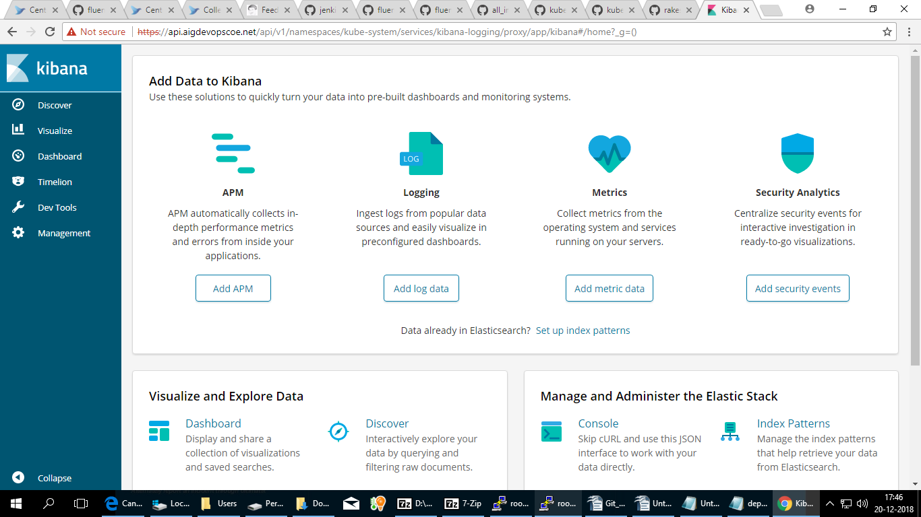
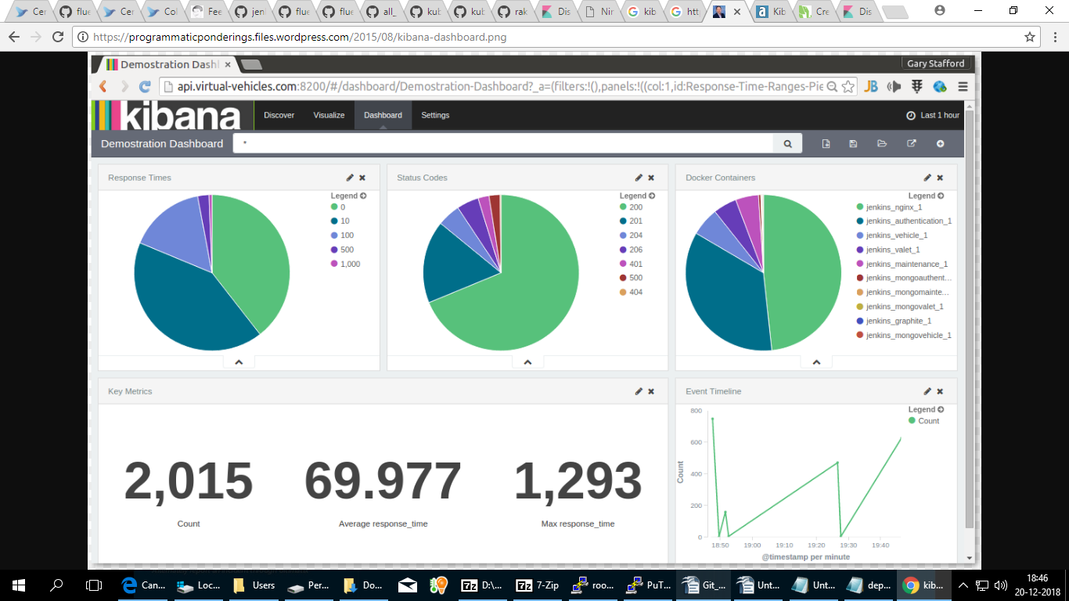
Kibana Dashboard

Slide 8

Thank You

