Slide 1



AIRLINE TRAFFIC MANAGEMENT SYSTEM
NAME : PRITIKA SA ROLL NO : 23ADR134 CLASS : AIDS-C
SUBJECT : JAVA MICRO PROJECT

Slide 2
OUTLINE
Airline Traffic Management is a system for managing flight schedules, bookings and seat availability.
It enhances efficiency and passenger experiencs.
The main objective of this program is to manage flights and booking effectively.

Slide 3
FEATURES ADDED
Adding flight details such as Flight ID, Flight service name, Source Location, Destination, Departure time, Arrival time, Status and Seats available.
Then, the passenger can view the available flight details so that the
passenger gains knowledge about available flights and the seat counts.
Now, the passenger proceeds to book the flight tickets by entering their name and the flight ID.
Now, the passenger can view all their booking details
Finally, after completing the whole process the passenger can exit the application.

Slide 4
CLASS STRUCTURE OVERVIEW
Flight:
Attributes: Flight ID, Airline Name, Source, Destination, Timings, Status, Total Seats, Seats Available.
Methods: bookSeat(), toString().
Booking:
Attributes: Passenger Name, Flight ID, Seat Number.
Methods: toString().
AirlineTrafficManagement:
Stores Flight and Booking objects. Handles main operations.
Relationships:
Flight and Booking are managed by AirlineTrafficManagement.
4

Slide 5
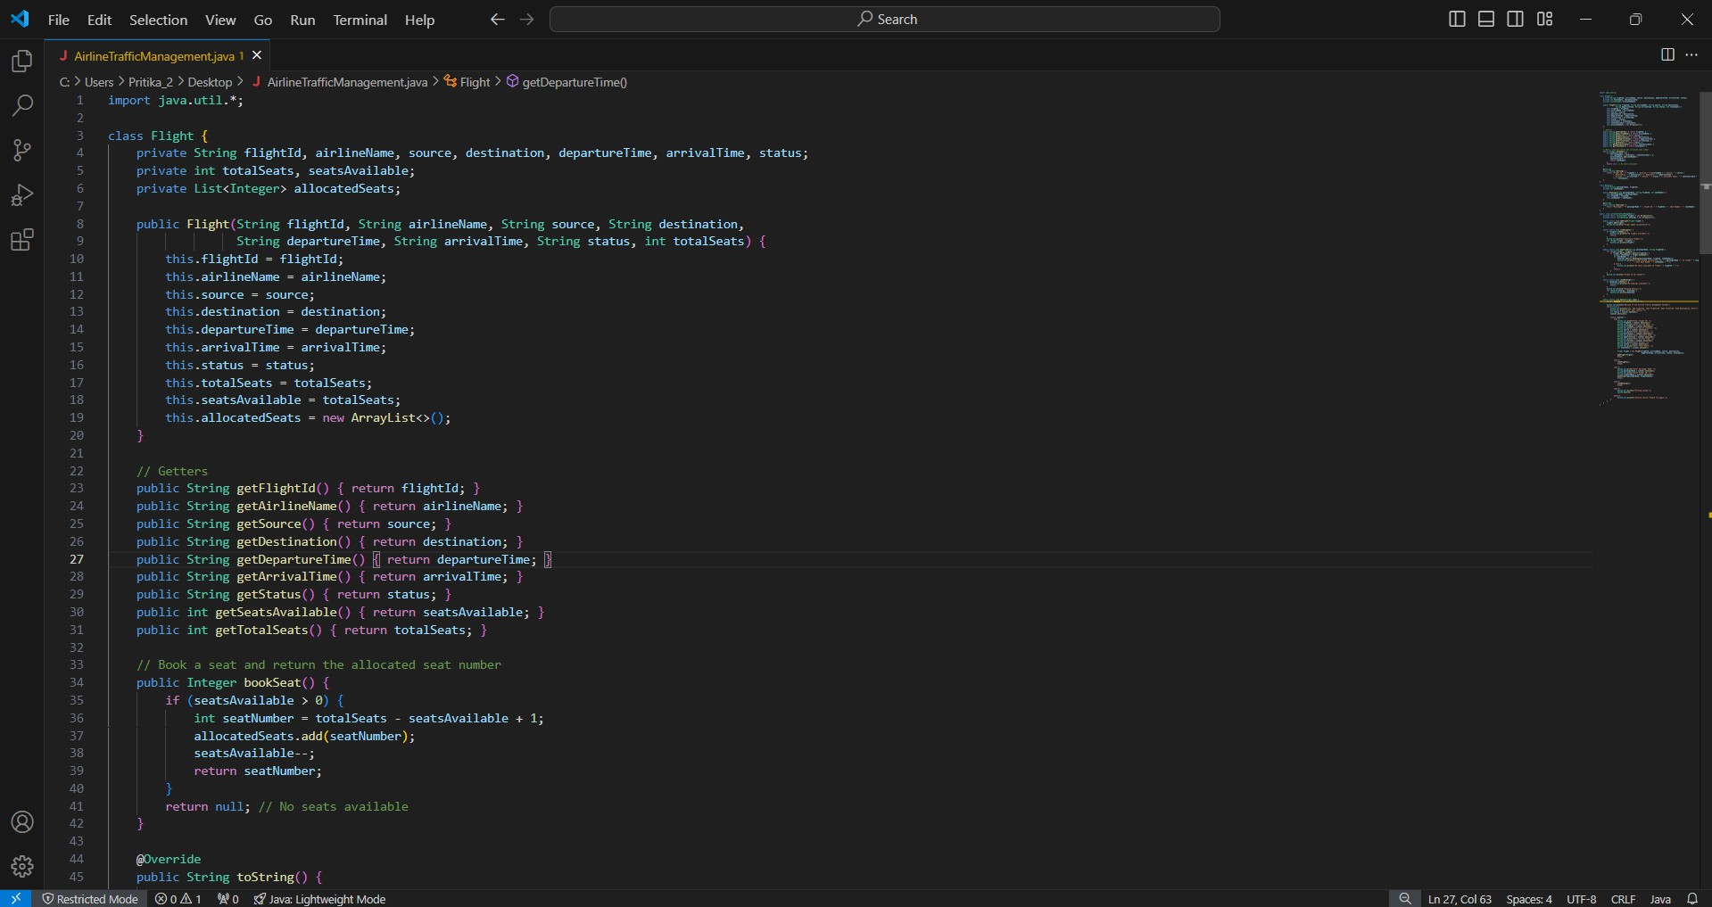
CODING

Slide 6
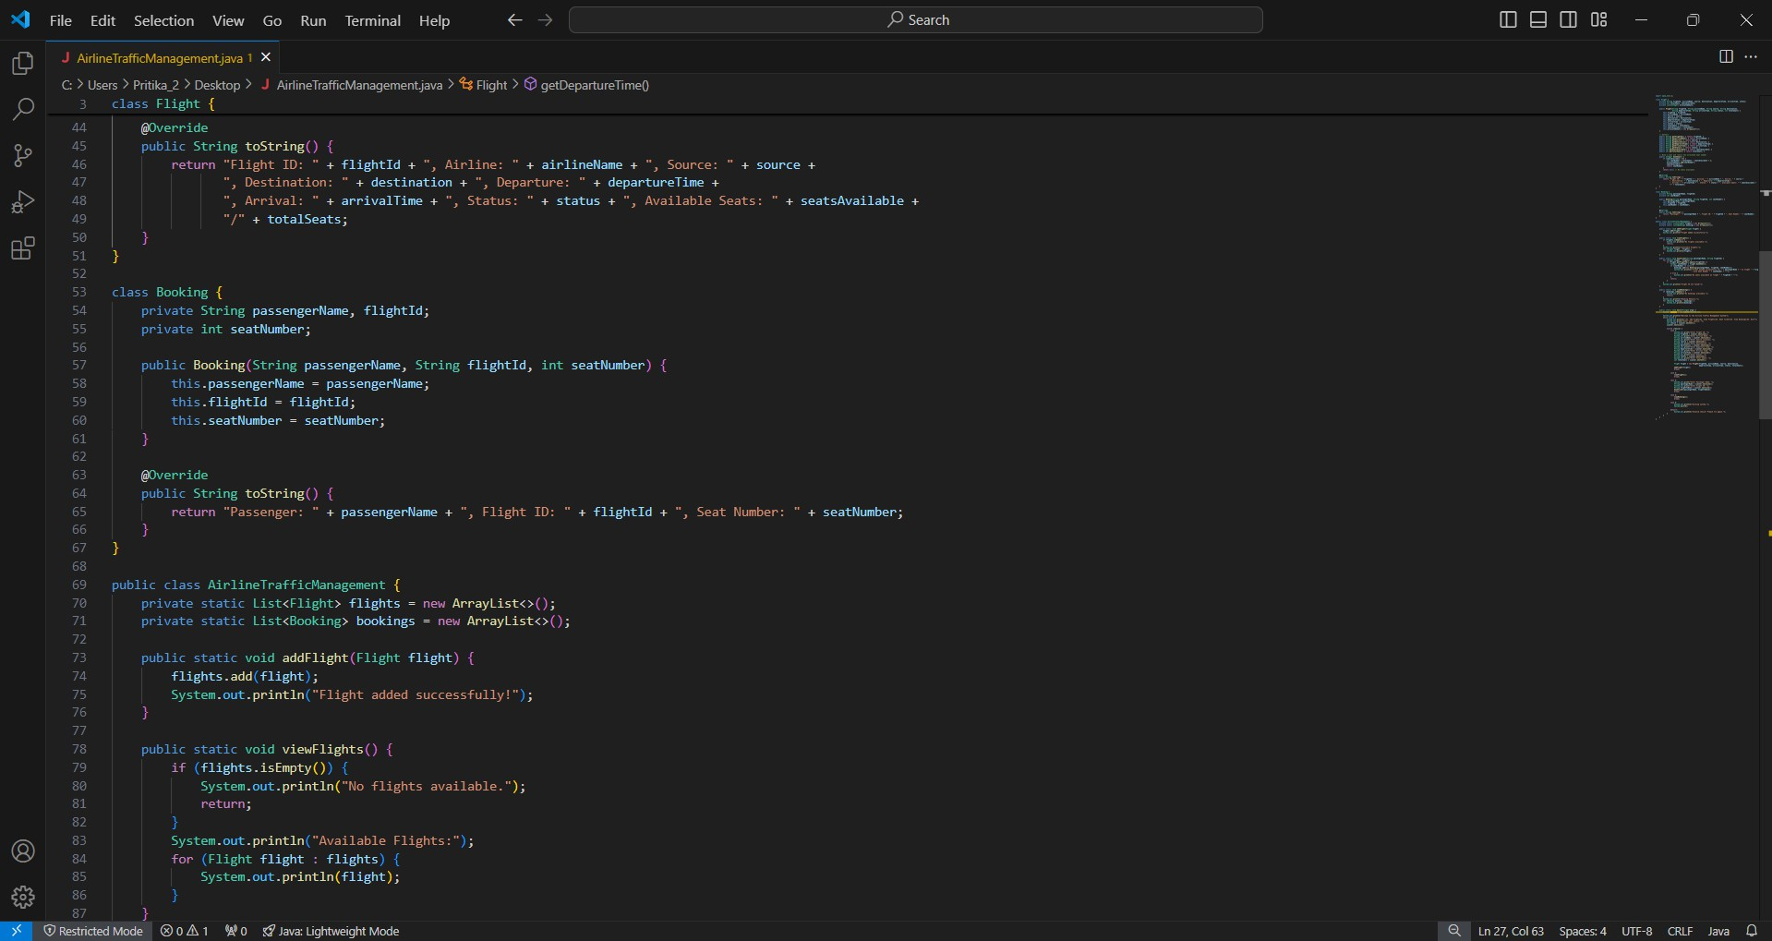

Slide 7
} File Edit Selectio n View Go Run Terminal Help
Q Search
B 6 B 0° —
x
C.' Users Pritika 2 Desktop Airline+rafficManagement. ava
nuh1 zz zla ss Ai r1 i neTraf(i era ‘a8e’e’’ ous1i c stat zc void vzewF 1ights ( ) t
(or Flight flight flights.
Flight @ petDepartureTimeg
u L i c st <t z c told booksi cket(String pas sengepName , St r i ng flightIdJ
for Flight flight flights
i (flight.getPlightId(}.equals(flightId)) (
Inte8er seatNumber = flight.bookSeat(); if (seatNumber != null} (
bookings.add new Booking(passengerName, flightld, seatNumber) ;
System. out. psi nt1n .*"Ticket booked succe s s-Fully’ *on " + pas sengenName +
+-ith Seat l'Jurrbe r " + seatNumben + " ' "
on *light
+ -FTightId +
Sys Mema. ut . pr'i ntl n' "f'lo sea ts a‘. a viable on ‘1 zp hI " + -F1ig held + "! ’’' ;
System. orit . pni nt 1n: "FLight ID not -L-ound ' " ;
System.ont.println "booking Details:" :;
TOr ’ BOo ' ’8 booking bookings : System. out. orlnt1n(booking) ;
Seannew scanner = ne'.• Scanner : Systen . in ,
System. orit . pni nt 1n: "'.leTcope I O the AI ruine Tra-F-Fic Planag=m=nt 5;’st=m" ': j
System.out.orintln(”\rl. Sdd Flight\n2. View Plighis\n5 Book Ticket\n4. Vie.‹ Bookings\r5. Exit"); System.out.orint(”Enter your choice: ");
z nt choice - s canner . nextInt( ) ;
fi“ O Restricted Mooe O 0 fi i R 0 % Java: lightweight Mode

Slide 8
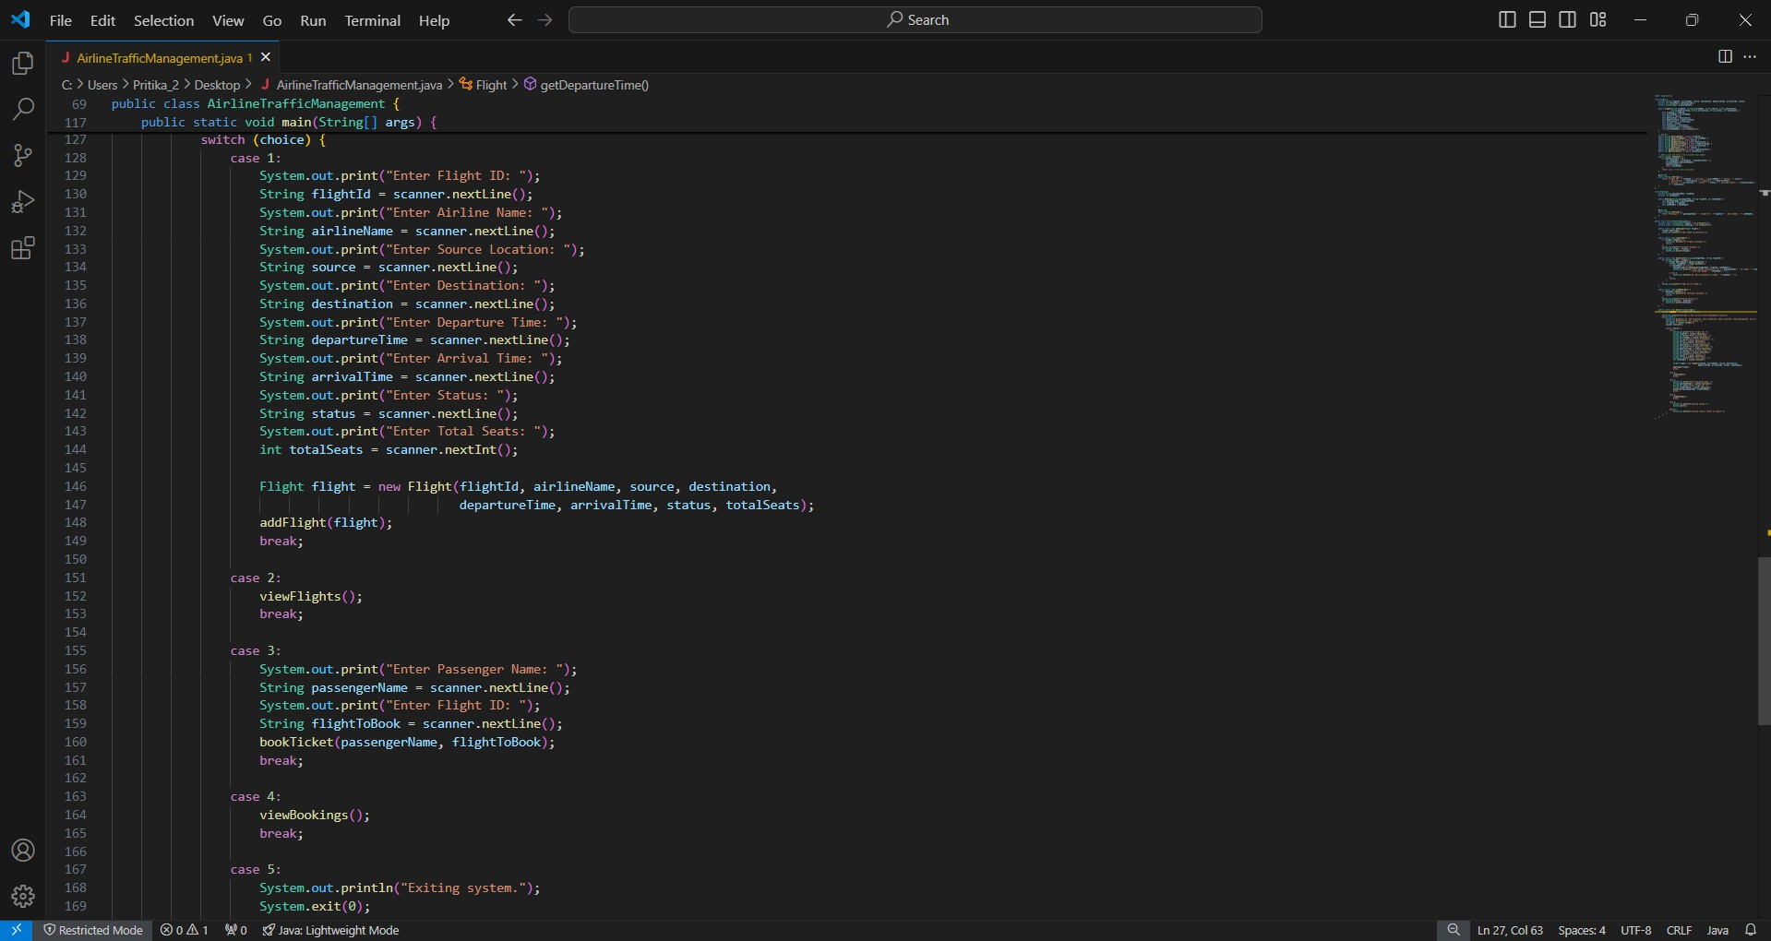

Slide 9
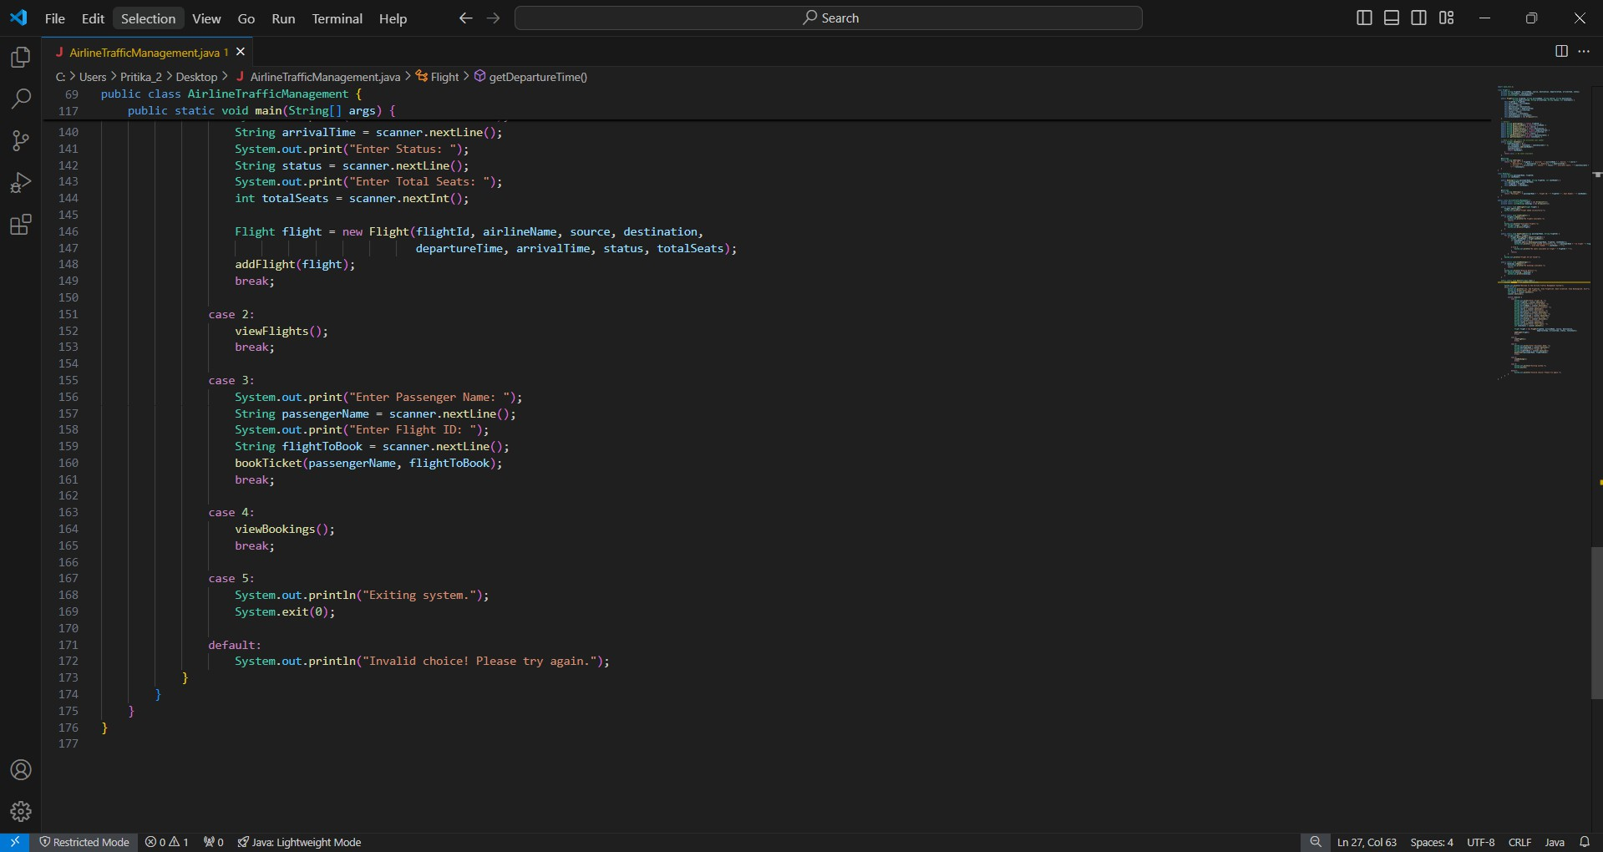

Slide 10
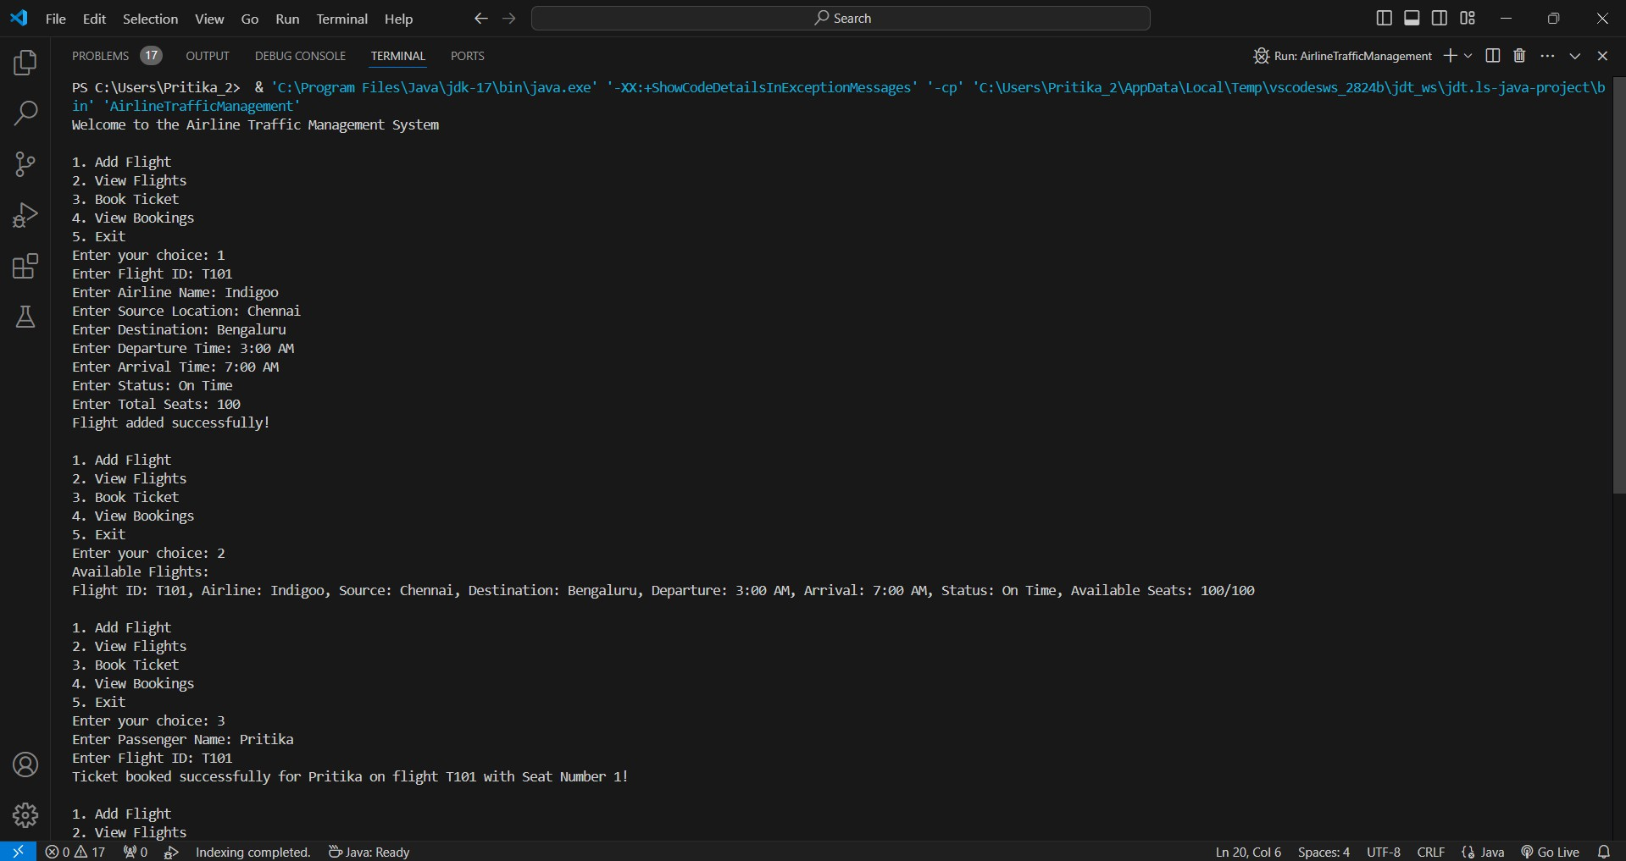
OUTPUT

Slide 11
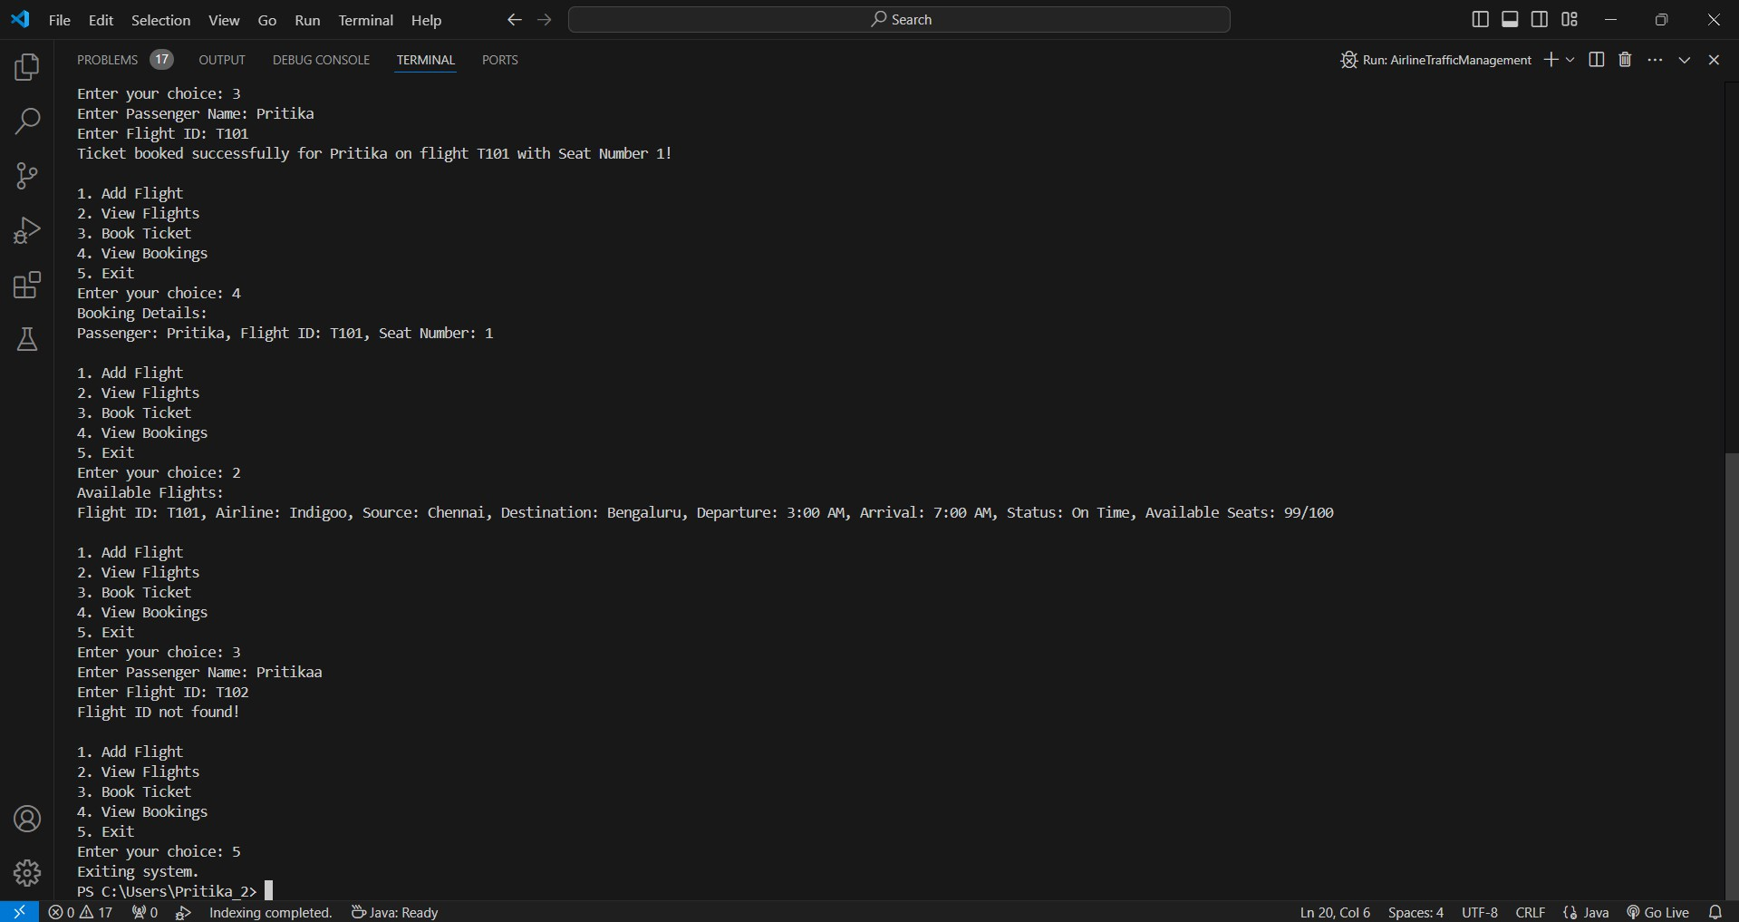

Slide 12
THANK YOU
GITHUB LINK :

