Slide 1
CAPSTONE PROJECT
Mira Capstone Project
Grounded • Routed • Multi-Agent Project Intelligence
ABCDE Ltd. AI Adoption Project
Agentic AI for Project Managers & Technical Program Managers
Capstone Presentation

Slide 2
OVERVIEW
Executive Summary
THE CHALLENGE
THE SOLUTION
THE VALUE
PMs spend time consolidating plans, risks, milestones and status data before they can make decisions.
Mira uses an AI router and specialist agents to answer project questions from controlled project data.
Faster reporting, consistent analysis, and stronger protection against unsupported project facts.
Capstone objective
Build a practical project-intelligence assistant that is useful to PM/TPM workflows without sacrificing grounding and traceability.
Core capabilities: Project Plan Generation • Risk Assessment • Weekly Status Report
02

Slide 3
BUSINESS NEED
Problem Statement & Success Criteria
PM/TPM pain points
Project information is distributed across plans, risk registers and task boards.
Weekly reporting requires repeated manual consolidation and interpretation.
Generative AI can introduce fabricated milestones, risks or task statuses if it is not grounded.
Decision-makers need concise answers that remain traceable to the project source of truth.
Success criteria
Grounded plans
Milestones trace to approved project data.
Relevant risks
Risks come from the official risk matrix.
Accurate status
Task counts match the Kanban source.
Safe behavior
Unsupported facts are not invented.
03

Slide 4
GROUNDING
Project Data Foundation
PROJECT DESCRIPTION
TIMELINE
ABCDE Ltd. AI Adoption Project Six-month delivery context
8 official milestones IDs + start/end dates
RISK MATRIX
KANBAN BOARD
8 official risks Impact • likelihood • rating • mitigation
25 project tasks Owner • status • due date • milestone
Source-of-truth rule
Timeline → milestones | Risk matrix → risks | Kanban board → task status
Working dataset note: synthetic replacement used because official course dataset files were unavailable.
04

Slide 5
TECHNICAL DESIGN
Solution Architecture
Project Plan Agent
Chat Trigger
Edit Fields Project Data
Mira Router
Switch
Risk Assessment Agent
Weekly Status Agent
OpenAI Chat Models
n8n Executions / Logs
Routing pattern: one user request → one capability → one specialist response
05

Slide 6
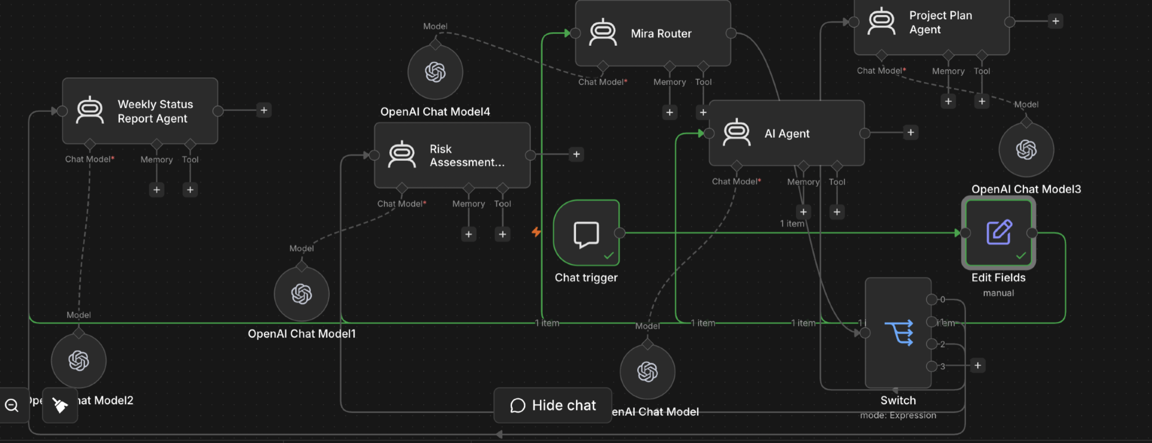

Slide 7
PRODUCT
Core Capabilities
01
02
03
Project Plan Generation
Risk Assessment
Weekly Status Report
Builds grounded plans using project objectives, workstreams, phases and official milestones.
Summarizes official risks while preserving IDs, ratings, mitigations, owners and status.
Reports task counts, blocked work, upcoming milestones and key project risks.
06

Slide 8
RESPONSIBLE AI
Grounding & Hallucination Controls
1
Milestone control
Generated milestones must trace to the timeline.
2
Risk control
Only risks in the official risk matrix are used.
3
Status control
Task counts and statuses come from the Kanban board.
4
Missing-data control
If information is unavailable, Mira says so rather than guessing.
5
Recommendation boundary
Recommendations are labeled separately from project facts.
Hallucination test: T024 is intentionally Blocked and must not be reported as completed.
07

Slide 9
VALIDATION
Testing & Evaluation
12 baseline prompts
Executed across planning, risks, status, milestones and hallucination checks.
Planning
Risk
Project plans, objectives, workstreams and official milestones
High-priority risks, mitigations, owners and security/data risks
Status
Hallucination
Weekly report, blocked work, task counts and upcoming milestones
Unsupported milestone + T024 completion check
Evidence retained in repository: baseline test document + test-results.png + observability.png
08

Slide 10
MEASUREMENT
Production Metrics
PLAN GROUNDEDNESS
RISK RELEVANCE
STATUS ACCURACY
% of generated milestones traceable to project data
% of identified risks that are project-specific
% of reported task counts matching the Kanban source
Recommended operating principle
Measure accuracy and grounding before optimizing for response speed or breadth.
09

Slide 11
PROJECT TRUTH
Verified Status Snapshot
25
10
4
10
1
TOTAL TASKS
DONE
IN PROGRESS
TODO
BLOCKED
T024 • Approve rollout recommendation • BLOCKED
These values are the Kanban source-of-truth counts used by Mira's status capability.
10

Slide 12
OPERATIONS
Observability & Cost Management
OBSERVABILITY
COST MANAGEMENT
n8n execution logs provide evidence of successful workflow runs, node execution and outputs. Future enhancement: Langfuse or LangWatch for centralized traces, latency, token and cost analysis.
Current model: gpt-5-mini for capability and reliability. Main cost driver: repeated project context and long prompts. Optimization levers: shorter prompts, reused/cached context and smaller models where quality permits.
Submission evidence includes observability screenshot and a dedicated Cost Analysis document.
11

Slide 13
NEXT STEPS
Business Value & Roadmap
TODAY
NEXT
Grounded project-plan generation
Risk assessment from official risk data
Weekly status reporting
Router + specialist-agent architecture
Live project-system integrations
Milestone alert system
Stakeholder update generator
Resource allocation advisor
Automated regression evaluation
Mira turns project data into decision-ready intelligence — with grounding as a design constraint.
12

Slide 14
CAPSTONE
Conclusion
Mira demonstrates a practical agentic AI pattern for PM/TPM workflows.
Route the request → ground the answer → preserve project truth → return actionable intelligence
Grounded
Modular
Tested
Observable
Uses controlled project context
Specialist agents by capability
12-prompt baseline + hallucination checks
n8n execution evidence
Repository deliverables: workflow • dataset • architecture • write-up • cost analysis • testing evidence • presentation
13

