Slide 1

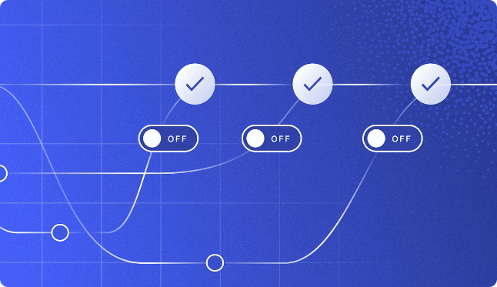

Git Branching: A Comprehensive Guide
Git branching is a powerful feature that allows developers to work on new features, bug fixes, or experimental code without affecting the main codebase. It provides a flexible and efficient way to manage different versions of your project, making it a cornerstone of modern software development.
rs
by raju scm

Slide 2
Git Branch Workflow: From Feature Branches to Releases
Feature Branch Creation
1
Start by creating a new branch for a specific feature or bug fix. This isolates your work from the main branch, ensuring stability.
2
Development and Commits
Develop and test your feature on the new branch, committing your changes regularly. This allows for clear versioning and easier rollback if needed.
Merge Request or Pull Request
3
Once your feature is ready, create a pull request, proposing your changes to the main branch for review. This enables collaboration and feedback from other developers.
4
Review and Merge
Code reviewers assess the pull request, ensuring quality and adherence to coding standards. If approved, the changes are merged into the main branch.
Release Branch
5
For official releases, create a dedicated release branch to handle bug fixes or minor updates. This keeps the main branch stable and ready for new features.
6
Tagging the Release
Tag the release branch with a unique identifier, creating a permanent snapshot of the code at that moment. This is crucial for versioning and documentation.

Slide 3


Git Tag Functionality: Versioning and Release Tracking
1
Versioning
2
Release Management
Tags act as permanent markers in Git history, allowing you to identify specific releases, versions, or milestones. They serve as a reliable point of reference for your codebase.
Tags are essential for release management, as they help you track and document different versions of your software. This is crucial for bug fixing, maintaining compatibility, and ensuring seamless updates.
3
Feature Rollbacks
4
Historical Reference
If a feature introduces bugs or regressions, you can easily revert to a tagged release. This ensures stability and allows you to fix issues before deploying to production.
Tags provide a clear historical context, allowing you to easily identify and understand the evolution of your project. They offer valuable insights into changes made over time.

Slide 4
Git Stash Basics: Managing Uncommitted Changes
Temporary Storage
Switching Branches
Applying Stashed Changes
Stashing allows you to temporarily store uncommitted changes in a stack. This is useful when you need to switch branches or pull in new changes but haven't finished working on your current feature.
Use stash to safely switch to another branch, even if you have uncommitted changes. Your work will be preserved in the stash and can be applied later.
When you're ready to continue working on your feature, you can apply the stashed changes to your current branch. This restores your work and lets you continue where you left off.

Slide 5


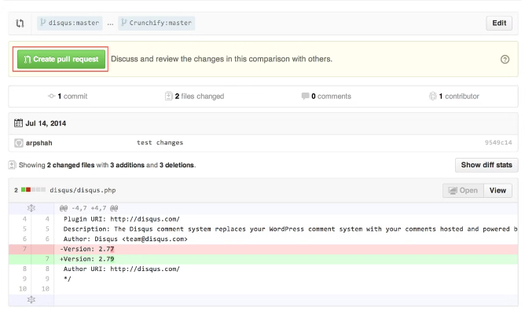



Understanding Pull Requests: Collaborative Code Review and Integration
Feature Branch Development
You work on a feature on a dedicated branch, committing changes regularly. This isolates your work and allows for independent development.
Pull Request Creation
Once your feature is ready, you create a pull request, submitting your changes to the main branch for review. This initiates the collaborative code review process.
Code Review and Feedback
Other developers review your code, providing feedback, suggesting improvements, and ensuring quality. This collaborative process ensures robust code and reduces errors.
Merging into the Main Branch
After review and approval, your changes are merged into the main branch, integrating the new feature into the main codebase.

Slide 6

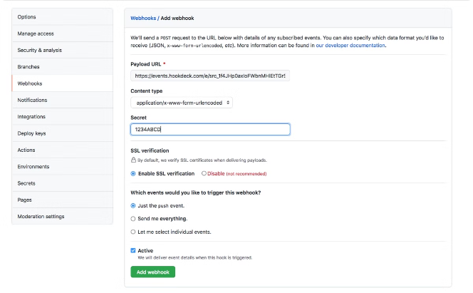
Implementing Webhooks: Triggering Actions Based on Git Events
Git Events
External Services
Webhooks are triggered by specific events within your Git repository. This includes events like pushes, pull requests, merges, and issue creation.
Webhooks allow you to connect your Git repository to external services, such as continuous integration/continuous delivery (CI/CD) platforms, issue tracking tools, or notification systems.
Automated Tasks
Example Use Cases
When a webhook is triggered, it can automatically execute tasks in your external services. This allows for seamless automation of various processes.
Webhooks can be used to automatically build and deploy code on every push, notify team members about new pull requests, or update issue statuses based on Git events.

Slide 7






Integrating Branching, Tags, Stash, and Webhooks: A Powerful Workflow
Branching for Collaboration
Tags for Versioning
Use branching to create isolated environments for development, facilitating parallel work and reducing conflicts.
Utilize tags to mark specific releases, ensuring clear identification and historical context for your project.
Stash for Temporary Changes
Webhooks for Automation
Stash uncommitted changes to seamlessly switch between branches, preserving your work while keeping your main branch clean.
Leverage webhooks to trigger automated tasks in external services, streamlining your development and deployment workflows.

Slide 8


Conclusion and Key Takeaways: Mastering Git for Effective Development
Git branching, tagging, stashing, and webhooks are powerful tools that, when combined, create a robust and efficient workflow for software development. By mastering these concepts, you can streamline your workflow, collaborate effectively, and manage your projects with ease. Embrace the flexibility and power of Git to elevate your development practices to a new level.

