Slide 1


Introduction to GitHub
GitHub is a powerful platform that serves as a central hub for software development and collaboration. It is a web-based hosting service for version control using Git. This document provides a comprehensive guide to GitHub, covering essential steps for creating an account, managing repositories, and collaborating with others. Through this guide, you will gain a practical understanding of the key functionalities of GitHub and how to leverage its features for efficient software development.
by raju scm
rs

Slide 2
Creating a GitHub Account
To embark on your GitHub journey, you need to create an account. The process is straightforward and user-friendly. Visit the GitHub website “https://github.com/” and click on the "Sign up" button. You will be prompted to enter your email address, username, and password. Choose a strong password that combines uppercase and lowercase letters, numbers, and symbols. Once you've provided the necessary information, click on the "Create account" button. You'll receive a confirmation email with a link to activate your account. Click on the link to complete the account creation process. After verifying your email address, you will be redirected to your GitHub profile page. Here, you can customize your profile, upload a profile picture, and start exploring GitHub's features.

Slide 3
Creating Public and Private Repositories
Repositories are like folders that store your projects on GitHub. Each repository holds your code, documentation, and other project-related files. GitHub allows you to create two types of repositories: public and private.
1
Public Repositories
2
Private Repositories
Public repositories are accessible to everyone on GitHub. They are often used to share code with the open-source community or showcase your projects.
Private repositories are only accessible to you and those you grant permission to. They are suitable for projects that require confidentiality, such as proprietary software or personal projects.
To create a repository, click on the "New" button on your GitHub profile page. Give your repository a name and choose whether it should be public or private. You can also include a description for your repository to provide context and clarity to others. Once you've created a repository, you can start adding files and making changes to your project.

Slide 4
Accessing Repositories from the Local Machine
After creating your repositories, you'll need to access them from your local machine to work on your projects. To do so, you need to install Git, the version control system that powers GitHub. Git is a command-line tool, but there are graphical user interfaces (GUIs) available for those who prefer a visual approach. You can download install https://github.com/git-for-windows/git/releases/download/v2.46.0.windows.1/Git-2.46.0-64-bit.exe. Once Git is installed, you can interact with your repositories using commands like "git clone" to download a copy of your repository to your local machine, "git add" to stage changes to your files, "git commit" to create a snapshot of your changes, and "git push" to upload your changes to the remote repository on GitHub. Git is the foundation of GitHub, and understanding its commands is crucial for effectively managing your projects.

Slide 5

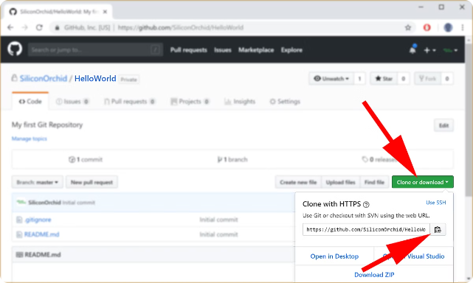
Cloning a Repository to the Local Machine
Cloning a repository brings a copy of it from GitHub to your local machine. This enables you to work on the project files directly on your computer. To clone a repository, open your terminal or command prompt and navigate to the directory where you want to store your local copy. Then, use the "git clone" command followed by the URL of the repository. For example, if the repository's URL is "https://github.com/username/repositoryname", you would use the command: "git clone https://github.com/username/repositoryname". This will create a new folder with the repository's name in the current directory containing all the project files. You can then make changes to the files in this local copy and push the changes back to GitHub.

Slide 6
Pushing Changes to a Repository
After making changes to your project files in the local copy, you need to push these changes back to the remote repository on GitHub. This ensures that your latest work is reflected on the online version of your project. Before pushing changes, you need to stage them using the "git add" command. Staging tells Git which changes you want to include in the next commit. Once staged, you can create a commit using the "git commit" command. A commit is like a snapshot of your project at a particular point in time, including all the changes you've made. Finally, you can use the "git push" command to upload your commit to the remote repository on GitHub. This synchronizes your local copy with the remote version of your project.

Slide 7

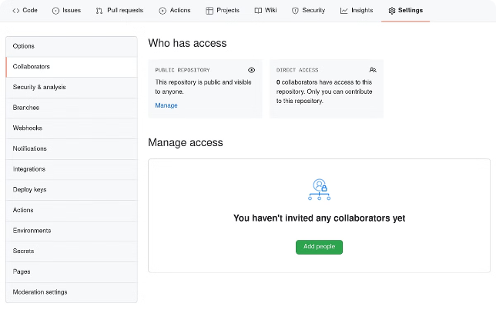
Granting Access to a Private Repository
When working on a private repository with a team, you need to grant access to your collaborators so they can contribute to the project. This involves adding them as collaborators to the repository and assigning appropriate permissions. To add a collaborator, go to your repository's settings page and click on the "Manage access" tab. Enter the username or email address of the person you want to add and select the desired access level. For example, you can grant "Read" access, allowing collaborators to view the repository's contents, or "Write" access, allowing them to make changes. You can also grant "Admin" access, which gives collaborators full control over the repository. When assigning permissions, consider the roles and responsibilities of your collaborators and choose the access level that aligns with their contributions.

Slide 8
Conclusion and Key Takeaways
GitHub is a powerful tool for software development and collaboration. It offers a streamlined approach to version control, project management, and code sharing. Mastering GitHub can significantly improve your productivity and efficiency as a developer. Key takeaways from this guide include understanding the fundamentals of creating an account, managing repositories, accessing repositories from the local machine, cloning repositories, pushing changes to the remote repository, and granting access to collaborators. By applying these steps and continuously exploring GitHub's functionalities, you can leverage its features to enhance your development workflow and collaborate effectively with others.

