Slide 1
STUDENT NAME: Sandhiya P REGISTER NO AND NMID: 222403853 /asunm293222403853 DEPARTMENT: COMPUTER SCIENCE COLLEGE: VIDHYA SAGAR WOMENS COLLEGE / MADRAS UNIVERSITY

Slide 2
PROJECT TITLE FrostVale Resort

Slide 3
AGENDA
1.Problem Statement
2.Project Overview
3.End Users
4.Tools and Technologies
5.Portfolio design and Layout
6.Features and Functionality
7.Results and Screenshots
8.Conclusion

Slide 4
PROBLEM STATEMENT
Objective: To design and develop an immersive, responsive, and visually appealing winter resort booking website that enhances user experience, showcases key offerings, and simplifies the booking process.
Challenges Identified:
Need for intuitive navigation
Engaging and cozy visual design for a winter-themed resort
Streamlined booking interaction
Interactive UI features (e.g., snowfall effect, modals)

Slide 5
Project overview
Title: FrostVale Resort — Winter Escape
Description: A fictional website project for FrostVale Resort that presents:
Accommodation options
Winter activities
Photo gallery
Interactive booking form
Engaging visuals with canvas snowfall animation
Purpose: Demonstrate front-end skills in UI/UX design, interactivity, responsiveness, and JavaScript functionality.

Slide 6
End users
Target Audience:
Tourists seeking winter retreats
Families and couples planning holiday stays
Adventure lovers looking for snow activities
Users on mobile or desktop devices
User Needs:
Quick and clear cottage information
Easy navigation and gallery previews
A simple, demo-friendly booking form

Slide 7
Tools and technologies
HTML5: Semantic structure
CSS3: Responsive layout, animations, gradient backgrounds
JavaScript (Vanilla JS):
Snowfall animation
Modal handling
Form validation and calculation
Google Fonts: "Poppins" for modern, clean typography
Unsplash: For high-quality royalty-free images

Slide 8
Portfolio design and layout
Design Highlights:
Modern layout with dark winter theme
Sticky navigation bar for easy access
Hero section with background overlay
Sectioned structure: cottages, activities, gallery, booking
Modals for interactive lightboxes and details
Responsive Design: Adapts to desktop, tablet, and mobile viewports

Slide 9
Features and functionality
Canvas-based snowfall animation ✅ Interactive gallery with lightbox previews ✅ Cottage cards with modal details ✅ Dynamic booking form
Calculates total price
Live updates on selection ✅ Escape key functionality to close modals ✅ Mobile responsiveness

Slide 10
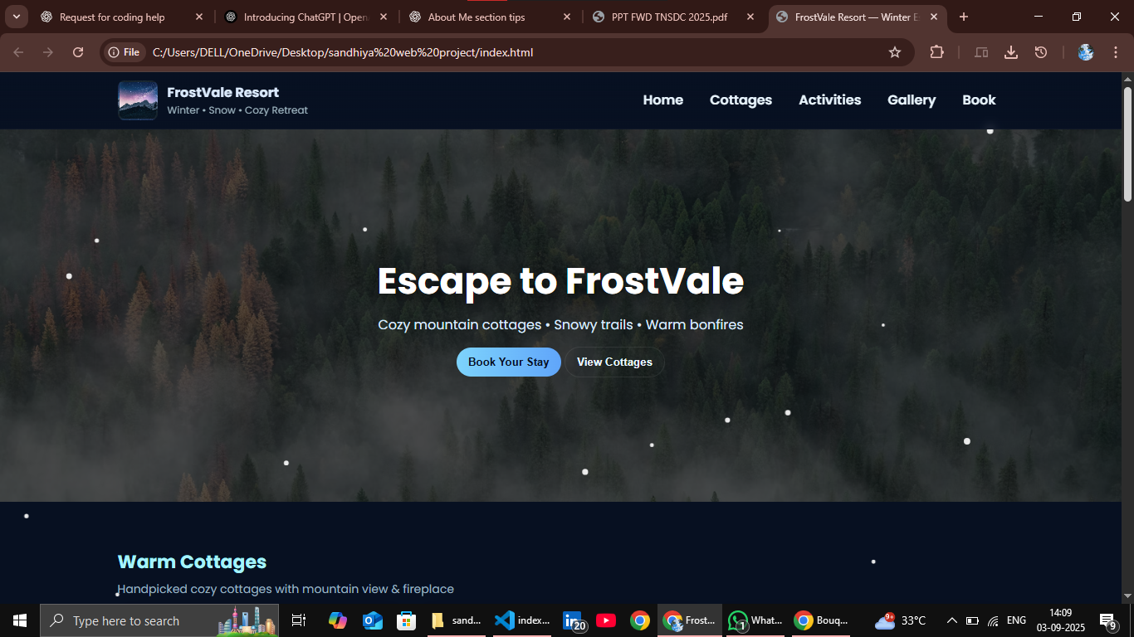
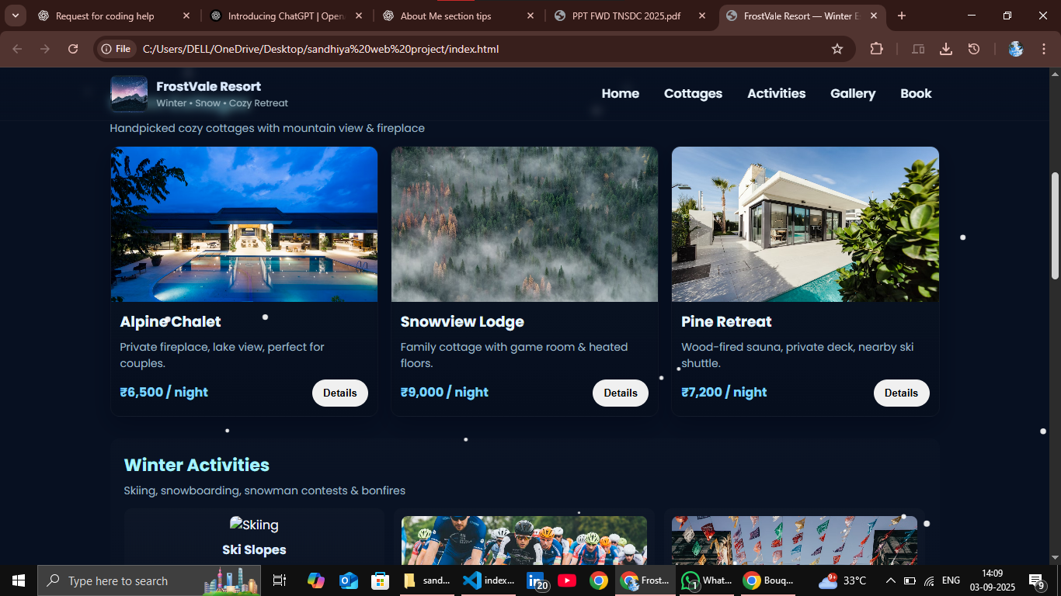
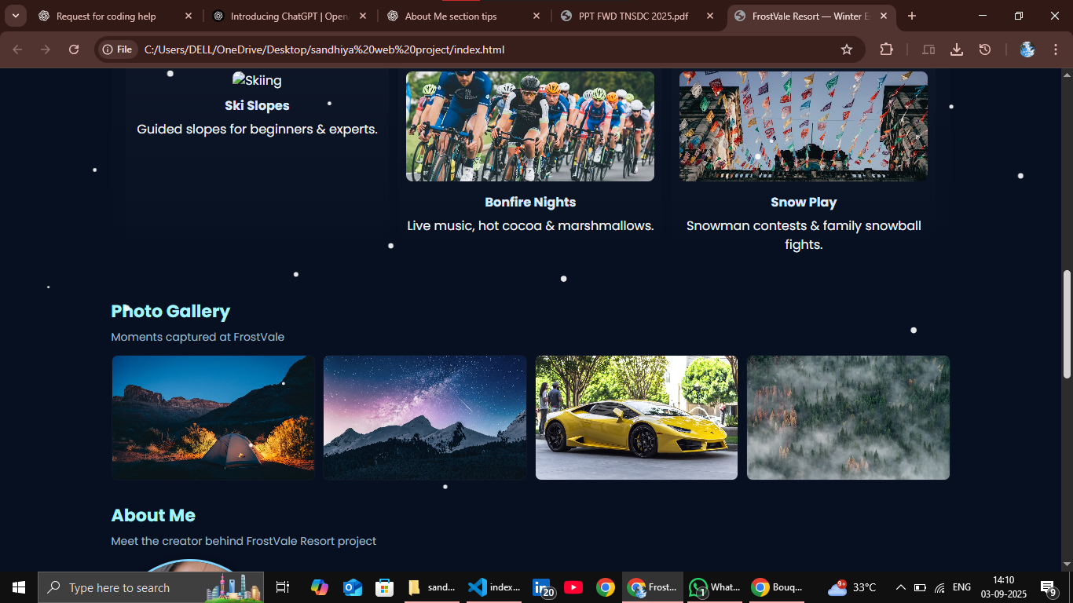
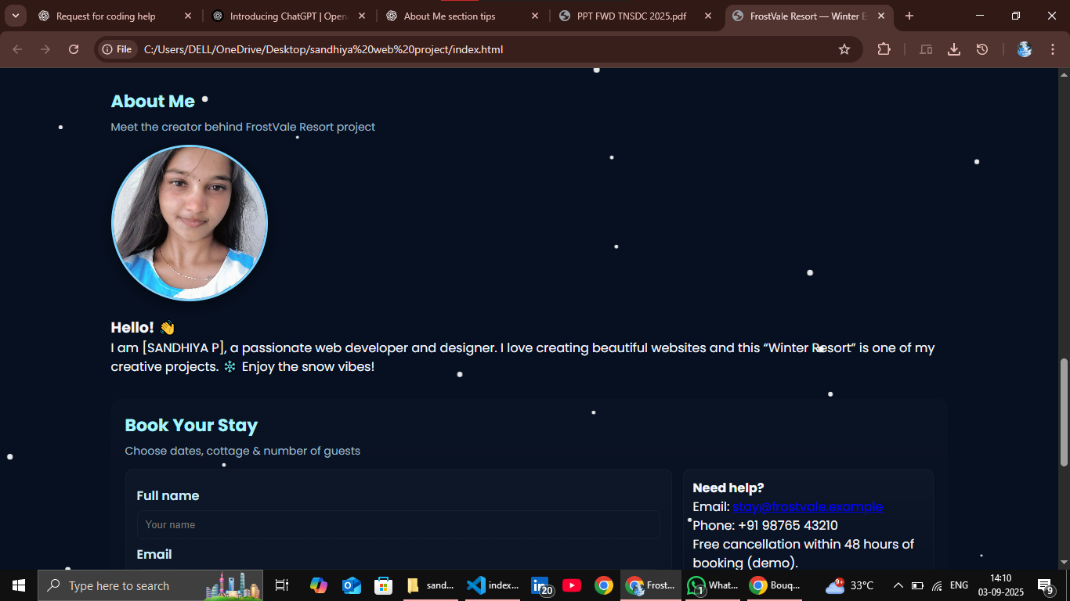
Results and screenshots
Visual Results:
A cozy, themed visual experience
Smooth navigation and interactions
Functional and clear UI for booking
(You can insert screenshots of:)
Hero section
Cottage cards
Activities row
Booking form
Modals (Gallery + Details)

Slide 11
conclusions
Successfully created a themed resort demo site with interactivity and usability.
Met all major UI/UX goals using only HTML, CSS, and vanilla JS.
Project demonstrates competency in responsive design, DOM manipulation, and user experience design.
Future Improvements:
Backend integration for real booking
User authentication and cottage availability
Enhanced accessibility (ARIA)

