Slide 1
Detecting Phishing Websites Using Machine Learning
Siva Ramalingam R Guna Aditya Vardhan Kalvagadda
17BCB0132 17BCB0060

Slide 2
Objective
A phishing website is a common social engineering method to collect sensitive information from innocent users. The target of this project is to train various machine learning models on the dataset created to predict phishing websites. The performance level of every model is measures and compared. And develop the web application.

Slide 3
Motivation
Phishing detection techniques do suffer low detection accuracy and high warning especially when novel phishing approaches are introduced. Besides, the most common technique used, blacklist-based method is inefficient in responding to emanating phishing attacks since registering new domain has become easier, no comprehensive blacklist can ensure a perfect up-to-date database. Therefore, ensemble is often seen to be a far better solution because it can combine the similarity in accuracy and different error-detection rate properties in selected algorithms.

Slide 4
Abstract
Nowadays usage of the web is increasing day by day. Therewith cyber-theft also increasing day by day. The attacker phishing method is employed to collect the private information of innocent users .A phishing attack is the easiest method to get sensitive information from innocent users. The phishers aim to accumulate sensitive information from the users like username, password, bank account details, and far more sensitive information. To successfully fool a person's user, these pages are designed to seem like legitimate ones. This paper deals with machine learning technology for the detection of phishing URLs by extracting and analyzing various features of legitimate and phishing URLs.

Slide 5
Problem statement
Phishing detection techniques do suffer low detection accuracy and high warning especially when novel phishing approaches are introduced. Besides, the most common technique used, blacklist-based method is inefficient in responding to emanating phishing attacks since registering new domain has become easier, no comprehensive blacklist can ensure a perfect up-to-date database. Furthermore, page content inspection has been employed by some strategies to beat the false negative problems and complement the vulnerabilities of the stale lists.

Slide 6
Background
Traditional method to detect phishing websites is by identifying and updating blacklisted URL’s, Internet Protocol (IP) to the antivirus which is commonly known as “Blacklist” method. Attackers to evade getting blacklisted use creative techniques to fool users by modifying URL so that it appears legitimate via obfuscation and many other simple techniques like fast-flux, in this technique the proxies are automatically generated to host the webpage, other technique is to generate URL’s algorithmically and etc.

Slide 7
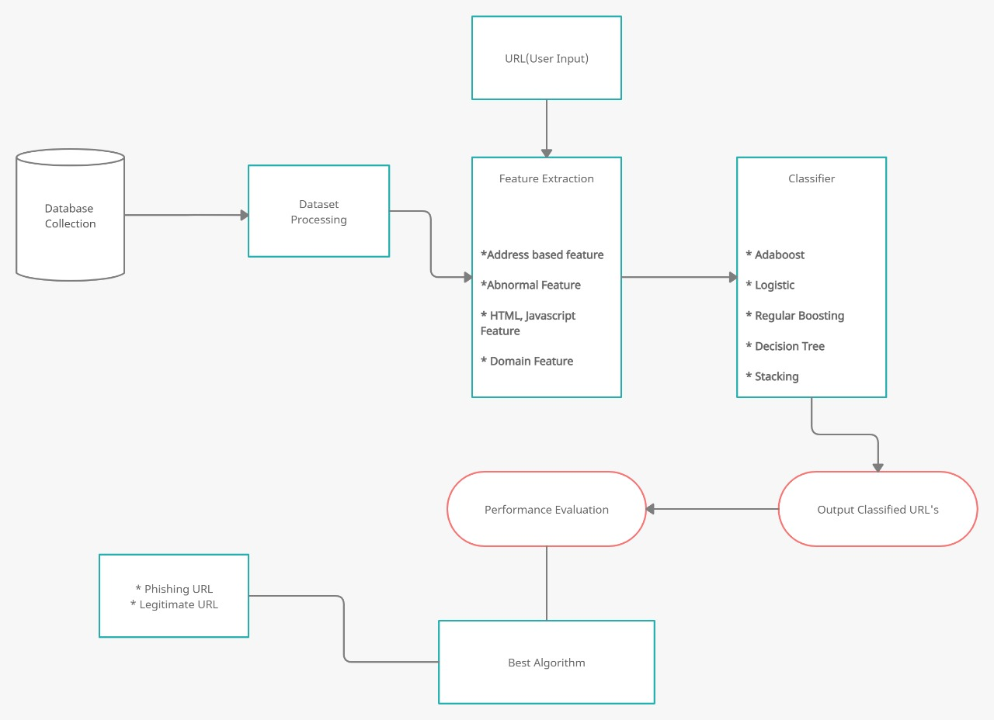

Slide 8
Approach
• Collect dataset containing phishing and legitimate websites from the open source platforms.
• Write a code to extract the required features from the URL database.
• Analyze and preprocess the dataset
• Divide the dataset into training and testing sets.
• Run selected machine learning algorithms like Logistic, Decision , AdaBoost , Regular, Stacking on the dataset.
• Compare the obtained results for trained models and specify which is better.

Slide 9
Hardware
Windows 7,8,10 64 bit
RAM 4GB

Slide 10
Software
Data Set
Python 2.7
Anaconda Navigator

Slide 11
Python Libraries
Pandas
Numpy
Sklearn
Matplotlib
Flask

Slide 12
Literature Review
(Roopak .S, Athira P Vijayaraghavan, Tony Thomas)
These Authors in 2019 identify phishing webpages from its URL domain and source code based feature.
They used RIPPER algorithm to Detect Phishing website. The webpage source code based rules can identify phishing websites with an accuracy of 92 % only.
URL and domain based features could be easily defeated by using black hat SEO technique.

Slide 13
Methodology
To evaluate our machine learning techniques, we have used the ‘Phishing Websites Dataset’ from UCI Machine learning repository. It consists of 11,055 URLs (instances) with 6157 phishing instances and 4898 legitimate instances. Each instance contains 30 features. Each feature is associated with a rule. If the rule satisfies, it is termed as phishing. In the event that the standard doesn't fulfill, it is named as legitimate .The features take three discrete values. ‘1’ if the rule is satisfied, ‘0’ if the rule is partially satisfied, ‘-1’ if the rule is not satisfied.

Slide 14
Feature Selection
Address Bar based features
Abnormal based features
HTML and JavaScript based features
Domain based features

Slide 15
ML Models
This is a supervised machine learning task. There are two major types of supervised machine learning problems, called classification and regression.
This data set comes under classification problem, as the input URL is classified as phishing (1) or legitimate (0).

Slide 16
Continue…
We have trained and tested supervised machine learning algorithms on the training dataset. The following algorithms were chosen based on their performance on classification problems. The dataset was split into training and test set in the ratio 8:2.

Slide 17
Algorithms
Logistic Regression
Regular Boosting
Decision Tree
AdaBoost Classifier
Stacking Classifier

Slide 18
Logistic Regression
Logistic regression is a fundamental classification technique. It belongs to the group of linear classifiers and is somewhat similar to polynomial and linear regression. Logistic regression is fast and relatively uncomplicated, and it’s convenient for you to interpret the results. Although it’s essentially a method for binary classification, it can also be applied to multiclass problems.

Slide 19
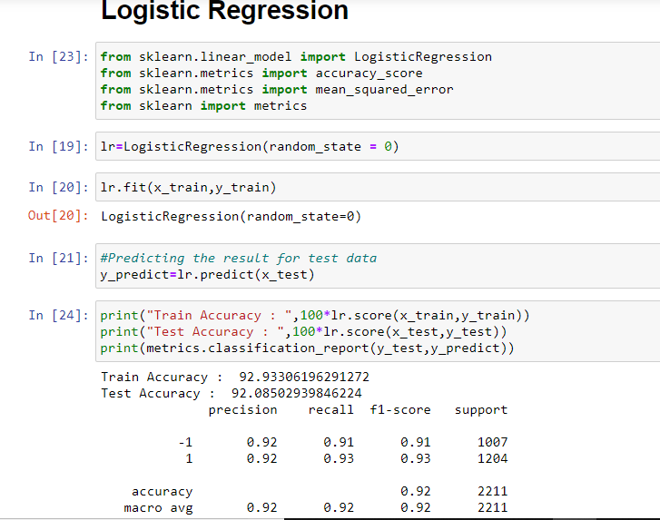

Slide 20
Regular Boosting
Regular boosting classifiers are a gathering of ML calculations that join numerous feeble learning models together to make a solid prescient model. Decision trees are normally utilized while doing inclination boosting. Regular boosting models are turning out to be well known due to their adequacy at arranging complex datasets, and have as of late been utilized to win numerous Kaggle information science rivalries.

Slide 21
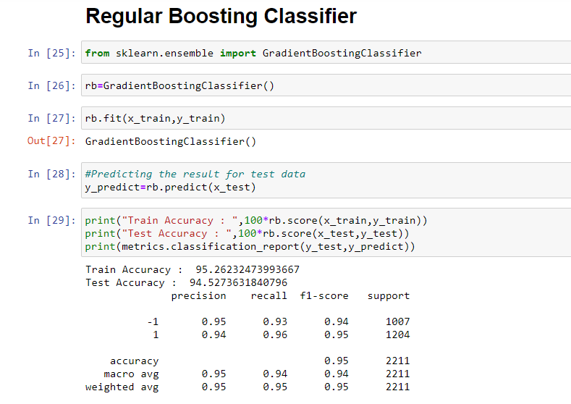

Slide 22
Decision Tree
Decision tree analysis involves making a tree-shaped diagram to chart out a course of action or a statistical probability analysis. It is used to break down complex problems or branches. Each branch of the decision tree could be a possible outcome.

Slide 23
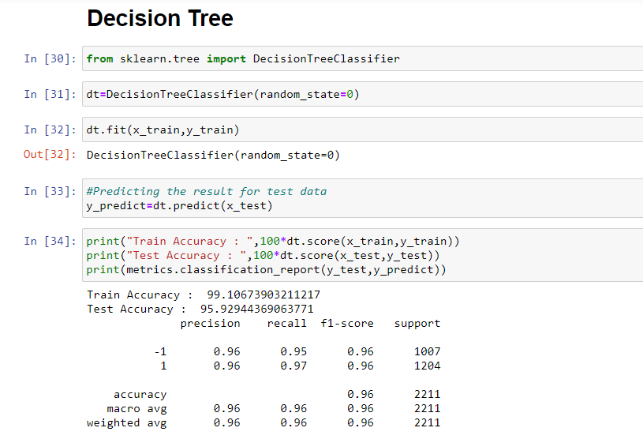

Slide 24
AdaBoost
AdaBoost is best used to boost the performance of decision trees on binary classification problems. AdaBoost can be used to boost the performance of any machine learning algorithm. It is best used with weak learners.

Slide 25
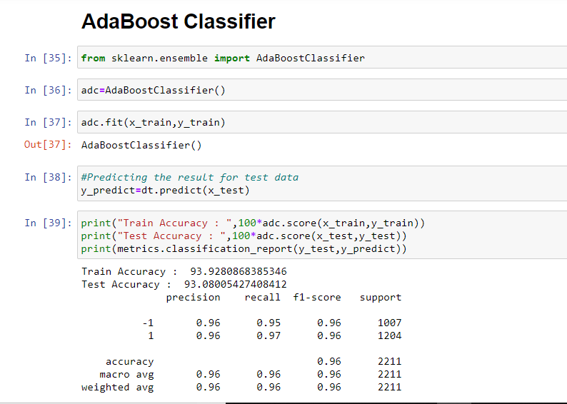

Slide 26
Stacking Classifier
Stacking is an ensemble machine learning algorithm. It uses a meta-learning algorithm to learn how to best combine the predictions from two or more base machine learning algorithms. The benefit of stacking is that it can harness the capabilities of a range of well-performing models on a classification or regression task and make predictions that have better performance than any single model in the ensemble . The architecture of a stacking model involves two or more base models. The meta-model is trained on the predictions made by base models on out-of-sample data.

Slide 27
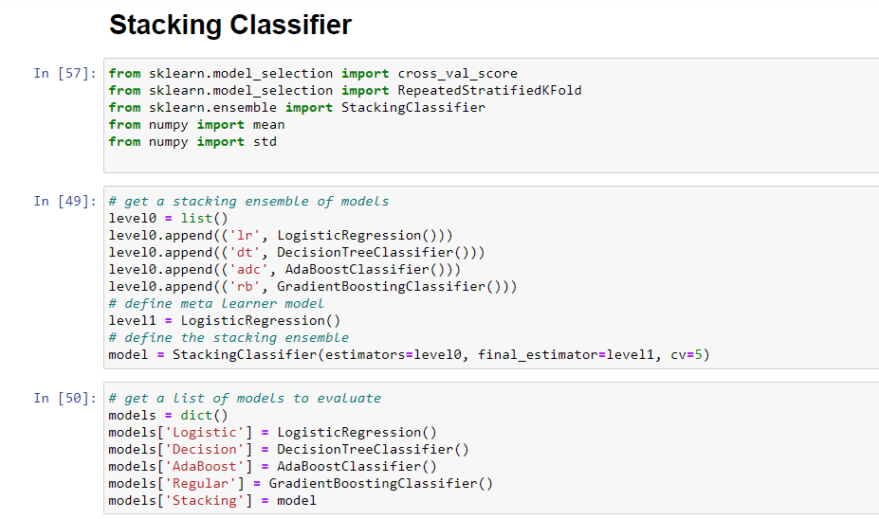

Slide 28
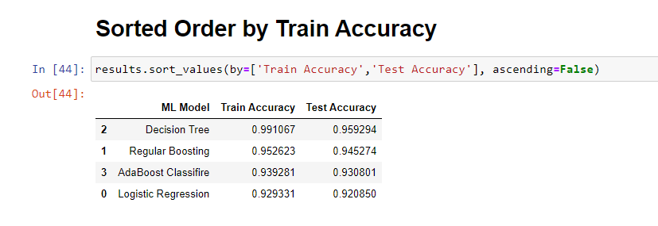
Results and Discussion

Slide 29
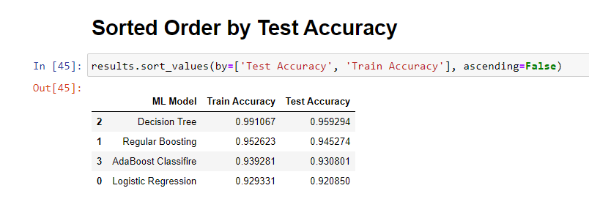

Slide 30
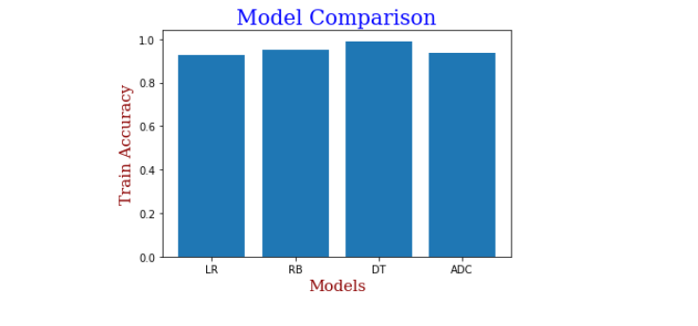

Slide 31
Results and Discussion
Logistic 0.928 (0.006)
Decision 0.961 (0.007)
AdaBoost 0.938 (0.007)
Regular 0.949 (0.007)
Stacking 0.964 (0.006)
In this case, we can see that the stacking ensemble appears to perform better than any single model on average, achieving an accuracy of about 96.4 %.

Slide 32
BENEFITS
Real-time protection for employees who access malicious websites or click on phishing links
Detect and prevent against unknown phishing attacks, as new patterns are created by attackers
Email filtering solutions help in filtering phishing/spam emails, but this provides holistic protection for all outgoing internet traffic

Slide 33
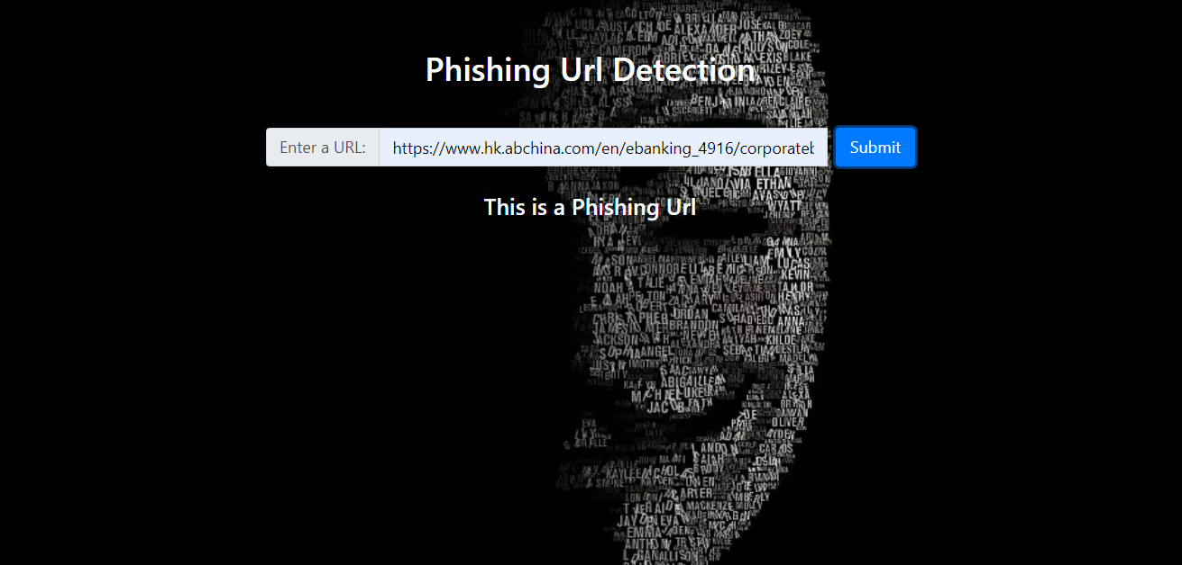
Project Demonstration
Phishing Website Detection

Slide 34
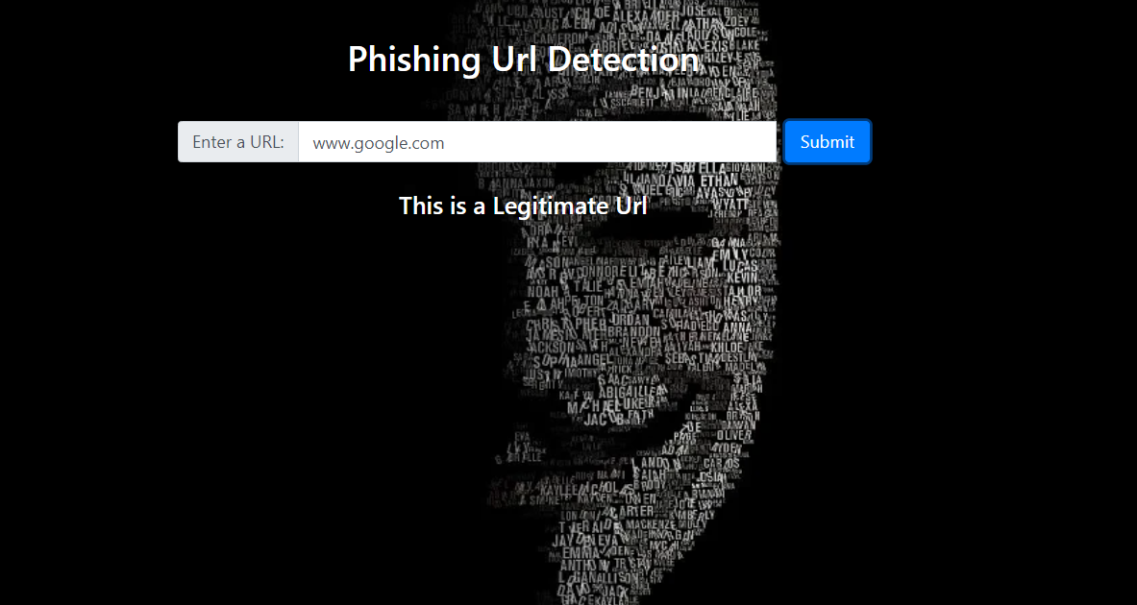
Project Demonstration
Legitimate Website Detection

Slide 35
Conclusion
Phishing is a growing crime and one that we must be aware of. Although laws have been enacted, education is the best defense against phishing. Being a bit suspicious of all electronic communications and websites is recommended. Lookout for the common characteristics - sense of urgency, request for verification, and grammar and spelling errors. Also, get in the habit of comparing the provided URL with the an independent search for the company's website.

Slide 36
Future Work
Brand Alert Host Alert

Slide 37
Brand Alert
A Brand alert program as we our users can check on our website if the url is of a phishing website or not, Our next step is to alert the companies or any Brand that are being targeted by the attackers so that they can warn and save their respective customers from being scammed

Slide 38
Host Alert
As a hosting services provider, your customer may be hacked and host phishing. To be alerted in real-time about all hosts that are currently hosting phishing websites, please fill out the following form.

Slide 39
THANK YOU

