Slide 1

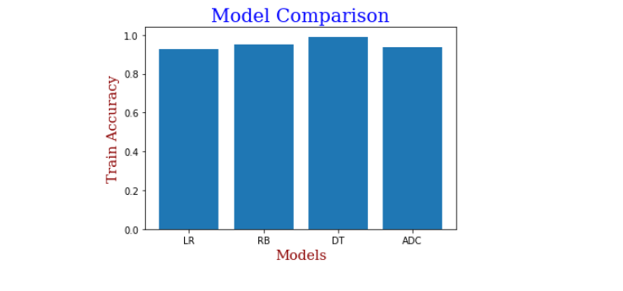
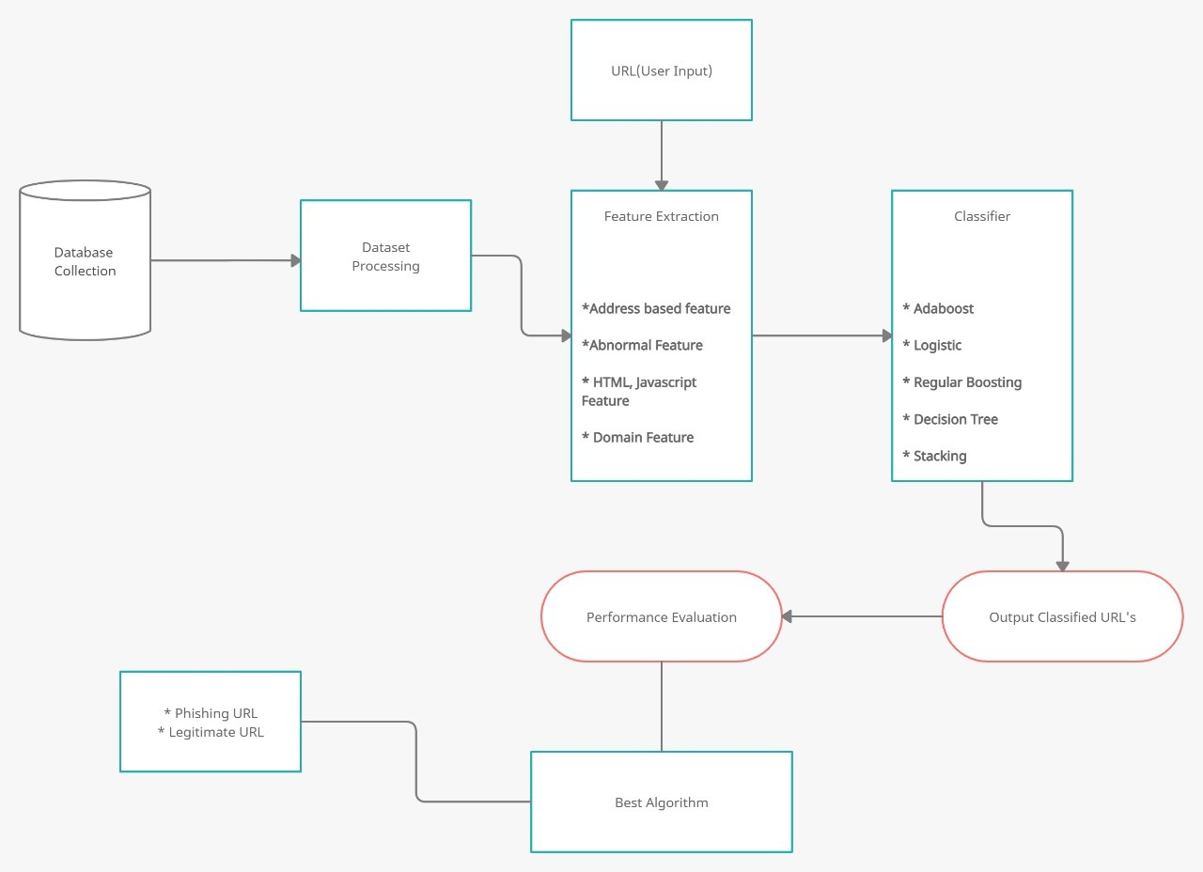
Detecting Phishing Websites Using Machine Learning
K Guna aditya(17BCB0060) Sivaramalingam R(17BCB0132) | Swarnalatha P| School of Computer Science & Engineering
Introduction
Results
Phishing is one of the methods adopted by fraudsters to obtain user credentials through disguise from malicious websites. We are going to test common machine learning algorithms for the purpose of classifying URLs. After comparing all the algorithms, we select the best algorithm for developing web application which algorithm gives more accuracy.
To evaluate our machine learning techniques, we have used the ‘Phishing Websites Dataset’ from UCI Machine learning repository. It consists of 11,055 URLs (instances) with 6157 phishing instances and 4898 legitimate instances
The features represented by the training dataset can be classified into four categories;
i Address Bar based features
ii Abnormal based features
iii HTML and JavaScript based features
iv Domain based features
We have trained and tested supervised machine learning algorithms on the training dataset. The following algorithms were chosen based on their performance on classification problems. The dataset was split into training and test set in the ratio 8:2. The results of our experiment are given in the results section
Logistic Regression
Regular Boosting
Decision Tree
Adaboost Classifier
Stacking Classifier
Model Comparison:
In out of four single machine learning algorithms decision tree gives highest accuracy among all.
In this case, we can see that the stacking ensemble appears to perform better than any single model on average, achieving an accuracy of about 96.4 %.
Motivation
Phishing detection techniques do suffer low detection accuracy and high warning especially when novel phishing approaches are introduced. Besides, the most common technique used, blacklist-based method is inefficient in responding to emanating phishing attacks since registering new domain has become easier, no comprehensive blacklist can ensure a perfect up-to-date database
Furthermore, page content inspection has been employed by some strategies to beat the false negative problems and complement the vulnerabilities of the stale lists. Moreover, page content inspection algorithms each have different approach to phishing website detection with varying degrees of accuracy. Therefore, ensemble is often seen to be a far better solution because it can combine the similarity in accuracy and different error-detection rate properties in selected algorithms.
Methodology
We used six classifiers algorithms: Random forest, Logistic Regression, Regular boosting classifier, Decision Tree, AdaBoost Classifier, and Bagging Classifier these are the machine-learning algorithms that are accustomed to detecting phishing websites. The paper aims to detect phishing URLs also as narrow them right down to the most effective machine learning algorithm by comparing accuracy rates. After finding the right algorithm for this problem with the very best accuracy rate. Then, we implement the web application which algorithm provides more accuracy compared to other machine learning algorithms.
Dataset:
To evaluate our machine learning techniques, we have used the ‘Phishing Websites Dataset’ from UCI Machine learning repository. It consists of 11,055 URLs (instances) with 6157 phishing instances and 4898 legitimate instances. Each instance contains 30 features. Each feature is associated with a rule. If the rule satisfies, it is termed as phishing. In the event that the standard doesn't fulfill, it is named as legitimate. The features take three discrete values. ‘1’ if the rule is satisfied, ‘0’ if the rule is partially satisfied, ‘-1’ if the rule is not satisfied.
The features represented by the training dataset can be classified into four categories;
✔ Address Bar based features
✔ Abnormal based features
✔ HTML and JavaScript based features
✔ Domain based features
Design Approach
Architecture Diagram:
Conclusion
Phishing is a growing crime and one that we must be aware of. Although laws have been enacted, education is the best defense against phishing. Being a bit suspicious of all electronic communications and websites is recommended. Lookout for the common characteristics - sense of urgency, request for verification, and grammar and spelling errors. Also, get in the habit of comparing the provided URL with an independent search for the company's website.
References
[1] Roopak .S, Athira P Vijayaraghavan, Tony Thomas, “On Effectiveness of Source Code and SSL Based Features for Phishing Website Detection,” in Indian Institute of Information technology and Management-Kerala Thiruvananthapuram, India. Springer, 2019.
[2] Arun Kulkarni, Leonard L. Brown, “Phishing Websites Detection using Machine Learning, ” Department of Computer Science The University of Texas at Tyler Tyler, TX, 75799. International Journal of Advanced Computer Science and Applications, Vol. 10, No. 7, 2019.

