Slide 1
MSWAT: Hardware Fault Detection and Diagnosis for Multicore Systems
Siva Kumar Sastry Hari, Man-Lap (Alex) Li,
Pradeep Ramachandran, Byn Choi, Sarita Adve
Department of Computer Science
University of Illinois at Urbana-Champaign
swat@cs.uiuc.edu

Slide 2
Motivation
Goal
  Hardware resilience with low overhead
Previous Work
  SWAT – low-cost fault detection and diagnosis
  For single-threaded workloads
This work
  Fault detection and diagnosis for multithreaded apps
Notes:
The goal of this project is to provide high hardware reliability with low overehad in terms of area, perf and power.
Since the reliability probelm is becoming pervasive across different markets, we need a low cost reliability solution.
Previously we propsed SWAT that detects faults with low overhead symptom detectors. And it diagnoses faults at
microarchitecture level
With the advent of multicore era, multithreaded applications are becoming common. Therefore, in this work we focus
on fault detection and diagnosis for multithreaded applications

Slide 3
SWAT Background
SWAT Observations
Need handle only hardware faults that propagate to software
Fault-free case remains common, must be optimized
SWAT Approach
Watch for software anomalies (symptoms)
    Zero to low overhead “always-on” monitors
Diagnose cause after symptom detected
May incur high overhead, but rarely invoked

Slide 4
SWAT Framework Components
Detectors with simple hardware
Detectors with compiler support
Checkpoint
Checkpoint
Fault
Error
Symptom
detected
Recovery
Diagnosis
Repair
µarch-level Fault Diagnosis (TBFD)

Slide 5
Challenge
Detectors with simple hardware
Detectors with compiler support
Checkpoint
Checkpoint
Shown to work well for single-threaded apps
Does SWAT approach work on multithreaded apps?
Fault
Error
Symptom
detected
Recovery
Diagnosis
Repair
µarch-level Fault Diagnosis (TBFD)

Slide 6
Multithreaded Applications
Multithreaded apps share data among threads
Symptom causing core may not be faulty
Need to diagnose faulty core
Core 1
Core 2
Fault
Store
Load
Memory
Symptom Detection
on a fault-free core

Slide 7
Contributions
Evaluate SWAT detectors on multithreaded apps
  High fault coverage for multithreaded workloads too
  Observed symptom from fault-free cores
Novel fault diagnosis for multithreaded apps
  Identifies the faulty core despite fault propagation
  Provides high diagnosability

Slide 8
Outline
Motivation
MSWAT Detection
MSWAT Diagnosis
Results
Summary and Advantages
Future Work

Slide 9
SWAT Hardware Fault Detection
Low-cost monitors to detect anomalous software behavior
Fatal traps detected by hardware
  Division by Zero, RED State, etc.
Hangs detected using simple hardware hang detector
High OS activity using performance counters
  Typical OS invocations take 10s or 100s of instructions

Slide 10
MSWAT Fault Detection
New symptom: Panic detected when kernel panics
  Detected using hardware debug registers
SWAT-like detectors provide high coverage

Slide 11
Fault Diagnosis
After detection, invoke diagnosis to identify the faulty core
Replay fault activating execution

Slide 12
SWAT Fault Diagnosis
Rollback/replay on same/different core
  Single-threaded application on multicore
Faulty
Good
Symptom detected
Rollback on faulty core
No symptom
Symptom
Deterministic s/w or
Permanent h/w bug
Transient or
Non-deterministic s/w bug
Rollback/replay
on good core
Continue
Execution
No symptom
Symptom
Permanent
h/w fault,
needs repair!
Deterministic s/w bug, send to s/w layer

Slide 13
SWAT Fault Diagnosis
Rollback/replay on same/different core
  Single-threaded application on multicore
Faulty
Good
Symptom detected
Faulty core is unknown
Rollback on faulty core
No symptom
Symptom
No known good core available
Deterministic s/w or
Permanent h/w bug
Transient or
Non-deterministic s/w bug
Rollback/replay
on good core
Continue
Execution
No symptom
Symptom
Permanent
h/w fault,
needs repair!
Deterministic s/w bug, send to s/w layer

Slide 14

Extending SWAT Diagnosis to Multithreaded Apps
Naïve extension – N known good cores to replay the trace
  Too expensive – area
  Requires full-system deterministic replay
Simple optimization – One spare core
  Not Scalable, requires N full-system deterministic replays
  Requires a spare core
  Single point of failure
C1
C2
C3
S
Symptom Detected
C1
C2
C3
S
Symptom Detected
Faulty core
is C2
C1
C2
C3
S
No Symptom Detected

Slide 15
MSWAT Diagnosis - Key Ideas
Multithreaded applications
Challenges
Full-system deterministic replay
No known
good core
Isolated deterministic replay
Emulated TMR
Key Ideas
A B C D
A B C D
T_{A}
T_{B}
T_{C}
T_{D}
T_{A}
T_{B}
T_{C}
T_{D}
T_{A}
T_{A}
T_{A}

Slide 16
MSWAT Diagnosis - Key Ideas
Multithreaded applications
Challenges
Full-system deterministic replay
No known
good core
Isolated deterministic replay
Emulated TMR
Key Ideas
A B C D
A B C D
T_{A}
T_{B}
T_{C}
T_{D}
T_{A}
T_{B}
T_{C}
T_{D}
T_{A}
T_{D}
T_{A}
T_{B}
T_{C}
T_{C}
T_{D}
T_{A}
T_{B}

Slide 17
Multicore Fault Diagnosis Algorithm
Diagnosis
Symptom
detected
Capture fault
activating trace
Re-execute
Captured trace
A B C D
T_{A}
T_{B}
T_{C}
T_{D}
Example

Slide 18
Multicore Fault Diagnosis Algorithm
Diagnosis
Symptom
detected
Capture fault
activating trace
Re-execute
Captured trace
A B C D
A B C D
T_{A}
T_{B}
T_{C}
T_{D}
Example

Slide 19
Multicore Fault Diagnosis Algorithm
Diagnosis
Symptom
detected
Capture fault
activating trace
Re-execute
Captured trace
Faulty
core
Look for divergence
A B C D
A B C D
T_{A}
T_{B}
T_{C}
T_{D}
T_{D}
T_{A}
T_{B}
T_{C}
Example
No Divergence
Divergence
A B C D
T_{A}
Faulty core is B

Slide 20
Multicore Fault Diagnosis Algorithm
What info to capture for
deterministic isolated replay?
Symptom
detected
Capture fault
activating trace
Deterministic
isolated replay
Faulty
core
Look for divergence

Slide 21
Enabling Deterministic Isolated Replay
Thread
Ld
Ld
Ld
Input to thread
Ld
Capturing input to thread is sufficient for deterministic replay
  Record all retiring loads
Enables isolated replay of each thread

Slide 22
Multicore Fault Diagnosis Algorithm
How to identify divergence?
Symptom
detected
Capture fault
activating trace
Deterministic
isolated replay
Faulty
core
Look for divergence

Slide 23
Identifying Divergence
Comparing all instructions ⇒ Large buffer requirement
Faults corrupt software through
  Memory and control instructions
  Comparing all retiring store and branch is sufficient
Thread
Store
Store
Branch
Store

Slide 24
Hardware Cost
The first replay is native execution
  Minor support for collection of trace
Deterministic replay is firmware emulated
  Requires minimal hardware support
  Replay threads in isolation
    ⇒ No need to capture memory orderings

Slide 25
Trace Buffer Size
Long detection latency ⇒ large trace buffers (8MB/core)
  Need to reduce the size requirement
  ⇒ Iterative Diagnosis Algorithm
Repeatedly execute on short traces
e.g. 100,000 instrns
Symptom
detected
Capture fault
activating trace
Deterministic
isolated replay
Faulty
core

Slide 26
Experimental Methodology
Microarchitecture-level fault injection
  GEMS timing models + Simics full-system simulation
  Six multithreaded applications on OpenSolaris
Permanent fault models
  Stuck-at faults in latches of 7 μarch structures
Simulate impact of fault in detail for 20M instructions
Fault
20M instr
If no symptom in 20M instr, run to completion
Timing simulation
Functional simulation
App masked, or symptom > 20M, or silent data corruption (SDC)

Slide 27
Experimental Methodology
Iterative algorithm with 100,000 instrns in each iteration
  Until divergence or 20M instrns
Deterministic replay is native execution
  not firmware emulated

Slide 28
Results: MSWAT Fault Detection
Coverage:
  Over 98% faults detected
  Only 0.2% give Silent Data Corruptions (SDCs)
Low SDC rate of 0.4% for transient faults as well
12% of detections occur in fault-free core
  Data sharing propagates faults from faulty to fault-free core

Slide 29
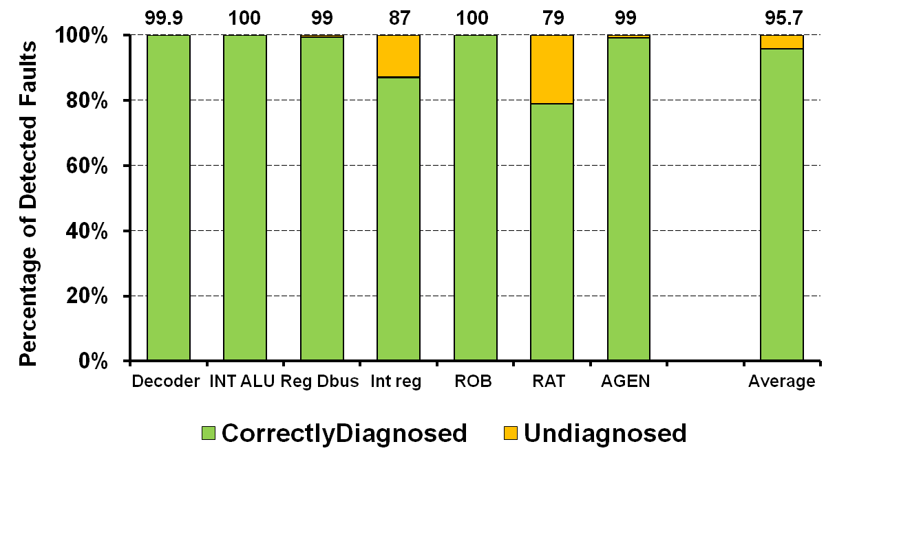
Results: MSWAT Fault Diagnosis (1/2)
  Over 95% of detected faults are successfully diagnosed
  All faults detected in fault-free core are diagnosed

Slide 30
Results: MSWAT Fault Diagnosis (2/2)
Diagnosis Latency
  97% diagnosed <10 million cycles (10ms in 1GHz system)
  93% of these were diagnosed in 1 iteration
    Showing the effectiveness of iterative approach
Trace Buffer size
  96% require <200KB/core of loadLog & compareLog
    Trace buffer can easily fit in L2 or L3 cache

Slide 31
MSWAT Summary and Advantages
Detection
  Coverage over 98% with low SDC rate of 0.2%
Diagnosis
  High diagnosability over 95% with low diagnosis latency
  Firmware based replay reduces hw overhead
  Scalable - maximum of 3 replays for any system
  Iterative approach significantly reduces
    Trace buffer size (8MB/core → 400KB/core)
    Diagnosis latency

Slide 32
Future Work
Extending this study to server applications
Off-core faults
Post-silicon debug and test
  Use faulty trace as test vector
Validation on FPGA (w/ Michigan)

Slide 33
Thank you

Slide 34
Backup

Slide 35
Hardware support
Detection
  Simple hardware detectors
  Hw support to ensure correct invocation of firmware
Diagnosis
  Small hardware buffer for memory backed trace buffer
  Minor design changes to capture retiring instrns
  Hw checks to prevent trace corruption of good cores

Slide 36
Trace Buffer
Collect loadLog and compareLog as a merged trace buffer
A small FIFO that is memory backed
  Minimizes hardware cost
  Diagnosis can tolerate small performance slack
  Similar to one used in BugNet and SWAT’s TBFD
Potential problem:
  Faulty core can corrupt trace buffer of other cores
  One solution:
    H/W bounds check – a core writes only to its trace region

Slide 37
Transient vs. SW Bug vs. Permanent Fault
Symptom detected
Screening phase
Symptom?
No
Yes
Transient h/w fault or
Non-deterministic s/w bug
Deterministic s/w bug or
Permanent h/w fault
Continue Execution

Slide 38
Multicore Fault Diagnosis Algorithm
Example: A three core system
Deterministic s/w bug or
Permanent h/w fault
A
B
C
Trace generation phase
Trace_{A} Trace_{B} Trace_{C}
First replay phase
Divergence
Number of divergences?
Trace_{C} Trace_{A} Trace_{B}
Zero
One
A
B
C
Deterministic
s/w bug
Second
replay phase
Faulty core
identified
Divergence
Trace_{B}
A

Slide 39
Multicore Fault Diagnosis Algorithm
Example: A three core system
Deterministic s/w bug or
Permanent h/w fault
A
B
C
Trace generation phase
Trace_{A} Trace_{B} Trace_{C}
First replay phase
Divergence
Divergence
Number of divergences?
Trace_{C} Trace_{A} Trace_{B}
Zero
Two
One
A
B
C
Deterministic
s/w bug
Second
replay phase
Faulty core
identified
SWAT TBFD to diagnose
μ-arch level faulty unit

Slide 40
Multicore Fault Diagnosis Algorithm
Symptom detected
Trace generation phase
First replay phase
Number of divergences?
Zero
Deterministic
s/w bug
One
Two
Second replay phase
Faulty core
identified
SWAT TBFD to diagnose
μ-arch level faulty unit

Slide 41
Reliability of firmware
SWAT philosophy
  Low hw overhead ⇒ firmware based implementation
How to guarantee correct execution of firmware on faulty hw?
Detection
  Hw support ensures correct invocation of firmware
Diagnosis
  Use hw check to not corrupt trace buffers of other cores
  Diagnosis outcome checked by two cores
    Prevents faulty core from subverting the process

