Slide 1




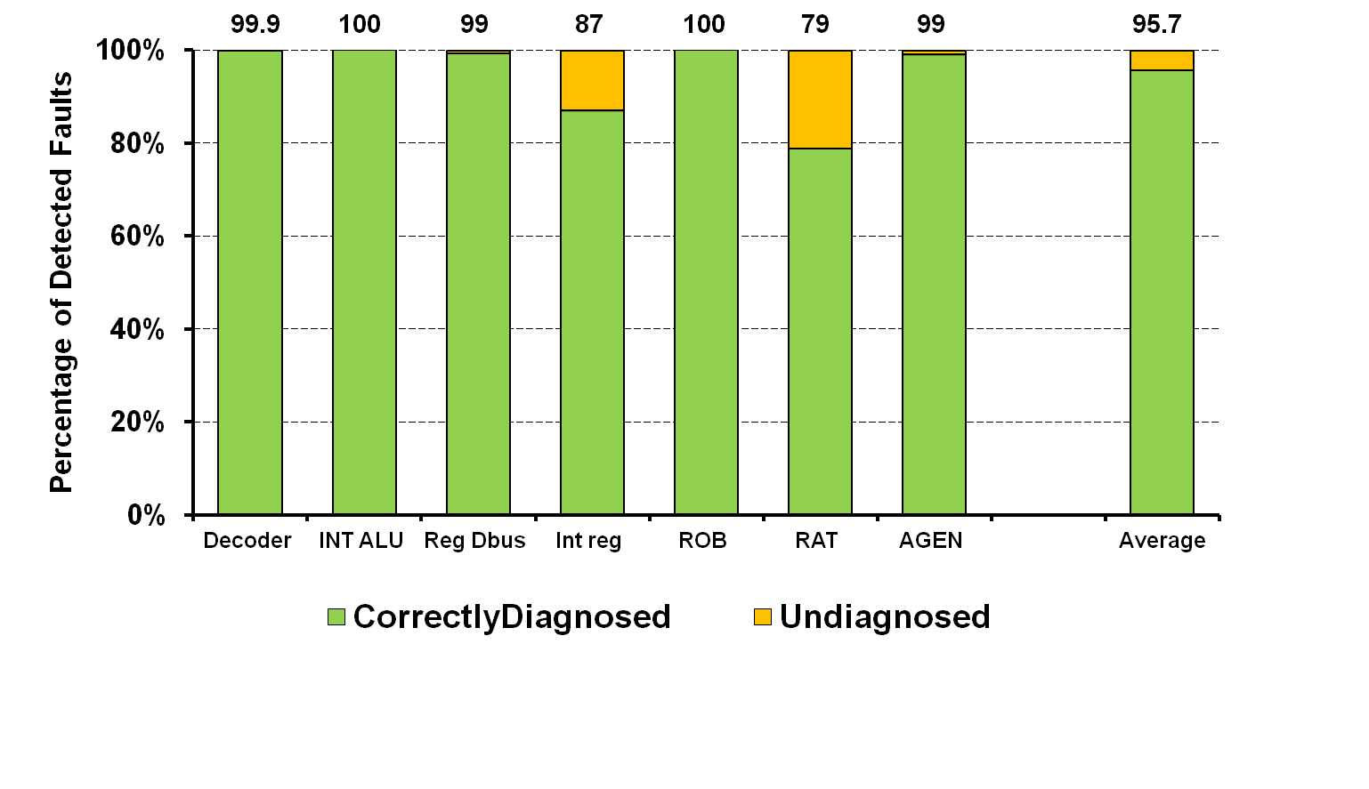
MSWAT: Low-Cost Hardware Fault Detection and Diagnosis for Multicore
Siva Kumar Sastry Hari, Manlap Li, Pradeep Ramachandran, Byn Choi and Sarita Adve
University of Illinois, Urbana-Champaign
Resilient Theme, Task # 1.2.2.5
Motivation
MSWAT Fault Diagnosis Algorithm
SoftWare Anomaly Treatment (SWAT) effective for HW faults in single-threaded apps
⇒ High coverage with low SDC rate (dedicated poster)
But multicore systems w/ multithreaded apps here to stay
Does the SWAT approach work for multicore?
Diagnosis
Symptom
detected
Capture fault
activating trace
Re-execute
Captured trace
Look for divergence
Faulty
core
Key Challenge: Cross-Core Fault Propagation
A B C D
A B C D
Multithreaded apps share data across threads
  ⇒ Fault may propagate across cores
⇒ Is SWAT effective in detecting these faults?
⇒ Symptom causing core is no longer faulty
  Implicit assumption in prior SWAT work
Need to detect fault and diagnose faulty core
Core 1
Core 2
T_{A}
T_{B}
T_{C}
T_{D}
T_{D}
T_{A}
T_{B}
T_{C}
Fault
Example
Store
Load
No Divergence
Compare Traces
Memory
Divergence
A B C D
Symptom Detection
on a fault-free core
T_{A}
Faulty core is B
MSWAT Fault Detection
Capture fault activating trace
Native execution ⇒ No added support for replay
Record inputs to each thread (loads) for replay
Low hardware overhead for buffering
Symptom Detection
Fatal Traps, Hangs, High OS,
Kernel Panic, No-Forward-Progress
Key Results
Low SDC rate of 0.2% of injected faults
Several detections from fault-free cores
Re-Execute Captured Trace
Firmware emulated isolated deterministic replay ⇒ Zero hardware overhead
Compare retiring mem/ctrl instructions for divergence ⇒ Fewer comparisons
MSWAT: Diagnosis Challenges and Approaches
Previous SWAT diagnosis
Distinguish HW/SW faults
Isolating the faulty core
Naïve solution: One spare core
High overhead, single point of failure
Our solution:
Iterative Diagnosis to reduce overheads
E.g., capture replay every 100k instructions till divergence
Symptom detected
Faulty Good
Diagnosis Results
Rollback/replay
on faulty core
Multithreaded applications
>95% of detected faults successfully diagnosed
µarch non-determinism ⇒ undiagnosed faults
97% faults diagnosed in <10M cycles
<10ms on a 1GHz processor ⇒ invisible
93% diagnosed in 1 iteration w/ 100K instructions
<200KB logs ⇒ fit in lower level caches
No symptom
Symptom
Non-deterministic s/w /
Transient h/w bug
Deterministic s/w /
permanent h/w bug
Challenges
Full-system deterministic replay
No known
good core
Continue
Execution
Rollback/replay
on good core
Symptom
No symptom
Key Ideas
Isolated deterministic replay
Emulated TMR
Conclusions and Future Work
Deterministic
s/w bug
Permanent
h/w defect
SWAT detection effective even for multicore systems with multithreaded apps
Novel diagnosis mechanism with minimal hardware changes
Ongoing and Future Work
Prototyping SWAT on FPGA in collaboration with University of Michigan
Distributed client/server applications
Faults in off-core components
A B C D
A B C D
Challenge in multicore: No known good core
MSWAT: Diagnosis without known good core
T_{A}
T_{B}
T_{C}
T_{D}
T_{A}
T_{B}
T_{C}
T_{D}
T_{A}
T_{D}
T_{A}
T_{B}
T_{C}
T_{C}
T_{D}
T_{A}
T_{B}

