Slide 1

Low-cost Program-level Detectors for Reducing Silent Data Corruptions
Siva Hari†, Sarita Adve†, and Helia Naeimi‡
†University of Illinois at Urbana-Champaign,
‡Intel Corporation
swat@cs.illinois.edu

Slide 2
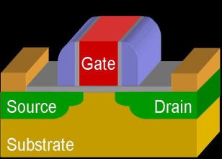
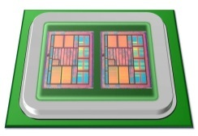
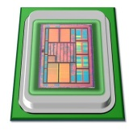
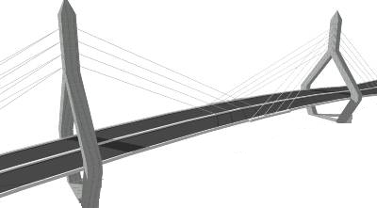
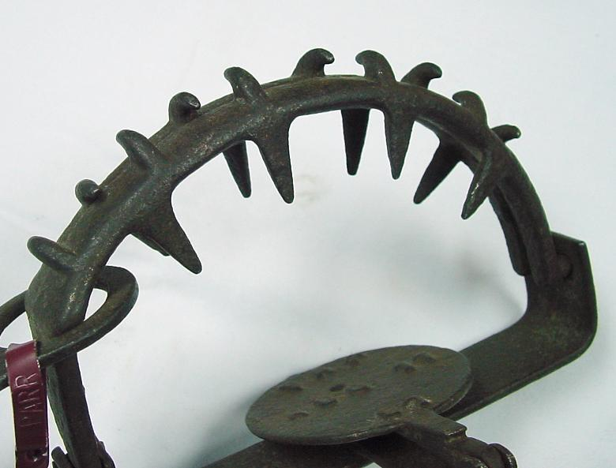


Motivation
Hardware reliability is a challenge
Transient (soft) errors are a major problem
Soft Error
Goals:
Full reliability at low-cost
Tunable reliability vs. overhead
Redundancy
Detect errors using
symptom monitors
Overhead (perf., power, area)
Fatal Traps
Kernel Panic
App Abort
How?
Very high
reliability at low-cost
Tunable
reliability
Symptom-based
Reliability

Slide 3
Fault Outcomes
Transient fault
(e.g., bit 4 in R2)
Transient
fault
Transient
fault
.
.
.
.
.
.
.
.
.
APPLICATION
APPLICATION
APPLICATION
Symptom of Fault
Output
Output
Output
Output
Symptom detectors (SWAT):
Fatal traps, kernel panic, etc.
Masked
Detection
Silent Data Corruption
(SDC)
How to convert SDCs to detections?

Slide 4
SDCs to Detections
.
.
.
.
.
Error Detection
APPLICATION
APPLICATION
Error Detectors
Output
Output
Silent Data Corruption
(SDC)
Add new detectors in error propagation path?
SDC coverage: Fraction of all SDCs converted to detections
Will it be low-cost?

Slide 5
Key Challenges
What to
SDC
-
causing fault sites
protect?
Identified using
Relyzer
[ASPLOS’12]
Low
-
cost Detectors
Many errors propagate to
Where to place?
few program values
How to
Protect?
What detectors?
Program
-
level properties
tests
Uncovered
Selective instruction
-
level duplication
fault
-
sites?

Slide 6
Contributions
Discovered common program properties around most SDC-causing sites
Devised low-cost program-level detectors
Average SDC reduction of 84%
Average execution overhead 10%
New detectors + selective duplication = Tunable resiliency at low-cost
Found near optimal detectors for any SDC target
Lower cost than pure redundancy for all SDC targets
E.g., 12% vs. 30% @ 90% SDC reduction

Slide 7
Outline
Motivation and introduction
Categorizing and protecting SDC-causing sites
Tunable resilience vs. overhead
Methodology
Results
Conclusions

Slide 8
Outline
Motivation and introduction
Categorizing and protecting SDC-causing sites
Loop incrementalization
Registers with long life
Application-specific behavior
Tunable resilience vs. overhead
Methodology
Results
Conclusions

Slide 9
Insights
Identify where to place the detectors and what detectors to use
Placement of detectors (where)
Many errors propagate to few program values
End of loops and function calls
Detectors (what)
Test program-level properties
E.g., comparing similar computations and checking value equality
Fault model
Single bit flips in integer arch. registers

Slide 10
Loop Incrementalization
C Code
ASM Code
Array a, b;
For (i=0 to n) {
. . .
a[i] = b[i] + a[i]
. . .
}
rA = base addr. of a
rB = base addr. of b
L: load r1 ← [rA]
. . .
load r2 ← [rB]
. . .
store r3 → [rA]
. . .
add rA = rA + 0x8
add rB = rB + 0x8
add i = i + 1
branch (i<n) L

Slide 11

Loop Incrementalization
C Code
ASM Code
Array a, b;
For (i=0 to n) {
. . .
a[i] = b[i] + a[i]
. . .
}
rA = base addr. of a
rB = base addr. of b
L: load r1 ← [rA]
. . .
load r2 ← [rB]
. . .
store r3 → [rA]
. . .
add rA = rA + 0x8
add rB = rB + 0x8
add i = i + 1
branch (i<n) L
Collect initial values of rA, rB, and i
SDC-hot app sites
What: Property checks on rA, rB, and i
Diff in rA = Diff in rB
Diff in rA = 8 $×$Diff in i
Where: Errors from all iterations propagate here in few quantities
No loss in coverage - lossless

Slide 12
Registers with Long Life
Some long lived registers are prone to SDCs
For detection
Duplicate the register value at its definition
Compare its value at the end of its life
No loss in coverage - lossless
R1 definition
Copy
Use 1
Life
time
Use 2
.
.
.
Compare
Use n

Slide 13



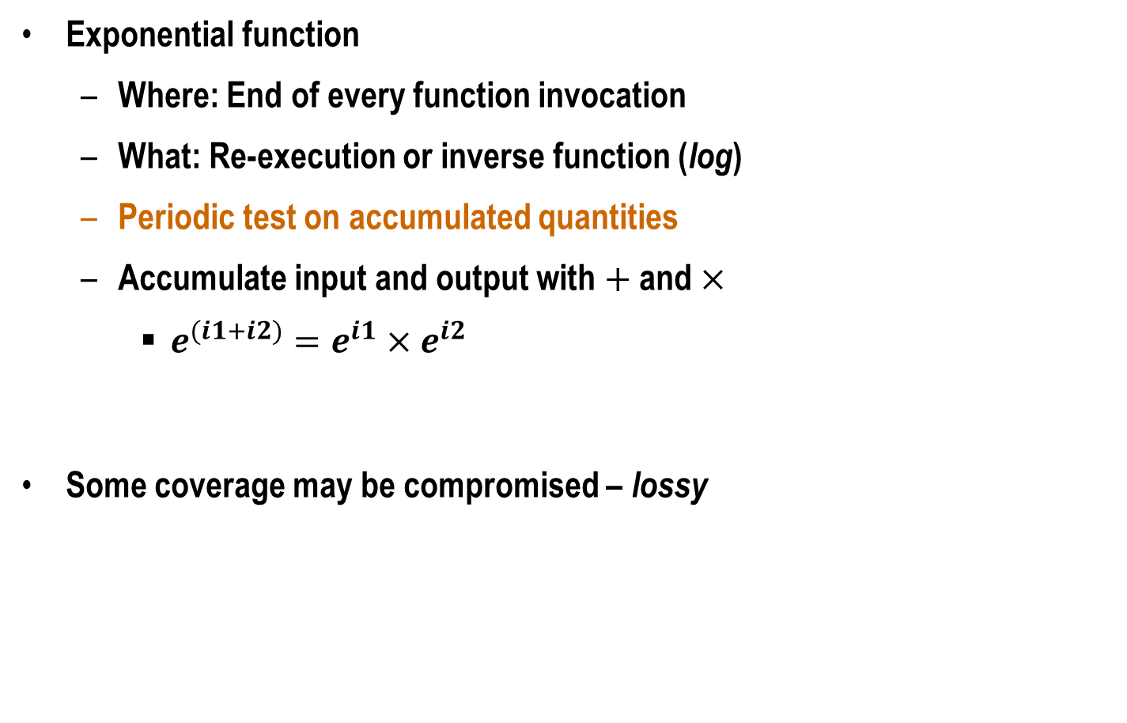





Application-Specific Behavior
Exponential function
Where: End of every function invocation
What: Re-execution or inverse function (log)
Periodic test on accumulated quantities
Accumulate input and output with $+$ and $×$
$e^{(i1+i2)}=e^{i1}×e^{i2}$
Some coverage may be compromised – lossy
few
exp
exp
s
$$in$$
$$out$$
$$I$$
$$I=I+in$$
$$O$$
$$O=O×out$$
$$==$$
$$O′$$

Slide 14

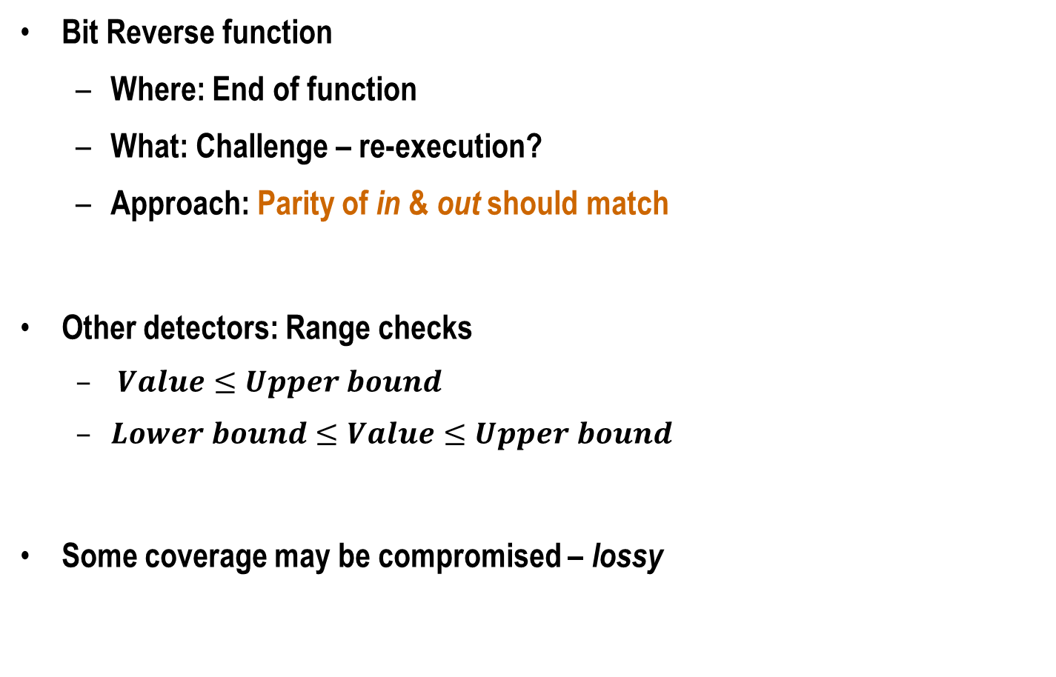



Application-Specific Behavior (Contd.)
Parity
Bit Reverse function
Where: End of function
What: Challenge – re-execution?
Approach: Parity of in & out should match
Other detectors: Range checks
$Value≤Upper bound$
$Lower bound≤Value≤Upper bound$
Some coverage may be compromised – lossy
$$P_{in}$$
Bit Reverse
Compare
$$in (0011)$$
$$out (1100)$$
Parity
$$P_{out}$$

Slide 15
Tunable Resiliency vs. Overhead
What if our detectors do not cover all SDC-causing sites?
Use selective instruction-level redundancy
What if our low-overhead is still not tolerable but lower resiliency is?
Tunable resiliency vs. overhead

Slide 16

Identifying Near Optimal Detectors: Naïve Approach
Example: Target SDC coverage = 60%
Overhead = 10%
SDC coverage
Sample 1
50%
SFI
Overhead = 20%
Sample 2
65%
Bag of detectors
SFI
Tedious and time consuming

Slide 17
Identifying Near Optimal Detectors: Our Approach
1. Set attributes, enabled by Relyzer [ASPLOS’12]
2. Dynamic programming
Constraint: Total SDC covg. ≥ 60%
Objective: Minimize overhead
Detector
SDC Covg.= X%
Overhead = Y%
Selected Detectors
Bag of detectors
Overhead = 9%
Obtained SDC coverage vs. Performance trade-off curves

Slide 18
Methodology
Six applications from SPEC 2006, Parsec, and SPLASH2
Fault model: single bit flips in int arch registers at every dynamic instr
Ran Relyzer, obtained SDC-causing sites, examined them manually
Our detectors
Implemented in architecture simulator
Overhead estimation: Num assembly instrns needed
Selective redundancy
Overhead estimation: 1 extra instrn for every uncovered instrn
Lossy detectors’ coverage
Statistical fault injections (10,000)

Slide 19
Categorization of SDC-causing Sites
Added Lossless Detectors
Added Lossy
Detectors
Categorized >88% SDC-causing sites

Slide 20
SDC coverage
84% average SDC coverage (67% - 92%)

Slide 21
SDC coverage
84% average SDC coverage (67% - 92%)

Slide 22
Execution Overhead
10% average overhead (0.1% - 18%)

Slide 23
Execution Overhead
10% average overhead (0.1% - 18%)

Slide 24
SDC Coverage vs. Overhead Curve
Pure Redundancy
Our detectors + Redundancy
24%
18%
90%
99%
Consistently better over pure (selective) instruction-level duplication

Slide 25
Conclusions
Reduction in SDCs is crucial for low-cost reliability
Discovered common program properties around most SDC-causing sites
Devised low-cost program-level detectors
84% avg. SDC coverage at 10% avg. cost
New detectors + selective duplication = Tunable resiliency at low-cost
Found near optimal detectors for any SDC target
Lower cost than pure redundancy for all SDC targets
Future directions
More applications and fault models
Automating detectors’ placement and derivation

