Slide 1

Eliminating Silent Data Corruptions
caused by Soft-Errors
Siva Hari,
Sarita Adve, Helia Naeimi, Pradeep Ramachandran,
University of Illinois at Urbana-Champaign,
shari2@illinois.edu

Slide 2
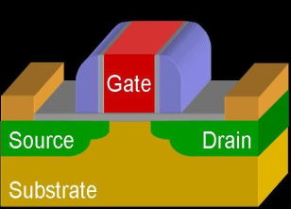
Technology Scaling and Reliability Challenges
Nanometers
Increase (X)
Our Focus
*Source: Inter-Agency Workshop on HPC Resilience at Extreme Scale
hosted by NSA Advanced Computing Systems, DOE/SC, and DOE/NNSA, Feb 2012
Notes:
With technology scaling, the increasingly smaller devices improve performance and power-efficiency of our future micro-processors. However, reliability challenges are also expected to increase at a high rate in near future. This graph now shows the expected contribution of different failure sources. Soft-errors in logic are among the major sources of in-field failures, which is the focus of work.

Slide 3
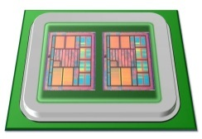
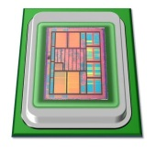
Motivation
Overhead (perf., power, area)
Redundancy
High reliability at low-cost
Reliability

Slide 4





SWAT: SoftWare Anomaly Treatment
Need handle only hardware faults that propagate to software
Fault-free case remains common, must be optimized
⇒ Watch for software anomalies (symptoms)
Zero to low overhead “always-on” monitors
Effective on SPEC, Server, and Media workloads
<1% µarch faults escape detectors and corrupt app output (SDC)
BUT, Silent Data Corruption rate is not zero
Fatal Traps
Hangs
Kernel Panic
App Abort
Out of Bounds

Slide 5
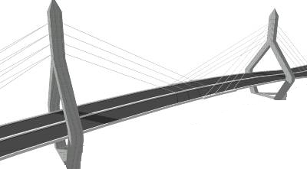
Motivation
Goals:
Full reliability at low-cost
Systematic resiliency evaluation
Tunable reliability vs. overhead
Redundancy
Overhead (perf., power, area)
How?
Very high
reliability at low-cost
Tunable
reliability
SWAT
Reliability

Slide 6
Fault Outcomes
Fault-free
execution
Faulty executions
Masked
Detection
Transient Fault
e.g., bit 4 in R1
Transient fault
again in bit 4 in R1
.
.
.
.
.
.
.
.
.
APPLICATION
APPLICATION
APPLICATION
Symptom of Fault
Output
Output
Output
Symptom detectors (SWAT):
Fatal traps, assertion violations, etc.

Slide 7
Fault Outcomes
Fault-free
execution
Faulty executions
Masked
Detection
SDC
SDCs are worst of all outcomes
How to eliminate SDCs?
.
.
.
.
.
.
.
.
.
.
.
.
APPLICATION
APPLICATION
APPLICATION
APPLICATION
Symptom of Fault
Output
Output
X
Output
Output
Silent Data
Corruption (SDC)

Slide 8
Approach
Find SDC causing application sites [ASPLOS 2012]
Comprehensive
resiliency analysis,
96% accuracy
~5 Years
for one app
Relyzer
<2 days
for one app
.
.
.
APPLICATION
APPLICATION
Detect at low cost [DSN 2012]
SDC-causing
fault
84% SDCs detected at 10% cost
Selective duplication for rest
.
.
APPLICATION
Program-level Error Detectors
APPLICATION
Error Detection
New detectors + selective duplication = Tunable resiliency at low cost

Slide 9
Relyzer: Application Resiliency Analyzer
Equivalence
Classes
Representatives
Pruning fault sites
Application-level error equivalence
Insight: Similar error propagation ⇒ similar outcome
Example:
Predict fault outcomes
.
.
.
APPLICATION
CFG
X
Output
Errors in X that take paths behave similarly

Slide 10
Relyzer Contributions [ASPLOS 2012]
Relyzer: A complete application resiliency analysis technique
Developed novel fault pruning techniques
3 to 6 orders of magnitude fewer injections for most apps
99.78% app fault sites pruned
Only 0.004% represent 99% of all fault sites
Can identify all potential SDC causing fault sites
.
.
Relyzer
.
.
APPLICATION
APPLICATION
Output
Output

Slide 11
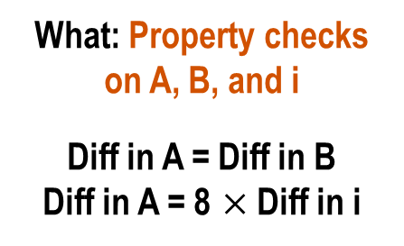
SDC-targeted Program-level Detectors
Detectors only for SDC-vulnerable app locations
Challenge: Where to place detectors and what detectors to use?
Where: Many SDC-causing errors propagate to few program values
What (detectors): Test program-level properties
Example:
C Code
ASM Code
Array a, b;
For (i=0 to n) {
a[i] = b[i] + a[i]
}
Collect initial values
of A, B, and i
A, B = base addr. of a, b
L: load r1, r2 ← [A], [B]
store r3 → [A]
. .
add A = A + 0x8
add B = B + 0x8
add i = i + 1
branch (i<n) L
SDC-hot app sites
What: Property checks on A, B, and i
Diff in A = Diff in B
Diff in A = 8 $×$Diff in i
All errors propagate here in few quantities

Slide 12
Contributions [DSN 2012]
Discovered common program properties around most SDC-causing sites
Devised low-cost program-level detectors
Avg. SDC reduction of 84% @ 10% avg. cost
New detectors + selective duplication = Tunable resiliency at low-cost
Relyzer + selective duplication
Relyzer + new detectors + selective duplication
24%
18%
90%
99%

Slide 13
Other Contributions
Complete Resiliency
Solution
Accurate fault modeling
FPGA validation of SWAT detectors [Pellegrini et al., DATE’12]
Gate-µarch-level simulator [Li et al., HPCA’09]
Time
APPLICATION
Detection
mSWAT [Hari et al., MICRO’09]
Symptom detectors on Multicore systems
Novel diagnosis to isolate faulty core
Diagnosis
Recovery
Checkpointing and rollback
I/O intensive apps
Latency-recoverability
Output
Siva Hari (shari2@illinois.edu)
University of Illinois at Urbana-Champaign

Slide 14
Backup

Slide 15

Identifying Near Optimal Detectors: Naïve Approach
Example: Target SDC coverage = 60%
Overhead = 10%
SDC coverage
Sample 1
50%
SFI
Overhead = 20%
Sample 2
65%
Bag of detectors
SFI
Tedious and time consuming

Slide 16
Identifying Near Optimal Detectors: Our Approach
1. Set attributes, enabled by Relyzer
2. Dynamic programming
Constraint: Total SDC covg. ≥ 60%
Objective: Minimize overhead
Detector
SDC Covg.= X%
Overhead = Y%
Selected Detectors
Bag of detectors
Overhead = 9%
Obtained SDC coverage vs. Performance trade-off curves [DSN’12]

