Slide 1

Preserving Application Reliability
on Unreliable Hardware
Siva Hari
Adviser: Sarita Adve
Department of Computer Science
University of Illinois at Urbana-Champaign

Slide 2
Technology Scaling and Reliability Challenges
Nanometers
Increase (X)
*Source: Inter-Agency Workshop on HPC Resilience at Extreme Scale
hosted by NSA Advanced Computing Systems, DOE/SC, and DOE/NNSA, Feb 2012

Slide 3
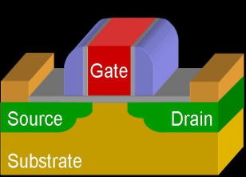
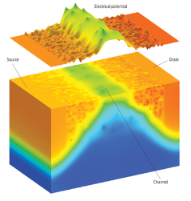
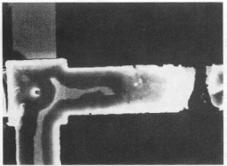
Technology Scaling and Reliability Challenges
Hardware Reliability Challenges are for Real!
Sun experienced soft-errors in flagship enterprise server line, 2000
America Online, eBay, and others were affected
Several documented in-field errors
LANL Q Supercomputer: 27.7 failures/week from soft errors, 2005
LLNL BlueGene/L experienced parity errors every 8 hours, 2007
Exascale systems are expected to fail every 35-40 minutes
Nanometers
Increase (X)
*Source: Inter-Agency Workshop on HPC Resilience at Extreme Scale
hosted by NSA Advanced Computing Systems, DOE/SC, and DOE/NNSA, Feb 2012

Slide 4
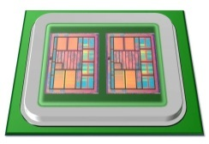
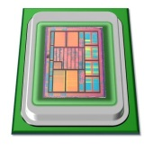
Motivation
Overhead (performance, power, area)
Redundancy
High reliability at low-cost
Hardware Reliability

Slide 5
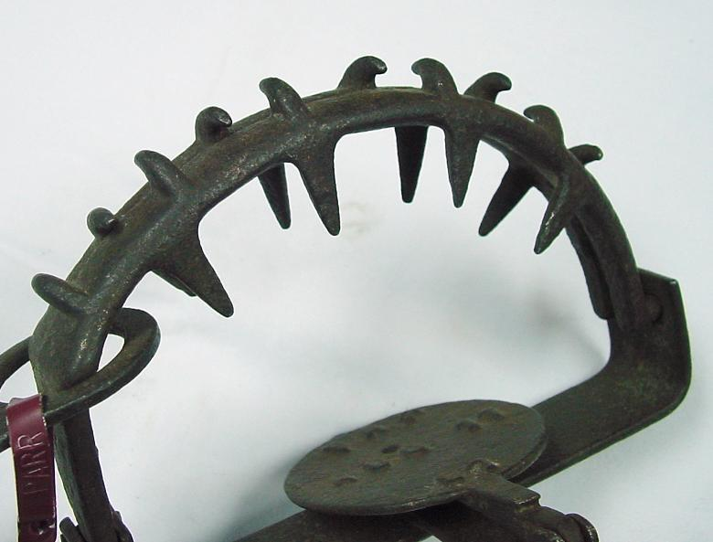




SWAT: A Low-Cost Reliability Solution
Need handle only hardware errors that propagate to software
Error-free case remains common, must be optimized
⇒ Watch for software anomalies (symptoms)
Zero to low overhead “always-on” monitors
Effective on SPEC, Server, and Media workloads
<0.6% µarch errors escape detectors & corrupt application output (SDC)
Fatal Traps
Hangs
Kernel Panic
App Abort
Out of Bounds
Division by zero,
RED state, etc.
Simple HW hang
detector
OS enters panic
state due to error
App abort due
to error
Flag illegal addresses

Slide 6
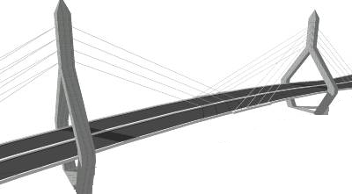
Motivation
Goals:
Full reliability at low-cost
Systematic reliability evaluation
Tunable reliability vs. overhead
Redundancy
Overhead (performance, power, area)
How?
Very high
reliability at low-cost
Tunable
reliability
SWAT
Hardware Reliability
Notes:
Goals for transient faults

Slide 7
Error Outcomes
Error-free
execution
Faulty executions
Masked
Detection
SDC
Transient error,
Single bit flip
e.g., bit 4 in R1
Transient error
again in bit 4 in R1
.
.
.
.
.
.
.
.
.
.
.
.
APPLICATION
APPLICATION
APPLICATION
APPLICATION
Symptom of error
Output
Output
X
Output
Output
Symptom detectors (SWAT):
Fatal traps, assertion violations, etc.
Silent Data
Corruption (SDC)

Slide 8
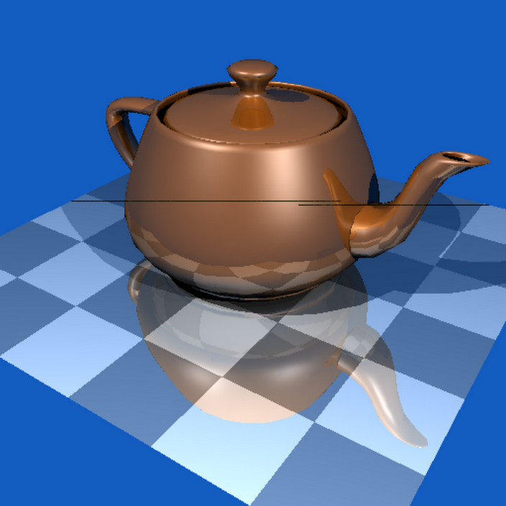
Error Outcomes
SDCs are worst of all outcomes
Examples
Blackscholes: Computes prices of options
23.34 → 1.33
65,000 values were incorrect
Libquantum: Factorizes 33 = 3 X 11
Unable to determine factors
LU: Matrix factorization
RMSE = 45,324,668
How to convert SDCs to detections?
SDC
.
.
.
APPLICATION
Ray Tracing
Output
Notes:
Remember the connection between recoverability and detection latency

Slide 9
Approach
Finding all SDC-causing application-sites
Speeding up error simulations
Traditional approach:
Statistical Error Injections?
Impractical, too many injections
>1,000 compute-years for one app
.
.
Relyzer: Prune Errors
.
.
Complete application
reliability evaluation
APPLICATION
APPLICATION
One injection at a time
Challenge: Analyze all errors with few injections
Output
Output
Challenge: Error simulations are time consuming
.
.
.
.
.
APPLICATION
APPLICATION
mvEqualizer: Shorten by comparing state for equivalence
Masked
or SDC?
Output

Slide 10
Advantages of Finding SDC-causing Sites
Convert SDCs to Detections at low cost
Evaluate simple program metrics to find SDCs
Can simple metrics find SDCs without error injections?
Example: lifetime, fan-out
SDC-causing error
Our approach
Naïve approach:
Duplicate SDC-causing code locations
.
.
.
APPLICATION
Error Detection
APPLICATION
Error Detectors
Output
⇒ Relyzer enables such evaluations

Slide 11
Contributions (1/3) [ASPLOS’12, Top Picks’13]
Relyzer: A complete application reliability analyzer for transient errors
Developed novel error pruning techniques
99.78% error sites pruned for our applications, error models
Only 0.004% represent 99% of all application error sites
Injections only in remaining sites ⇒ SDCs from virtually all app sites
.
.
Relyzer
.
.
APPLICATION
APPLICATION
Output
Output
Notes:
Identified >99% SDCs for our apps, error models
=> Comprehensively analyze pin point SDCs in virtually all applications sites

Slide 12
Contributions (2/3) [In review]
mvEqualizer: Speed up Relyzer by shortening full error simulations
Compare simulation states repeatedly to show equivalence
Leveraged program structure to identify when and what to compare
Only 36% require full application simulation for our workloads
94% of saved simulations required execution of only 2,850 instructions
Injection 1
Injection 2
Injection n
. . .
.
.
.
.
.
.
.
APPLICATION
APPLICATION
APPLICATION
Masked
or SDC?
Output

Slide 13
Contributions (3/3)
Convert identified SDCs to detections [DSN’12]
Devised low cost program-level detectors
84% SDCs reduced on average at 10% average execution overhead
Selective duplication for rest
Tunable reliability at low cost [DSN’12]
Found near optimal detectors for any SDC target
Lower cost than pure duplication at all SDC targets
E.g., 12% vs. 30% @ 90% SDC reduction
Evaluating simple metrics to find SDCs [in review, led by Venkatagiri]
Found little correlation with SDC-causing instruction
⇒ Relyzer + mvEqualizer is much needed
18%
90%
Instr. duplication
Our approach

Slide 14
Other Contributions
Complete Reliability
Solution
Accurate error modeling
FPGA-based [DATE’12]
Gate-µarch-level simulator [HPCA’09]
Time
Error
APPLICATION
Detection
Multicore detection & diagnosis [MICRO’09]
Diagnosis
Recovery
Checkpointing and rollback Handling I/O
Output

Slide 15
Outline
Motivation
Relyzer: Application reliability analysis
mvEqualizer: Speeding up Relyzer
Applications of Relyzer:
Converting SDCs to detections
Tunable Reliability
Evaluating simple metrics for finding SDCs
Summary and limitations
Next

Slide 16
Relyzer: Application Reliability Analyzer
Pilots
Equivalence Classes
Relyzer
Prune error sites
Application-level error equivalence
Predict error outcomes
Injections for remaining sites
.
.
.
.
.
APPLICATION
APPLICATION
Output
Output
Can find SDCs from virtually all application sites

Slide 17
Methodology for Relyzer
Pruning
12 applications (from SPEC 2006, Parsec, and Splash 2)
Error model
When (application) and where (hardware) to inject transient errors
When: Every dynamic instruction that uses these units
Where: Hardware error sites
Errors in integer architectural registers
Errors in output latch of address generation unit
Single bit flip, one error at a time
Notes:
Since the focus is on application level error analysis, we selected 2 hardware error sites in this study. In particular, we selected single bit flips in integer registers and output latch of the address generation unit. Faults in these hardware units are considered whenever that unit is unitized by the application.

Slide 18
Pruning Results
99.78% of error sites are pruned
3 to 6 orders of magnitude pruning for most applications
For mcf, two store instructions observed low pruning (of 20%)
Overall 0.004% error sites represent 99% of total error sites

Slide 19
Outline
Motivation
Relyzer: Application reliability analysis
mvEqualizer: Speeding up Relyzer
Error simulation framework
Evaluation
Applications of Relyzer:
Converting SDCs to detections
Tunable Reliability
Evaluating simple metrics for finding SDCs
Summary and limitations
Next

Slide 20
mvEqualizer: Motivation
Relyzer is practical with 72 hrs of running time for 8 applications
65% of time is spent in error injections
Error sites in different dynamic instances of one static instruction
Relyzer
.
.
.
Error sites from pruned
instances of an instruction
mvEqualizer
.
.
.
.
Reducing full
app executions
Error sites in different instructions in a block
Error sites that need full application execution

Slide 21
Challenges in Reducing Full Executions
Error simulations are time-consuming
Run until output is produced
Aim: Shorten simulations
Compare state for masking & similar corruptions
What to compare?
Complete full system state (registers + memory)?
How frequently?
Comparisons can be expensive
.
.
.
APPLICATION
Output
Masked or SDC?

Slide 22
Approach: Fast Simulation Framework
Leverage program structure: SESE (single-entry-single-exit) regions*
All data will flow through the exit point
a
1
b
e
Control-flow edges
2
f
9
c
SESE regions
3
10
4
11
12
5
6
13
7
14
8
15
16
*R. Johnson et al. The program structure tree: computing control regions in linear time. SIGPLAN Not., 1994

Slide 23
Approach: Fast Simulation Framework
Leverage program structure: SESE (single-entry-single-exit) regions*
All data will flow through the exit point
Check for corruption in limited state (live registers + touched memory)
a
Program Structure Tree (PST)
1
b
e
2
f
9
a
c
3
10
4
b
e
11
12
5
6
13
c
15
f
7
14
3
5
6
9
11
8
15
16
Control-flow edges
SESE regions
SESE Region
Other instructions
*R. Johnson et al. The program structure tree: computing control regions in linear time. SIGPLAN Not., 1994

Slide 24
Error Simulation Algorithm
Group error sites to check for equivalence
Start from a system checkpoint
All injection runs start from the beginning of a group
Start of a group
Injection 1
Injection 2
.
.
.
Typical group size in our framework was 100-1000
State for comparison:
(live) processor registers
+
touched memory locations
(stored incrementally from the
starting point of the group)
SESE exit 1
SESE exit 2
SESE exit 3

Slide 25
Error Simulation Algorithm
Group error sites to check for equivalence
Start from a system checkpoint
Start of a group
Injection 1
Injection 2
Injection 3
.
.
.
X
SESE exit 1
X
X
=
X
SESE exit 2
=
SESE exit 3
Only one error injection needs full simulation in this example

Slide 26
Methodology for mvEqualizer
Eight applications from Parsec and SPLASH2
Error model: single bit flips in integer architectural registers at every dynamic instruction
Employed after Relyzer
Implemented in architecture simulator (Simics)

Slide 27
Efficacy of mvEqualizer
36%
35%
29%
Only 36% of error sites need full simulations

Slide 28
Savings from Equalized Simulations
94% of equalized simulations require 2,850 instructions to be executed

Slide 29
Outline
Motivation
Relyzer: Application reliability analysis
mvEqualizer: Speeding up Relyzer
Applications of Relyzer:
Converting SDCs to detections
Program-level detectors
Evaluation
Tunable Reliability
Evaluating simple metrics for finding SDCs
Summary and limitations
Next

Slide 30
Converting SDCs to Detections: Our Approach
SDC-causing
error
.
.
.
APPLICATION
Error Detection
APPLICATION
Error Detectors
Output
Challenges:
Where to place?
What to use?
Uncovered error-sites?
Approach:
: Many errors propagate to few program values
End of loops and function calls
: Test program-level properties
E.g., comparing similar computations, value equality
: Selective instruction-level duplication

Slide 31
SDC-Causing Code Properties
Loop incrementalization
Registers with long life
Application-specific behavior

Slide 32
Categorization of SDC-causing Sites
Added Lossless Detectors
Added Lossy
Detectors
Categorized >88% SDC-causing sites

Slide 33
Efficacy of Detectors
84% average SDC reduction at 10% average overhead

Slide 34
Tunable Reliability
What if our low-overhead is still not tolerable but lower reliability is?
Tunable reliability vs. overhead
Need to find a set of optimal-cost detectors at any given SDC target

Slide 35

Tunable Reliability: Challenges
Naïve approach
Example: Target SDC reduction = 60%
Sample 1
SFI
50% SDC
reduction
Overhead = 10%
Sample 2
65% SDC
reduction
SFI
Bag of detectors
(program-level +
duplication-based)
Overhead = 20%
Challenges:
Repeated statistical error injections ⇒ time consuming
Do not know detectors’ contribution in reducing SDCs a priori

Slide 36

Identifying Near Optimal Detectors: Our Approach
Relyzer lists SDC-causing sites, number of SDCs these sites produce
⇒ Knowledge of SDCs covered by each detector
1. Set attributes, enabled by Relyzer
2. Dynamic programming
Constraint: Total SDC red. ≥ 60%
Objective: Minimize overhead
Detector
SDC Red.= X%
Overhead = Y%
Selected Detectors
Bag of detectors
(program-level + duplication-based)
Overhead = 9%
Obtained SDC reduction vs. Performance trade-off curves

Slide 37
SDC Reduction vs. Overhead Trade-off Curve
Selective duplication

Slide 38
SDC Reduction vs. Overhead Trade-off Curve
Our detectors +
selective duplication
Selective duplication
24%
18%
90%
99%
Program-level detectors provide lower cost solutions

Slide 39
Outline
Motivation
Relyzer: Application reliability analysis
mvEqualizer: Speeding up Relyzer
Applications of Relyzer:
Converting SDCs to detections
Tunable Reliability
Evaluating simple metrics for finding SDCs
Summary and limitations
Next

Slide 40
Evaluating Program Analysis Based Metrics
Relyzer requires significant time to obtain applications’ resiliency profile
Expensive input specific program analyses
Error injection experiments
Can simple metrics find SDCs?
Prior approach to predict error detections
Lifetime (average, aggregate) per instruction
Fanout (average, aggregate) per instruction
Dynamic instruction count
Evaluating these for SDCs is tedious
⇒ Relyzer enables this evaluation
W_{i}
R_{i}
W_{i}
R_{i}
Lifetime
W_{i}
R_{i}
R_{i} . . .
R_{i}
Fanout = number of reads

Slide 41
Evaluation Methodology
Five applications from Parsec and SPLASH2
Error model: single bit flips in destination integer architectural registers
Collected metric information using architectural simulator (Simics)
Direct correlation of simpler metrics with Relyzer
Compare effectiveness of detectors added by Relyzer vs. simpler metrics
Combination of simpler metrics
Linear
Linear combination on polynomials

Slide 42
Results: Simple Metrics are Non-trivial (1/2)
Correlation coefficient between metrics and Relyzer
Comparing the effectiveness of adding duplication based detectors
Lifetime (agg) | Fanout (agg) | Lifetime (av) | Fanout (av) | Dyn. Inst.
Poor (< 0.31) | Poor-Fair (0.12 – 0.59) | Poor (< 0.08) | Poor (< 0.04) | Poor-Good (0.18 – 0.82)
LU: Fanout (agg) (Corr. Coeff. = 0.59)
Significant difference
Relyzer
Predicted coverage of detectors selected using metric
Actual coverage of
detectors selected
using metric

Slide 43
Results: Simple Metrics are Non-trivial (2/2)
Only 7% – 68% variance in SDCs can be explained by linear combination
26% – 79% for linear combination of polynomials
No common model explains SDCs for our workloads
Unable to adequately predict an instruction’s vulnerability to SDCs
⇒ Relyzer + mvEqualizer is much needed
LU: Dyn. Inst. (Corr. Coeff. = 0.82)
FFT: Dyn. Inst. (Corr. Coeff. = 0.80)
Relyzer
Predicted for metric
% SDCs Covered
% SDCs Covered
Significant difference
Actual for metric
% dynamic instructions for duplication (cost)
% dynamic instructions for duplication (cost)

Slide 44
Summary
Relyzer: Novel error pruning for reliability analysis [ASPLOS’12, TopPicks’13]
3 to 6 orders of magnitude fewer injections for most applications
Identified SDCs from virtually all applications sites
mvEqualizer: Reducing error injection time
Only 36% remaining error sites need full application simulation
Applications of Relyzer (+ mvEqualizer)
Devised low cost program-level detectors [DSN’12]
84% average SDC reduction at 10% average cost
Tunable reliability at low cost [DSN’12]
Obtained SDC reduction vs. performance trade-off curves
Evaluated simpler program analyses based metrics
Finding a simpler metric is hard ⇒ Relyzer is valuable
Other contributions: Multicore detection and diagnosis [MICRO’09], Accurate error modeling [DATE’12, HPCA’09], Checkpointing and rollback

Slide 45
Limitations and Future Directions
Relyzer
More (multithreaded) applications and error models
Obtaining input independent reliability profiles
Detectors
Automating detectors’ placement and derivation
Developing app independent, failure-source-oblivious detectors
Designing inherently error resilient programs
Detection latency and recoverability
Application-aware SDC categorization

Slide 46
Thank You

Slide 47
Backup

Slide 48
Related Work

Slide 49
iSWAT vs. Our Work
iSWAT [DSN’08] | Our Work
Permanent errors | Transient errors
Range-based likely invariants on stores | Broad range of detectors
Suffers from false positives | No false positives
Combining insights for both error models is interesting future direction

Slide 50
Pattabiraman et al. vs. Our Work
Our Work | Pattabiraman et al. [EDDC’06, PRDC’05]
Goal: Reduce SDCs | Avoid crashes, limit error propagation
Relyzer [ASPLOS’12] identifies SDC-causing app sites | Lifetime, fanout identify vulnerable variables [PRDC’05]
Property checks involve multiple variables | Tests do not consider other variables
No false positives | Suffers from false positives

Slide 51
SymPLFIED vs. Relyzer
Similar goal of finding SDCs
Symbolic execution to abstract erroneous values
Performs model checking with abstract execution technique
Reduces the number of injections per application site
Relyzer reduces the number of applications sites
Relyzer restricts the injections/app site by selecting few error models
Combining SymPLFIED and Relyzer would be interesting

Slide 52
Shoestring vs. Relyzer
Similar goal: Finding and reducing SDCs
Our Work | Shoestring
Static + dynamic program analyses | Pure static analysis Finds short-enough data paths to the symptom generating instructions
Detection mechanism: Program-level property checks | Instruction-level duplication
Combining Shoestring and Relyzer would be interesting

Slide 53
Relyzer

Slide 54

Store Equivalence
Insight: Errors in stores may be similar if stored values are used similarly
Heuristic to determine similar use of values:
Same number of loads use the value
Loads are from same PCs
PC
PC1
PC2
Instance 1
Load
Load
Store
Memory
Instance 2
Load
Load
Store
PC
PC1
PC2

Slide 55
Pruning Predictable Errors
Prune out-of-bounds accesses
Detected by symptom detectors
Memory addresses not in &
Boundaries obtained by profiling
SPARC Address Space Layout
Reserved
Stack
Reserved
Heap
Data
Text
0xffffffffffbf0000
0xfffff7ff00000000
0x80100000000
0x100000000
0x0

Slide 56
Definition to First-Use Equivalence
Error in first use is equivalent to error in definition ⇒ prune definition
Error model: single bit flips in operands, one error at a time
r1 = r2 + r3
r4 = r1 + r5
…
If there is no first use, then definition is dead ⇒ prune definition
Definition
First use

Slide 57
Control Flow Equivalence
Insight: Errors flowing through similar control paths may behave similarly*
CFG
X
Errors in X that take paths behave similarly
Heuristic: Use direction of next 5 branches
*Errors in stores are handled differently

Slide 58
Methodology: Validating Pruning Techniques
Validation for Control and Store equivalence pruning
Equivalence
Classes
PILOTS
.
.
.
APPLICATION
SAMPLE
Compute Prediction Rate
Output

Slide 59
Validating Pruning Techniques
Validated control and store equivalence
>2M injections for randomly selected pilots, samples from equivalent set
96% combined accuracy (including fully accurate prediction-based pruning)
99% confidence interval with <5% error

Slide 60
Potential Impact of Relyzer
Relyzer, for the first time, finds SDCs from virtually all program locations
SDC-targeted error detectors
Placing detectors where needed
Designing application-centric detectors
Tuning reliability at low cost
Balancing reliability vs. performance
Designing inherently error resilient programs
Why do certain errors remain silent?
Why do errors in certain code sequences produce more detections?

Slide 61
mvEqualizer

Slide 62
Significance of Comparing Live Processor State
46%
36%
35%
25%
29%
29%
40% more equalizations occurred when live state was compared

Slide 63
Fraction of unsaved (need full) simulations
More comparison points may yield better simulation time savings

Slide 64
Detectors

Slide 65
Loop Incrementailzation
C Code
ASM Code
Array a, b;
For (i=0 to n) {
. . .
a[i] = b[i] + a[i]
. . .
}
A = base addr. of a
B = base addr. of b
L: load r1 ← [A]
. . .
load r2 ← [B]
. . .
store r3 → [A]
. . .
add A = A + 0x8
add B = B + 0x8
add i = i + 1
branch (i<n) L

Slide 66

Loop Incrementailzation
C Code
ASM Code
Array a, b;
For (i=0 to n) {
. . .
a[i] = b[i] + a[i]
. . .
}
A = base addr. of a
B = base addr. of b
L: load r1 ← [A]
. . .
load r2 ← [B]
. . .
store r3 → [A]
. . .
add A = A + 0x8
add B = B + 0x8
add i = i + 1
branch (i<n) L
Collect initial values of A, B, and i
SDC-hot app sites
What: Property checks on A, B, and i
Diff in A = Diff in B
Diff in A = 8 $×$Diff in i
Where: Errors from all iterations propagate here in few quantities

Slide 67
Registers with Long Life
Some long lived registers are prone to SDCs
For detection
Duplicate the register value at its definition
Compare its value at the end of its life
R1 definition
Copy
Use 1
Life
time
Use 2
.
.
.
Compare
Use n

Slide 68









Application-Specific Behavior
Exponential function
Where: End of every function invocation
What: Re-execution or inverse function (log)
Periodic test on accumulated quantities
Accumulate input and output with $+$ and $×$
$e^{(i1+i2)}=e^{i1}×e^{i2}$
Other detectors: Range checks
$Value≤Upper bound$
$Lower bound≤Value≤Upper bound$
Some coverage may be compromised – lossy
few
exp
exp
s
$$in$$
$$out$$
$$I$$
$$I=I+in$$
$$O$$
$$O=O×out$$
$$==$$
$$O′$$

Slide 69

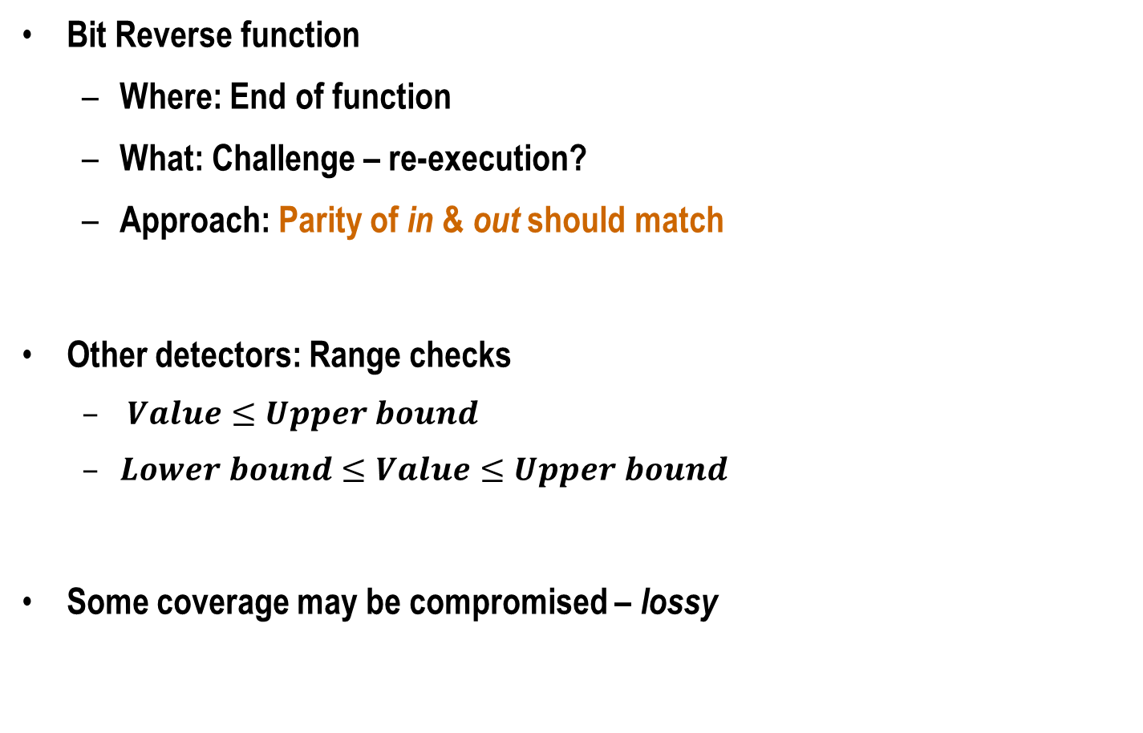



Application-Specific Behavior
Parity
Bit Reverse function
Where: End of function
What: Challenge – re-execution?
Approach: Parity of in & out should match
Other detectors: Range checks
$Value≤Upper bound$
$Lower bound≤Value≤Upper bound$
Some coverage may be compromised – lossy
$$P_{in}$$
Bit Reverse
Compare
$$in (0011)$$
$$out (1100)$$
Parity
$$P_{out}$$

Slide 70
Methodology for Detectors
Six applications from SPEC 2006, Parsec, and SPLASH2
Error model: single bit flips in integer architectural registers at every dynamic instruction
Ran Relyzer, obtained SDC-causing sites, examined them manually
Our detectors
Implemented in architecture simulator
Overhead estimation: number of assembly instructions needed

Slide 71
SDC Reduction
84% average SDC reduction (67% - 92%)

Slide 72
Execution Overhead
10% average overhead (0.1% - 18%)

Slide 73
Tunable Reliability: Challenges
Naïve approach
Example: Target SDC reduction = 60%
Sample 1
SFI
50% SDC
reduction
Overhead = 10%
Sample 2
65% SDC
reduction
SFI
Bag of detectors
(program-level +
duplication-based)
Overhead = 20%
Challenges:
Repeated statistical error injections ⇒ time consuming
Do not know detectors’ contribution in reducing SDCs a priori

Slide 74
Regressions
Linear combination
Linear combination of polynomials

Slide 76
SDC Examples
Blackscholes
4.13125 → 4.12999
23.33927 → 1.33247
65,000 values were incorrect
Libquantum: Factorizes 33 to 11 x 3
Impossible measurement
Unable to determine factors
LU
RMSE = 217781729.775298
RMSE = 45324667.7812618

Slide 77
Hardware vs. Software Errors
Statistics across LANL systems [Schroeder et al. SciDAC 2007]

