Slide 1
Software Managed Resiliency
Siva Hari
Lei Chen, Xin Fu, Pradeep Ramachandran, Swarup Sahoo,
Rob Smolenski, Sarita Adve
Department of Computer Science
University of Illinois at Urbana-Champaign
swat@cs.illinois.edu

Slide 2
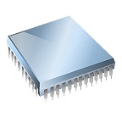

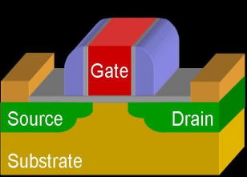

Motivation
Hardware will fail in-the-field due to several reasons
⇒ Need in-field detection, diagnosis, recovery, repair
Reliability problem pervasive across many markets
Traditional redundancy solutions (e.g., nMR) too expensive
⇒ Need low-cost solutions for multiple failure sources
Must incur low area, performance, power overhead
Wear-out
(Devices are weaker)
Transient errors
(High-energy particles )
Design Bugs
… and so on

Slide 3
Observations
Need handle only hardware faults that propagate to software
Fault-free case remains common, must be optimized
⇒ Watch for software anomalies (symptoms)
Zero to low overhead “always-on” monitors
Diagnose cause after symptom detected
May incur high overhead, but rarely invoked
⇒ SWAT: SoftWare Anomaly Treatment

Slide 4
SWAT Framework Components
Detection: Symptoms of software misbehavior
Diagnosis: Rollback/replay on multicore
Recovery: Checkpoint/rollback, output buffering
Repair/reconfiguration: Redundant, reconfigurable hardware
Flexible control through firmware
Checkpoint
Checkpoint
Fault
Error
Symptom
detected
Recovery
Diagnosis
Repair

Slide 5
SWAT Contributions So Far
Very low-cost detectors, 99+% coverage
[ASPLOS’08, DSN’08]
Checkpoint
Checkpoint
Fault
Error
Symptom
detected
Recovery
Accurate fault modeling
[HPCA’09]
Diagnosis
Repair
Multithreaded workloads
[MICRO’09]
In-situ diagnosis
[DSN’08]
Notes:
Out-of-bound detectors, rr for app-aware
No new scheme, but lay foundation for future work
I would like to mention two pieces of recent work that I was involved in.
While detection and diagnosis assume single threaded enironment

Slide 6
SWAT on Multicore and Distributed Systems
Simulated
Server
Simulated
Client
T_{A}
T_{B}
T_{C}
T_{D}
T_{D}
T_{A}
T_{B}
T_{C}
Fault
Application
Application
OS
OS
Hardware
Hardware
T_{C}
T_{D}
T_{A}
T_{B}
Simulated Network
Simics
Off-core faults
Client/server interactions
Exploit safe parallel languages
DeNovo + Deterministic Parallel Java for safe parallelism
Will explore for resiliency
Notes:
In a different project, we are pursuing ways to make parallel programming simpler by providing safe languages that avoid unsafe constructs like data races by design. We have a companion hardware effort called DeNovo that is exploiting the information and guarantees available in such programs for correctness and performance. In the future, we plan to use this information for resilience.

Slide 7


Application-Driven Resiliency
Fault-free
Faulty
Leverage app knowledge and structure for s/w reliability
Can improve both SDCs and recovery
E.g., stateless recovery for server threads,
transactional semantics for clients,
assertions in production code

Slide 8
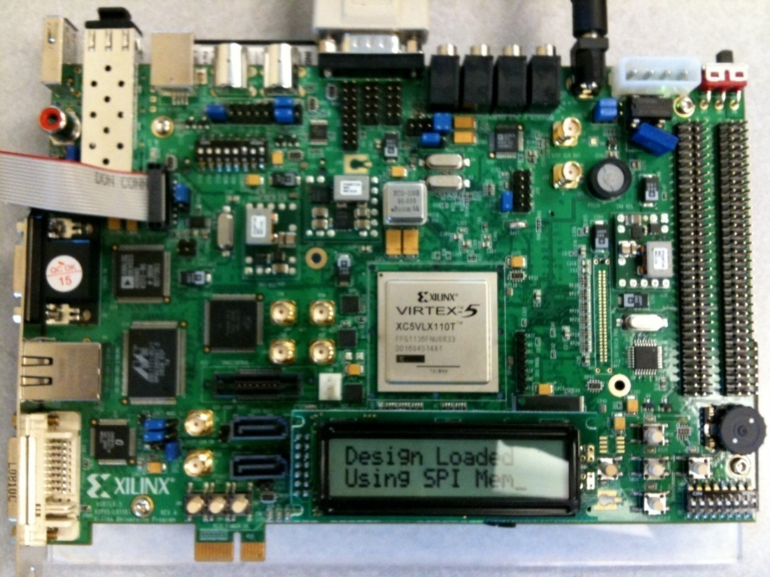
Validation and Prototype
FPGA prototype with Michigan CrashTest
Realistic fault models
Full multicore implementation with firmware

