Slide 1

Preserving Application Reliability
on Unreliable Hardware
Siva Hari
Department of Computer Science
University of Illinois at Urbana-Champaign

Slide 2
Technology Scaling and Reliability Challenges
Nanometers
Increase (X)
*Source: Inter-Agency Workshop on HPC Resilience at Extreme Scale
hosted by NSA Advanced Computing Systems, DOE/SC, and DOE/NNSA, Feb 2012

Slide 3
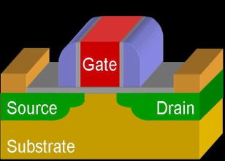
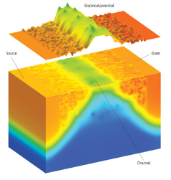
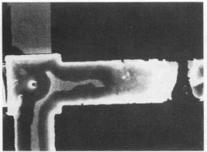
Technology Scaling and Reliability Challenges
Hardware Reliability Challenges are for Real!
Sun experienced soft-errors in flagship enterprise server line, 2000
America Online, Ebay, and others were affected
Several documented in-field errors
LANL Q Supercomputer: 27.7 failures/week from soft errors, 2005
LLNL BlueGene/L experienced parity errors every 8 hours, 2007
Exascale systems are expected to fail every 35-40 minutes
Nanometers
Increase (X)
*Source: Inter-Agency Workshop on HPC Resilience at Extreme Scale
hosted by NSA Advanced Computing Systems, DOE/SC, and DOE/NNSA, Feb 2012

Slide 4
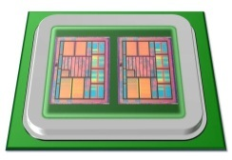
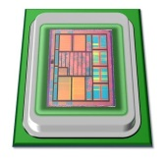
Motivation
Overhead (performance, power, area)
Redundancy
High reliability at low-cost
Hardware Reliability

Slide 5
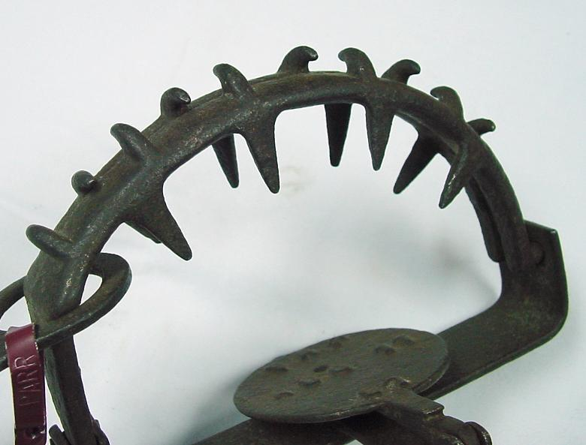
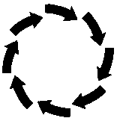



SWAT: A Low-Cost Reliability Solution
Need handle only hardware faults that propagate to software
Fault-free case remains common, must be optimized
⇒ Watch for software anomalies (symptoms)
Zero to low overhead “always-on” monitors
Effective on SPEC, Server, and Media workloads
<0.5% µarch faults escape detectors and corrupt application output (SDC)
Can we bring silent data corruptions (SDCs) to zero?
Fatal Traps
Hangs
Kernel Panic
App Abort
Out of Bounds
Division by zero,
RED state, etc.
Simple HW hang
detector
OS enters panic
state due to fault
App abort due
to fault
Flag illegal addresses

Slide 6
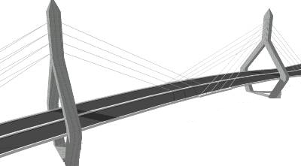
Motivation
Goals:
Full reliability at low-cost
Systematic reliability evaluation
Tunable reliability vs. overhead
Redundancy
Overhead (performance, power, area)
How?
Very high
reliability at low-cost
Tunable
reliability
SWAT
Hardware Reliability
Notes:
Goals for transient faults

Slide 7
Fault Outcomes
Fault-free
execution
Faulty executions
Masked
Detection
Transient fault,
Single bit flip
e.g., bit 4 in R1
Transient fault
again in bit 4 in R1
.
.
.
.
.
.
.
.
.
APPLICATION
APPLICATION
APPLICATION
Symptom of Fault
Output
Output
Output
Symptom detectors (SWAT):
Fatal traps, assertion violations, etc.

Slide 8
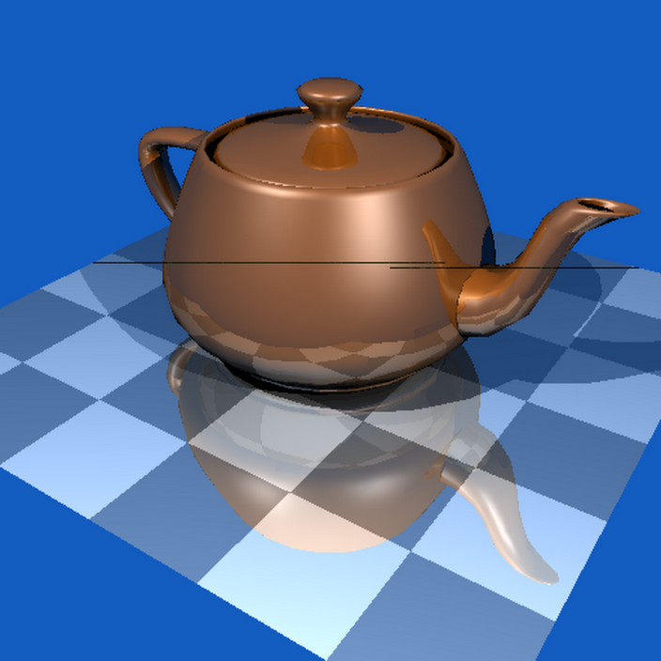
Fault Outcomes
Fault-free
execution
Faulty executions
SDCs are worst of all outcomes
Examples
Blackscholes: Computes prices of options
23.34 → 1.33
65,000 values were incorrect
Libquantum: Factorizes 33 = 3 X 11
Unable to determine factors
LU: Matrix factorization
RMSE = 45,324,668
How to convert SDCs to detections?
Masked
Detection
SDC
.
.
.
.
.
.
.
.
.
.
.
.
APPLICATION
APPLICATION
APPLICATION
APPLICATION
Symptom of Fault
Ray Tracing
Output
Output
Output
X
Output
Silent Data
Corruption (SDC)
Notes:
Remember the connection between recoverability and detection latency

Slide 9
Approach
Find all SDC-causing application-sites
Convert SDCs to Detections
Traditional approach:
Statistical Fault Injections?
Impractical, too many injections
>1,000 compute-years for one app
Complete application
reliability evaluation
.
.
Relyzer: Prune Faults
.
.
APPLICATION
APPLICATION
One injection at a time
Challenge: Analyze all faults with few injections
Output
Output
Duplicate SDC-producing values?
SDC-causing fault
Challenges:
What detectors to use?
Where to place?
.
.
.
APPLICATION
Error Detection
APPLICATION
Error Detectors
Output

Slide 10
Contributions (1/2) [ASPLOS’12, Top Picks’13]
Relyzer: A complete application reliability analyzer for transient faults
Developed novel fault pruning techniques
99.78% fault sites pruned for our applications, fault models
Only 0.004% represent 99% of all application fault sites
Identified SDCs from virtually all applications sites
.
.
Relyzer
.
.
APPLICATION
APPLICATION
Output
Output
Notes:
Identified >99% SDCs for our apps, fault models
=> Comprehensively analyze pin point SDCs in virtually all applications sites

Slide 11
Contributions (2/2) [DSN’12]
Convert identified SDCs to detections
Discovered common program properties for SDC-causing sites
Devised low cost program-level detectors
84% SDCs reduced on average at 10% average execution overhead
Selective duplication for rest
Tunable reliability at low cost
Found near optimal detectors for any SDC target
Lower cost than pure duplication at all SDC targets
E.g., 12% vs. 30% @ 90% SDC reduction
18%
90%
Instr. duplication
Our approach

Slide 12
Other Contributions
Complete Reliability
Solution
Accurate fault modeling
FPGA-based [DATE’12]
Gate-µarch-level simulator [HPCA’09]
Time
Fault
APPLICATION
Detection
Multicore detection & diagnosis [MICRO’09]
Diagnosis
Checkpointing and rollback
Handling I/O
Recovery
Output

Slide 13
Outline
Motivation
Relyzer: Complete application reliability analysis
Converting SDCs to detections
Tunable Reliability
Summary and future directions

Slide 14
Outline
Motivation
Relyzer: Complete application reliability analysis
Pruning techniques
Evaluation methodology
Results
Converting SDCs to detections
Tunable Reliability
Summary and future directions

Slide 15
Relyzer: Application Reliability Analyzer
Pilots
Equivalence Classes
Relyzer
Prune fault sites
Application-level fault equivalence
Predict fault outcomes
Injections for remaining sites
.
.
.
.
.
APPLICATION
APPLICATION
Output
Output
Can find SDCs from virtually all application sites

Slide 16
Definition to First-Use Equivalence
Fault in first use is equivalent to fault in definition ⇒ prune definition
Fault model: single bit flips in operands, one fault at a time
r1 = r2 + r3
r4 = r1 + r5
…
If there is no first use, then definition is dead ⇒ prune definition
Definition
First use

Slide 17
Control Flow Equivalence
Insight: Faults flowing through similar control paths may behave similarly*
CFG
X
Faults in X that take paths behave similarly
Heuristic: Use direction of next 5 branches
*Faults in stores are handled next

Slide 18

Store Equivalence
Insight: Faults in stores may be similar if stored values are used similarly
Heuristic to determine similar use of values:
Same number of loads use the value
Loads are from same PCs
PC
PC1
PC2
Instance 1
Load
Load
Store
Memory
Instance 2
Load
Load
Store
PC
PC1
PC2

Slide 19
Pruning Predictable Faults
Prune out-of-bounds accesses
Detected by symptom detectors
Memory addresses not in &
Boundaries obtained by profiling
SPARC Address Space Layout
Reserved
Stack
Reserved
Heap
Data
Text
0xffffffffffbf0000
0xfffff7ff00000000
0x80100000000
0x100000000
0x0

Slide 20
Methodology for Relyzer
Pruning
12 applications (from SPEC 2006, Parsec, and Splash 2)
Fault model
When (application) and where (hardware) to inject transient faults
When: Every dynamic instruction that uses these units
Where: Hardware fault sites
Faults in integer architectural registers
Faults in output latch of address generation unit
Single bit flip, one fault at a time
Notes:
Since the focus is on application level fault analysis, we selected 2 hardware fault sites in this study. In particular, we selected single bit flips in integer registers and output latch of the address generation unit. Faults in these hardware units are considered whenever that unit is unitized by the application.

Slide 21
Pruning Results
99.78% of fault sites are pruned
3 to 6 orders of magnitude pruning for most applications
For mcf, two store instructions observed low pruning (of 20%)
Overall 0.004% fault sites represent 99% of total fault sites

Slide 22
Methodology: Validating Pruning Techniques
Validation for Control and Store equivalence pruning
Equivalence
Classes
PILOTS
.
.
.
APPLICATION
SAMPLE
Compute Prediction Rate
Output

Slide 23
Validating Pruning Techniques
Validated control and store equivalence
>2M injections for randomly selected pilots, samples from equivalent set
96% combined accuracy (including fully accurate prediction-based pruning)
99% confidence interval with <5% error

Slide 24
Potential Impact of Relyzer
Relyzer, for the first time, finds SDCs from virtually all program locations
SDC-targeted error detectors
Placing detectors where needed
Designing application-centric detectors
Tuning reliability at low cost
Balancing reliability vs. performance
Designing inherently error resilient programs
Why do certain errors remain silent?
Why do errors in certain code sequences produce more detections?

Slide 25
Outline
Motivation
Relyzer: Complete application reliability analysis
Converting SDCs to detections
Program-level detectors
Evaluation methodology
Results
Tunable Reliability
Summary and future directions

Slide 26
Converting SDCs to Detections: Our Approach
SDC-causing
fault
.
.
.
APPLICATION
Error Detection
APPLICATION
Error Detectors
Output
Challenges:
Where to place?
What to use?
Uncovered fault-sites?
Approach:
: Many errors propagate to few program values
End of loops and function calls
: Test program-level properties
E.g., comparing similar computations, value equality
: Selective instruction-level duplication

Slide 27
SDC-Causing Code Properties
Loop incrementalization
Registers with long life
Application-specific behavior

Slide 28
Loop Incrementailzation
C Code
ASM Code
Array a, b;
For (i=0 to n) {
. . .
a[i] = b[i] + a[i]
. . .
}
A = base addr. of a
B = base addr. of b
L: load r1 ← [A]
. . .
load r2 ← [B]
. . .
store r3 → [A]
. . .
add A = A + 0x8
add B = B + 0x8
add i = i + 1
branch (i<n) L

Slide 29

Loop Incrementailzation
C Code
ASM Code
Array a, b;
For (i=0 to n) {
. . .
a[i] = b[i] + a[i]
. . .
}
A = base addr. of a
B = base addr. of b
L: load r1 ← [A]
. . .
load r2 ← [B]
. . .
store r3 → [A]
. . .
add A = A + 0x8
add B = B + 0x8
add i = i + 1
branch (i<n) L
Collect initial values of A, B, and i
SDC-hot app sites
What: Property checks on A, B, and i
Diff in A = Diff in B
Diff in A = 8 $×$Diff in i
Where: Errors from all iterations propagate here in few quantities

Slide 30
Registers with Long Life
Some long lived registers are prone to SDCs
For detection
Duplicate the register value at its definition
Compare its value at the end of its life
R1 definition
Copy
Use 1
Life
time
Use 2
.
.
.
Compare
Use n

Slide 31









Application-Specific Behavior
Exponential function
Where: End of every function invocation
What: Re-execution or inverse function (log)
Periodic test on accumulated quantities
Accumulate input and output with $+$ and $×$
$e^{(i1+i2)}=e^{i1}×e^{i2}$
Other detectors: Range checks
$Value≤Upper bound$
$Lower bound≤Value≤Upper bound$
Some coverage may be compromised – lossy
few
exp
exp
s
$$in$$
$$out$$
$$I$$
$$I=I+in$$
$$O$$
$$O=O×out$$
$$==$$
$$O′$$

Slide 32
Methodology for Detectors
Six applications from SPEC 2006, Parsec, and SPLASH2
Fault model: single bit flips in integer architectural registers at every dynamic instruction
Ran Relyzer, obtained SDC-causing sites, examined them manually
Our detectors
Implemented in architecture simulator
Overhead estimation: number of assembly instructions needed
Lossy detectors’ coverage
Statistical fault injections (10,000)

Slide 33
Categorization of SDC-causing Sites
Added Lossless Detectors
Added Lossy
Detectors
Categorized >88% SDC-causing sites

Slide 34
SDC Reduction
84% average SDC reduction (67% - 92%)

Slide 35
Execution Overhead
10% average overhead (0.1% - 18%)

Slide 36
Outline
Motivation
Relyzer: Complete application reliability analysis
Converting SDCs to detections
Tunable Reliability
Summary and future directions

Slide 37
Tunable Reliability
What if our low-overhead is still not tolerable but lower reliability is?
Tunable reliability vs. overhead
Need to find a set of optimal-cost detectors at any given SDC target

Slide 38

Tunable Reliability: Challenges
Naïve approach
Example: Target SDC reduction = 60%
Sample 1
SFI
50% SDC
reduction
Overhead = 10%
Sample 2
65% SDC
reduction
SFI
Bag of detectors
(program-level +
duplication-based)
Overhead = 20%
Challenges:
Repeated statistical fault injections ⇒ time consuming
Do not know detectors’ contribution in reducing SDCs a priori

Slide 39

Identifying Near Optimal Detectors: Our Approach
Relyzer lists SDC-causing sites, number of SDCs these sites produce
⇒ Knowledge of SDCs covered by each detector
1. Set attributes, enabled by Relyzer
2. Dynamic programming
Constraint: Total SDC red. ≥ 60%
Objective: Minimize overhead
Detector
SDC Red.= X%
Overhead = Y%
Selected Detectors
Bag of detectors
(program-level + duplication-based)
Overhead = 9%
Obtained SDC reduction vs. Performance trade-off curves

Slide 40
SDC Reduction vs. Overhead Trade-off Curve
Selective duplication

Slide 41
SDC Reduction vs. Overhead Trade-off Curve
Our detectors +
selective duplication
Selective duplication
24%
18%
90%
99%
Program-level detectors provide lower cost solutions

Slide 42
Summary
Relyzer: Novel fault pruning for reliability analysis [ASPLOS’12, TopPicks’13]
3 to 6 orders of magnitude fewer injections for most applications
Identified SDCs from virtually all applications sites
Devised low cost program-level detectors [DSN’12]
84% average SDC reduction at 10% average cost
Tunable reliability at low cost
Obtained SDC reduction vs. performance trade-off curves
Lower cost than pure duplication: 12% vs. 30% @ 90% SDC reduction
Other contributions:
Multicore detection and diagnosis [MICRO’09]
Accurate fault modeling [DATE’12, HPCA’09]
Checkpointing and rollback

Slide 43
Future Directions
Automating detectors’ placement and derivation
Developing app independent, failure-source-oblivious detectors
More (parallel, server) applications
More fault models: µarch/gate-level, permanent, un-core components
Obtaining input independent reliability profiles
Designing inherently error resilient programs
Detection latency and recoverability
Emerging platforms have diverse reliability demands
Application-aware error tolerance, approximate computation
Holistic view ⇒ balancing reliability, energy, & cost budgets
Ubiquitous Sensors
(Data collection)
Cloud Servers
(Processing)
Portable Devices
(Analysis)

Slide 44
Thank You

Slide 45
Backup

Slide 46
iSWAT vs. Our Work
iSWAT [DSN’08] | Our Work
Permanent faults | Transient Faults
Range-based likely invariants on stores | Broad range of detectors
Suffers from false positives | No false positives
Combining insights for both fault models is interesting future direction

Slide 47
Pattabiraman et al. vs. Our Work
Our Work | Pattabiraman et al. [EDDC’06, PRDC’05]
Goal: Reduce SDCs | Avoid crashes, limit error propagation
Relyzer [ASPLOS’12] identifies SDC-causing app sites | Lifetime, fanout identify vulnerable variables [PRDC’05]
Property checks involve multiple variables | Tests do not consider other variables
No false positives | Suffers from false positives

Slide 48
SymPLFIED vs. Relyzer
Similar goal of finding SDCs
Symbolic execution to abstract erroneous values
Performs model checking with abstract execution technique
Reduces the number of injections per application site
Relyzer reduces the number of applications sites
Relyzer restricts the injections/app site by selecting few fault models
Combining SymPLFIED and Relyzer would be interesting

Slide 49
Shoestring vs. Relyzer
Similar goal: Finding and reducing SDCs
Our Work | Shoestring
Static + dynamic program analyses | Pure static analysis Finds short-enough data paths to the symptom generating instructions
Detection mechanism: Program-level property checks | Instruction-level duplication
Combining Shoestring and Relyzer would be interesting

Slide 50

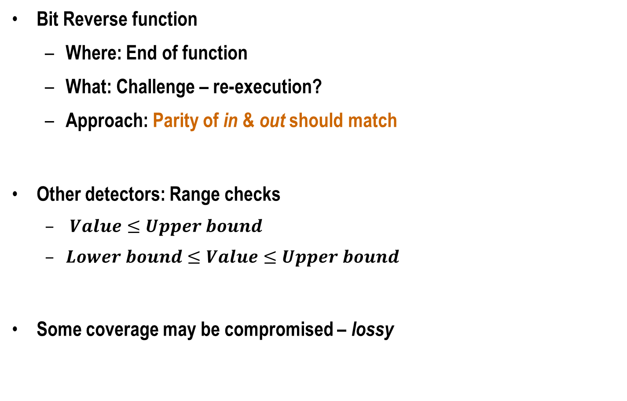



Application-Specific Behavior
Parity
Bit Reverse function
Where: End of function
What: Challenge – re-execution?
Approach: Parity of in & out should match
Other detectors: Range checks
$Value≤Upper bound$
$Lower bound≤Value≤Upper bound$
Some coverage may be compromised – lossy
$$P_{in}$$
Bit Reverse
Compare
$$in (0011)$$
$$out (1100)$$
Parity
$$P_{out}$$

Slide 51
SDC Examples
Blackscholes
4.13125 → 4.12999
23.33927 → 1.33247
65,000 values were incorrect
Libquantum: Factorizes 33 to 11 x 3
Impossible measurement
Unable to determine factors
LU
RMSE = 217781729.775298
RMSE = 45324667.7812618

Slide 52
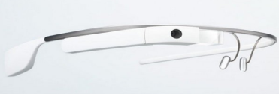
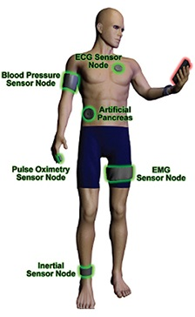
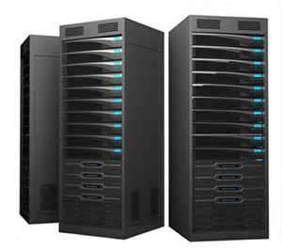

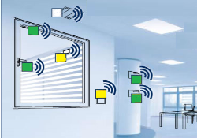

Future Directions
Emerging applications have diverse reliability demands
Personalized healthcare, market analysis, etc.
Leverage inherent application error-tolerance
Holistic view ⇒ balancing reliability, energy, & cost budgets
Ubiquitous Sensors
Cloud Servers
Portable Devices
Data collection → Processing → Analysis

