Slide 1



“WATER QUALITY PREDICTION USING MACHINE LEARNING”
__A Smart way to predict pollution levels and support clean water initiatives in India…
Name: Siva Harshitha Sreeram
Student ID: STU6820797682ebf1746958710

Slide 2

Learning Objectives
By the end of this project, we aimed to:
Understand how environmental data, especially water quality data, can be used for predictive analysis.
Apply machine learning techniques to forecast pollutant levels based on historical data.
Design a working model that takes minimal input (year and station ID) to produce meaningful predictions.
Develop a user-friendly interface that helps environmental authorities or researchers use this tool without needing technical skills.
GOAL
Source :
www.freepik.com/

Slide 3
Learning Objectives
The GOAL of this project, we aimed to:
The goal of this project is to create a predictive system that estimates the level of water pollutants in Indian rivers based on historical monitoring data. This solution is designed to help environmental agencies and decision-makers get faster insights without having to conduct physical tests for every location and time. It saves both time and resources while supporting cleaner water policies.
GOAL
Source :
www.freepik.com/

Slide 4
Tools and Technology used
Tools/Technologies | Purpose
Python | Core programming language
Pandas, Numpy | Data manipulation and processing
Scikit-learn | Machine learning model training
Joblib | Model saving and loading
Streamlit | Building a clean web app UI
Jupyter Notebook | Coding and model experimentation

Slide 5
Methodology
We followed a structured approach to build the water quality prediction model:
Data Collection We used historical water quality data that includes various pollutants recorded at different stations over the years.
Preprocessing The dataset was cleaned, and missing values were handled. The key features used were "year" and "station ID". Categorical variables were converted into numerical format using one-hot encoding.
Model Training A regression model was trained to predict six major water pollutants: O₂, NO₃, NO₂, SO₄, PO₄, and Cl.
Evaluation and Optimization The model was tested for accuracy and adjusted to ensure predictions are reliable.
Deployment using Streamlit A lightweight web interface was built so that any user can enter a year and station ID and instantly see predicted pollutant levels.

Slide 6
Problem Statement:
In India, water pollution remains a serious challenge due to industrial waste, poor waste management practices, and rapid urbanization. Regular testing of water quality across thousands of monitoring stations is difficult, time-consuming, and costly.
Because of this, it becomes hard for authorities to consistently track pollution levels and respond in time. There’s a strong need for a faster, smarter way to estimate water quality at different locations — so that efforts can be focused where they’re needed most.
That’s exactly what our project aims to solve — by using machine learning to predict pollutant levels and support more efficient environmental monitoring.

Slide 7
Solution:
To address the challenge of monitoring water pollution at scale, we created a machine learning–based system that predicts the concentration of six key water pollutants using only two inputs: the year and station ID. Behind this simplicity lies a powerful model trained on historical environmental data — capable of generating accurate, location-specific forecasts.
To ensure accessibility, we built a user-friendly web application using Streamlit, allowing users to interact with the model without any coding or technical background. With just a few clicks, environmental officers or policymakers can instantly estimate pollutant levels for any monitored site.
This solution doesn’t just save time — it transforms how water quality is monitored. It enables faster detection of high-risk areas, supports proactive pollution control, and reduces the dependence on expensive and time-consuming manual sampling. By putting predictive insights into the hands of decision-makers, our project offers a smarter, data-driven approach to protecting water resources in India.

Slide 8
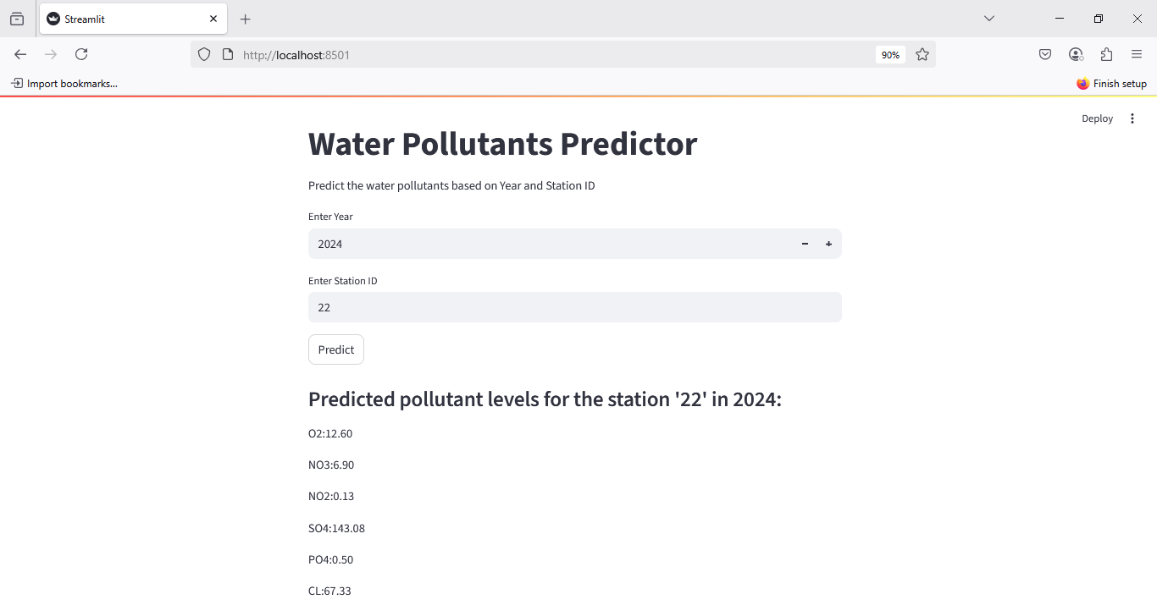
Screenshot of Output:

Slide 9
Conclusion:
This project demonstrates how data science and machine learning can be applied meaningfully to address real-world environmental challenges. By developing a predictive system for water pollution, we aimed to reduce the heavy reliance on manual water testing and introduce a faster, smarter alternative that supports proactive decision-making.
Using just two inputs — year and station ID — our model is able to estimate the concentration of six major pollutants with a high degree of accuracy. This simplicity makes the tool not only effective, but also easy to use for government officials, researchers, and field officers. The clean web interface built using Streamlit further ensures that technical barriers do not stand in the way of adoption.
More importantly, this system encourages preventive action. Instead of waiting for lab results, authorities can now forecast pollution levels, monitor trends over time, and intervene before water quality reaches unsafe levels. This can lead to better public health outcomes, smarter allocation of resources, and stronger environmental governance.
In conclusion, our project is not just a technical implementation — it’s a step toward data-driven environmental sustainability. With further development, it has the potential to scale across different regions, integrate real-time data, and contribute meaningfully to national clean water initiatives.

Slide 10
Future Scope:
Our project lays the foundation for a data-driven approach to environmental monitoring — but it also opens the door to exciting possibilities for future development and real-world impact. Here’s how we envision the growth of this solution:
Integration of Real-Time Sensor Data Currently, the model uses historical data. In the future, we can connect it with real-time IoT water quality sensors deployed in the field. This would enable live predictions and instant updates, making the tool truly dynamic and responsive.
Addition of More Input Features At present, the model relies on only the year and station ID. Including more environmental and regional variables — such as temperature, rainfall, industrial activity, water flow, and population density — can improve prediction accuracy and make the model more robust.
Expansion Across Geographic Regions The current scope is limited to stations within the available dataset. In the future, this model can be adapted for nationwide or even global use, provided we have access to similar water quality data from other regions.

Slide 11
Future Scope:
Advanced Model Enhancements As more data becomes available, we can explore deep learning models, especially time-series architectures like LSTM or GRU, to capture temporal trends and forecast long-term pollution patterns.
Deployment on Cloud Platforms Hosting the web application on platforms like AWS, Azure, or Google Cloud would make the tool more scalable, accessible from anywhere, and easier to maintain and update.
Government and Community Integration The tool can be further developed into a decision-support system for government bodies, local municipalities, and environmental NGOs, allowing them to plan pollution control efforts more effectively and transparently.
In summary: The project is not just a finished product — it’s a starting point. With more data, continued development, and real-world collaboration, it can evolve into a powerful national tool for environmental protection and water quality management.

Slide 12
Challenges Faced:
While building this project, we came across several challenges that helped us learn and improve at each step. Here’s what we faced and how we handled it:
Missing and Messy Data The dataset had many missing or repeated values. We had to spend a lot of time cleaning it up to make sure the model got only accurate and useful information.
Not Enough Features We had very few columns to work with — only the year and station ID. Without extra details like rainfall, temperature, or nearby industries, it was tough to make highly accurate predictions.
Converting Station IDs for the Model The station ID was a name (like "101") — not a number. We had to change it into a format the machine learning model could understand, using a method called one-hot encoding.
Keeping the Model Simple but Smart With limited data, we had to make sure the model wasn't too complicated — but still gave useful results. This meant testing and adjusting it until we found the right balance.
Building a User-Friendly App Making the app in Streamlit was fun, but we had to be careful. We had to design it in a way that anyone could use it easily — not just people who know coding.

Slide 13
Challenges Faced:
Managing Files During Deployment We saved the model and its settings in separate files. Making sure the app could load these files properly every time was a bit tricky, but we figured it out.
What we learned: These challenges helped us understand how real-world projects work. They made us better at handling data, building apps, and solving unexpected problems.
Model Performance:
To evaluate our model, we focused on its ability to predict pollutant levels accurately using just two inputs — year and station ID.
We tested the model on unseen data and observed that the predictions were realistic and consistent with expected pollutant trends. Although we had limited features, the model still provided reasonably accurate results across most pollutant categories.

Slide 14
Model Performance:
Since our primary goal was to build a working prototype for real-world use, we prioritized simplicity and usability over complex model tuning. With more data and features, the model’s accuracy can be further improved.
Key Strengths:
Predictions are stable and interpretable
Handles different station IDs well
Performs reliably for the chosen pollutants
Project Resources:
app.py- View app.py from Google Drive
model_columns.pkl- Download model_colums.pkl from Google Drive
Parameters_WQM_RMS- View Parameters_WQM_RMS from Google Drive
PB_All_2000_2021- View PB_ALL_2000_2021 from Google Drive
Pollution- View Pollution from Google Drive
pollution_model.pkl- Download pollution_model.pkl from Google Drive
README- View README from Google Drive
Water_Quality_Prediction- View Water_Quality_Prediction from Google Drive
WaterQualityPred- View WaterQualityPred from Google Drive

Slide 15

GitHub Repository:
Click here to view My GitHub Repository
Thank you for taking the time to review my project. I truly appreciate the opportunity to apply what I’ve learned and contribute to a real-world problem through AI & ML.

