Slide 1


Slide 2
Topics to be covered
Cascading Failures
Hystrix Command
Circuit Breaker
Hystrix Turbine
Hystrix Dashboard

Slide 3
Microservice fails due to
Exception
Network Latency

Slide 4
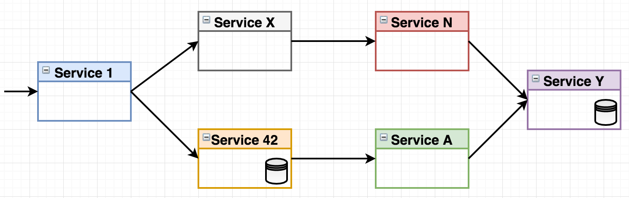
Cascading Failures
Having a large number of services as dependencies can lead to a Cascading failures.

Slide 5
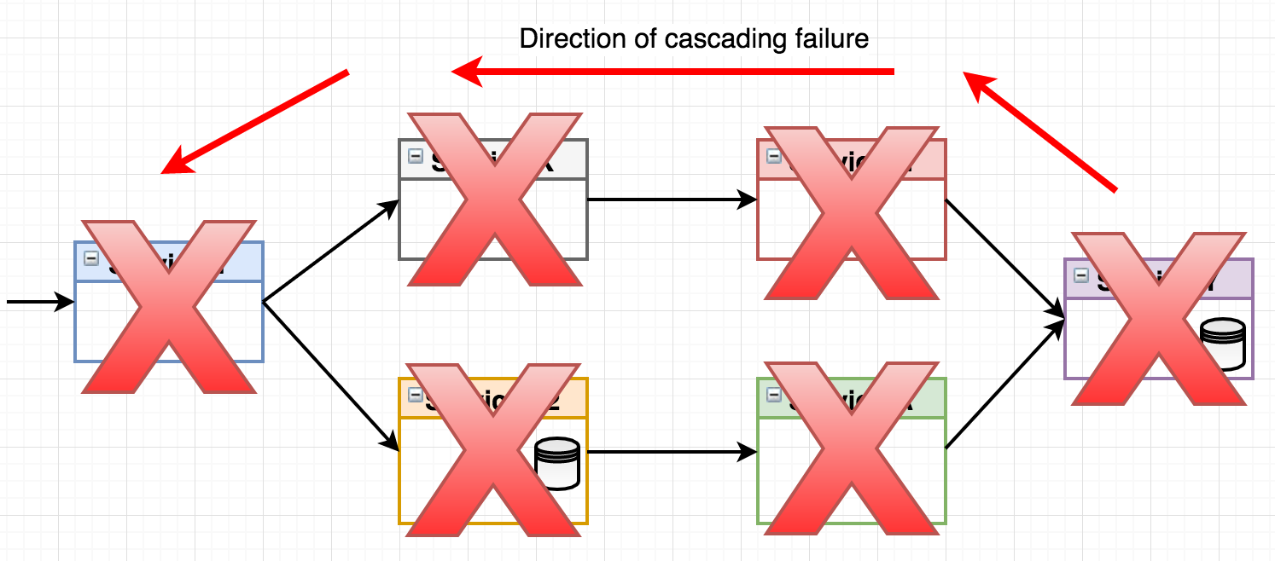
Cascading Failures

Slide 6
What is hystrix ?
Latency and fault tolerance library
Isolates points of access to remote systems, services and 3rd party libraries
Stops cascading failure
Enables resilience in complex distributed systems where failure is inevitable.

Slide 7
Common patterns for HysterixCommand
Fail Fast
Fail Silent
Fallback: Static
Fallback: Stubbed
Primary + Secondary with Fallback
Fallback: Cache via Network

Slide 8
Fail fast (throw Exception)
Example1:
@HystrixCommand
public User getUserById(String id) {
return userResource.getUserById(id);
}
Example2:
@HystrixCommand(fallbackMethod = "fallback1")
User getUserById(String id) {
throw new RuntimeException("getUserById command failed");
}
@HystrixCommand
User fallback1(String id, Throwable e) {
// throw new NullPointerException("fallback1 failed");
}

Slide 9
Fail Silent (return null)
@HystrixCommand(fallbackMethod = "defaultUser")
public User getUserById(String id) {
return userResource.getUserById(id);
}
private User defaultUser(String id) {
return new User(null, null);
}

Slide 10
Fallback: Static
@HystrixCommand(fallbackMethod = "galleryFallBack")
@RequestMapping("/{id}")
public Gallery getGallery(@PathVariable final String id) {
Gallery gallery = new Gallery();
gallery.setId(id);
ResponseEntity<GalleryImageList> response = restTemplate.getForEntity("http://image-service/images/", GalleryImageList.class);
gallery.setImages(response.getBody());
return gallery;
}
private Gallery galleryFallBack(final String galleryId, Throwable hystrixCommand) {
Gallery fallbackGallery = new Gallery();
fallbackGallery.setId(galleryId);
GalleryImageList galleryImageList = new GalleryImageList();
List<GalleryImage> images = Arrays.asList(
new GalleryImage(11, "Treehouse of Horror V", "https://www.imdb.com/title/tt0096697/mediaviewer/rm3842005760"),
new GalleryImage(22, "The Town", "https://www.imdb.com/title/tt0096697/mediaviewer/rm3698134272")); galleryImageList.setImages(images);
fallbackGallery.setImages(galleryImageList);
return fallbackGallery;
}

Slide 11
Fallback: Stubbed
@HystrixCommand(fallbackMethod = "galleryFallBack")
@RequestMapping("/{id}")
public Gallery getGallery(@PathVariable final String id) {
Gallery gallery = new Gallery();
gallery.setId(id);
ResponseEntity<GalleryImageList> response = restTemplate.getForEntity("http://image-service/images/", GalleryImageList.class);
gallery.setImages(response.getBody());
return gallery;
}
private Gallery galleryFallBack(final String galleryId, Throwable hystrixCommand) {
Gallery fallbackGallery = new Gallery();
fallbackGallery.setId(galleryId);
GalleryImageList galleryImageList = new GalleryImageList();
fallbackGallery.setImages(galleryImageList);
return fallbackGallery;
}

Slide 12
Chain of Hystrix Command
@HystrixCommand(fallbackMethod = "defaultUser")
public User getUserById(String id) {
return userResourceItaly.getUserById(id);
}
@HystrixCommand(fallbackMethod = "defaultUserSecond")
private User defaultUser(String id) {
return userResourceIndia.getUserById(id);
}
private User defaultUserSecond(String id) {
return new User("def", "def");
}

Slide 13
Exception Propagation
@HystrixCommand(commandKey = "GetGallery", groupKey = "GalleryControllerGroup", fallbackMethod = "galleryFallBack", ignoreExceptions = TimeoutException.class)
@RequestMapping("/{id}")
public Gallery getGallery(@PathVariable final int id) {
Gallery gallery = new Gallery(); gallery.setId(id);
ResponseEntity<GalleryImageList> response = restTemplate.getForEntity("http://image-service/images/", GalleryImageList.class);
GalleryImageList images = response.getBody();
gallery.setImages(images);
return gallery;
}
private Gallery galleryFallBack(final int galleryId, Throwable hystrixCommand){
Gallery fallbackGallery = new Gallery();
fallbackGallery.setId(galleryId);
GalleryImageList galleryImageList = new GalleryImageList();
fallbackGallery.setImages(galleryImageList);
return fallbackGallery;
}

Slide 14
Default Fallback
public class Service {
@RequestMapping(value = "/test1")
@HystrixCommand(fallbackMethod = "fallback")
public APIResponse test1(String param1) {
return APIResponse.success("success");
}
@RequestMapping(value = "/test2")
@HystrixCommand(fallbackMethod = "fallback")
public APIResponse test2() {
return APIResponse.success("success");
}
@RequestMapping(value = "/test3")
@HystrixCommand(fallbackMethod = "fallback")
public APIResponse test3(ObjectRequest obj) {
return APIResponse.success("success");
}
private APIResponse fallback(String param1) {
return APIResponse.failed("Server is busy");
}
private APIResponse fallback() {
return APIResponse.failed("Server is busy");
}
private APIResponse fallback(ObjectRequest obj) {
return APIResponse.failed("Server is busy");
}
}

Slide 15
Method Level
Default fallback feature allows to engage DRY principle and get rid of redundancy:
public class Service {
@RequestMapping(value = "/test1")
@HystrixCommand(defaultFallback = "fallback")
public APIResponse test1(String param1) {
return APIResponse.success("success");
}
@RequestMapping(value = "/test2")
@HystrixCommand(defaultFallback = "fallback")
public APIResponse test2() {
return APIResponse.success("success");
}
@RequestMapping(value = "/test3")
@HystrixCommand(defaultFallback = "fallback")
public APIResponse test3(ObjectRequest obj) {
return APIResponse.success("success");
}
private APIResponse fallback() {
return APIResponse.failed("Server is busy");
}
}

Slide 16
Class Level
@DefaultProperties(defaultFallback = "fallback")
public class Service {
@RequestMapping(value = "/test1")
@HystrixCommand
public APIResponse test1(String param1) {
return APIResponse.success("success");
}
@RequestMapping(value = "/test2")
@HystrixCommand
public APIResponse test2() {
return APIResponse.success("success");
}
@RequestMapping(value = "/test3")
@HystrixCommand
public APIResponse test3(ObjectRequest obj) {
return APIResponse.success("success");
}
private APIResponse fallback() {
return APIResponse.failed("Server is busy");
}
}

Slide 17
Fallback Priority
Fallbacks listed in descending order of priority:
command fallback defined using fallbackMethod property of @HystrixCommand
command default fallback defined using defaultFallback property of @HystrixCommand
class default fallback defined using defaultFallback property of @DefaultProperties

Slide 18
Properties Override
Default commands properties are groupKey, threadPoolKey, commandProperties, threadPoolProperties, ignoreExceptions.
@DefaultProperties(groupKey = "DefaultGroupKey")
class Service {
@HystrixCommand // hystrix command group key is 'DefaultGroupKey'
public Object commandInheritsDefaultProperties() {
return null;
}
@HystrixCommand(groupKey = "SpecificGroupKey") // command overrides default group key
public Object commandOverridesGroupKey() {
return null;
}
}

Slide 19
Command Properties
Properties that control HystrixCommand behavior
@HystrixCommand(commandProperties = {
@HystrixProperty(name = "execution.isolation.thread.timeoutInMilliseconds", value = "500")
})
public User getUserById(String id) {
return userResource.getUserById(id);
}

Slide 20
Execution Strategy
execution.isolation.strategy
THREAD
SEMAPHORE
execution.isolation.semaphore.maxConcurrentRequests=10

Slide 21
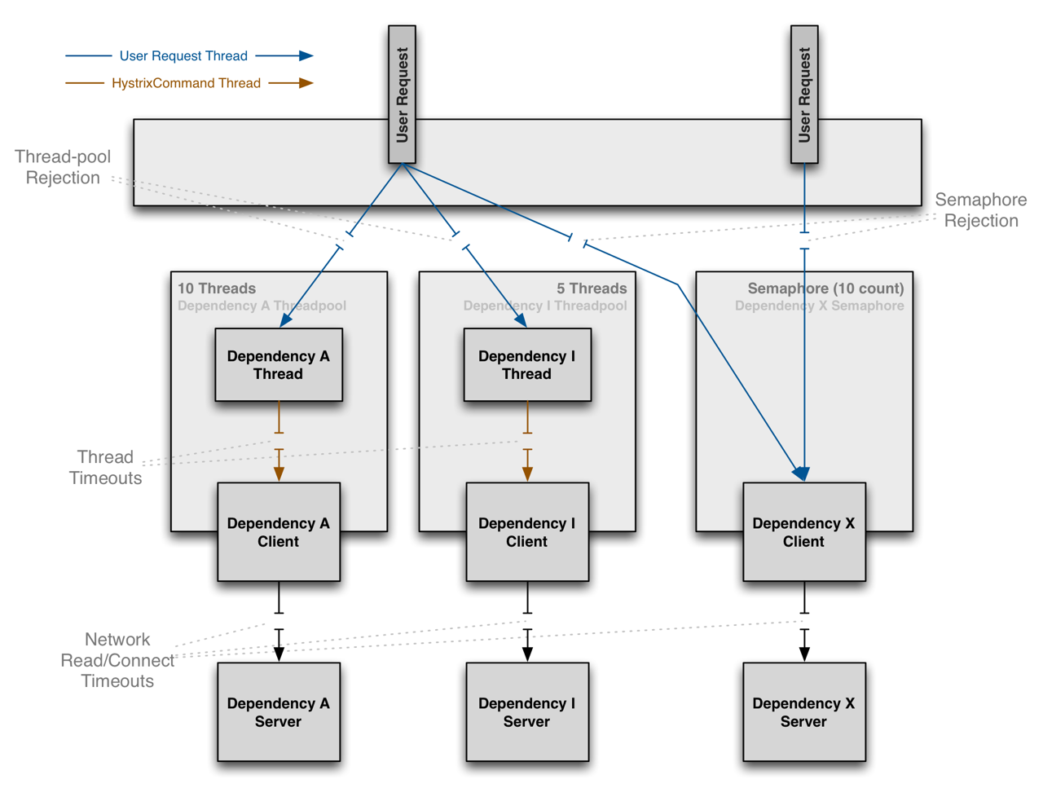
THREAD & SEMAPHORE

Slide 22
ThreadPool Properties
Properties that control the behavior of the thread-pools that Hystrix Commands execute on.
@HystrixCommand(commandProperties = { threadPoolProperties = {
@HystrixProperty(name = "coreSize", value = "30"),
@HystrixProperty(name = "maxQueueSize", value = "60"),
@HystrixProperty(name = "queueSizeRejectionThreshold", value = "55")
})
public User getUserById(String id) {
return userResource.getUserById(id);
}

Slide 23
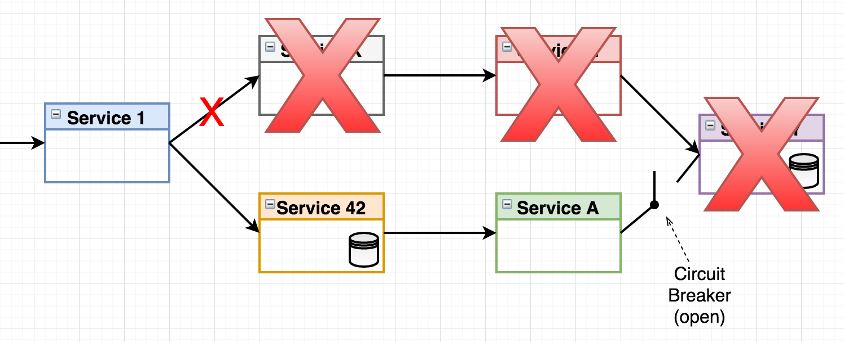
Circuit Breaker
Detects a number of similar failures in rapid succession and breaks circuit
Forces all subsequent calls to fail without making remote calls
After some configurable period, circuit will be closed again to make remote calls

Slide 24
Circuit Breaker
Maven Dependency
<dependency>
<groupId>org.springframework.cloud</groupId>
<artifactId>spring-cloud-starter-netflix-hystrix</artifactId>
</dependency>
Annotation
@EnableCircuitBreaker or @EnableHystrix
Properties
hystric.command.default.circuitBreaker.enabled=true hystrix.command.default.circuitBreaker.sleepWindowInMilliseconds=30000 hystrix.command.default.circuitBreaker.requestVolumeThreshold=20 hystrix.threadpool.default.metrics.rollingStats.timeInMilliseconds=1000 hystrix.command.default.circuitBreaker.errorThresholdPercentage=50 hystrix.command.default.circuitBreaker.forceClosed=false

Slide 25
Monitoring Hystrix
Maven Dependency
<dependency>
<groupId>org.springframework.boot</groupId>
<artifactId>spring-boot-starter-actuator</artifactId>
</dependency>
Properties
management.endpoint.health.enabled=true
management.endpoints.jmx.exposure.include=*
management.endpoints.web.exposure.include=*
management.endpoints.web.cors.allowed-origins=true
management.endpoint.health.show-details=always
Spring Actuator - Hystrix Health Endpoint URL: http://localhost:8092/hystrix.stream

Slide 26
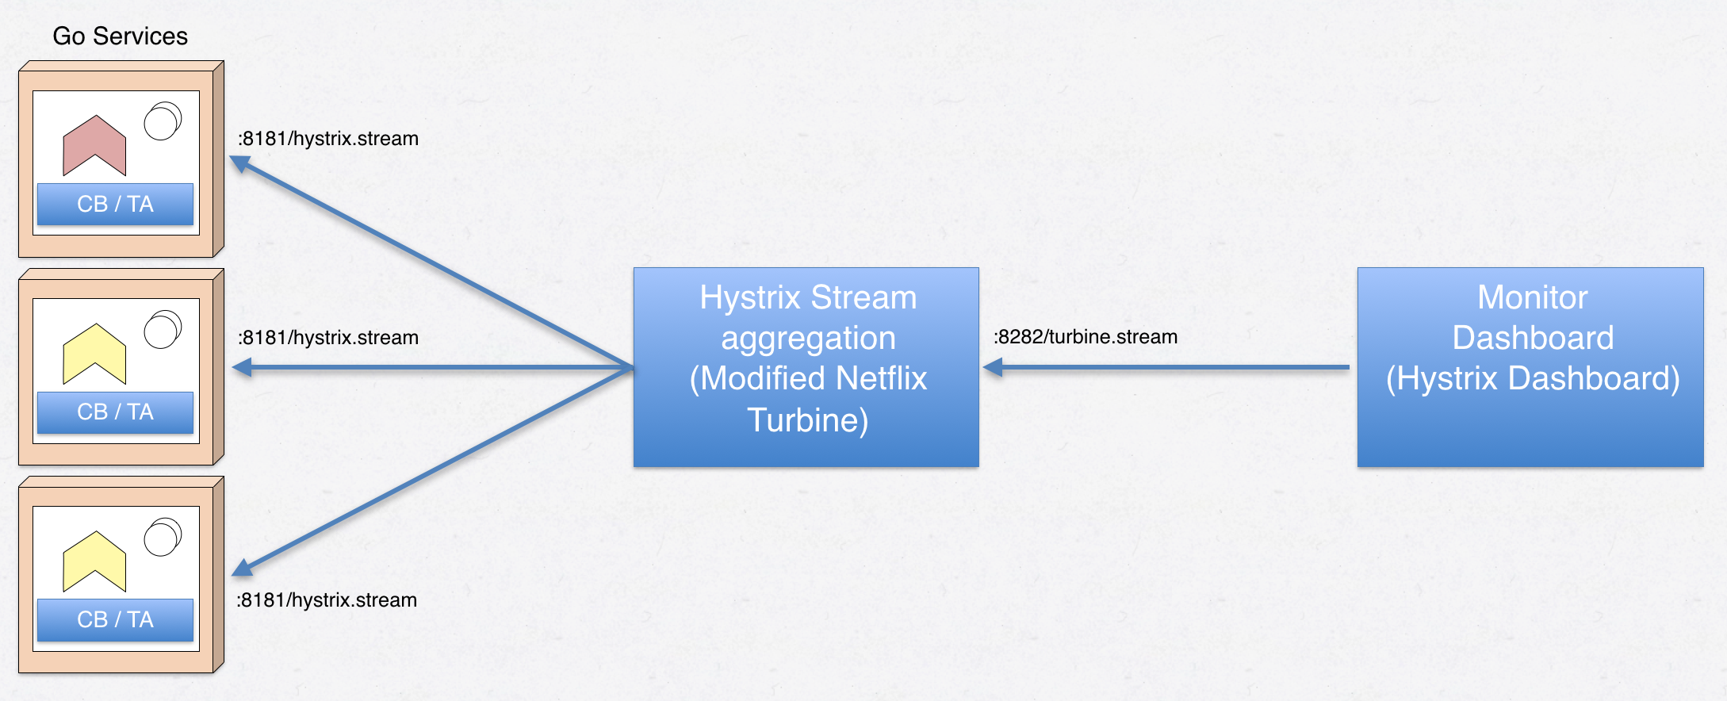
Hystrix Turbine

Slide 27
Hystrix Turbine
Maven Dependency
<dependency>
<groupId>org.springframework.cloud</groupId>
<artifactId>spring-cloud-starter-netflix-turbine</artifactId>
</dependency>
Annotation
@EnableTurbine
Properties
turbine.app-config=image-service,hystrix-circuit-breaker-service
turbine.cluster-name-expression=new String("default")
turbine.instanceUrlSuffix.default: actuator/hystrix.stream
turbine.aggregator.cluster-config=default
Endpoint URL: http://localhost:8989/turbine.stream

Slide 28
Hystrix Dashboard
Maven Dependency
<dependency>
<groupId>org.springframework.cloud</groupId>
<artifactId>spring-cloud-starter-netflix-hystrix-dashboard</artifactId>
</dependency>
Annotation
@EnableHystrixDashboard
Endpoint URL: http://localhost:8092/hystrix

Slide 29
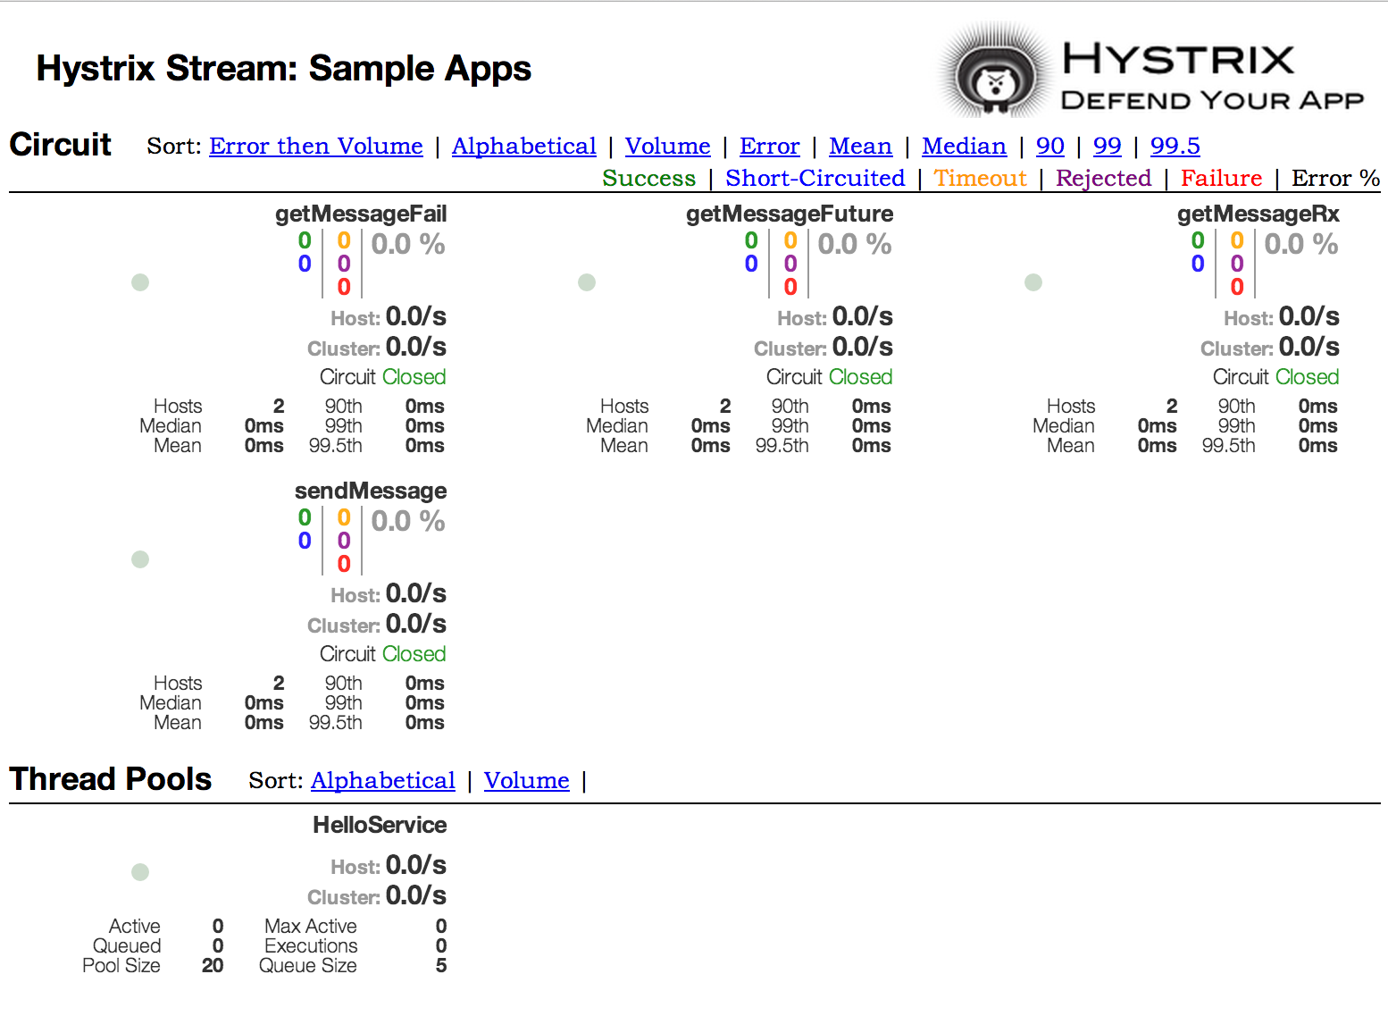

Slide 30
References
https://medium.com/omarelgabrys-blog/microservices-with-spring-boot-circuit-breaker-log-tracing-part-4-9cdf5e898988
http://callistaenterprise.se/blogg/teknik/2017/09/11/go-blog-series-part11/
https://cloud.spring.io/spring-cloud-static/spring-cloud-netflix/1.4.3.RELEASE/single/spring-cloud-netflix.html
https://github.com/Netflix/Hystrix/tree/master/hystrix-contrib/hystrix-javanica
https://github.com/Netflix/Hystrix/wiki/How-To-Use
https://github.com/Netflix/Hystrix/wiki/Configuration
https://github.com/Netflix/Hystrix/wiki/How-it-Works

Slide 31
Thank You

