Slide 1
Microservices
Service Discovery
Load Balancing

Slide 2
Agenda
Introduction to Microservices
Service Discovery
Load Balancing

Slide 3
Introduction to Microservices
Microservices need to be able to change independently of each other, and be deployed by themselves without requiring consumers to change. We need to think about what our services should expose, and what they should allow to be hidden
In a microservice architecture, the services tend to get simpler, but the architecture tends to get more complex. That complexity is often managed with tooling, automation, and process.

Slide 4
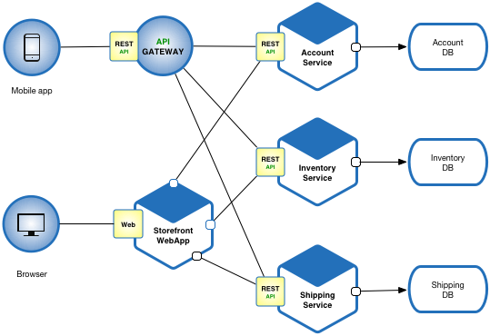
Microservices Architecture

Slide 5
Service Discovery
Service Discovery is just a registry of running instances for one or many services.
“How does Service A talk to Service B without having any knowledge about where to find Service B?”

Slide 6
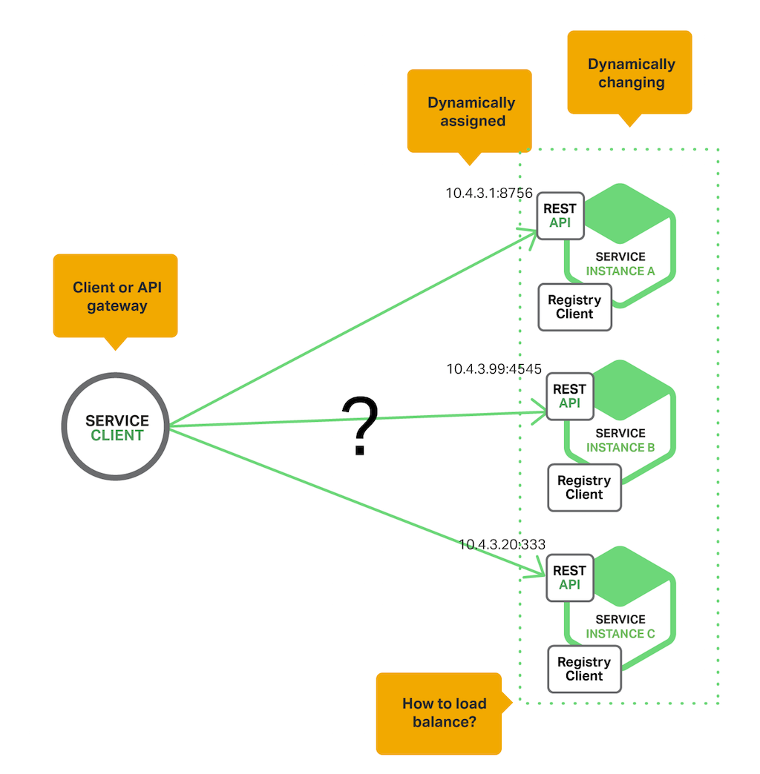
Why we need Service Discovery

Slide 7
Service Discovery Patterns
Client-Side Discovery
Server-Side Discovery

Slide 8
Client-Side Service Discovery
The client is responsible for determining the network locations of available service instances and load balancing requests across them.

Slide 9
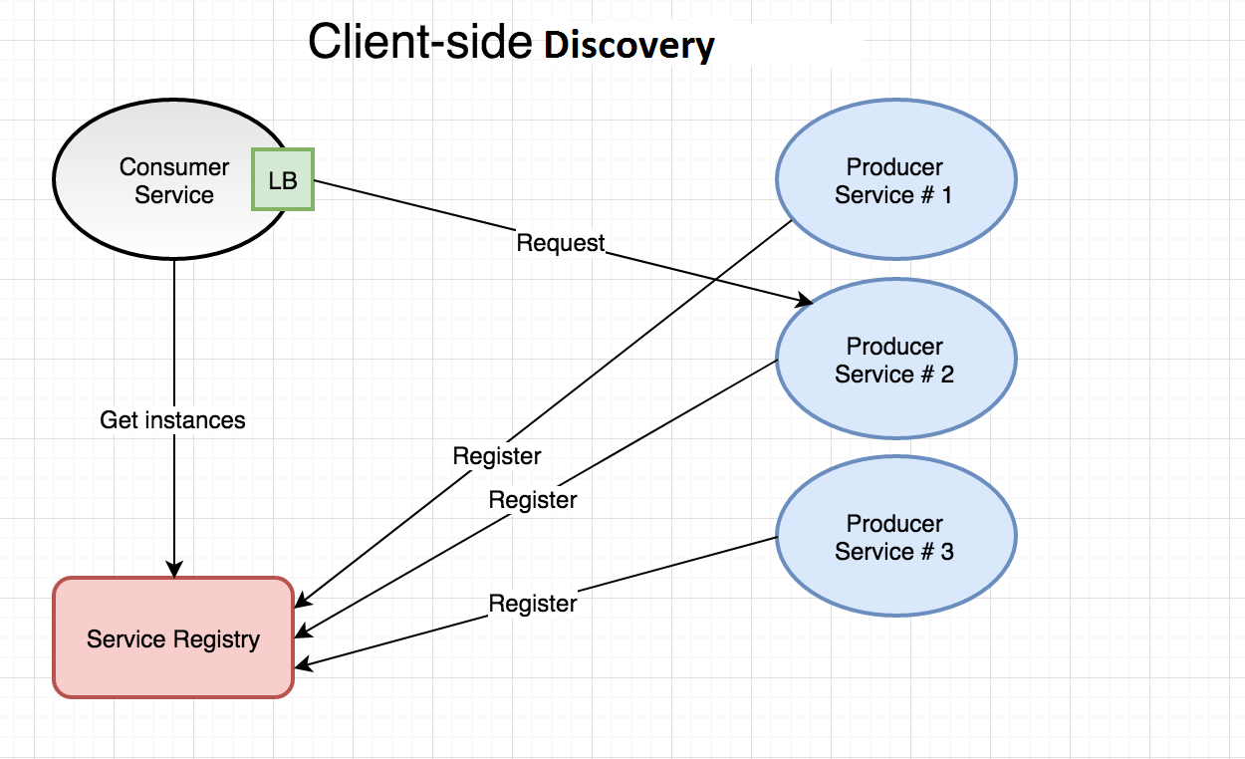
Client-Side Discovery Architecture

Slide 10
Server-Side Service Discovery
The load-balancer and service discovery mechanism is typically built into your container orchestrator and you don’t have to care about installing or managing those components. Also, the client (e.g. our service) doesn’t have to be aware of the service registry - the load-balancer takes care of that for us.

Slide 11
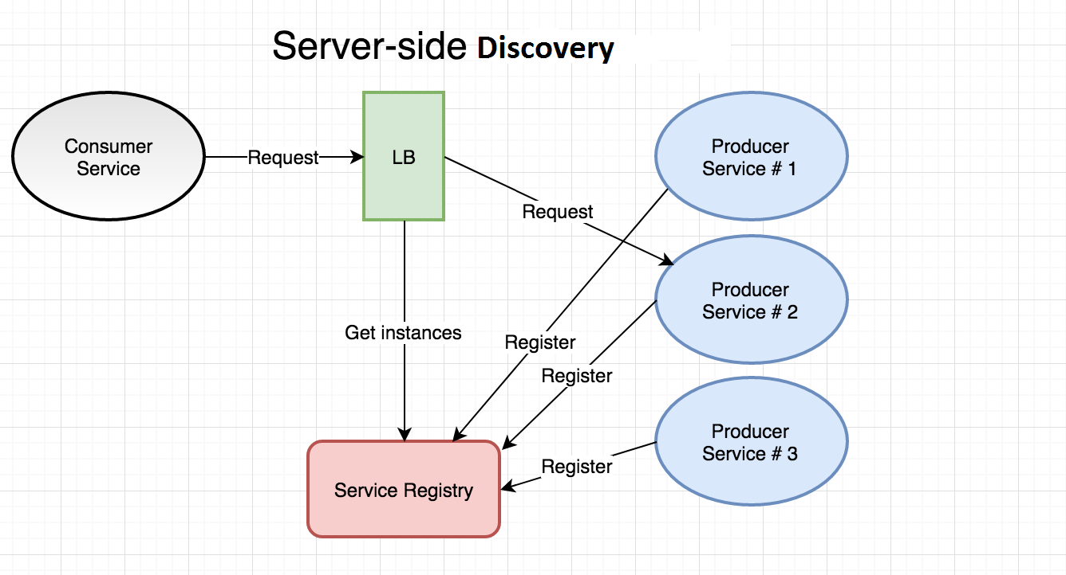
Server-Side Discovery Architecture

Slide 12

Load Balancing
Load balancing refers to efficiently distributing incoming network traffic across a group of backend servers, also known as a server farm or server pool

Slide 13
Load Balancing Patterns
Client-Side Load Balancing
Server-Side Load Balancing

Slide 14
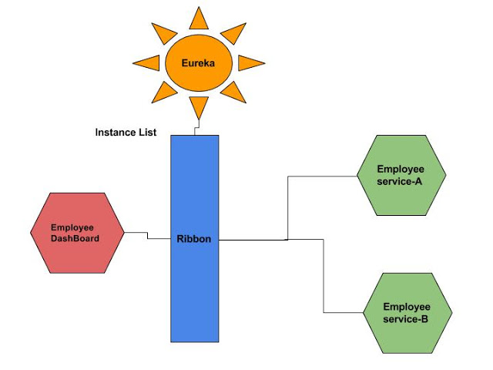
Client-Side Load Balancing

Slide 15
Server-Side Load Balancing

Slide 16
“பயன்தூக்கார் செய்த உதவி நயன்தூக்கின் நன்மை கடலின் பெரிது”
நன்றி
விளக்கம்: இவருக்கு உதவினால் பிறகு நமக்கு இது கிடைக்கும் என்று எண்ணாதவராய் ஒருவர் செய்த உதவியின் அன்பை ஆய்ந்து பார்த்தால், அவ்வுதவியின் நன்மை கடலைவிடப் பெரியது ஆகும்.

