Slide 1





Digital Portfolio
STUDENT NAME:JEEVANANTHAM M REGISTER NO AND NMID: 2422J0271/asbru202422J0271 DEPARTMENT: BACHELOR OF COMPUTER APPLICATION COLLEGE: THAVATHIRU SANTHALINGA ADIGALAR ARTS SCIENCE AND TAMIL COLLEGE AFFILIATED TO BHARATHIYAR UNIVERSITY
1

Slide 2


PROJECT TITLE
Personal Portfolio Website: A website showcasing your skills, experience, and pr oj ect s.
2

Slide 3



AGENDA
1.Problem Statement 2.Project Overview 3.End Users 4.Tools and Technologies 5.Portfolio design and Layout 6.Features and Functionality 7.Results and Screenshots 8.Conclusion 9.Github Link
3/21/2024
Annual Rev iew
3

Slide 4



PROBLEM STATEMENT
This digital portfolio aims to effectively showcase skills, experience, and projects, while also providing a great user experience for visitors.
4

Slide 5

PROJECT OVERVIEW
1. About Section: Brief introduction to background, skills, and experience. 2. Project Showcase: Curated selection of best work, with descriptions, images, and links to live projects or code repositories. 3. Skills and Expertise: List of technical skills and areas of expertise. 4. Contact Information: Contact form or email address for potential employers, clients, or collaborators.
5

Slide 6

WHO ARE THE END USERS?
1. Potential employers: Hiring managers, recruiters, and other stakeholders in the web development/design industry. 2. Clients: Businesses or individuals looking for web development/design services. 3. Collaborators: Other developers, designers, or professionals interested in potential collaborations.
6

Slide 7

TOOLS AND TECHNIQUES
HTML CSS JA VA SC RI PT CODEPEN AS CODE EDITOR GITHUB AS HOSTING PLATFORM
7

Slide 8


PORTFOLIO DESIGN AND LAYOUT
Clean and Simple Design: Use a minimalist approach to showcase your work without distractions. Consistent Typography: Choose a clear, readable font and use it consistently throughout the portfolio. Color Scheme: Select a palette that reflects your personal brand and use it consistently. White Space: Use ample white space to make your content stand out and improve readability. Imagery: Use high-quality images and graphics to showcase your work. Responsive Design: Ensure that your portfolio looks great on desktop, tablet, and mobile devices.
Na v i ga ti on:
Use a simple, intuitive navigation menu that makes it easy for visitors to find what they're looking for. LAYOUTS 1. Grid-based layout:A clean and simple layout that showcases projects in a grid format. 2. Masonry layout: A layout that showcases projects in a grid format with varying heights and widths. 3. Single-page layout: A layout that showcases all content on a single page, with sections and scrolling. 4. Multi-page layout:A layout that separates content into multiple pages, with navigation between sections.
8

Slide 9

FEATURES AND FUNCTIONALITY
Features: 1. Project showcase: A curated selection of projects with images, descriptions,
and links.
2. About page: A brief bio and introduction to background, skills, and experience. 3. Contact form: A form for visitors to send messages or inquiries. 4. Social media integration: Links to social media profiles. 5. Responsive design: Adapts to different screen sizes and devices. Functionality: 1. Easy navigation: Simple and intuitive menu for easy content access. 2. Fast loading times: Optimized for quick loading on various devices. 3. Interactive elements: Animations, transitions, or other interactive features. 4. Search engine optimization (SEO): Optimized for search engine visibility. 5. Regular updates: Easy to update with new projects, skills, and experiences.

Slide 10
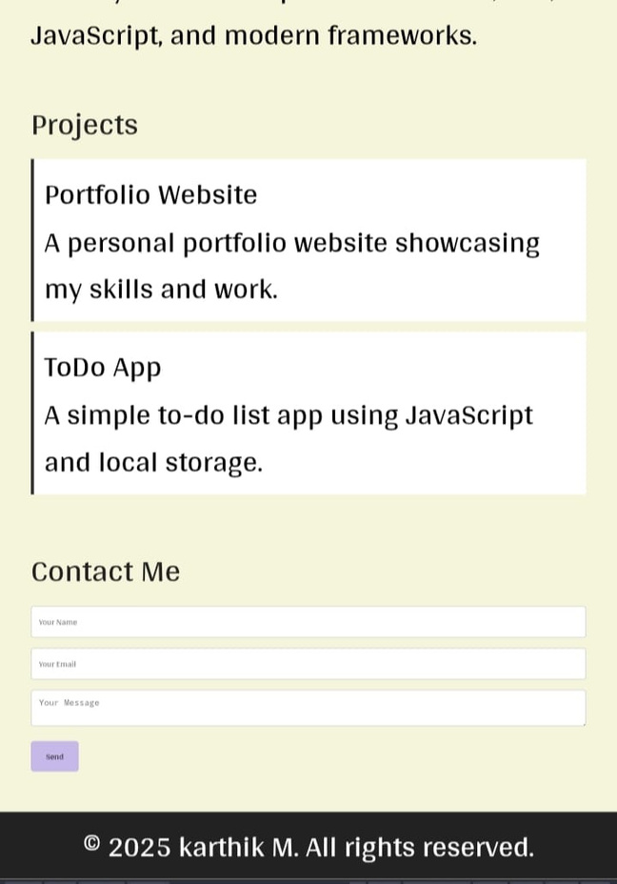
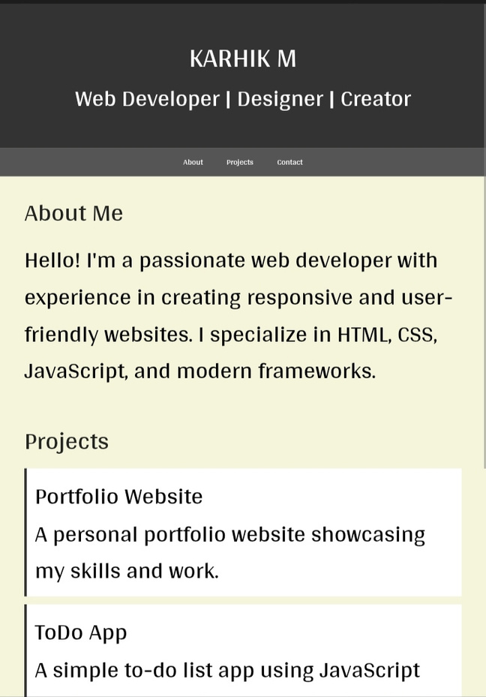

RESULTS AND SCREENSHOTS
VISWANATHAN
3/21/2024
Annual Rev iew
Viswanathan
10

Slide 11

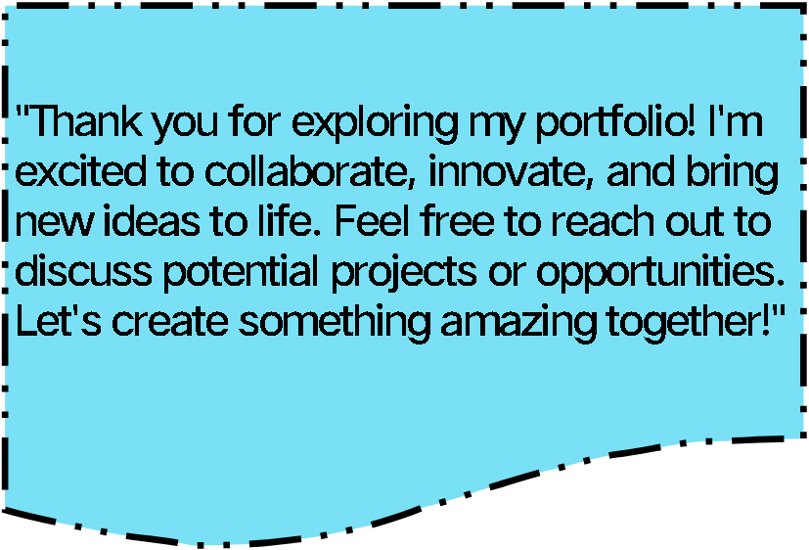
CONCLUSION
11

