Slide 1
Loan Process
A
Employment Check
A
M
Validate Borrower
+
Completeness
Correctness
+
Credit Check
M
A
M
A
A
+
All Checks Done
Automatic Decision
Review Result
Notify Customer
Validate Property

Slide 2
Loan Process
A
Employment Check
A
M
Credit Check
A
Completeness
Correctness
+
M
A
+
R
pass
Review Result
Notify Customer
M
Property Check
fail

Slide 3
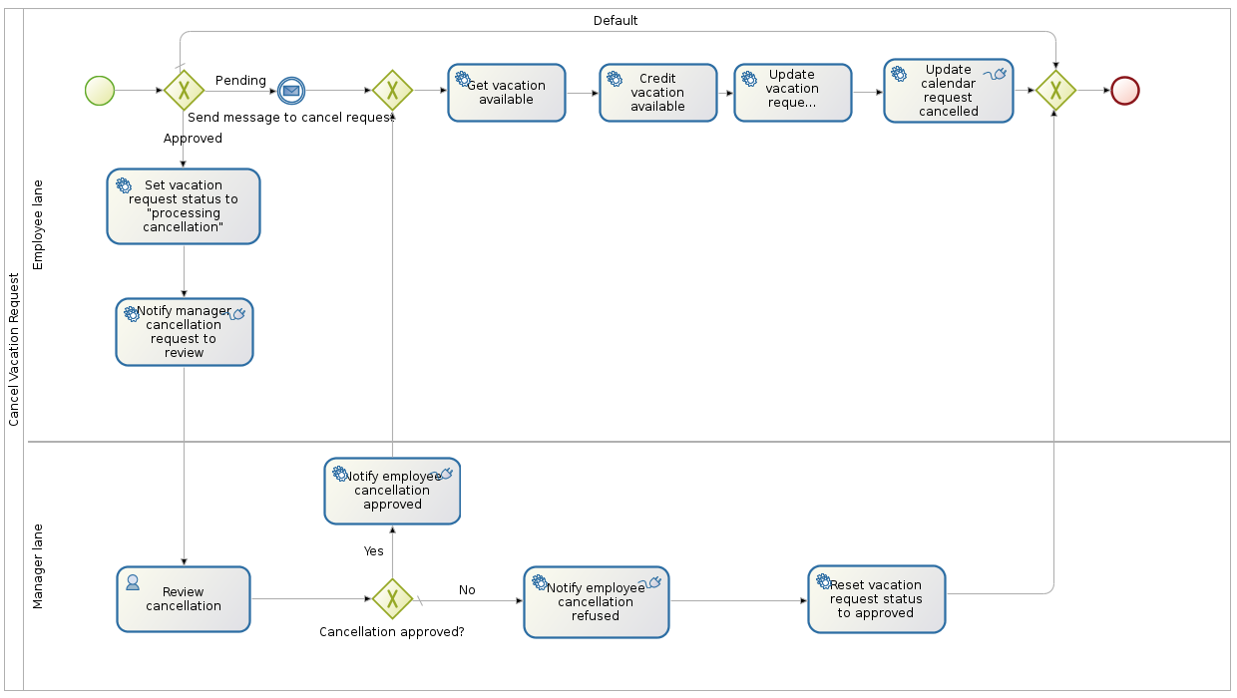
https://raw.githubusercontent.com/Bonitasoft-Community/vacation-management-example/master/screenshots/cancelVacationRequest.png?raw=true

Slide 4
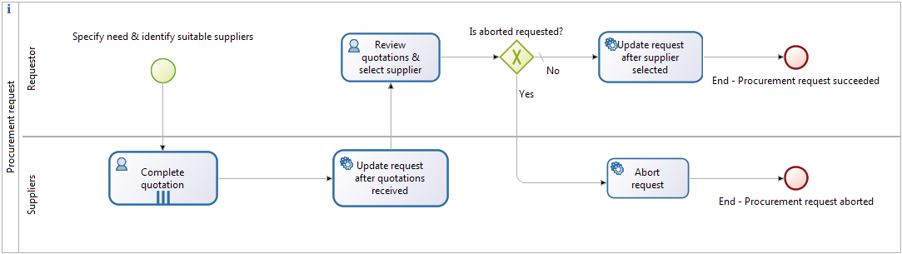
https://community.bonitasoft.com/sites/community.bonitasoft.com/files/blog/procurement-example/procurement-request-diagram.png

Slide 5
