Slide 1
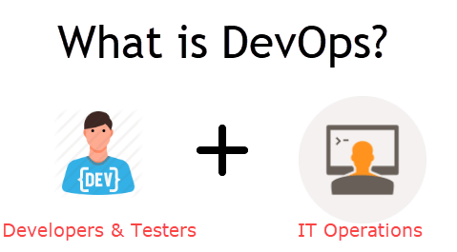
DevOps is a culture which promotes collaboration between Development and Operations Team to deploy code to production faster in an automated & repeatable way. The word 'DevOps' is a combination of two words 'development' and 'operations.'
DevOps helps to increases an organization's speed to deliver applications and services. It allows organizations to serve their customers better and compete more strongly in the market.

Slide 2
Why is DevOps is Needed?
Before DevOps, the development and operation team worked in complete isolation.
Testing and Deployment were isolated activities done after design-build. Hence they consumed more time than actual build cycles.
Without using DevOps, team members are spending a large amount of their time in testing, deploying, and designing instead of building the project.
Manual code deployment leads to human errors in production
Coding & operation teams have their separate timelines and are not in synch causing further delays.
There is a demand to increase the rate of software delivery by business stakeholders. As per Forrester Consulting Study, Only 17% of teams can use delivery software fast enough. This proves the pain point

Slide 3
Why is DevOps used?
DevOps allows Agile Development Teams to implement Continuous Integration and Continuous Delivery. This helps them to launch products faster into the market.
Other Important reasons are:
1. Predictability: DevOps offers significantly lower failure rate of new releases
2. Reproducibility: Version everything so that earlier version can be restored anytime.
3. Maintainability: Effortless process of recovery in the event of a new release crashing or disabling the current system.
4. Time to market: DevOps reduces the time to market up to 50% through streamlined software delivery. This is particularly the case for digital and mobile applications.
5. Greater Quality: DevOps helps the team to provide improved quality of application development as it incorporates infrastructure issues.
6. Reduced Risk: DevOps incorporates security aspects in the software delivery lifecycle. It helps in reduction of defects across the lifecycle.
7. Resiliency: The Operational state of the software system is more stable, secure, and changes are auditable.
8. Cost Efficiency: DevOps offers cost efficiency in the software development process which is always an aspiration of IT companies' management.
9. Breaks larger code base into small pieces: DevOps is based on the agile programming method. Therefore, it allows breaking larger code bases into smaller and manageable chunks.

Slide 4
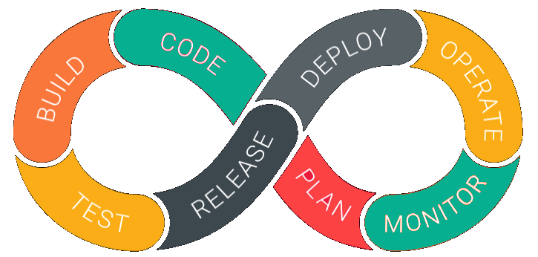
DevOps Lifecycle
DevOps is deep integration between development and operations. Understanding DevOps is not possible without knowing DevOps lifecycle.

Slide 5
1. Development
In this DevOps stage the development of software takes place constantly. In this phase, the entire development process is separated into small development cycles. This benefits DevOps team to speed up software development and delivery process.
2. Testing
QA team use tools like Selenium to identify and fix bugs in the new piece of code.
3. Integration
In this stage, new functionality is integrated with the prevailing code, and testing takes place. Continuous development is only possible due to continuous integration and testing.
4. Deployment
In this phase, the deployment process takes place continuously. It is performed in such a manner that any changes made any time in the code, should not affect the functioning of high traffic website.
5. Monitoring
In this phase, operation team will take care of the inappropriate system behavior or bugs which are found in production.

Slide 6
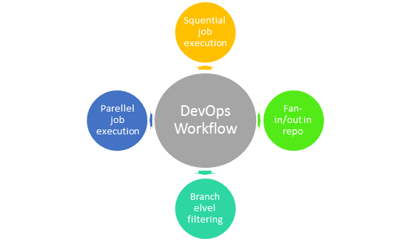
DevOps Work Flow
Workflows provide a visual overview of the sequence in which input is provided. It also tells about actions are performed, and output is generated for an operations process.
Workflow allows the ability to separate and arrange jobs which are top-requested by the users. It also gives the ability to mirror their ideal process in the configuration jobs.

Slide 7
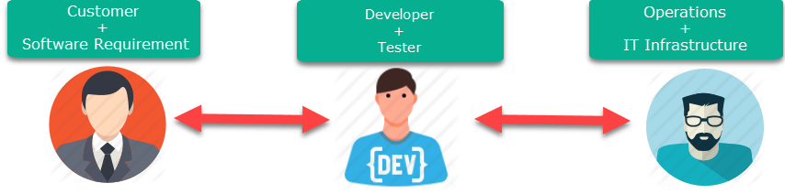
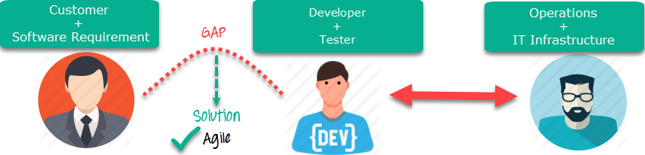
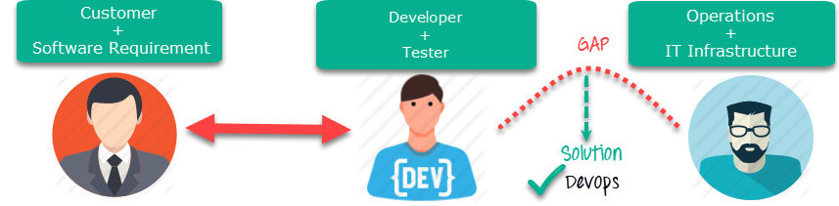
DevOps Vs Agile
Stakeholders and communication chain a typical IT process.
Agile addresses gaps in Customer and Developer communications
DevOps addresses gaps in Developer and IT Operations communications

Slide 8
Agile | DevOps
Emphasize breaking down barriers between developers and management. | DevOps is about software deployment and operation teams.
Addresses gap between customer requirements and development teams. | Addresses the gap between development and Operation team
Focuses more on functional and non-functional readiness | It focuses operational and business readiness.
Agile development pertains mainly to the way development is thought out by the company. | DevOps emphases on deploying software in the most reliable and safest ways which aren't necessarily always the fastest.
Agile development puts a huge emphasis on training all team members to have varieties of similar and equal skills. So that, when something goes wrong, any team member can get assistance from any member in the absence of the team leader. | DevOps, likes to divide and conquer, spreading the skill set between the development and operation teams. It also maintains consistent communication.
Agile development manages on "sprints. It means that the time table is much shorter (less than a month) and several features are to be produced and released in that period. | DevOps strives for consolidated deadlines and benchmarks with major releases, rather than smaller and more frequent ones.

Slide 9
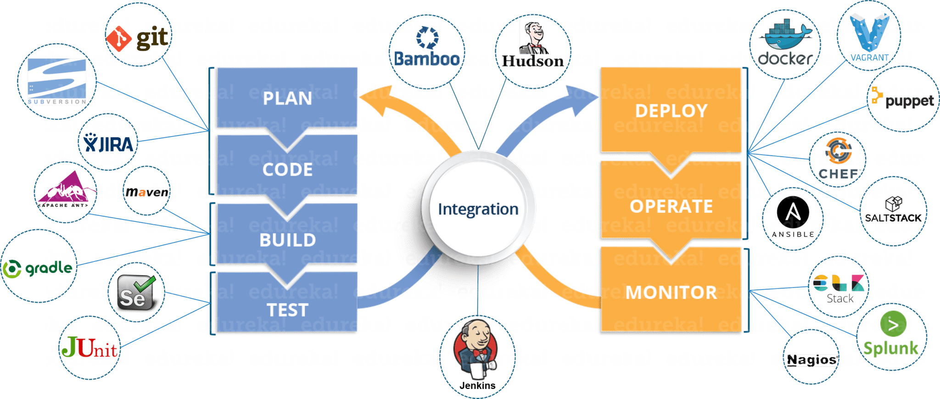

Slide 10
