Slide 1
Modeling the National Debt
Presented by: Dan O’Brien, Tori Wang, Sivaji Turimella, Anish Dulla, Nishant Jain, and Shashvat Patel

Slide 2

Introduction
Deficit is often overlooked in government policy - especially after COVID
Deficit: Spending - Income
Political Climate is a give and take of spending and income
Data is from White House Table
We want to predict the deficit for the next decade based on different conditions
Income Tax Rates
Catastrophe
War
Time Step: 1 Year

Slide 3
General Assumptions
We are making general assumptions to simplify the model:
We are using past 20 years data
Income is resistant to catastrophe
Within each category, we are simplifying the categories explored
Assuming policies will remain in place for next 10 years
Ie: assuming one President until 2028
The US will not go through a period of sustained hyperinflation

Slide 4
The Model

Slide 5
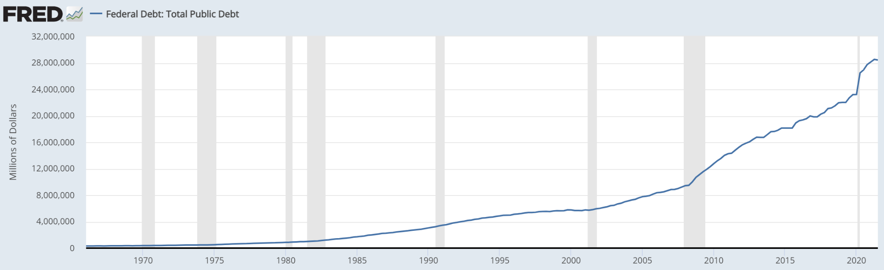
The Model and The Plan
Annual changes in the national debt depend on the total outlays and receipts (expenditures and revenue)
We decided to split up the calculations for outlays and receipts, and then combine them to calculate the change in national debt
The main factors we will use are changes in expenditure policy, government revenue policy, and economic catastrophe
Our plan is to predict the annual deficit that contributes to the debt using these factors
Notes:
The existing model of the Total public debt per year shows a general exponential growth
We are using the factors to try and predict the variation from this exponential growth
We will be using the last 20 years to reflect more accurate variability

Slide 6
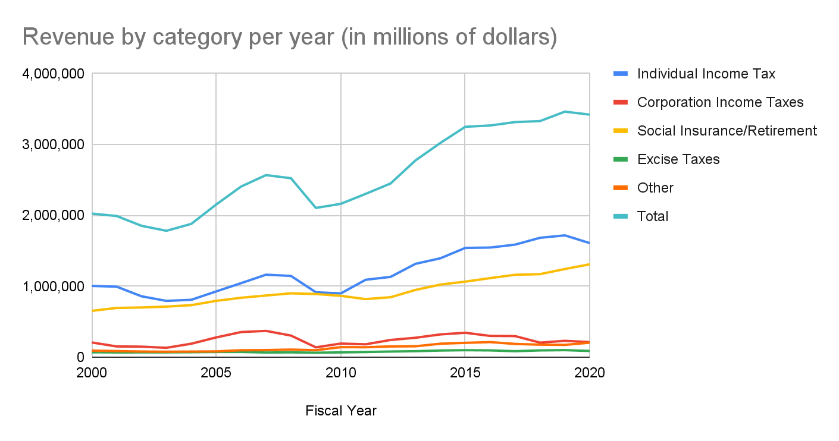
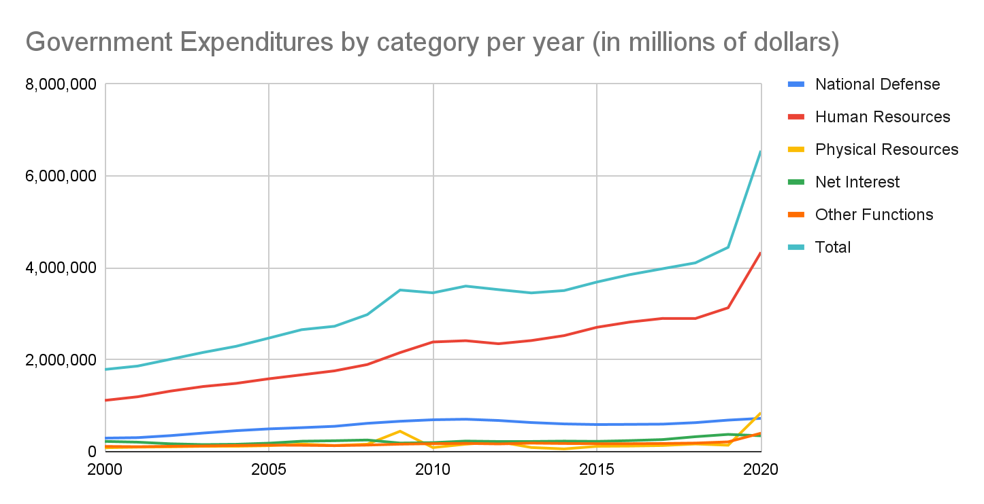
Modeling Income, Expenditures, and Catastrophes
Our data consists of numbers that have not been adjusted for inflation
We plan to account for this in the percentage change for each category of income and expenditures per year
One of the reasons for variability is due to economic catastrophes, such as Covid-19. We will include an environmental stochasticity element in our model in order to account for this
Notes:
Revenue shows a general growth, but includes variability year to year from tax cuts and other
From the government expenditures per year, we include National Defense, Human Resources, Physical Resources, Net interest, and other functions
These categories can be further expanded into niches such as education, medicare, and transportation
The graph for the percentage of total expenditure by category per year shows how the budget division for the US government has changed over time.
The graph shows a clear decrease in the National defense expenditures, and a heavy increase in the Human Resources expenditures.
We will be using demographic stochasticity based on the changes in income and expenditures to make our predictions
One of the reasons for the variability is due to economic catastrophes, ex covid- we will include an environmental stochastistity in our model to account for this

Slide 7
End Goal
National defense | 748,408 | 770,567 | 772,344 | 790,334 | 807,055 | 820,848
Human resources | 5,128,208 | 4,361,165 | 4,352,401 | 4,414,589 | 4,644,380 | 4,775,854
Physical resources | 708,898 | 335,696 | 342,941 | 371,070 | 378,356 | 387,653
Net interest | 303,002 | 304,939 | 319,886 | 367,872 | 445,067 | 524,344
Other functions | 564,549 | 382,595 | 346,619 | 367,328 | 360,359 | 368,305
Total | 7,249,456 | 6,011,148 | 6,012,960 | 6,186,795 | 6,507,720 | 6,746,286
 | 2021 estimate | 2022 estimate | 2023 estimate | 2024 estimate | 2025 estimate | 2026 estimate
Using our model, we will create plans with different policies and analyze how they perform with with our built in demographic and environmental stochasticity
We can demonstrate how plausible our plans are and compare it against other predictions
Fiscal Year | Individual Income Tax | Corporation Income Tax | Social Insurance | Excise Taxes | Other | Total
2021 estimate | 1,704,919 | 268,482 | 1,296,179 | 74,092 | 237,105 | 3,580,777
2022 estimate | 2,038,575 | 370,985 | 1,462,013 | 84,277 | 218,347 | 4,174,197
2023 estimate | 2,242,112 | 576,645 | 1,527,133 | 88,696 | 206,440 | 4,641,026
2024 estimate | 2,287,615 | 648,702 | 1,590,139 | 93,453 | 207,902 | 4,827,811
2025 estimate | 2,435,542 | 672,724 | 1,646,414 | 93,664 | 189,559 | 5,037,903
2026 estimate | 2,675,980 | 664,236 | 1,711,381 | 94,831 | 185,673 | 5,332,101
Notes:
Our end goal is to create different plans and analyze how they perform in our model with demographic and environmental stochasticity
We can use these simulations and see how plausible they are
The numbers shown here are the expenditure and income estimates from the White house historical tables, based off current circumstances and Biden’s financial plans. We can compare our numbers against these, and see how they differ

Slide 8
Deficit

Slide 9
Modeling the Deficit
Focused primarily on deficit spikes/peaks
Nature of deficit spikes has changed dramatically over the past few years
Modeled the frequency of deficit spikes since 1977
Modeled severity of the deficit spikes since 2001
Severity of deficit spikes have increased in the past two decades
Main Causes of Deficit Spikes:
Wars
Economic Catastrophes
Tax cuts

Slide 10
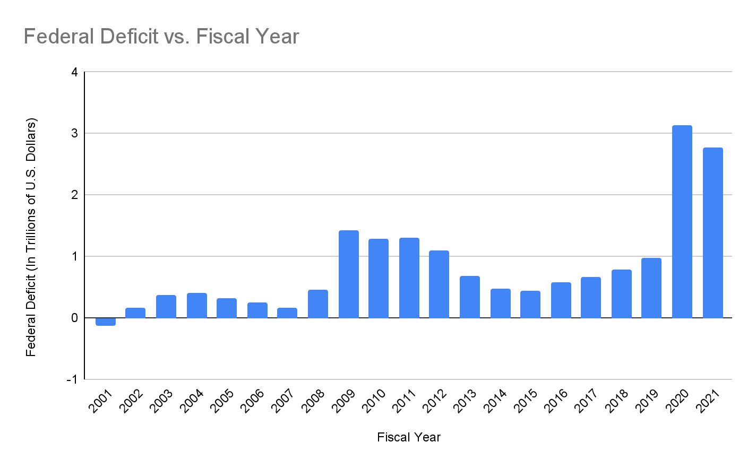
Recent Deficit Data
Fiscal Year | Federal Deficit
2001 | -127,165,000,000
2002 | 158,520,000,000
2003 | 374,219,000,000
2004 | 412,553,000,000
2005 | 318,615,000,000
2006 | 247,698,000,000
2007 | 162,833,000,000
2008 | 454,806,000,000
2009 | 1,417,121,000,000
2010 | 1,294,090,000,000
2011 | 1,298,614,000,000
2012 | 1,089,353,000,000
2013 | 680,276,000,000
2014 | 483,350,000,000
2015 | 438,899,000,000
2016 | 587,412,000,000
2017 | 665,712,000,000
2018 | 778,996,000,000
2019 | 984,388,026,331
2020 | 3,131,917,248,888
2021 | 2,772,178,788,289

Slide 11
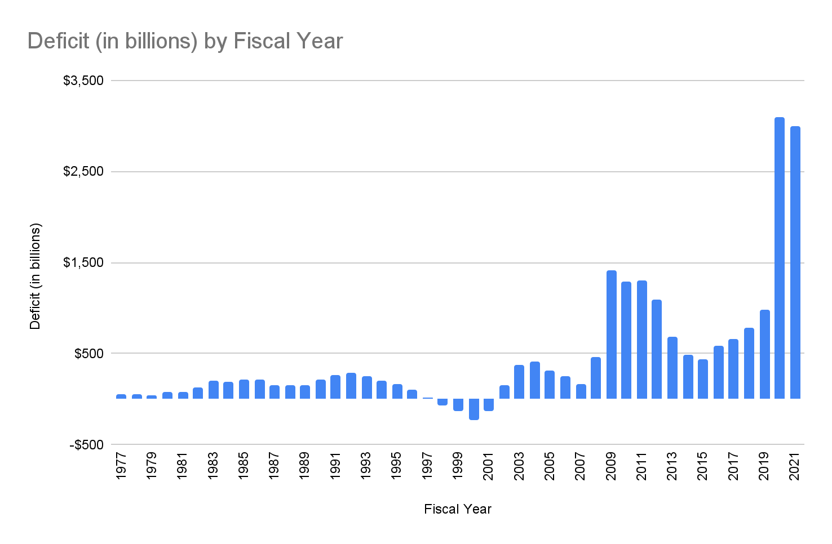
Longer Term Deficit Data

Slide 12
Modeling Deficit Parameters
Spikes occur an Average of every 8 years with standard deviation of 3.11 years
Over the past two decades
New spikes are approximately 2.88 times larger than previous spike
Deficit reduces to approximately 35.22% of the of the previous spike before ticking up again

Slide 13
Income

Slide 14
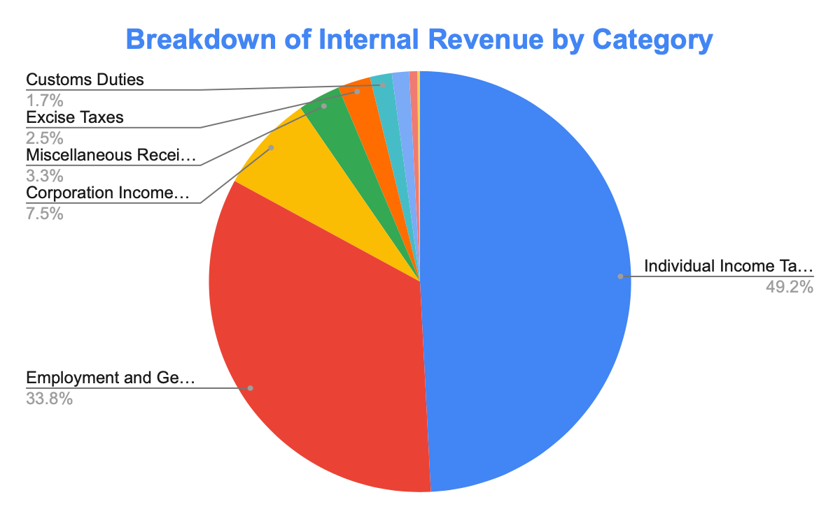
Overview of Modeling Process
Investigating Sources of Government Revenue:
Individual Income Tax (49%)
Social Security / Medicare (34%)
Corporate Income Tax (8%)
We aim to model government revenue by separately modeling each of these three sources of revenue, then aggregating our results to achieve an overall revenue model.

Slide 15

Income Modeling Assumptions
Modeling Government Revenue can be broken down into three categories.
Government Revenue is most accurately tracked on a discrete year by year basis.
Revenue Growth Rates are most accurately modeled with demographic stochasticity and sampling from a normal distribution based on the mean and std. dev. of previous years’ growth rates.
Changes in tax legislation are most accurately modeled through environmental stochasticity.

Slide 16
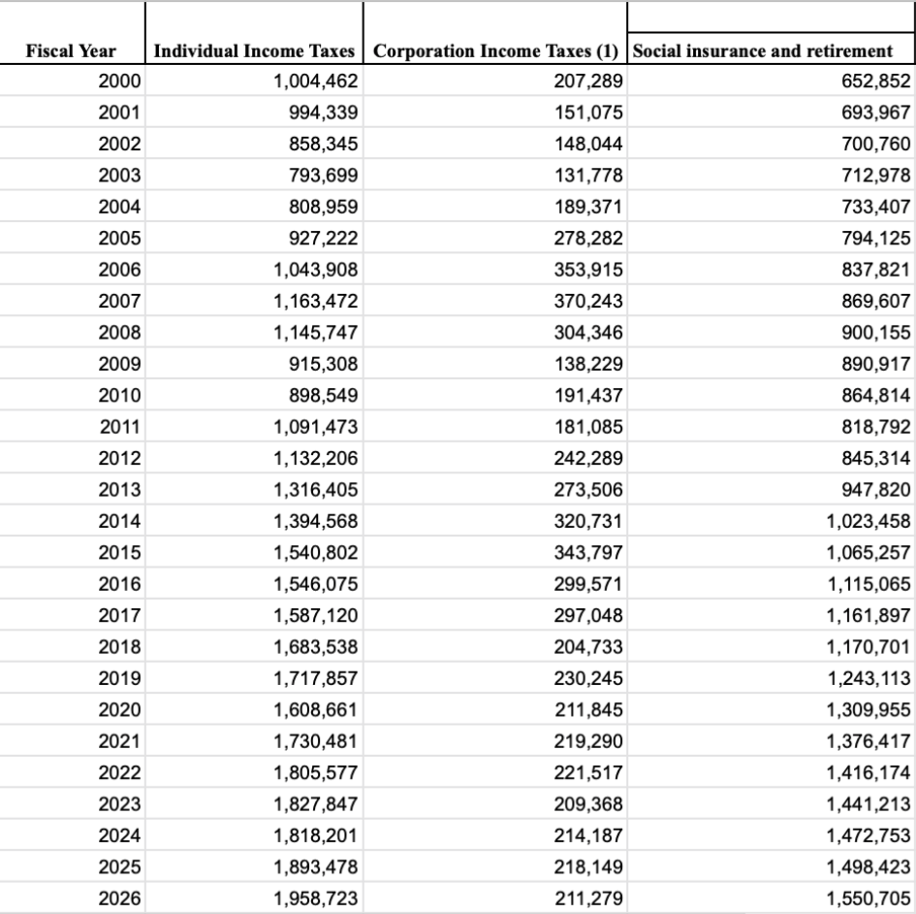
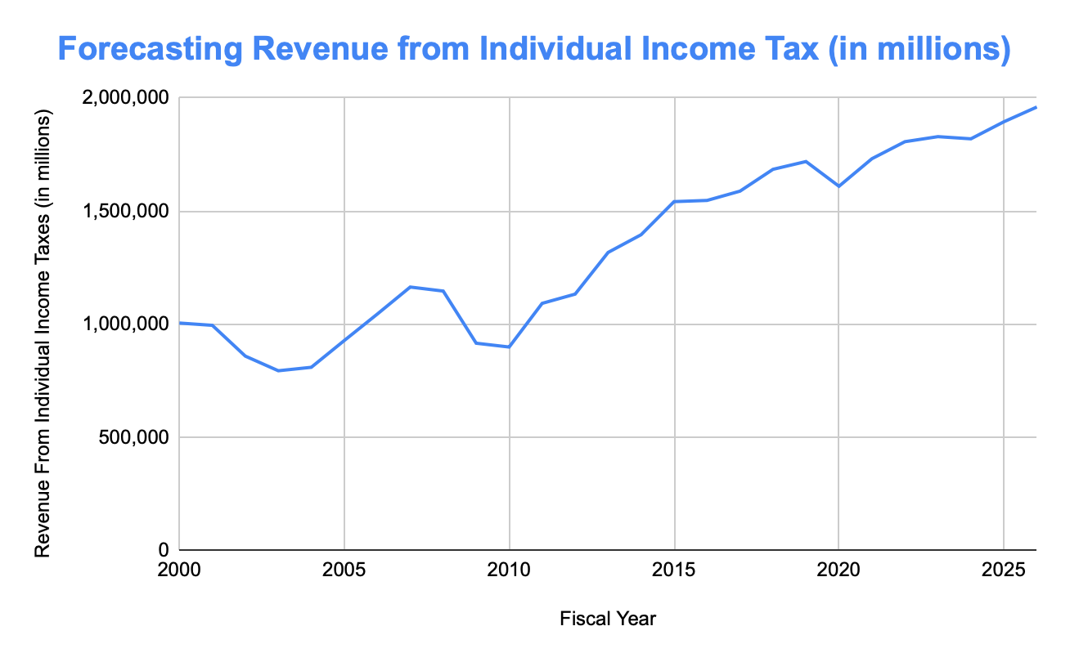
Modeling Process
Independent Discrete Demographic Stochastic Models
Time Step: Δt = 1 year
Demographic Stochasticity Used With Revenue Category Mean and Std. Dev. f
Example of Modeling Individual Income Tax:

Slide 17
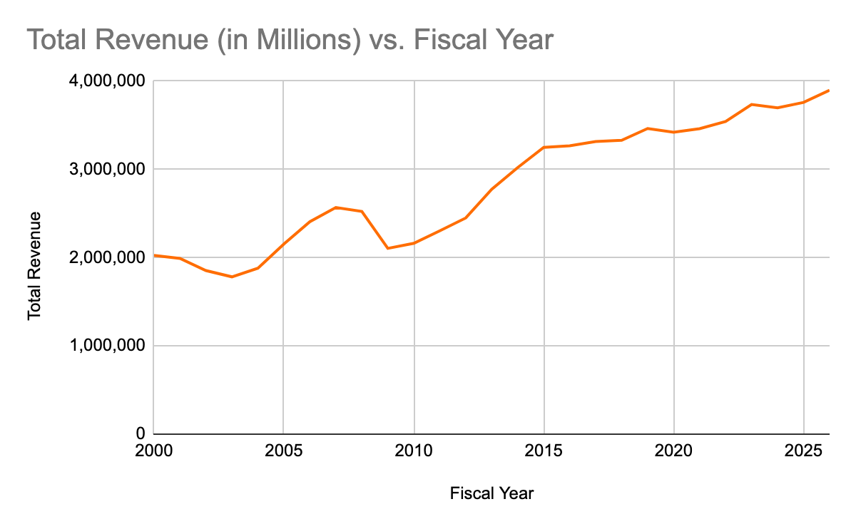
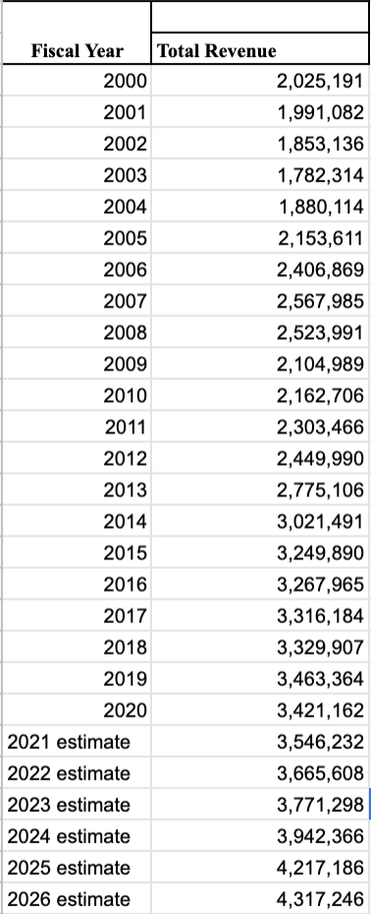
Total Revenue Aggregate Model
Aggregating these individual revenue category models gives us an overall total revenue model.
Our ten-year forecast model is shown below:

Slide 18

Model Improvements / Next Steps
Incorporate Environmental Stochasticity With Changes in Financial Crisis
Financial Recessions
COVID-19 Pandemic
Modeling Changes in Revenue Categories With Environmental Stochasticity
Break up tax rates into smaller categories based on financial standing
Correct for Miscellaneous Revenue Streams
Add Hacking multiplier into total revenue model

Slide 19
Spending

Slide 20
Expenditure Modeling Assumptions
Expenditure data is broken down into 5 overarching categories: (National Defense, Human Resources, Physical Resources, Net Interest, Other functions – data from the White House)
Expenditure spikes in 2020/2021 were due to the COVID-19 Pandemic and these drastic increases in spending will not continue over the next decade
Expenditure Growth Rates are most accurately modeled with demographic stochasticity and sampling from a normal distribution based on the mean and std. dev. of previous years’ growth rates by each category.

Slide 21
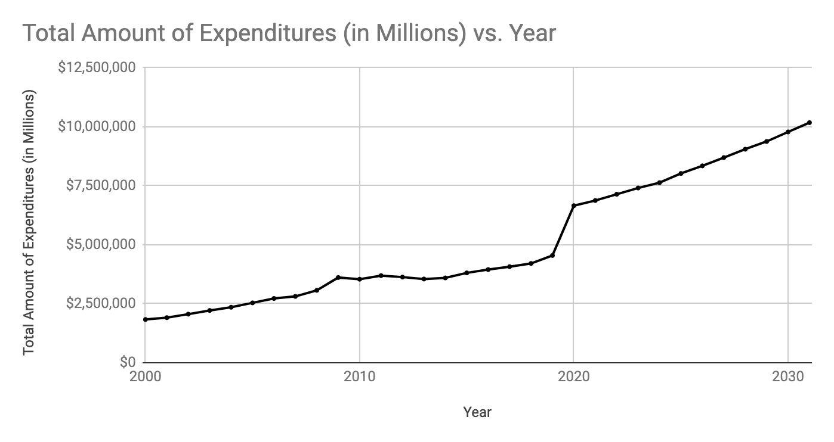
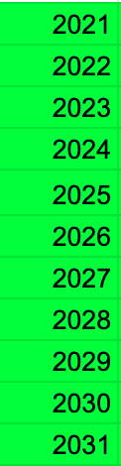
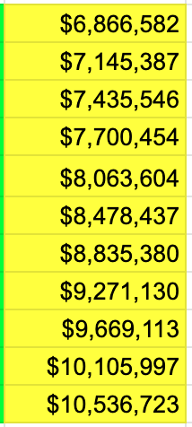
Modeling Process
Independent Discrete Demographic Stochastic Models
Time Step: Δt = 1 year
Demographic Stochasticity Used With Expenditure Category Mean and Std. Dev.
YEAR TOTAL EXPENDITURE

Slide 22
Comparison with White House Predictions
YEAR | OUR MODEL | WHITE HOUSE
2021 | $6,866,582 | $7,249,456
2022 | $7,145,387 | $6,011,148
2023 | $7,435,546 | $6,012,960
2024 | $7,700,454 | $6,186,795
2025 | $8,063,604 | $6,507,720
2026 | $8,478,437 | $6,746,286
Clearly, our model predicts a much faster growth in expenditure than the White House. We used 20 years of data to create our model, using a normal distribution to predict growth rate for recursive growth. The White House may have taken many other factors into account, including their plan for the next half-decade.

Slide 23
Drawbacks
The Covid-19 Pandemic and its effects
Would like to break up income tax rates by income tax brackets
Factor for political change (change of power/political party)
Tested for income tax rates, but would like to do so with corporate and social security tax rates as well

Slide 24

Thank You!

