Slide 1
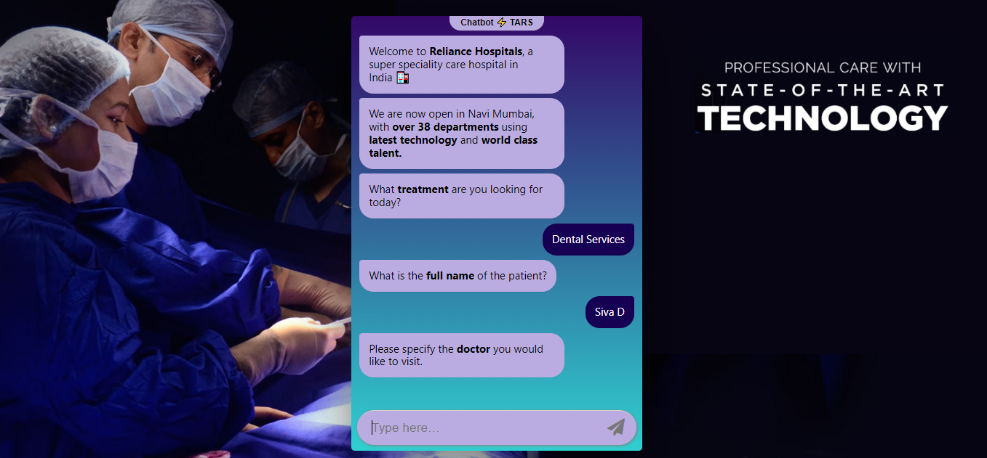
Website url: http://tinyurl.com/yqachcc2

Slide 2
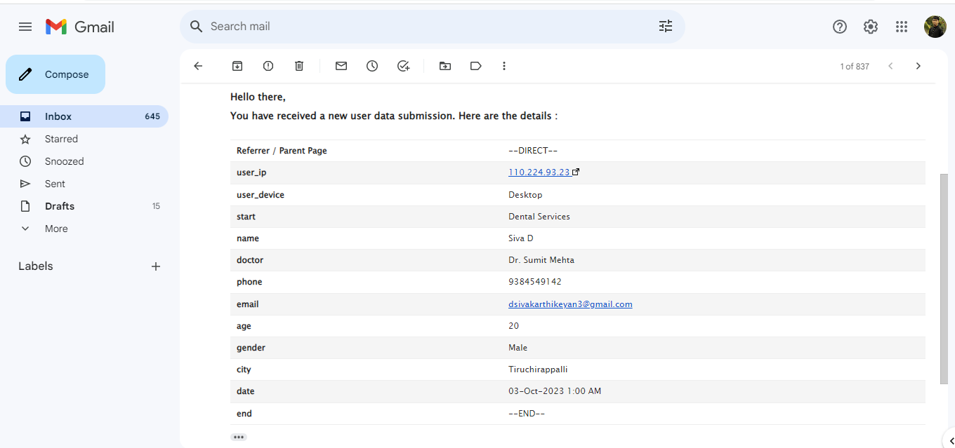
After BOOKING the appointment ,the patient details will be sent to the hospital gmail.

