Slide 1
Capacity analysis
Project on
M/M/2 based model

Slide 2
GOAL
Design a model which can give appropriate results for a car wash company on how many cars are washed in a given a time. If a service rate and arrival rates differ. Usually the working hours of a company is 8 to 10 hours, so we are using a 2 server model for a minimum loss system.

Slide 3
WHAT IS MEANT BY QUEUING THEORY?
Queuing theory as an operations management technique is commonly used to determine and streamline staffing needs, scheduling, and inventory, which helps improve overall customer service. It is often used by six sigma practitioners to improve processes.
queuing theory is the study of congestion and waiting in line.
The theory can help with creating an efficient and cost-effective workflow, allowing the user to improve traffic flow.
Queuing theory assesses two keys aspects-customer arrival at the facility and service requirements.
Often used as an operations management tool, queuing theory can address staffing, scheduling, and customer service shortfalls.

Slide 4
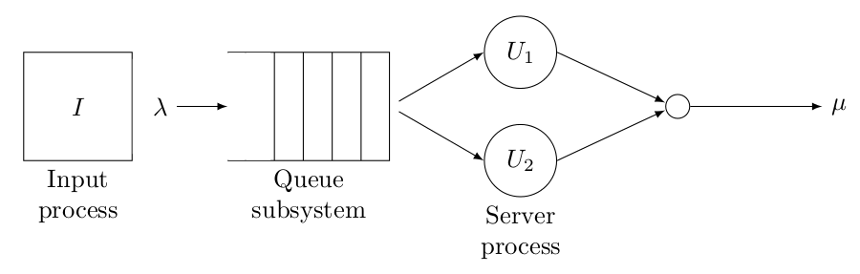
M/M/2 queuing model

Slide 5
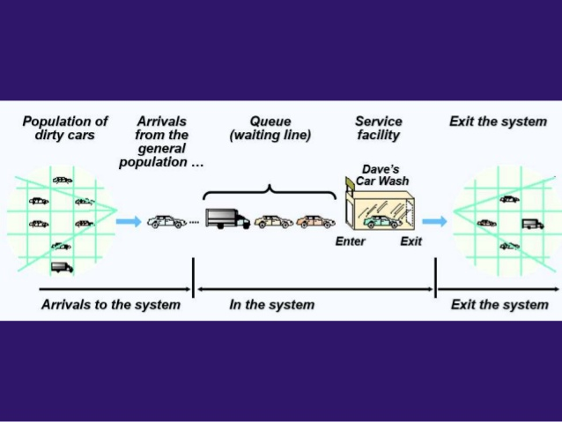
Pictorial representation of car washers
=2
25

Slide 6
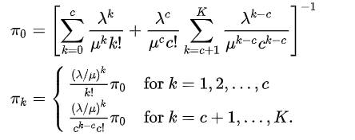
Formulae for Theoretical Calculations
Here pi0 is the ideal state where there are no service provided or zero number of cars in the queue.

Slide 7


Formulae :

Slide 8
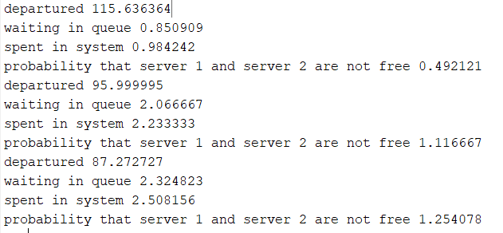
Results:
For arrival rate = lamda= 15,22,28 cars per hour
For service rate = mu = 60/8,60/10,60/11 time in hrs
Total time is 8hrs

Slide 9
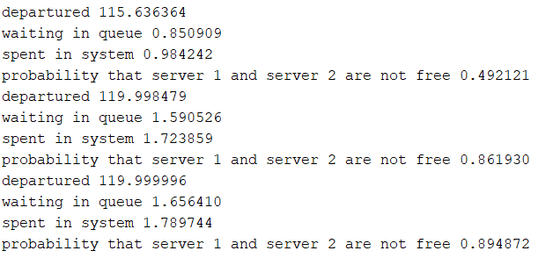
If the service time remains same and arrival rate increases

Slide 10
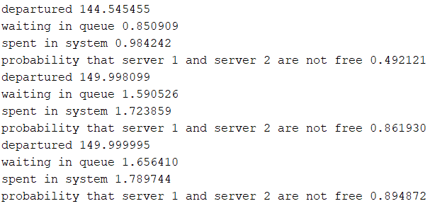
Total service time is 10hrs

Slide 11
Conclusion:
From the results we can conclude that with 2 carwashers a carwash company can obtain max customers if the service rate of carwasher is 8minutes per car.
If the duration of working of carwash company is increase then it reduces the losses incurred on the company.
The service rate for a carwasher must be less 8minutes per car so as to control the number of cars leaving the carwash without entering.

